Slide 1


REVOLUTION ART
TEAM 1

Slide 2
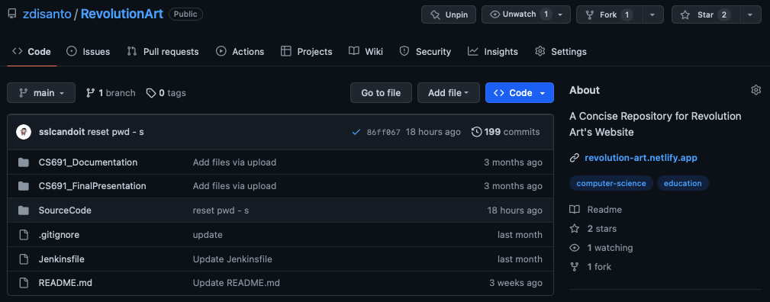
SOURCE CODE HTTPS://GITHUB.COM/ZDISANTO/REVOLUTIONART

Slide 3
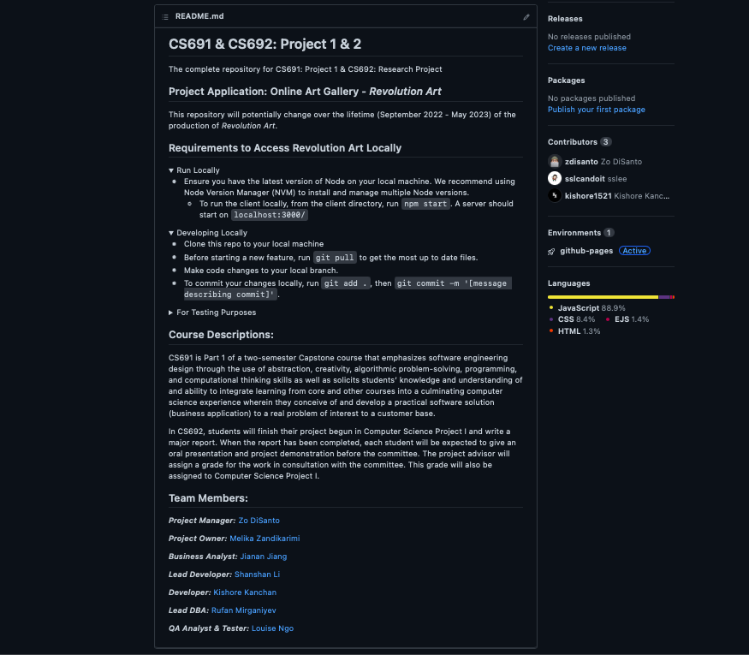
BUILD/DEPLOYMENT PROCEDURE

Slide 4
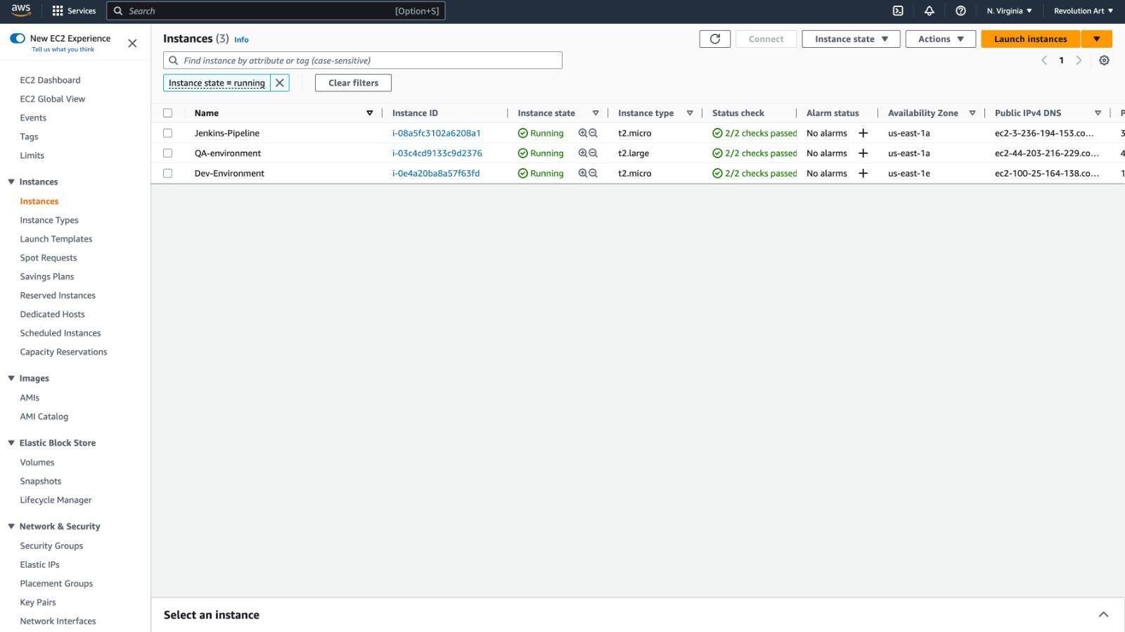
AWS EC2 NODES (DEV/QA)

Slide 5
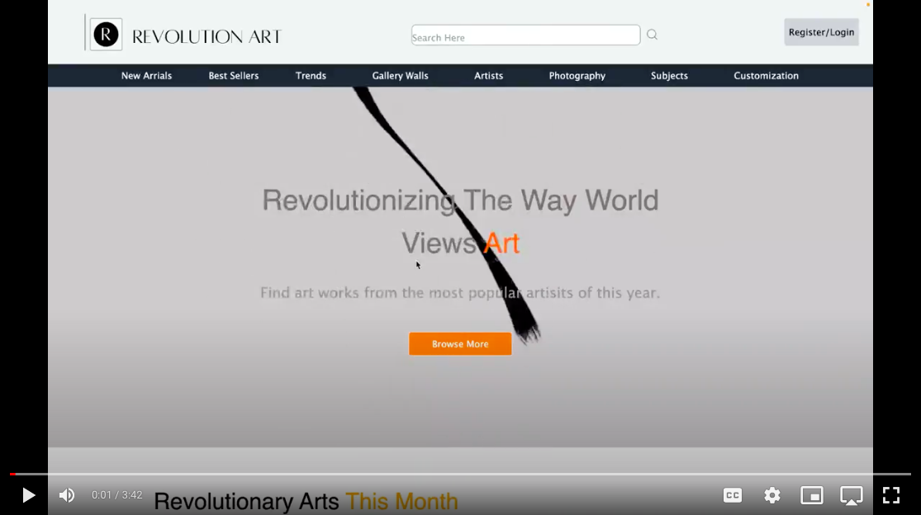
Recorded Demo

Slide 6
CONTENTS
Buyer (01.04) & Seller (02.04): Modify General User’s Information
Buyer (01.05) & Seller (02.11): Review & Choose a Subscription Plan
Buyer (01.06) & Seller (02.08): Update Password

Slide 7
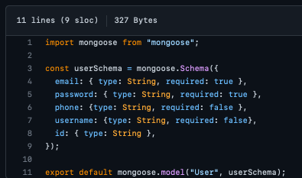
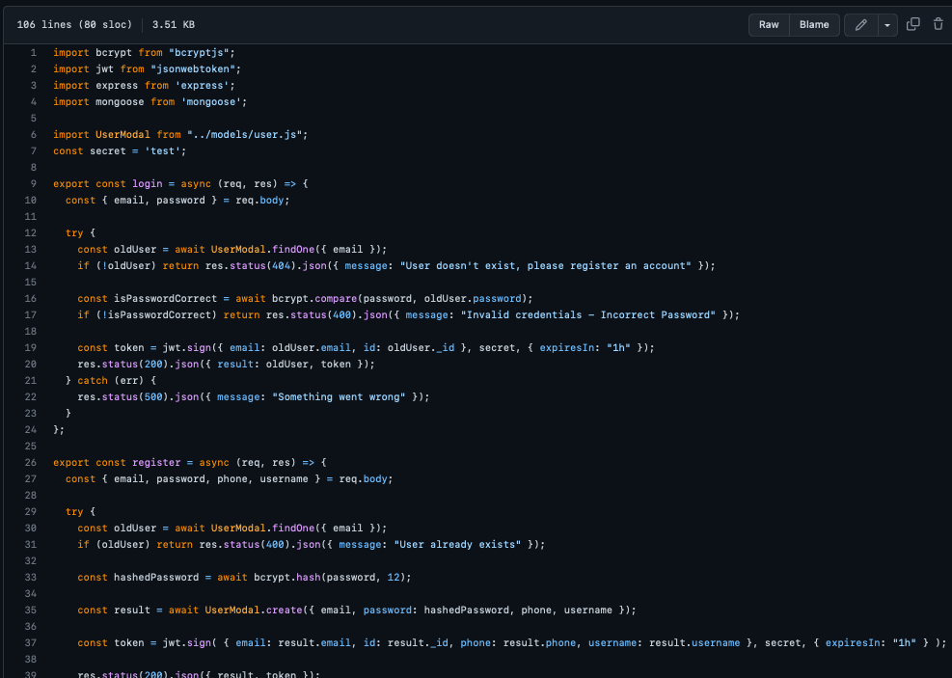
BUYER: MODIFY GENERAL USER INFO

Slide 8
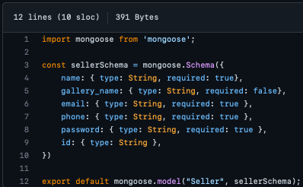
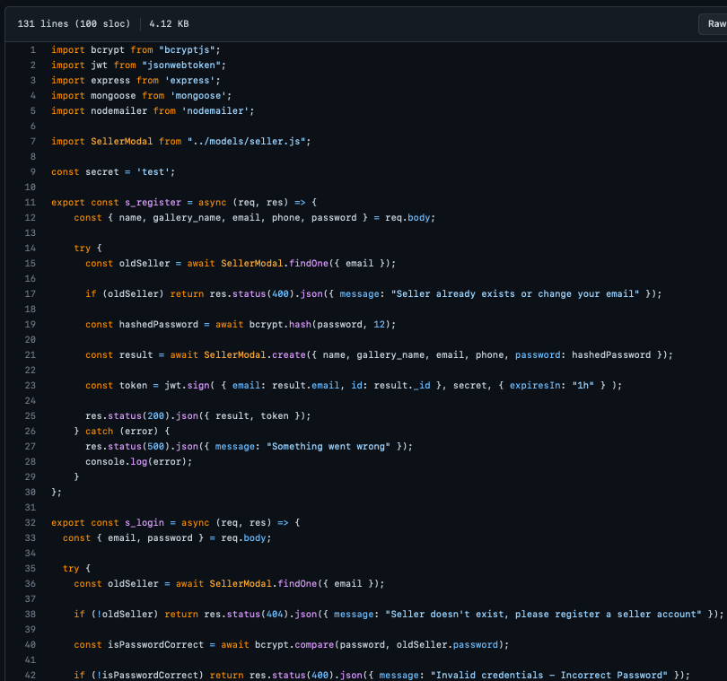
SELLER: MODIFY GENERAL USER INFO

Slide 9
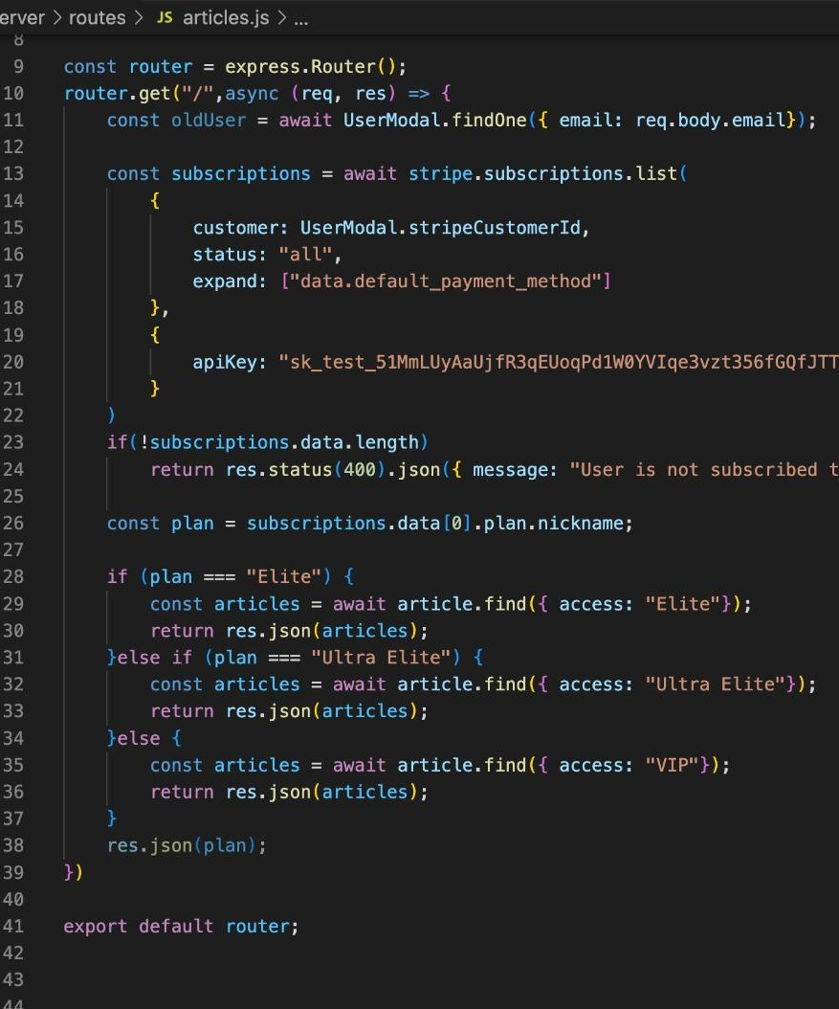
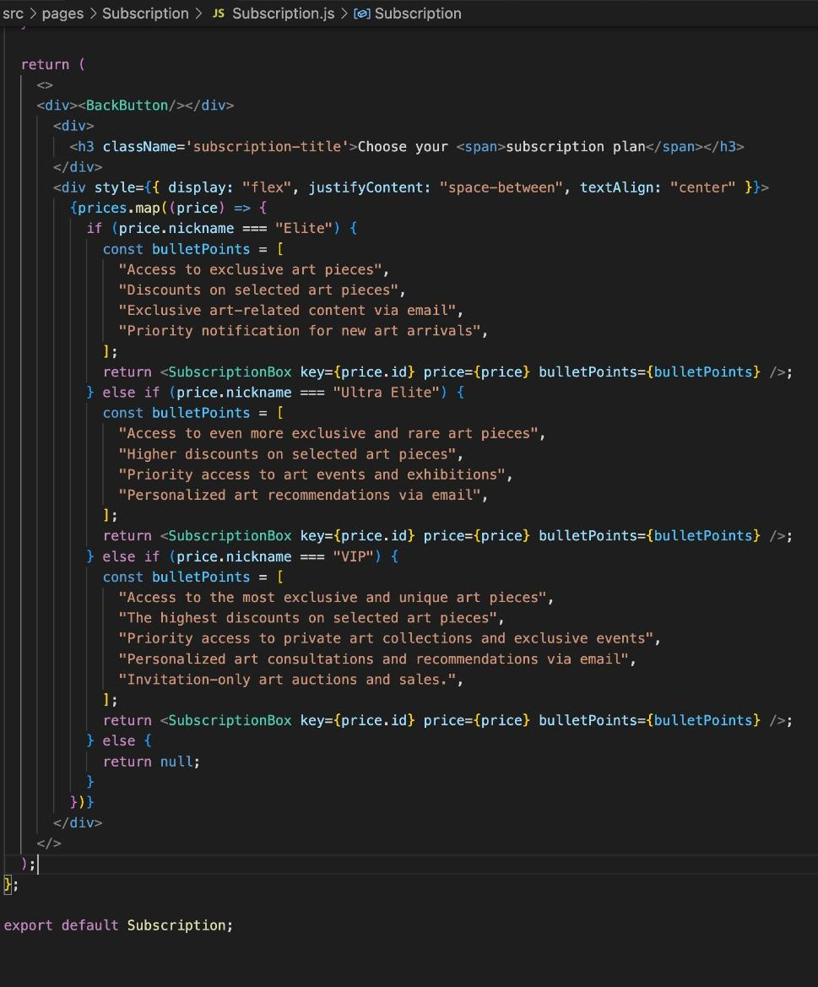
BUYER: CHOOSE A SUBSCRIPTION PLAN

Slide 10
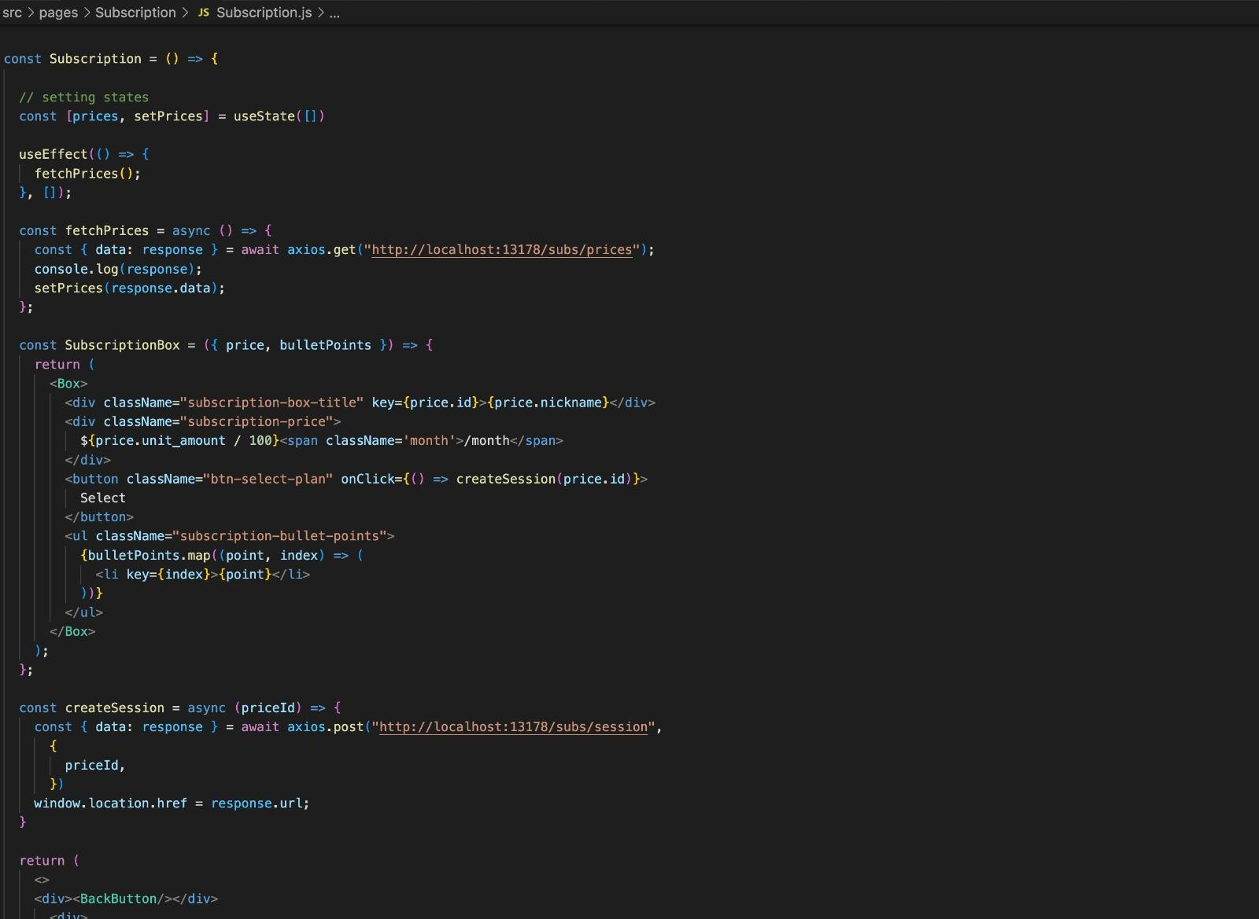
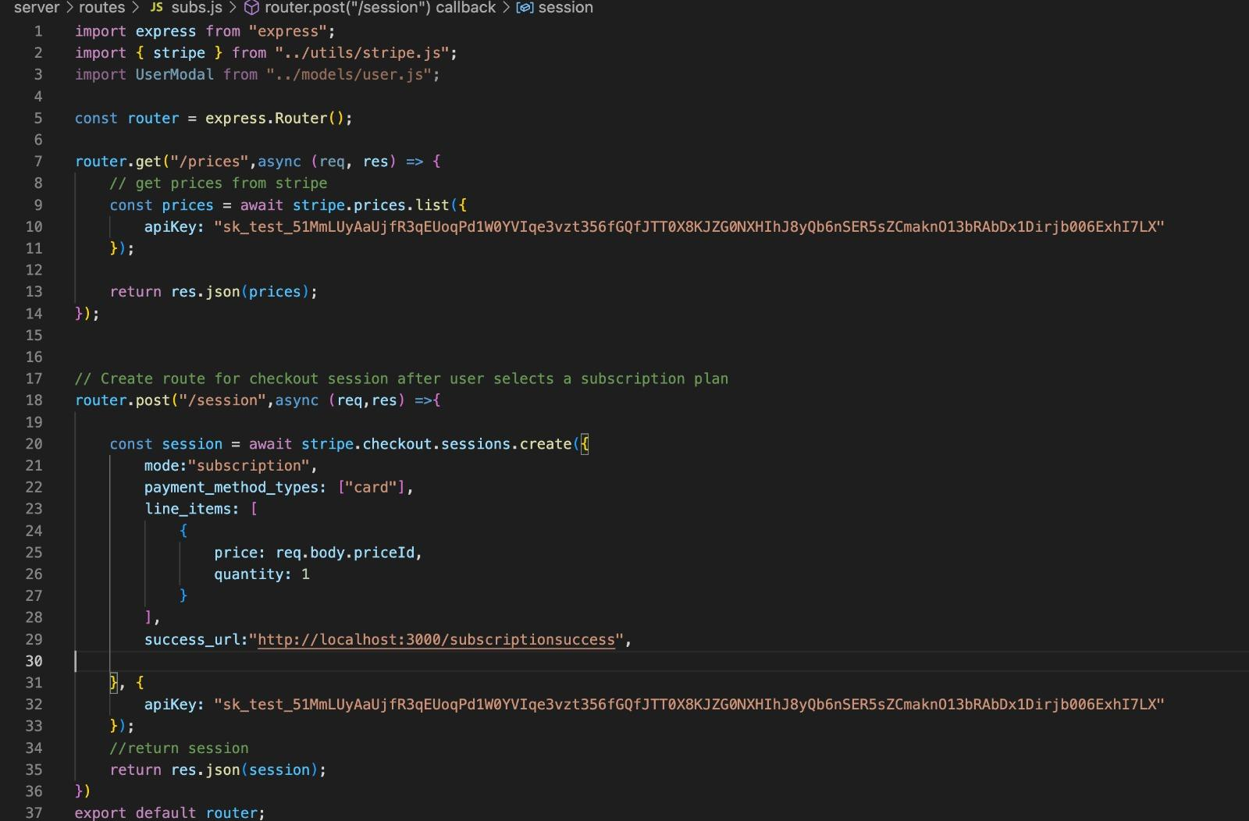
SELLER: CHOOSE A SUBSCRIPTION PLAN

Slide 11
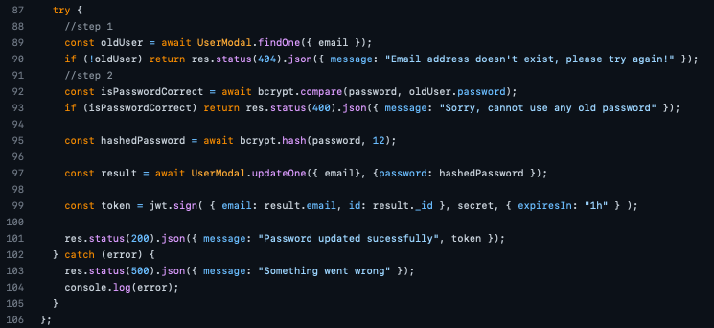
BUYER: UPDATE PASSWORD

Slide 12
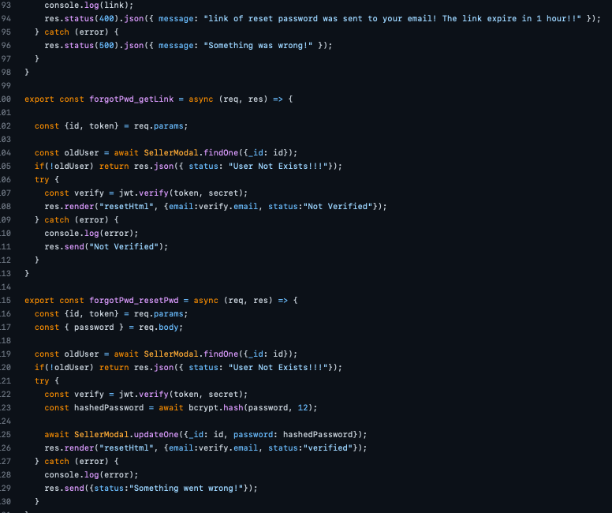
SELLER: UPDATE PASSWORD

