Slide 1

Revolution Art
GIT REPOSITORY
TEAM 1

Slide 2
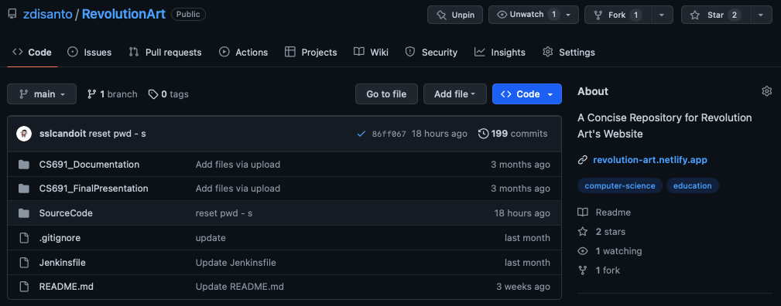
https://github.com/zdisanto/RevolutionArt

Slide 3
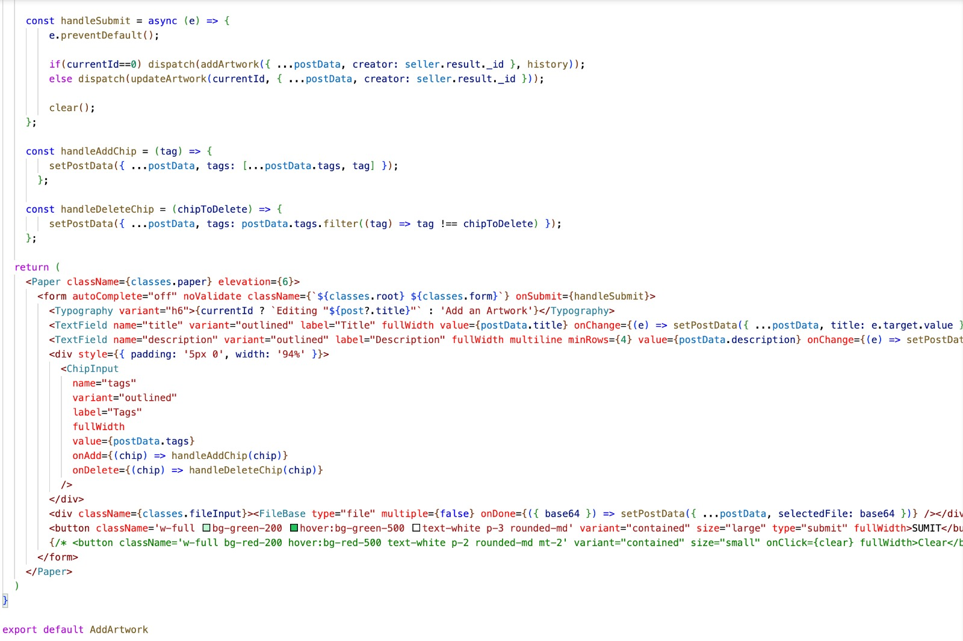
Sample Source Code
[02.07 - Modify Artwork Information]

Slide 4
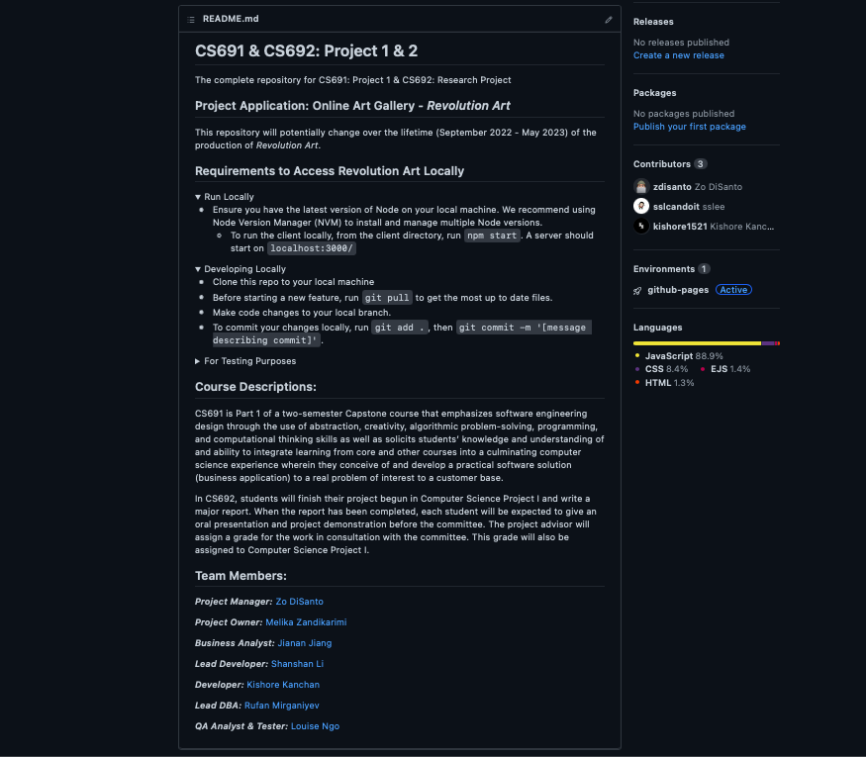
Build & Deployment Procedure

Slide 5
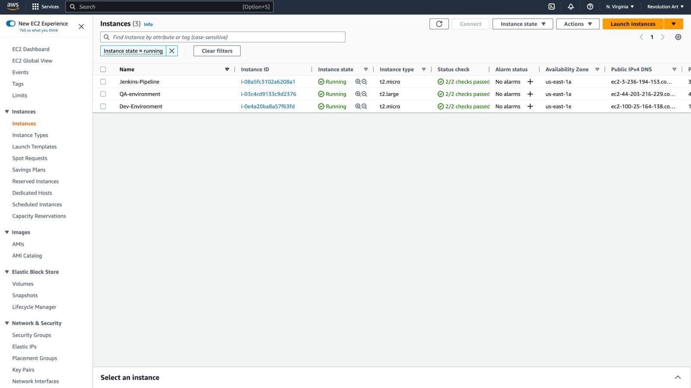
AWS EC2 Nodes (DEV/QA)

