Slide 1
DDBS Group Project Presentation
Zhao Dongjie : P18206023
Shi Lingqi : P18206024
2019/6/11
Notes:
大家好，我是赵东杰，另一位成员是石灵奇，下面开始我们的展示

Slide 2
Content
Problem Background
Goals
Solutions to Choose
System Design and Implementation
Screenshots
Conclusion

Slide 3
Problem Background
Development of social economy and fast-paced world
More attention need to paid to mental health
Meet the needs to read more interesting articles

Slide 4
Goals
Build a electronic management system to provide reading experience
Meet the basic requirments of the project
Gain deep and insight knowledge of the course
Grasp the techs to solve real-world problems
Team Spirit

Slide 5

Solutions to Choose
Docker
The Driving force behind the containerized applications
consistency,cross platforms and fast configuration
light-weight and easy

Slide 6

Solutions to Choose
Mongo
NoSQL Database
More flexible
Hierarchical structure by subdocuments
opensource
scalability and performace

Slide 7

Solutions to Choose
Redis
In-memory key-value store
Memcached better for small and static data
Redis: more structural and powerful

Slide 8

Solutions to Choose
Python
Familar
Powerful
Resources

Slide 9
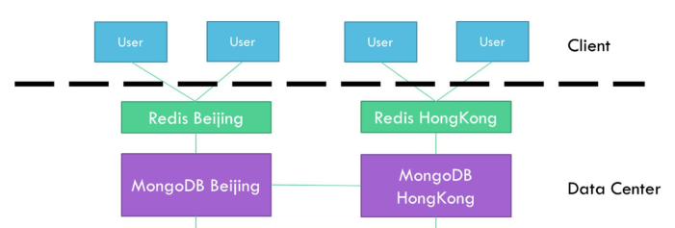
System Design
Notes:
开题报告中的架构

Slide 10
System Implementation
Ubuntu 18.04.2 LTS
Docker 18.09.6
Mongo docker image(adminMongo)
Redis docker image(redisboard)
Python virtualenv Python 3.6.7
Pycharm

Slide 11
System Implementation
Server-end
Basic Data Generation
Import to Mongo
Caculate be-read and popular-rank (everyday) table based on the existing data
Redis
Effective data manipulation
Notes:
虚拟环境，这样更方便一点

Slide 12
Server-end
Data generation
set the test nums
run the python file

Slide 13
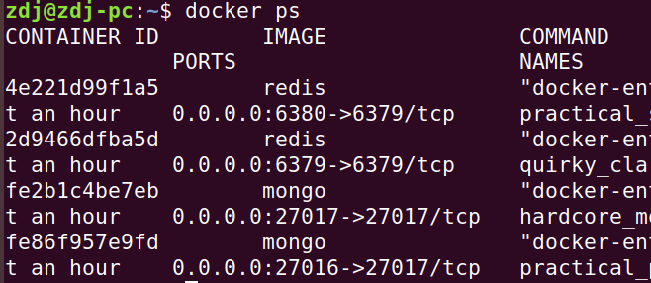
Server-end
Mongo and Redis
Docker image
two containter for different ports for both redis
tools to monitor the db status
adminmongo and redisboard

Slide 14
Server-end
Data import and calculate
import three base tables into mongo
considering the partition and duplication
calculate be-read and popular-rank table and update in the redis
Notes:
就算，这个每天执行一下就可以了，通过be-read 和article

Slide 15
Server-end
Data munipulate
python
related libs, including pymongo, redis
excute the commands from client-end

Slide 16
System Implementation
Client-end
Command-line ui
Unconsious of the distribute environments
Friendly hints
Basic operations
Notes:
我们就是没做前端，就直接在pycharm中调试运行了

Slide 17
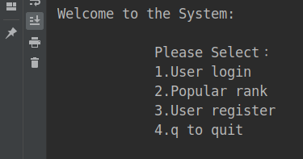
Client-end
System entry
user login
popular
user register
quit

Slide 18
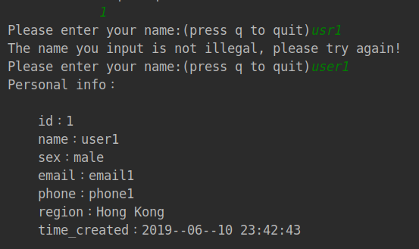
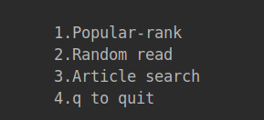
Client-end
user login
by username
after login
1.Popular-rank
2.Random read
3.Article search
4.q to quit

Slide 19
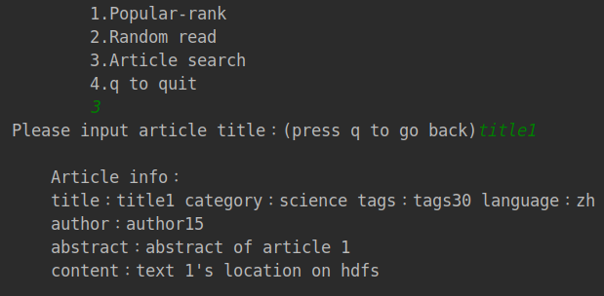
Client-end
Article search
by title

Slide 20
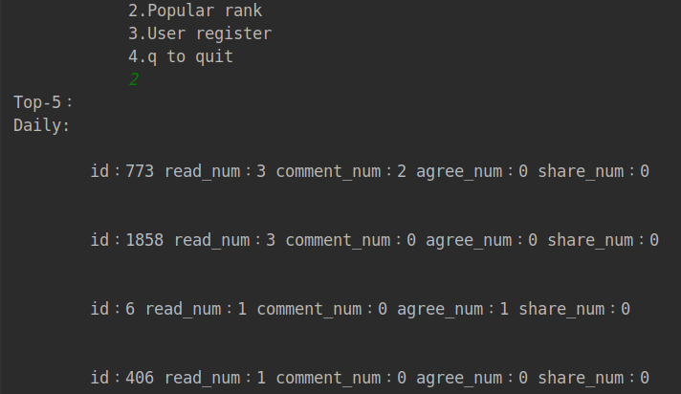
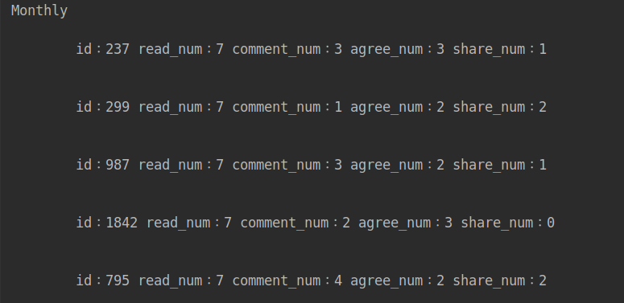
Client-end
Popular rank

Slide 21
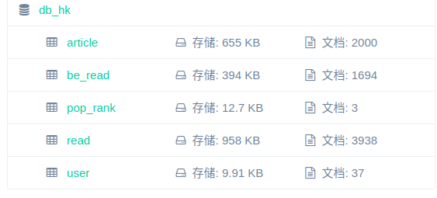
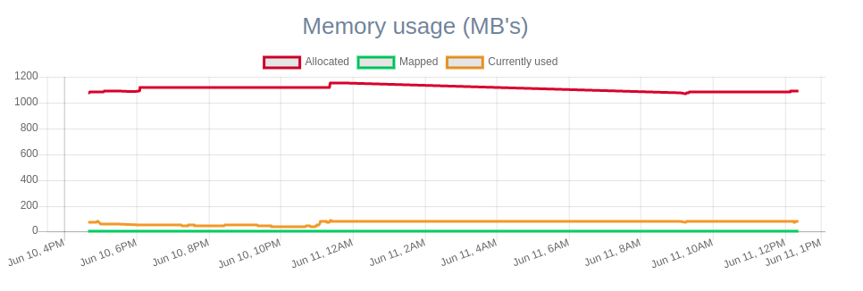
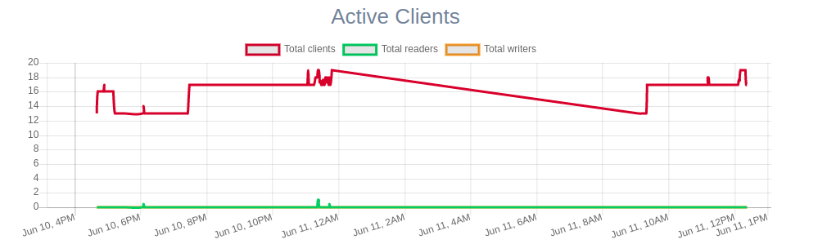
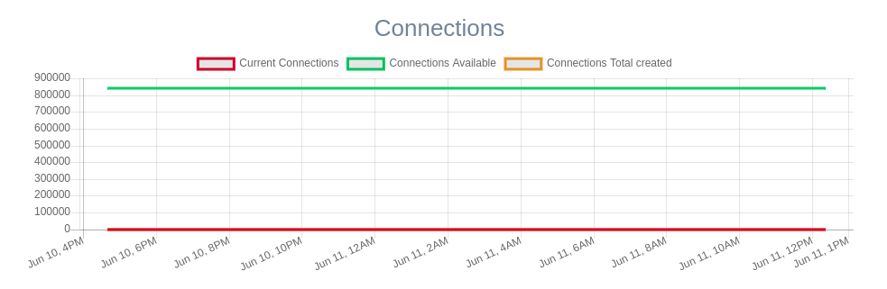
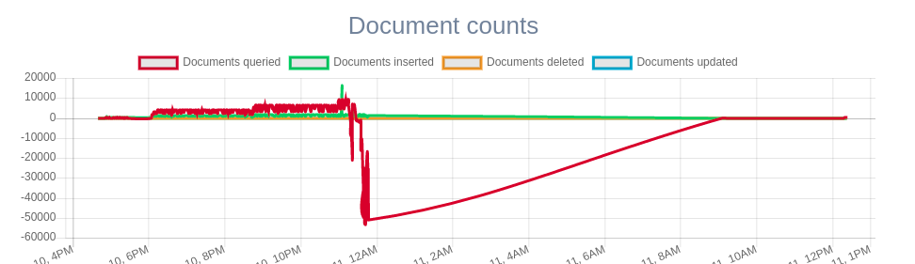
Screenshots
Database
mongo tables
mongo status

Slide 22
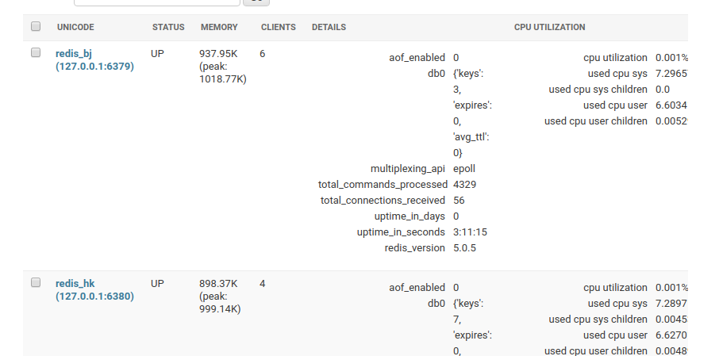
Screenshots
Redis
first check
update

Slide 23
Conclusion
works to do
more functions for users
maybe a web ui
add hadoop
maybe the advanced functions
acquisition
the containter
basic distributed application to solve real problems
special thanks to qjb

Slide 24
Thank you

