Slide 1

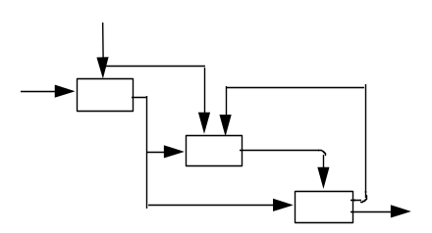



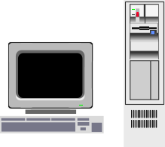
Business Process Engineering
Minder Chen, Ph.D.
Minder.chen@csuci.edu
Organization
Technology
Process

Slide 2
References
Hammer, Michael and Champy, James, Reengineering the Corporation: A Manifesto for Business Revolution, New York: HarperCollins Publishers, Inc., 2001
Davenport, Thomas H., Process Innovation: Reengineering Work through Information Technology, Harvard Business School Press, 1992.
Hammer, Michael, “Reengineering Work: Don’t Automate, Obliterate,” Harvard Business Review, July-August, 1990.
Davenport, Thomas H. and Short, James E., “The New Industrial Engineering: Information Technology and Business Process Redesign,” Sloan Management Review, Summer 1990, pp. 11-27.

Slide 3
RFID Video
http://rfid.net/applications/retail
Pay attention to
  What activities or processes had RDIF been used in the video?
  What benefits had been achieved?
  Comparing information contents carried by Bar Code and RFID
  Identify innovative applications mentioned in the video

Slide 4
Definition of Reengineering
The fundamental rethinking
and radical redesign of
core business processes to
achieve dramatic improvements in critical performance measures such as quality, cost, and cycle time.
Source: Adapted from Hammer and Champy, Reengineering the Corporation, 1993

Slide 5
What Business Reengineering Is Not?
Automating: Paving the cow paths. (Automate poor processes.)
Downsizing: Doing less with less. Cut costs or reduce payrolls.
BPR involves innovation: Creating new products and services, as well as positive thinking are critical to the success of BPR.

Slide 6
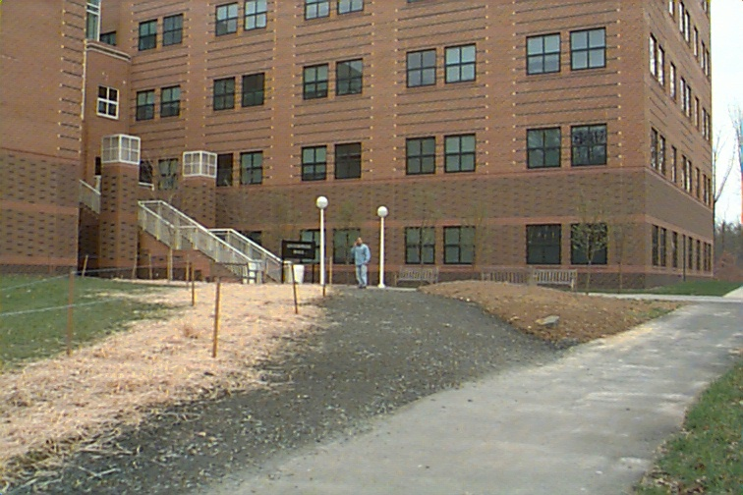
A Cow Path?

Slide 7
Reengineering Is ...
Extremist's View
Obliterate what you have now and start from scratch.
Transform every aspect of your organization.
Source: Michael Hammer, “Reengineering Work: Don’t Automate, Obliterate,” Harvard Business Review, July-August, 1990, pp. 104-112.

Slide 8
Definition of Process
A process is simply a structured, measured set of activities designed to produce a specific output for a particular customers or market.
    -- Thomas Davenport
Characteristics:
  A specific sequencing of work activities across time and place
  A beginning and an end
  Clearly defined inputs and outputs
  Customer-focus
  How the work is done
  Process ownership
  Measurable and meaningful performance

Slide 9
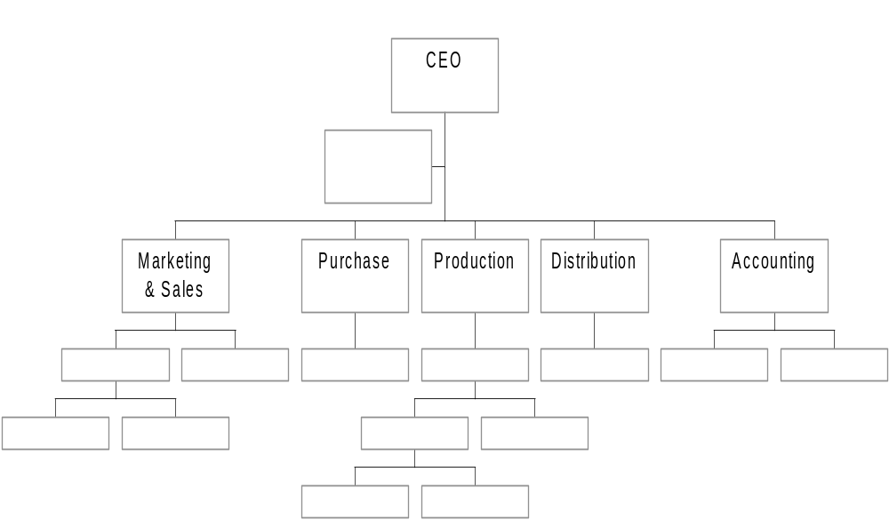


Processes Are Often Cross Functional Areas
"Manage the white space on the organization chart!"
Customer/
Markets
Needs
Supplier
Value-added
Products/
Services to
Customers
"We cannot improve or measure the performance of a hierarchical structure. But, we can increase output quality and customer satisfaction, as well as reduce the cost and cycle time of a process to improve it."

Slide 10
BPR Examples
Ford: Accounts Payable
Mutual Benefit Life: New Life Insurance Policy Application
Capital Holding Co.: Customer Service Process
Taco Bell: Company-wide BPR
Others

Slide 11


Ford Accounts Payable Process*
Purchasing
Vendor
Purchase order
Receiving
Goods
Copy of
purchase
order
Receiving
document
Accounts
Payable
Invoice
?
?
Payment
PO = Receiving Doc. = Invoice
*Source: Adapted from Hammer and Champy, 1993

Slide 12
Trigger for Ford’s AP Reengineering
Mazda only uses 1/5 personnel to do the same AP. (Ford: 500; Mazda: 5)
When goods arrive at the loading dock at Mazda:
  Use bar-code reader is used to read delivery data.
  Inventory data are updated.
  Production schedules may be rescheduled if necessary.
  Send electronic payment to the supplier.

Slide 13

Ford Procurement Process
Purchasing
Vendor
Purchase order
Receiving
Goods
Purchase
order
Goods
received
Accounts
Payable
Data base
Payment

Slide 14
Ford Accounts Payable
Before
More than 500 accounts payable clerks matched purchase order, receiving documents, and invoices and then issued payment.
It was slow and cumbersome.
Mismatches were common.
After
Reengineer “procurement” instead of AP process.
The new process cuts head count in AP by 75%.
Invoices are eliminated.
Matching is computerized.
Accuracy is improved.

Slide 15


New Life Insurance Policy Application Process at
Mutual Benefits Life Before Reengineering*
. . . .
Department A
Step 1
Department A
Step 2
Issuance
Application
Mutual Benefits Life Before Reengineering*
Issuance
Policy
Department E
Step 19
30 steps, 5 departments, 19 persons
Issuance application processing cycle time: 24 hours minimum; average 22 days
only 17 minutes in actually processing the application
*Source: Adapted from Rethinking the Corporate Workplace: Case Manager at Mutual Benefit Life, Harvard Business School case 9-492-015, 1991.

Slide 16

The New Life Insurance Policy Application Process
Handled by Case Managers
Mainframe
Physician
Underwriter
LAN
Server
Case Manager
PC
Workstation
application processing cycle time: 4 hours minimum; 2-5 days average
Application handling capacity double
Cut 100 field office positions

Slide 17
Capital Holding Co. - Direct Response Group*
A direct marketer of insurance-life, health, property, and casualty-via television, telephone, and direct mail.
In 1988, DRG president Norm Phelps and other senior executives decided that for our company, the days of mass marketing were over.
Need to strengthen DRG's relationships with existing customers and target our marketing to those potential customers whose profiles matched specific company strategies.
A new vision for DRG: The company needed to be exactly what most people didn't expect it to be an insurance company that cares about its customers and wants to give them the best possible value for their premium dollar.
*Source: Adapted from Capital Holding Corporation-Reengineering the Direct Response Group, Harvard Business School case 192-001, 1992.

Slide 18
Capital Holding Co.: Vision
Caring, Listening, Satisfying... one by one
Each of us is devoted to satisfying the financial concerns of every member of our customer family by:
Deeply caring about and understanding each member’s unique financial concerns.
Providing value through products and services that meet each member’s financial concerns.
Responding with the clear information, personal attention and respect to which each member is entitled.
Nurturing an enduring relationship that earns each member’s loyalty and recommendation.

Slide 19
New Business Model: A Conceptual Breakthrough
Market Management
Target & Segment
of Aggregate Market
Use Group
Information
“I Think I Know.”
Use Individual
Information
Prospects
Customers
&
Capture Individual
Information
“I Know for Sure.”
Sell &
Renew
Personalized
Service
Customer Management

Slide 20


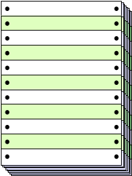


A High-Level Service Process Model Today
Increase my A&H coverage
Give me information about my Life Policy beneficiaries
CSR Life A&H Micro- Data Letter- System
Customer Corres. Policy film Entry shop
        Change
Day 8
Customer
receives
two separate
responses
Action
Request
Input
Requested
Change
What’s your
policy #’s?
Day 2
A&H change
confirmation letter
mailed to customer
Day 5
Action
Request
Challis 3
Day 6
Day 1
System
Update
Life 70
Micro-film
Request
Day 6
(Batch)
Life Policy
beneficiaries letter mailed to customer
Micro-film
Response
Day 5

Slide 21

Customer Management Team (CMT):
A Flavor of How DRG Service Process Will Change
Increase my A&H coverage
Give me information about my Life Policy beneficiaries
CMT:
Teleservice
Representative
System:
Client-server
architecture
Customer
Day 1
Day 1
Answers
Immediate
Response to
Customer
Day 1-2
Day 3-4
Send written
acknowledgment
Outbound
Paper

Slide 22
Taco Bell*
“We were going backwards - fast ... If something was simple, we made it complex. If it was hard, we figured out a way to make it impossible.” - Taco Bell CEO, John E. Martin
Customer buy for $1 are worth about 25 cents. 75 cents goes into marketing, advertising, and overhead.
Reengineering from the customer’s point of view. “Are customer willing to pay for these ‘value-added’ activities?”
*Source: Adapted from Hammer and Champy, 1993

Slide 23
Taco Bell
Corporate Vision: “We want to be number one in share of stomach.”
Slashed kitchen:
Kitchens : Seating capacity
70% : 30% ⇨ 30% : 70% 
Eliminate district managers. Restaurant managers are given profit-and-loss responsibility.
Moving cooking of meat and bean outside.
Boost peak serving capacity at average restaurant from $400 an hour to $1,500 a hour.
$500 millions regional company in 1982 to $3 billion national company in 1992.

Slide 24
Reengineering Example
Cash Lane
No more than 10 items
Which line is shorter and faster?

Slide 25
Reengineered Process
Key Concept:
One queue for multiple service points
Multiple services workstation

Slide 26
BPR Principles
Organize around outcomes, not tasks.
Have those who use the output of the process perform the process.
Subsume information-processing work into the real work that produces the information.
Treat geographically dispersed resources as though they were centralized.
Link parallel activities instead of integrating their results.
Put decision points where the work is performed and build controls into the process.
Capture information once and at the source.
Source: Michael Hammer, “Reengineering Work: Don’t Automate, Obliterate,” Harvard Business Review, July-August, 1990, pp. 104-112.

Slide 27
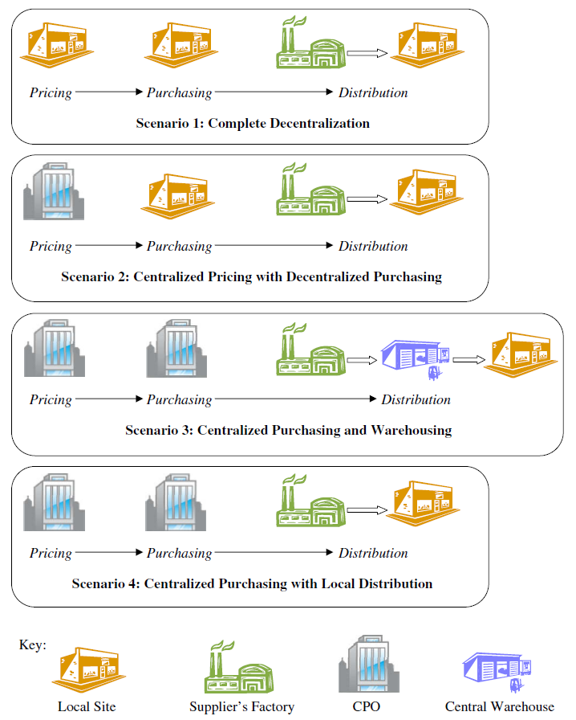

Notes:
Quantity discounts
Large orders
Long-term contracts
Reduced duplication of effort
Economies of scale
More expertise
More resources
Company-wide programs
Economies of scope
Risk pooling
Global vs. local optimization
Best price for all
Disadvantages
Logistics
Double handling
Higher transportation costs
More complicated inventory control
Loss of control at the field sites
Local needs may be ignored
Accounting difficulties
How should CPO overhead be allocated?
Cost allocation with incremental quantity discounts

Slide 28
A BPR Framework
Organization
  Job skills
  Structures
  Reward
  Values
Technology
  Enabling technologies
  IS architectures
  Methods and tools
  IS organizations
Process
  Core business processes
  Value-added
  Customer-focus
  Innovation

Slide 29
Business Process Reengineering Life Cycle
Define corporate visions and business goals
BPR-LC ©
Visioning
Identify business processes to be reengineered
Enterprise-wide engineering
Identifying
Analyze and measure an existing process
Analyzing
Process-specific
engineering
Identify enabling IT & generate alternative process redesigns
Redesigning
Evaluate and select a process redesign
Evaluating
Implement the reengineered process
Implementing
Continuous improvement of the process
Improving
Manage change and stakeholder interests

Slide 30
TI Semiconductor Business Process Map
Customer Communication
Market
Customers
Concept
Development
Manufacturing
Strategy
Development
Product
Development
Customer
Design &
Support
Order
Fulfillment
Manufacturing Capability Development
Source: Adapted from Hammer and Champy, 1993, p. 119.

Slide 31
Using Value Chain to Identify High-Level Processes
Corporate Infrastructure
Human Resource Management
Supporting
Activity
Technology Deployment
Procurement
Added
Value
Inbound
Logistic
Outbound
Logistic
Sales
and
Marketing
Service
Operation
Primary
Activity

Slide 32
Criteria for Selecting Processes
Broken
Bottleneck
Cross-functional or cross-organizational units
Core processes that have high impacts
Front-line and customer serving - the moment of the truth
Value-adding
New processes and services
Feasible

Slide 33
Process Data
Basic Overall process data:
  Customers and customer requirements
  Suppliers and suppliers qualifications
  Breakthrough goals
  Performance characteristics: Cost, cycle time, reliability, and defect rate.
  Systems constraints: Budgetary, business, legal, social, environmental, and safety issues and constraints.
Measure critical process metrics
  Cycle time
  Cost
  Input quality
  Output quality
  Frequency and distribution of inputs

Slide 34
Phase 4: Redesigning
Identify enabling IT & generate
alternative process redesigns
How can business processes be transformed using IT?
Business
Reengineering
Business-pulled
Technology-driven
Information
Technology
How can IT support business processes?
Source: Thomas H. Davenport and James E. Short, “The New Industrial Engineering: Information technology and Business Process Redesign,” Sloan Management Review, Summer 1990, pp. 11-26.

Slide 35
Evaluation Criteria
Costs
  Design and implementing the business process
  Hire and train employee
  Develop supporting IS
  Purchase of other equipment and facilities
Benefits
  Customer requirements
  Breakthrough goals
  Performance criteria
  Constraints
Risk
  Technology availability and maturity
  Time required for design and implementation
  Learning curve
  Cost and schedule overrun

Slide 36
Enabling IT to Consider
Client/server technology
Groupware and collaboration technologies
Mobile computing (wireless LAN, pen-based computing, GPS, iPhone)
Data capturing technology (scanner/barcode reader/RFID)
Telephony: Integration of computer and telephone systems; VoIP; Unified communications
Web services and Service-Oriented Architecture (SOA)
Imaging technology, work flow management systems, Business Process Management (BPM)
Decision support systems, Data warehouse, Business intelligence, Data mining, Digital dashboard
ERP, CRM, SCM
Electronic Data Interchange (EDI), Electronic Commerce, WWW, and Internet
Web 2.0 ….

Slide 37
IT Enabling Effects
Dimensions & Type
Examples
IT Enabling Effects
Organization Entity
Interorganizational
Interfunctional
Interpersonal
Objects
Physical
Informational
Activities
Operational
Managerial
Order from a supplier
Develop a new product
Approve a bank loan
Manufacture a product
Prepare a proposal
Fill a customer order
Develop a budget
Lower transaction costs
Eliminate intermediaries
Work across geography
Greater concurrency
Integrate role and task
Increase outcome flexibility
Control process
Routinize complex decision
Reduce time and costs
Increase output quality
Improve analysis
Increase participation
Adapted from: Davenport, T. H. and Short, J. E., "The New Industrial Engineering: Information Technology and Business Process Redesign," Sloan Management Review, Summer 1990, p. 17.

Slide 38


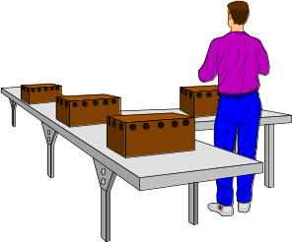
End-to-End Processes
Customer
Account
Receivable
Marketing/
Sales
Shipping
Manufacturing
Inventory Mgmt.

Slide 39
Order Management Cycle
1. Order Planning
2. Order Generation
3. Cost estimation and pricing
4. Order receipt and entry
5. Order selection and prioritization
6. Scheduling
7. Fulfillment
  Procurement
  Manufacturing
  Assembling
  Testing
  Shipping
  Installation
8. Billing
9. Returns and Claims
10. Postsales Services

Slide 40

Empowered Customer-Focus Processes
Manager as Coach
Teamwork
Customer-facing Process
Empowered
Font-line
worker
Values and Quality
delivered to
Customers timely

Slide 41
Think from the Customer Back
Define
Outcomes
The Customer
Redesign
Outputs
Activities/Tasks
Determine
Activities
Functions/Processes
Organization
Define
Job Responsibilities
Management
* Adapted from The Price Waterhouse Change Integration Team, Better Change, Irwin, 1995, p. 163.
Develop
Organization Structure

Slide 42
The Business Context of Business Networking
Share:
Costs
Skills
Market access
Technology
Virtual Enterprising
Suppliers/ Partner
Company
Customer
Customer's Customer
N C
N C
N C
N C
Competitor
N: Needs and Perceived Needs
C: Capabilities
Source: Adapted from Charles M. Savage, "The Dawn of the Knowledge Era," OR/MS Today, pp. 18-23.

Slide 43
Standard Flowchart Symbols
Annotation
Activity
Delay
Direction of
process flow
Movement/
Transportation
Storage
Connector
Transmission
Decision Point
Begin/End
Paper
document

Slide 44
Functional Flowchart (Process Mapping)
PROCESS
ACTIVITY
CYCLE
Customer
Customer
Service
Credit
Checking
Inventory
Shipping
•
•
1
2
Begin
Enter
Order
Check
Credit
1 1 1
2 0.1 4
3 0.2 1
4 ... ...
...
No
Yes
Order
Processing
Update
Inventory
Wait for
shipping
Ship order
End

Slide 45
Workflows, Data Flows, and Physical Flows
OLTP
Database
Process order
Allocate inventory
Customer
Ship order Billing
Warehouse
Account Receivable
Legend:
Actual flow of information (i.e., data flow)
Receive
payment
Logical flow of operational data (i.e., workflow)
Flow of physical objects
Money flow

Slide 46
Islands of Automation & Fragmented Processes
Order processing
IBM/MVS
DB2
Inventory management
UNIX
Informix
Shipping & distribution
Windows/NT
SQL Server
Accounts Receivable
Netware
Oracle

Slide 47
Flow of Problem Tracing vs. Data Flow
Order processing
Inventory management
Data Flow
Flow of Problem Tracing
Shipping & distribution
Accounts Receivable

Slide 48
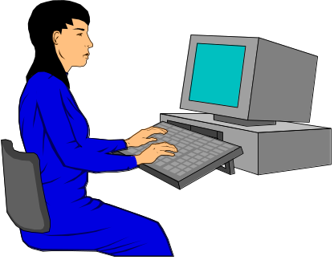
Front-End Integration
Front-end integration:
A single-system view of the process and the customer
Order processing
Inventory management
Shipping & distribution
Process Owner
Front-line Worker
Accounts Receivable

Slide 49
The Reengineering Diamond
Customers &
Suppliers
Values and
Beliefs
Competitors
Enlighten
Foster
Customers
&
Info. Tech.
Business
Processes & Functions
Management & Measurement
Systems
Entail
Demand
Jobs , Skills, & Organizational Structures
Culture
Markets

