Slide 1
Hashing
Algorithm : Design & Analysis
[09]

Slide 2
In the last class…
Definition of red-black tree
Black height
Insertion into a red-black tree
Deletion from a red-black tree

Slide 3
Hashing
Hashing
Collision Handling for Hashing
  Closed Address Hashing
  Open Address Hashing
Hash Functions
Array Doubling and Amortized Analysis

Slide 4
Hashing: the Idea
Very large, but only a small part is used in an application
In feasible size
E[0]
Index distribution
Collision handling
E[1]
x
Hash Function
Key Space
E[k]
H(x)=k
Value of a specific key
A calculated array index for the key
E[m-1]

Slide 5
Collision Handling: Closed Address
Each address is a linked list
k₁
k₄
k₁
k₅
k₂
k₇
k₄
k₅
k₂
k₇
k₃
k₆
k₆
k₃

Slide 6
Closed Address: Analysis
Assumption: simple uniform hashing: for j=0,1,2,...,m-1, the average length of the list at E[j] is n/m.
The average cost of an unsuccessful search:
  Any key that is not in the table is equally likely to hash to any of the m address. The average cost to determine that the key is not in the list E[h(k)] is the cost to search to the end of the list, which is n/m. So, the total cost is Θ(1+ n/m).

Slide 7
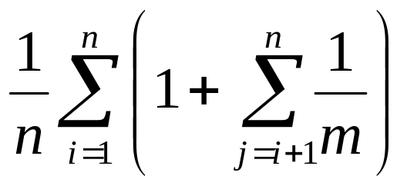
Closed Address: Analysis(cont.)
For successful search: (assuming that x_{i} is the ith element inserted into the table, i=1,2,...,n)
  For each i, the probability of that x_{i} is searched is 1/n.
  For a specific x_{i}, the number of elements examined in a successful search is t+1, where t is the number of elements iserted into the same list as x_{i}, after x_{i} has been inserted. And for any j, the probability of that x_{j} is inserted into the same list of x_{i} is 1/m. So, the cost is:
Expected number of elements in front of the searched one in the same linked list.
Cost for computing hashing

Slide 8
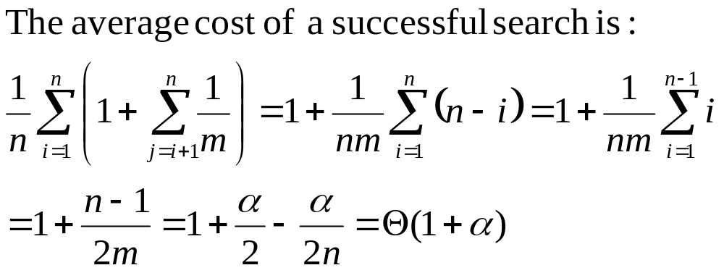
Closed Address: Analysis(cont.)
The average cost of a successful search:
  Define α=n/m as load factor,
Number of elements in front of the searched one in the same linked list.
Cost for computing hashing

Slide 9
Collision Handling: Open Address
All elements are stored in the hash table, no linked list is used. So, α, the load factor, can not be larger than 1.
Collision is settled by “rehashing”: a function is used to get a new hashing address for each collided address, i.e. the hash table slots are probed successively, until a valid location is found.
The probe sequence can be seen as a permutation of (0,1,2,..., m-1)

Slide 10

Commonly Used Probing
Linear probing:
Given an ordinary hash function h’, which is called an auxiliary hash function, the hash function is: (clustering may occur)
h(k,i) = (h’(k)+i) mod m (i=0,1,...,m-1)
Quadratic Probing:
Given auxiliary function h’ and nonzero auxiliary constant c₁ and c₂, the hash function is: (secondary clustering may occur)
h(k,i) = (h’(k)+c₁i+ c₂i²) mod m (i=0,1,...,m-1)
Double hashing:
Given auxiliary functions h₁ and h₂, the hash function is:
h(k,i) = (h₁(k)+ ih₂(k)) mod m (i=0,1,...,m-1)

Slide 11
Linear Probing: an Example
Index
H
Hash function: h(x)=5x mod 8
0
1776
1
2
1812
3
1055
hashing
4
1492
1945
rehashing
hashing
5
1812
6
1918
Rehash function: rh(j)=(j+1) mod 8
7
1945
chain of rehashings

Slide 12
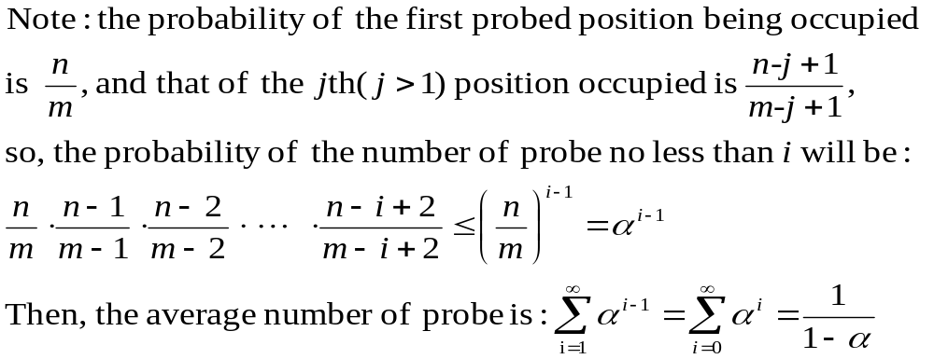
Analysis for Open Address Hash
Assuming uniform hashing, the average number of probes in an unsuccessful search is at most 1/(1-α) (α=n/m<1)

Slide 13
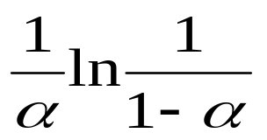

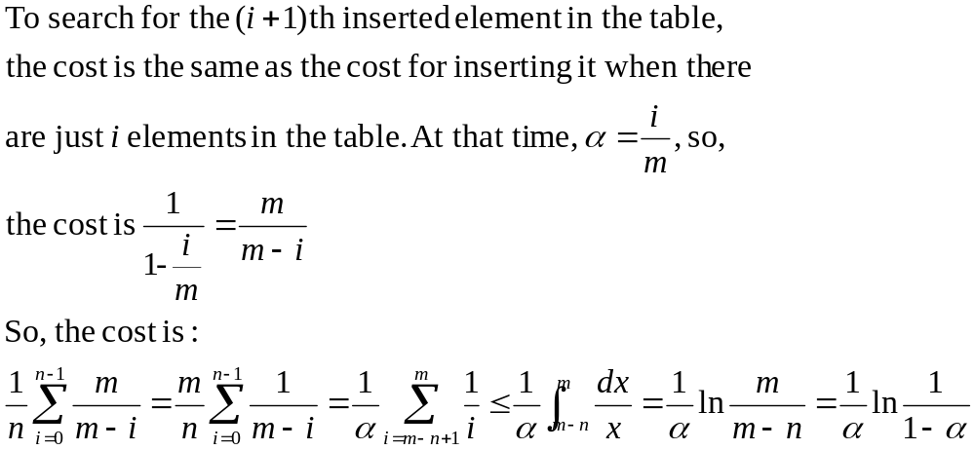
Analysis for Open Address Hash
Assuming uniform hashing, the average cost of probes in an successful search is at most (α=n/m<1)
For your reference:
Half full: 1.387; 90% full: 2.559

Slide 14
Hashing Function
A good hash function satisfies the assumption of simple uniform hashing.
Heuristic hashing functions
  The division method: h(k)=k mod m
  The multiplication method: h(k)=⎣m(kA mod 1)⎦ (0<A<1)
No single function can avoid the worst case Θ(n), so, “Universal hashing” is proposed.
Rich resource about hashing function:
Gonnet and Baeza-Yates: Handbook of Algorithms and Data Structures, Addison-Wesley, 1991

Slide 15
Array Doubling
Cost for search in a hash table is Θ(1+α), then if we can keep α constant, the cost will be Θ(1)
Space allocation techniques such as array doubling may be needed.
The problem of “unusually expensive” individual operation.

Slide 16

Looking at the Memory Allocation
hasthingInsert(HASHTABLE H, ITEM x)
integer size=0, num=0;
if size=0 then allocate a block of size 1; size=1;
if num=size then
allocate a block of size 2size;
move all item into new table;
size=2size;
insert x into the table;
num=num+1;
return
Insertion with expansion: cost size
Elementary insertion: cost 1

Slide 17
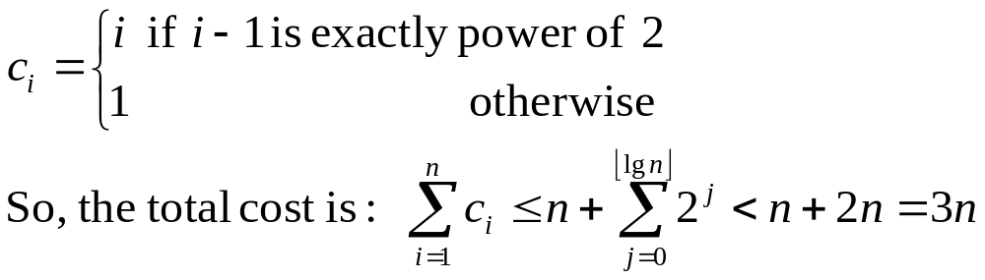
Worst-case Analysis of the Insertion
For n execution of insertion operations
  A bad analysis: the worst case for one insertion is the case when expansion is required, up to n
  So, the worst case cost is in O(n²).
Note the expansion is required during the ith operation only if i=2^{k}, and the cost of the ith operation
Of course NOT !

Slide 18
Amortized Time Analysis
Amortized equation:
amortized cost = actual cost + accounting cost
Design goals for accounting cost
  The amortized cost of each operation is fairly regular, in spite of the wide fluctuate possible for the actual cost of individual operations.

Slide 19

Amortized Analysis: MultiPop Stack
Pop:
Cost=1
MultiPop:
Cost=min(s,t)
Push:
Cost=1
s
t
Amortized cost: push:2; pop, multipop: 0

Slide 20
Amortized Analysis: Binary Counter
0 0 0 0 0 0 0 0 0 0
0 0 0 0 0 0 0 1 1
2 0 0 0 0 0 0 1 0 3
3 0 0 0 0 0 0 1 1 4
4 0 0 0 0 0 1 0 0 7
5 0 0 0 0 0 1 0 1 8
6 0 0 0 0 0 1 1 0 10
7 0 0 0 0 0 1 1 1 11
8 0 0 0 0 1 0 0 0 15
9 0 0 0 0 1 0 0 1 16
10 0 0 0 0 1 0 1 0 18
11 0 0 0 0 1 0 1 1 19
12 0 0 0 0 1 1 0 0 22
13 0 0 0 0 1 1 0 1 23
14 0 0 0 0 1 1 1 0 25
0 0 0 0 1 1 1 1 26
0 0 0 1 0 0 0 0 31
Cost measure: bit flip
amortized cost:
set 1: 2
set 0: 0

Slide 21
Accounting Scheme for Stack Push
Push operation with array doubling
  No resize triggered: 1
  Resize(n→2n) triggered: tn+1 (t is a constant)
Accounting scheme (specifying accounting cost)
  No resize triggered: 2t
  Resize(n→2n) triggered: -nt+2t
So, the amortized cost of each individual push operation is 1+2t∈Θ(1)

Slide 22
Home Assignment
pp.302-
  6.1
  6.2
  6.18
  6.19

