Slide 1
Quicksort
Algorithm : Design & Analysis
[4]

Slide 2
In the last class…
Recursive Procedures
Proving Correctness of Recursive Procedures
Deriving recurrence equations
Solution of the Recurrence equations
  Guess and proving
  Recursion tree
  Master theorem
Divide-and-conquer

Slide 3
Quicksort
Insertion sort
Analysis of insertion sorting algorithm
Lower bound of local comparison based sorting algorithm
General pattern of divide-and-conquer
Quicksort
Analysis of Quicksort

Slide 4
Comparison-Based Algorithm
The class of “algorithms that sort by comparison of keys”
  comparing (and, perhaps, copying) the key
  no other operations are allowed
The measure of work used for analysis is the number of comparison.

Slide 5
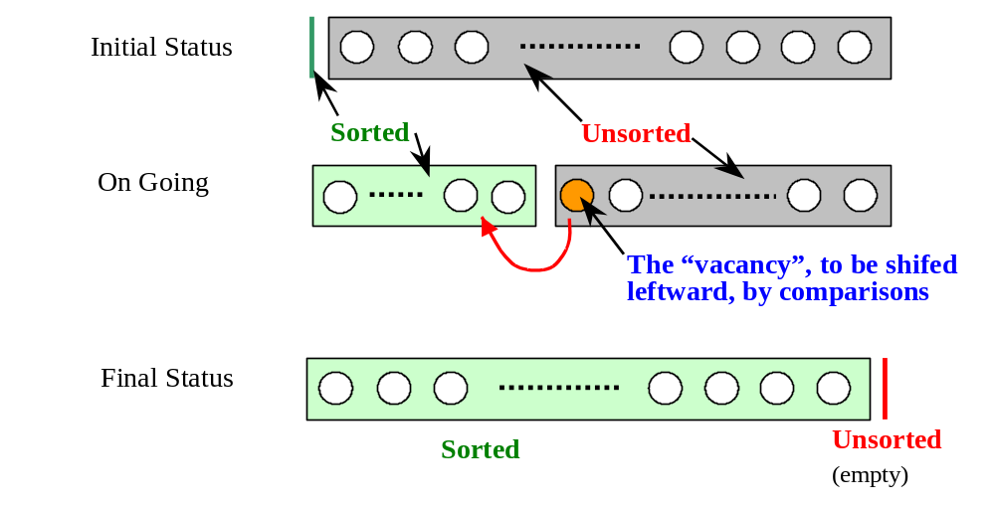
As Simple as Inserting

Slide 6
Shifting Vacancy: the Specification
int shiftVac(Element[ ] E, int vacant, Key x)
Precondition: vacant is nonnegative
Postconditions: Let xLoc be the value returned to the caller, then:
  Elements in E at indexes less than xLoc are in their original positions and have keys less than or equal to x.
  Elements in E at positions (xLoc+1,…, vacant) are greater than x and were shifted up by one position from their positions when shiftVac was invoked.

Slide 7
Shifting Vacancy: Recursion
int shiftVacRec(Element[] E, int vacant, Key x)
  int xLoc
1. if (vacant==0)
2. xLoc=vacant;
3. else if (E[vacant-1].key≤x)
4. xLoc=vacant;
5. else
6. E[vacant]=E[vacant-1];
7. xLoc=shiftVacRec(E,vacant-1,x);
8. Return xLoc
The recursive call is working on a smaller range, so terminating;
The second argument is non-negative, so precondition holding
Worse case frame stack size is Ο(n)

Slide 8
Shifting Vacancy: Iteration
int shiftVac(Element[] E, int xindex, Key x)
  int vacant, xLoc;
  vacant=xindex;
  xLoc=0; //Assume failure
  while (vacant>0)
    if (E[vacant-1].key≤x)
      xLoc=vacant; //Succeed
      break;
    E[vacant]=E[vacant-1];
    vacant--; //Keep Looking
  return xLoc

Slide 9
Insertion Sorting: the Algorithm
Input: E(array), n≥0(size of E)
Output: E, ordered nondecreasingly by keys
Procedure:
  void insertSort(Element[] E, int n)
    int xindex;
    for (xindex=1; xindex<n; xindex++)
      Element current=E[xindex];
      Key x=current.key;
      int xLoc=shiftVac(E,xindex,x);
      E[xLoc]=current;
    return;

Slide 10
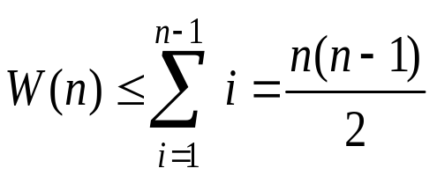
Worst-Case Analysis
Sorted (i entries)
At the beginning, there are n-1 entries in the unsorted segment, so:
x
To find the right position for x in the sorted segment, i comparisons must be done in the worst case.
The input for which the upper bound is reached does exist, so: W(n)∈Θ(n²)
Notes:
能否达到最坏？可以的！正好是倒序时，就达到最坏情况。

Slide 11
Average Behavior
Sorted (i entries)
Assumptions:
  All permutations of the keys are equally likely as input.
  There are not different entries with the same keys.
Note: For the (i+1)th interval (leftmost), only i comparisons are needed.
x
x may be located in any one of the i+1 intervals(inclusive), assumingly, with the same probabiliy

Slide 12
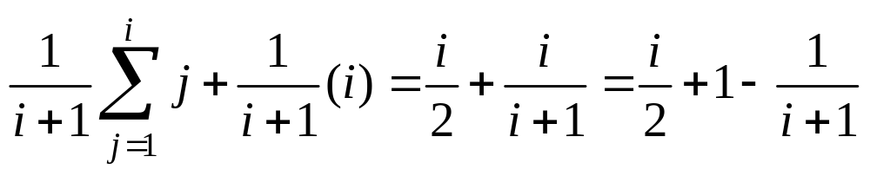
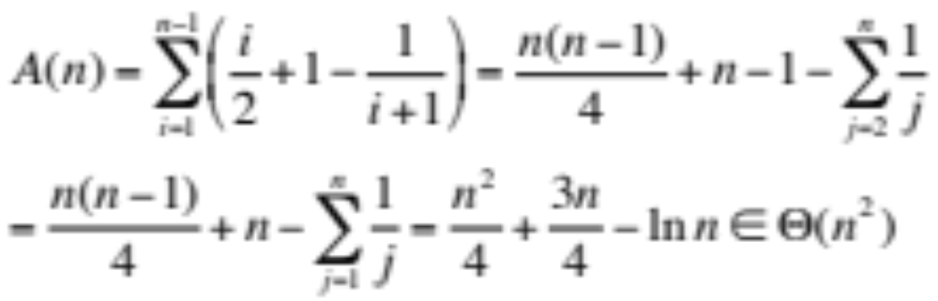
Average Complexity
The average number of comparisons in shiftVac to find the location for the ith element:
For all n-1 insertions:
for the leftmost interval

Slide 13
Inversion and Sorting
An unsorted sequence E:
  x₁, x₂, x₃, …, x_{n-1}, x_{n}
If there are no same keys, for the purpose of sorting, it is a reasonable assumption that {x₁, x₂, x₃, …, x_{n-1}, x_{n}}={1,2,3,…,n-1,n}
<x_{i}, x_{j}> is an inversion if x_{i}>x_{j}, but i<j
All the inversions must be eliminated during the process of sorting

Slide 14
Eliminating Inverses: Worst Case
Local comparison is done between two adjacent elements.
At most one inversion is removed by a local comparison.
There do exist inputs with n(n-1)/2 inversions, such as (n,n-1,…,3,2,1)
The worst-case behavior of any sorting algorithm that remove at most one inversion per key comparison must in Ω(n²)

Slide 15
Elininating Inverses: Average
Computing the average number of inversions in inputs of size n (n>1):
  Transpose: x₁, x₂, x₃, …, x_{n-1}, x_{n}
    x_{n}, x_{n-1}, …, x₃, x₂, x₁
  For any i, j, (1≤j≤i≤n), the inversion (x_{i},x_{j} ) is in exactly one sequence in a transpose pair.
  The number of inversions (x_{i},x_{j} ) on n distinct integers is n(n-1)/2.
  So, the average number of inversions in all possible inputs is n(n-1)/4, since exactly n(n-1)/2 inversions appear in each transpose pair.
The average behavior of any sorting algorithm that remove at most one inversion per key comparison must in Ω(n²)

Slide 16
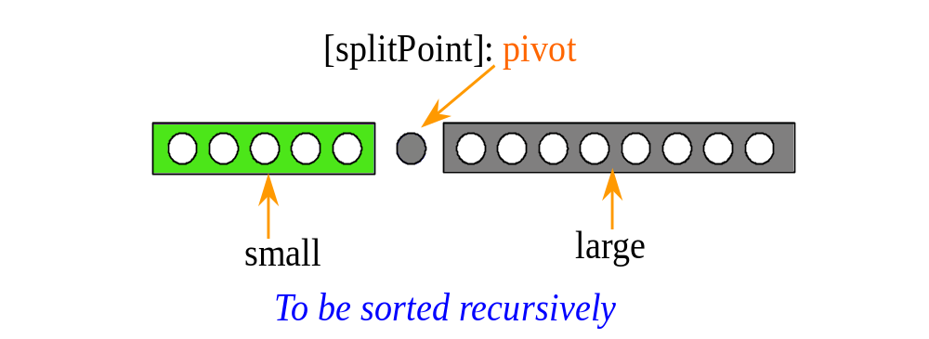
Quicksort: the Strategy
Dividing the array to be sorted into two parts: “small” and “large”, which will be sorted recursively.
[first]
[last]
for any element in this segment, the key is not less than pivot.
for any element in this segment, the key is less than pivot.

Slide 17
QuickSort: the algorithm
Input: Array E and indexes first, and last, such that elements E[i] are defined for first≤i≤last.
Output: E[first],…,E[last] is a sorted rearrangement of the same elements.
The procedure:
void quickSort(Element[ ] E, int first, int last)
if (first<last)
Element pivotElement=E[first];
Key pivot=pivotElement.key;
int splitPoint=partition(E, pivot, first, last);
E[splitPoint]=pivotElement;
quickSort(E, first, splitPoint-1);
quickSort(E, splitPoint+1, last);
return
The splitting point is chosen arbitrarily, as the first element in the array segment here.

Slide 18
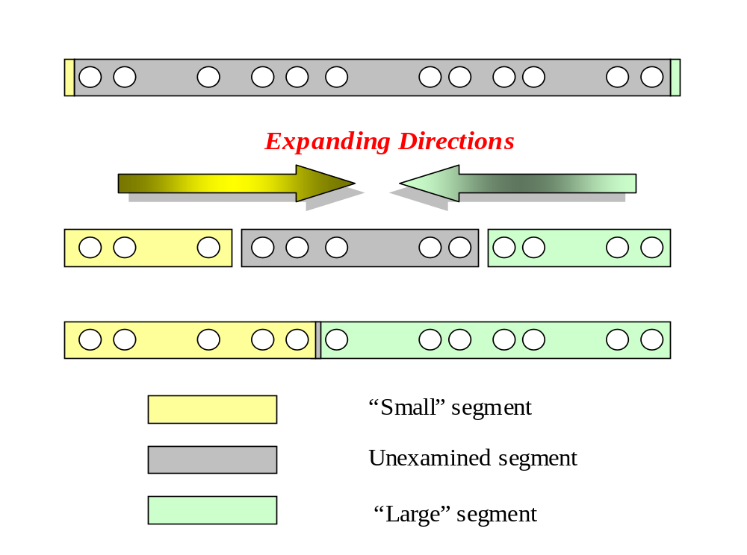
Partition: the Strategy

Slide 19
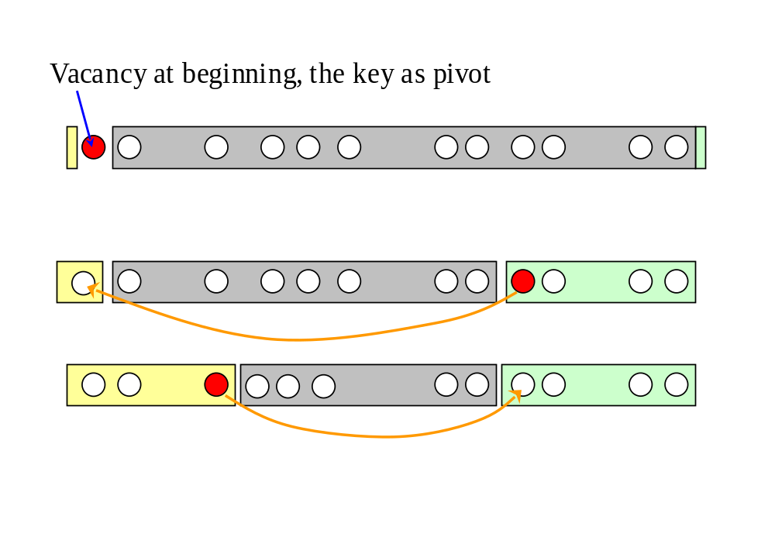
Partition: the Process
Always keep a vacancy before completion.
First met key that is less than pivot
Moving as far as possible!
highVac
First met key that is larger than pivot
lowVac
Vacant left after moving

Slide 20
Partition: the Algorithm
Input: Array E, pivot, the key around which to partition, and indexes first, and last, such that elements E[i] are defined for first+1≤i≤last and E[first] is vacant. It is assumed that first<last.
Output: Returning splitPoint, the elements origingally in first+1,…,last are rearranged into two subranges, such that
  the keys of E[first], …, E[splitPoint-1] are less than pivot, and
  the keys of E[splitPoint+1], …, E[last] are not less than pivot, and
  first≤splitPoint≤last, and E[splitPoint] is vacant.

Slide 21
Partition: the Procedure
int partition(Element [ ] E, Key pivot, int first, int last)
int low, high;
1. low=first; high=last;
2. while (low<high)
3. int highVac=extendLargeRegion(E,pivot,low,high);
4. int lowVac = extendSmallRegion(E,pivot,low+1,highVac);
5. low=lowVac; high=highVac-1;
6 return low; //This is the splitPoint
highVac has been filled now.

Slide 22
Extending Regions
Specification for
  Precondition:
    lowVac<high
  Postcondition:
    If there are elements in E[lowVac+1],...,E[high] whose key is less than pivot, then the rightmost of them is moved to E[lowVac], and its original index is returned.
    If there is no such element, lowVac is returned.
extendLargeRegion(Element[ ] E, Key pivot, int lowVac, int high)

Slide 23
Example of Quicksort
45 14 62 51 75 96 33 84 20
45 as pivot
high
low
20 14 62 51 75 96 33 84
highVac
20 14 51 75 96 33 84 62
lowVac
20 14 51 75 96 33 84 62
low
high =highVac-1
20 14 33 51 75 96 84 62
highVac
20 14 33 75 96 51 84 62
lowVac
highVac
To be processed in the next loop

Slide 24
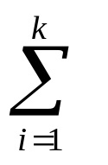
Divide and Conquer: General Pattern
solve(I)
n=size(I);
if (n≤smallSize)
solution=directlySolve(I)
else
divide I into I₁,… I_{k};
for each i∈{1,…,k}
S_{i}=solve(I_{i});
solution=combine(S₁ ,… ,S_{k});
return solution
T(n)=B(n) for n≤smallSize
T(n)=D(n)+ T(size(I_{i}))+C(n)
for n>smallSize

Slide 25
Workhorse
“Hard division, easy combination”
“Easy division, hard combination”
Usually, the “real work” is in one part.

Slide 26
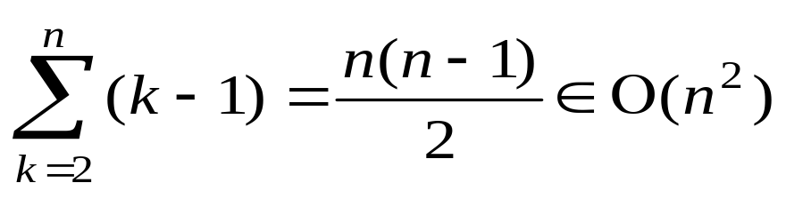
Worst Case: a Paradox
For a range of k positions, k-1 keys are compared with the pivot(one is vacant).
If the pivot is the smallest, than the “large” segment has all the remaining k-1 elements, and the “small” segment is empty.
If the elements in the array to be sorted has already in ascending order(the Goal), then the number of comparison that Partition has to do is:

Slide 27
Average Analysis
Assumption: all permutation of the keys are equally likely.
A(n) is the average number of key comparison done for range of size n.
In the first cycle of Partition, n-1 comparisons are done
If split point is E[i](each i has probability 1/n), Partition is to be executed recursively on the subrange [0,…i] and [i+1,…,n-1]

Slide 28

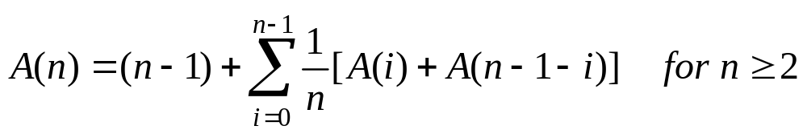
The Recurrence Equation
Why the assumed probability is still hold for each subrange?
E[0]
splitPoint: E[i]
E[n-1]
with i∈{0,1,2,…n-1}, each value with the probability 1/n
So, the average number of key comparison A(n) is:
and A(1)=A(0)=0
No two keys within a subrange have been compared each other!
subrange 1: size= i
subrange 2: size= n-1-i
The number of key comparison in the first cycle(finding the splitPoint) is n-1

Slide 29
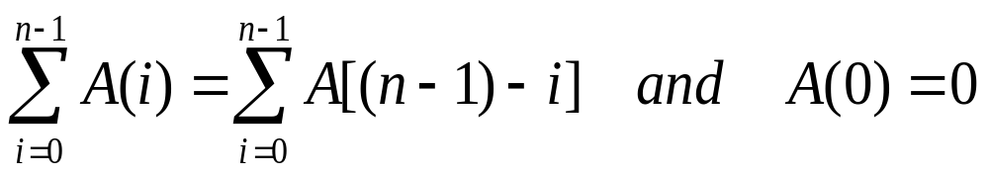
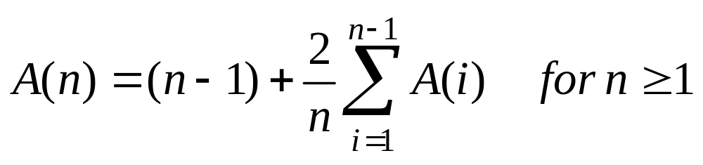
Simplified Recurrence Equation
Note:
So:
Two approaches to solve the equation
  Guess and prove by induction
  Solve directly

Slide 30
Guess the Solution
A special case as clue for guess
  Assuming that Partition divide the problem range into 2 subranges of about the same size.
  So, the number of comparison Q(n) satisfy:
  Q(n) ≈ n+2Q(n/2)
  Applying Master Theorem, case 2:
  Q(n)∈Θ(nlogn)
  Note: here, b=c=2, so E=lg(b)/lg(c)=1, and, f(n)=n=n^{E}

Slide 31
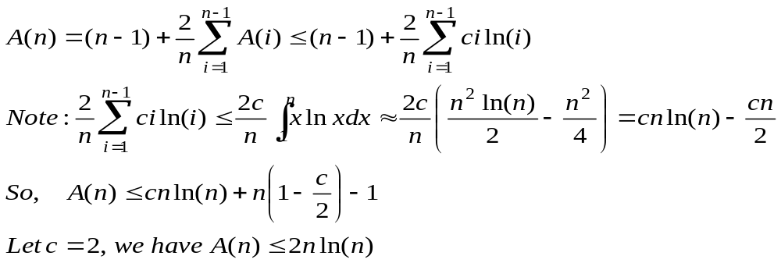
Inductive Proof: A(n)∈O(nlnn)
Theorem: A(n)≤cnlnn for some constant c, with A(n) defined by the recurrence equation above.
Proof:
  By induction on n, the number of elements to be sorted. Base case(n=1) is trivial.
  Inductive assumption: A(i)≤cilni for 1≤i<n

Slide 32


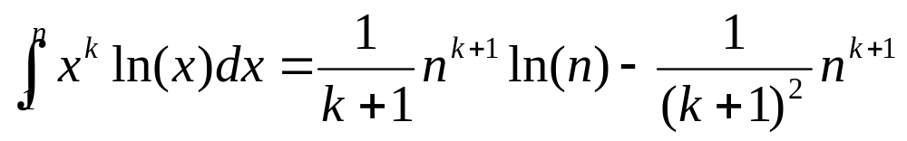
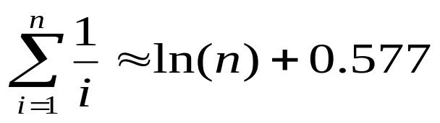
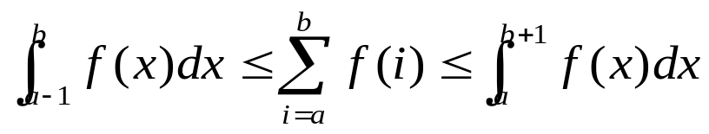
For Your Reference
Harmonic Series
a
b

Slide 33
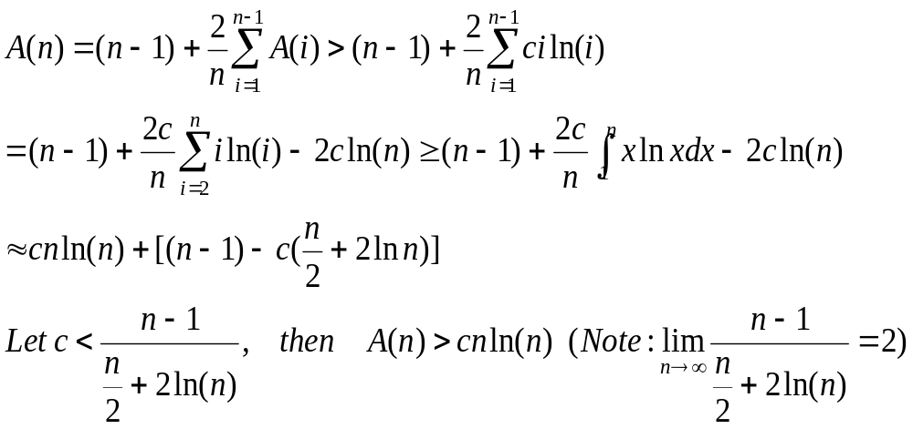
Inductive Proof: A(n)∈Ω(nlnn)
Theorem: A(n)>cnlnn for some co c, with large n
Inductive reasoning:
Inductive
assumption

Slide 34
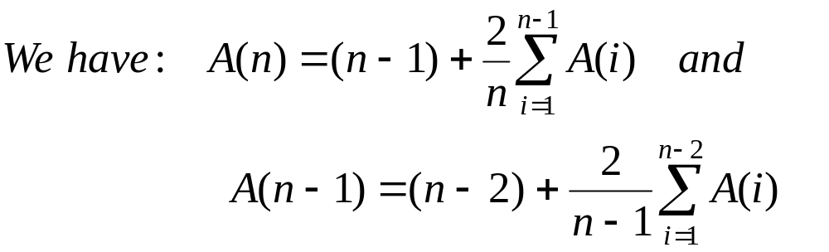
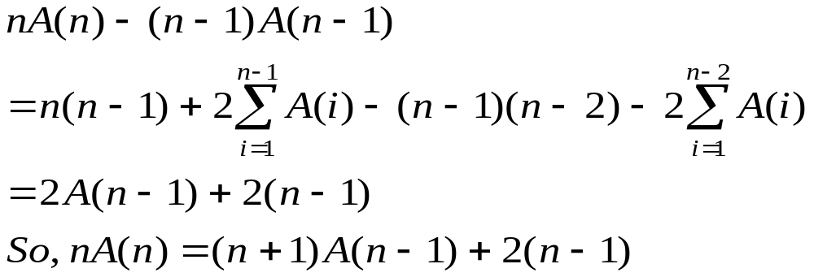
Directly Derived Recurrence Equation
Combining the 2 equations in some way, we can remove all A(i) for i=1,2,…,n-2

Slide 35
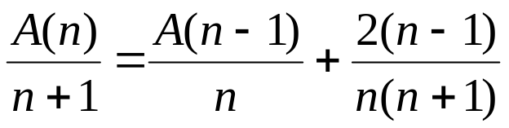
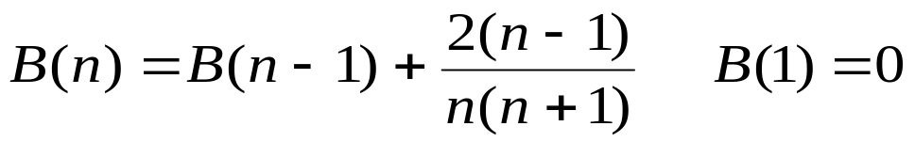
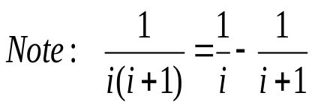
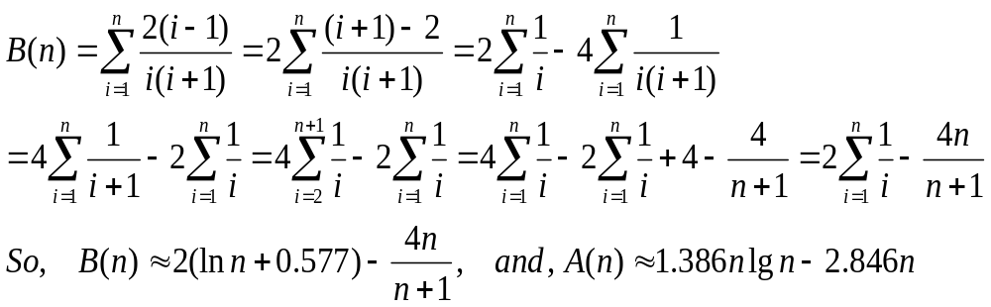
Solving the Equation
Let it be B(n)
We have equation:
Note: lnn ≈ 0.693 lgn

Slide 36
Space Complexity
Good news:
  Partition is in-place
Bad news:
  In the worst case, the depth of recursion will be n-1
  So, the largest size of the recursion stack will be in Θ(n)

Slide 37
Home Assignment
pp.208-
  4.6
  4.8-4.9
  4.11-4.12
  4.17-4.18
  4.21-4.22

