Slide 1

MergeSort
Algorithm : Design & Analysis
[5]

Slide 2
In the last class…
Insertion sort
Analysis of insertion sorting algorithm
Lower bound of local comparison based sorting algorithm
General pattern of divide-and-conquer
Quicksort
Analysis of Quicksort

Slide 3
Mergesort
Mergesort
Worst Case Analysis of Mergesort
Lower Bounds for Sorting by Comparison of Keys
  Worst Case
  Average Behavior

Slide 4
MergeSort: the Strategy
Easy division
  No comparison is done during the division
  Minimizing the size difference between the divided subproblems
Merging two sorted subranges
  Using Merge

Slide 5
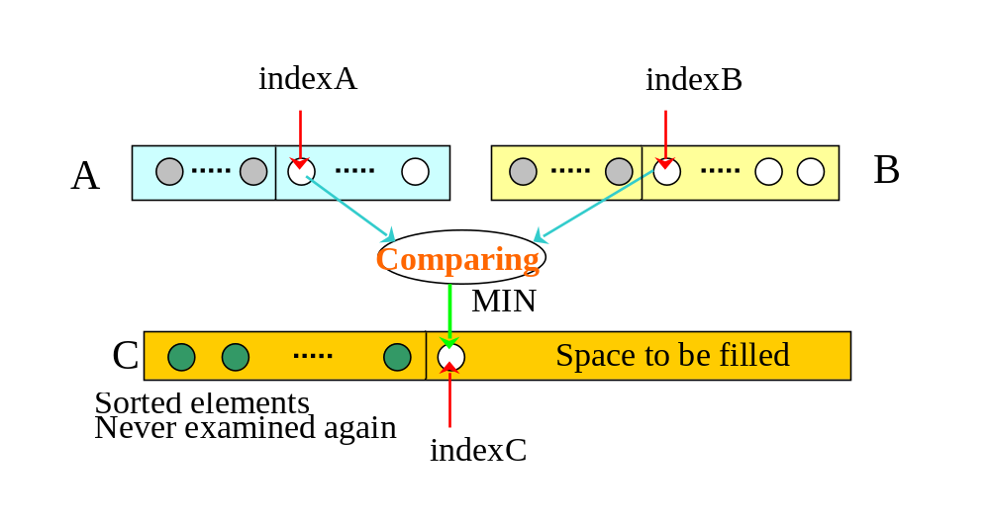
Merging Sorted Arrays
A[0]
A[k-1]
B[0]
B[m-1]

Slide 6
Merge: the Specification
Input: Array A with k elements and B with m elements, each in nondecreasing order of their key.
Output: C, an array containing n=k+m elements from A and B in nondecreasing order. C is passed in and the algorithm fills it.

Slide 7
Merge: the Recursive Version
merge(A,B,C)
if (A is empty)
rest of C = rest of B
else if (B is empty)
rest of C = rest of A
else
if (first of A ≤ first of B)
first of C =first of A
merge(rest of A, B, rest of C)
else
first of C =first of B
merge(A, rest of B, rest of C)
return
Base cases

Slide 8
Worst Case Complexity of Merge
Observations:
  After each comparison, one element is inserted into Array C, at least.
  After entering Array C, an element will never be compared again
  After the last comparison, at least two elements have not yet been moved to Array C. So at most n-1 comparisons are done.
  Worst case is that the last comparison is conducted between A[k-1] and B[m-1]
In worst case, n-1 comparisons are done, where n=k+m

Slide 9

Optimality of Merge
Any algorithm to merge two sorted arrays, each containing k=m=n/2 entries, by comparison of keys, does at least n-1 comparisons in the worst case.
  Choose keys so that:
  b₀<a₀<b₁< a₁<...<b_{i}<a_{i}<b_{i+1},...,<b_{m-1}<a_{k-1}
  Then the algorithm must compare a_{i} with b_{i} for every i in [0,m-1], and must compare a_{i} with b_{i+1} for every i in [0, m-2], so, there are n-1 comparisons.
Valid for |k-m|≤1, as well.

Slide 10
Space Complexity of Merge
A algorithm is “in space”, if the extra space it has to use is in Θ(1)
Merge is not a algorithm “in space”, since it need enough extra space to store the merged sequence during the merging process.

Slide 11
Overlapping Arrays for Merge
extra space
Before the merge
0
k-1
k+m-1
0
B
m-1
A
Merge from the right
Partly finished
Merged
0
k-1
k+m-1
0
m-1
0
k-1
k+m-1
0
m-1
A/C
Finished

Slide 12
MergeSort
Input: Array E and indexes first, and last, such that the elements of E[i] are defined for first≤i≤last.
Output: E[first],…,E[last] is a sorted rearrangement of the same elements.
Procedure
  void mergeSort(Element[] E, int first, int last)
  if (first<last)
  int mid=(first+last)/2;
  mergeSort(E, first, mid);
  mergeSort(E, mid+1, last);
  merge(E, first, mid, last)
  return

Slide 13
Analysis of Mergesort
The recurrence equation for Mergesort
  W(n)=W(⎣n/2⎦)+W(⎡n/2⎤)+n-1
  W(1)=0
  Where n=last-first+1, the size of range to be sorted
The Master Theorem applies for the equation, so:
W(n)∈Θ(nlogn)

Slide 14
Recursion Tree for Mergesort
n-1
Level 0
Base cases occur at depth ⎡lg(n+1)⎤-1 and ⎡lg(n+1)⎤
Level 1
n-2
Level 2
n-4
n-8
Level 3
Note:
nonrecursive costs on level k is n-2^{k} for all level without basecase node
T(n)
n-1
T(n/2)
n/2-1
k/2 may be ⎡k/2⎤ or ⎣k/2⎦
T(n/4)
n/4-1
T(n/8)
n/8-1

Slide 15
Non-complete Recursive Tree
Example: n=11
2^{D-1} nodes
B base-case nodes on the second lowest level
Since each nonbase-case node has 2 children, there are (n-B)/2 nonbase-case nodes at depth D-1
n-B base-case nodes
No nonbase-case nodes at this depth

Slide 16
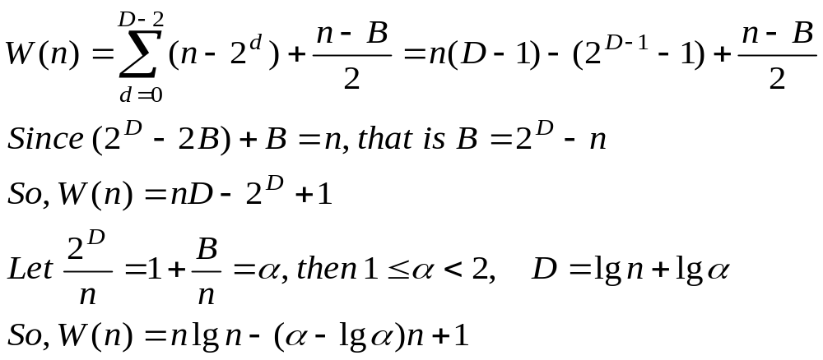
Number of Comparison of Mergesort
The maximum depth D of the recursive tree is ⎡lg(n+1)⎤.
Let B base case nodes on depth D-1, and n-B on depth D, (Note: base case node has nonrecursive cost 0).
(n-B)/2 nonbase case nodes at depth D-1, each has nonrecursive cost 1.
So:
⎡nlg(n)-n+1⎤ ≤ number of comparison ≤ ⎡nlg(n)-0.914n⎤

Slide 17
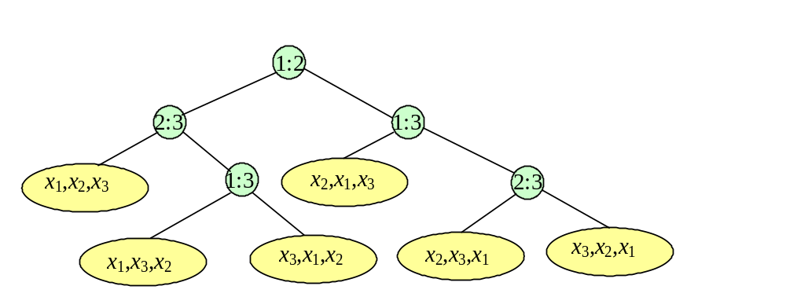
Decision Tree for Sorting
Internal node
A example for n=3
Decision tree is a 2-tree.(Assuming no same keys)
The action of Sort on a particular input corresponds to following on path in its decision tree from the root to a leaf associated to the specific output
External node

Slide 18
Characteristics of the Decision Tree
For a sequence of n distinct elements, there are n! different permutation, so, the decision tree has at least n! leaves, and exactly n! leaves can be reached from the root. So, for the purpose of lower bounds evaluation, we use trees with exactly n! leaves.
The number of comparison done in the worst case is the height of the tree.
The average number of comparison done is the average of the lengths of all paths from the root to a leaf.

Slide 19
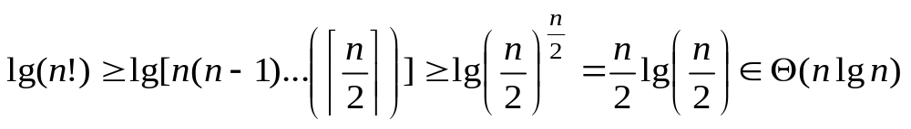
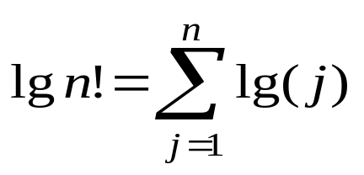
Lower Bound for Worst Case
Theorem: Any algorithm to sort n items by comparisons of keys must do at least ⎡lgn!⎤, or approximately ⎡nlgn-1.443n⎤, key comparisons in the worst case.
  Note: Let L=n!, which is the number of leaves, then L≤2^{h}, where h is the height of the tree, that is h≥ ⎡lgL⎤=⎡lgn!⎤
  For the asymptotic behavior:
  derived using:

Slide 20
2-Tree
2-Tree
Common Binary Tree
internal nodes
Both left and right children of these nodes are empty tree
external nodes
no child
any type

Slide 21
External Path Length(EPL)
The EPL of a 2-tree t is defined as follows:
  [Base case] 0 for a single external node
  [Recursion] t is non-leaf with sub-trees L and R, then the sum of:
    the external path length of L;
    the number of external node of L;
    the external path length of R;
    the number of external node of R;

Slide 22
Properties of EPL
Let t is a 2-tree, then the epl of t is the sum of the paths from the root to each external node.
epl ≥mlg(m), where m is the number of external nodes in t
    epl=epl_{L}+epl_{R}+m≥ m_{L}lg(m_{L})+m_{R}lg(m_{R})+m,
    note f(x)+f(y)≥2f((x+y)/2) for f(x)=xlgx
    so,
    epl ≥ 2((m_{L}+m_{R})/2)lg((m_{L}+m_{R})/2)+m = m(lg(m)-1)+m =mlgm.

Slide 23
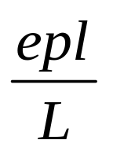
Lower Bound for Average Behavior
Since a decision tree with L leaves is a 2-tree, the average path length from the root to a leaf is .
The trees that minimize epl are as balanced as possible.
Recall that epl ≥ Llg(L).
Theorem: The average number of comparison done by an algorithm to sort n items by comparison of keys is at least lg(n!), which is about nlgn-1.443n.
to be proved

Slide 24
Reducing External Path Length
Assuming that h-k>1, when calculating epl, h+h+k is replaced by (h-1)+2(k+1). The net change in epl is k-h+1<0, that is, the epl decreases.
So, more balanced 2-tree has smaller epl.
X
level
k
X
level
k
+1
Y
level
h
-
1
Y
level
h

Slide 25
Mergesort Has Optimal Average Performance
We have proved that the average number of comparisons done by an algorithm to sort n items by comparison of keys is at least about nlgn-1.443n
The worst complexity of mergesort is in Θ(nlgn)
But, the average performance can not be worse the the worst case performance.
So, mergesort is optimal as for its average performance.

Slide 26
Home Assignment
pp.212-
  4.24
  4.25
  4.27
  4.29
  4.30
  4.32

