Slide 1
The Selection
Algorithm : Design & Analysis
[7]

Slide 2
In the last class…
Heap Structure and Patial Order Tree Property
The Strategy of Heapsort
Keep the Partial Order Tree Property after the maximal element is removed
Constructing the Heap
Complexity of Heapsort
Accelerated Heapsort

Slide 3
The Selection
Finding max and min
Finding the second largest key
Adversary argument and lower bound
Selection Problem – Median
A Linear Time Selection Algorithm
Analysis of Selection Algorithm
A Lower Bound for Finding the Median

Slide 4
The Selection Problem
Problem:
  Suppose E is an array containing n elements with keys from some linearly order set, and let k be an integer such that 1≤k≤n. The selection problem is to find an element with the kth smallest key in E.
A Special Case
  Find the max/min – k=n or k=1

Slide 5
Lower Bound of Finding the Max
For any algorithm A that can compare and copy numbers exclusively, in the worst case, A can’t do fewer than n-1 comparisons to find the largest entry in an array with n entries.
  Proof: an array with n distinct entries is assumed. We can exclude a specific entry from being the largest entry only after it is determined to be “loser” to at least one entry. So, n-1 entries must be “losers” in comparisons done by the algorithm. However, each comparison has only one loser, so at least n-1 comparisons must be done.

Slide 6
Decision Tree and Lower Bound
Since the decision tree for the selection problem must have at least n leaves, the height of the tree is at least ⎡lgn⎤. It’s not a good lower bound.
Example: n=4
0:1
≤
<
1:2
0:2
2:3
1:3
……
3
2
3
1
There are more than n leaves!
In fact, 2^{n-1} leaves at least.

Slide 7
Finding max and min
The strategy
  Pair up the keys, and do n/2 comparisons(if n odd, having E[n] uncompared);
  Doing findMax for larger key set and findMin for small key set respectively (if n odd, E[n] included in both sets)
Number of comparisons
  For even n: n/2+2(n/2-1)=3n/2-2
  For odd n: (n-1)/2+2((n-1)/2+1-1)=⎡3n/2⎤-2

Slide 8
Unit of Information
That x is max can only be known when it is sure that every key other than x has lost some comparison.
That y is min can only be known when it is sure that every key other than y has win some comparison.
Each win or loss is counted as one unit of information, then any algorithm must have at least 2n-2 units of information to be sure of specifying the max and min.

Slide 9
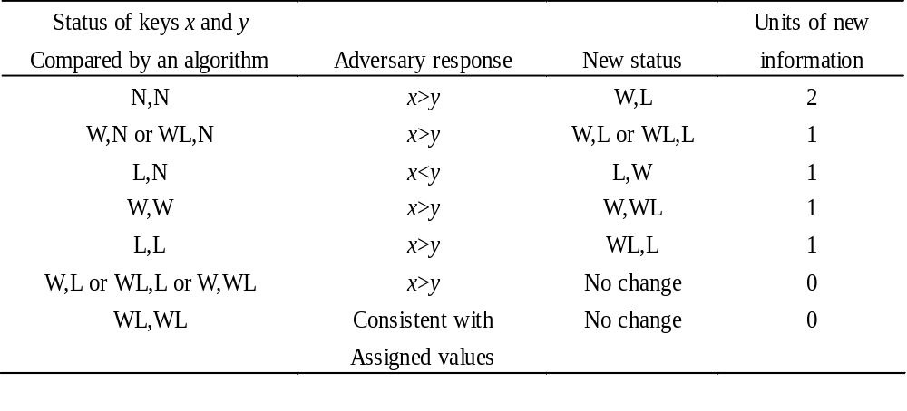

Adversary Strategy
The principle: let the key win if it never lose, or, let the key lose if it never win, and
change one value if necessary

Slide 10
Lower Bound by Adversary Strategy
Construct a input to force the algorithm to do more comparisons as possible, that is, to give away as few as possible units of new information with each comparison.
It can be achieved that 2 units of new information are given away only when the status is N,N.
It is always possible to give adversary response for other status so that at most one new unit of information is given away, without any inconsistencies.
So, the Lower Bound is n/2+n-2(for even n)

Slide 11
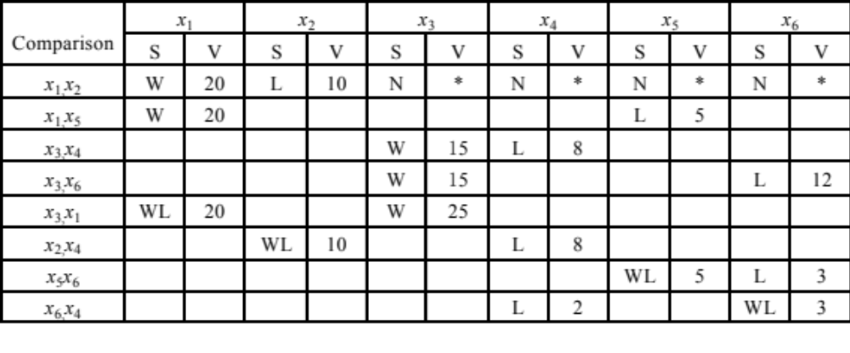

An Example Using Adversary
Now, x₃ is the only one which never loses, so, Max is x₃
Now, x₄ is the only one which never wins, so, x₄ is Min
8 Comparisons!
The lower bound is 7.
Raising/lowering the value according to strategy

Slide 12
Finding the Second-Largest Key
Using FindMax twice is a solution with 2n-3 comparisons.
For a better algorithm, the idea is to collect some useful information from the first FindMax to decrease the number of comparisons in the second FindMax.
Useful information: the key which lost to a key other than max cannot be the second-Largest key.
The worst case for twice FindMax is “No information”.(x₁ is Max)

Slide 13
Second Largest Key by Tournament
The length of the longest path is ⎡lgn⎤ , as many as those compared to max at most.
Larger key bubbles up
2
6
x₂ is max
Only x₁, x₃, x₅, x₆ may be the second largest key.
2
2
5
6
9
2
3
4
5
6
7
8
9
1
2

Slide 14
Analysis of Finding the Second
Any algorithm that finds secondLargest must also find max before. (n-1)
The secondLargest can only be in those which lose directly to max.
On its path along which bubbling up to the root of tournament tree, max beat ⎡lgn⎤ keys at most.
Pick up secondLargest. (⎡lgn⎤ -1)
n+ ⎡lgn⎤-2

Slide 15
Lower Bound by Adversary
Theorem
  Any algorithm (that works by comparing keys) to find the second largest in a set of n keys must do at least n+⎡lgn⎤-2 comparisons in the worst case.
  Proof
  There is an adversary strategy that can force any algorithm that finds secondLargest to compare max to ⎡lgn⎤ distinct keys.

Slide 16
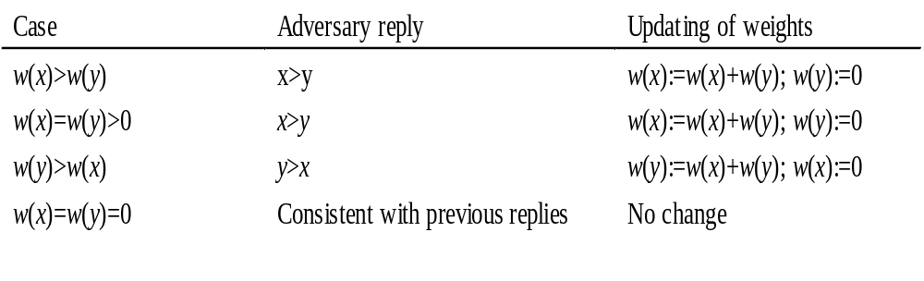
Weighted Key
Note: for one comparison, the weight increasing is no more than doubled.
Assigning a weight w(x) to each key. The initial values are all 1.
Adversary rules:
Zero=Loss

Slide 17
Lower Bound by Adversary: Details
Note: the sum of weights is always n.
Let x is max, then x is the only nonzero weighted key, that is w(x)=n.
By the adversary rules:
w_{k}(x)≤ 2w_{k-1}(x)
Let K be the number of comparisons x wins against previously undefeated keys:
n=w_{K}(x)≤2^{K}w₀(x)=2^{K}
So, K≥⎡lgn⎤

Slide 18

Tracking the Losers to MAX
x₈
To be filled with winners
Building a heap structure of 2n-1 entries, using n-1 extra space
x₈
x₈
x₈
x₁
x₂
x₃
x₄
x₅
x₆
x₇
x₈
x₉
x₁₀
n entries in input

Slide 19
Finding the Median: the Strategy
Obervation: If we can partition the problem set of keys into 2 subsets: S1, S2, such that any key in S1 is smaller that that of S2, then the median must located in the set with more elements.
Divide-and-Conquer: only one subset is needed to be processed recursively.

Slide 20
Adjusting the Rank
The rank of the median (of the original set) in the subset considered can be evaluated easily.
An example
  Let n=255
  The rank of median we want is 128
  Assuming |S₁|=96, |S₂|=159
  Then, the original median is in S₂, and the new rank is 128-96=32

Slide 21

Partitioning: Larger and Smaller
Dividing the array to be considered into two subsets: “small” and “large”, the one with more elements will be processed recursively.
A “bad” pivot will give a very uneven partition!
[splitPoint]:
pivot
for any element in this segment, the key is less than pivot.
for any element in this segment, the key is not less than pivot.
small
large
To be
p
rocessed
recursively

Slide 22
Selection: the Algorithm
Input: S, a set of n keys; and k, an integer such that 1≤k≤n.
Output: The kth smallest key in S.
Note: Median selection is only a special case of the algorithm, with k=⎡n/2⎤.
Procedure
Element select(SetOfElements S, int k)
  if (|S|≤5) return direct solution; else
  Constructing the subsets S₁ and S_{2;}
  Processing one of S₁,S₂ with more elements, recursively.
There is the same question with quicksort-imbalanced partition

Slide 23
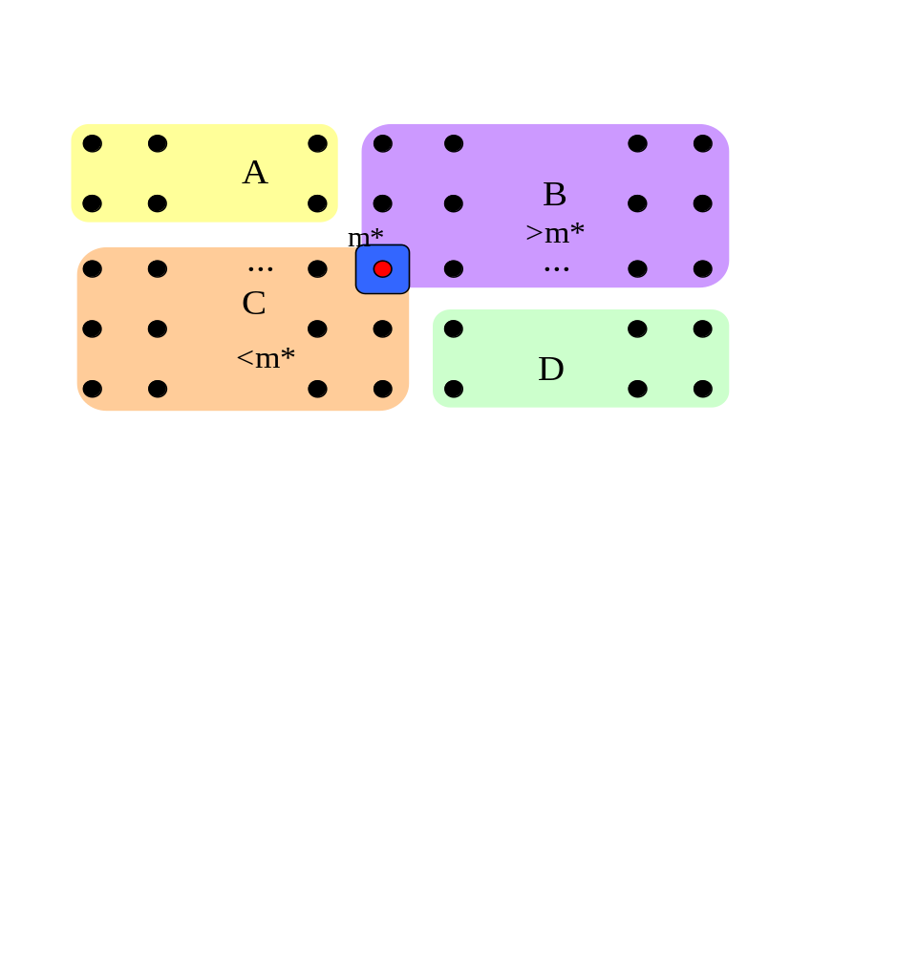
Partition Improved: the Strategy
All the elements are put in groups of 5
Medians
Increasing
Increasing by medians

Slide 24
Constructing the Partition
Find the m*, the median of medians of all the groups of 5, as illustrated previously.
Compare each key in sections A and D to m*, and
  Let S₁=C∪{x|x∈A∪D and x<m*}
  Let S₂=B∪{x|x∈A∪D and x>m*}
  (m* is to be used as the pivot for the partition)

Slide 25
Divide and Conquer
if (k=|S₁|+1)
return m*;
else if (k≤|S₁|)
return select(S₁,k); //recursion
else
return select(S₂,k-|S₁|-1); //recursion

Slide 26
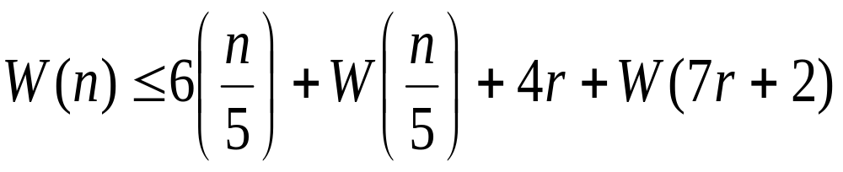
Counting the Number of Comparisons
For simplicity:
  Assuming n=5(2r+1) for all calls of select.
Note: r is about n/10, and 0.7n+2 is about 0.7n, so
The extreme case: all the elements in A∪D in one subset.
Comparing all the elements in A∪D with m*
Finding the median in every group of 5
Finding the median of the medians

Slide 27
Worst Case Complexity of Select
W(n) 1.6n
1.6n
Note: Row sums is a decreasing geometric series, so
W(n)∈Θ(n)
W(.2n) 1.6(.2n)
W(.7n) 1.6(.7n)
1.6(. 9)n
1.6(. 81)n
W(.04n) 1.6(.04n)
W(.14n) 1.6(.14n)
W(.14n) 1.6(.14n)
W(.49n) 1.6(.49n)
1.6(. 9)³n
W(.2³n)
W(.2²(.7)n)
W(.2²(.7)n)
W(.2(.7)²n)
W(.2²(.7)n)
W(.2(.7)²n)
W(.2(.7)²n)
W(.2³n)

Slide 28
Relation to Median
Observation: Any algorithm of selection must know the relation of every element to the median.
y
Median
y
Wrong

Slide 29
Crucial Comparison
A crucial comparison establishes the relation of some x to the median.
Definition (for a comparison involving a key x)
  Crucial comparison for x: the first comparison where x>y, for some y≥median, or x<y for some y≤median
  Non-crucial comparison: the comparison between x and y where x>median and y<median

Slide 30
Adversary for Lower Bound
Status of the key during the running of the Algorithm:
  L: Has been assigned a value larger than median
  S: Has been assigned a value smaller than median
  N: Has not yet been in a comparison
Adversary rule:
Comparands Adversary’s action
N,N one L, the another S
L,N or N,L change N to S
S,N or N,S change N to L
(In all other cases, just keep consistency)

Slide 31
Notes on the Adversary Arguments
All actions explicitly specified above make the comparisons un-crucial.
At least, (n-1)/2 L or S can be assigned freely.
If there are already (n-1)/2 S, a value larger than median must be assigned to the new key, and if there are already (n-1)/2 L, a value smaller than median must be assigned to the new key. The last assigned value is the median.
So, an adversary can force the algorithm to do (n-1)/2 un-crucial comparisons at least(In the case that the algorithm start out by doing (n-1)/2 comparisons involving two N.

Slide 32
Lower Bound for Selection Problem
Theorem: Any algorithm to find the median of n keys(for odd n) by comparison of keys must do at least 3n/2-3/2 comparisons in the worst case.
Argument:
  There must be done n-1 crucial comparisons at least.
  An adversary can force the algorithm to perform as many as (n-1)/2 uncrucial comparisons. (Note: the algorithm can always start out by doing (n-1)/2 comparisons involving 2 N-keys, so, only (n-1)/2 L or S left for the adversary to assign freely as the adversary rule.

Slide 33
Home Assignment
5.2
5.4
5.6
5.8
5.12-14
5.17

