Slide 1



Pruning Techniques for Graph Isomorphism:
Monte Carlo, Lanczos and BFS
Zi-kai Lin, Ruo-zhou Du

Slide 2

Background & Introduction

Slide 3
Background & Introduction
Graph Isomorphism: structure, vertex label, edge label
Setup:
Graph Database: nearly static, features can be extracted offline
Query Graph: streaming, unknown
Goal: develop practical pruning techniques before running standard isomorphism algorithm, e.g. VF2

Slide 4
Background & Introduction
Only consider sparse matrix, control sparsity at p=O(1/|V|)
i.e. |E|= O(|V|)
Only consider weakly connected graph

Slide 5
Background & Introduction
Indicator Matrix: M
Weighted adjacency matrix: A
Transition matrix: P (A normalized by row)
One step of transition: x_{t+1} = P^{T} x_{t}

Slide 6
Adjacency Matrix Revisited

Slide 7
Directed vs Undirected
Equivalent statement: whether indicator matrix M is symmetric
Advantage of undirected graph:
Symmetric matrix has real eigenvalue (comparable!)
Symmetric matrix yields Cauchy Interlacing Theorem (prune!)
Symmetric matrix is suitable for Lanczos algorithm (sparsity!)
Strongly connected graph guarantee unique stationary state in Monte Carlo
Conclusion: undirected graph for MC and Lanczos

Slide 8
Weighted vs Unweighted
Weights in adjacency matrix A can be seen as a kind of information encoding.
Structure(degree), vertex label, edge label…
Let’s wait and see…

Slide 9
Part1: Monte Carlo

Slide 10


Monte Carlo: Particle Transition
Mr. Li came up with this idea first.
Idea: use particle transition to simulate
Where the state vector only contains integer
transition probability is proportional to square of degree:
Motivation: vertex with high degree contains more structural information and is worth investigating more frequently.

Slide 11
Monte Carlo: Particle Transition
u

Slide 12


Measurement for convergence
One step of transition:
Normalized state (like PDF):
We have three kind of measurement, denoted as
2-Norm
JS divergence
Wasserstein

Slide 13
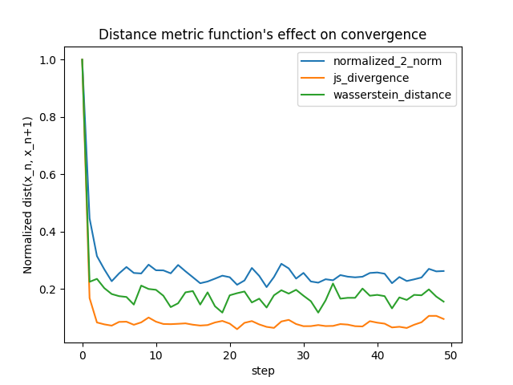
Measurement for convergence

Slide 14
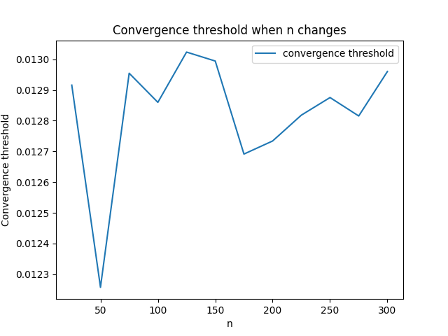
Threshold for convergence

Slide 15


Pruning by stationary state (?)
We have two distinct graph G1 and G2
By MC, we obtain their sorted normalized limited state:
Can we tell the different between G1 and G2 by ?
Experiment setup: |V|=200, |E|≈ 1200

Slide 16
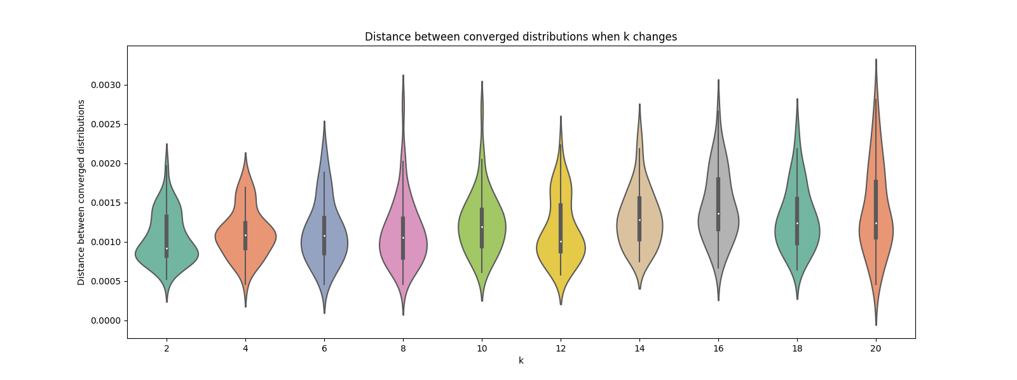
Pruning by stationary state (?)
|V|=200, |E|≈1200

Slide 17
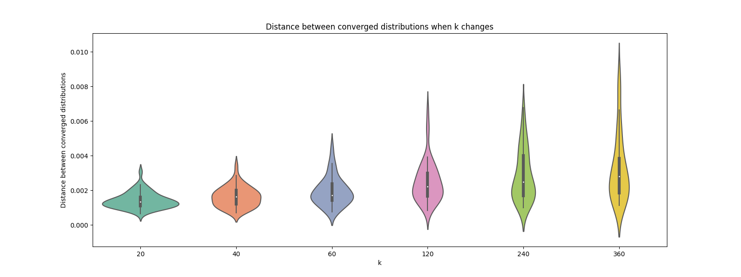
Pruning by stationary state (?)
|V|=200, |E|≈1200

Slide 18
Part2: Lanczos

Slide 19
From MC to Lanczos
MC only uses the stationary vector corresponding to the largest eigenvalue
Can we use more vectors and more eigenvalue to prune?
This idea leads us to Cauchy interlacing theorem and Lanczos algorithm.

Slide 20
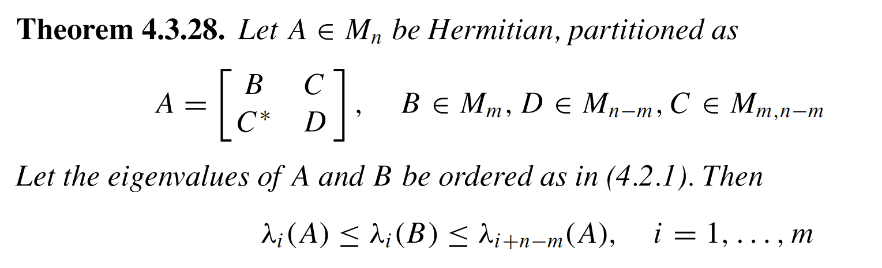
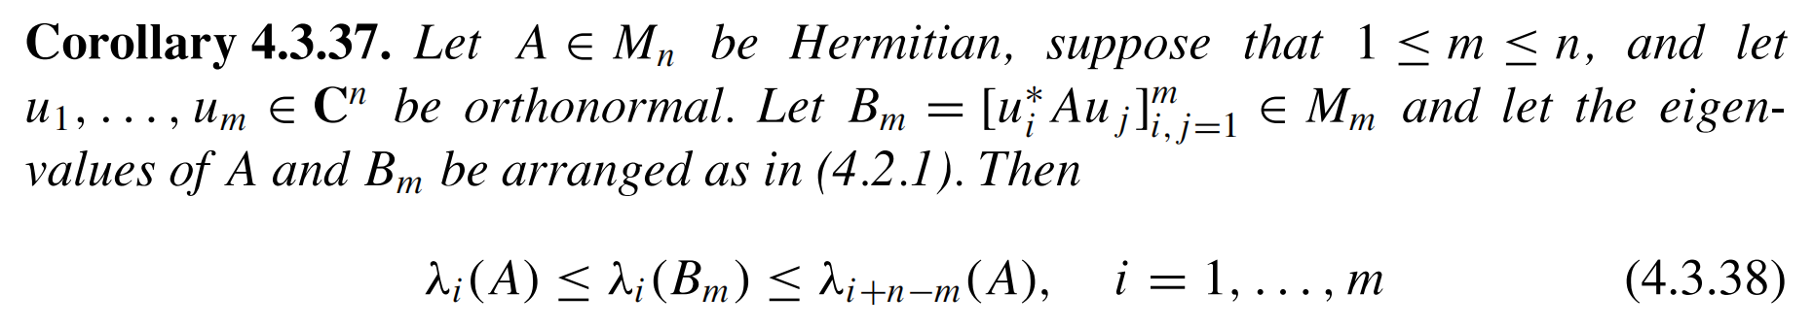
Cauchy Interlacing Theorem
Use this corollary to prune!

Slide 21

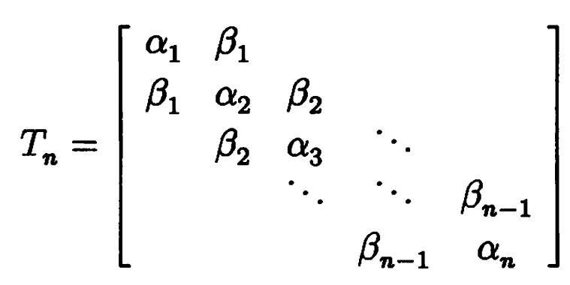

Lanczos Algorithm

Slide 22
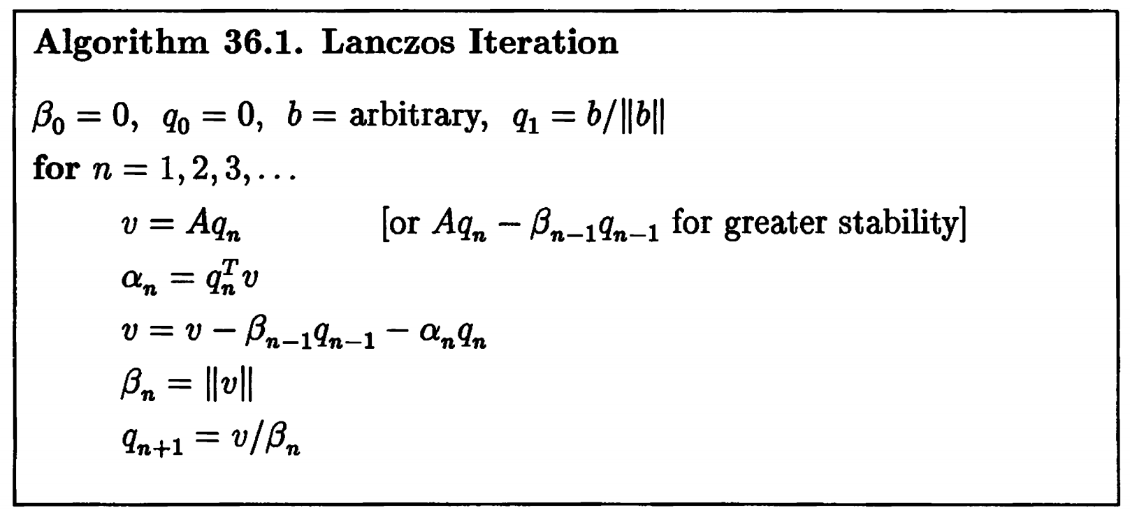
Lanczos Algorithm

Slide 23
Pros & Cons of Lanczos Algorithm
Pros
Very efficient. Often detect distinction when T is still small.
Very easy to estimate the eigenvalues of tridiagonal matrix T.
Still works even when the perturbation is little.
Make good use of sparsity.
No need to store Q and T in practice. Save space.
Cons
Numerically instable. When Q loses orthogonality, false positive result occur.

Slide 24
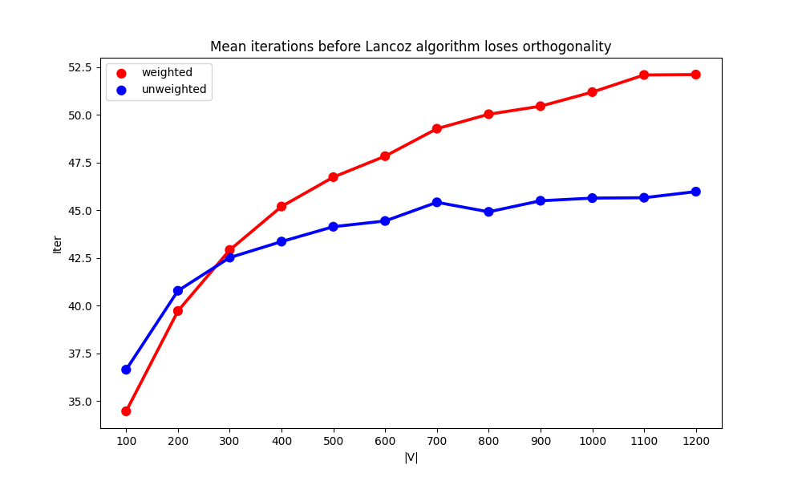
When Lanczos loses orthogonality

Slide 25
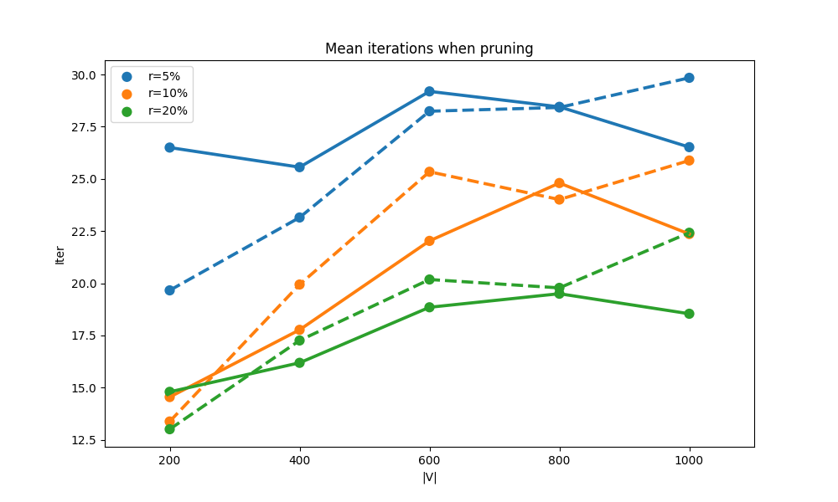
When Lanczos detect difference

Slide 26
Pros & Cons of Lanczos Algorithm
Pros
Very efficient. Often detect distinction when T is still small.
Very easy to estimate the eigenvalues of tridiagonal matrix T.
Still works even when the perturbation is little.
Make good use of sparsity.
No need to store Q and T in practice. Save space.
Cons
Numerically instable. When Q loses orthogonality, false positive result occur.

Slide 27
Part3: BFS with depth

Slide 28


Graph characteristics for determining isomorphism
Vertex, edge, degree, etc.
Overall information is not enough——internal positional relationships
A simple method to capture them——BFS with depth
Inspiration

Slide 29
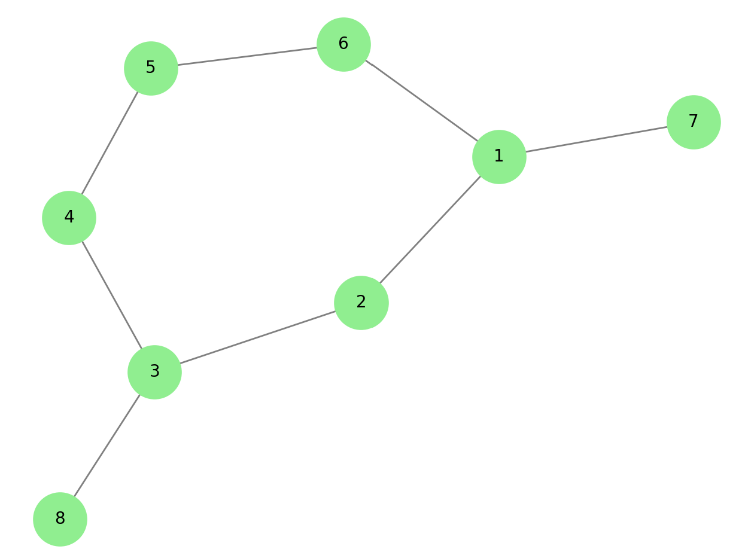
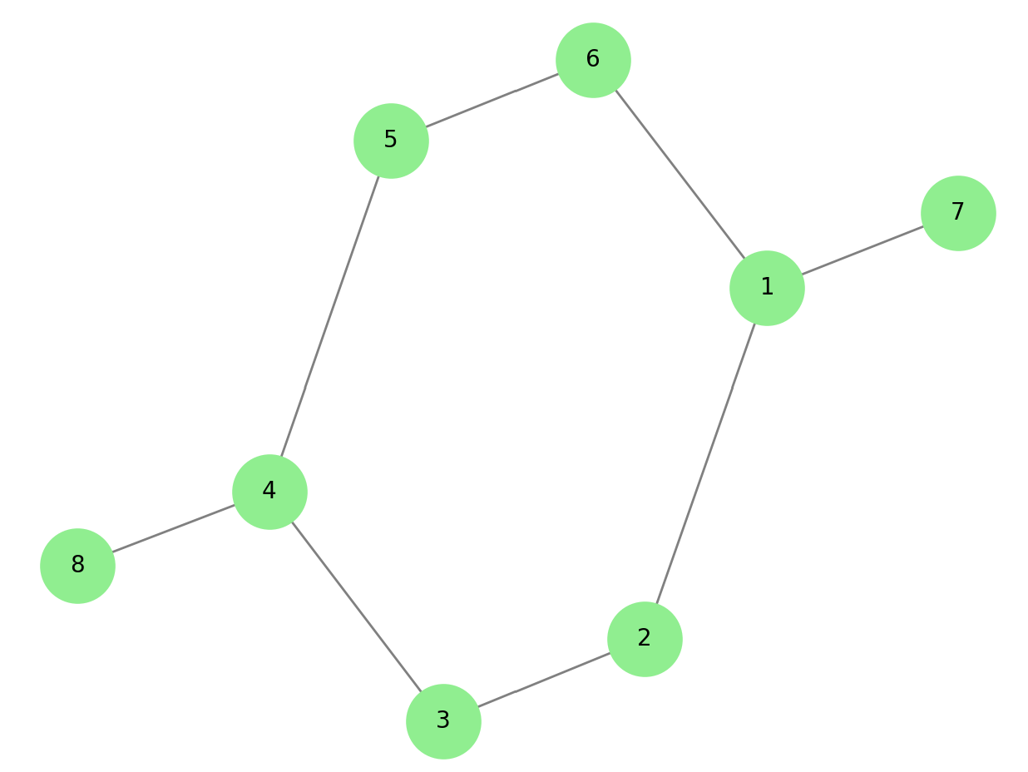
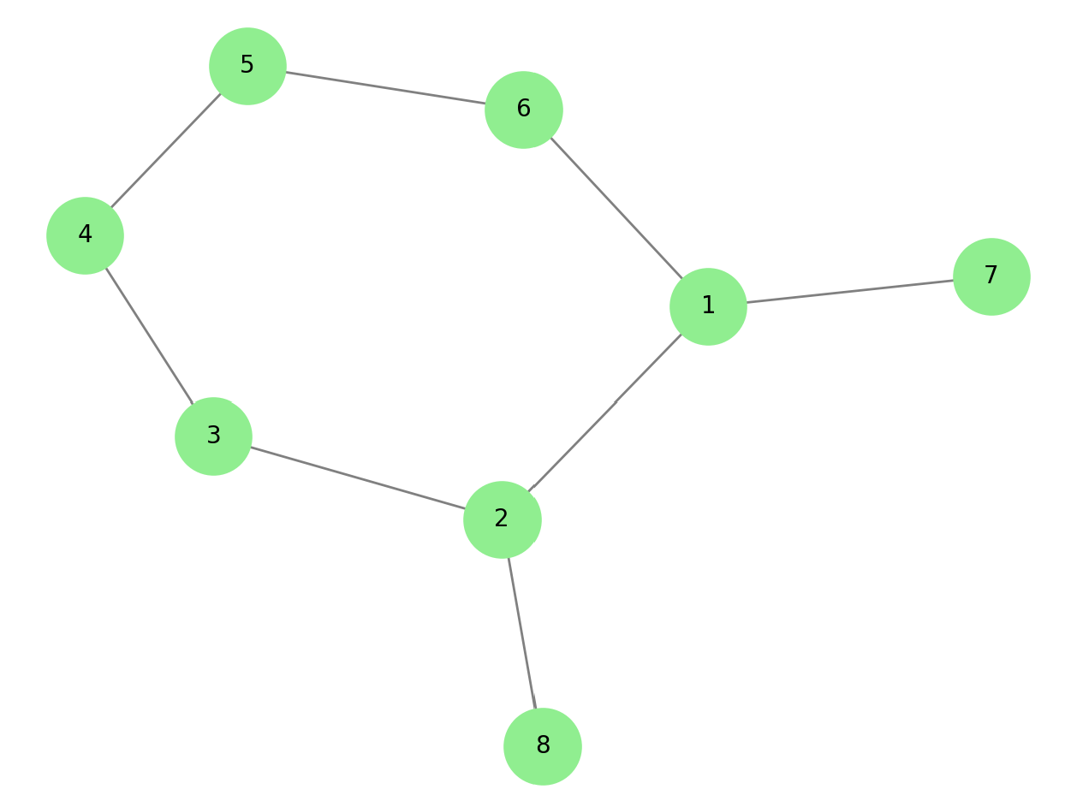
Inspiration
Vertex: 8 Edge: 8
Degree: 1, 1, 2, 2, 2, 2, 3, 3 Discuss the condition that the graphs to be compared have the same V, E, Degrees

Slide 30
Inspiration
Do BFS to obtain depth information of all nodes relative to some node(s)
If two graphs are isomorphic, then these nodes should be equivalent, ensuring that the BFS results are identical under isomorphism
If two graphs are non-isomorphic, we hope that their results will likely be different, which can be used to verify non-isomorphism

Slide 31
Inspiration
A method for selecting nodes: select all nodes with the same degree
Selecting all nodes with the maximum degree

Slide 32
Inspiration
A method for selecting nodes: select all nodes with the same degree
Selecting all nodes with the maximum degree
BFS start

Slide 33
Inspiration
A method for selecting nodes: select all nodes with the same degree
Selecting all nodes with the maximum degree
BFS start

Slide 34
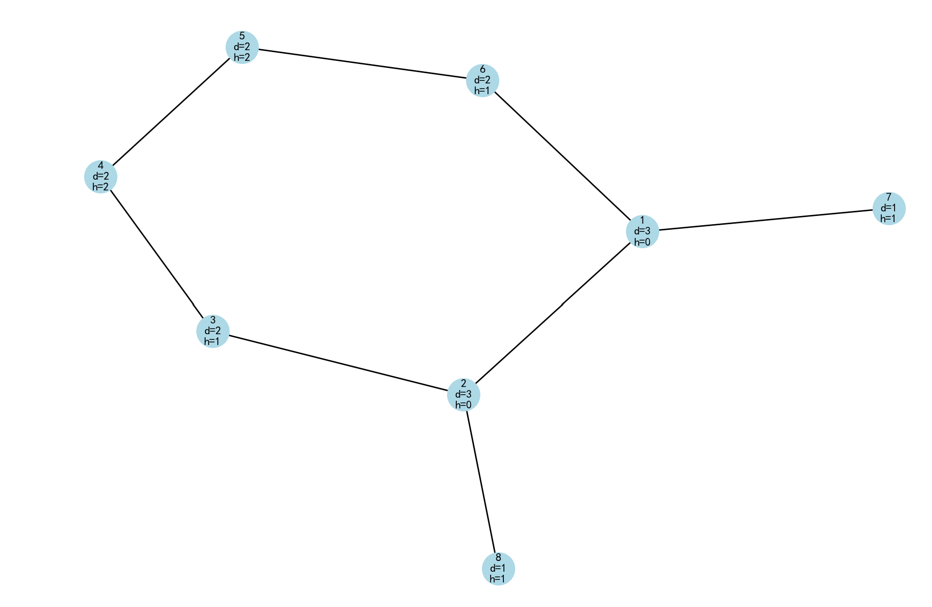
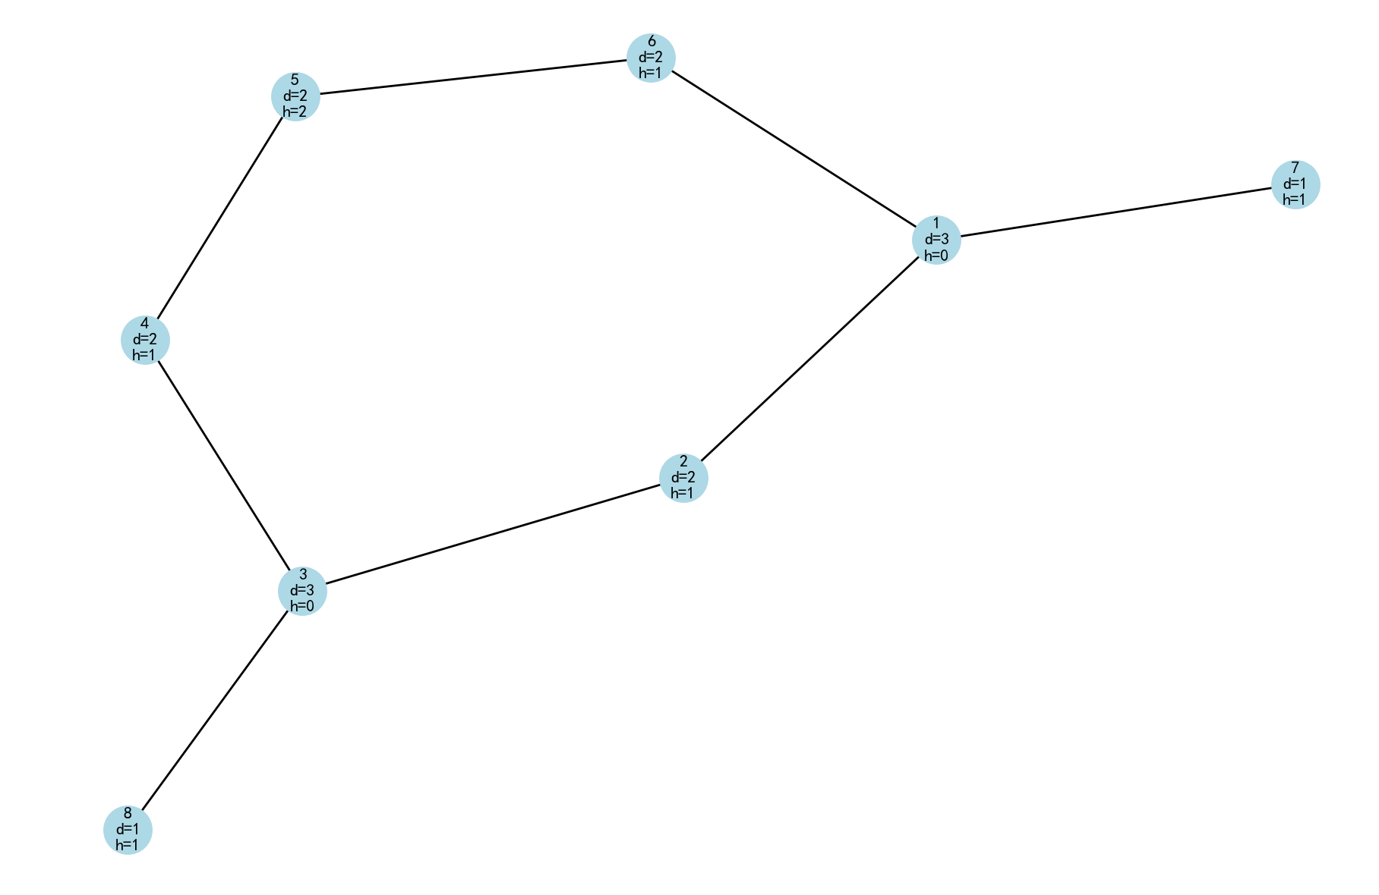
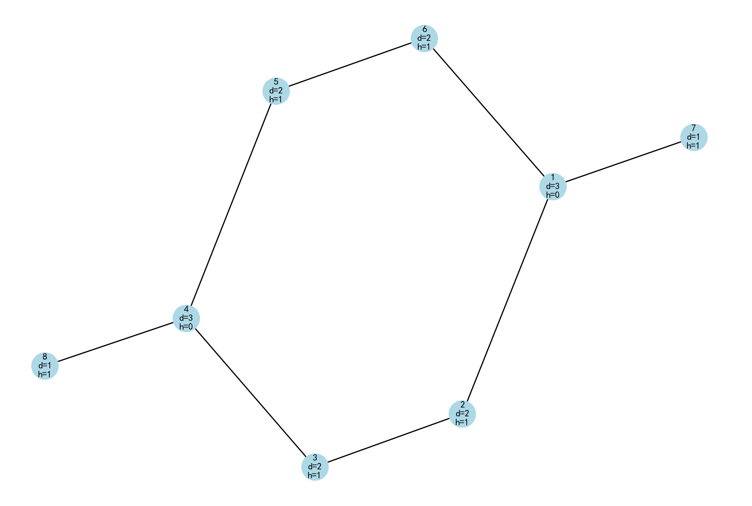
Inspiration
Result: the depth of all nodes
To enhance identification capability, combine the degree and depth of each node

Slide 35
Inspiration
Results of the combination of the degree and depth :
[1,1], [1,1], [2,1], [2,1], [2,2], [2,2], [3,0], [3,0]
[1,1], [1,1], [2,1], [2,1], [2,1], [2,2], [3,0], [3,0]
[1,1], [1,1], [2,1], [2,1], [2,1], [2,1], [3,0], [3,0]

Slide 36
Algorithm DegreesDepthCombination(G, x)
Input: Graph G, initial degree x
Output: List of degree-depth combinations
// Calculate degrees for all nodes
for each node v in G.nodes:
degree[v] = calculate_degree(v)
// Find initial nodes with degree x
N = empty list
for each node v in G.nodes:
if degree[v] == x:
add v to N
// Initialize result dictionary R
R = empty dictionary
for each node v in G.nodes:
R[v] = [degree[v], INFINITY]
Algorithms

Slide 37
// Multi-source BFS from nodes in N
Queue = empty queue
for each node n in N:
R[n][1] = 0 // Set initial depth
enqueue n to Queue
while Queue is not empty:
current = dequeue from Queue
current_depth = R[current][1]
for each neighbor v of current:
if R[v][1] == INFINITY:
R[v][1] = current_depth + 1
enqueue v to Queue
// Convert dictionary to list of values
Result = list(R.values)
return Result
Algorithms

Slide 38
Algorithm CompareGraphStructures(G1, G2, x1=null, x2=null)
Input: Graphs G1 and G2, optional initial degrees x1, x2
Output: Boolean indicating if structures are equivalent
// If x1 not specified, use maximum degree in G1
if x1 is null:
x1 = max_degree(G1)
// If x2 not specified, use maximum degree in G2
if x2 is null:
x2 = max_degree(G2)
//Actually x1=x2 because of the condition mentioned above
// Get degree-depth combinations for both graphs
Result1 = DegreesDepthCombination(G1, x1)
Result2 = DegreesDepthCombination(G2, x2)
// Compare results (order-independent)
return AreEquivalentLists(Result1, Result2)
Algorithms

Slide 39
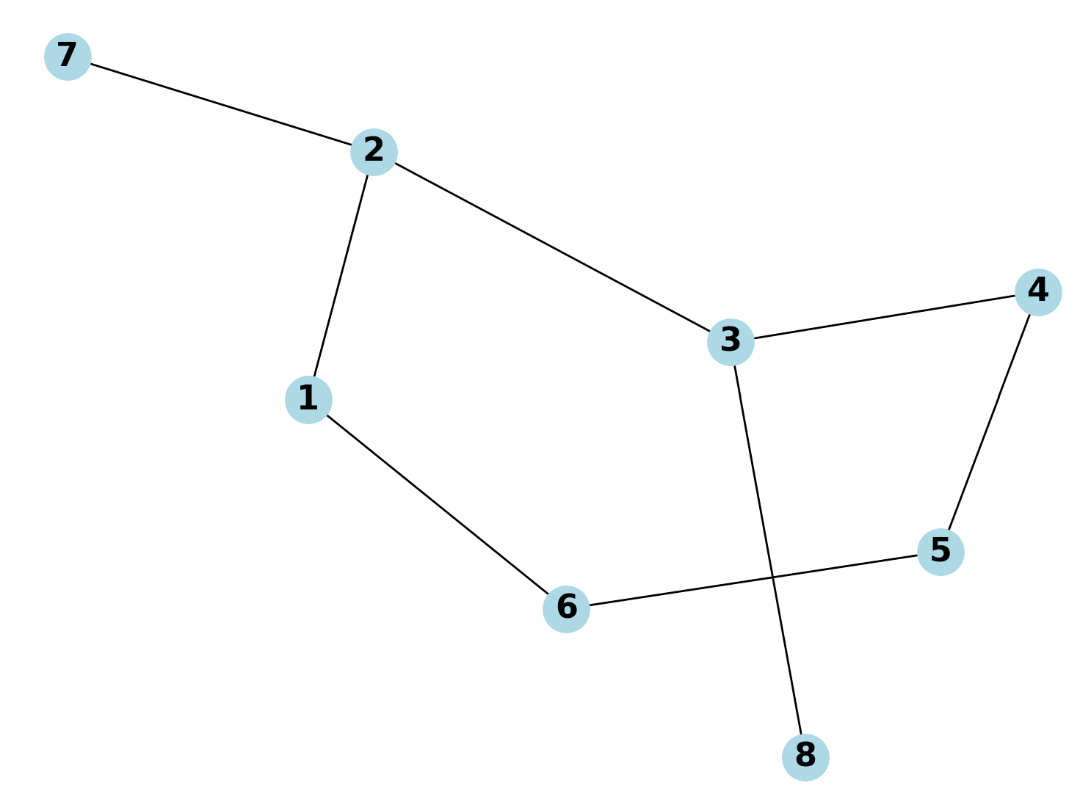
Algorithms
An algorithm is needed to generate two isomorphic or similar graphs for experimental purposes.

Slide 40
Algorithms
Core steps:
1. Generate random graph G1 (Erdős-Rényi model)
2. If connectivity required, regenerate until connected
3. Create G2:
If isomorphic: copy G1
If non-isomorphic: modify k-couple edges
(remove k existed, add k non-existed)
Check the non-isomorphism and regenerate if needed
4. Randomize G2's node ordering
5. Return G1, G2

Slide 41
Algorithms
Core params:
n_nodes: number of nodes
p_edge: probability of edge generation
is_isomorphic: whether graphs should be isomorphic
is_connected: whether graphs must be connected
is_directed: whether graphs are directed
k: if non-isomorphic, number of edge pairs to modify

Slide 42
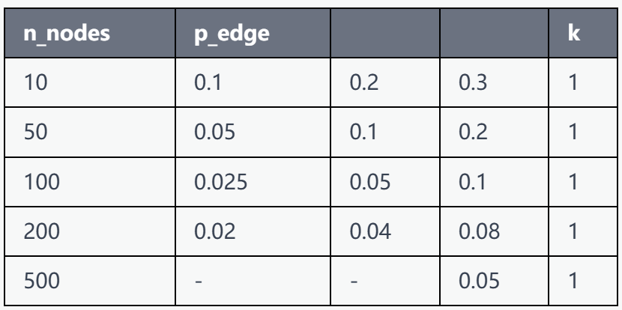
Selection of params:
is_connected: True
is_directed: False
k
Experiment

Slide 43
For each parameter combination, repeat the experiment 500 times
Generate isomorphic or non-isomorphic graphs with equal probability
Compare the algorithm results with the actual isomorphism
Calculate the statistics for TP (True Positive), FP (False Positive), FN (False Negative), and TN (True Negative). P- isomorphic N-non-isomorphic
Experiment

Slide 44
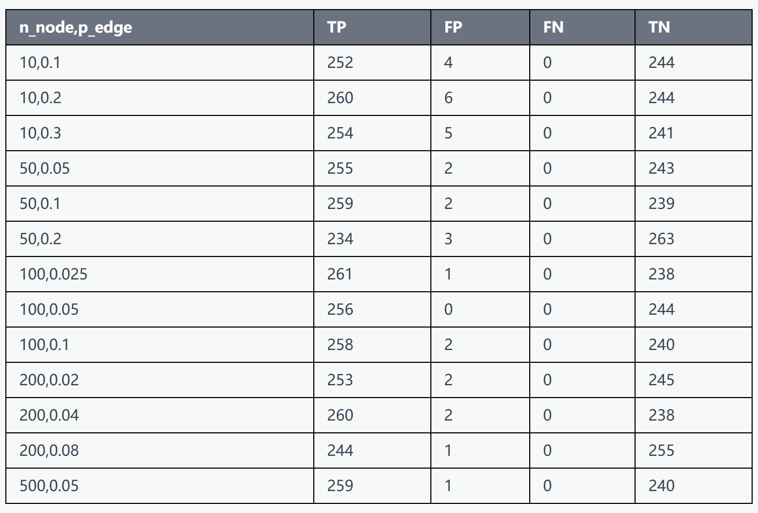
Experiment results:
n=10 error rate≈1%
n≥50 error rate≤0.6%
Experiment

Slide 45
Supplementary Verification
The results may not always be satisfactory
So consider performing a secondary verification:
Algorithm CompareGraphStructures(G1, G2, x1, x2) can be repeated with different x values:
If isomorphic, the comparison result will always be True
If non-isomorphic, starting BFS from nodes with different degrees has a high probability of capturing new structural differences.
As long as False appears once, the graphs can be determined to be non-isomorphic
Experiment

Slide 46
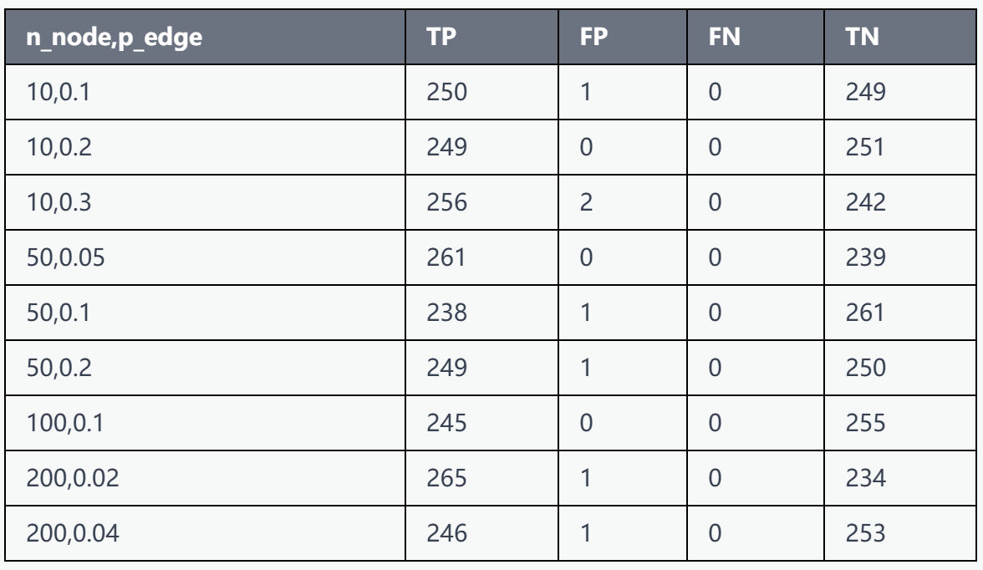
Supplementary Verification
Do supplementary verification for FP>1:
x1 = second_min_degree(G1)
x2 = second_min_degree(G2)
Experiment

Slide 47
Algorithm Complexity:
Algorithm DegreesDepthCombination(G, x):
Calculate degrees: O(V) (list) or O(V+E) (BFS)
Initialization: O(V)
Multi-source BFS：O(V+E)
CompareGraphStructures(G1, G2, x1, x2): DegreesDepthCombination: O(V+E)
AreEquivalentLists: O(V) (Hash table)
Overall: O(V+E)
Complexity

Slide 48
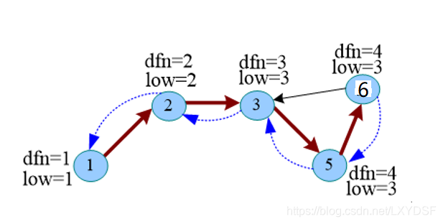
Application of the Algorithm in Directed Graphs:
Strongly Connected Graph: Excellent performance
Weakly Connected Graph: BFS cannot traverse the graph completely, may need to find strongly connected components first
(Tarjan's Algorithm)
Discussion

Slide 49
Application of the Algorithm in Subgraph Isomorphism
For determining whether complex structured graphs exist within a larger graph:
Fewer nodes with maximum degree: auxiliary search effects
Many nodes with maximum degree: huge complexity
Performs poorly when counting the occurrences of simple structured graphs in a larger graph.
Discussion

Slide 50
Thanks

