Slide 1
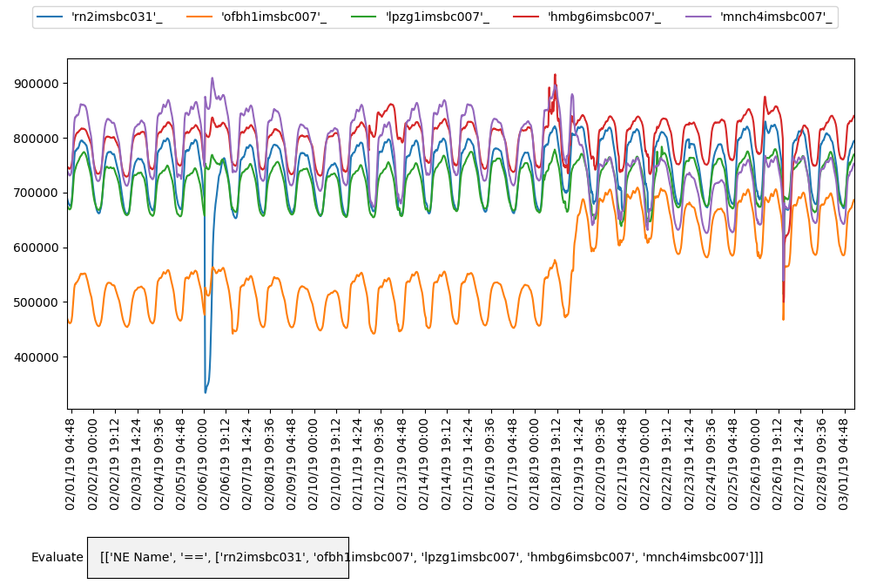
Number of Registered Users

Slide 2
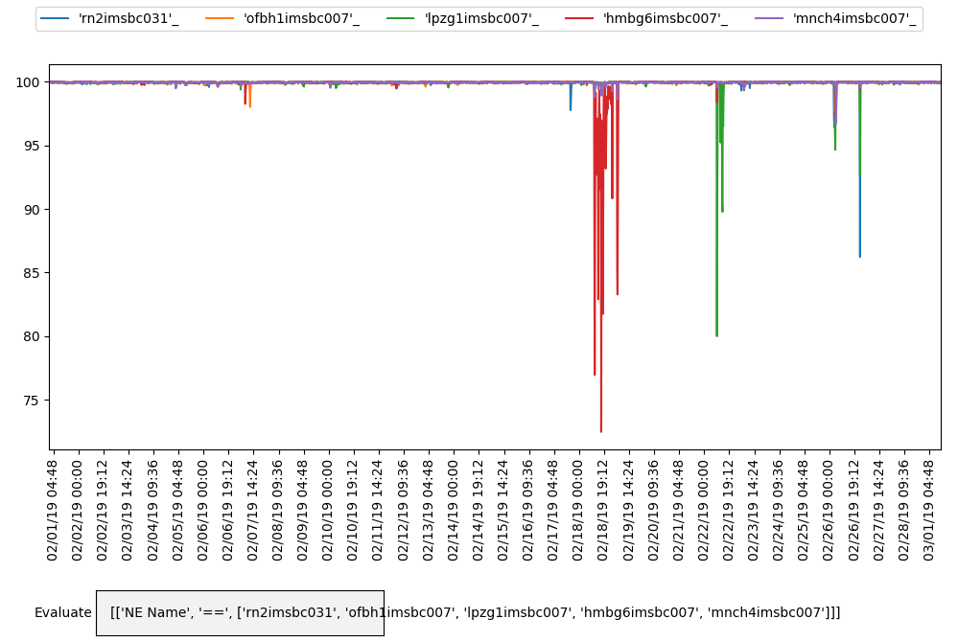
Rate of ABCF Successful Deregistrations

