Slide 1
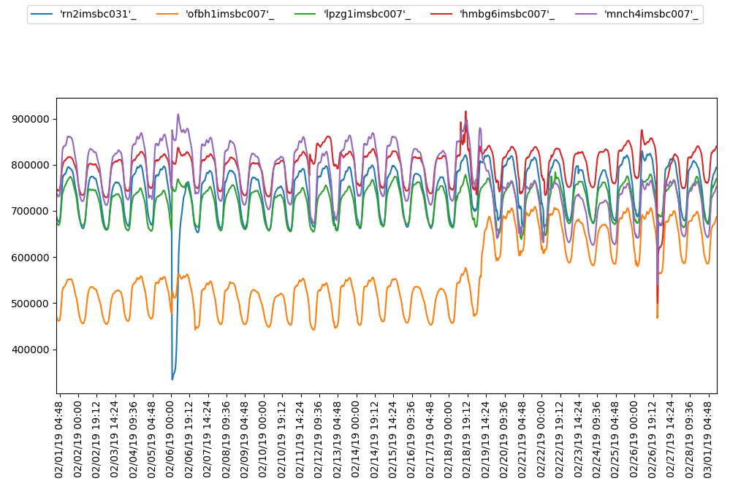
Number of Registered Users

