Slide 1
Effects of the Legalization of Marijuana in the State of Colorado
Outline

Slide 2
Colorado - Recreational marijuana was legalized in 2012
Areas of focus
Rates of marijuana use before and after legalization.
Rates of other substance use before and after legalization.
Rates of mental health issues before and after legalization.
Rates of crime before and after legalization.

Slide 3
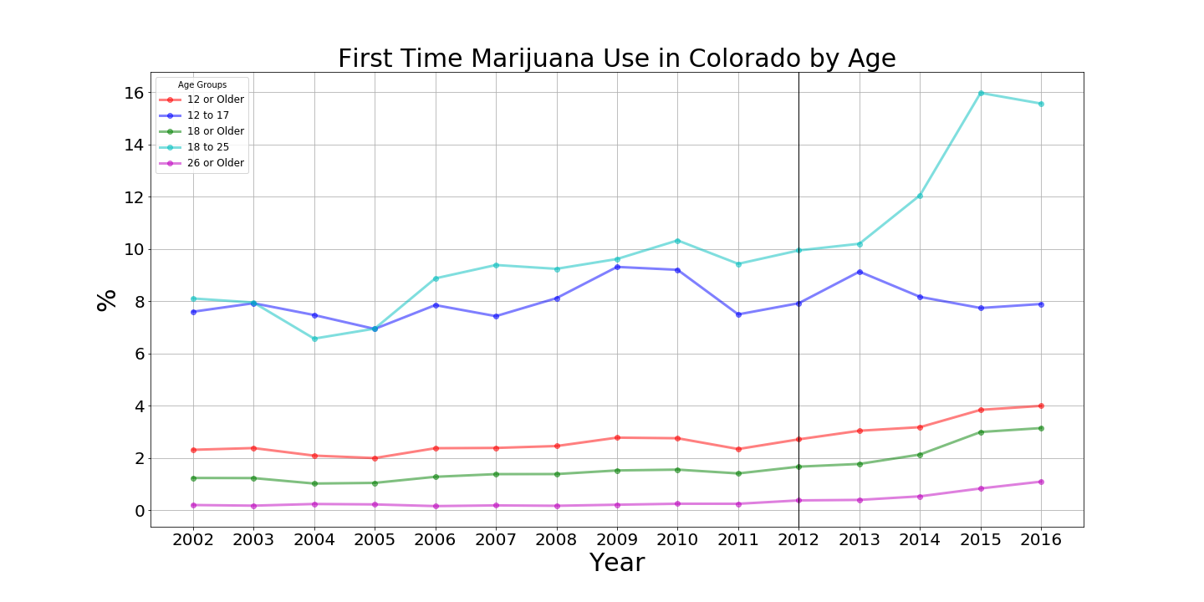

Slide 4
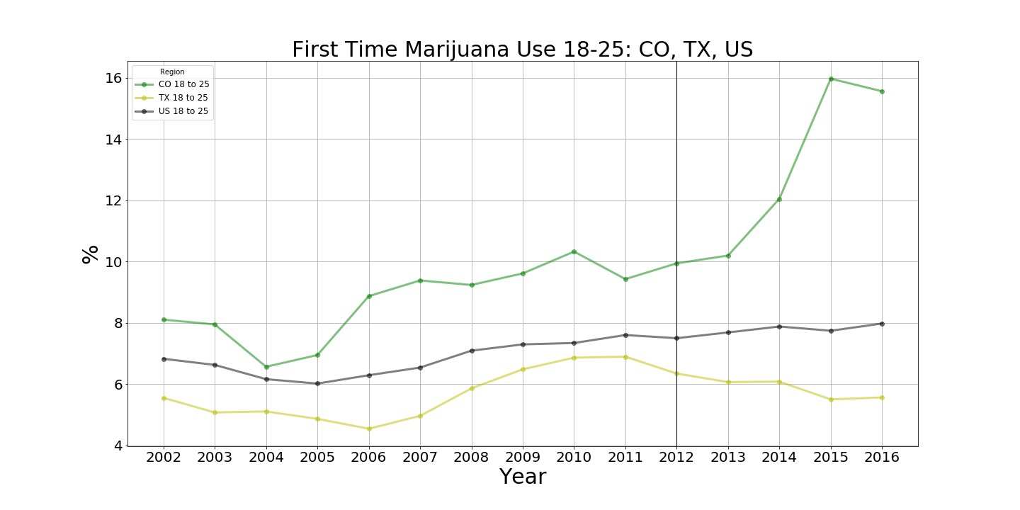
Focusing on ages 18-25

Slide 5
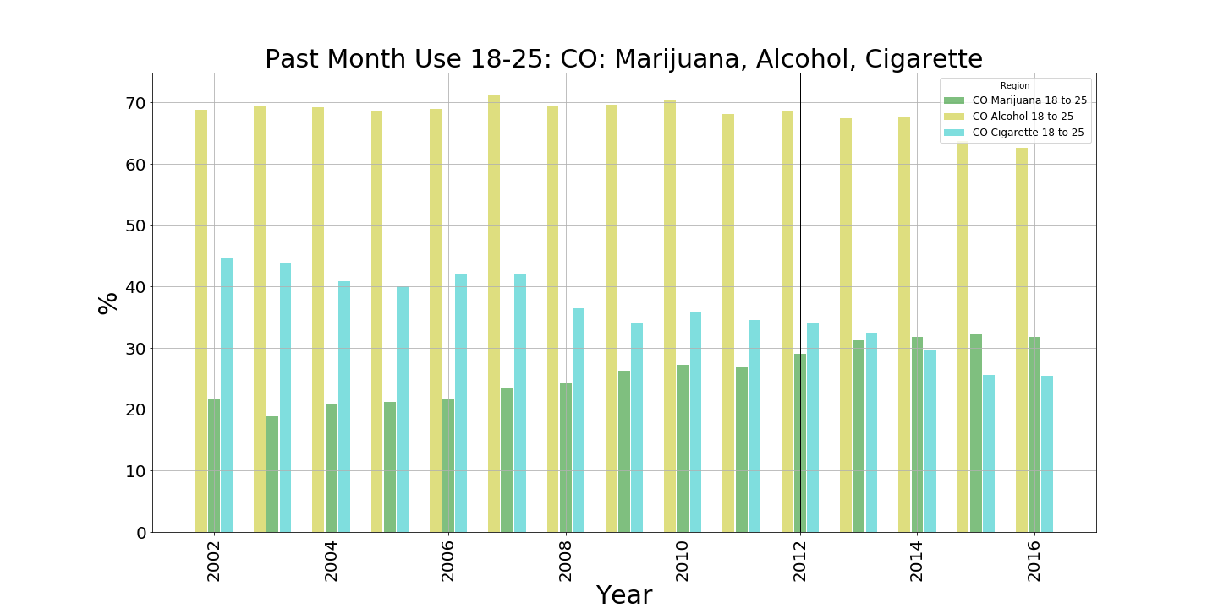
Past Month use Colorado (Cig, Mar, Alch) (18-25 year-olds)

Slide 6
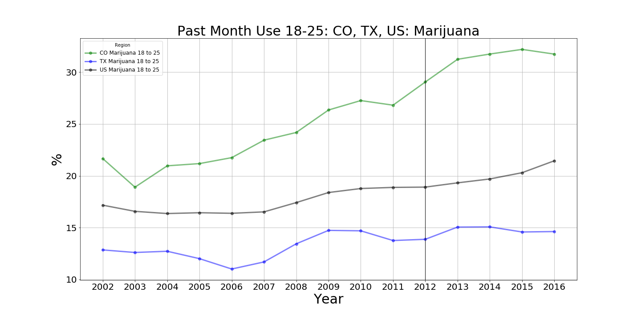
Past Month Marijuana (CO, TX, USA) (18-25 year olds)

Slide 7
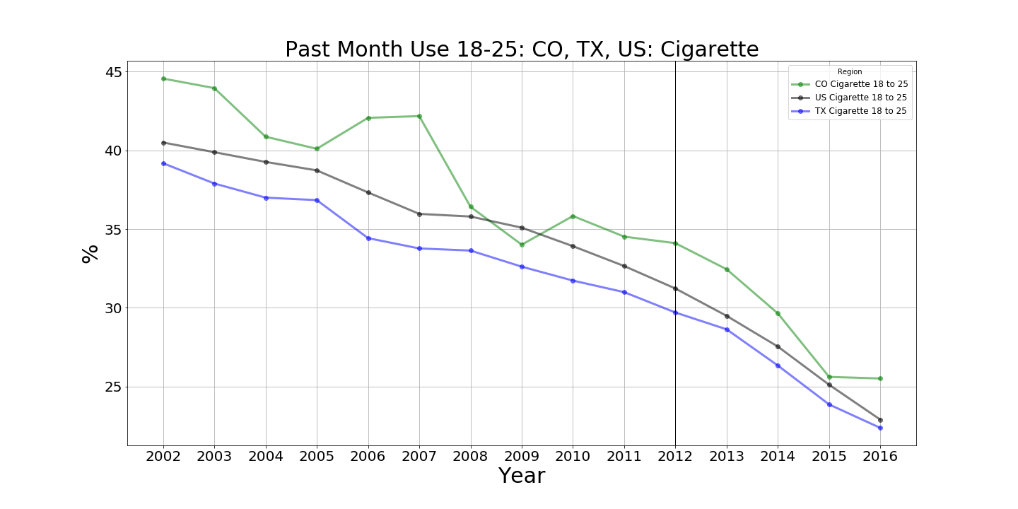
Past Month Cigarrete (CO, TX, USA) (18-25 year-olds)

Slide 8
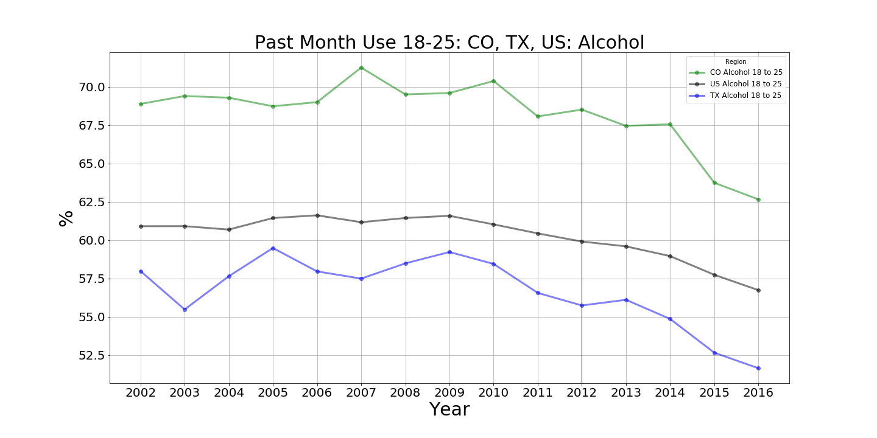
Past Month Alcohol (CO, TX, USA) (18-25 year -olds

Slide 9
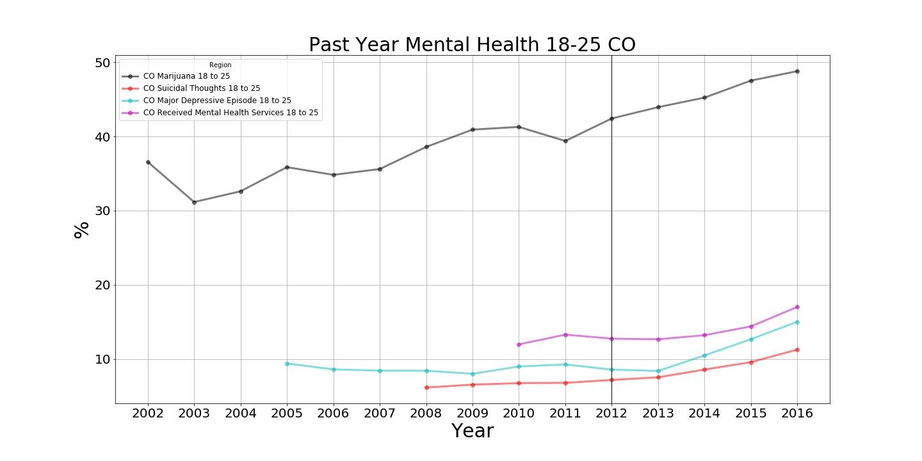
Mental Health Rates in Colorado (18-25 year old's)

Slide 10
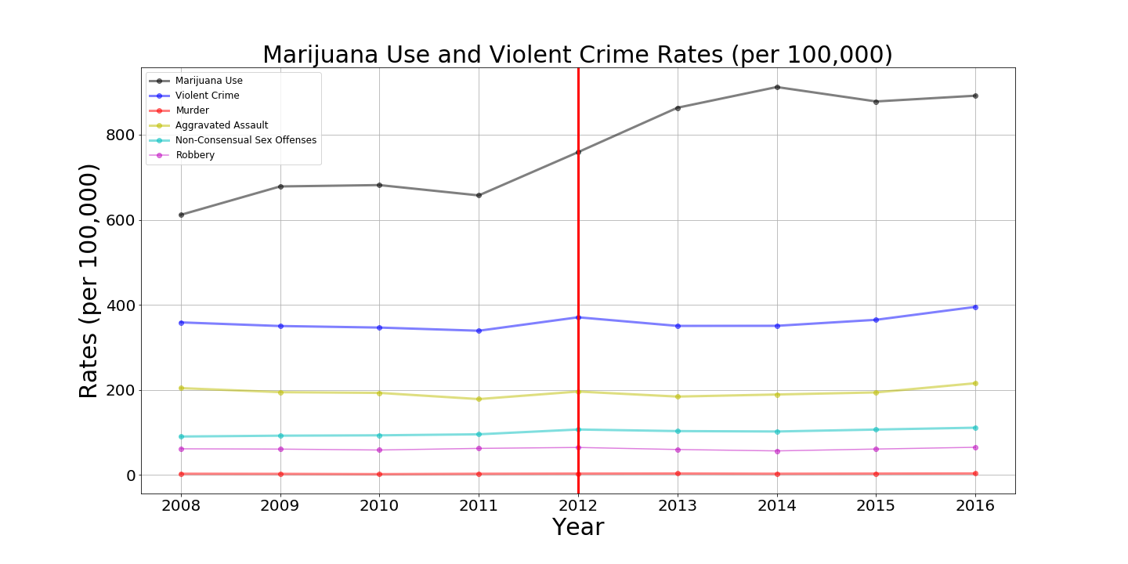
Colorado Crime vs. Marijuana use

Slide 11
