Slide 1
Effects of the Legalization of Marijuana in the State of Colorado
Outline

Slide 2
Colorado - Recreational marijuana was legalized in 2012
Areas of focus
Rates of marijuana use before and after legalization.
Rates of other substance use before and after legalization.
Rates of mental health issues before and after legalization.
Rates of crime before and after legalization.

Slide 3



Data Sources

Slide 4
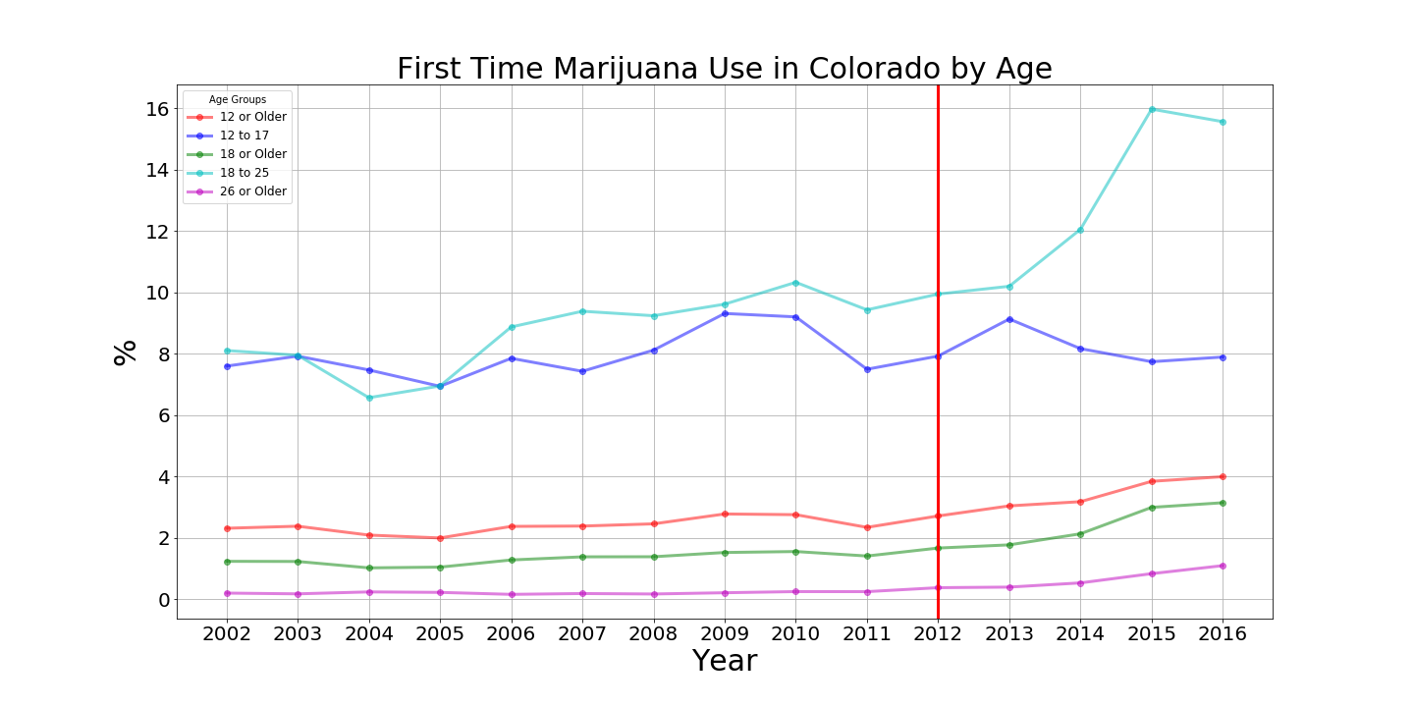

Slide 5
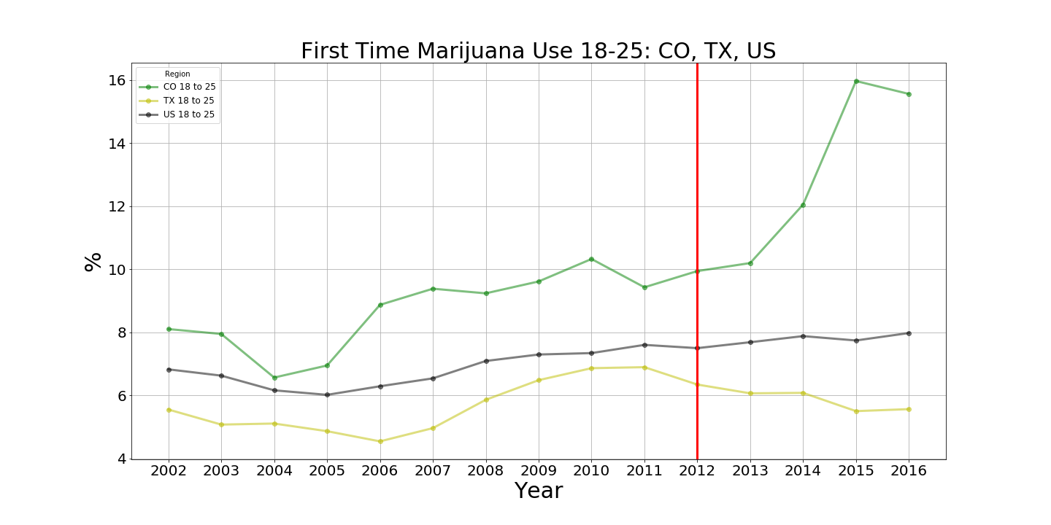

Slide 6
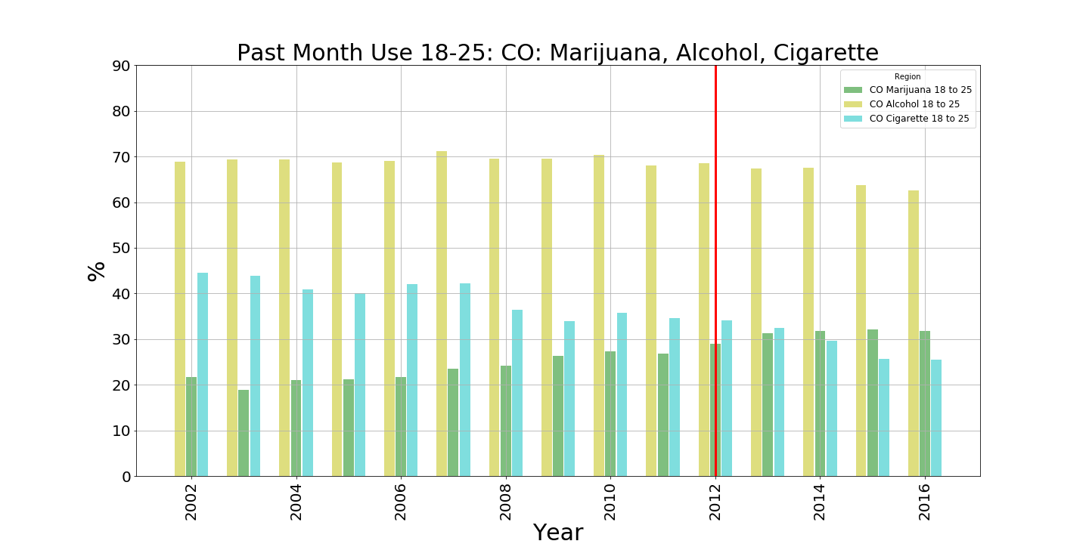

Slide 7
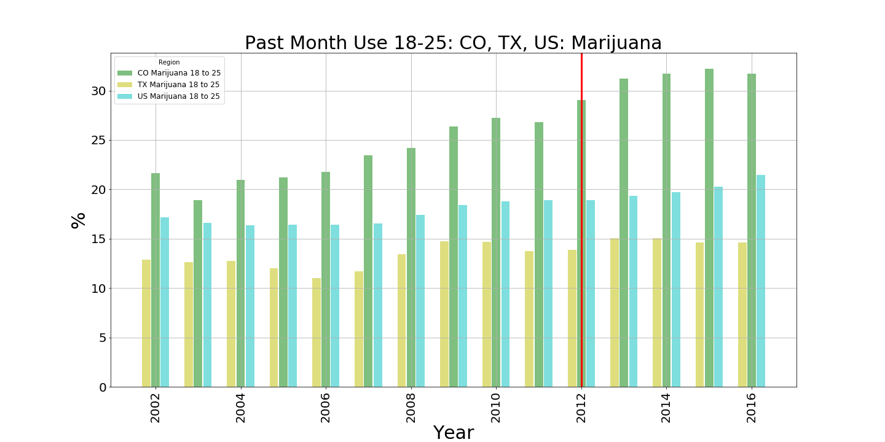

Slide 8
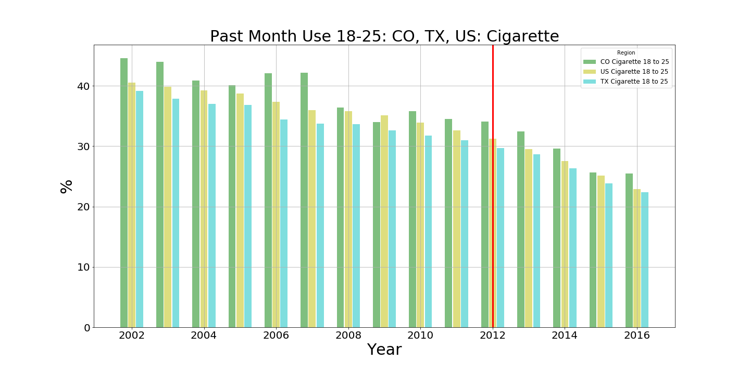

Slide 9
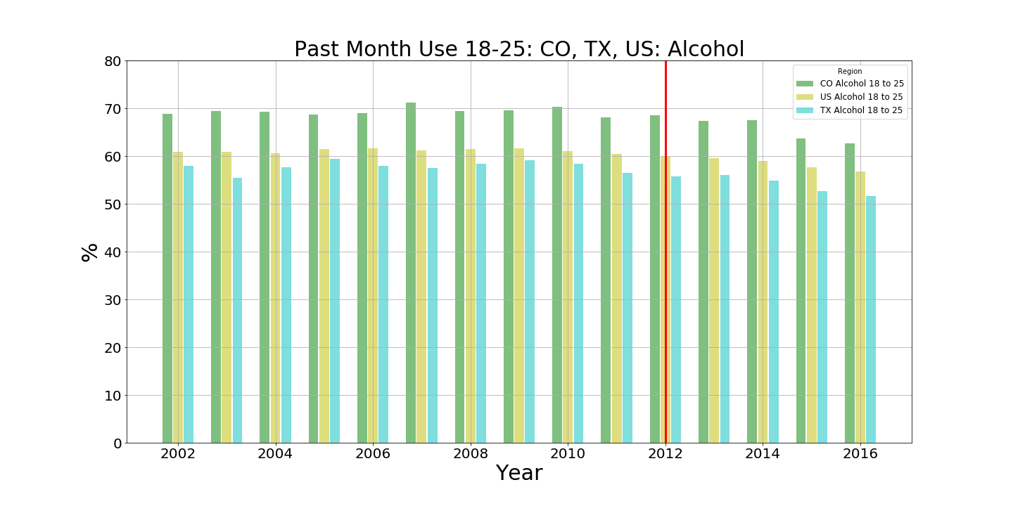

Slide 10
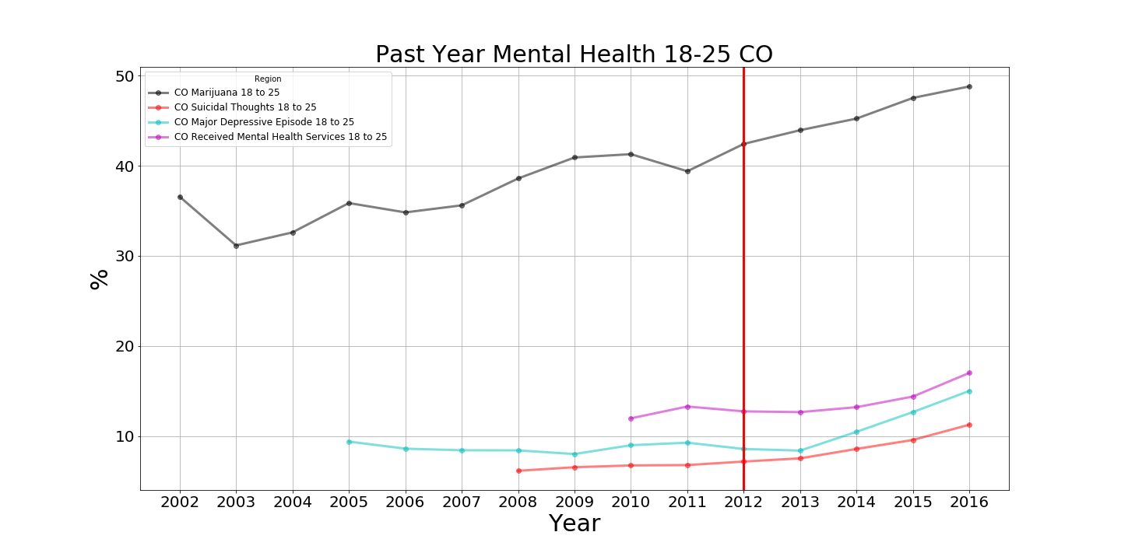

Slide 11
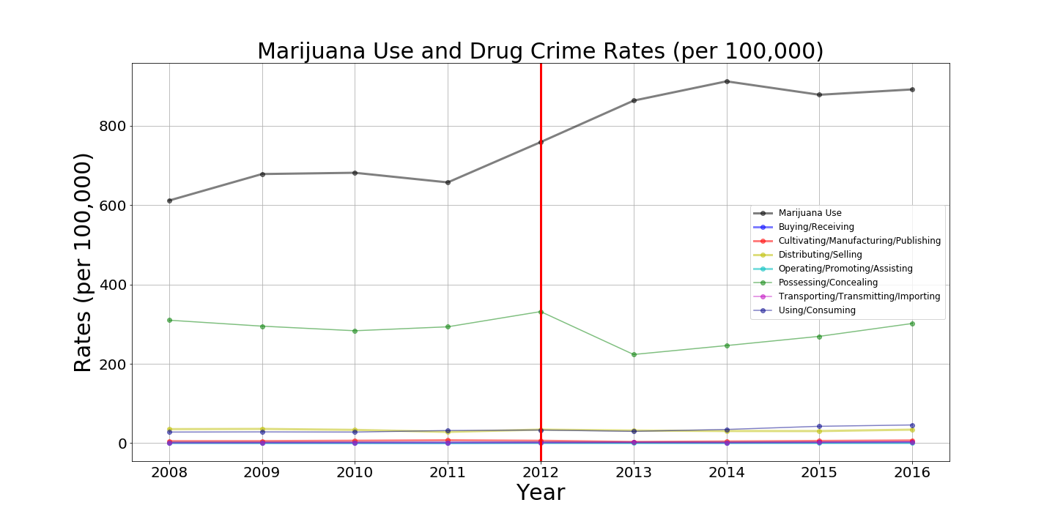

Slide 12
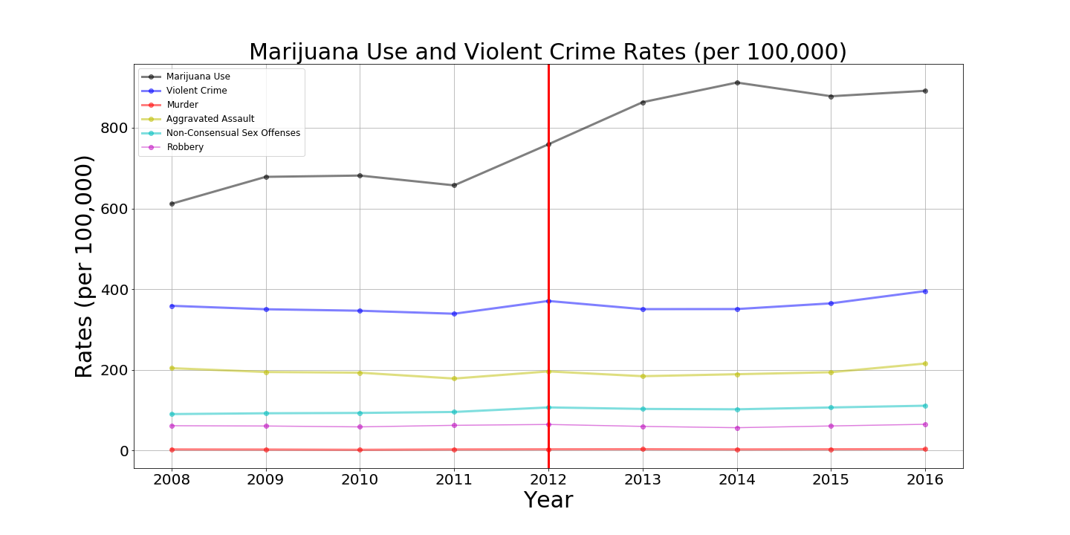

Slide 15
Conclusions:

