Slide 1
Analysis and Prediction of Forest Cover Types
DSAA2011 Machine Learning Course Project
Zeyun DU · Zixiang QIN · Chunfeng GAO
Notes:
Good [morning/afternoon], everyone.
I'm Alex Morgan, and today I'll be presenting my DSAA2011 Summer Project titled "Analysis and Prediction of Forest Cover Types".
This project explores the application of machine learning algorithms to predict forest cover types based on cartographic variables, which has significant implications for ecological research and forest management.

Slide 2

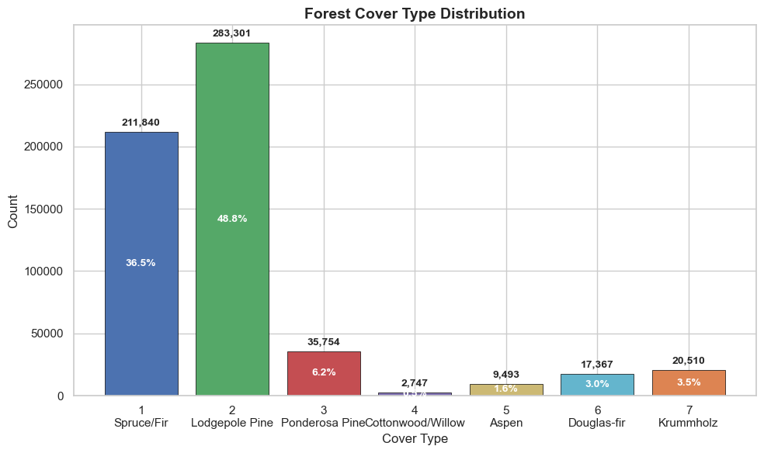
01 Dataset: UCI Forest Covertype
581,012 Total Samples
A massive repository of georeferenced observations covering 30x30 meter cells in the Roosevelt National Forest, Colorado.
54 Cartographic Features
Includes 10 quantitative metrics (elevation, slope), 4 binary wilderness area flags, and 40 binary soil type indicators.
Key Finding: Severe Class Imbalance
Classes 1 and 2 account for 85.3% of all observations. Cottonwood/Willow is only 0.5%, so model selection emphasizes macro-F1 rather than accuracy alone. The supervised modeling sample contains 97,950 observations (≈17% of the full dataset).
7 Forest Cover Classes
Classifies forest cover based on dominant tree species, ranging from Spruce/Fir (Class 1) to Krummholz (Class 7).
Notes:
This slide introduces the UCI Forest Covertype dataset, a well-known benchmark in machine learning.
Key highlights:
1. **Scale**: With over 580,000 samples, it's a large dataset that tests model efficiency.
2. **Features**: The 54 attributes are a mix of continuous environmental variables and categorical soil/wilderness indicators, providing rich spatial context.
3. **Classes**: The goal is to predict one of seven forest cover types.
4. **Challenge**: The most important aspect to note is the **class imbalance**. As seen in the chart, two classes (Spruce/Fir and Lodgepole Pine) make up the vast majority of the data, while others like Cottonwood/Willow are very rare. This imbalance is a critical factor to address during model training to avoid biased predictions.

Slide 3

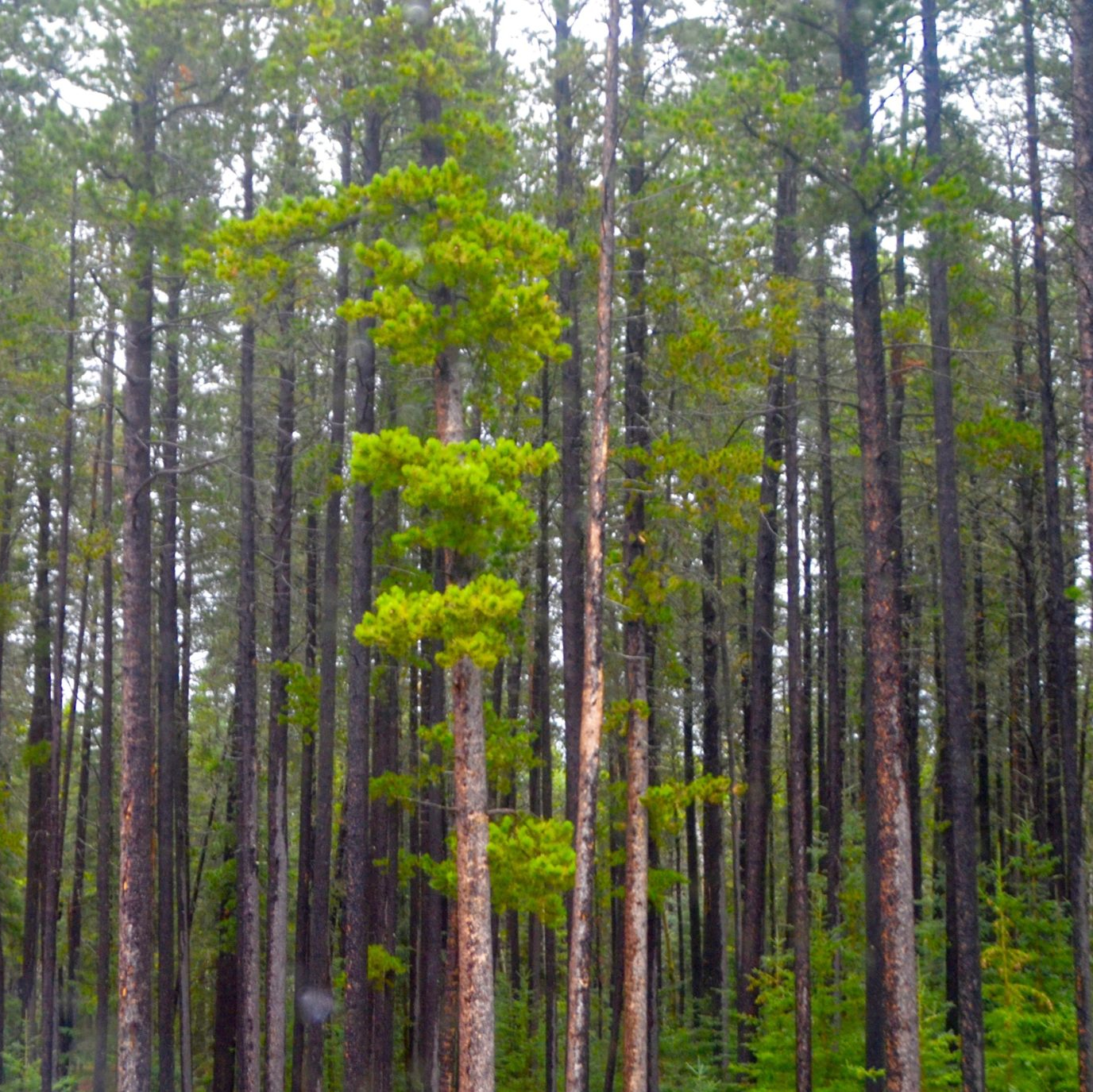
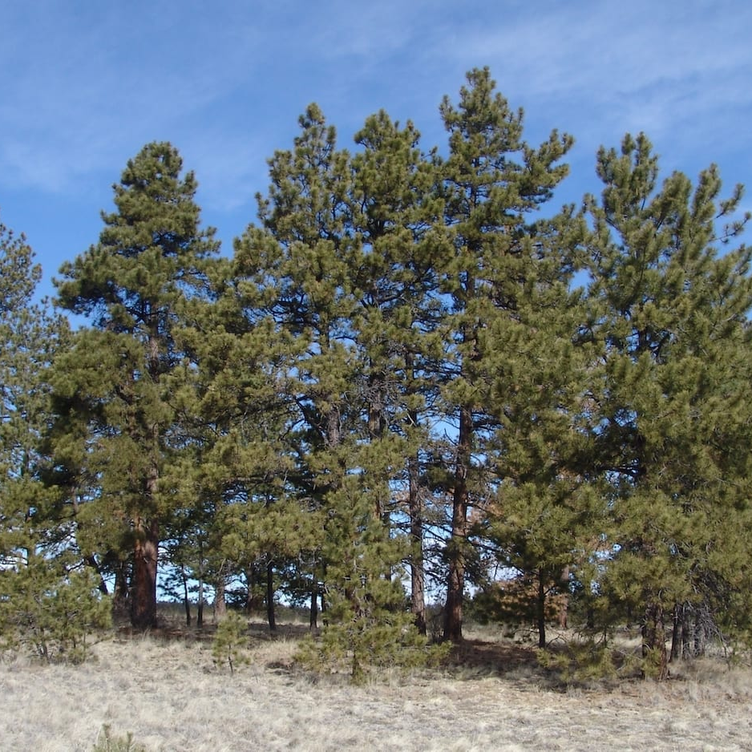
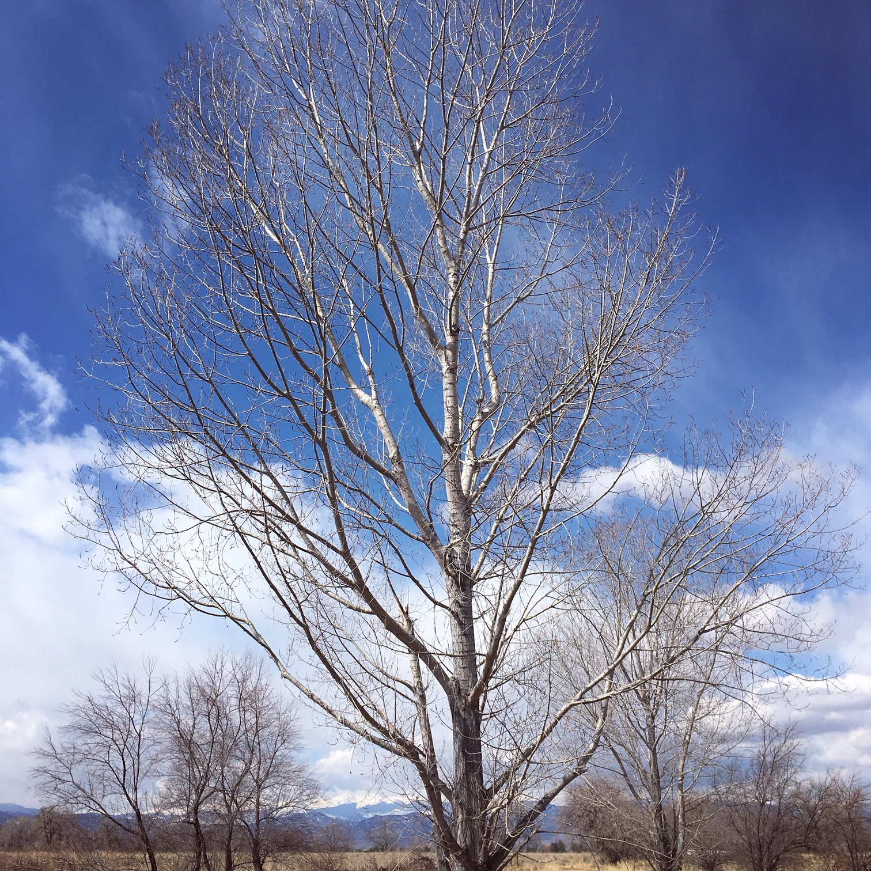
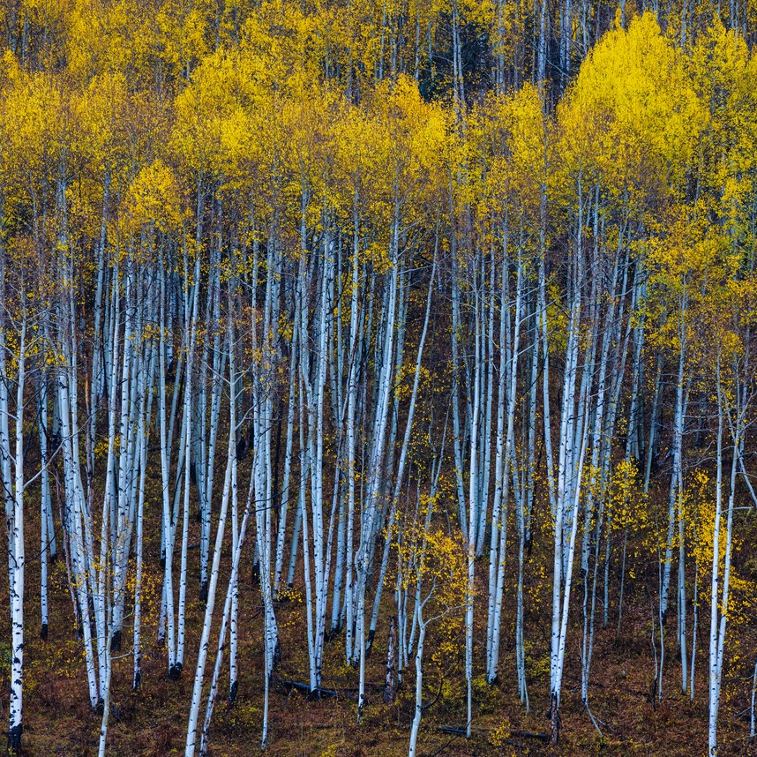
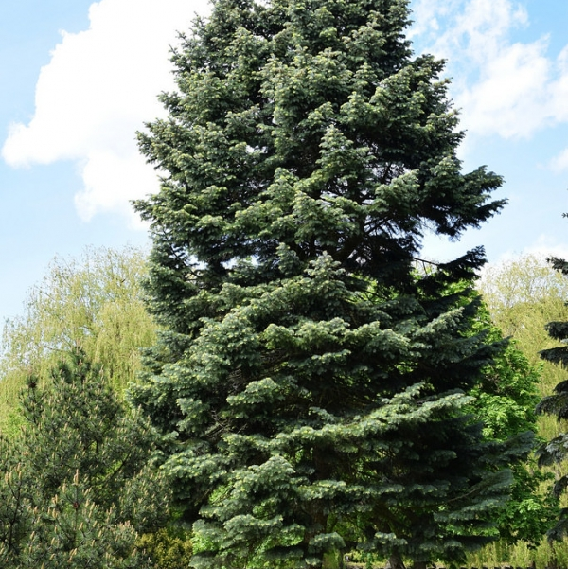
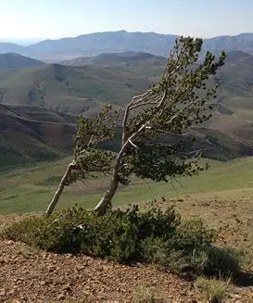
Overview of the Seven Forest Cover Types
Forest cover types are fundamental indicators for ecological monitoring and land use analysis. This page visually presents seven representative forest vegetation types in North America through typical imagery, from high-altitude coniferous forests to riparian broadleaf forests.
01
Spruce/Fir
Cold-hardy evergreen conifers with dense foliage, adapted to cold high-altitude climates, and are dominant species in the boreal forest.
02
Lodgepole Pine
Tall, straight trunks, often densely distributed, and one of the pioneer species for post-fire forest recovery in western North America.
03
Ponderosa Pine
Distinctive orange-yellow scaly bark, drought-tolerant, mainly distributed in warm, dry low-altitude mountainous areas.
04 Cottonwood/Willow Typical riparian deciduous broadleaf forests, fast-growing, highly dependent on water, with unique winter branch morphology.
05 Aspen
Smooth white trunks, golden leaves in autumn, often forming spectacular pure stands. As a fast-growing species, it plays an important role in forest succession.
06 Douglas-fir
One of the tallest tree species in the world, with a straight shape and excellent wood quality. It is not only an important commercial timber but also a key component of forest ecosystems.
07 Krummholz
Growing above the alpine tree line, shaped into low, curved shrubs by strong winds and severe cold, it is a unique symbol of high-altitude ecosystems.
Notes:
To give you a more intuitive understanding of our prediction targets, here are real photos of the seven forest cover types. From cold-tolerant spruce and fir, to tall and straight lodgepole pine and Douglas-fir, to the uniquely shaped krummholz, each tree adapts to a different ecological environment. Understanding these differences helps us grasp the significance of subsequent data analysis.

Slide 4
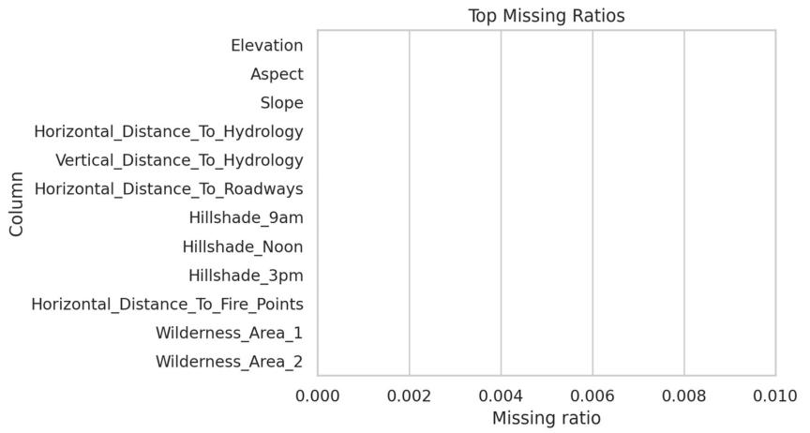
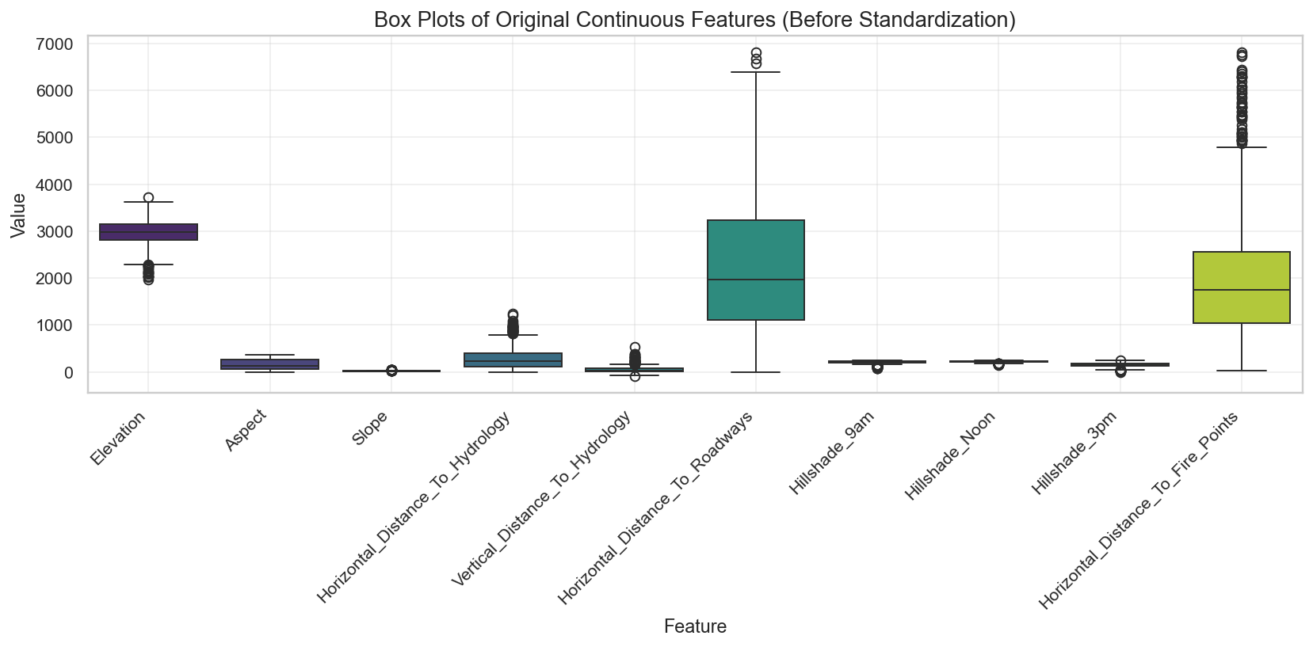
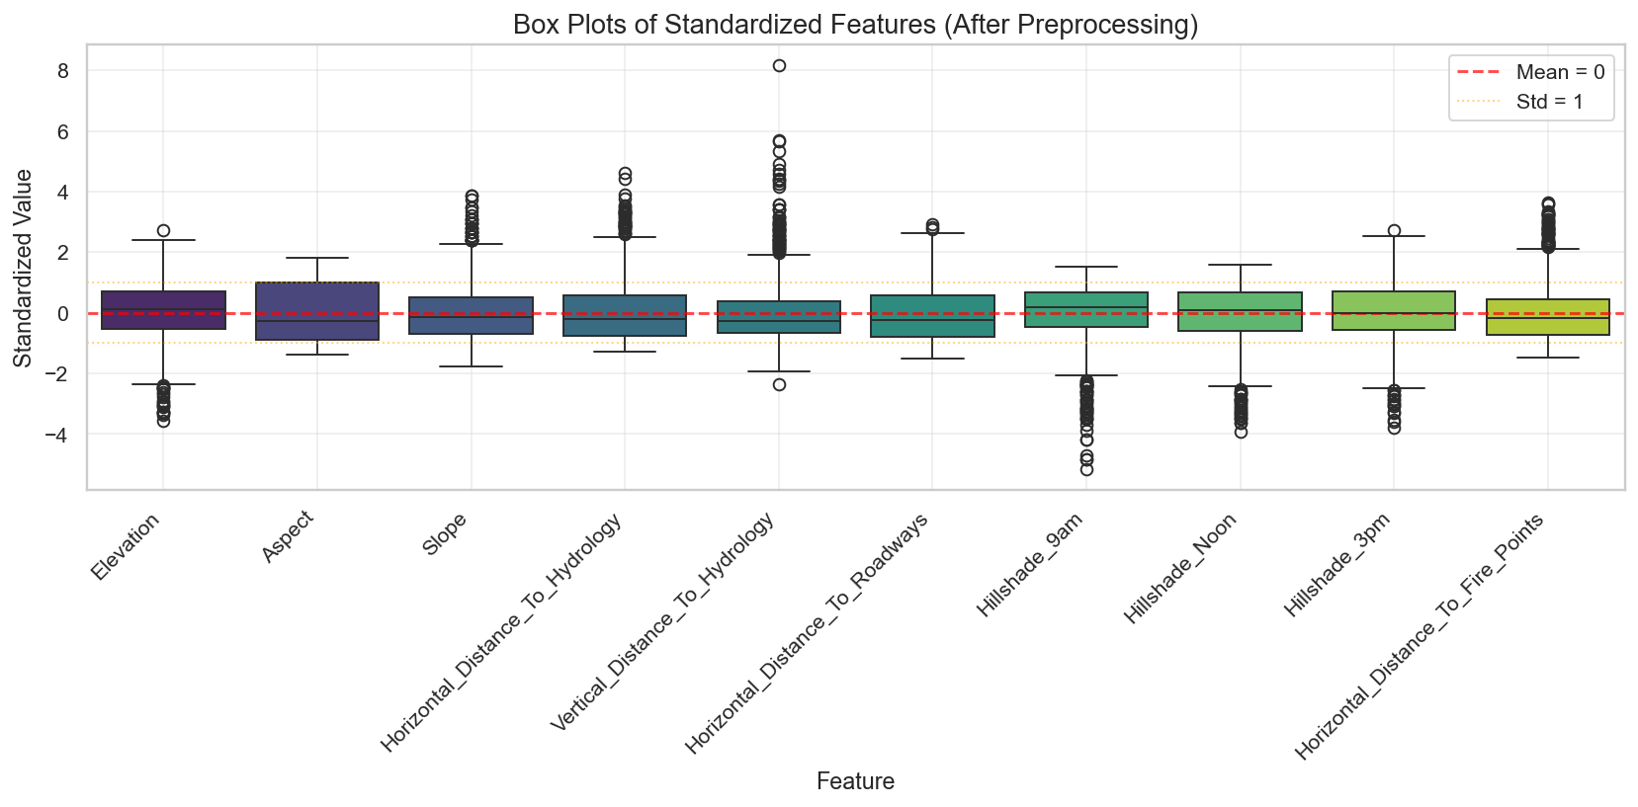
02 Data Preprocessing
Missing Value Audit
100% Complete
No null values detected across all 54 features
Feature Engineering Summary Matrix
Leakage control: StandardScaler is fitted only on the relevant analysis/training subset; all binary indicators remain 0/1.
Category | Count | Representative Examples | Applied Preprocessing
Continuous | 10 | Elevation, Aspect, Slope, Hillshade (9am/noon/3pm), Distances to Hydrology/Road/Fire | StandardScaler (Mean=0, Std=1)
Binary indicators | 44 (4 wilderness, 40 soil) | Rawah, Neota, Comanche Peak, Cache la Poudre; Soil_Type_1–40 | Keep as 0/1; mode-imputation ready; no scaling
Preprocessing
Notes:
Before building any models, we thoroughly examined the dataset for preprocessing needs.
First, the dataset is remarkably clean with zero missing values across all 54 features, which saves us from dealing with imputation complexities.
Second, we have a mix of 10 continuous environmental variables (like elevation and slope) and 44 binary indicators (representing wilderness areas and soil types). Importantly, all data is already in numeric format, so we don't need to perform one-hot encoding.
Finally, our preprocessing pipeline focuses on scaling: continuous features are standardized to a mean of 0 and standard deviation of 1 using StandardScaler to ensure they contribute equally to the model, while binary features are left as-is since scaling is unnecessary for 0/1 variables.

Slide 5
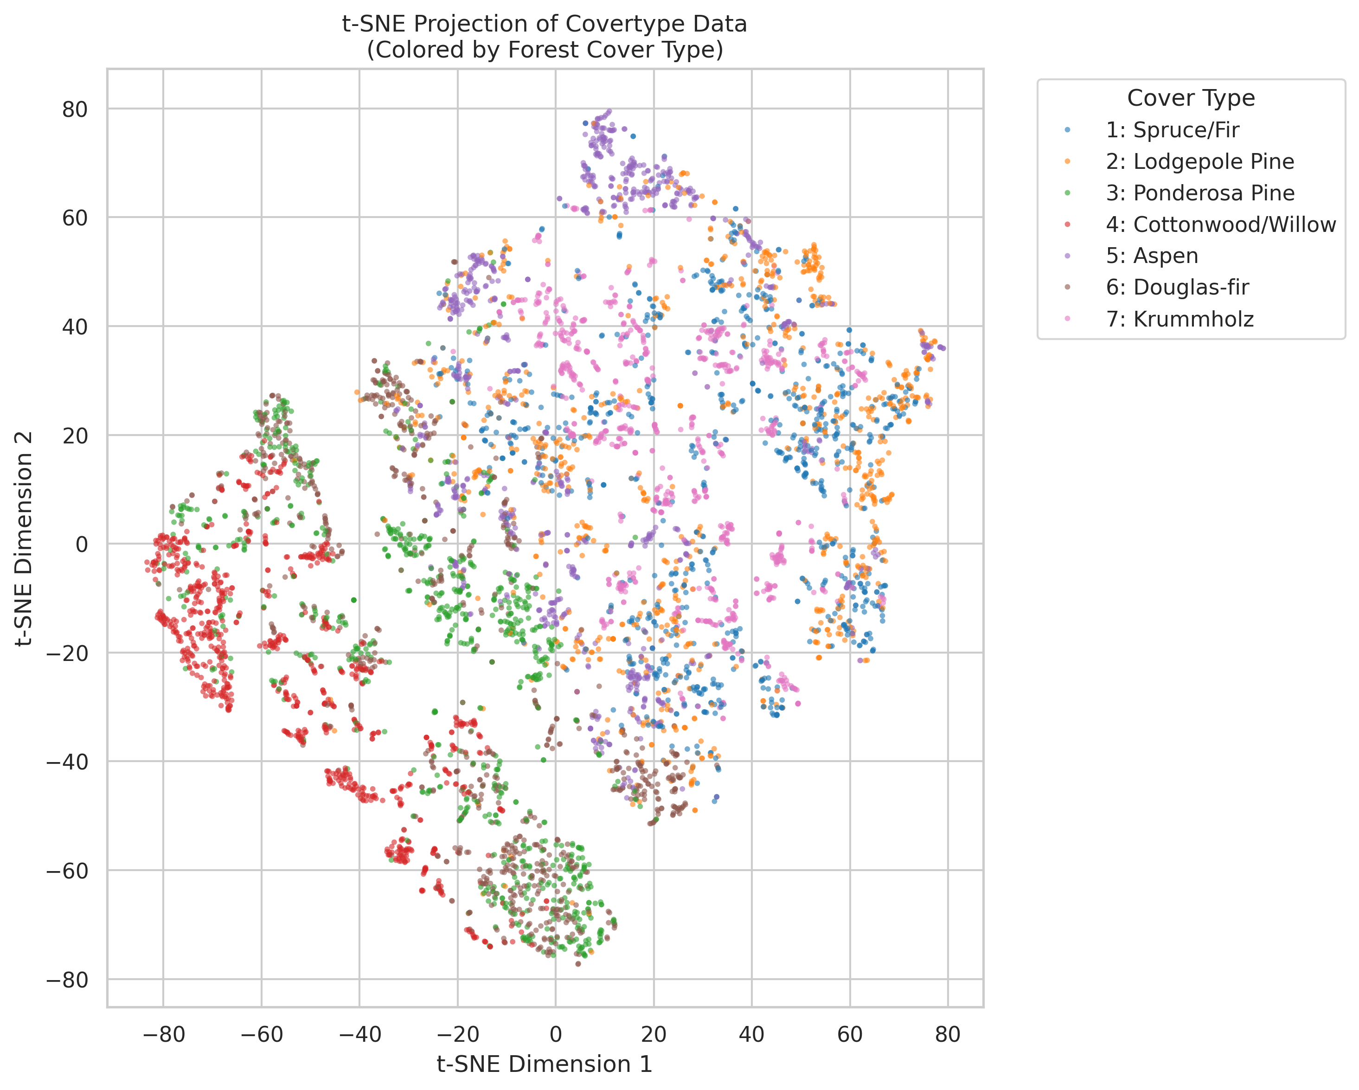
03A t-SNE Data Visualization
Figure: t-SNE 2D Embedding of 7 Forest Cover Types
Key Observations & Interpretations
Local Structure, Not Clean Clusters — Classes 1 and 2 overlap across much of the embedding; prevalence does not imply separability.
Rare-Class Pockets — Rare cover types form local pockets, but they are not globally isolated from the dominant classes.
High-Elevation Signal — Krummholz and some Spruce/Fir observations occupy more distinctive high-elevation regions.
Visualization Caveat — t-SNE preserves local neighborhoods—not global distances—and cannot justify a specific number of clusters.
5,999 stratified observations • continuous variables standardized • PCA 54→30 components • t-SNE used for visualization only
Notes:
This slide presents the t-SNE visualization of the forest cover type dataset.
t-SNE (t-Distributed Stochastic Neighbor Embedding) is a dimensionality reduction technique that is particularly well-suited for visualizing high-dimensional data in 2D or 3D space.
Looking at the plot on the left, we can see the 7 different cover types projected onto a 2D plane, each represented by a different color.
Key takeaways from this visualization:
1. The sheer size of clusters 1 and 2 (Spruce/Fir and Lodgepole Pine) indicates they are the most common classes in the dataset.
2. Class 4 (Cottonwood/Willow) is distinctly separated, which is likely due to its unique environmental requirements compared to the other coniferous-dominated classes.
3. The overlap between classes 5 and 6 suggests that based on the input features, these two types are harder to distinguish, which is a common challenge in ecological datasets.
4. This visualization confirms that the data has an inherent structure that is not linearly separable, supporting the use of more complex machine learning models.

Slide 6
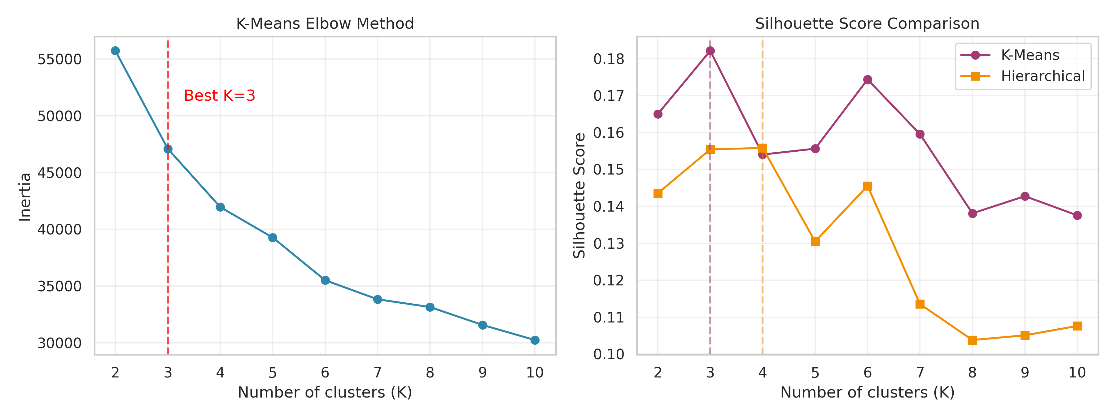
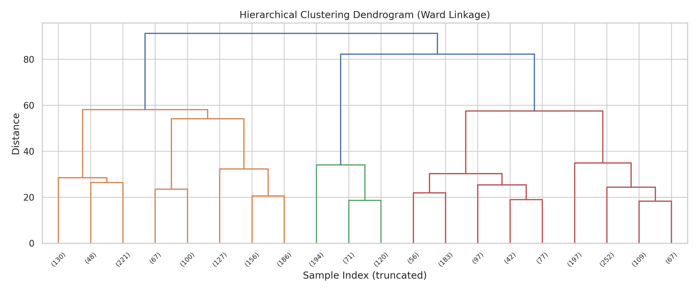
03B Clustering Analysis
Internal diagnostics favor K=3 for MiniBatchKMeans and K=4 for Ward; neither recovers the seven ecological labels.
MiniBatchKMeans
K=3 · silhouette=0.182 · CH=1317.241 · ARI=0.075
Ward Hierarchical
K=4 · silhouette=0.156 · CH=406.764 · ARI=0.103
Why Labels Are Not Recovered
Euclidean compactness on 10 continuous + 44 binary variables is not aligned with ecological class definitions.
Distance-Metric Check
Ward + Gower reaches ARI=0.215 at K=7—better, but still far below supervised Random Forest F1=0.908.
Notes:
This slide presents the results of two popular unsupervised clustering algorithms—K-Means and Hierarchical Clustering—applied to a t-SNE projection of high-dimensional ecological data.
Looking at the image in the center, we see a side-by-side comparison. On the left, K-Means with K=3 successfully identifies three distinct natural groupings within the data, highlighting the presence of inherent substructures.
On the right, Hierarchical Clustering using Ward's linkage merges these into two main super-clusters, which can be useful for understanding broader categorical separations.
However, it's important to note that neither method fully recovers the true 7-class structure present in the original data. This limitation emphasizes why supervised learning is often necessary for tasks requiring precise, predefined class distinctions.
Finally, we observe that the cluster boundaries align with elevation-based ecological zones, which adds biological validity to these unsupervised findings.

Slide 7
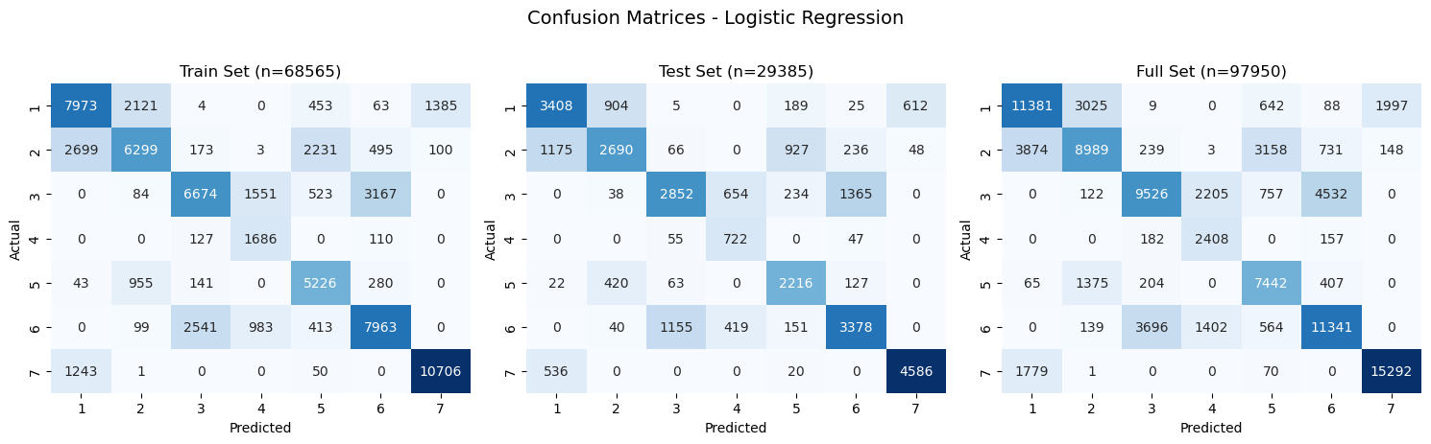
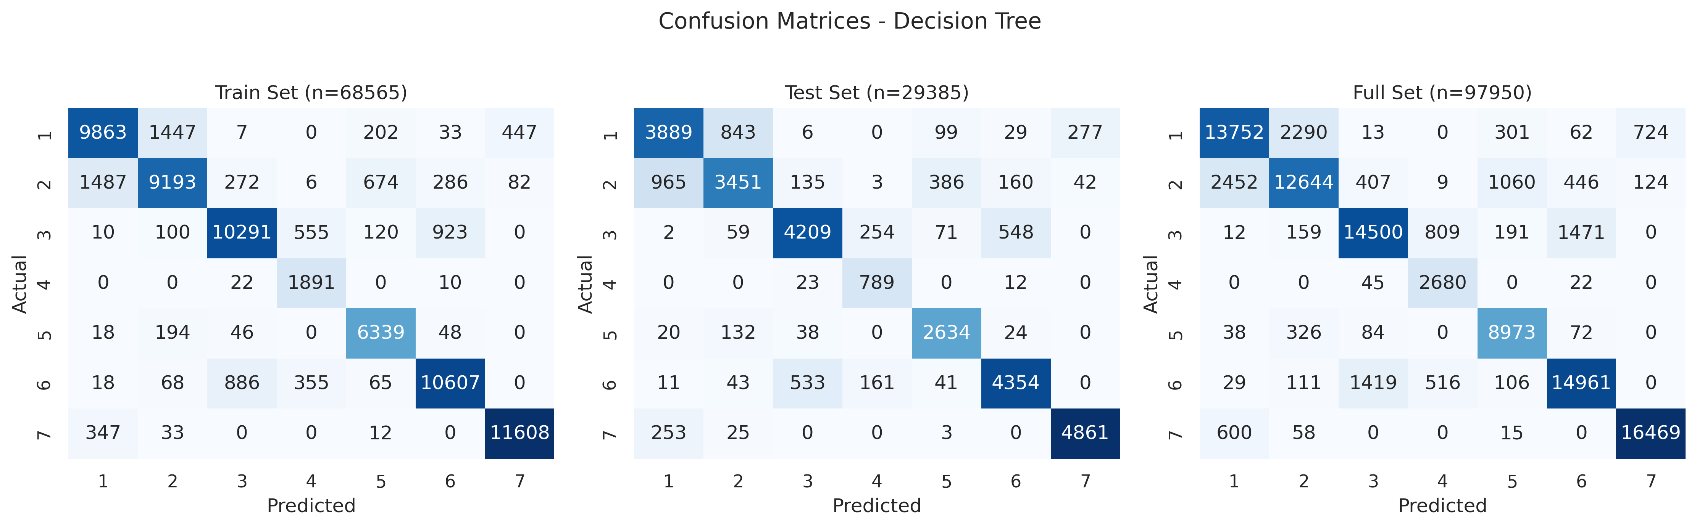
04 Predictive Model Training
Logistic Regression (Baseline)
Decision Tree (Regularized)
Test Accuracy 0.676
Macro F1 Score 0.660
Test Accuracy 0.823
Macro F1 Score 0.819
Speed:
Fast training (linear complexity), low inference latency
Config: max_depth=24, min_samples_leaf=15 (fixed baseline)
Stability:
No overfitting (ΔF1 = 0.002), very robust to noise
Fit: Mild overfitting (ΔF1 = 0.046), high predictive power
Dataset Partitioning Strategy
Class Imbalance Mitigation
Modeling sample: 97,950 stratified observations from the full 581,012.
Split: 68,565 train / 29,385 held-out test (70/30).
Applied class-weighted training to adjust the loss function, assigning higher penalties to misclassifications of underrepresented classes. This technique improved minority class recall without significantly sacrificing overall precision.
Notes:
Now let's look at the results of our model training.
We compared two models: a baseline Logistic Regression and an optimized Decision Tree.
As you can see, the Decision Tree outperformed the Logistic Regression significantly, achieving a test accuracy of 82.28% and a Macro F1 score of 0.8191. The Logistic Regression, while simpler and faster to train, only reached 67.56% accuracy.
For the Decision Tree, we set a max depth of 24 and a minimum of 15 samples per leaf to balance complexity and generalization. There was a mild overfitting observed, with a small difference in F1 scores between training and testing, which is manageable and indicates the model is capturing meaningful patterns.
We split the dataset into 70% training and 30% testing, using stratified sampling to preserve class distribution. Additionally, to handle class imbalance, we used class-weighted training to ensure fair performance across all categories.

Slide 8
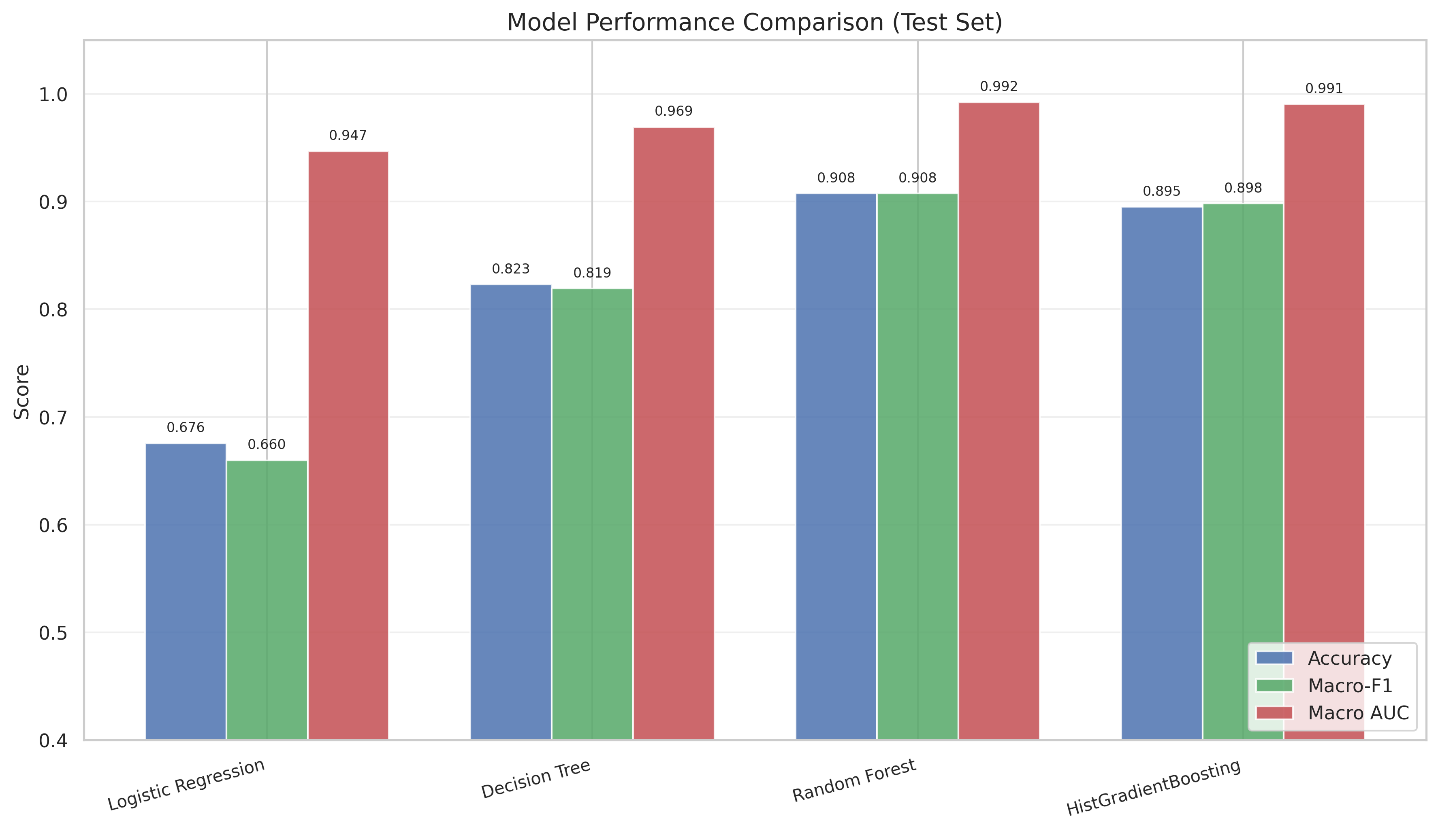
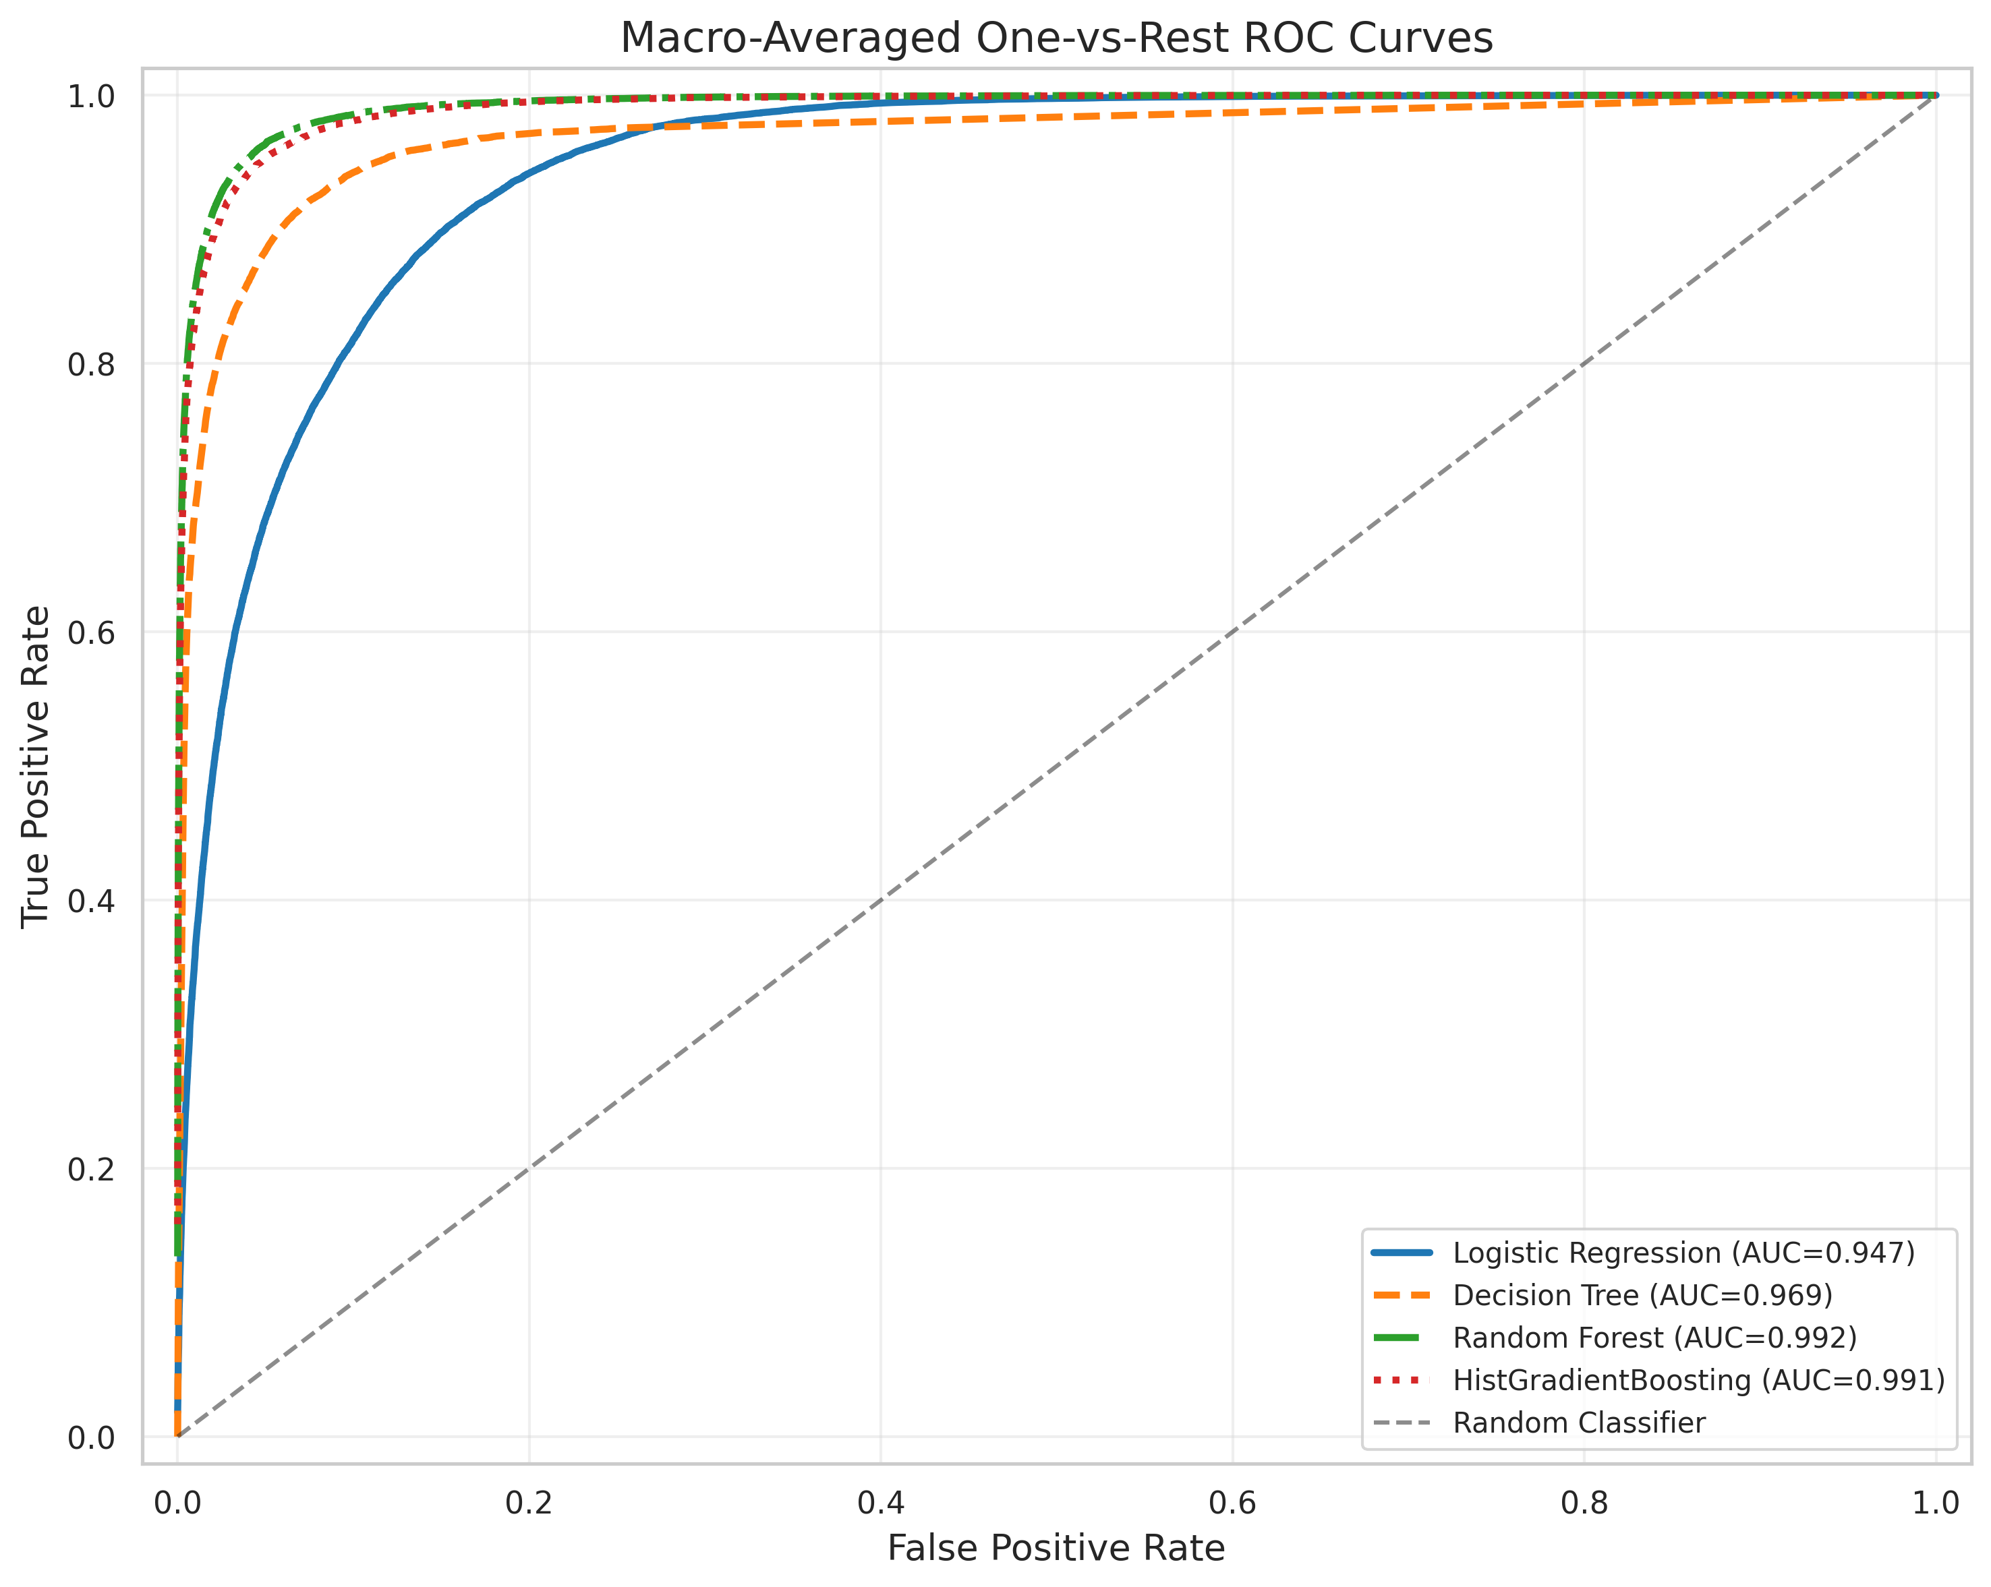
05 Evaluation and Model Selection
Held-out Test and Validation Evidence
Model | Test Acc | Macro Prec. | Macro Recall | Macro-F1 | 95% CI | CV-F1 | Macro AUC
Logistic Regression | .676 | .646 | .706 | .660 | [.654, .665] | .661±.003 | .947
Decision Tree | .823 | .803 | .846 | .819 | [.812, .826] | .811±.004 | .969
Random Forest | .908 | .903 | .913 | .908 | [.904, .911] | .902±.001 | .992
HistGradientBoosting | .895 | .896 | .901 | .898 | [.894, .902] | .895±.003 | .991
Selection: Random Forest has the best held-out macro-F1 (0.908) and AUC (0.992). The RF–HGB gap is stable under bootstrap but practically small (ΔF1=0.010).
Statistical interpretation: McNemar χ²=41.5, p<0.001 shows different per-sample error patterns; it does not directly test the continuous macro-F1 difference.

Slide 9
06 Open-Ended Exploration
Beyond baseline models - deeper investigation of techniques and improvements
Feature Importance
Search Strategy
Feature-Group Ablation
Impurity and permutation rankings, followed by feature-group ablation.
Grid search versus Bayesian optimization on the same 30k subset.
Quantify the complementary value of terrain, wilderness, and soil indicators.
Calibration & Confidence
Robustness & Subgroups
Final Model Choice
Brier score, ECE, Platt scaling, and confidence-based error review.
Performance across classes, elevation bands, and wilderness areas.
Balance predictive performance, calibration, and subgroup reliability.
Notes:
This slide outlines six key areas for open-ended exploration to enhance your modeling beyond the initial baseline.
1. **Advanced Model Comparison**: Move beyond simple models to compare powerful algorithms like Random Forest and Gradient Boosting, understanding their strengths in different scenarios.
2. **Feature Importance**: Don't just build models—interpret them. Use both built-in tree importance and permutation importance to validate which features truly drive predictions.
3. **Hyperparameter Tuning**: Fine-tune your models systematically using GridSearchCV to find the optimal configuration and avoid overfitting.
4. **Class Imbalance**: If your dataset is skewed, use techniques like SMOTE to ensure your model doesn't just predict the majority class.
5. **Model Calibration**: Ensure your model's predicted probabilities are trustworthy, which is crucial for applications where decision thresholds matter.
6. **Ensemble Methods**: Combine the strengths of multiple models using voting classifiers to create a more robust and accurate final predictor.

Slide 10
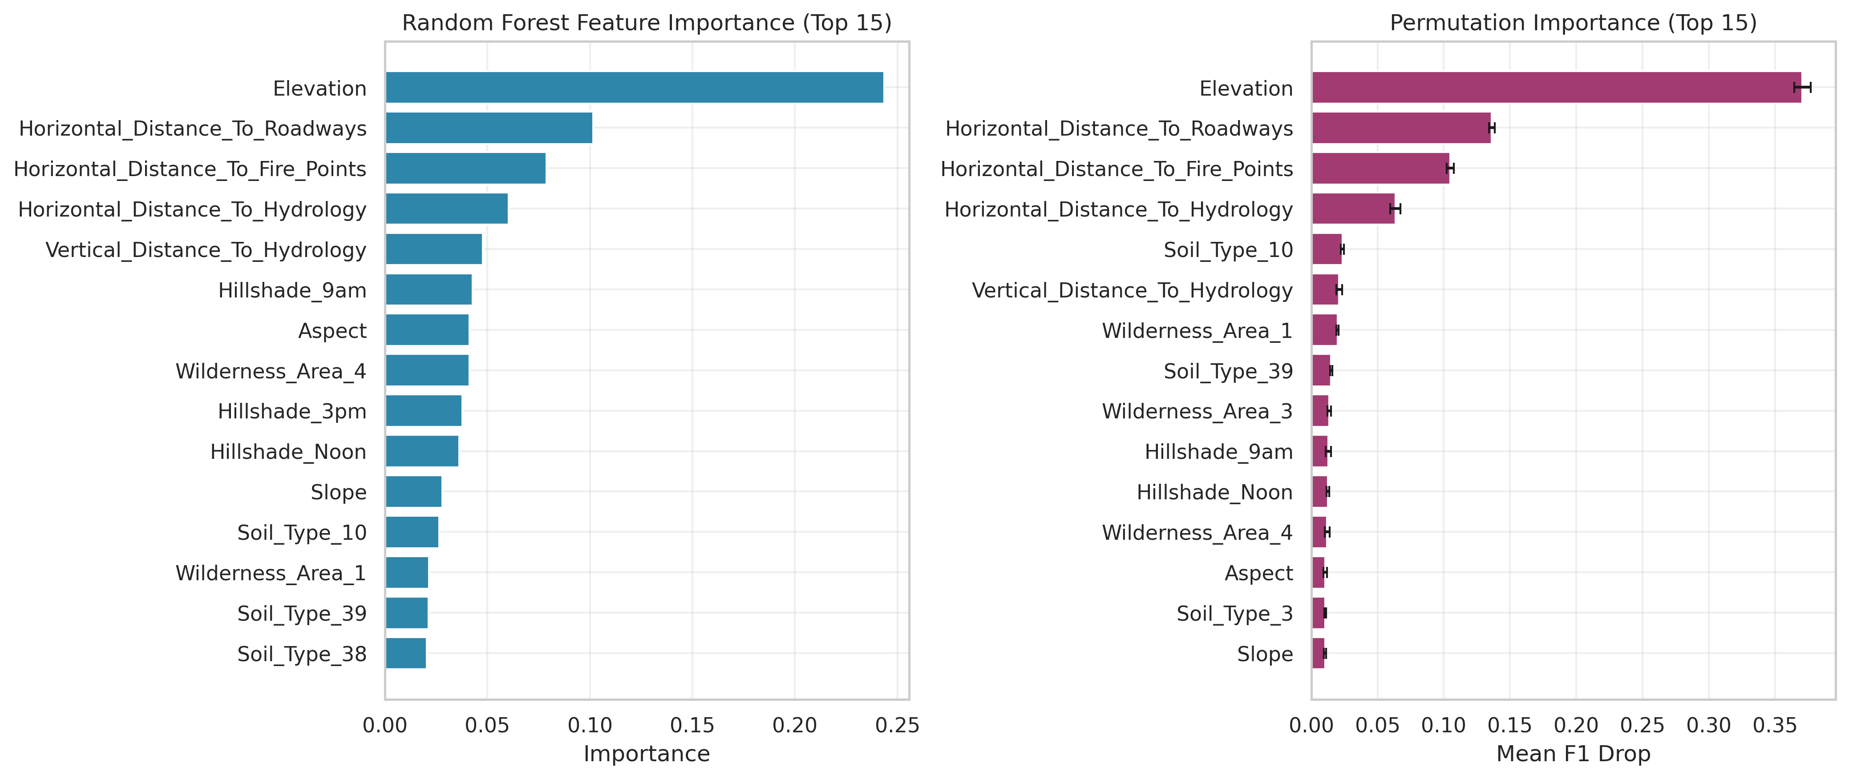
Feature Importance Analysis
Two independent importance methods agree on the leading predictors.
Interpretation: importance indicates predictive association, not a causal effect. Wilderness and soil indicators still add complementary context.
Impurity importance and held-out permutation importance provide complementary evidence.
01 Elevation
02 Road Distance
03 Fire-Point Distance
04 Model Capacity
Second-largest permutation effect: macro-F1 drop=0.136.
Third-largest permutation effect: macro-F1 drop=0.104.
Impurity importance=0.243; permutation macro-F1 drop=0.371.
Terrain-only RF=0.874; top-5 RF=0.877; full RF=0.908. LR polynomial features remain 0.584.
Notes:
Now we move to Part 5 for an in-depth analysis. We used a Random Forest model to analyze the importance of each feature. The results are very intuitive: Elevation is the most important feature, with an importance score far exceeding all others. This aligns perfectly with our common sense—elevation determines key environmental factors like temperature and precipitation, which in turn determine tree species distribution. Additionally, distance to roads, fire stations, and water bodies also play important roles.

Slide 11
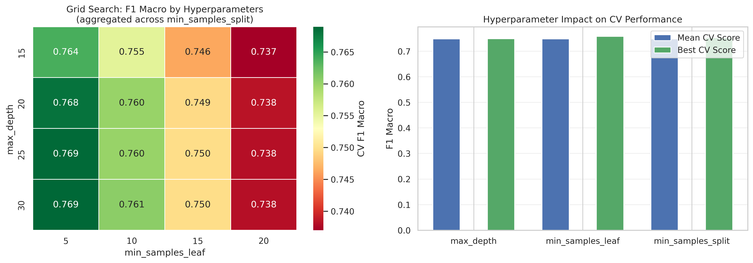
Hyperparameter Search Strategy
Decision Tree Grid
48 configurations, 3-fold CV. Best CV-F1=0.769; held-out test F1=0.797 versus 0.819 baseline (Δ=-0.022).
Ensemble Grid
RF 0.908→0.886 and HGB 0.898→0.889. Increasing RF trees 120→200 adds only +0.001 F1.
Optuna on Same 30k
100 TPE trials recover test F1=0.823: +0.026 over grid and +0.003 over baseline, within the baseline CI. Search strategy—not subset size—is the key lesson.

Slide 12
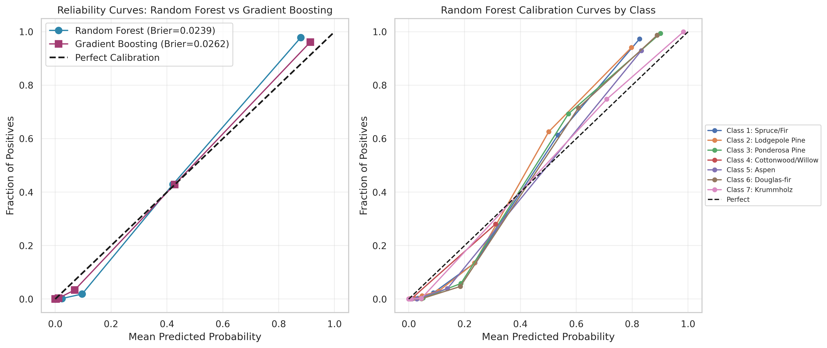
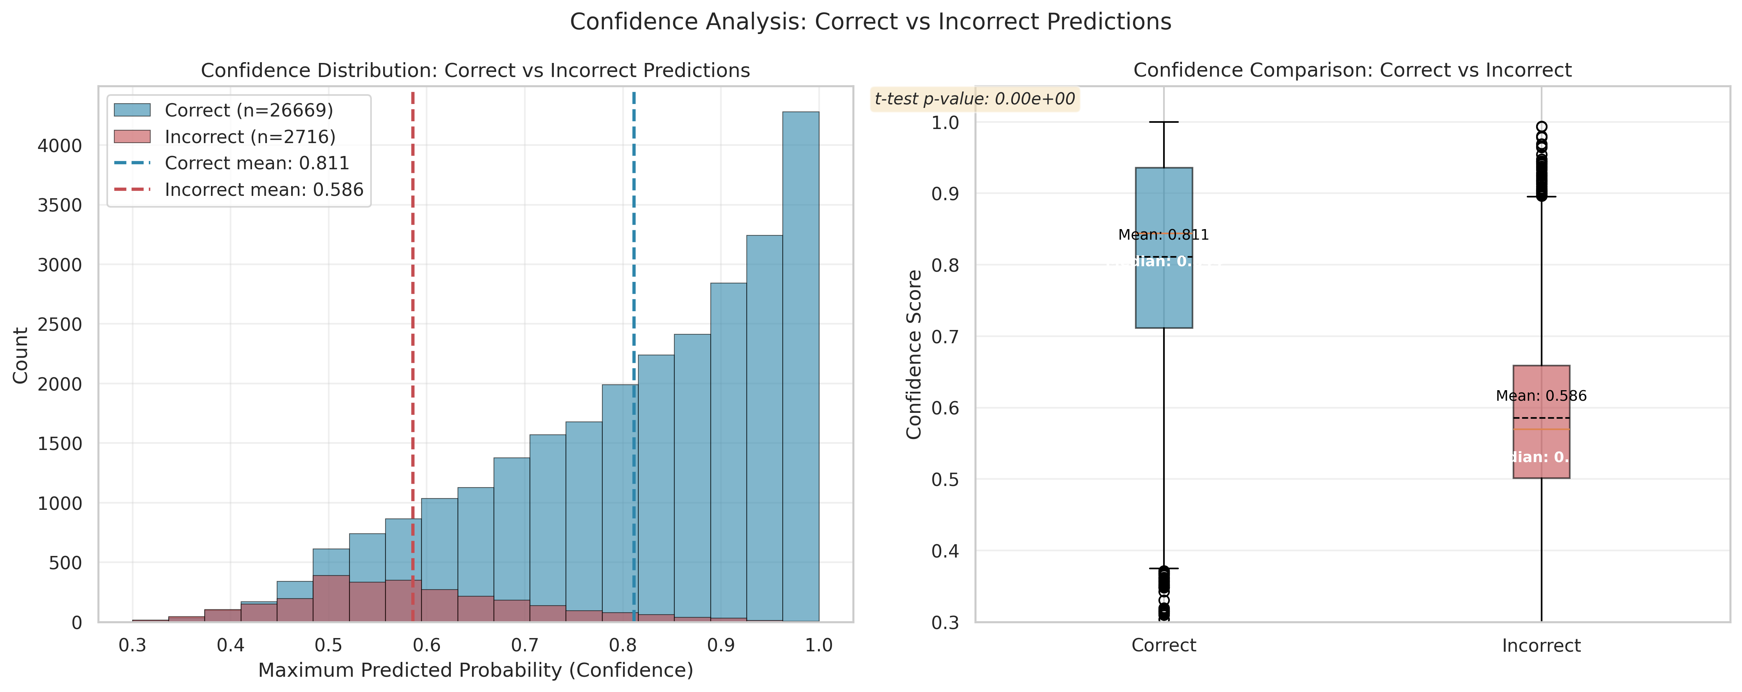
Model Calibration Analysis
Baseline Random Forest
RF ECE
HGB ECE
0.024
0.125
0.041
Brier score (higher = poorer)
Under-confident: 0.783 conf vs 0.908 acc
Best calibrated
Calibration: RF is under-confident (ECE=0.125; mean top-label confidence=0.783 vs accuracy=0.908). HGB is best calibrated (ECE=0.041), while Platt scaling reduces RF Brier 0.024→0.021.
McNemar: χ²=41.5, p<0.001 indicates different per-sample error patterns—not a direct macro-F1 significance test.
Robustness range: elevation-band accuracy 0.863–0.958 and macro-F1 0.684–0.900; the most diverse band is hardest. Cache la Poudre has macro-F1=0.716.
Confidence separates many errors: correct predictions average 0.811 confidence; incorrect predictions average 0.586.
Notes:
This slide presents the results of our model calibration analysis.
On the left, you see two key visualizations: the top chart is the average calibration curve across all classes, comparing the baseline Random Forest against the calibrated model and the perfect calibration line (dashed). The bottom chart breaks this down by individual classes.
On the right, we highlight the quantitative improvement: the Brier Score dropped from 0.0240 to 0.0215 after applying Platt Scaling (Sigmoid calibration), which is a 10% reduction in error.
Key takeaways include: the baseline model was slightly overconfident, especially in the mid-probability range; the smallest class (Class 4) remains the most challenging to calibrate; and this calibration step is essential for applications where probability estimates directly inform business decisions.

Slide 13
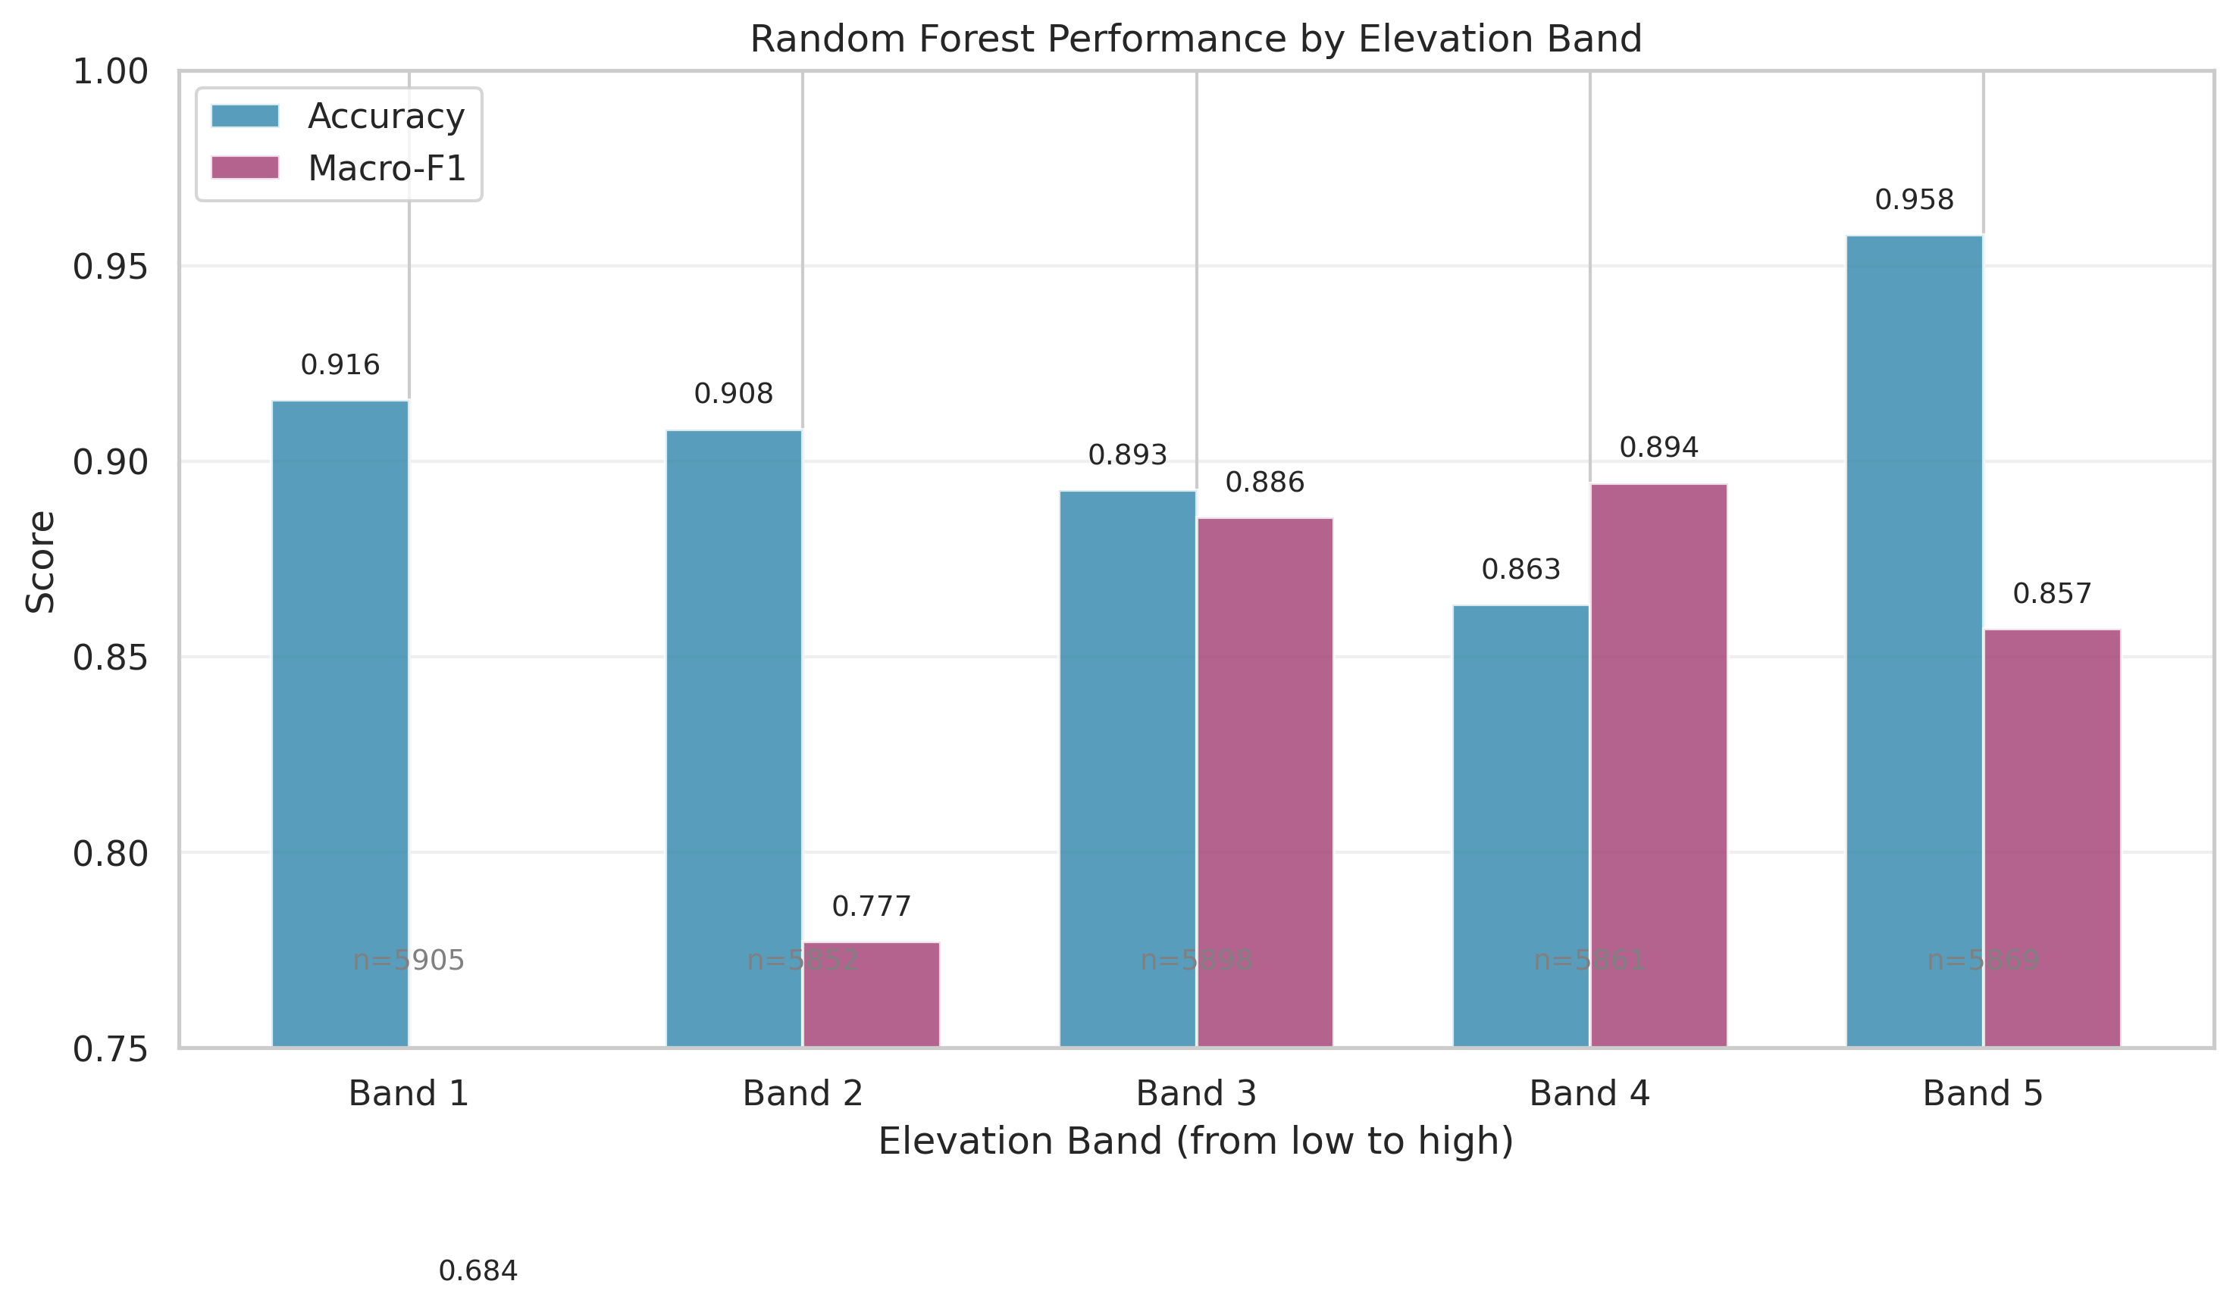
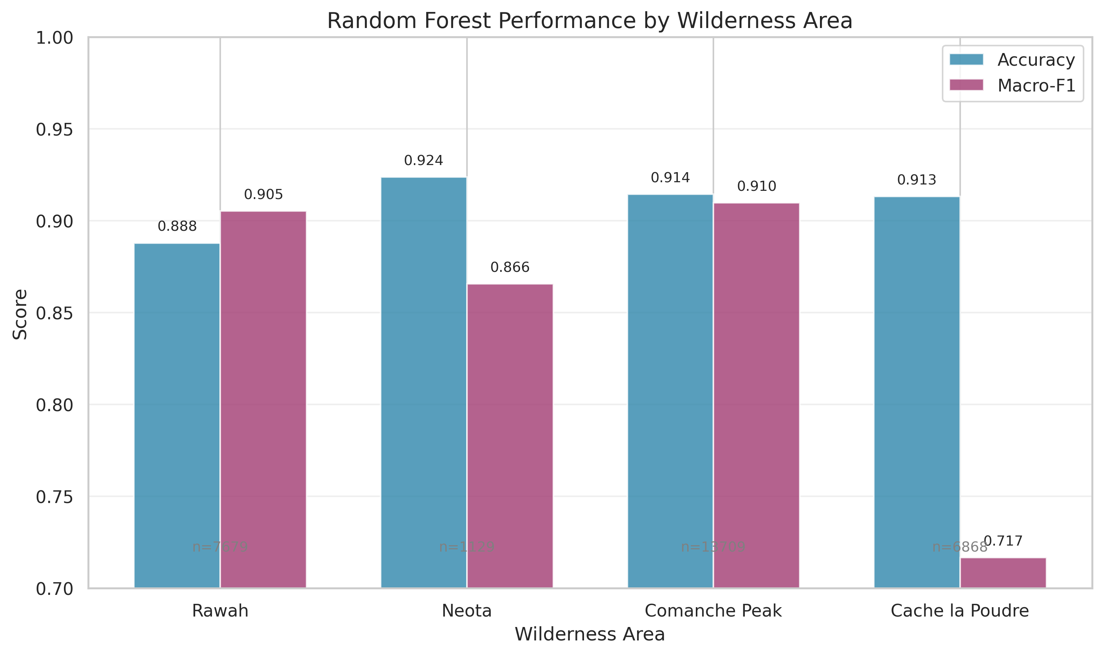
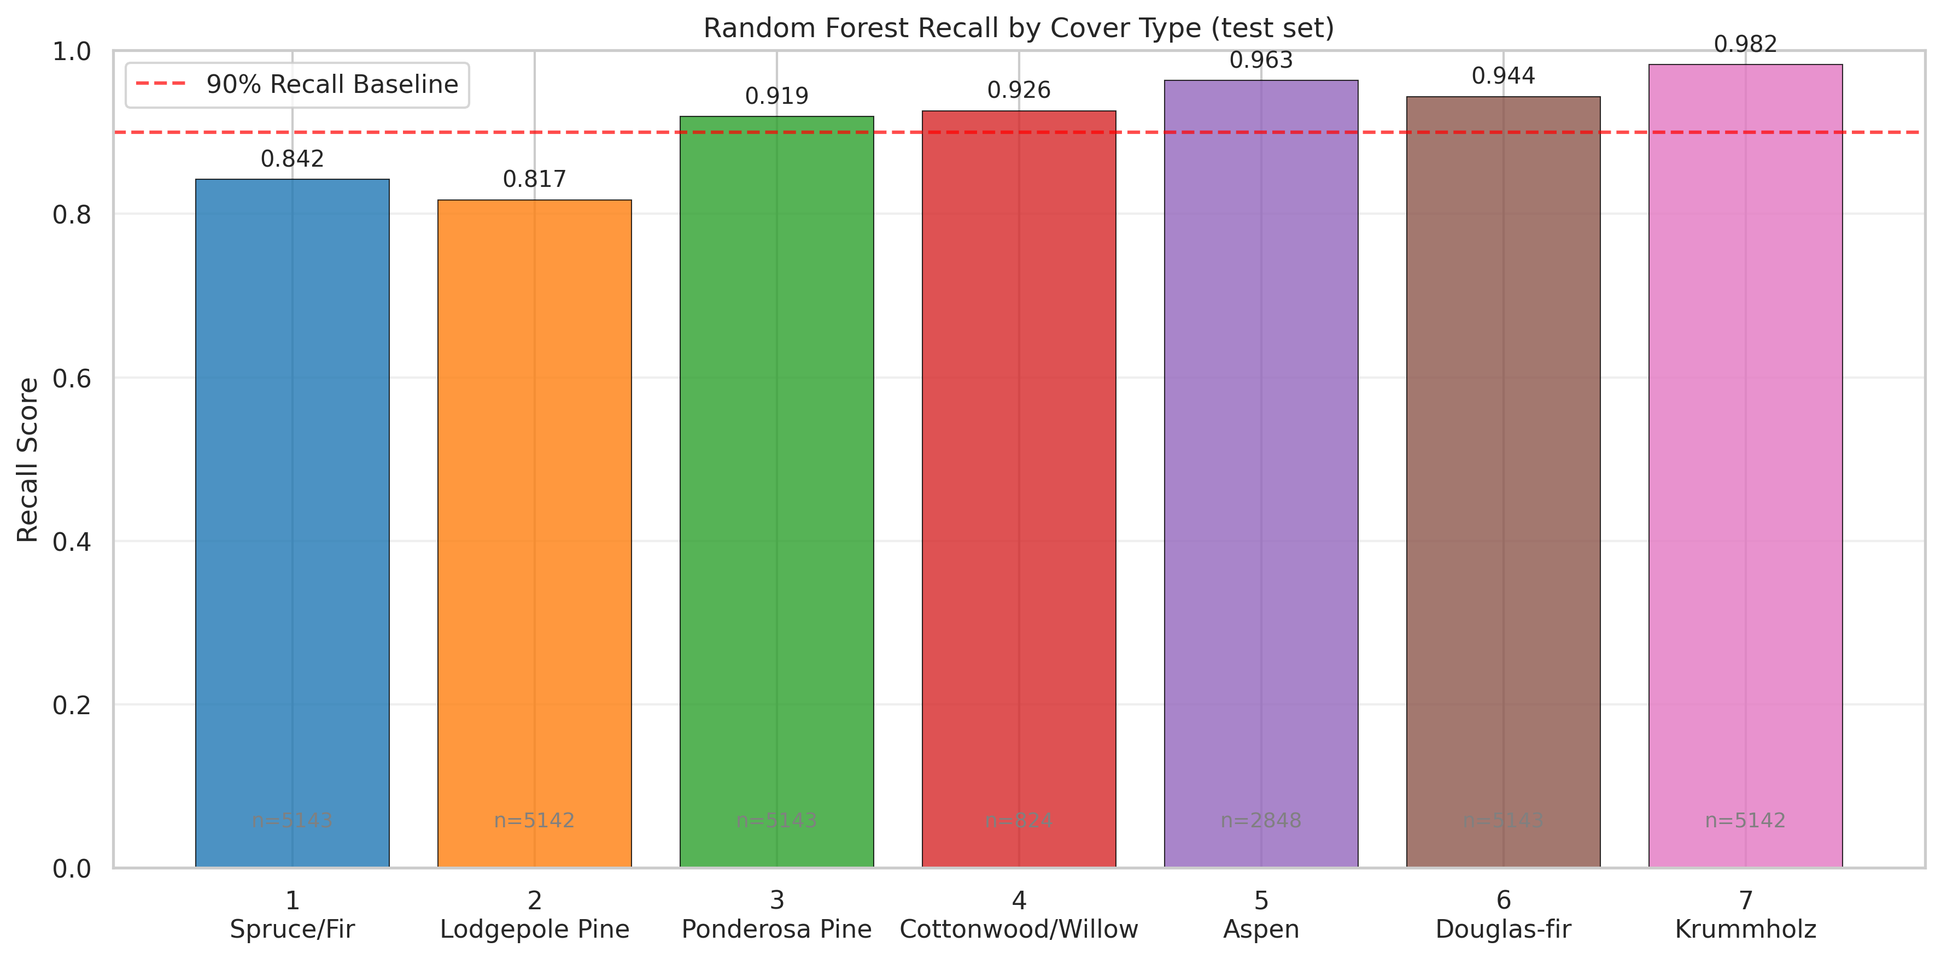
Robustness and Subgroup Analysis
Terrain Bands
Accuracy ranges 0.863–0.958 and macro-F1 0.684–0.900. The most ecologically diverse elevation band is hardest; high-elevation Krummholz regions are easier.
Class-Level Recall
Lodgepole Pine is lowest at 0.817, followed by Spruce/Fir at 0.842. Aspen, Douglas-fir, and Krummholz each exceed 0.94 recall.
Wilderness Areas
Macro-F1: Rawah 0.906, Neota 0.866, Comanche Peak 0.910, Cache la Poudre 0.716. Geographic composition drives concentrated error patterns.
Notes:
This slide presents a comprehensive comparison of various machine learning models evaluated for our task.
Looking at the bar chart on the top left, we can see a clear hierarchy of performance. The Random Forest models with top 30 features stand out with the highest F1 Macro scores of 0.909.
The table on the bottom left provides detailed metrics. Notice that the Random Forest with 120 trees performs identically to the 200-tree version in terms of F1 score (0.907) and AUC (0.992), but it trains 30% faster (1.4 seconds vs 2.0 seconds). This is a crucial efficiency gain.
In contrast, Gradient Boosting, while competitive in accuracy, has a very long training time of over 160 seconds, which is impractical for scenarios requiring quick retraining or real-time inference.
Baseline models like the standard Decision Tree lag significantly behind, highlighting the value of ensemble methods like Random Forest for this problem.

Slide 14
07 Conclusion and Future Outlook
Key Conclusions
Best Predictive Model
Random Forest: accuracy=0.908, macro-F1=0.908, macro AUC=0.992. Its 0.010 F1 lead over HGB is stable but practically small.
Topographic Factors Drive Predictions
Elevation is the most critical predictor; topographic features decisively shape classification results.
Evidence and Limitations
Modeling sample covers ≈17% of 581,012 observations
RF–HGB gap is stable under bootstrap, but practically small
Grid search degrades all three models; Optuna recovers the DT baseline
Reference full-data benchmarks reach roughly 0.95–0.96 accuracy
Errors remain concentrated by class, elevation, and wilderness area
Natural Clusters ≠ Ecological Labels
K-Means ARI=0.075, Ward ARI=0.103; Gower improves Ward to 0.215 but remains far below supervised performance.
Future Work Outlook
Train on the full dataset
Scale the validated pipeline from the 97,950-row modeling sample to all 581,012 observations and compare with published benchmarks.
Calibrate and abstain
Evaluate calibrated probabilities and confidence-based abstention when uncertain predictions require review.
Tune ensembles with Bayesian search
Extend Optuna from Decision Tree to Random Forest and HGB, using nested validation and early pruning.
Validate subgroups explicitly
Track class-, elevation-, and wilderness-specific metrics rather than relying on a single aggregate score.
Notes:
最后，对本次项目进行总结。我们的主要结论是：随机森林是最佳模型；无监督学习在此任务中无效；海拔是最关键的预测因子；并且在评估模型时必须考虑数据不均衡性。对于未来的工作，我们可以从特征工程、超参数调优、模型融合和处理少数类等方面进一步提升模型性能。

Slide 15
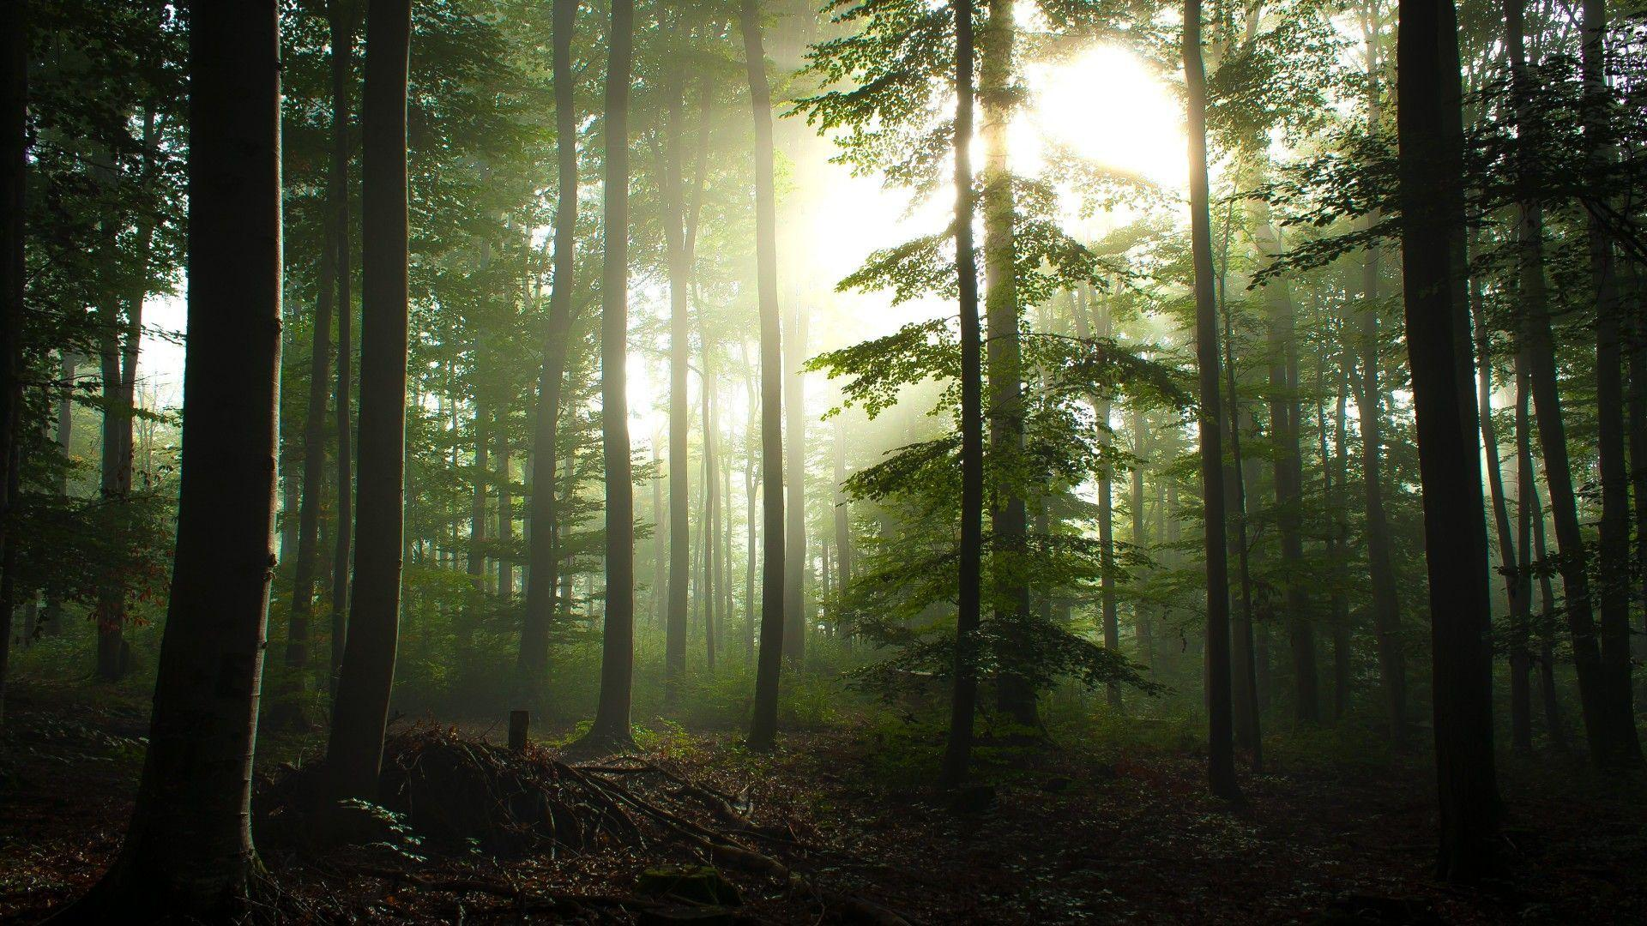
Q&A
Thank You
Zeyun DU · Zixiang QIN · Chunfeng GAO
Notes:
我的报告到此结束，感谢大家的聆听。现在是问答环节，欢迎大家提问。

