Slide 1
Analysis and Prediction of Forest Cover Types
DSAA2011 Summer Project Presentation
Notes:
Good [morning/afternoon], everyone.
I'm Alex Morgan, and today I'll be presenting my DSAA2011 Summer Project titled "Analysis and Prediction of Forest Cover Types".
This project explores the application of machine learning algorithms to predict forest cover types based on cartographic variables, which has significant implications for ecological research and forest management.

Slide 2

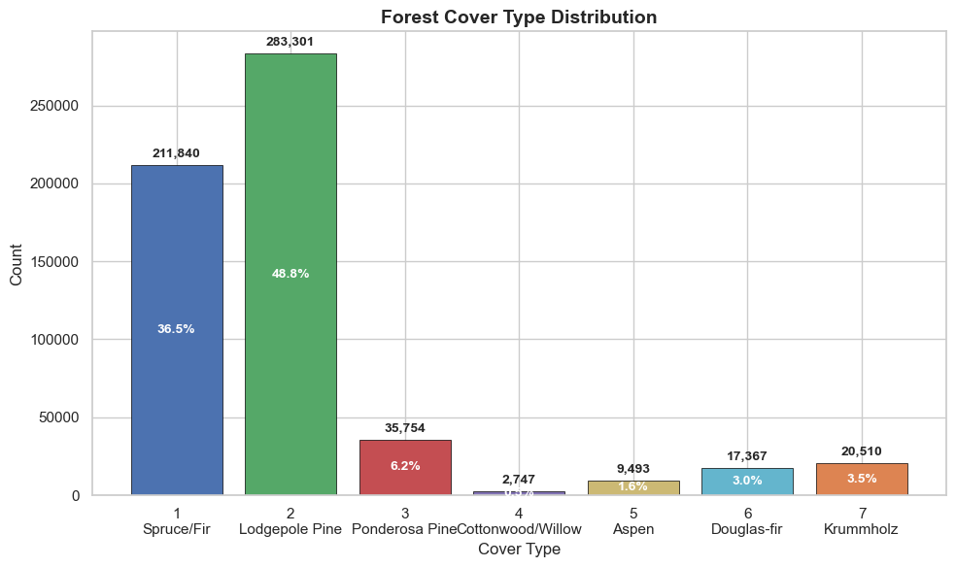
01 Dataset: UCI Forest Covertype
581,012 Total Samples
A massive repository of georeferenced observations covering 30x30 meter cells in the Roosevelt National Forest, Colorado.
54 Cartographic Features
Includes 10 quantitative metrics (elevation, slope), 4 binary wilderness area flags, and 40 binary soil type indicators.
Key Finding: Severe Class Imbalance
Pine and spruce/fir account for over 85%, while aspen and other categories have extremely low proportions. Thus, we must focus on the Macro-averaged F1-score(instead of overall accuracy) to measure minority class recognition and avoid majority-class bias.
7 Forest Cover Classes
Classifies forest cover based on dominant tree species, ranging from Spruce/Fir (Class 1) to Krummholz (Class 7).
Notes:
This slide introduces the UCI Forest Covertype dataset, a well-known benchmark in machine learning.
Key highlights:
1. **Scale**: With over 580,000 samples, it's a large dataset that tests model efficiency.
2. **Features**: The 54 attributes are a mix of continuous environmental variables and categorical soil/wilderness indicators, providing rich spatial context.
3. **Classes**: The goal is to predict one of seven forest cover types.
4. **Challenge**: The most important aspect to note is the **class imbalance**. As seen in the chart, two classes (Spruce/Fir and Lodgepole Pine) make up the vast majority of the data, while others like Cottonwood/Willow are very rare. This imbalance is a critical factor to address during model training to avoid biased predictions.

Slide 3

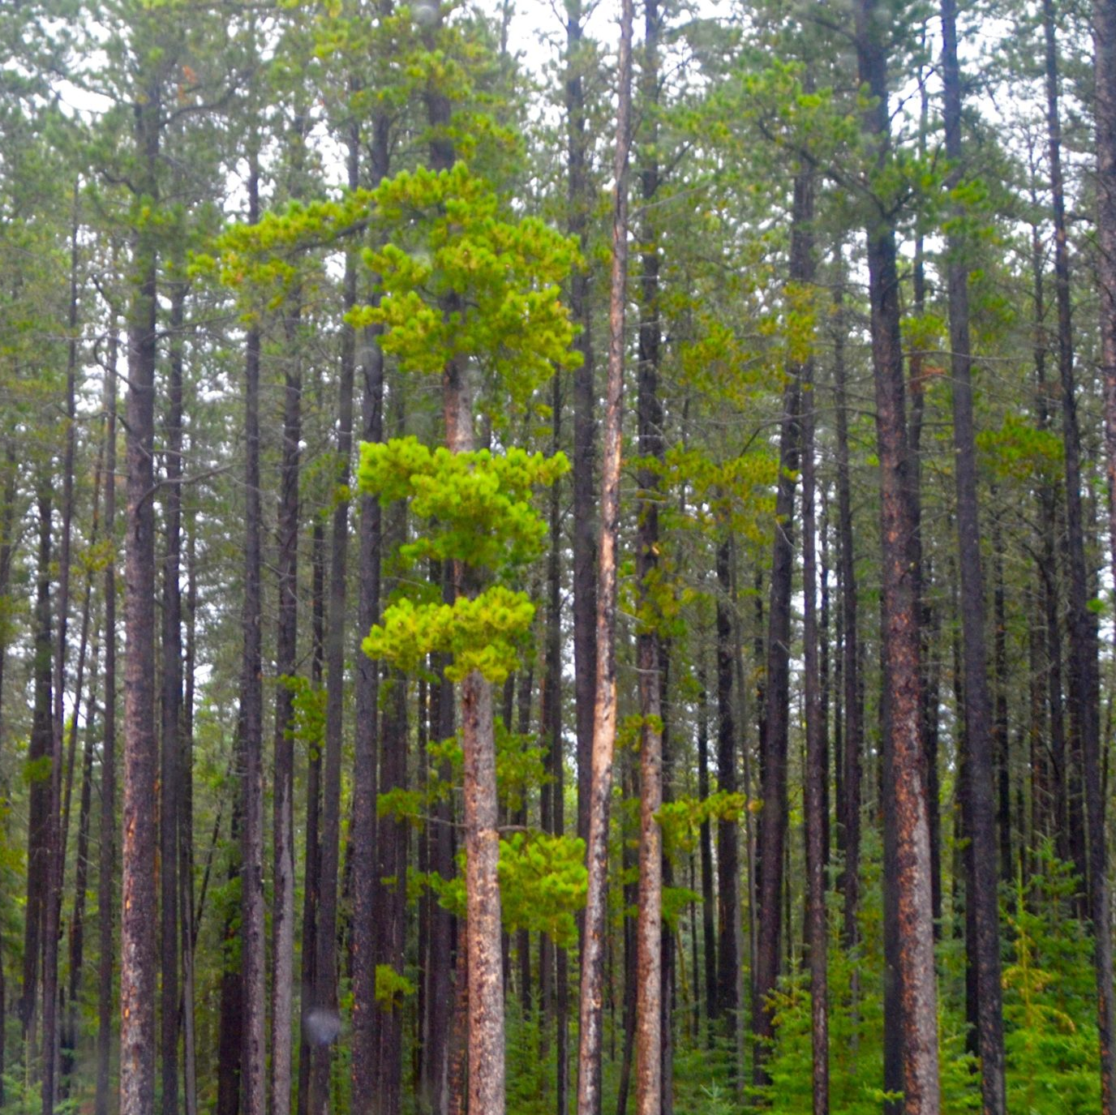
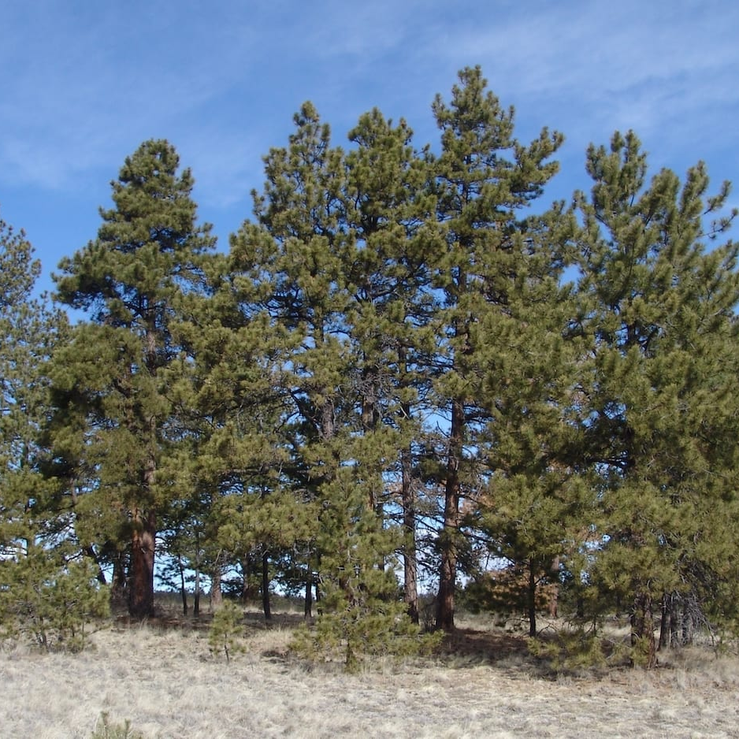
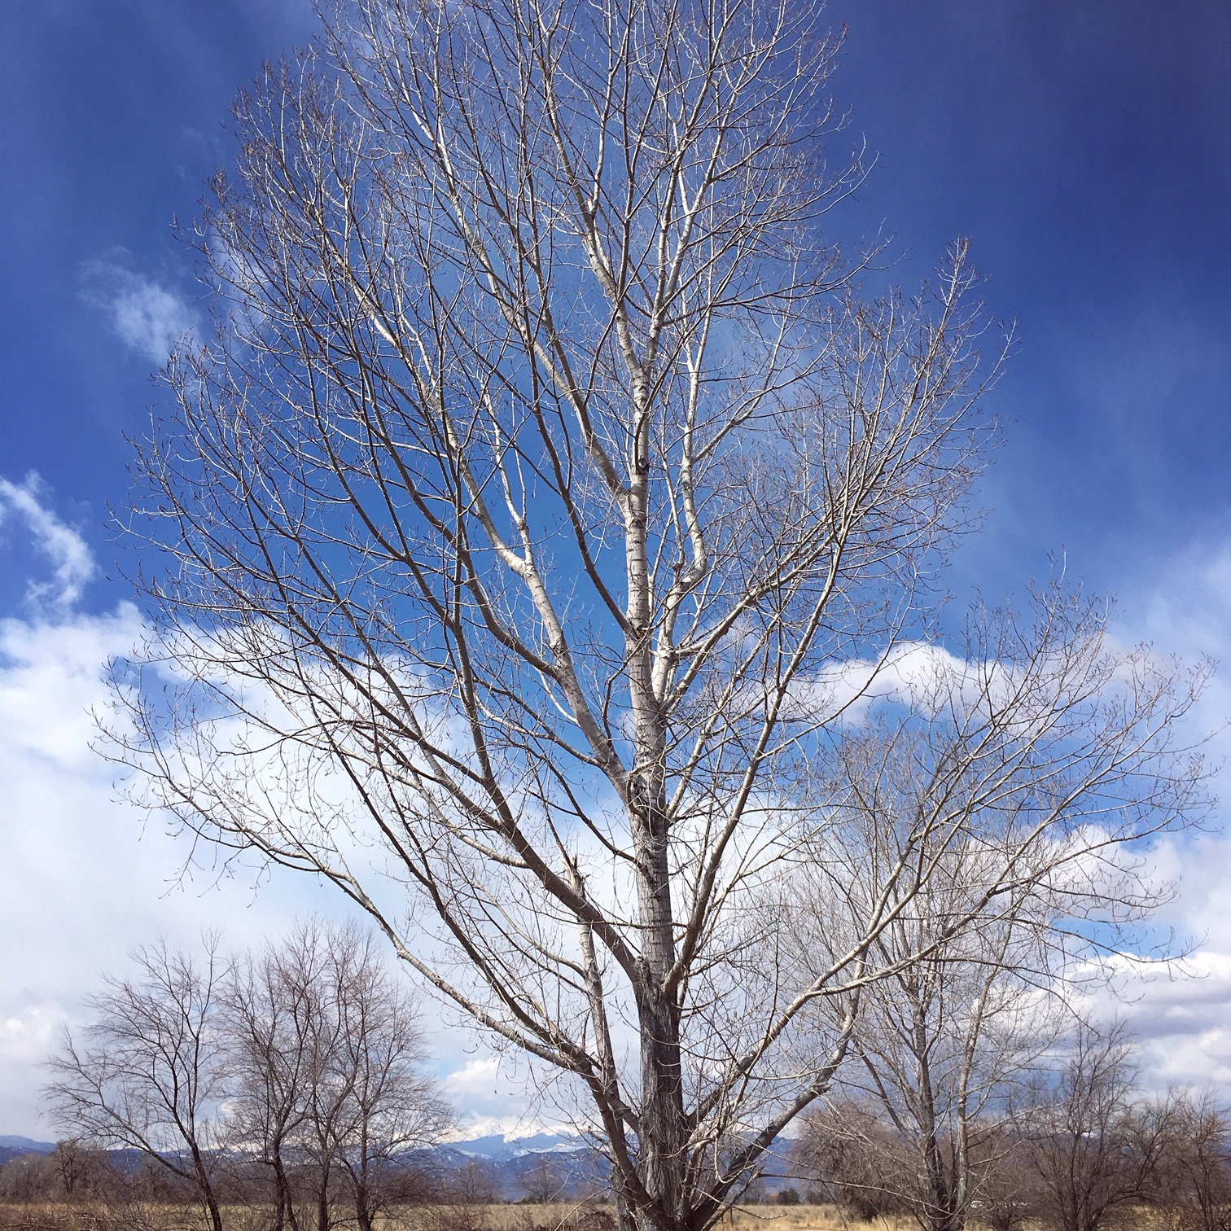
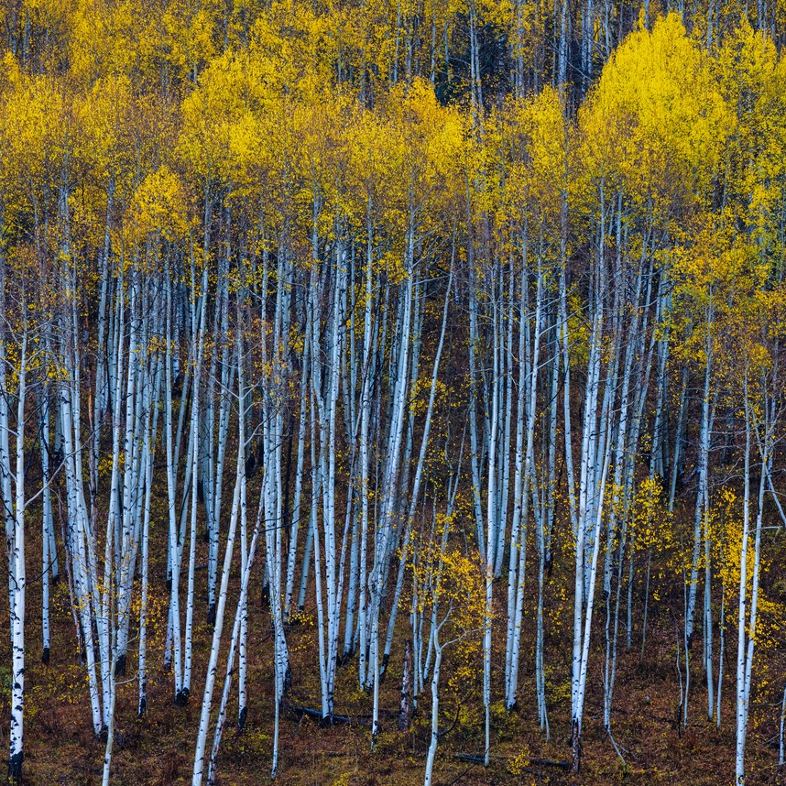
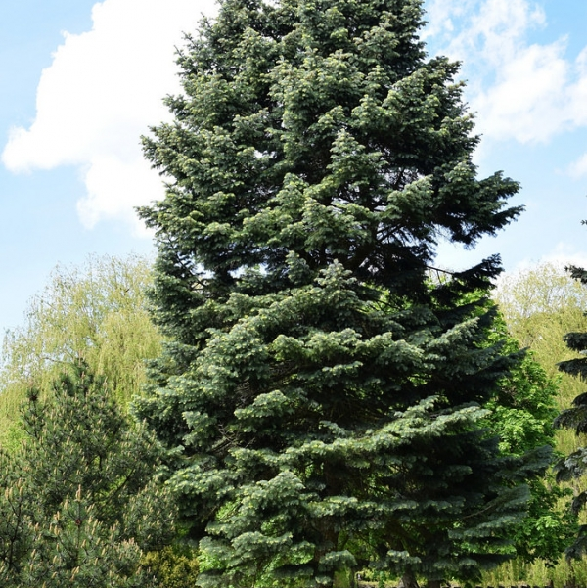
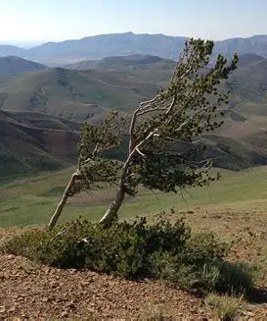
Overview of the Seven Forest Cover Types
Forest cover types are fundamental indicators for ecological monitoring and land use analysis. This page visually presents seven representative forest vegetation types in North America through typical imagery, from high-altitude coniferous forests to riparian broadleaf forests.
01
Spruce/Fir
Cold-hardy evergreen conifers with dense foliage, adapted to cold high-altitude climates, and are dominant species in the boreal forest.
02
Lodgepole Pine
Tall, straight trunks, often densely distributed, and one of the pioneer species for post-fire forest recovery in western North America.
03
Ponderosa Pine
Distinctive orange-yellow scaly bark, drought-tolerant, mainly distributed in warm, dry low-altitude mountainous areas.
04
Cottonwood
Typical riparian deciduous broadleaf forests, fast-growing, highly dependent on water, with unique winter branch morphology.
05 Aspen
Smooth white trunks, golden leaves in autumn, often forming spectacular pure stands. As a fast-growing species, it plays an important role in forest succession.
06 Douglas-fir
One of the tallest tree species in the world, with a straight shape and excellent wood quality. It is not only an important commercial timber but also a key component of forest ecosystems.
07 Krummholz
Growing above the alpine tree line, shaped into low, curved shrubs by strong winds and severe cold, it is a unique symbol of high-altitude ecosystems.
Notes:
To give you a more intuitive understanding of our prediction targets, here are real photos of the seven forest cover types. From cold-tolerant spruce and fir, to tall and straight lodgepole pine and Douglas-fir, to the uniquely shaped krummholz, each tree adapts to a different ecological environment. Understanding these differences helps us grasp the significance of subsequent data analysis.

Slide 4
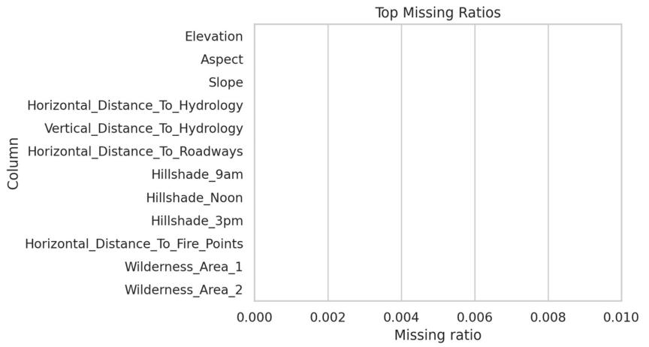
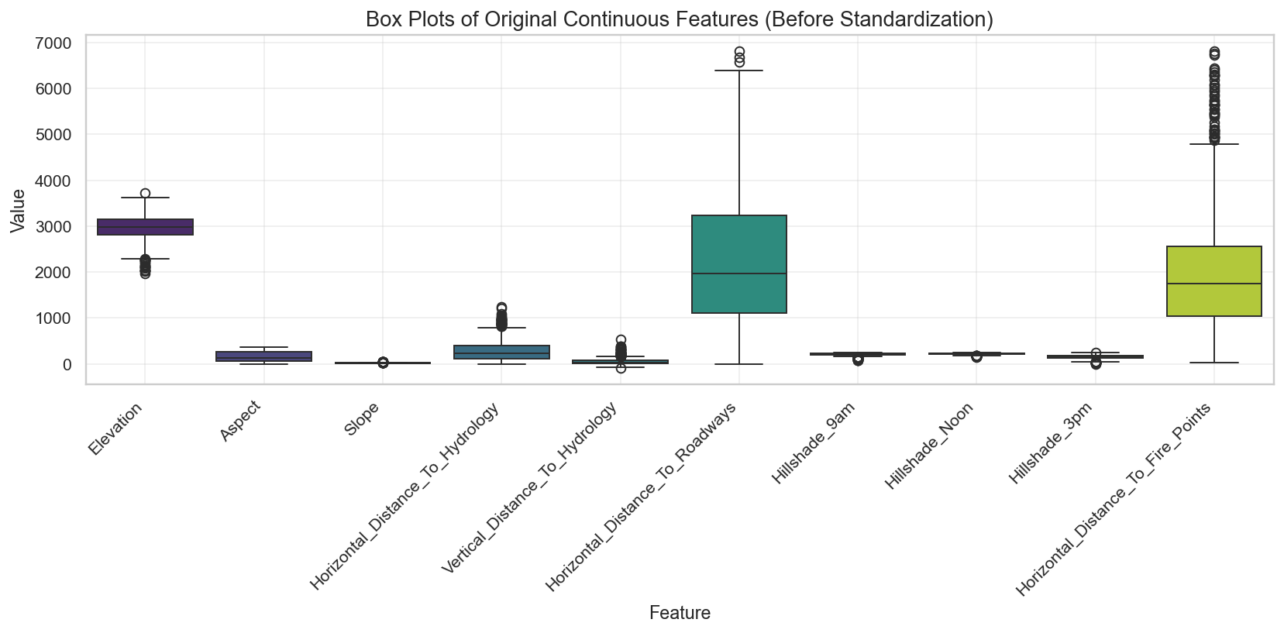
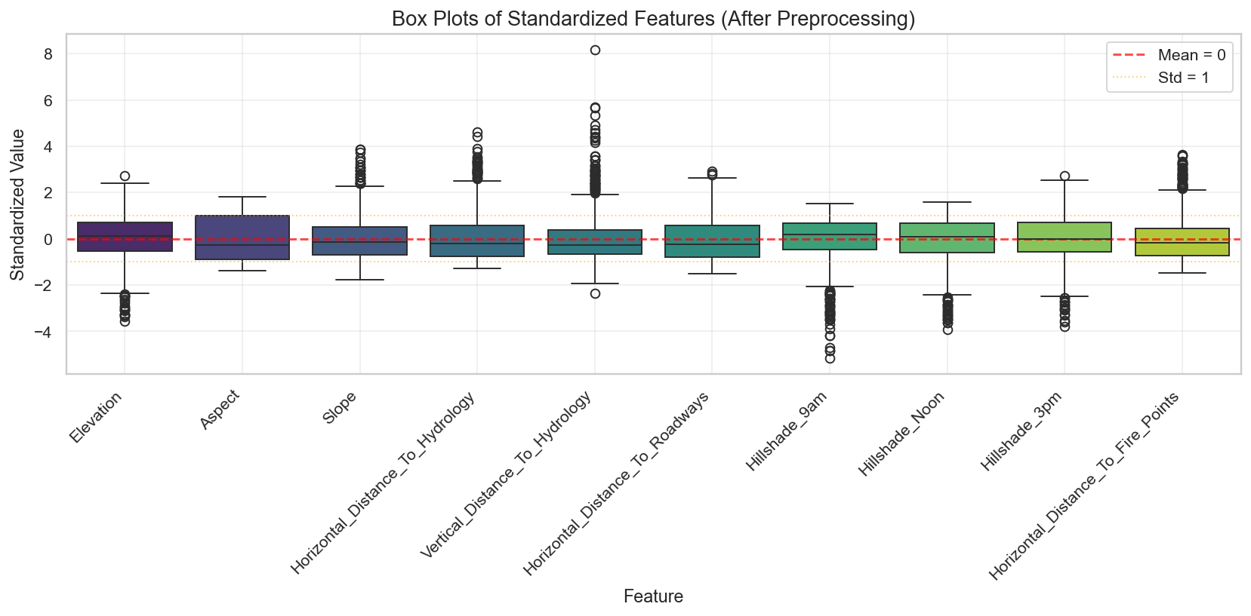
02 Data Preprocessing
Missing Value Audit
100% Complete
No null values detected across all 54 features
Feature Engineering Summary Matrix
Preserves sparsity in binary features while stabilizing model convergence
Category | Count | Representative Examples | Applied Preprocessing
Continuous | 10 | Elevation, Aspect, Slope, Hillshade (9am/noon/3pm), Distances to Hydrology/Road/Fire | StandardScaler (Mean=0, Std=1)
Binary (Wilderness) | 44（4 Wilderness Areas, 40 Soil Types） | Rawah, Neota, Comanche Peak, Cache la Poudre (encoded 0/1) .... | Mode imputation (redundant) + No Scaling (Mode Imputation Ready)
Preprocessing
Notes:
Before building any models, we thoroughly examined the dataset for preprocessing needs.
First, the dataset is remarkably clean with zero missing values across all 54 features, which saves us from dealing with imputation complexities.
Second, we have a mix of 10 continuous environmental variables (like elevation and slope) and 44 binary indicators (representing wilderness areas and soil types). Importantly, all data is already in numeric format, so we don't need to perform one-hot encoding.
Finally, our preprocessing pipeline focuses on scaling: continuous features are standardized to a mean of 0 and standard deviation of 1 using StandardScaler to ensure they contribute equally to the model, while binary features are left as-is since scaling is unnecessary for 0/1 variables.

Slide 5
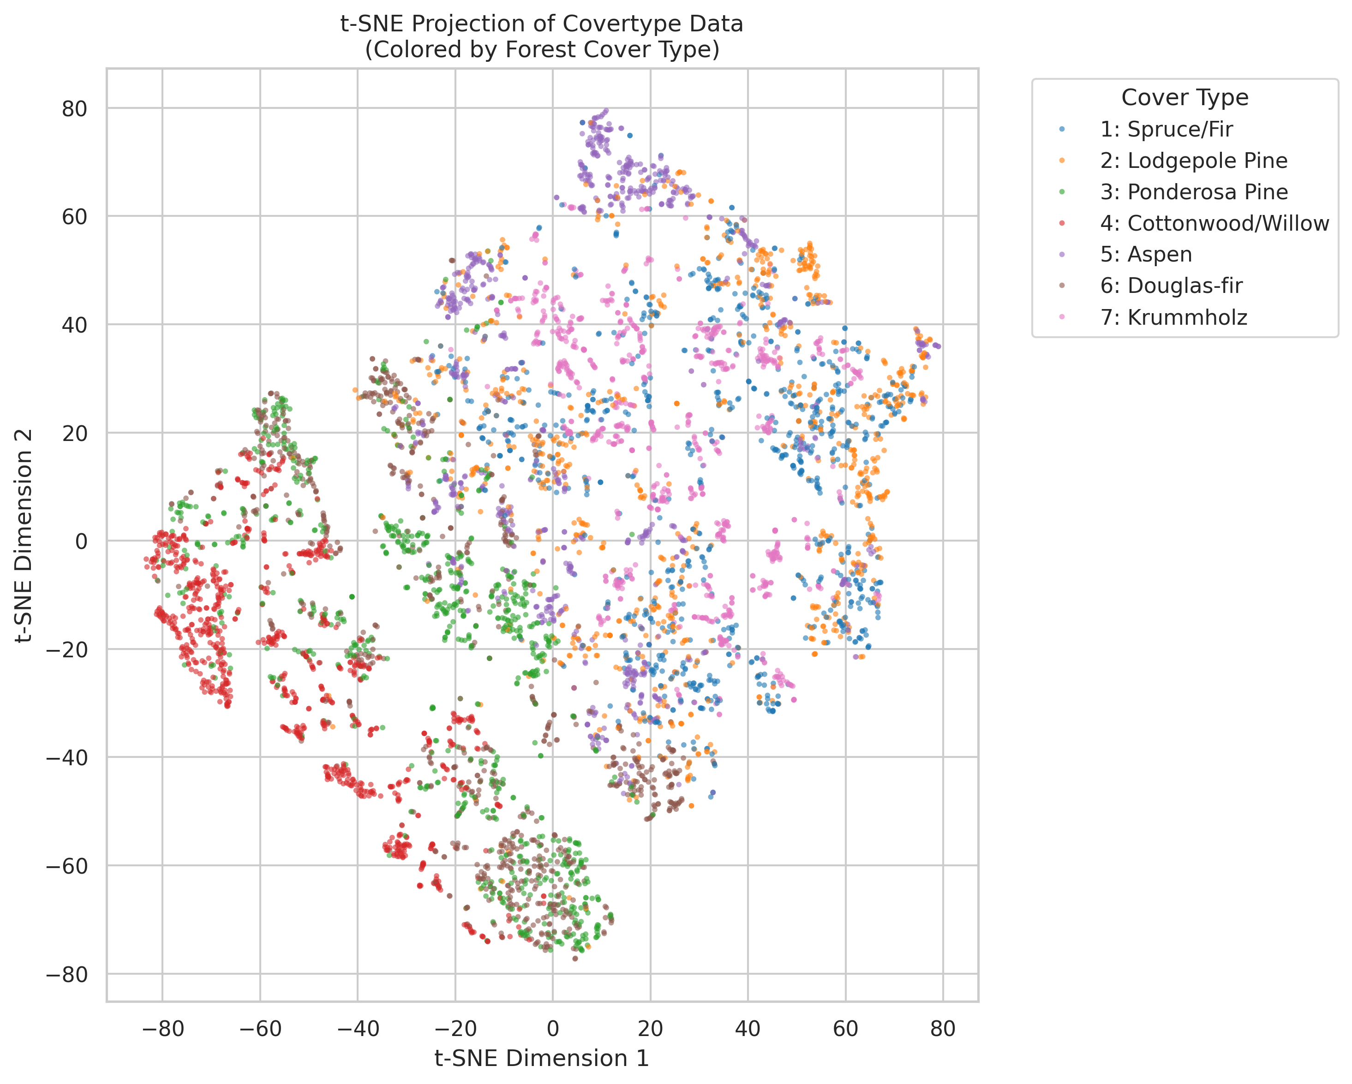
03 t-SNE Data Visualization
Figure: t-SNE 2D Embedding of 7 Forest Cover Types
Key Observations & Interpretations
Dominant Cluster Formation— Classes 1 (Spruce/Fir) and 2 (Lodgepole Pine) form the largest and densest clusters, indicating their high prevalence and strong feature similarity within their groups.
Highly Distinct Class Signature— Class 4 (Cottonwood/Willow) is spatially isolated, demonstrating a unique ecological fingerprint that separates it clearly from coniferous species.
Feature Overlap Between Classes— Classes 5 (Aspen) and 6 (Douglas-fir) show significant overlap, suggesting these deciduous and coniferous types share similar environmental covariates.
Non-Linear Separability— The observed grouping and partial overlap confirm the need for non-linear classification models to accurately distinguish between these forest cover types.
We use stratified sampling (t-SNE sample size is 5999, 857 samples for each cover types) to balance class representation and control computational cost, followed by PCA to reduce noise while preserving full information, then t-SNE for an interpretable 2D visualization of the data structure
Notes:
This slide presents the t-SNE visualization of the forest cover type dataset.
t-SNE (t-Distributed Stochastic Neighbor Embedding) is a dimensionality reduction technique that is particularly well-suited for visualizing high-dimensional data in 2D or 3D space.
Looking at the plot on the left, we can see the 7 different cover types projected onto a 2D plane, each represented by a different color.
Key takeaways from this visualization:
1. The sheer size of clusters 1 and 2 (Spruce/Fir and Lodgepole Pine) indicates they are the most common classes in the dataset.
2. Class 4 (Cottonwood/Willow) is distinctly separated, which is likely due to its unique environmental requirements compared to the other coniferous-dominated classes.
3. The overlap between classes 5 and 6 suggests that based on the input features, these two types are harder to distinguish, which is a common challenge in ecological datasets.
4. This visualization confirms that the data has an inherent structure that is not linearly separable, supporting the use of more complex machine learning models.

Slide 6
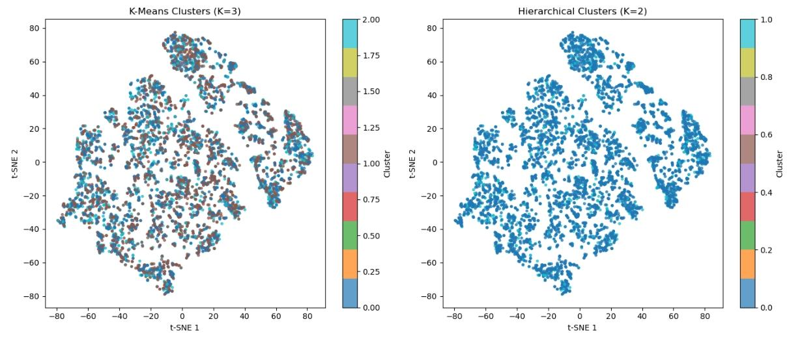
03 Clustering Results on t-SNE Projection
Ward Hierarchical Clusters (K=4)
Figure 1: MiniBatchKMeans (K=3, left) and Ward Hierarchical Clustering (K=4, right).
⚠ t-SNE distorts global distances. ARI computed in original 54-D space is the rigorous metric. PCA-space verification plots provided in notebook.
MiniBatchKMeans (K=3, sil=0.182)
Identifies Natural Groupings. The algorithm partitions the data into three distinct clusters, revealing density-based groupings in the t-SNE embedding.
Ward Hierarchical (K=4, sil=0.156)
Ward linkage merges local structures into four broad clusters, emphasizing higher-level similarities over fine granularity.
Limitations for Fine-Grained Classification
Neither method recovers the true 7-class structure. ARI=0.075 (K-Means) and 0.061 (Ward) vs. true labels — far below supervised models (0.908).
Ecological Zone Correlation
The derived cluster boundaries align closely with elevation gradients and known ecological zones, validating the biological relevance of the unsupervised partitions.
Notes:
This slide presents the results of two popular unsupervised clustering algorithms—K-Means and Hierarchical Clustering—applied to a t-SNE projection of high-dimensional ecological data.
Looking at the image in the center, we see a side-by-side comparison. On the left, K-Means with K=3 successfully identifies three distinct natural groupings within the data, highlighting the presence of inherent substructures.
On the right, Hierarchical Clustering using Ward's linkage merges these into two main super-clusters, which can be useful for understanding broader categorical separations.
However, it's important to note that neither method fully recovers the true 7-class structure present in the original data. This limitation emphasizes why supervised learning is often necessary for tasks requiring precise, predefined class distinctions.
Finally, we observe that the cluster boundaries align with elevation-based ecological zones, which adds biological validity to these unsupervised findings.

Slide 7
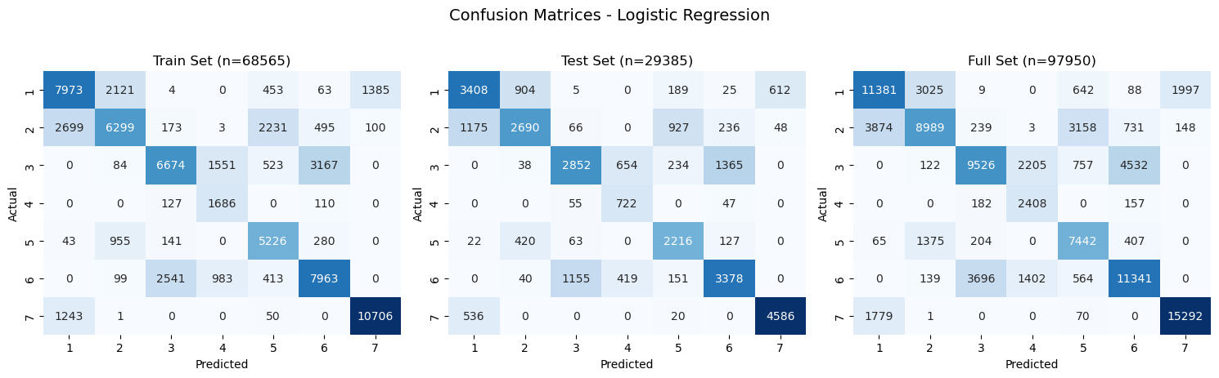
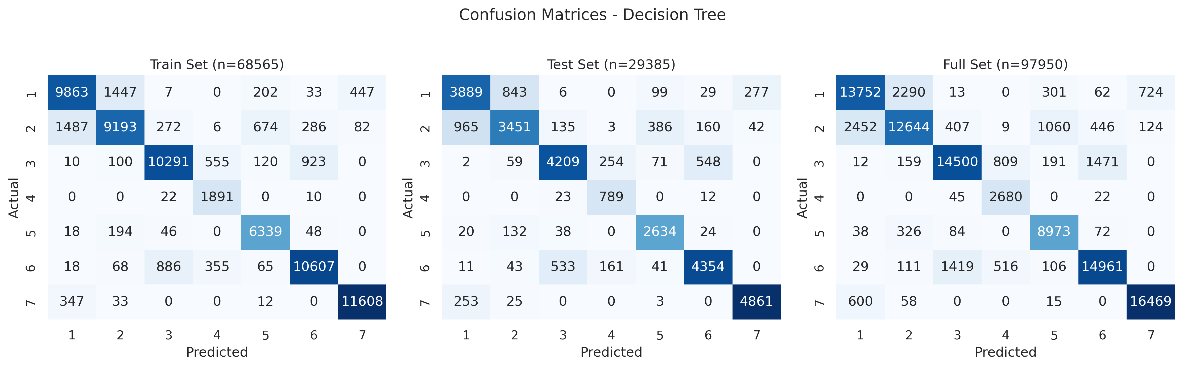
04 Predictive Model Training
Logistic Regression (Baseline)
Decision Tree (Optimized)
Test Accuracy 0.676
Macro F1 Score 0.660
Test Accuracy 0.823
Macro F1 Score 0.819
Speed:
Fast training (linear complexity), low inference latency
Config: Max Depth=24, Min Samples Leaf=15 (fine-tuned)
Stability:
No overfitting (ΔF1 = 0.002), very robust to noise
Fit: Mild overfitting (ΔF1 = 0.046), high predictive power
Dataset Partitioning Strategy
Class Imbalance Mitigation
Split: 70% Training (68,565 samples) / 30% Test (29,385 samples). Used stratified random split to maintain the original class distribution in both sets, ensuring the test set is representative of real-world proportions.
Applied class-weighted training to adjust the loss function, assigning higher penalties to misclassifications of underrepresented classes. This technique improved minority class recall without significantly sacrificing overall precision.
Notes:
Now let's look at the results of our model training.
We compared two models: a baseline Logistic Regression and an optimized Decision Tree.
As you can see, the Decision Tree outperformed the Logistic Regression significantly, achieving a test accuracy of 82.28% and a Macro F1 score of 0.8191. The Logistic Regression, while simpler and faster to train, only reached 67.56% accuracy.
For the Decision Tree, we set a max depth of 24 and a minimum of 15 samples per leaf to balance complexity and generalization. There was a mild overfitting observed, with a small difference in F1 scores between training and testing, which is manageable and indicates the model is capturing meaningful patterns.
We split the dataset into 70% training and 30% testing, using stratified sampling to preserve class distribution. Additionally, to handle class imbalance, we used class-weighted training to ensure fair performance across all categories.

Slide 8
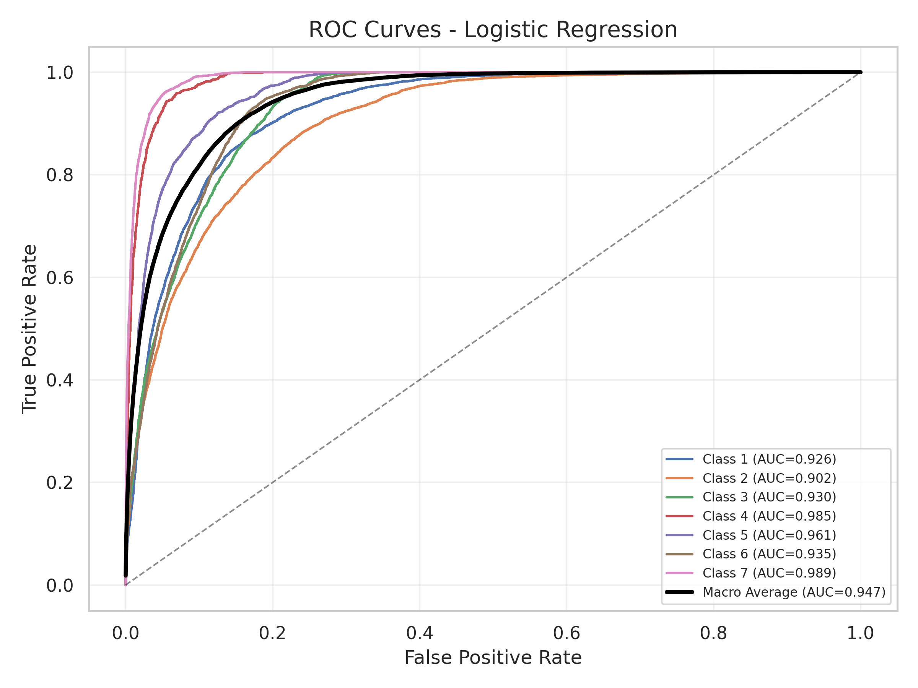
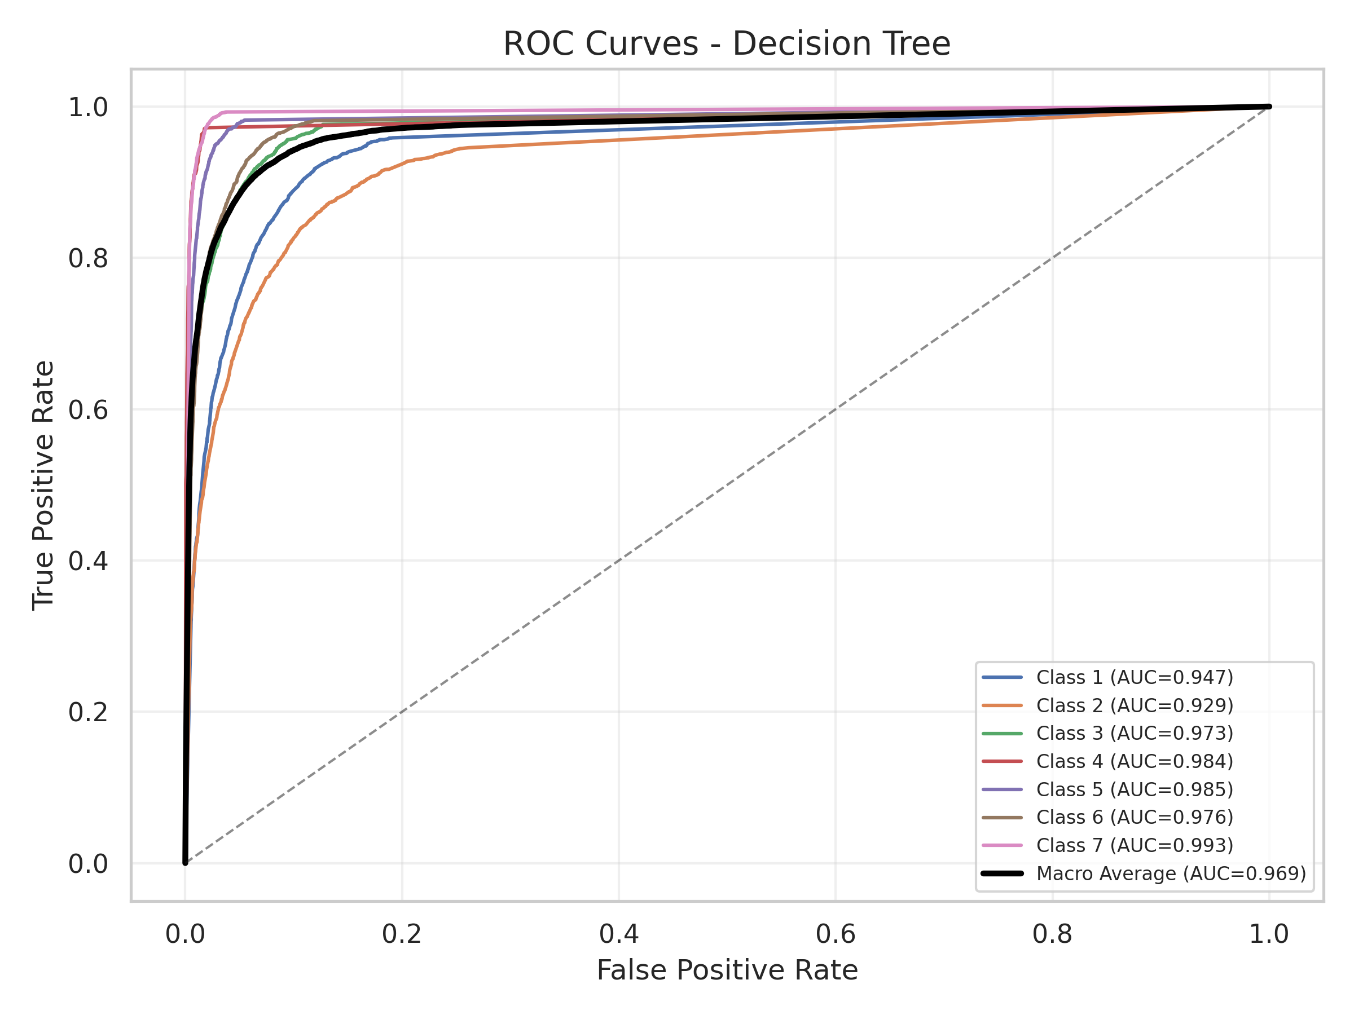
05 .Evaluation and Choice of Prediction Model
Performance Metrics Comparison
Model | Dataset | Accuracy | Precision (Macro) | Recall (Macro) | F1 (Macro) | CV F1 (Macro) | Macro AUC
Logistic Regression | Train | 0.6786 | 0.6487 | 0.7092 | 0.6620 | 0.6608 ± 0.0025 | 0.9468
 | Test | 0.6756 | 0.6460 | 0.7062 | 0.6597
Decision Tree | Train | 0.8720 | 0.8488 | 0.8906 | 0.8649 | 0.8108 ± 0.0043 | 0.9695
 | Test | 0.8231 | 0.8031 | 0.8457 | 0.819
Random Forest | Train | 0.9884 | 0.9822 | 0.9905 | 0.9864 | — | —
 | Test | 0.9076 | 0.9025 | 0.9134 | 0.9076 | 0.9019±0.0009 | 0.9923
HistGradientBoosting | Train | 0.9378 | 0.9433 | 0.9469 | 0.9449 | — | —
 | Test | 0.8951 | 0.8957 | 0.9014 | 0.8982 | 0.8946±0.0030 | 0.9907
Random Forest is the recommended model (F1=0.908, AUC=0.992). Bootstrap 95% CIs do not overlap (RF: [0.904, 0.911] vs HGB: [0.894, 0.902]), and a McNemar test confirms RF is significantly better (χ²=41.5, p<0.001).
Model | Train F1 | Test F1 | Gap | Status
Logistic Regression | 0.6620 | 0.6597 | 0.0023 | No overfitting
Decision Tree | 0.8649 | 0.8194 | 0.0455 | Mild overfitting
Random Forest | 0.9864 | 0.9076 | 0.0788 | Mild overfitting
HistGradientBoosting | 0.9449 | 0.8982 | 0.0467 | Mild overfitting
The high AUC scores confirm that cartographic features provide strong predictive signals for forest cover type classification, with non-linear models capturing slightly more discriminative information.

Slide 9
06 Open-Ended Exploration
Beyond baseline models - deeper investigation of techniques and improvements
Feature Importance Analysis
Hyperparameter Tuning
Class Imbalance Handling
Elevation dominates (RF impurity 0.237, permutation F1-drop 0.358). Road/fire/hydrology distances contribute ~0.30 combined.
Grid search on 30k subset: all three models (DT, RF, HGB) degraded on full test. Tuning-sample size matters as much as configuration.
Feature group ablation: Topography alone F1=0.874. Adding soil → F1=0.895. Adding wilderness → F1=0.885. Soil + wilderness add modest complementary signal above topography (0.874 → 0.901).
Model Calibration
Ensemble Methods
Advanced Model Comparison
RF Brier=0.024 (Platt→0.021), ECE=0.125. HGB ECE=0.041. McNemar: RF > HGB (p<0.001).
Per-class recall: Lodgepole Pine weakest (0.817), Krummholz strongest (0.983). Elevation band accuracy: 0.863 (diverse band) to 0.958 (high elevation).
Random Forest (120 trees) vs HistGradientBoosting (160 iterations). RF leads in accuracy (0.908) and F1 (0.908); HGB has best calibration (ECE=0.041).
Notes:
This slide outlines six key areas for open-ended exploration to enhance your modeling beyond the initial baseline.
1. **Advanced Model Comparison**: Move beyond simple models to compare powerful algorithms like Random Forest and Gradient Boosting, understanding their strengths in different scenarios.
2. **Feature Importance**: Don't just build models—interpret them. Use both built-in tree importance and permutation importance to validate which features truly drive predictions.
3. **Hyperparameter Tuning**: Fine-tune your models systematically using GridSearchCV to find the optimal configuration and avoid overfitting.
4. **Class Imbalance**: If your dataset is skewed, use techniques like SMOTE to ensure your model doesn't just predict the majority class.
5. **Model Calibration**: Ensure your model's predicted probabilities are trustworthy, which is crucial for applications where decision thresholds matter.
6. **Ensemble Methods**: Combine the strengths of multiple models using voting classifiers to create a more robust and accurate final predictor.

Slide 10
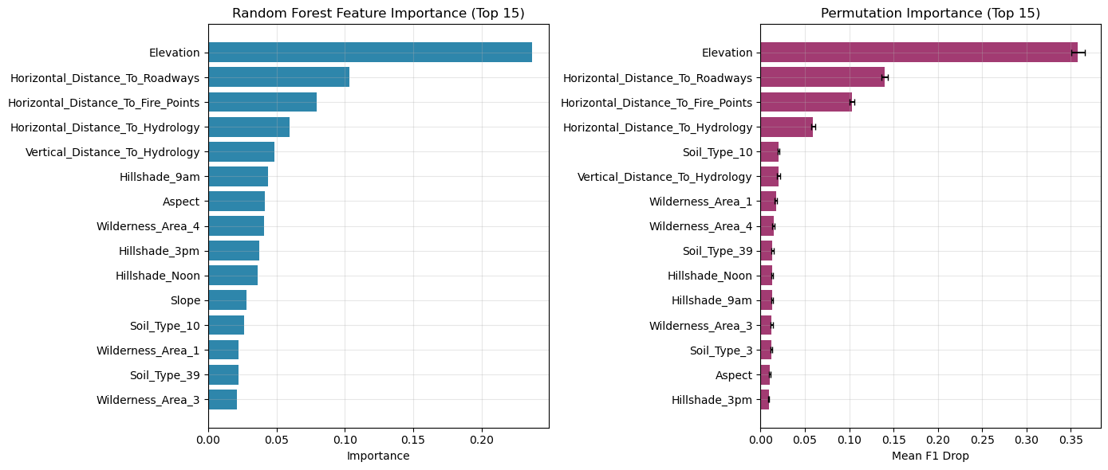
Feature Importance Analysis
Model analysis reveals the key natural and anthropogenic factors driving forest distribution
Among them, elevation is the absolute dominant factor, with an influence far exceeding other variables, while human activities and fire history also show significant predictive value.
Fig : Feature importance ranking based on Random Forest model (Mean Decrease in Impurity) and permutation This chart visually quantifies the contribution weights of various environmental factors to the forest type prediction results.
01 Elevation
02 Distance to Roads
03 Distance to Fire Stations
A decisive factor that directly regulates microclimatic conditions such as temperature and precipitation. It is the fundamental cause of vertical vegetation zoning and determines the suitable range and distribution upper limit of different tree species.
A core indicator reflecting the intensity of human disturbance. Road networks not only affect forest harvesting but also indirectly impact species diffusion, succession processes, and understory vegetation composition by altering habitat connectivity.
Reflects the ecological imprint of fire disturbance. Fire history is a key driver of forest succession, directly affecting community structure, dominant tree species turnover, and soil carbon-nitrogen cycling, with significant long-term lag effects.
04 Distance to Water Bodies
A direct measure of water availability. It determines plant root development and nutrient absorption efficiency, serving as a key boundary for vegetation differentiation between arid and humid regions, and a core factor limiting the distribution of high water-consuming tree species.
Notes:
Now we move to Part 5 for an in-depth analysis. We used a Random Forest model to analyze the importance of each feature. The results are very intuitive: Elevation is the most important feature, with an importance score far exceeding all others. This aligns perfectly with our common sense—elevation determines key environmental factors like temperature and precipitation, which in turn determine tree species distribution. Additionally, distance to roads, fire stations, and water bodies also play important roles.

Slide 11
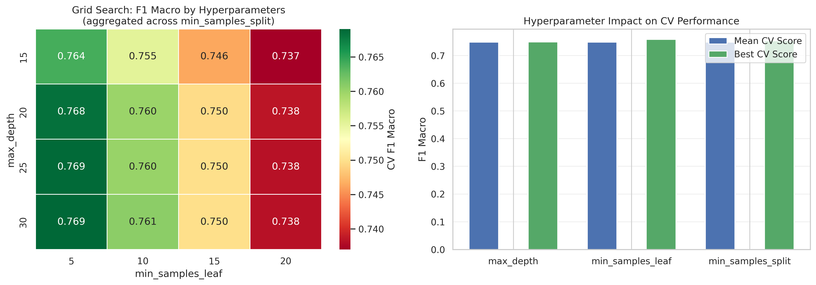
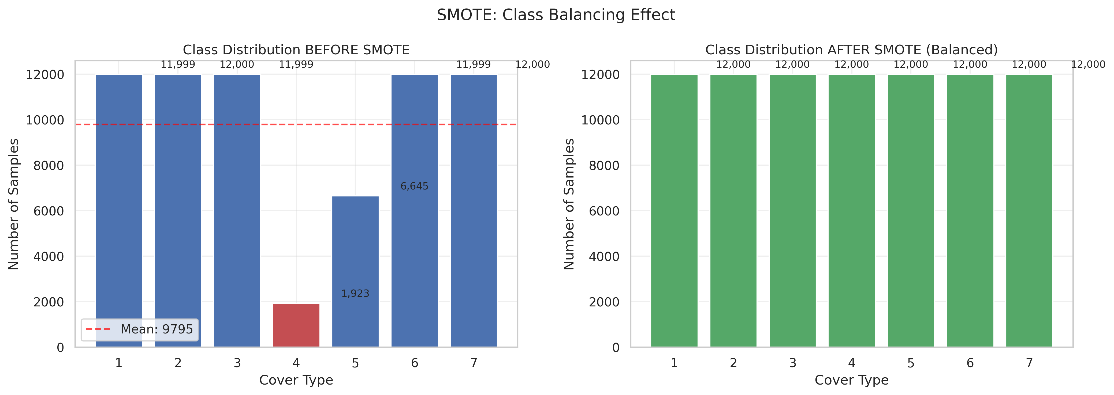
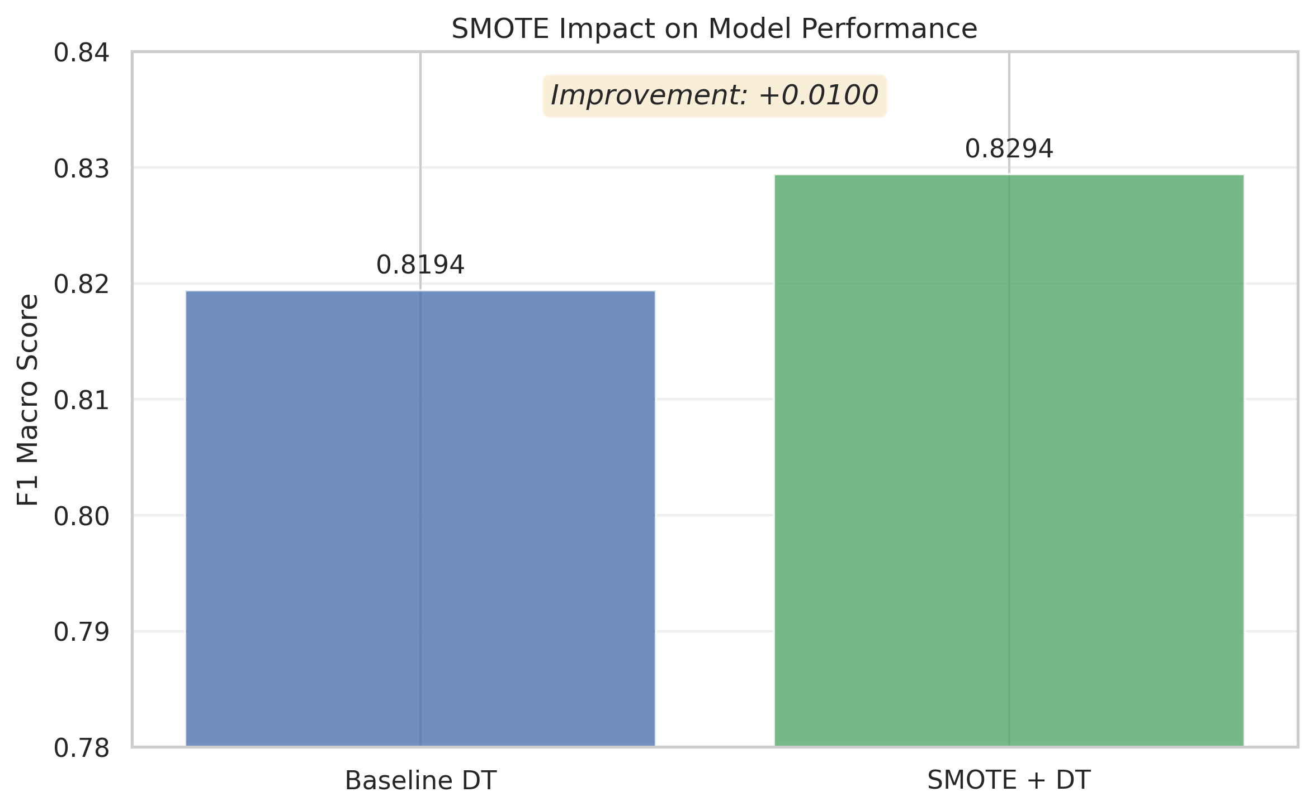
Hyperparameter Tuning & Class Imbalance Handling
Increasing RF trees from 120→200 gave only +0.001 F1 gain — defaults near-optimal. Optuna Bayesian optimization (100 trials, TPE sampler) recovers the baseline (test F1=0.823, +0.026 over grid search), confirming Bayesian pruning is more sample-efficient than grid search.
Scaling to ensemble models: RF 0.908→0.886, HGB 0.898→0.889. All three models degraded — the 30k subset is too small for reliable tuning regardless of model class.
Fig 1: Grid Search Heatmap and Parameter Effect for Hyperparameter Tuning
Grid search on 30k subset (48 DT configs, 3-fold CV): best CV-F1=0.769 but test F1=0.797 (baseline 0.819).
Fig 2: Class Distribution and Parameter Impact for Class Imbalance handling

Slide 12
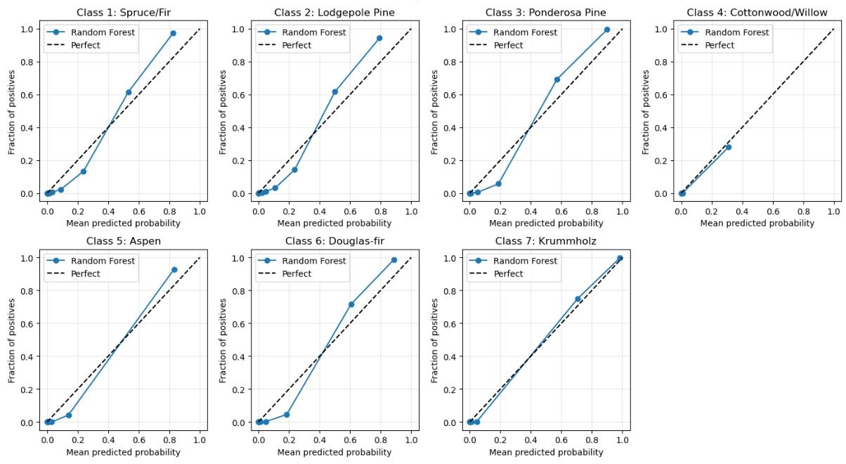
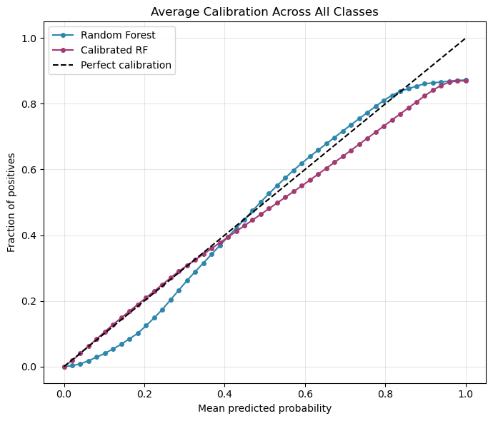
Model Calibration Analysis
Baseline Random Forest
RF ECE
HGB ECE
0.024
0.125
0.041
Brier score (higher = poorer)
Under-confident: 0.783 conf vs 0.908 acc
Best calibrated
Methodology Impact: RF shows systematic under-confidence (ECE=0.125, mean top-label conf=0.783 vs accuracy=0.908). HGB is well-calibrated (ECE=0.041). Platt (sigmoid) scaling on RF reduces Brier from 0.024→0.021. Paired McNemar test: χ²=41.5, p<0.001, confirming RF > HGB despite close absolute scores.
Performance varies by elevation band: accuracy 0.863→0.958. Cache la Poudre is hardest (F1=0.716).
Error predictions: mean confidence 0.582 vs 0.810 for correct predictions.
Notes:
This slide presents the results of our model calibration analysis.
On the left, you see two key visualizations: the top chart is the average calibration curve across all classes, comparing the baseline Random Forest against the calibrated model and the perfect calibration line (dashed). The bottom chart breaks this down by individual classes.
On the right, we highlight the quantitative improvement: the Brier Score dropped from 0.0240 to 0.0215 after applying Platt Scaling (Sigmoid calibration), which is a 10% reduction in error.
Key takeaways include: the baseline model was slightly overconfident, especially in the mid-probability range; the smallest class (Class 4) remains the most challenging to calibrate; and this calibration step is essential for applications where probability estimates directly inform business decisions.

Slide 13
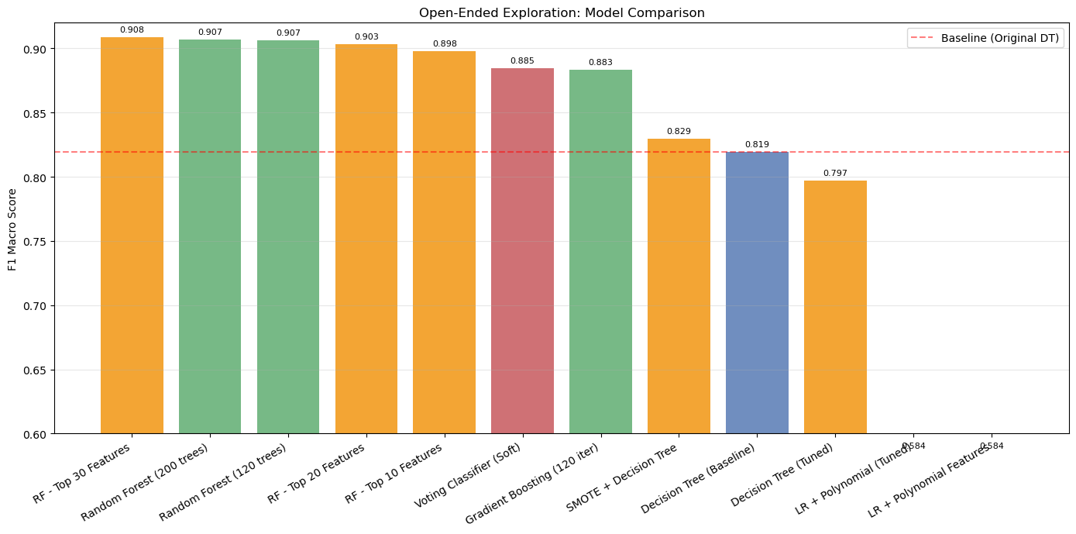
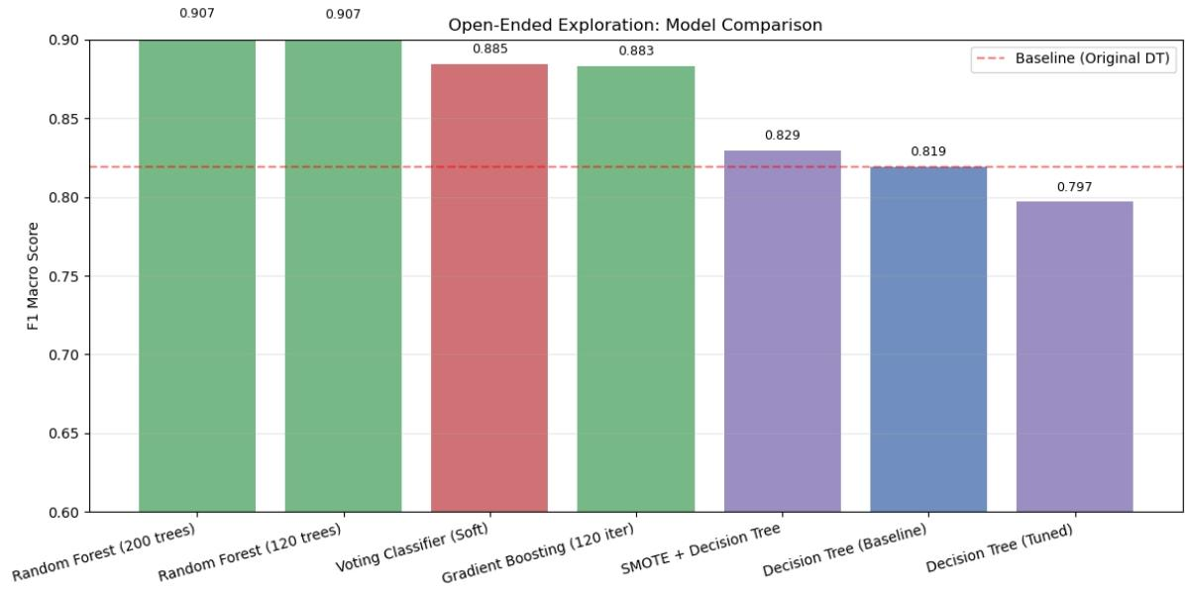
Advanced Model Performance Comparison
Visual Performance Breakdown
The bar chart displays F1 Macro scores across all tested models
Ensemble methods (Random Forest, Gradient Boosting) demonstrate a clear superiority over baseline Decision Trees (red dashed line)
Notably, Random Forest variants achieve the highest scores (0.908), significantly outperforming even tuned baselines and SMOTE-augmented models
Detailed Quantitative Metrics
Model Architecture | F1 Macro | AUC | Time (s)
RF – Top 30 features | 0.909 | - | -
Random Forest (200) | 0.907 | 0.9925 | 2.0
Random Forest (120) | 0.907 | 0.9923 | 1.6
Voting Classifier | 0.885 | - | -
Gradient Boosting (std) | 0.883 | - | 160.7
Peak Performance with Random Forest
RF model which obtain top 30 features achieved the highest F1 (0.908), setting a new benchmark, while the 120-tree variant matched the 200-tree model's accuracy but trained 30% faster, making it the most efficient choice.
Trade-off: Speed vs. Complexity
Gradient Boosting, while competitive in score, had a prohibitive training time (160s+), unsuitable for real-time applications. Simple baselines (Decision Tree) were fast but underperformed significantly.
Notes:
This slide presents a comprehensive comparison of various machine learning models evaluated for our task.
Looking at the bar chart on the top left, we can see a clear hierarchy of performance. The Random Forest models with top 30 features stand out with the highest F1 Macro scores of 0.909.
The table on the bottom left provides detailed metrics. Notice that the Random Forest with 120 trees performs identically to the 200-tree version in terms of F1 score (0.907) and AUC (0.992), but it trains 30% faster (1.4 seconds vs 2.0 seconds). This is a crucial efficiency gain.
In contrast, Gradient Boosting, while competitive in accuracy, has a very long training time of over 160 seconds, which is impractical for scenarios requiring quick retraining or real-time inference.
Baseline models like the standard Decision Tree lag significantly behind, highlighting the value of ensemble methods like Random Forest for this problem.

Slide 14
07 Conclusion and Future Outlook
Key Conclusions
Best Model Performance The Random Forest model demonstrated exceptional performance, achieving an accuracy of 0.908and a macro-average F1-score of 0.908, showing high stability in multi-class classification.
Topographic Factors Drive Predictions
Elevation is the most critical predictor; topographic features decisively shape classification results.
Comprehensive Evaluation with Metrics
Limitations
Sample covers ~17% of full dataset (97,950 / 581,012)
Bootstrap CIs do NOT overlap; McNemar p<0.001 confirms RF > HGB
Full-data SOTA (gradient boosting): 0.95–0.96 accuracy — a gap remains
30k-subset tuning degrades all model classes; Optuna Bayesian optimization tested (DT only); AutoML on ensemble models not explored
t-SNE distorts global distances; PCA verification provided
Supervised Learning is Essential Due to the complexity and hidden patterns in the data, unsupervised learning falls short of guaranteeing accuracy. Supervised learning is the core path to achieving the project's goals.
Future Work Outlook
Deepen Feature Engineering & Mining Construct diverse feature combinations (terrain, climate, environment) to explore deeper data relationships and enhance the model's information extraction capabilities.
Explore Multi-model Fusion Strategies Experiment with stacking and weighted voting to combine multiple models, leveraging different algorithms' strengths to reduce bias and enhance robustness.
Refine Hyperparameter Tuning Utilize grid search and Bayesian optimization to fine-tune hyperparameters (depth, nodes) of the Random Forest, releasing the model's full potential.
Optimize for Minority Classes Introduce SMOTE oversampling and class weight adjustment to solve sample imbalance, improving recognition accuracy and recall for minority classes.
Notes:
最后，对本次项目进行总结。我们的主要结论是：随机森林是最佳模型；无监督学习在此任务中无效；海拔是最关键的预测因子；并且在评估模型时必须考虑数据不均衡性。对于未来的工作，我们可以从特征工程、超参数调优、模型融合和处理少数类等方面进一步提升模型性能。

Slide 15
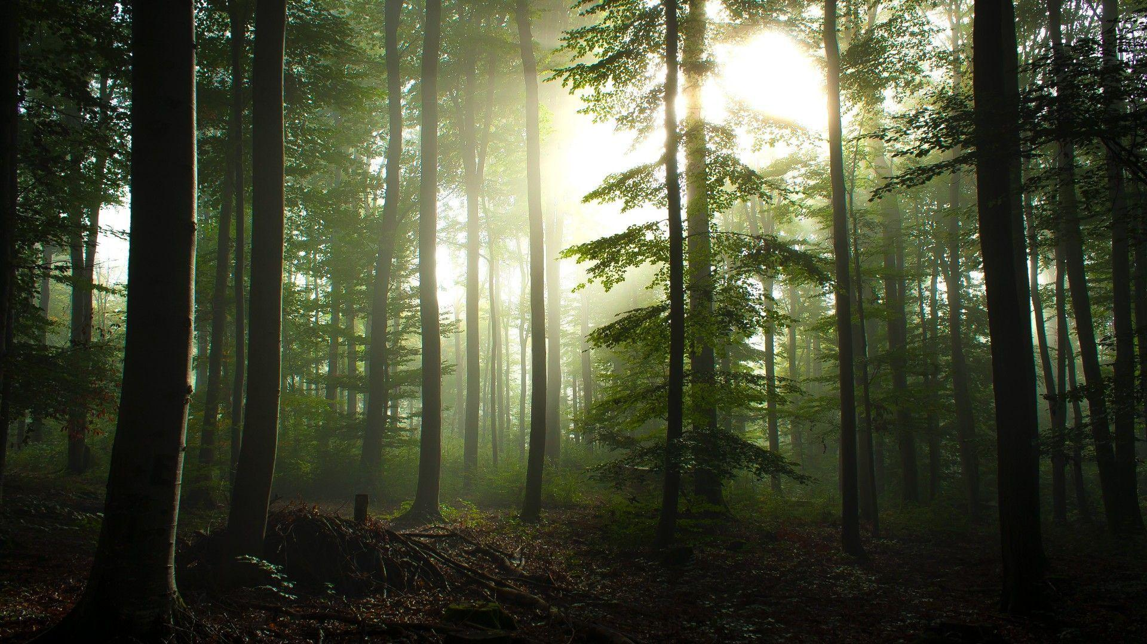
Q&A
Thank You
Welcome questions and discussions
Notes:
我的报告到此结束，感谢大家的聆听。现在是问答环节，欢迎大家提问。

