Slide 1
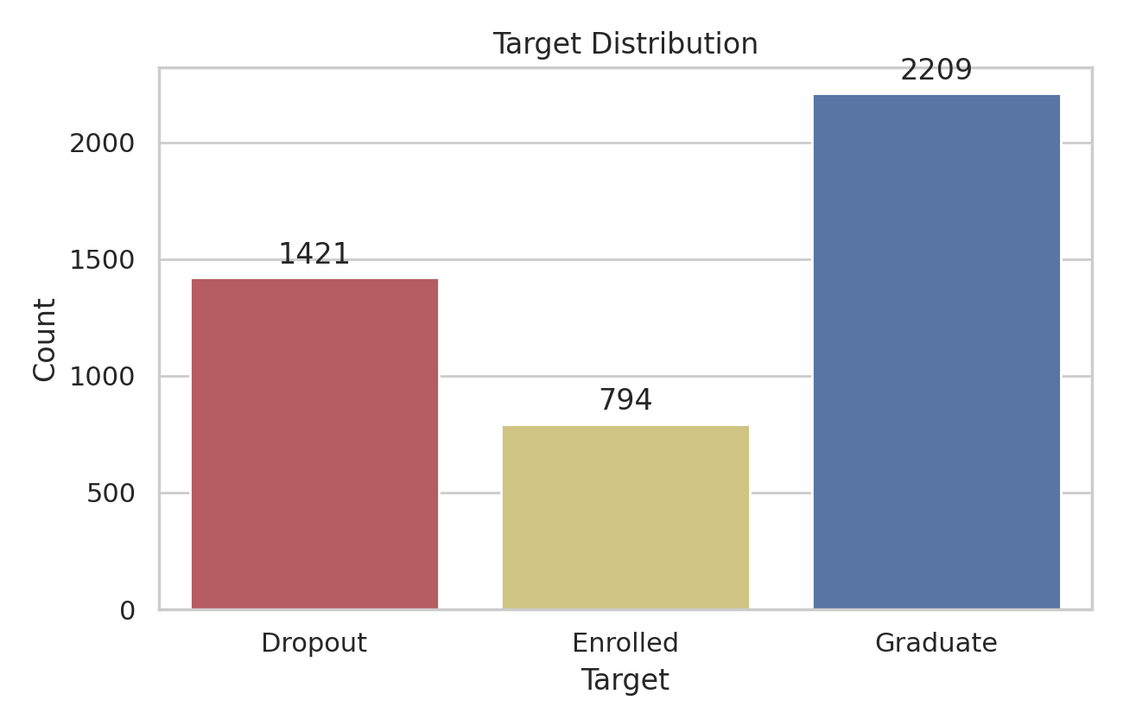
Introduction
Student dropout risk analysis with reproducible ML workflow
4424
36
96
Students
Raw features
Processed features
Target distribution: Dropout 1421, Enrolled 794, Graduate 2209.
Pipeline: preprocessing, t-SNE, clustering, binary prediction, validation, open exploration.
Main supervised task: detect Dropout against Graduate after excluding uncertain Enrolled labels.
DSAA2011 Student Dropout | 1/6

Slide 2
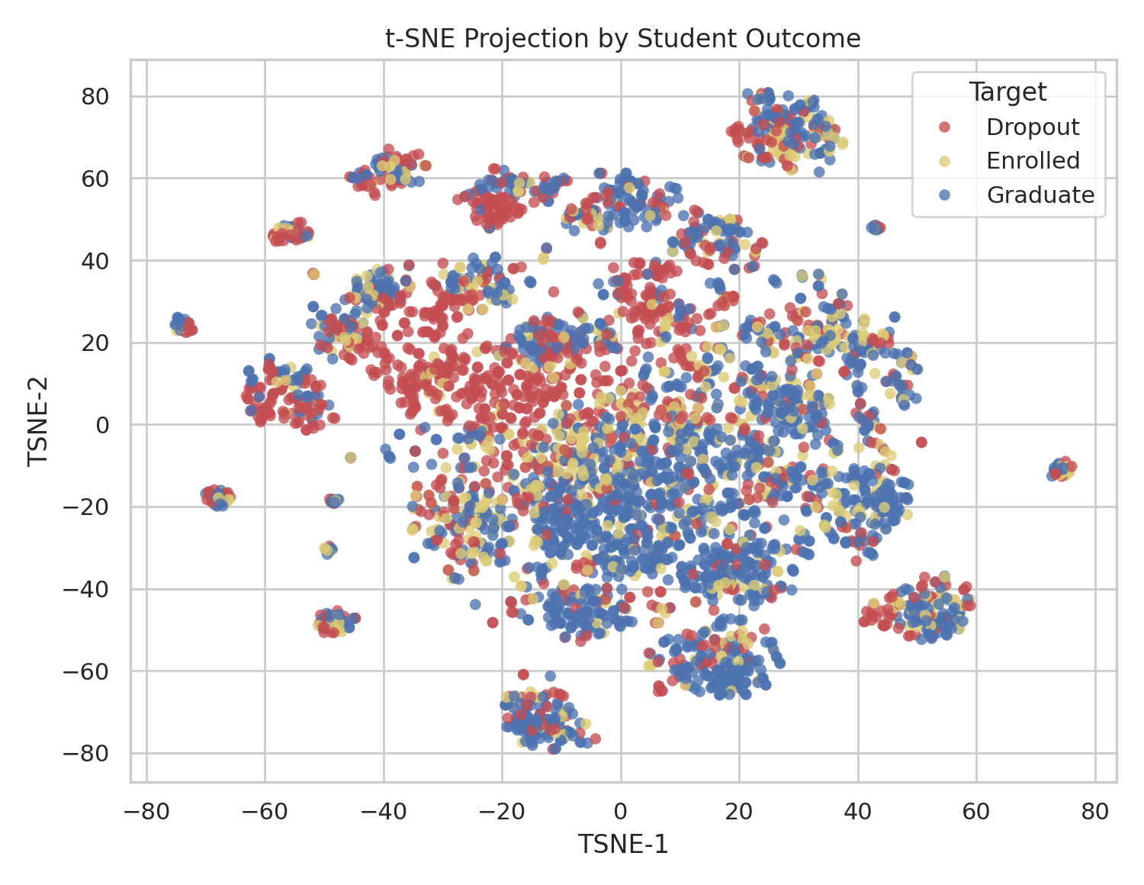
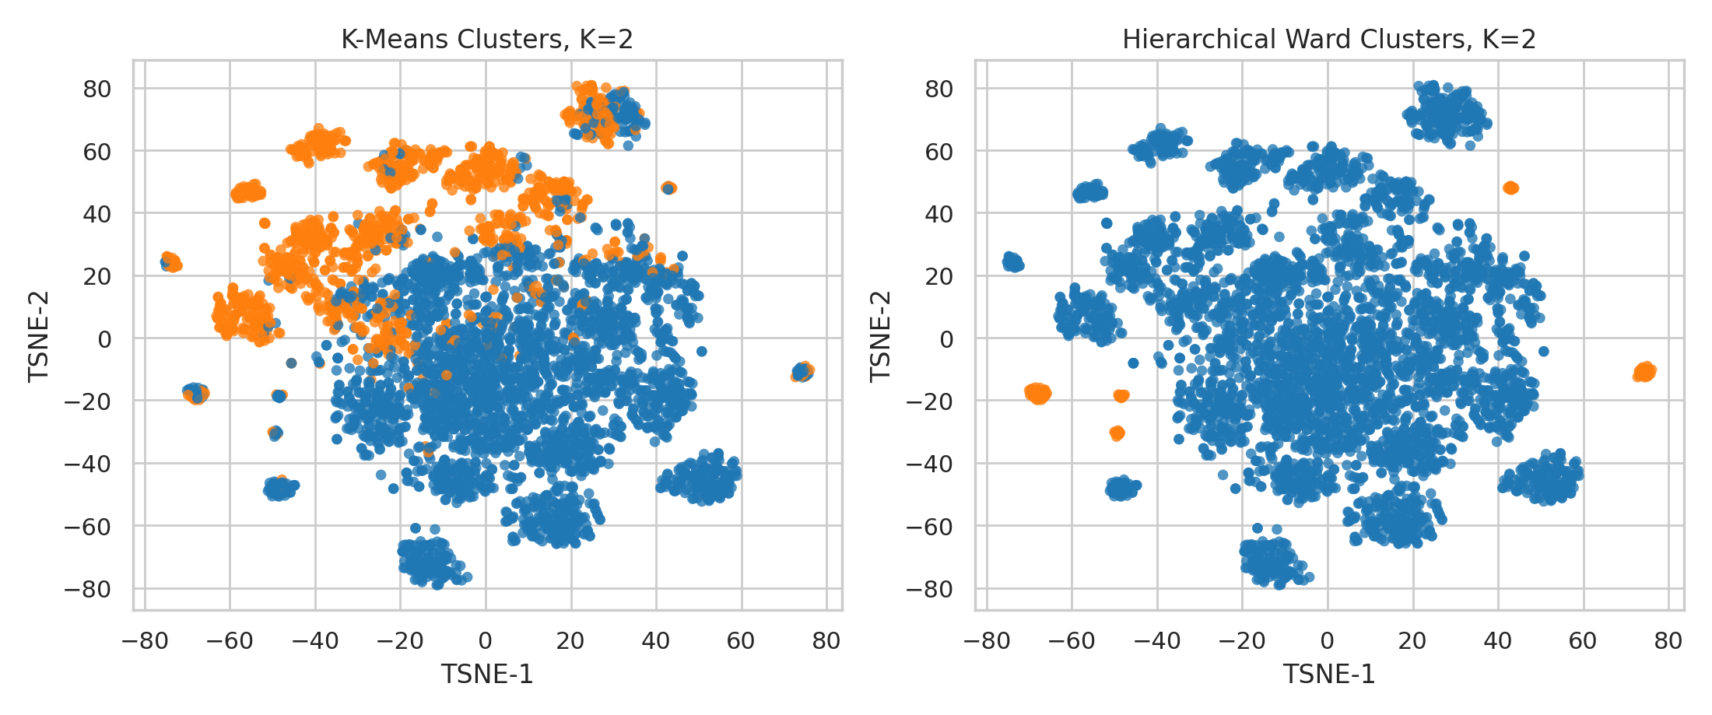
t-SNE & Clustering
Local structure is visible, but true labels remain strongly overlapped
Algorithm
K
Sil.
ARI
Both methods select K=2, suggesting a coarse high-risk vs lower-risk split.
K-Means
2
0.111
0.072
Ward has stronger internal separation; K-Means aligns better with true labels by ARI.
Ward
2
0.411
0.001
Low ARI confirms that natural clusters are not equivalent to academic outcomes.
DSAA2011 Student Dropout | 2/6

Slide 3
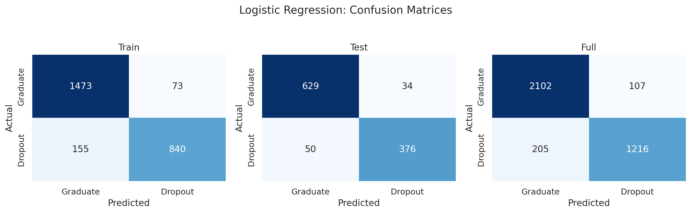

Prediction Results
Confusion matrices for train, test, and full binary data
Binary target: Dropout is positive, Graduate is negative.
Logistic regression test matrix: 376 true Dropout detected, 50 missed.
Decision tree test matrix: 342 true Dropout detected, 84 missed.
DSAA2011 Student Dropout | 3/6

Slide 4
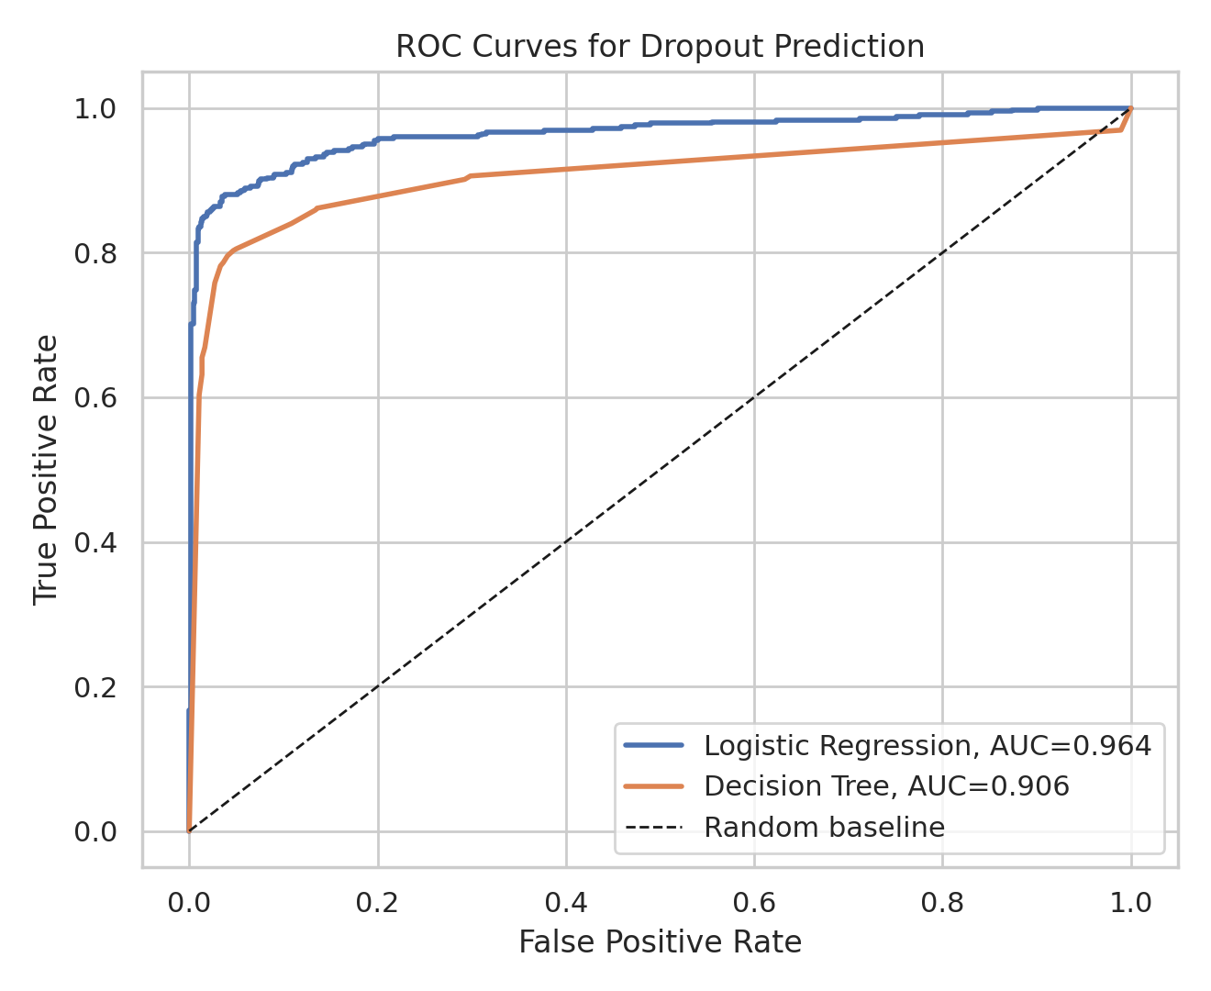
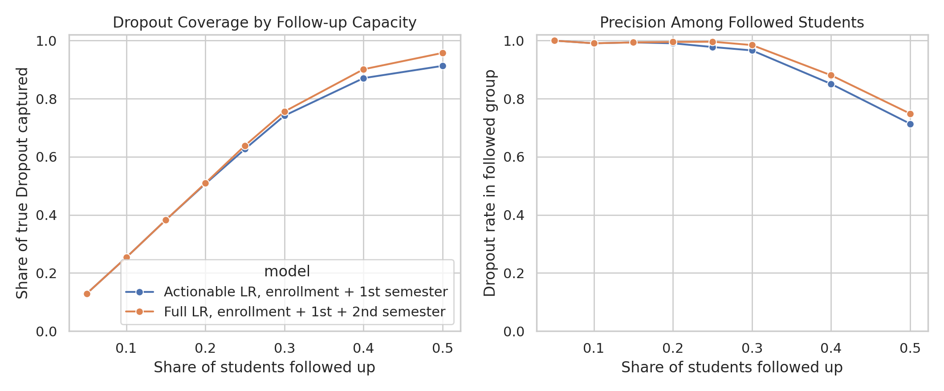
Evaluation & Intervention
ROC/AUC plus coverage under limited advising capacity
Model
Acc.
Recall
F1
AUC
Logistic
0.923
0.883
0.900
0.964
Tree
0.894
0.803
0.856
0.906
RF tuned
0.921
0.857
0.895
0.958
5-fold CV AUC: logistic 0.951±0.006, tree 0.914±0.004.
Top 25% actionable first-semester follow-up covers 0.627 of true Dropout cases.
Full second-semester model covers 0.638 at the same capacity, but is later for prevention.
DSAA2011 Student Dropout | 4/6

Slide 5
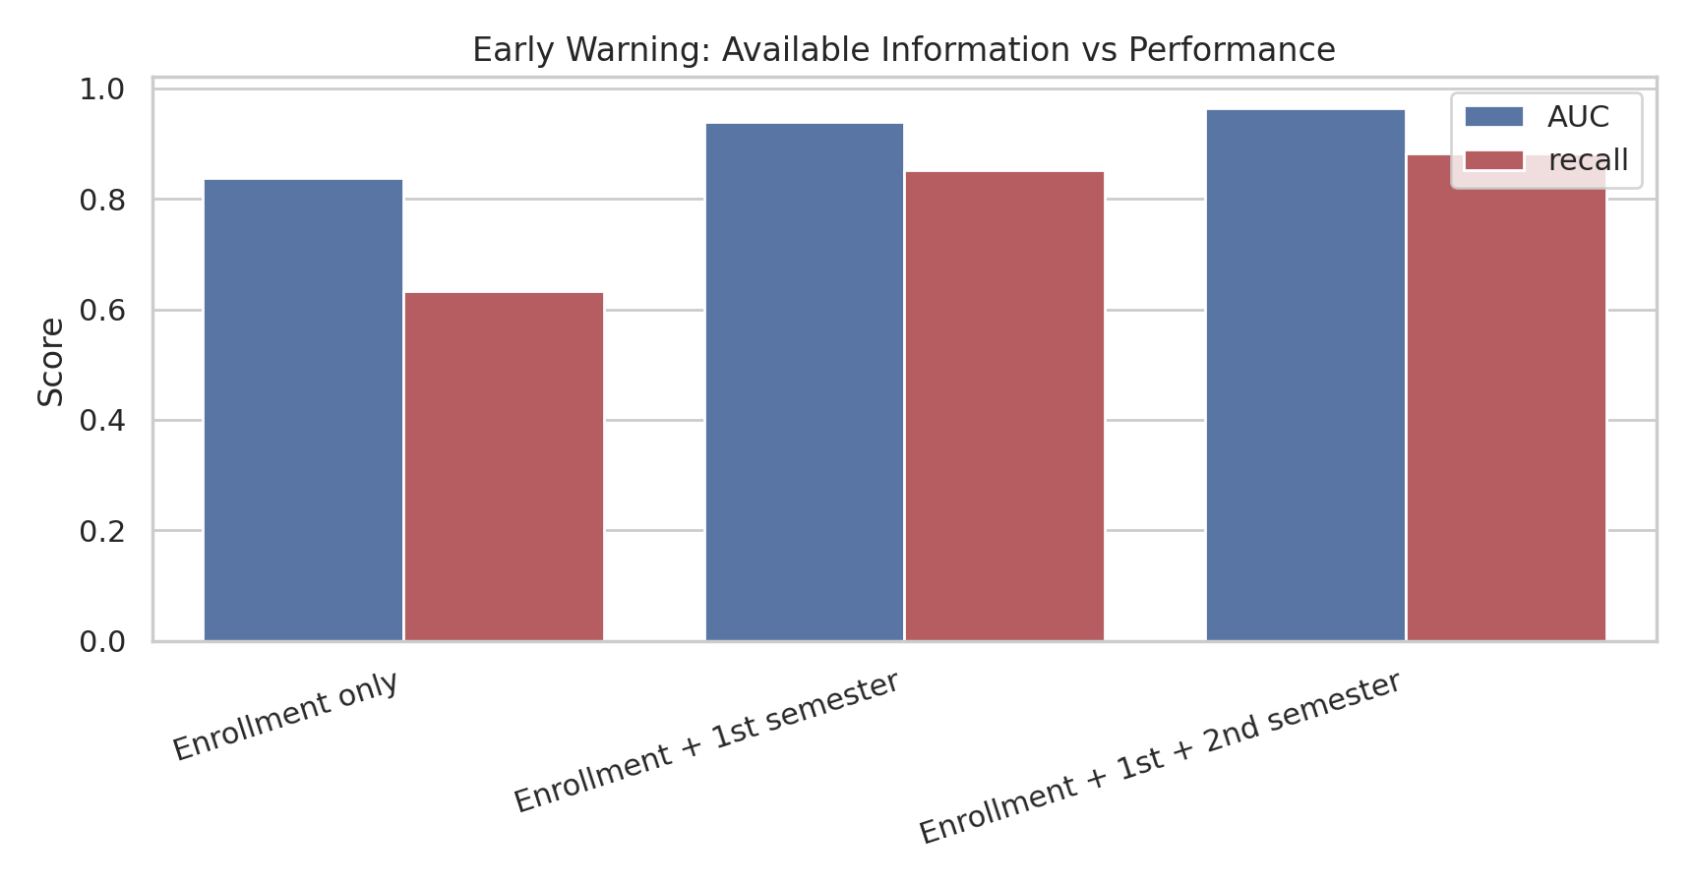
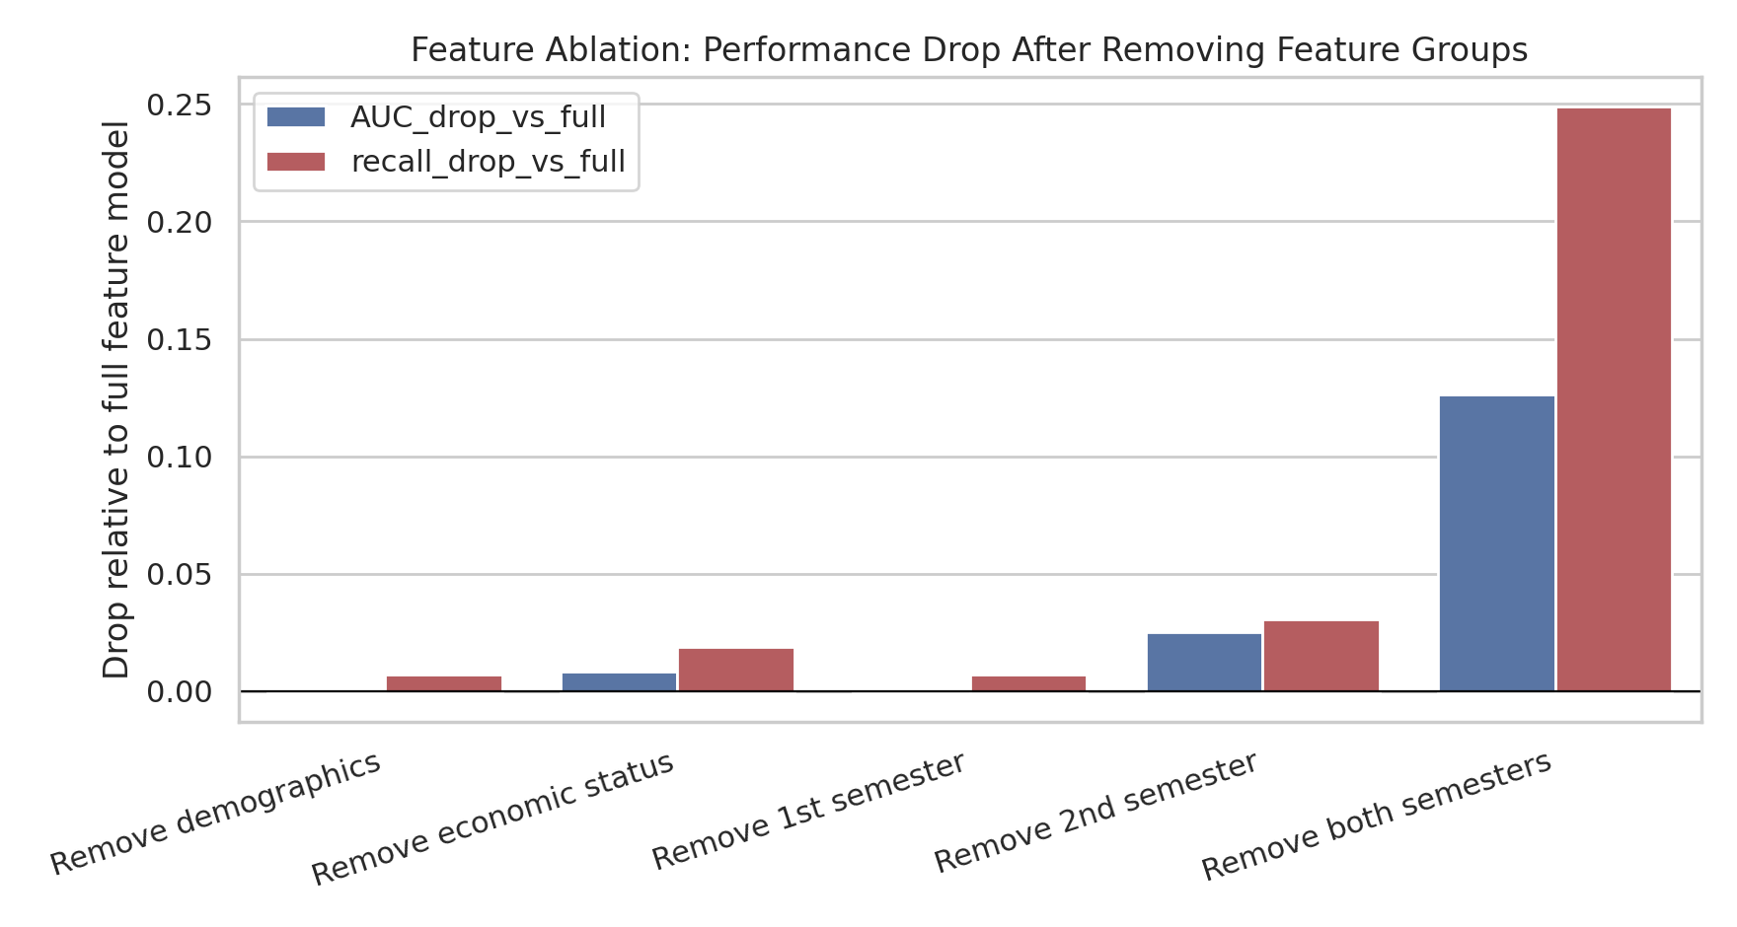
Early Warning & Ablation
The first semester is the practical intervention window
Enrollment-only AUC 0.838 rises to 0.939 after first-semester data.
Adding second-semester data reaches AUC 0.964, useful but later for intervention.
Removing both semesters drops recall by 0.249; removing second semester drops AUC by 0.025.
DSAA2011 Student Dropout | 5/6

Slide 6
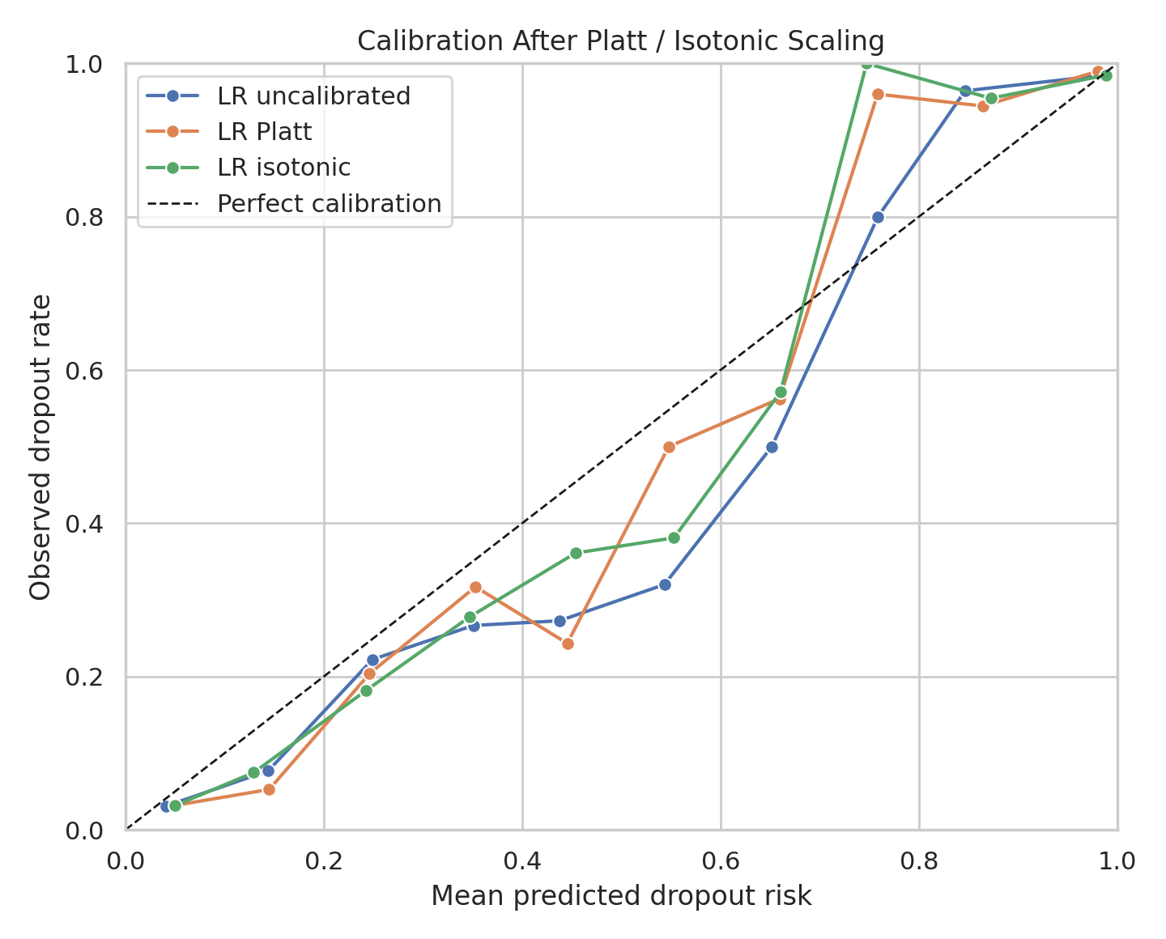
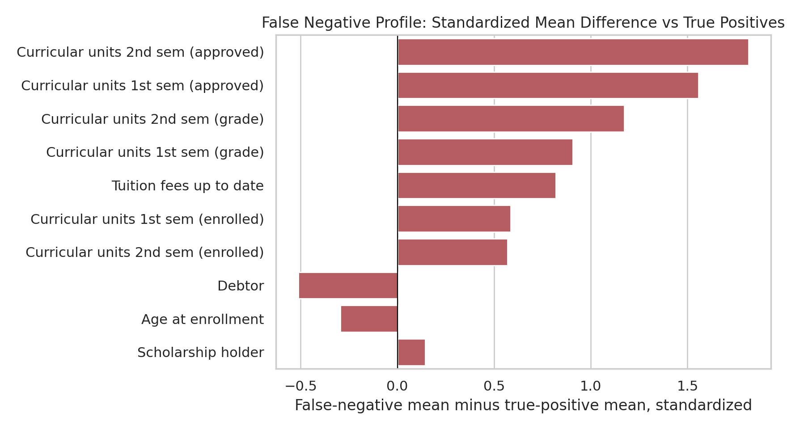
Trustworthy Explanation & Risk
Calibrated probability, uncertainty, and failure-mode analysis
Deployment Checks
0.057
best Brier score
0.951-0.976
LR AUC 95% CI
50 FN
missed Dropout cases
Counterfactual-style scenario: tuition up-to-date and +3 approved units lowers predicted risk by 0.166 on average.
False negatives look stronger academically; top FN contrast is Curricular units 2nd sem (approved).
Dataset: UCI Predict Students' Dropout and Academic Success | Tools: pandas, scikit-learn, matplotlib, seaborn, imbalanced-learn
DSAA2011 Student Dropout | 6/6

