Slide 1
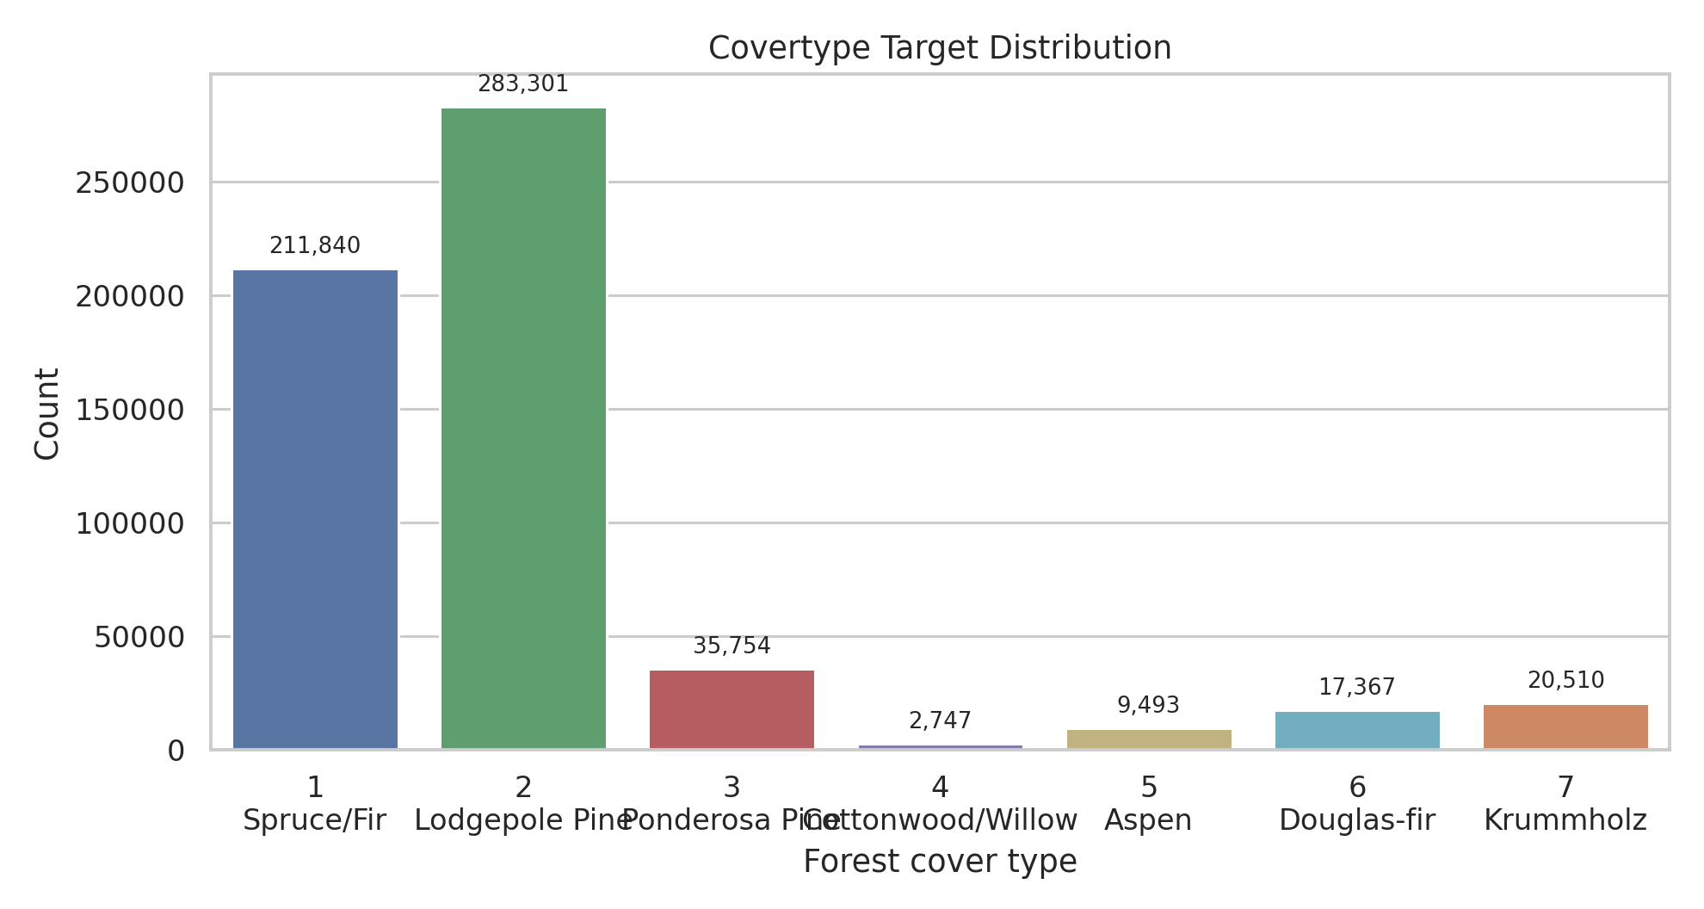
Covertype Forest Cover Analysis
DSAA2011 machine learning project
581,012
54
7
rows
features
cover classes
0.845
0.902
0.991
best macro-F1
best accuracy
macro AUC
Natural clusters reveal terrain structure but do not recover the seven labels.
Wilderness Area analysis adds a regional robustness view.
Random Forest is the best classifier on the stratified test set.
Elevation, road/fire/hydrology distances, hillshade, soil context, and region explain errors.
DSAA2011 Covertype Project | 1

Slide 2
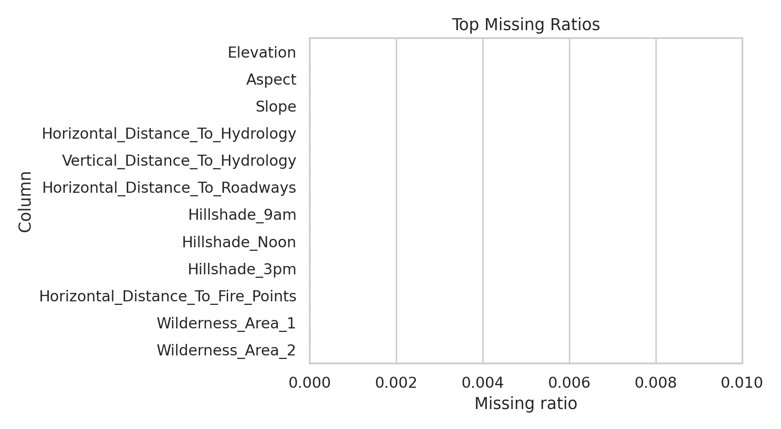
Dataset and Preprocessing
UCI Covertype: cartographic measurements with a seven-class forest cover target
1 Spruce/Fir: 211,840 (36.5%)
2 Lodgepole Pine: 283,301 (48.8%)
3 Ponderosa Pine: 35,754 (6.2%)
4 Cottonwood/Willow: 2,747 (0.5%)
5 Aspen: 9,493 (1.6%)
6 Douglas-fir: 17,367 (3.0%)
7 Krummholz: 20,510 (3.5%)
No missing values after parsing; maximum missing ratio is 0.000.
10 continuous terrain features are standardized for linear and distance-based methods.
4 wilderness and 40 soil indicators are already one-hot encoded.
Large-scale steps use stratified samples to preserve class proportions while keeping runtime reproducible.
DSAA2011 Covertype Project | 2

Slide 3
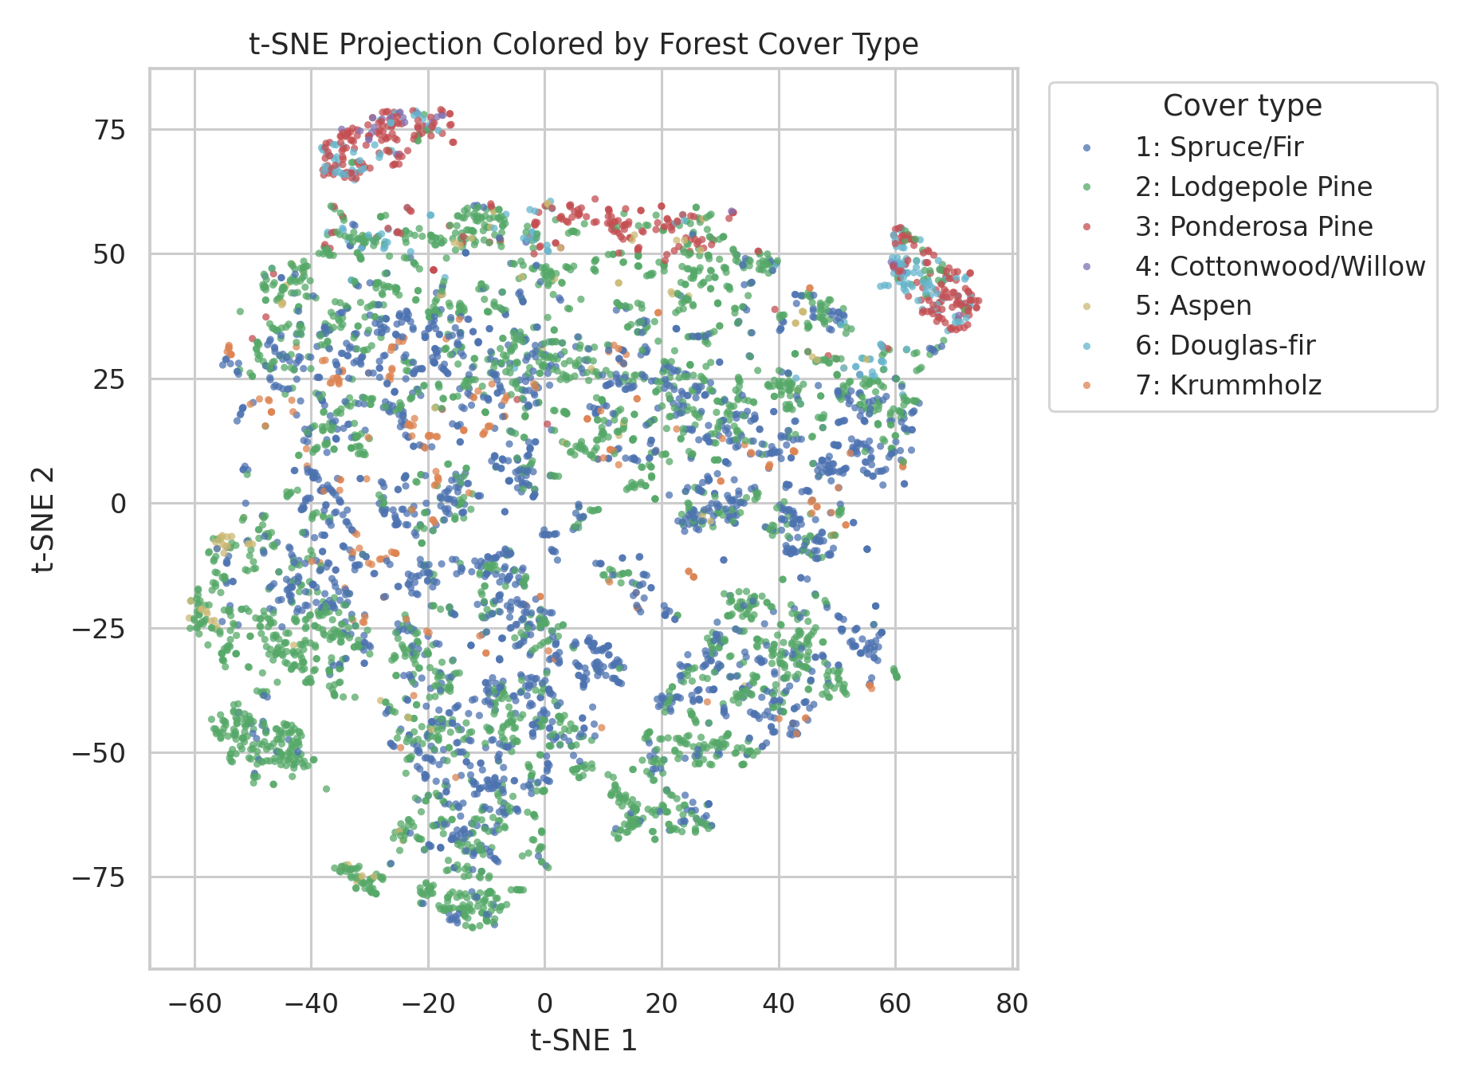
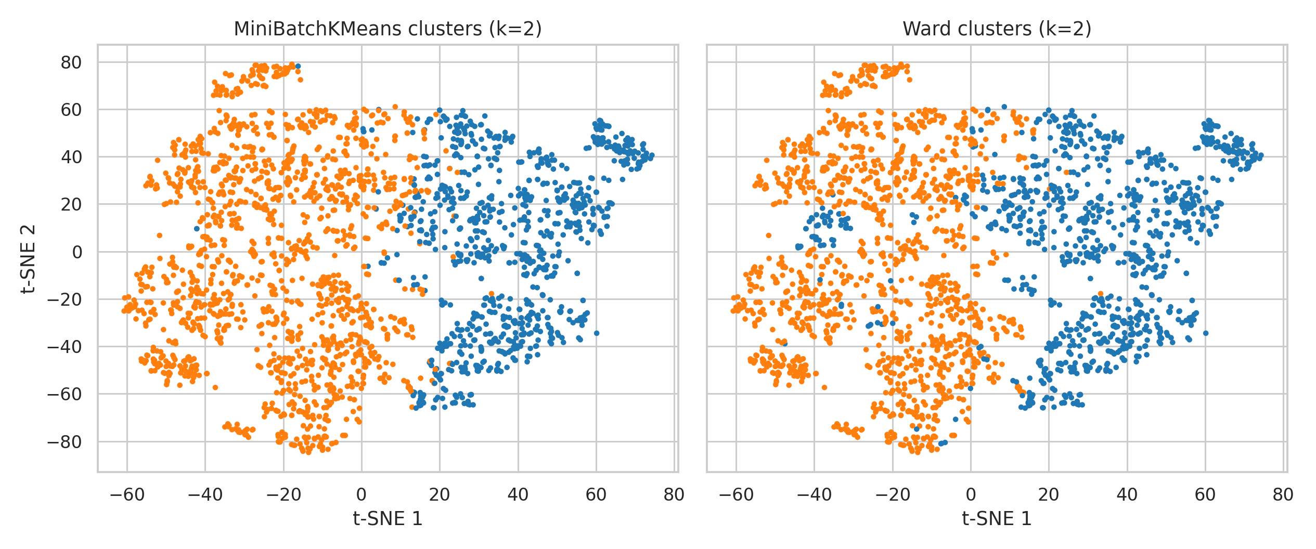
Visualization and Clustering
t-SNE shows partial local structure; clusters are not the same as cover labels
MiniBatchKMeans: k=2, silhouette=0.191, ARI target=0.003, ARI wild=0.039
Agglomerative Ward: k=2, silhouette=0.153, ARI target=0.004, ARI wild=0.013
Near-zero ARI versus Cover_Type only means the natural partitions do not reproduce the supervised labels.
ARI versus Wilderness is also modest, so clusters are better read as coarse terrain/region mixtures.
DSAA2011 Covertype Project | 3

Slide 4
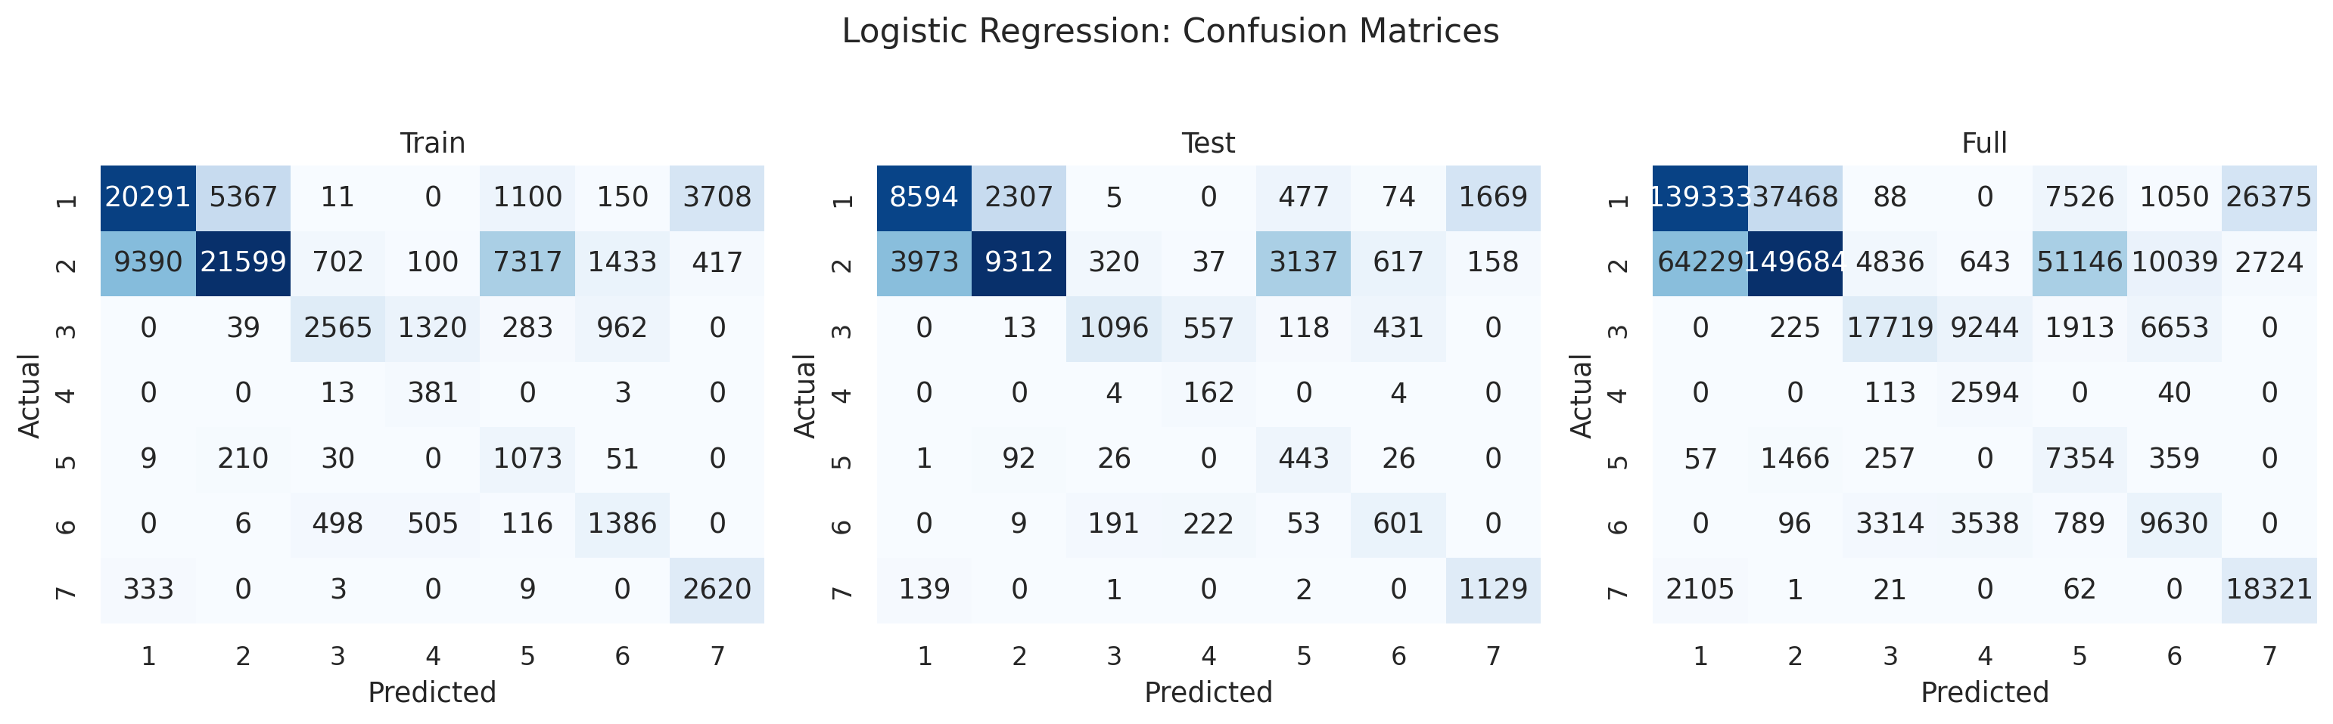
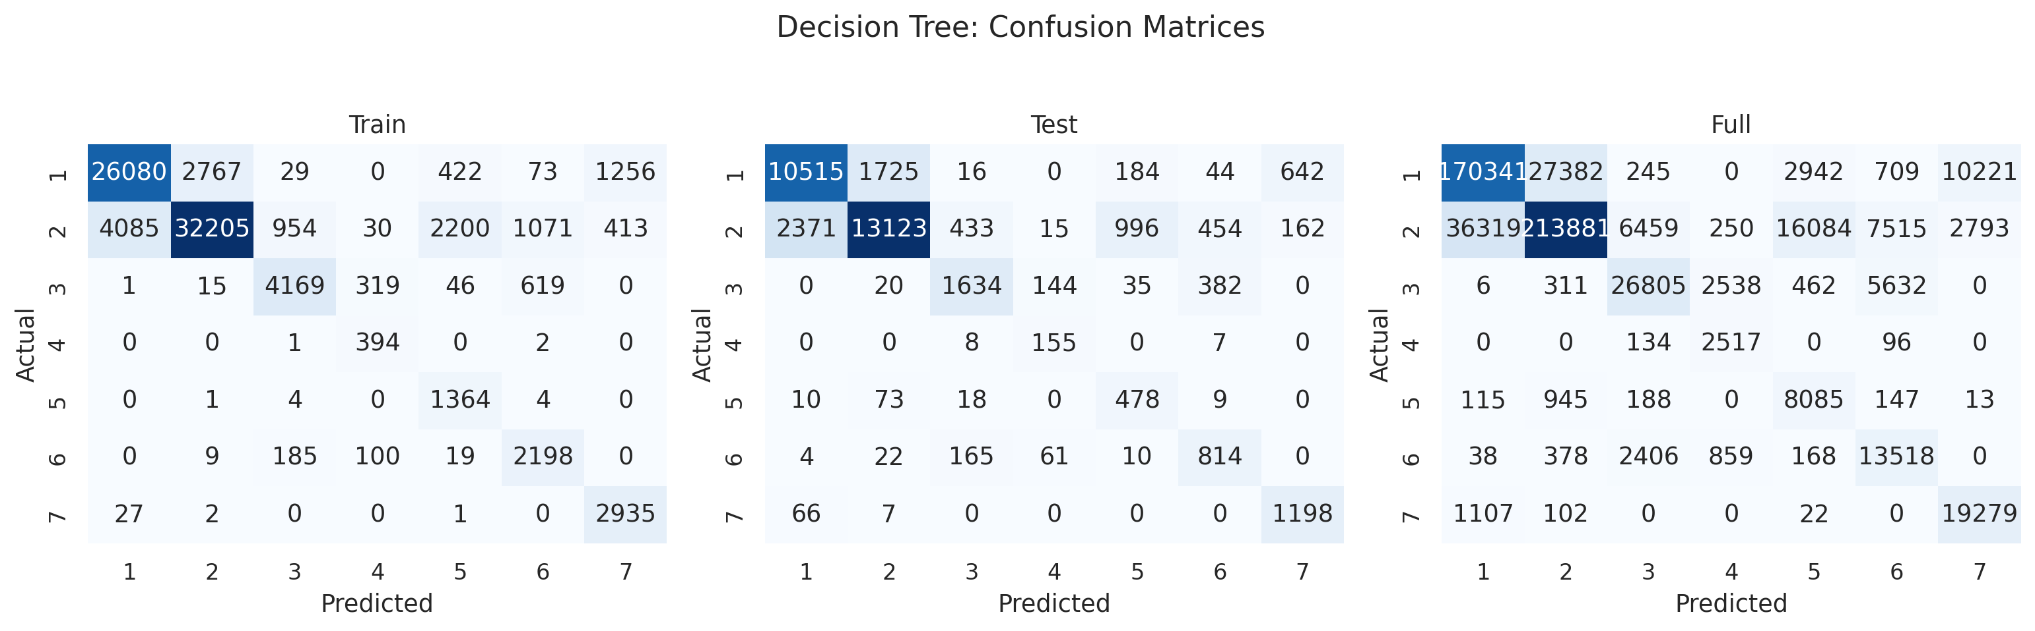
Simple Prediction Models
Logistic regression is a linear baseline; decision tree captures nonlinear splits
Logistic Regression: accuracy=0.593, macro-F1=0.471, macro AUC=0.923
Decision Tree: accuracy=0.775, macro-F1=0.663, macro AUC=0.942
Logistic regression reaches high macro AUC but weak class-level F1.
The decision tree improves nonlinear separation but still lags tree ensembles.
Both simple models are evaluated on train, test, and the full dataset after training.
DSAA2011 Covertype Project | 4

Slide 5
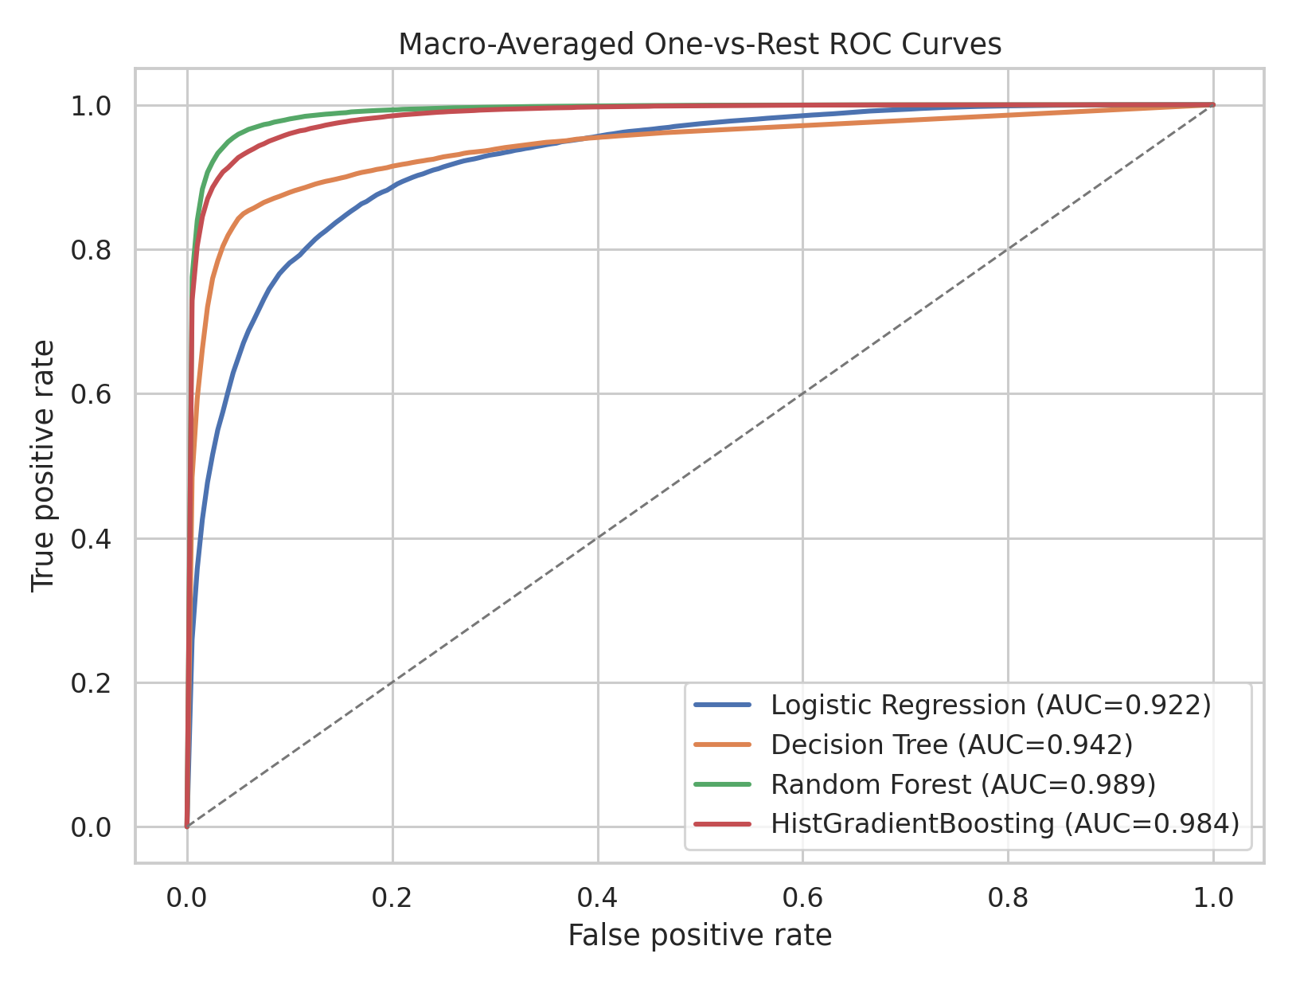
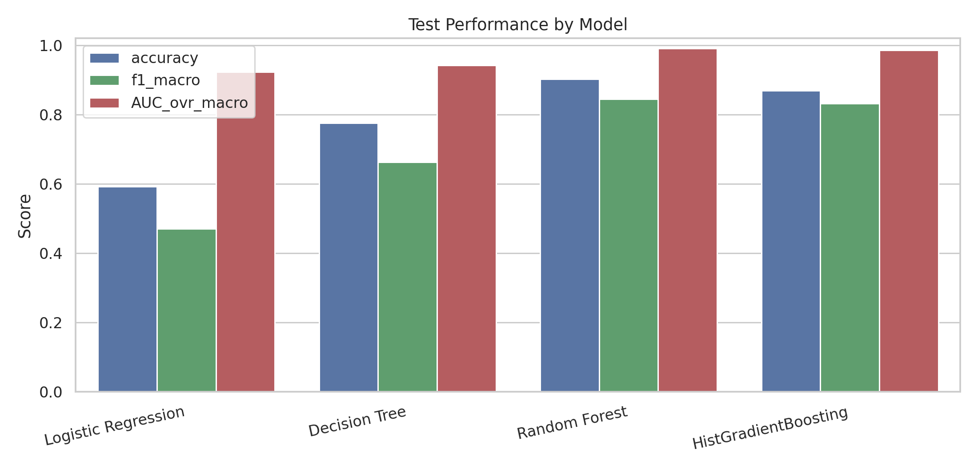
Model Choice
Random Forest gives the best test macro-F1 and macro one-vs-rest AUC
Logistic Regression: acc=0.593, macro-F1=0.471, AUC=0.923
Decision Tree: acc=0.775, macro-F1=0.663, AUC=0.942
Random Forest: acc=0.902, macro-F1=0.845, AUC=0.991
HistGradientBoosting: acc=0.869, macro-F1=0.831, AUC=0.985
Cross-validation keeps the same ranking: Random Forest first, HistGradientBoosting second.
Macro metrics matter because Cottonwood/Willow and Aspen are rare.
DSAA2011 Covertype Project | 5

Slide 6
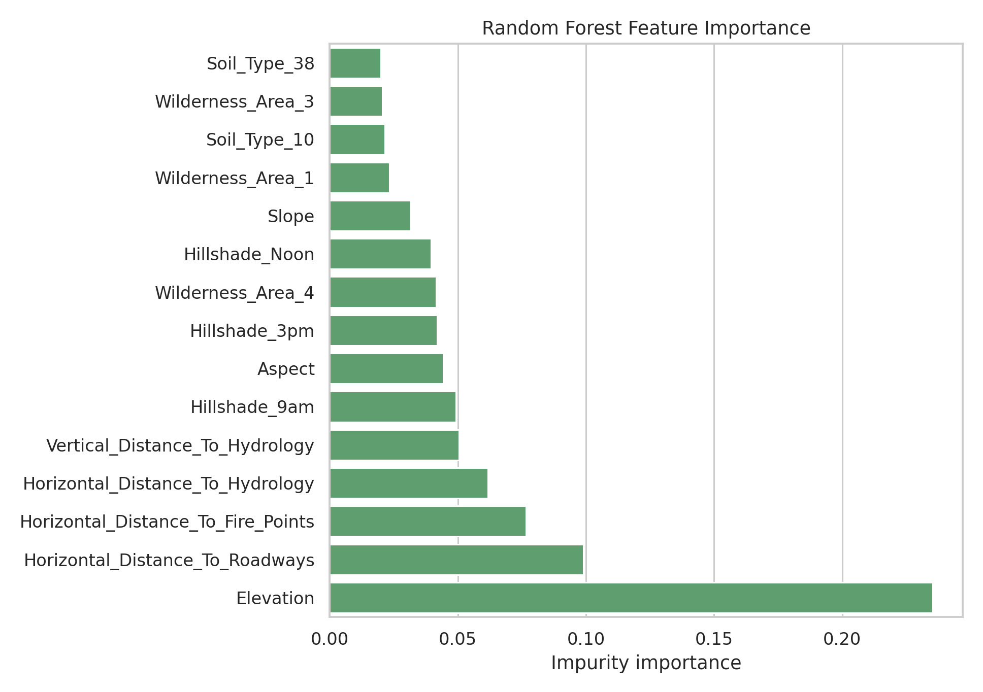
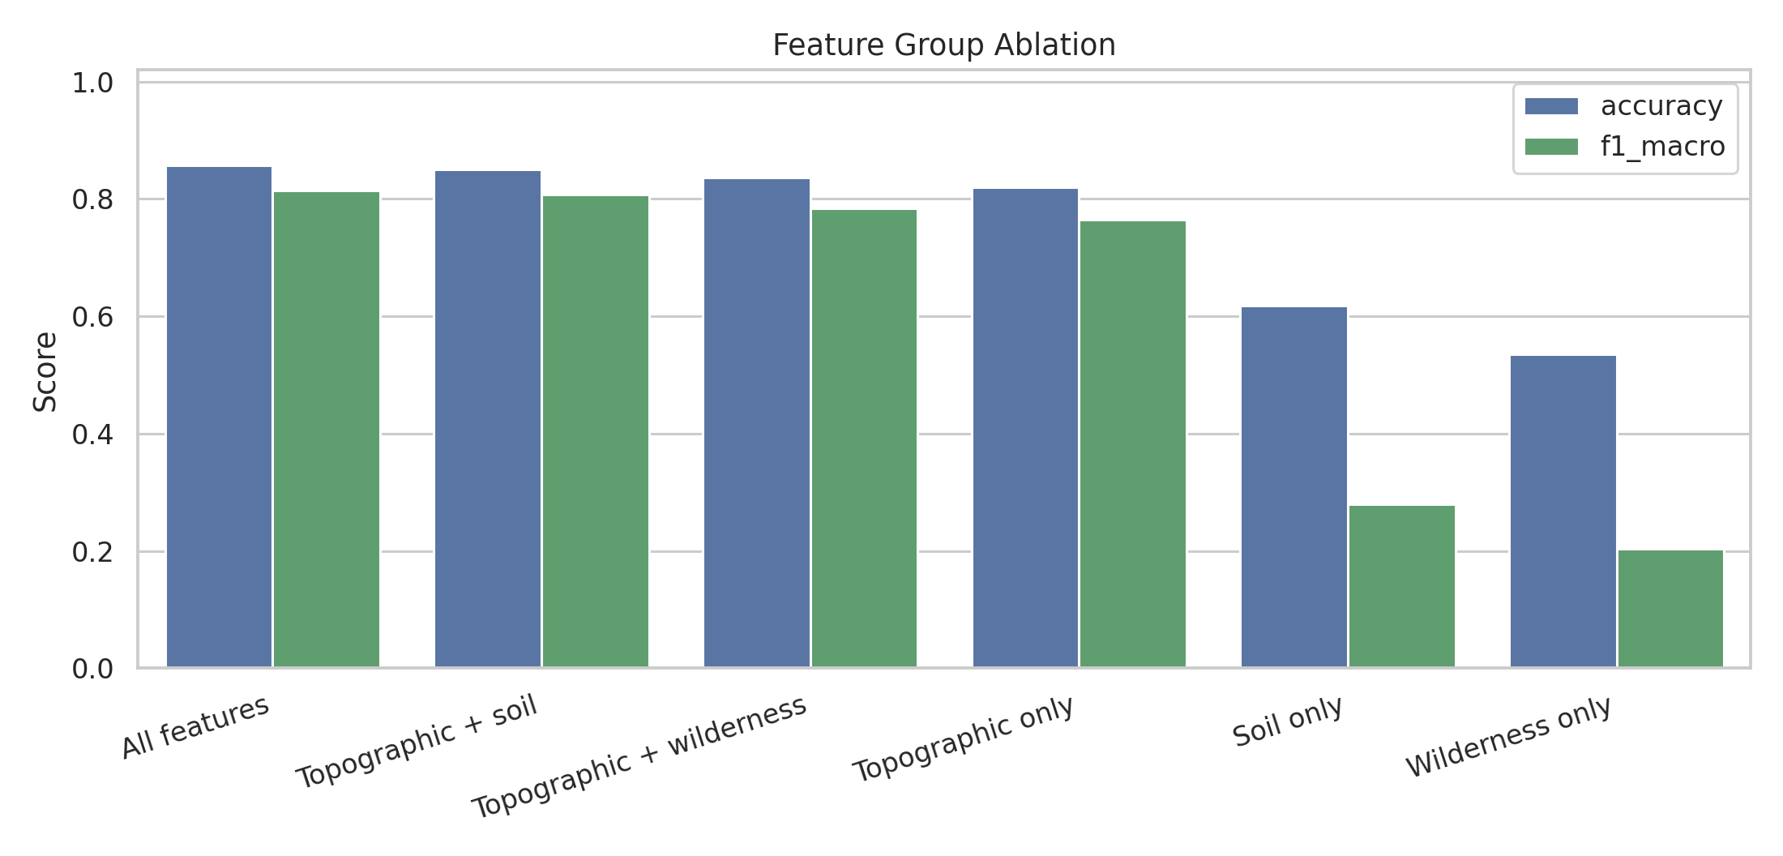
What Drives Cover Type?
Topography dominates, but soil indicators recover meaningful extra signal
1. Elevation (0.235)
2. Horizontal_Distance_To_Roadways (0.099)
3. Horizontal_Distance_To_Fire_Points (0.077)
4. Horizontal_Distance_To_Hydrology (0.062)
5. Vertical_Distance_To_Hydrology (0.050)
All features: F1=0.815
Topographic + soil: F1=0.807
Topographic + wilderness: F1=0.784
Topographic only: F1=0.764
DSAA2011 Covertype Project | 6

Slide 7
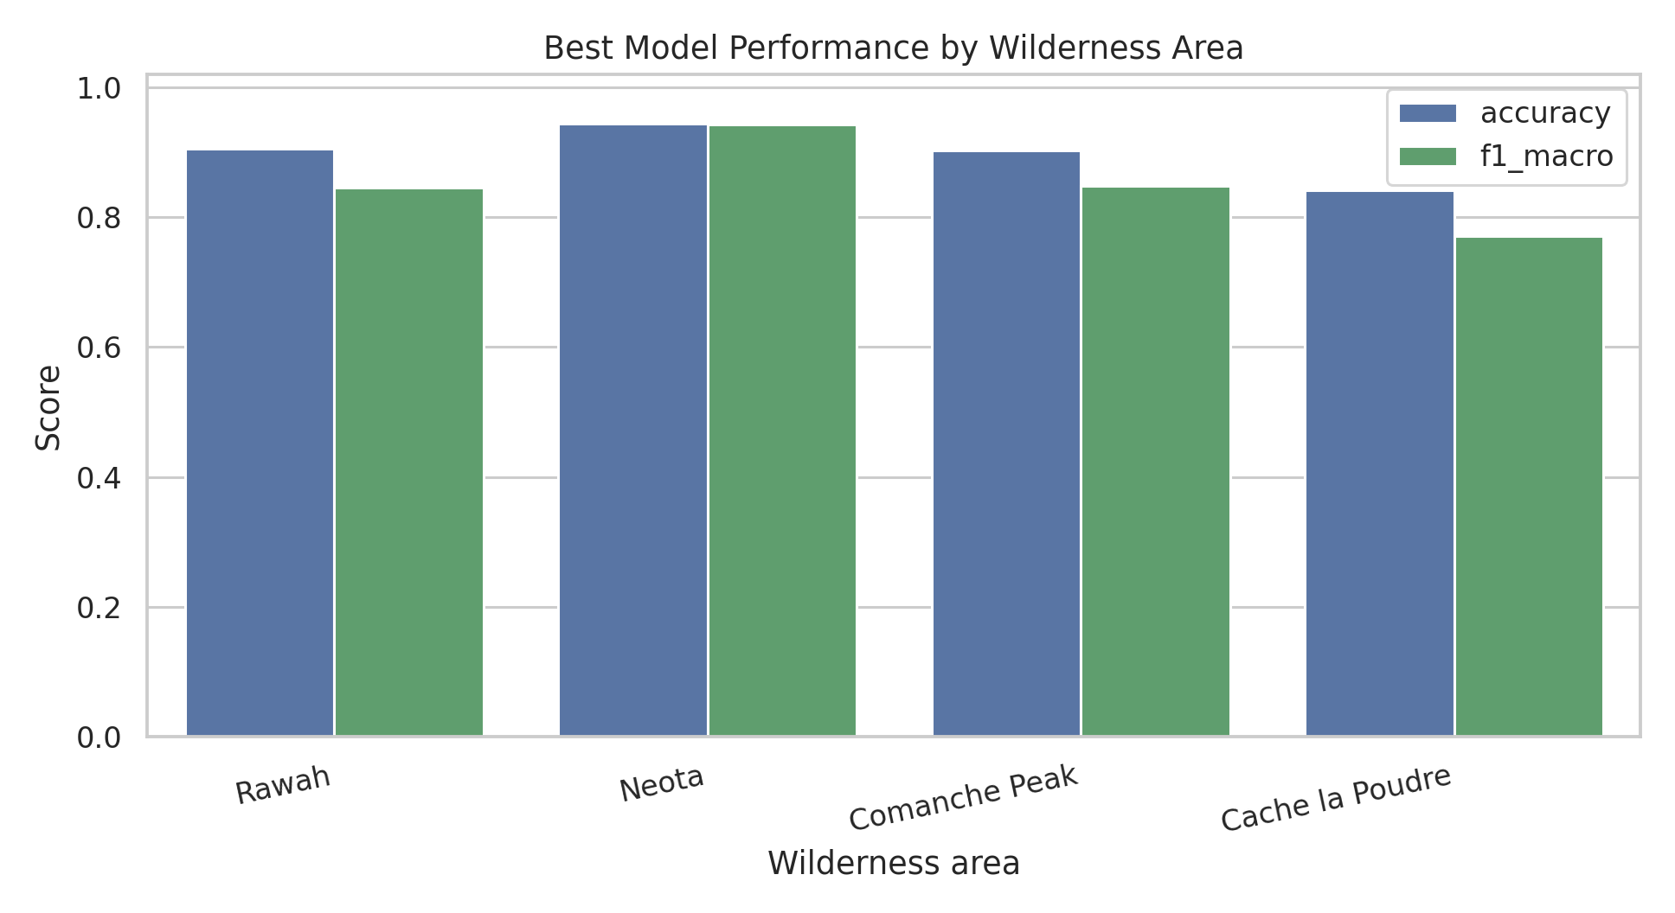
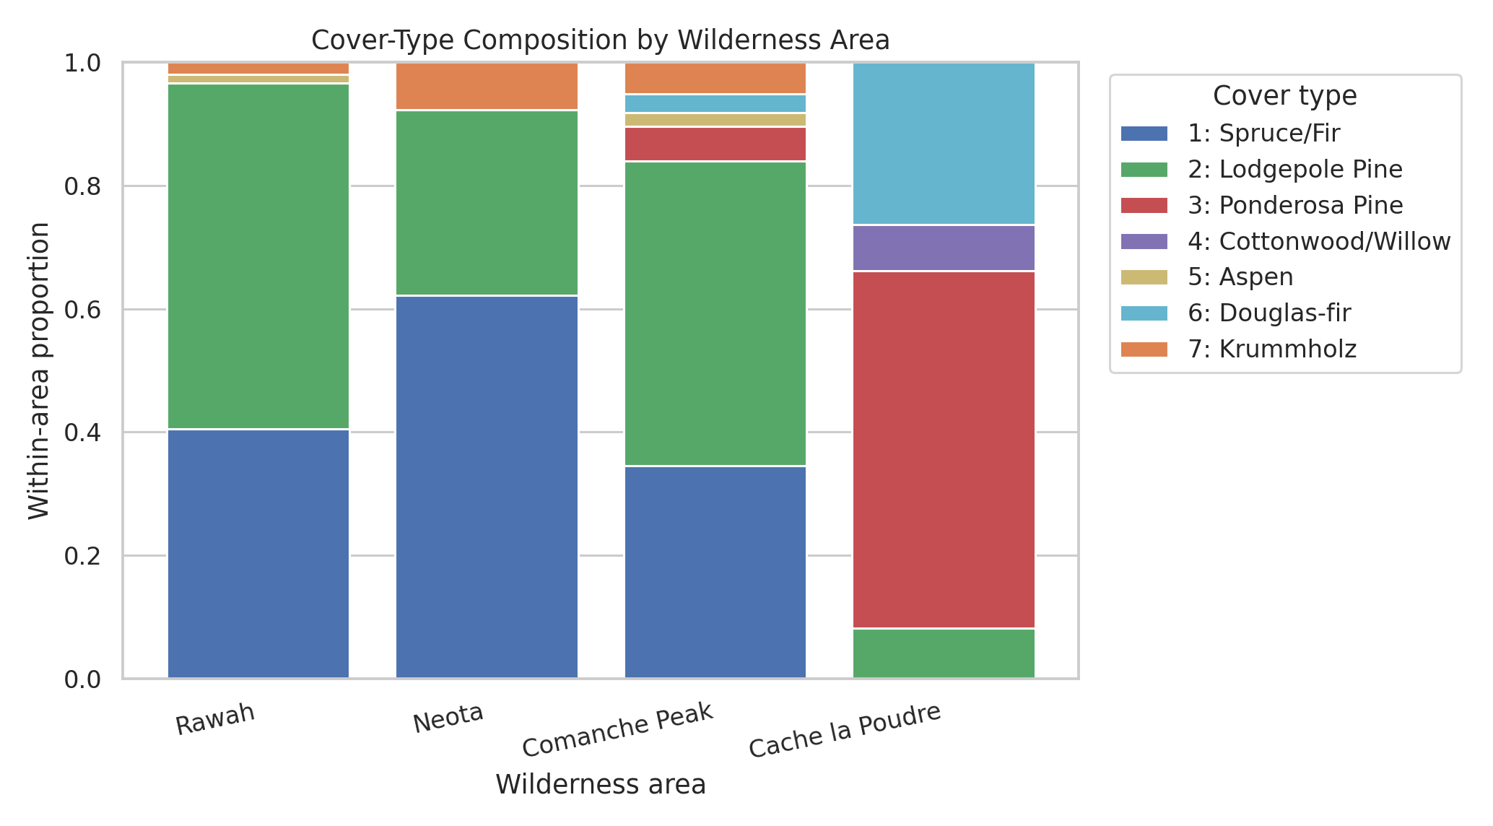
Wilderness Area Extension
Regional composition and held-out performance explain where the model is easier or harder
Hardest held-out area: Cache la Poudre, macro-F1 0.771.
Regional evaluation checks robustness beyond aggregate test accuracy.
Wilderness indicators alone are weak predictors, but the area split is useful for interpretation.
Rawah: 44.9%, dominant Lodgepole Pine (56.1%)
Neota: 5.1%, dominant Spruce/Fir (62.2%)
Comanche Peak: 43.6%, dominant Lodgepole Pine (49.4%)
Cache la Poudre: 6.4%, dominant Ponderosa Pine (58.0%)
DSAA2011 Covertype Project | 7

Slide 8
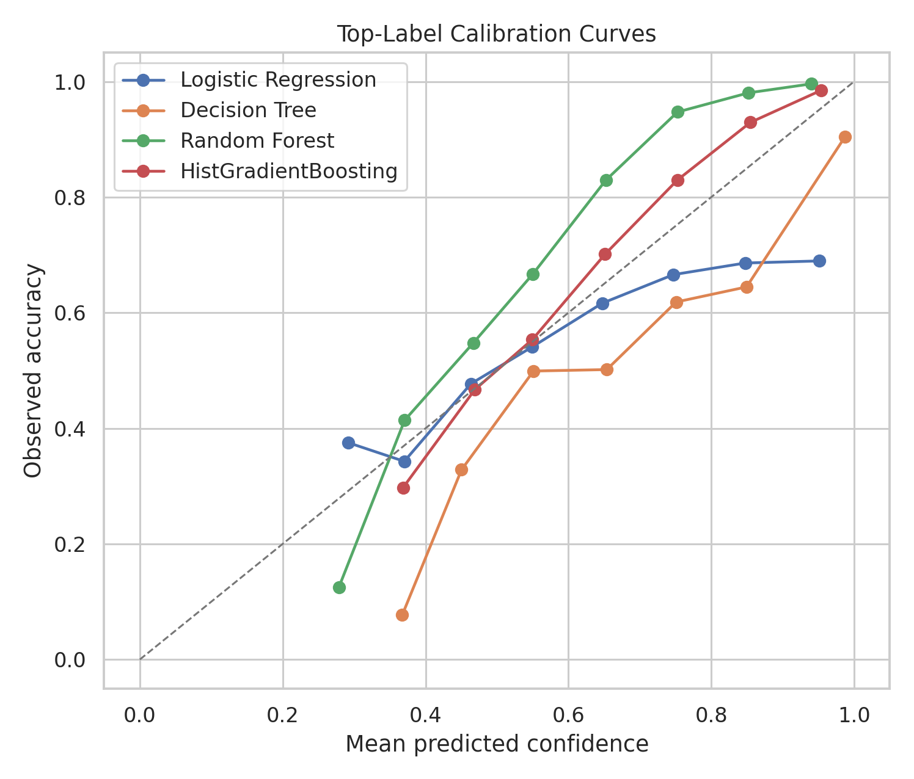
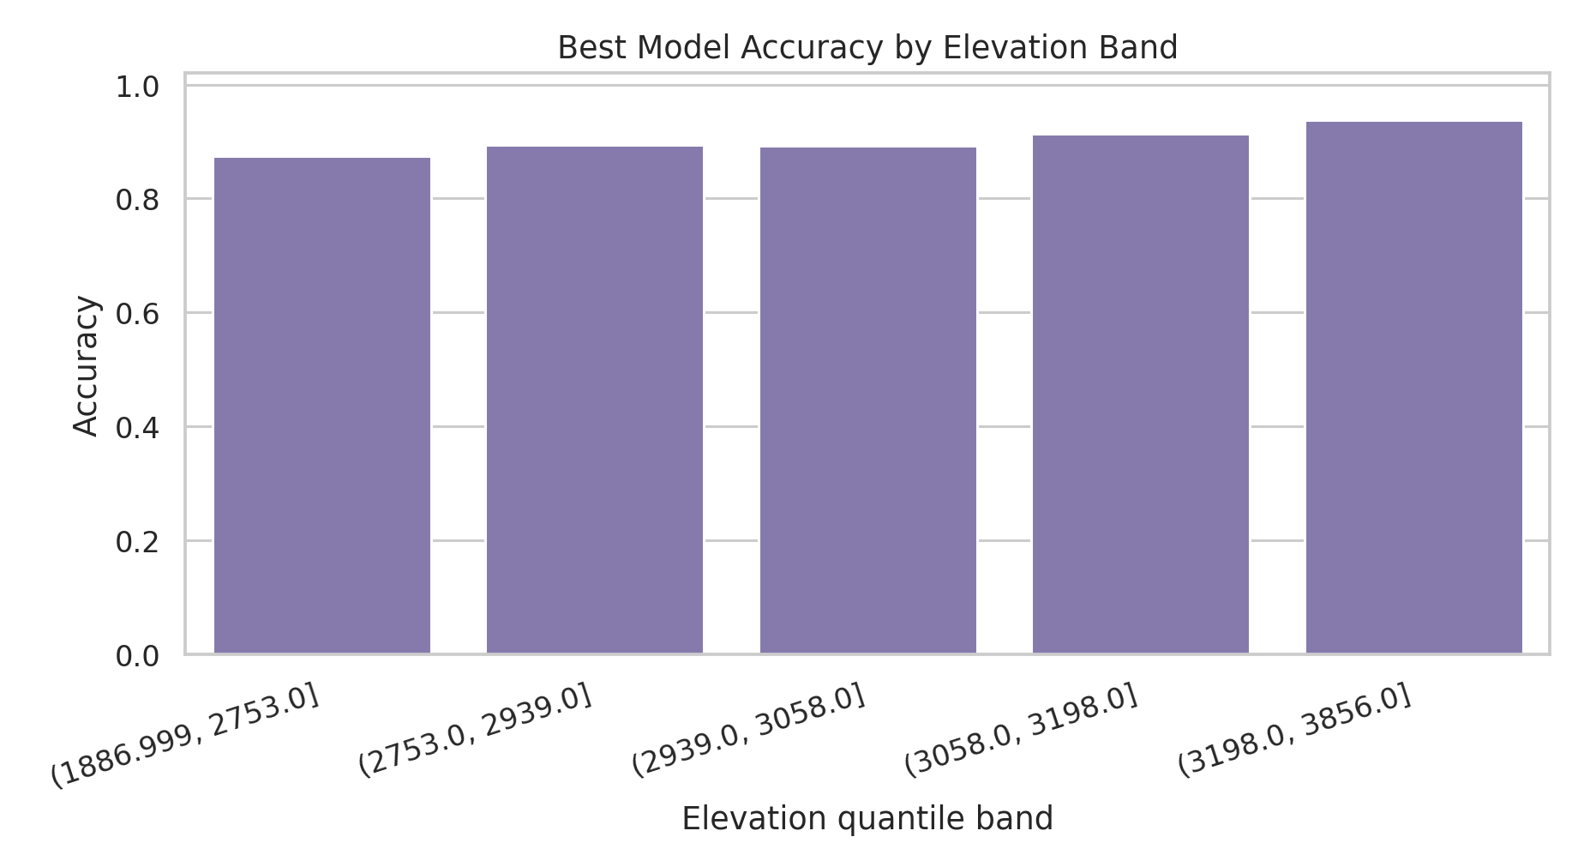
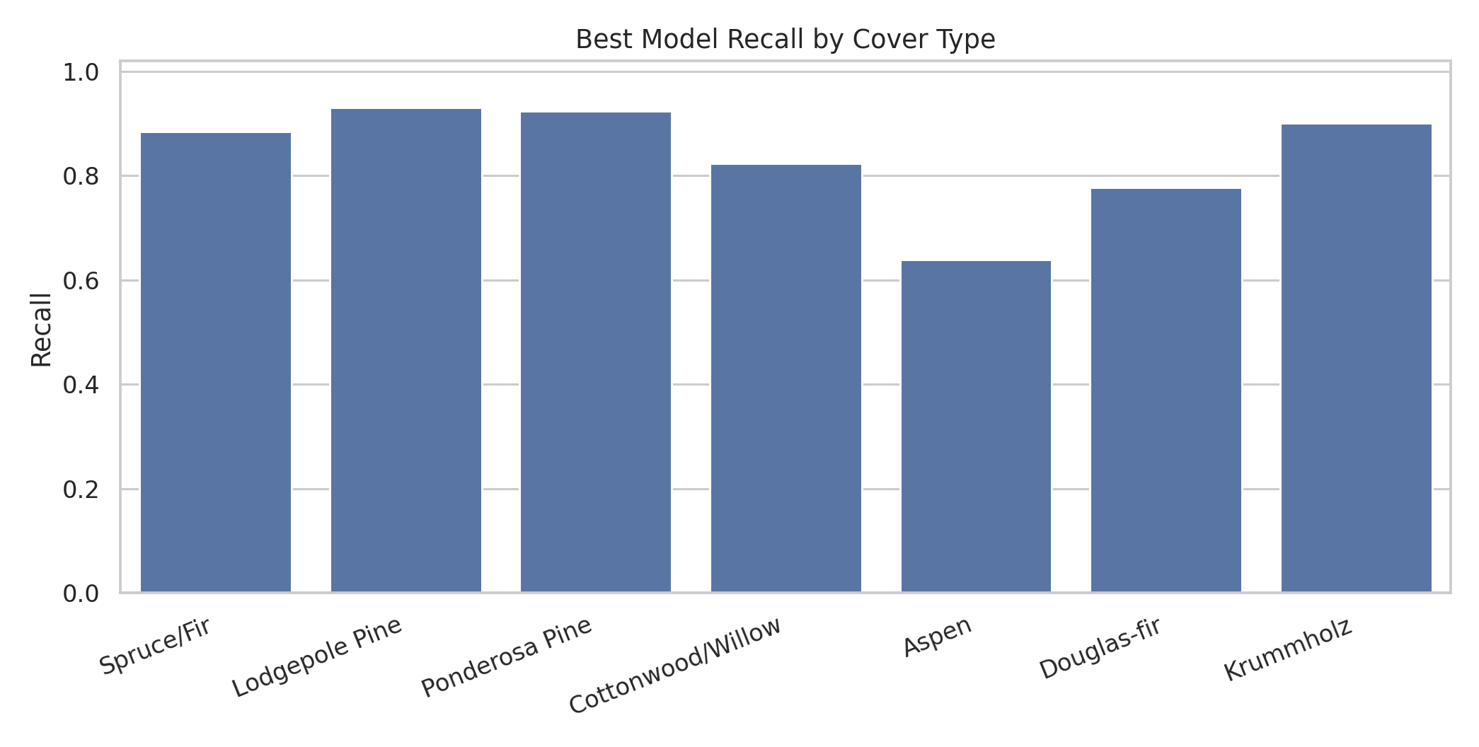
Calibration, Error Review, and Takeaways
Accuracy is strong, but uncertainty and terrain bands still matter
Best classifier: Random Forest with accuracy 0.902, macro-F1 0.845, macro AUC 0.991.
Best calibration ECE: HistGradientBoosting at 0.047.
Unsupervised clusters are useful for terrain/region exploration, but not for replacing supervised labels.
Report macro metrics, class recall, calibration, elevation-band, and wilderness-area performance together.
DSAA2011 Covertype Project | 8

Slide 9
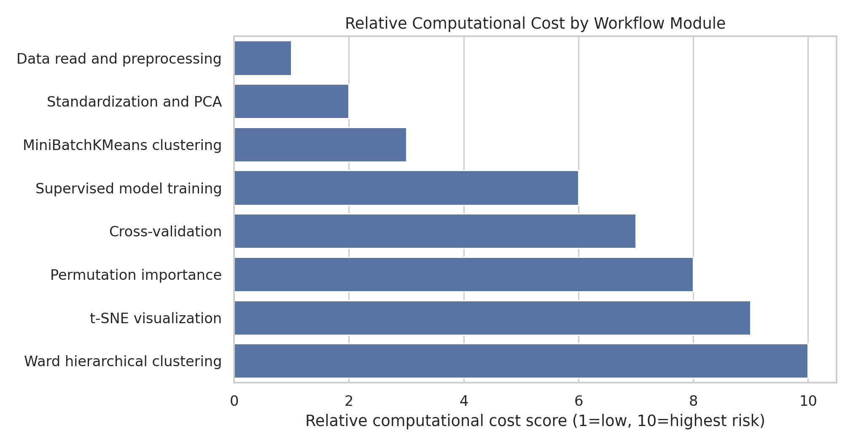
Scalable Computation
Large-data workflow choices keep expensive steps reproducible
243.8 MB
47.1 MB
naive int64 estimate
optimized memory
t-SNE visualization: score 9
Ward hierarchical clustering: score 10
Permutation importance: score 8
Memory reduction after downcast: 80.7%.
Use full data for descriptive statistics, not for every diagnostic.
Use stratified samples for t-SNE, Ward clustering, cross-validation, and permutation importance.
Run PCA before distance-based visualization and clustering.
Cache heavy stages with manifests; train scalable ensembles with parallelism.
DSAA2011 Covertype Project | 9

