Slide 1
COMP4901K/Math4824B Machine Learning for Natural Language Processing
Lecture 10: Perceptron, Error-Driven Classification
Instructor: Yangqiu Song
Slides credits: Dan Roth, Barbara Rosario

Slide 2
A General Pipeline of Building a Classifier
Pre-processing data
Tokenization
Stemming/
normalization
N-gram
Stopwords filtering
Preparing input data for machine learning
Feature construction (e.g., VSM)
Feature construction (e.g., word embeddings)
Feature selection
(e.g., DF filtering)
Configuration of Data and Metrics for Test
Training/Dev/Testing
K-Fold Cross Validation
Evaluation Metrics
Model Specification and Selection
Specify models based on assumptions
Evaluate model based on C.V. and metrics
Output the model for future use

Slide 3





Tuning on Held-Out Data
Now we’ve got two kinds of unknowns
Parameters: the probabilities P(X|Y), P(Y)
Hyperparameters: e.g. the amount / type of smoothing to do, k, α. (eg: if k=0, we are prone to overfit training data. We need some other data to tune k.
Hyperparameters are parameters that cannot be learnt from training data.
What should we learn where?
Learn parameters from training data
Tune hyperparameters on different data
Why?
For each value of the hyperparameters, train and test on the held-out data
Choose the best value and do a final test on the test data

Slide 4
Important Concepts
Data: labeled instances, e.g. emails marked spam/not spam
Training set (tune parameters)
Held out set (development set/validation set)
(tune hyperparameters)
Test set
Features: attribute-value pairs which characterize each x
Experimentation cycle
Learn parameters (e.g. model probabilities) on training set
(Tune hyperparameters on held-out set)
Compute accuracy of test set
Very important: never “peek” at the test set!
Training
Data
Held-Out
Data
Test
Data

Slide 5
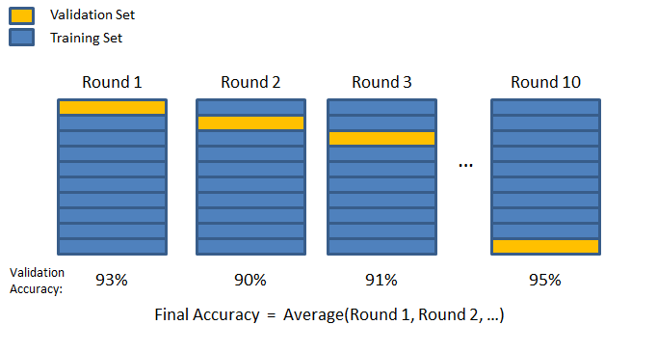
Cross validation
Cross validation
Avoid noise in train/test separation
k-fold cross-validation

Slide 6
What to Do About Errors?
Need more features– words aren’t enough!
Have you emailed the sender before?
Have 1K other people just gotten the same email?
Is the sending information consistent?
Is the email in ALL CAPS?
Do inline URLs point where they say they point?
Does the email address you by (your) name?
Can add these information sources as new variables in the NB(naïve bayes) model

Slide 7
Summary
Bayes rule lets us do diagnostic queries with causal probabilities
The naïve Bayes assumption takes all features to be independent given the class label
We can build classifiers out of a naïve Bayes model using training data
Smoothing estimates is important in real systems

Slide 8
Today
Algorithms for Discriminative Classification
Binary classification
Perceptron

Slide 9
Binary Classification: examples
Spam filtering (spam, not spam)
Customer service message classification (urgent vs. not urgent)
Information retrieval (relevant, not relevant)
Sentiment classification (positive, negative)

Slide 10
Binary Classification
Given: some data items that belong to a positive (+1 ) or a negative (-1 ) class
Task: Train the classifier and predict the class for a new data item
Geometrically: find a separator

Slide 11
Linear versus Non Linear algorithms
Linearly separable data: if all the data points can be correctly classified by a linear (hyperplanar) decision boundary

Slide 12
Linearly separable data
Class1
Linear Decision boundary
Class2

Slide 13
Non linearly separable data
Class1
Class2

Slide 14
Non linearly separable data
Class1
Non Linear Classifier
Class2

Slide 15
Linear versus Non Linear algorithms
Linear or Non linear separable data?
We can find out only empirically (we cannot distinguish the data by any theory.)
Linear algorithms (algorithms that find a linear decision boundary)
When we think the data is linearly separable
Advantages
Simpler, less parameters
Disadvantages
Data (like for texts) is usually not linearly separable
Examples: Perceptron, Winnow, SVM

Slide 16
Linear versus Non Linear algorithms
Non Linear
When the data is non linearly separable
Advantages
More accurate
Disadvantages
More complicated, more parameters
Example: Deep learning

Slide 17
Simple linear algorithms
Perceptron algorithm
Linear
Binary classification
Online (process data sequentially, one data point at the time)
Mistake driven
Simple single layer Neural Networks

Slide 18
Linear binary classification
Data: {(x_{i},y_{i})}_{i=1...n}
x in R^{d} (x is a vector in d-dimensional space)
→ feature vector
y in {-1,+1}
→ label (class, category)
Question:
Design a linear decision boundary: w^{T}x + b (equation of hyperplane) such that the classification rule associated with it has minimal probability of error
classification rule
y = sign( w^{T}x + b ) which means:
if w^{T}x + b > 0 then y = +1
if w^{T}x + b < 0 then y = -1

Slide 19
Linear binary classification
Find a good hyperplane
(w,b) in R^{d+1}
that correctly classifies data points as much as possible
In online fashion: one data point at the time, update weights as necessary
w^{T}x + b=0
Classification Rule:
y = sign( w^{T}x + b )

Slide 20
Perceptron learning rule
On-line, mistake driven algorithm.
Rosenblatt (1959) suggested that when a target output value is provided for a single neuron with fixed input, it can incrementally change weights and learn to produce the output using the Perceptron learning rule
(Perceptron == Linear Threshold Unit)
Threshold unit:
1
2
T
7
3
4
5
6

Slide 21
Perceptron learning rule
We learn f:X→{-1,+1} represented as f =sgn{w^{T}x}
Where X= {0,1}^{n} or X= R^{n} and w∈ R^{n}
Given Labeled examples: {(x₁, y₁), (x₂, y₂),…(x_{N}, y_{N})}
w^{T}x =b
-
-
-
-
-
-
-
-
-
-
-
-
-
-
w^{T}x=0
-

Slide 22
Footnote About the Threshold
On previous slide, Perceptron has no threshold
But we don’t lose generality:

Slide 23
Perceptron algorithm
Initialize: w₁ = 0 in R^{n}
Updating rule
For each data point x
Predict the label y’= sgn{w^{T}x}
if y’!= y, update the weight vector
w_{k+1} ← w_{k} + a y_{i}x_{i}
(a - a constant, learning rate)
else
w_{k+1} ← w_{k}
Function: y’= sgn{w^{T}x}
if w^{T}x > 0 return +1
else return -1
w_{k}
+1
0
w_{k+1}
-1
w_{k} x + b = 0
w_{k+1} x + b = 0

Slide 24
Perceptron in action
x (with y = +1)
next item to be classified
x as a vector
wx = 0
New decision boundary
wx = 0
Current decision boundary
w Current weight vector
w New weight vector
x as a vector added to w
Positive
(Figures from Bishop 2006)
Negative

Slide 25
Perceptron in action
wx = 0
New decision boundary
x (with y = +1)
next item to be classified
x as a vector
wx = 0
Current decision boundary
w Current weight vector
x as a vector added to w
w New weight vector
Positive
(Figures from Bishop 2006)
Negative

Slide 26
Perceptron learning rule
If x is Boolean, only weights of active features are updated

Slide 27
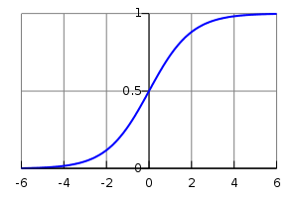
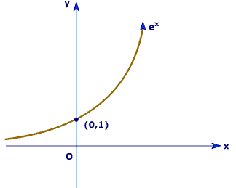
Perceptron learning rule

Slide 28
Perceptron Learnability
Obviously can’t learn what it can’t represent Only linearly separable functions
Minsky and Papert (1969) wrote an influential book demonstrating Perceptron’s representational limitations
Parity functions can’t be learned (XOR)
In vision, if patterns are represented with local features, can’t represent symmetry, connectivity
Research on Neural Networks stopped for years
Rosenblatt himself (1959) asked,
“What pattern recognition problems can be transformed so as to become linearly separable?”

Slide 30
Perceptron Convergence
Perceptron Convergence Theorem:
If there exist a set of weights that are consistent with the data (i.e., the data is linearly separable), the perceptron learning algorithm will converge
How long would it take to converge ?
Perceptron Cycling Theorem:
If the training data is not linearly separable the perceptron learning algorithm will eventually repeat the same set of weights and therefore enter an infinite loop.
How to provide robustness, more expressivity ?

Slide 31
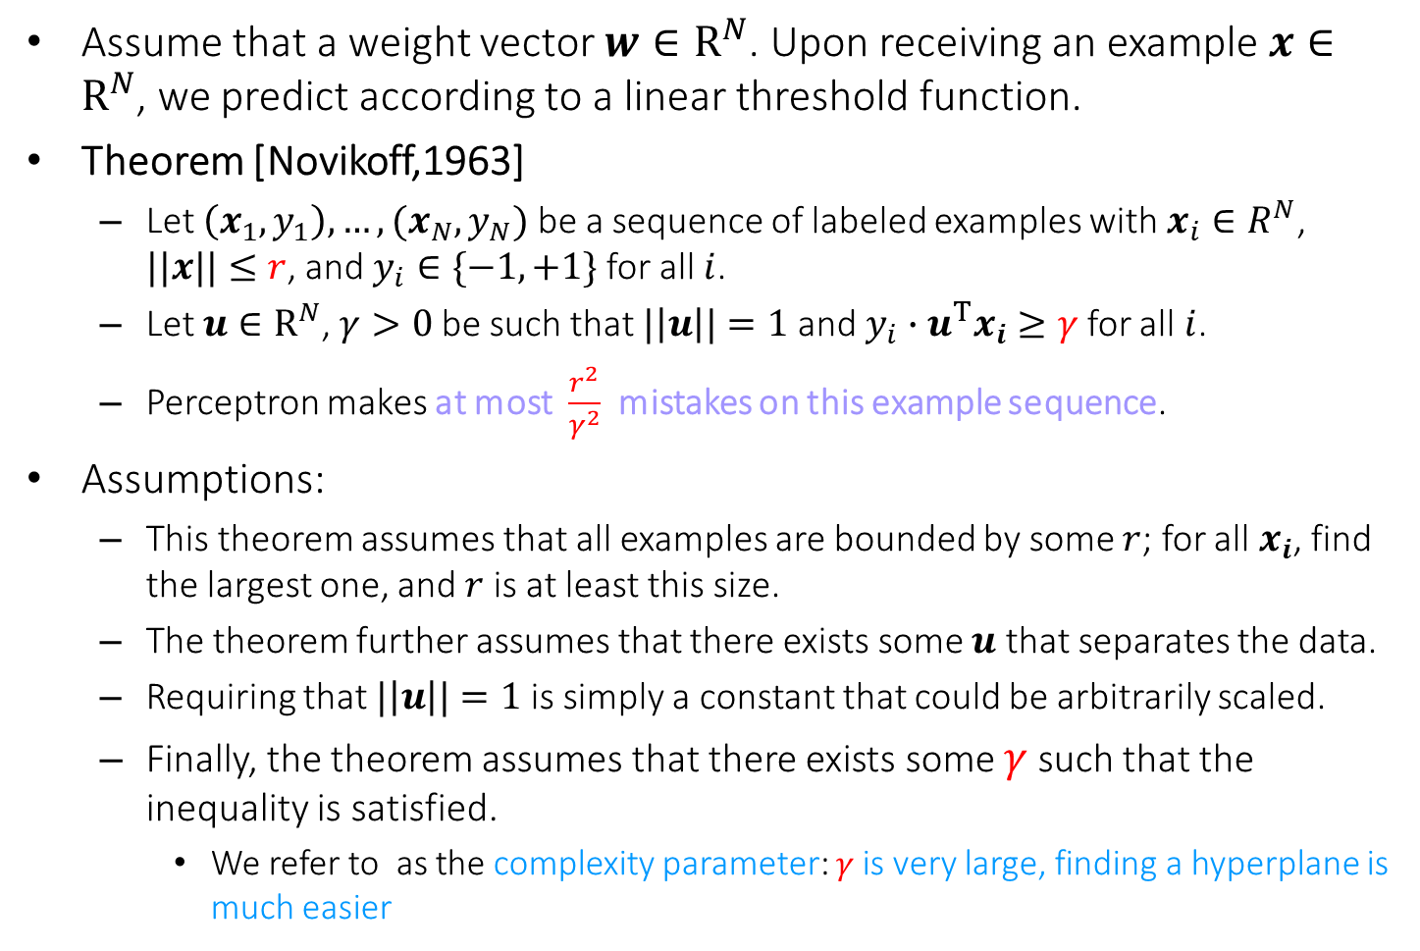
Perceptron-Mistake Bound
Assume that a weight vector $w∈R^{N}$. Upon receiving an example $x∈R^{N}$, we predict according to a linear threshold function.
Theorem [Novikoff,1963]
Let $\left(x_{1},y_{1}\right),…,(x_{N},y_{N})$ be a sequence of labeled examples with $x_{i}∈R^{N}$, $||x||≤r$, and $y_{i}∈\{−1,+1\}$ for all $i$.
Let $u∈R^{N}$, $γ>0$ be such that $|\left|u\right||=1$ and $y_{i}∙u^{T}x_{i}≥γ$ for all $i$.
Perceptron makes at most $\frac{r^{2}}{γ^{2}}$ mistakes on this example sequence.
Assumptions:
This theorem assumes that all examples are bounded by some $r$; for all $x_{i}$, find the largest one, and $r$ is at least this size.
The theorem further assumes that there exists some $u$ that separates the data.
Requiring that $|\left|u\right||=1$ is simply a constant that could be arbitrarily scaled.
Finally, the theorem assumes that there exists some $γ$ such that the inequality is satisfied.
We refer to as the complexity parameter: $γ$is very large, finding a hyperplane is much easier

Slide 32
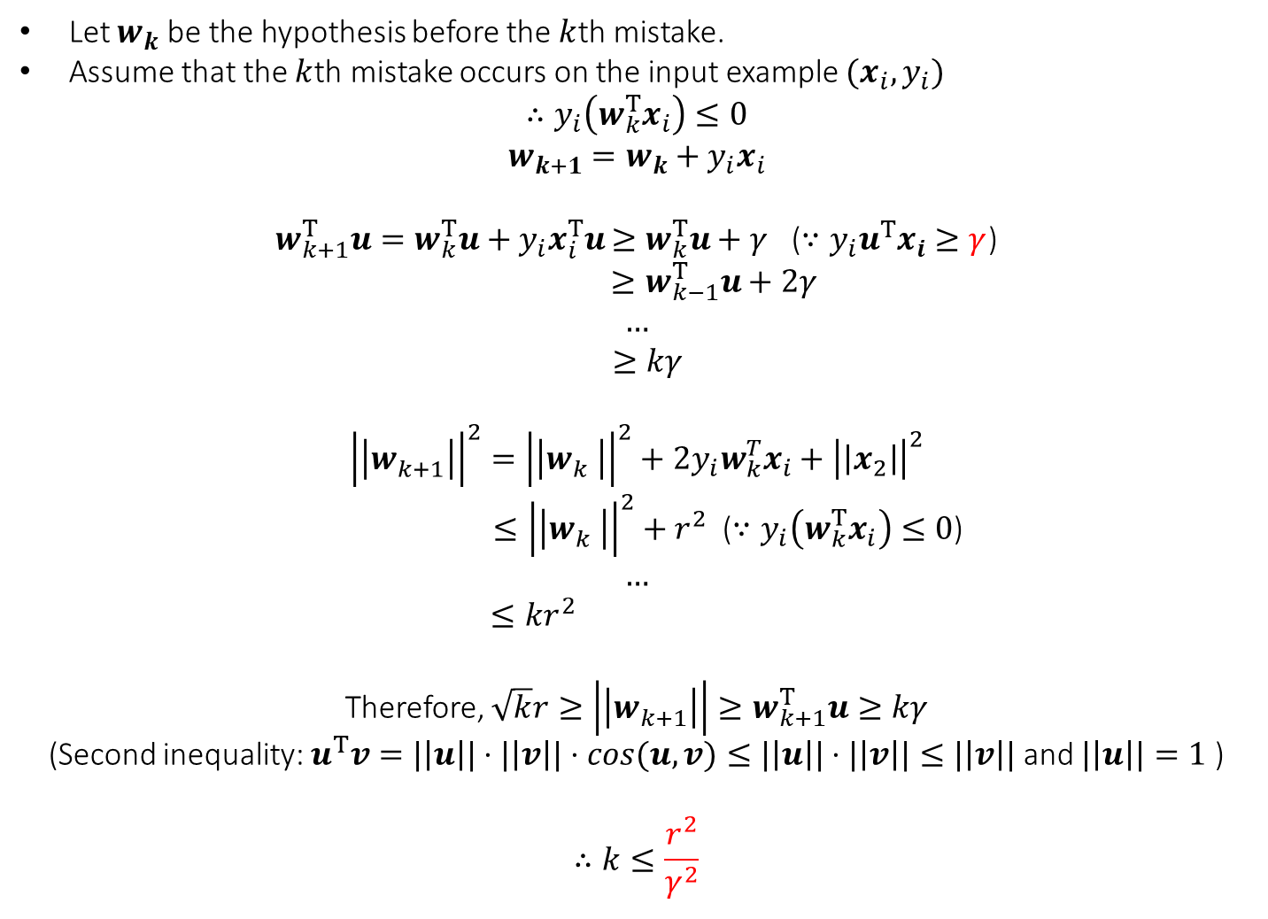
Proof
Let $w_{k}$ be the hypothesis before the $k$th mistake.
Assume that the $k$th mistake occurs on the input example $(x_{i},y_{i})$
$$∴y_{i}\left(w_{k}^{T}x_{i}\right)≤0$$
$$w_{k+1}=w_{k}+y_{i}x_{i}$$
$w_{k+1}^{T}u=w_{k}^{T}u+y_{i}x_{i}^{T}u$ $≥w_{k}^{T}u+γ$ ($∵y_{i}u^{T}x_{i}≥γ$)
$$≥w_{k−1}^{T}u+2γ$$
$$…$$
$$≥kγ$$
$${\left|\left|w_{k+1}^{}\right|\right|}^{2}={\left|\left|w_{k}^{}\right|\right|}^{2}+2y_{i}w_{k}^{T}x_{i}+{\left|\left|x_{2}\right|\right|}^{2}$$
$≤{\left|\left|w_{k}^{}\right|\right|}^{2}+r^{2}$ ($∵y_{i}\left(w_{k}^{T}x_{i}\right)≤0$)
$$…$$
$$≤kr^{2}$$
Therefore, $\sqrt{k}r≥\left|\left|w_{k+1}^{}\right|\right|≥w_{k+1}^{T}u≥kγ$
(Second inequality: $u^{T}v=|\left|u\right||⋅|\left|v\right||⋅cos(u,v)≤|\left|u\right||⋅|\left|v\right||≤|\left|v\right||$ and $|\left|u\right||=1$ )
$$∴k≤\frac{r^{2}}{γ^{2}}$$

Slide 33
Practical Issues and Extensions
There are many extensions that can be made to these basic algorithms.
Some are necessary for them to perform well
Regularization (later soon)
Some are for ease of use and tuning
Converting the output of a Perceptron to a conditional probability
P(y = +1 |x) = [1+ exp(-Awx)]⁻¹
Can tune the parameter A
Multiclass classification

Slide 34
Regularization Via Averaged Perceptron
An Averaged Perceptron Algorithm is motivated by the following considerations:
In the mistake bound model: We don’t know when we will make the mistakes.
Averaged Perceptron returns a weighted average of a number of earlier hypotheses; the weights are a function of the length of no-mistakes stretch.

Slide 35
Regularization Via Averaged Perceptron
Training:
[m: #(examples); k: #(mistakes) = #(hypotheses); c_{i}: consistency count for w_{i} ]
Input: a labeled training set {(x₁, y₁),…(x_{m}, y_{m})}
Number of epochs T
Output: a list of weighted perceptrons {(w₁, c₁),…,(w_{k}, c_{k})}
Initialize: k=0; w₁ = 0, c₁ = 0
Repeat T times:
For i =1,…m:
Compute prediction y’ = sign(w_{k}^{T} x_{i} )
If y’ = y, then c_{k} = c_{k} + 1
else: w_{k+1} = w_{k} + w_{i} x ; c_{k+1} = 1; k = k+1 k: 当前已经有了几个perceptron.
# weight是从1开始，就是说就算一上来就错了也是1，没有w的weight是0
Prediction:
Given: a list of weighted perceptrons {(w₁, c₁),…(w_{k}, c_{k})} ; a new example x
Predict the label(x) as follows:
y(x)= sign [ ∑_{1, k} c_{i} sign(w_{i} ^{T} x) ]

Slide 36
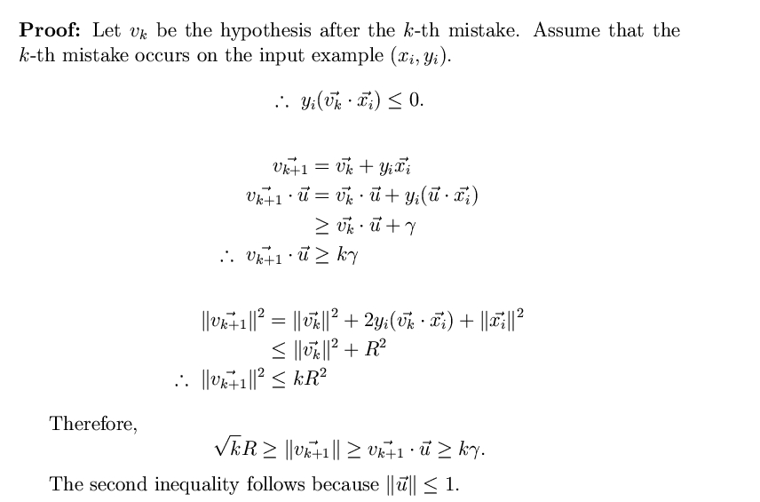
Perceptron-Mistake Bound
Note that the bound does not
depend on the dimensionality
nor on the number of examples.
Note that we place weight vectors
and examples in the same space.
Assumptions
v₁ = 0
||u|| = 1
y_{i} u ^{T} x_{i} ≥ γ
k < R² / γ ²
Second inequality: u^{T} v = ||u|| ||v|| cos(u,v) <=||u|| ||v|| <= ||v||

Slide 37
Perceptron algorithm
Online: can adjust to changing target, over time
Advantages
Simple and computationally efficient
Guaranteed to learn a linearly separable problem (convergence, global optimum)
Limitations
Only linear separations
Only converges for linearly separable data
Not really “efficient with many features”

