Slide 1
COMP4901K/Math4824B Machine Learning for Natural Language Processing
Lecture 10: Perceptron, Error-Driven Classification
Instructor: Yangqiu Song
Slides credits: Dan Roth, Barbara Rosario

Slide 2
Perceptron learning rule
On-line, mistake driven algorithm.
Rosenblatt (1959) suggested that when a target output value is provided for a single neuron with fixed input, it can incrementally change weights and learn to produce the output using the Perceptron learning rule
(Perceptron == Linear Threshold Unit)
1
2
T
7
3
4
5
6

Slide 3
Linear binary classification
Data: {(x_{i},y_{i})}_{i=1...n}
x in R^{d} (x is a vector in d-dimensional space)
→ feature vector
y in {-1,+1}
→ label (class, category)
Question:
Design a linear decision boundary: w^{T}x + b (equation of hyperplane) such that the classification rule associated with it has minimal probability of error
classification rule
y = sign( w^{T}x + b ) which means:
if w^{T}x + b > 0 then y = +1
if w^{T}x + b < 0 then y = -1

Slide 4
Perceptron learning rule
We learn f:X→{-1,+1} represented as f =sgn{w^{T}x}
Where X= {0,1}^{n} or X= R^{n} and w∈ R^{n}
Given Labeled examples: {(x₁, y₁), (x₂, y₂),…(x_{N}, y_{N})}
w^{T}x =b
-
-
-
-
-
-
-
-
-
-
-
-
-
-
w^{T}x=0
-

Slide 5
Footnote About the Threshold
On previous slide, Perceptron has no threshold
But we don’t lose generality:

Slide 6
Perceptron algorithm
Initialize: w₁ = 0 in R^{n}
Updating rule
For each data point x
Predict the label y’= sgn{w^{T}x}
if y’!= y, update the weight vector
w_{k+1} ← w_{k} + a y_{i}x_{i}
(a - a constant, learning rate)
else
w_{k+1} ← w_{k}
Function: y’= sgn{w^{T}x}
if w^{T}x > 0 return +1
else return -1
w_{k}
+1
0
w_{k+1}
-1
w_{k} x + b = 0
w_{k+1} x + b = 0

Slide 7
Perceptron in action
x (with y = +1)
next item to be classified
x as a vector
wx = 0
New decision boundary
wx = 0
Current decision boundary
w Current weight vector
w New weight vector
x as a vector added to w
Positive
(Figures from Bishop 2006)
Negative

Slide 8
Perceptron in action
wx = 0
New decision boundary
x (with y = +1)
next item to be classified
x as a vector
wx = 0
Current decision boundary
w Current weight vector
x as a vector added to w
w New weight vector
Positive
(Figures from Bishop 2006)
Negative

Slide 9
Perceptron Convergence
Perceptron Convergence Theorem:
If there exist a set of weights that are consistent with the data (i.e., the data is linearly separable), the perceptron learning algorithm will converge
How long would it take to converge ?
Perceptron Cycling Theorem:
If the training data is not linearly separable the perceptron learning algorithm will eventually repeat the same set of weights and therefore enter an infinite loop.
How to provide robustness, more expressivity ?

Slide 10
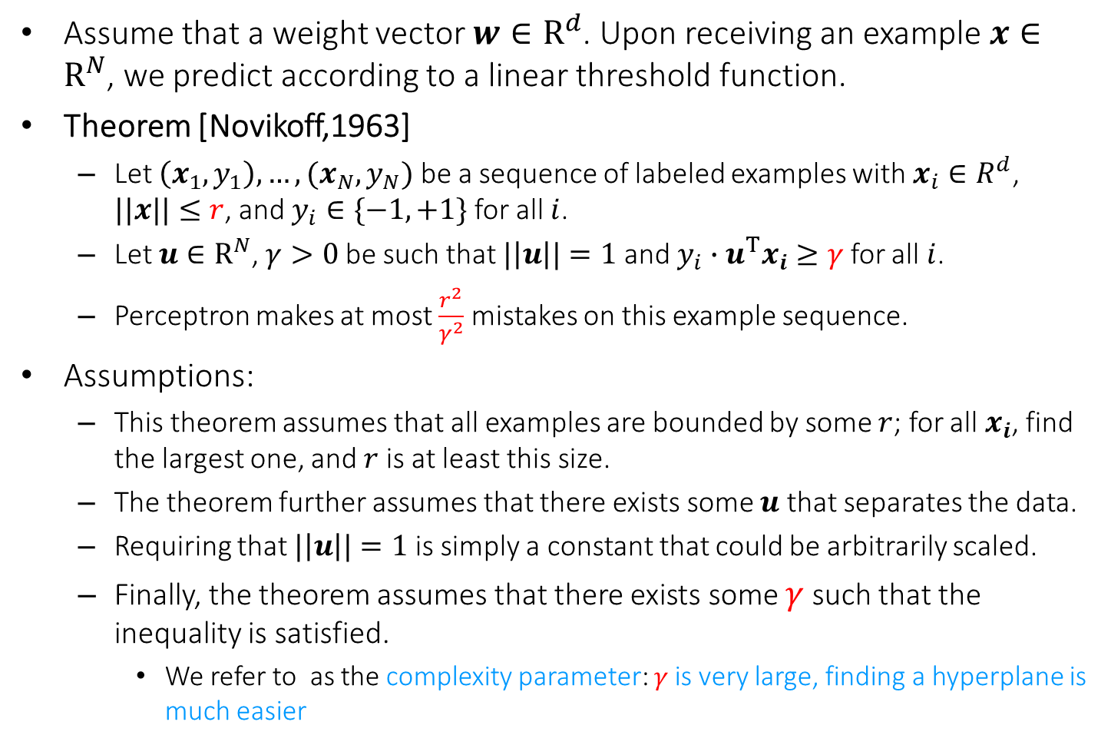
Perceptron-Mistake Bound
Assume that a weight vector $w∈R^{d}$. Upon receiving an example $x∈R^{N}$, we predict according to a linear threshold function.
Theorem [Novikoff,1963]
Let $\left(x_{1},y_{1}\right),…,(x_{N},y_{N})$ be a sequence of labeled examples with $x_{i}∈R^{d}$, $||x||≤r$, and $y_{i}∈\{−1,+1\}$ for all $i$.
Let $u∈R^{N}$, $γ>0$ be such that $|\left|u\right||=1$ and $y_{i}∙u^{T}x_{i}≥γ$ for all $i$.
Perceptron makes at most $\frac{r^{2}}{γ^{2}}$ mistakes on this example sequence.
Assumptions:
This theorem assumes that all examples are bounded by some $r$; for all $x_{i}$, find the largest one, and $r$ is at least this size.
The theorem further assumes that there exists some $u$ that separates the data.
Requiring that $|\left|u\right||=1$ is simply a constant that could be arbitrarily scaled.
Finally, the theorem assumes that there exists some $γ$ such that the inequality is satisfied.
We refer to as the complexity parameter: $γ$is very large, finding a hyperplane is much easier

Slide 11
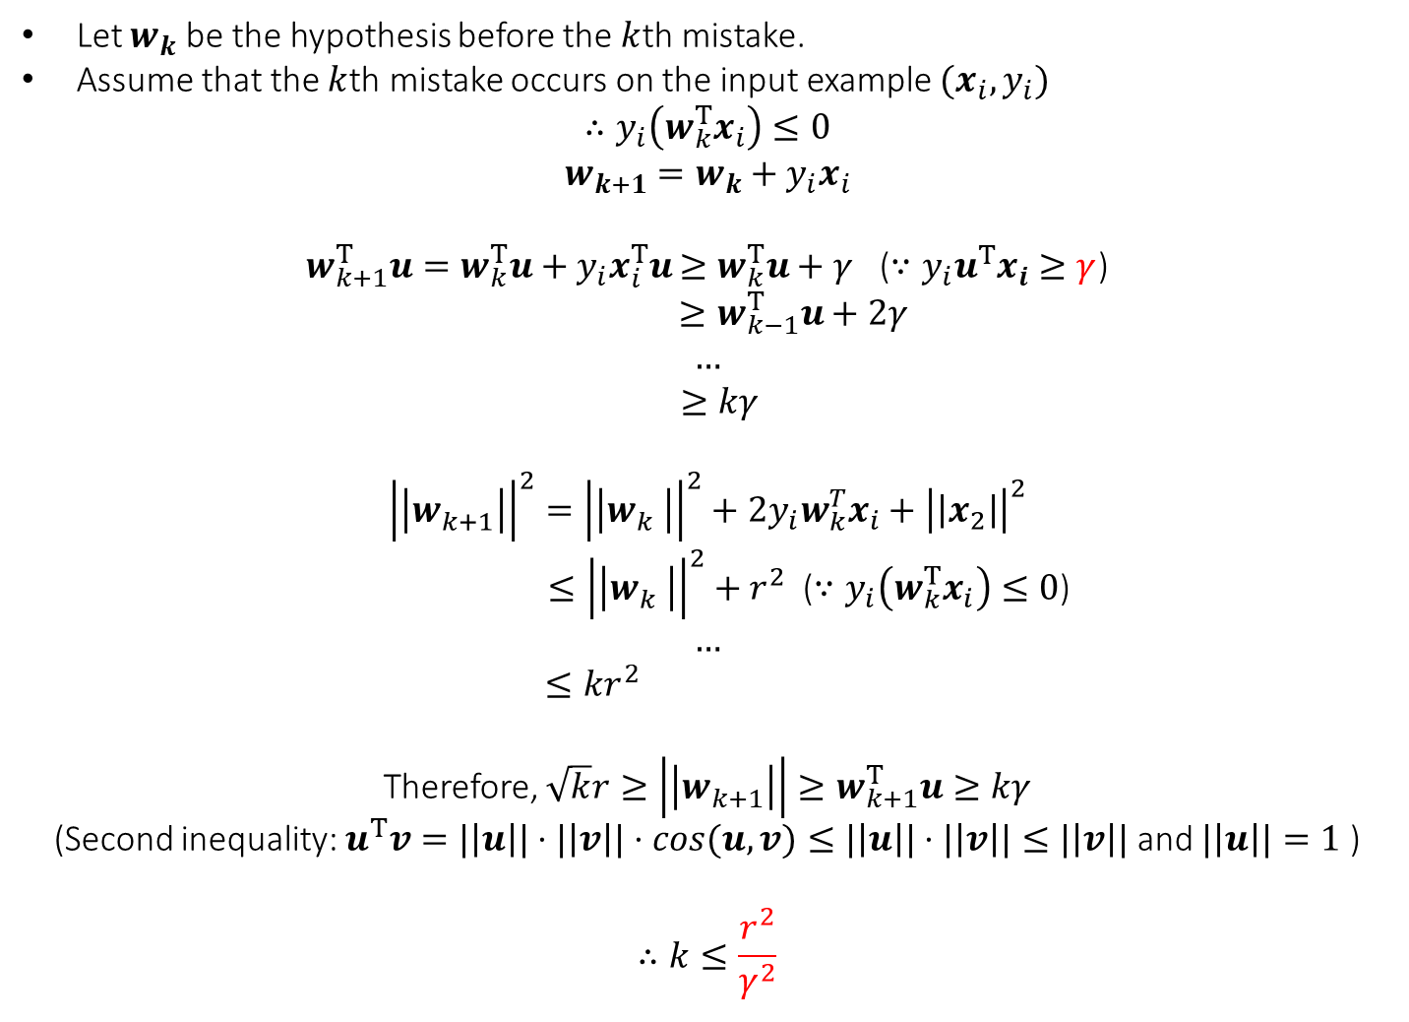
Proof
Let $w_{k}$ be the hypothesis before the $k$th mistake.
Assume that the $k$th mistake occurs on the input example $(x_{i},y_{i})$
$$∴y_{i}\left(w_{k}^{T}x_{i}\right)≤0$$
$$w_{k+1}=w_{k}+y_{i}x_{i}$$
$w_{k+1}^{T}u=w_{k}^{T}u+y_{i}x_{i}^{T}u$ $≥w_{k}^{T}u+γ$ ($∵y_{i}u^{T}x_{i}≥γ$)
$$≥w_{k−1}^{T}u+2γ$$
$$…$$
$$≥kγ$$
$${\left|\left|w_{k+1}^{}\right|\right|}^{2}={\left|\left|w_{k}^{}\right|\right|}^{2}+2y_{i}w_{k}^{T}x_{i}+{\left|\left|x_{2}\right|\right|}^{2}$$
$≤{\left|\left|w_{k}^{}\right|\right|}^{2}+r^{2}$ ($∵y_{i}\left(w_{k}^{T}x_{i}\right)≤0$)
$$…$$
$$≤kr^{2}$$
Therefore, $\sqrt{k}r≥\left|\left|w_{k+1}^{}\right|\right|≥w_{k+1}^{T}u≥kγ$
(Second inequality: $u^{T}v=|\left|u\right||⋅|\left|v\right||⋅cos(u,v)≤|\left|u\right||⋅|\left|v\right||≤|\left|v\right||$ and $|\left|u\right||=1$ )
$$∴k≤\frac{r^{2}}{γ^{2}}$$

Slide 12
If you want to further read
https://www.cse.iitb.ac.in/~shivaram/teaching/old/cs344+386-s2017/resources/classnote-1.pdf

Slide 13
Practical Issues and Extensions
There are many extensions that can be made to these basic algorithms.
Some are necessary for them to perform well
Regularization (later soon)
Some are for ease of use and tuning
Converting the output of a Perceptron to a conditional probability
P(y = +1 |x) = [1+ exp(- a wx)]⁻¹
Can tune the hyper-parameter a
Multiclass classification

Slide 14
Regularization Via Averaged Perceptron
An Averaged Perceptron Algorithm is motivated by the following considerations:
In the mistake bound model: We don’t know when we will make the mistakes.
Averaged Perceptron returns a weighted average of a number of earlier hypotheses; the weights are a function of the length of no-mistakes stretch.

Slide 15
Regularization Via Averaged Perceptron
Training:
[m: #(examples); k: #(mistakes) = #(hypotheses); c_{k}: consistency count for w_{k} ]
Input: a labeled training set {(x₁, y₁),…(x_{m}, y_{m})}
Number of epochs T
Output: a list of weighted perceptrons {(w₁, c₁),…,(w_{k}, c_{k})}
Initialize: k=0; w₁ = 0, c₁ = 0
Repeat T times:
For i =1,…m:
Compute prediction y’ = sign(w_{k}^{T} x_{i} )
If y’ = y, then c_{k} = c_{k} + 1
else: w_{k+1} = w_{k} + w_{i} x ; c_{k+1} = 1; k = k+1
Prediction:
Given: a list of weighted perceptrons {(w₁, c₁),…(w_{k}, c_{k})} ; a new example x
Predict the label(x) as follows:
y(x)= sign [ ∑_{1, k} c_{k} sign(w_{k} ^{T} x) ]

Slide 16
Perceptron algorithm
Online: can adjust to changing target, over time
Advantages
Simple and computationally efficient
Guaranteed to learn a linearly separable problem (convergence, global optimum)
Limitations
Only linear separations
Only converges for linearly separable data
Not really “efficient with many features”

