Slide 1
COMP4901K/Math4824B Machine Learning for Natural Language Processing
Lecture 12: Logistic Regression
Instructor: Yangqiu Song
Slides credits: John Canny

Slide 2
No lab this week
Public holiday
Projects 1 and 2

Slide 3
Perceptron algorithm
Initialize: w₁ = 0 in R^{d}
Updating rule
For each data point x
Predict the label y’= sgn{w^{T}x}
if y’!= y, update the weight vector
w_{k+1} ← w_{k} + a y_{i}x_{i}
(a - a constant, learning rate)
else
w_{k+1} ← w_{k}
Function: y’= sgn{w^{T}x}
if w^{T}x > 0 return +1
else return -1
w_{k}
+1
0
w_{k+1}
-1
w_{k} x + b = 0
w_{k+1} x + b = 0

Slide 4
Practical Issues and Extensions
There are many extensions that can be made to these basic algorithms.
Some are necessary for them to perform well
Regularization (later soon)
Some are for ease of use and tuning
Converting the output of a Perceptron to a conditional probability
P(y = +1 |x) = [1+ exp(- a wx)]⁻¹
Can tune the hyper-parameter a
Multiclass classification

Slide 5
Regularization Via Averaged Perceptron
An Averaged Perceptron Algorithm is motivated by the following considerations:
In the mistake bound model: We don’t know when we will make the mistakes.
Averaged Perceptron returns a weighted average of a number of earlier hypotheses; the weights are a function of the length of no-mistakes stretch.

Slide 6
Regularization Via Averaged Perceptron
Training:
[m: #(examples); k: #(mistakes) = #(hypotheses); c_{k}: consistency count for w_{k} ]
Input: a labeled training set {(x₁, y₁),…(x_{m}, y_{m})}
Number of epochs (时代) T
Output: a list of weighted perceptrons {(w₁, c₁),…,(w_{k}, c_{k})}
Initialize: k=0; w₁ = 0, c₁ = 0
Repeat T times:
For i =1,…m:
Compute prediction y’ = sign(w_{k}^{T} x_{i} )
If y’ = y, then c_{k} = c_{k} + 1
else: w_{k+1} = w_{k} + w_{i} x ; c_{k+1} = 1; k = k+1
Prediction:
Given: a list of weighted perceptrons {(w₁, c₁),…(w_{k}, c_{k})} ; a new example x
Predict the label(x) as follows:
y(x)= sign [ ∑_{1, k} c_{k} sign(w_{k} ^{T} x) ]
一个好的classifier就会连续好几个data都不出错，它的c会较大。最后的classifier是weighted average of all classifiers.

Slide 7
Perceptron algorithm
Online: can adjust to changing target, over time
Advantages
Simple and computationally efficient
Guaranteed to learn a linearly separable problem (convergence, global optimum)
Limitations
Only linear separations
Only converges for linearly separable data
Not really “efficient with many features”

Slide 8
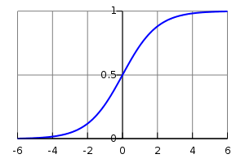
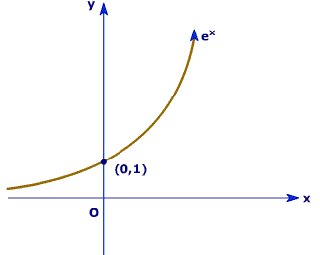
Revisit Perceptron Prediction

Slide 9
Perceptron learning rule
On-line, mistake driven algorithm.
Rosenblatt (1959) suggested that when a target output value is provided for a single neuron with fixed input, it can incrementally change weights and learn to produce the output using the Perceptron learning rule
(Perceptron == Linear Threshold Unit)
1
2
T
7
3
4
5
6

Slide 10
What if I directly optimize the output probability?

Slide 11
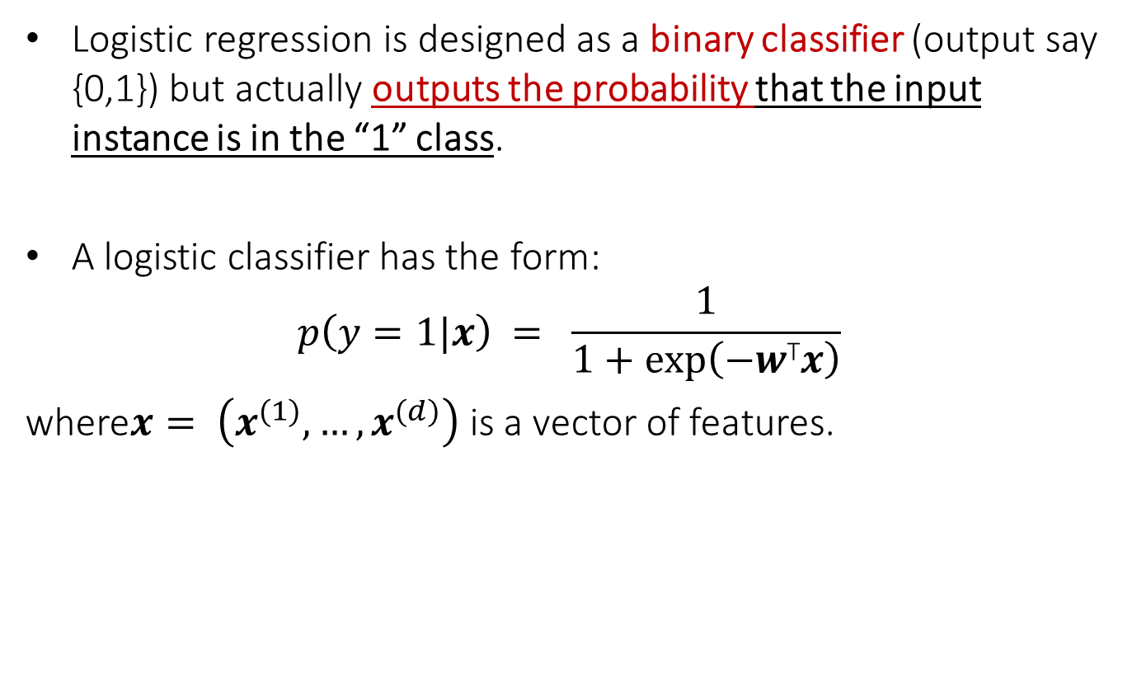
Logistic Regression
Logistic regression is designed as a binary classifier (output say {0,1}) but actually outputs the probability that the input instance is in the “1” class.
A logistic classifier has the form:
$$p\left(y=1|x\right) = \frac{1}{1+exp⁡\left(−w\text{T}x\right)}$$
where$x= \left(x^{(1)},…,x^{(d)}\right)$ is a vector of features.

Slide 12
Logistic Regression
Logistic regression is probably the most widely used general-purpose classifier.
Its very scalable and can be very fast to train. It’s used for
Spam filtering
News message classification
Web site classification
Most classification problems with large, sparse feature sets.
The only caveat (限制) is that it can overfit on very sparse data, so its often used with Regularization

Slide 13

Logistic Regression
Logistic regression maps the “regression” value $−w\text{T}x$ in (-∞,∞) to the range [0,1] using a “logistic” function:
$$p\left(y=1|x\right) = \frac{1}{1+exp⁡\left(−w\text{T}x\right)}$$
i.e. the logistic function maps any value on the real line to a probability in the range [0,1]

Slide 14

Logistic Regression
Where did the logistic function come from?

Slide 15
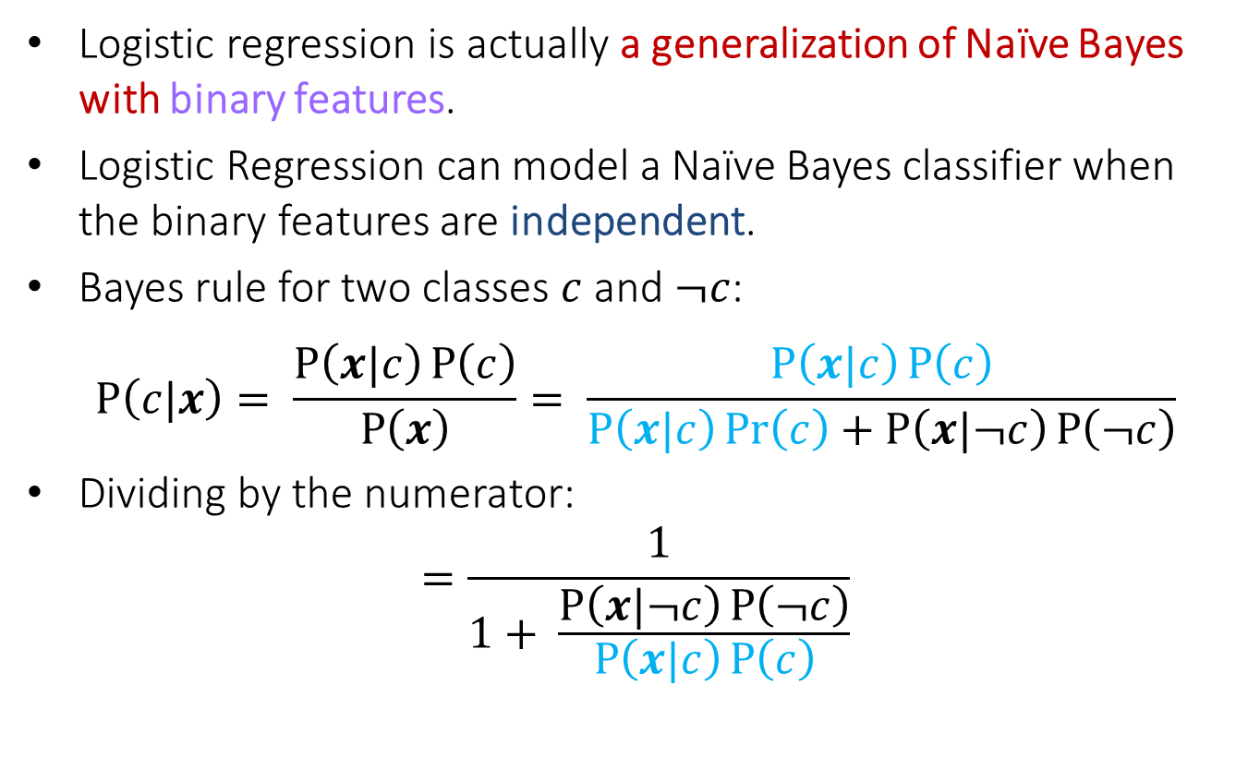
Logistic Regression and Naïve Bayes
Logistic regression is actually a generalization of Naïve Bayes with binary features.
Logistic Regression can model a Naïve Bayes classifier when the binary features are independent.
Bayes rule for two classes $c$ and $¬c$:
$$P\left(c|x\right)= \frac{P\left(x|c\right)P\left(c\right)}{P\left(x\right)}= \frac{P\left(x|c\right)P\left(c\right)}{P\left(x|c\right)\operatorname{Pr}\left(c\right)+P\left(x|¬c\right)P\left(¬c\right)}$$
Dividing by the numerator:
$$=\frac{1}{1+ \frac{P\left(x|¬c\right)P\left(¬c\right)}{P\left(x|c\right)P\left(c\right)}}$$

Slide 16
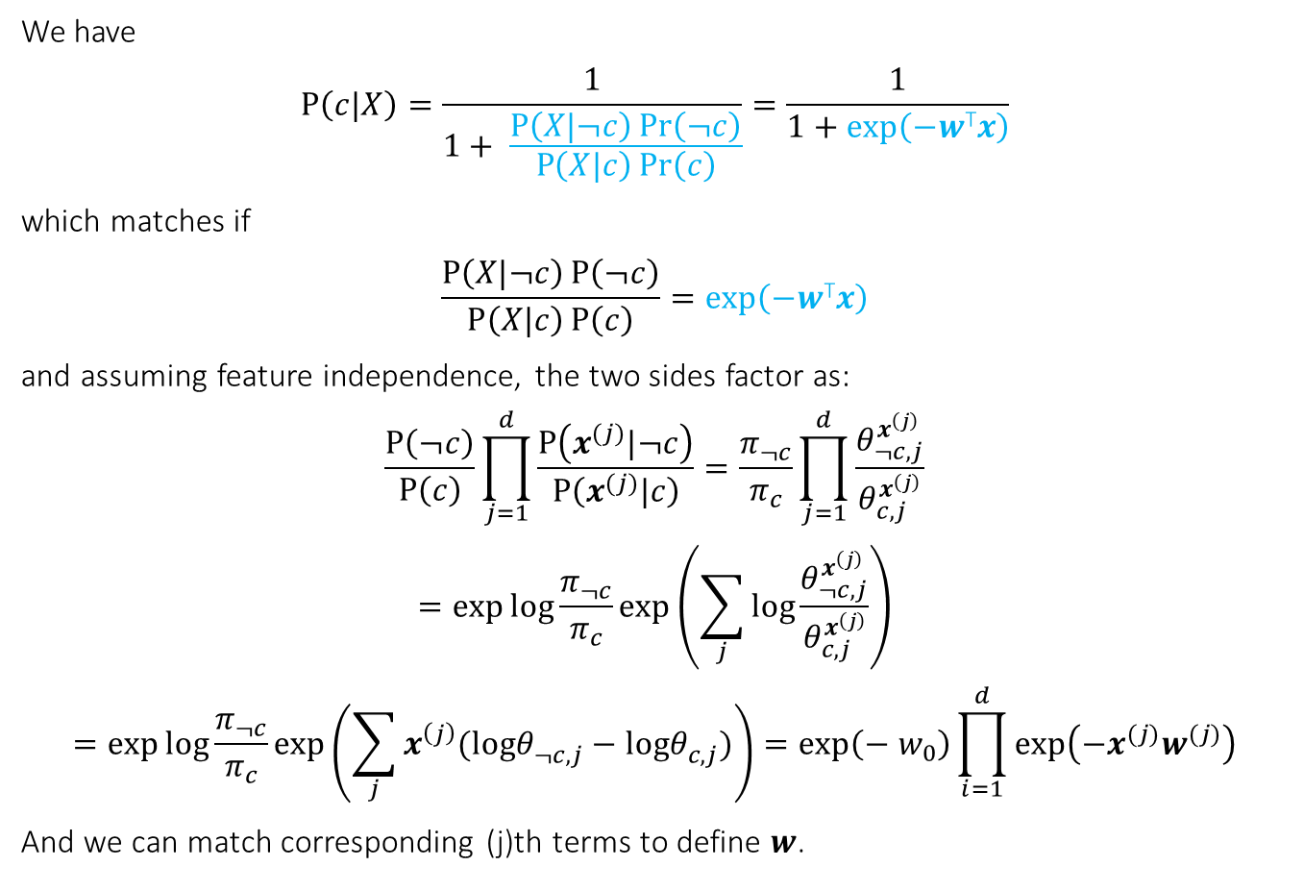

Logistic Regression and Naïve Bayes
We have
$$P\left(c|X\right)=\frac{1}{1+ \frac{P\left(X|¬c\right)\operatorname{Pr}\left(¬c\right)}{P\left(X|c\right)\operatorname{Pr}\left(c\right)}}=\frac{1}{1+exp⁡\left(−w\text{T}x\right)}$$
which matches if
$$\frac{P\left(X|¬c\right)P\left(¬c\right)}{P\left(X|c\right)P\left(c\right)}=exp⁡\left(−w\text{T}x\right)$$
and assuming feature independence, the two sides factor as:
$$\frac{P\left(¬c\right)}{P\left(c\right)}\prod_{j=1}^{d}{\frac{P\left(x^{(j)}|¬c\right)}{P\left(x^{(j)}|c\right)}}=\frac{π_{¬c}}{π_{c}}\prod_{j=1}^{d}{\frac{θ_{¬c,j}^{x^{\left(j\right)}}}{θ_{c,j}^{x^{\left(j\right)}}}}$$
$$=\exp{\log{\frac{π_{¬c}}{π_{c}}}}exp\left(\sum_{j}{\log{\frac{θ_{¬c,j}^{x^{\left(j\right)}}}{θ_{c,j}^{x^{\left(j\right)}}}}}\right)$$
$$=\exp{\log{\frac{π_{¬c}}{π_{c}}}}exp\left(\sum_{j}{x^{\left(j\right)}(logθ_{¬c,j}^{}−logθ_{c,j}^{})}\right)=\exp\left(−{ w}_{0}\right)\prod_{i=1}^{d}{exp\left(−x^{(j)}w^{(j)}\right)}$$
And we can match corresponding (j)th terms to define $w$.
$$e^{x+y}=e^{x}e^{y}$$
$$\log{xy=\log{x+\log{y}}}$$
$$e^{\log{x}}=x$$

Slide 17

Logistic Regression and Naïve Bayes
Summary: Logistic regression has this form:
$$P\left(c|X\right)=\frac{1}{1+exp⁡\left(−w\text{T}x\right)}$$
Models Naïve Bayes formula with two classes
after dividing through by one of them
Models product of contributions from different (independent) features

Slide 18
Results on UCI datasets (Ng and Jordan (2001))

Slide 19
Results on UCI datasets (Ng and Jordan (2001))

Slide 20
Results on UCI datasets (Ng and Jordan (2001))

Slide 21
Outline
Logistic Regression
Gradient-based optimization

Slide 22
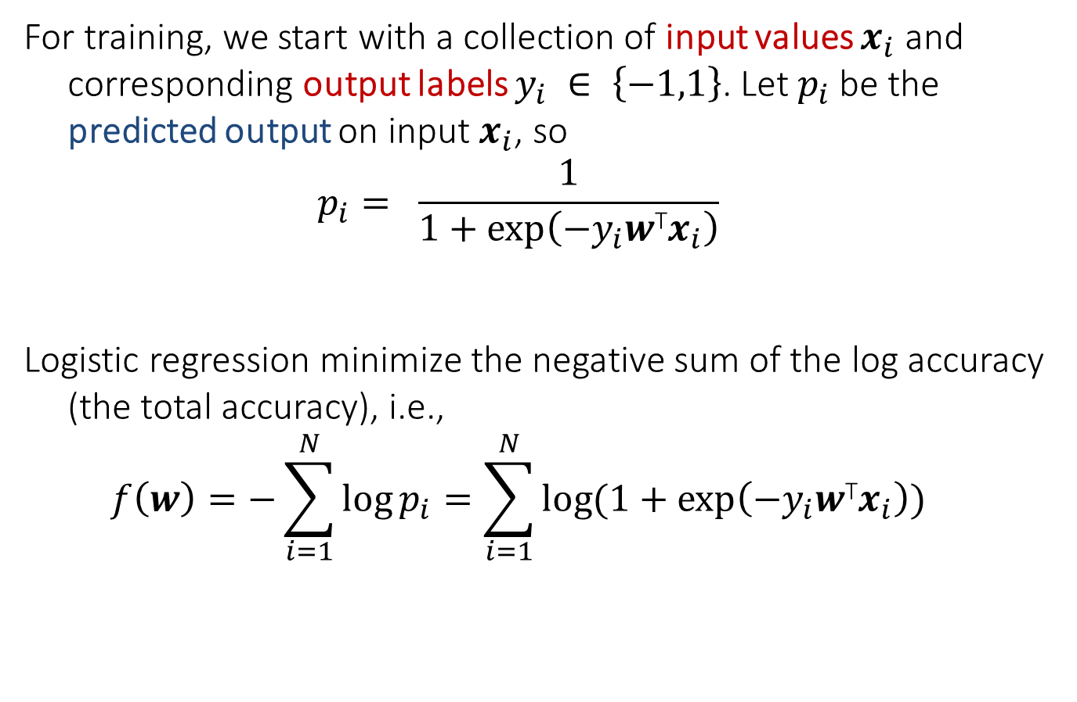
Training
For training, we start with a collection of input values $x_{i}$ and corresponding output labels $y_{i} ∈ \left\{−1,1\right\}$. Let $p_{i}$ be the predicted output on input $x_{i}$, so
$$p_{i}= \frac{1}{1+exp⁡\left(−{y_{i}w\text{T}x}_{i}\right)}$$
Logistic regression minimize the negative sum of the log accuracy (the total accuracy), i.e.,
$$f\left(w\right)=−\sum_{i=1}^{N}{\log{p_{i}}}=\sum_{i=1}^{N}{\log{(1+exp⁡\left(−{y_{i}w\text{T}x}_{i}\right))}}$$

Slide 23
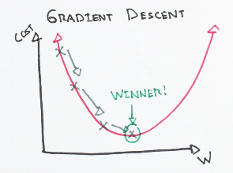
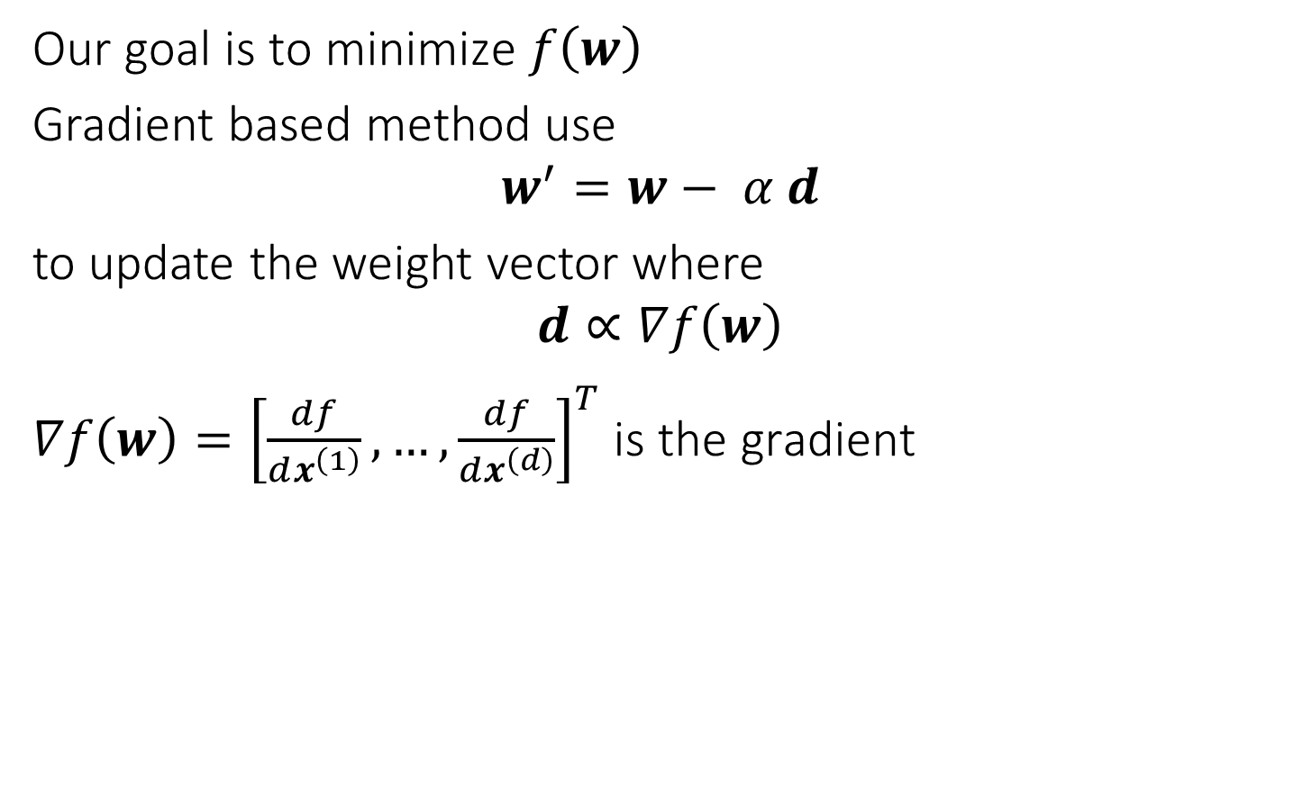
Gradient based methods
Our goal is to minimize $f\left(w\right)$
Gradient based method use
$$w^{′}=w− α d$$
to update the weight vector where
$$d∝∇f\left(w\right)$$
$∇f\left(w\right)={\left[\frac{df}{dx^{\left(1\right)}},…,\frac{df}{dx^{\left(d\right)}}\right]}^{T}$ is the gradient

Slide 24
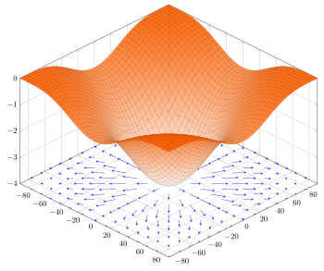
The gradient of the function f(x,y) = −(cos²x + cos²y)²depicted as a projected vector field on the bottom plane.

Slide 25
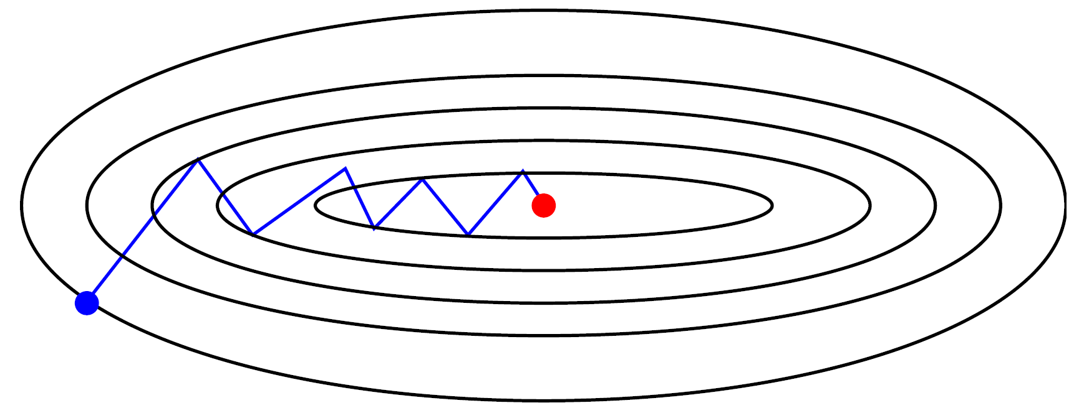
Gradient based methods

Slide 26
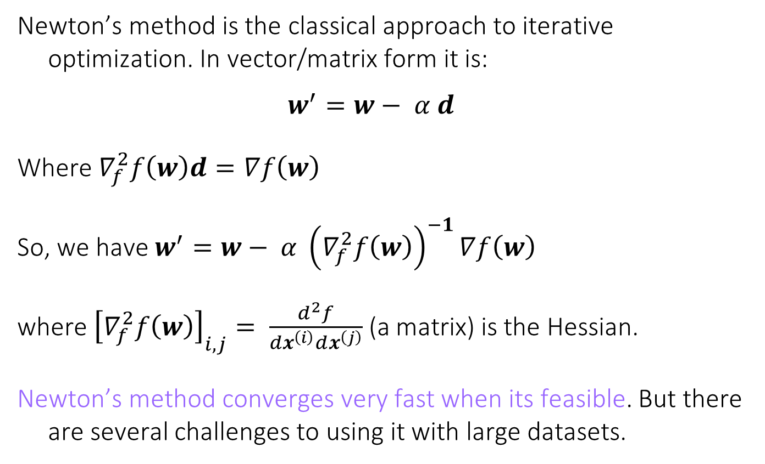
*Newton’s Method
Newton’s method is the classical approach to iterative optimization. In vector/matrix form it is:
$$w^{′}=w− α d$$
Where $∇_{f}^{2}f\left(w\right)d=∇f\left(w\right)$
So, we have $w^{′}=w− α {\left(∇_{f}^{2}f\left(w\right)\right)}^{−1}∇f\left(w\right)$
where ${\left[∇_{f}^{2}f\left(w\right)\right]}_{i,j}= \frac{d^{2}f}{dx^{\left(i\right)}dx^{\left(j\right)}}$ (a matrix) is the Hessian.
Newton’s method converges very fast when its feasible. But there are several challenges to using it with large datasets.

Slide 27
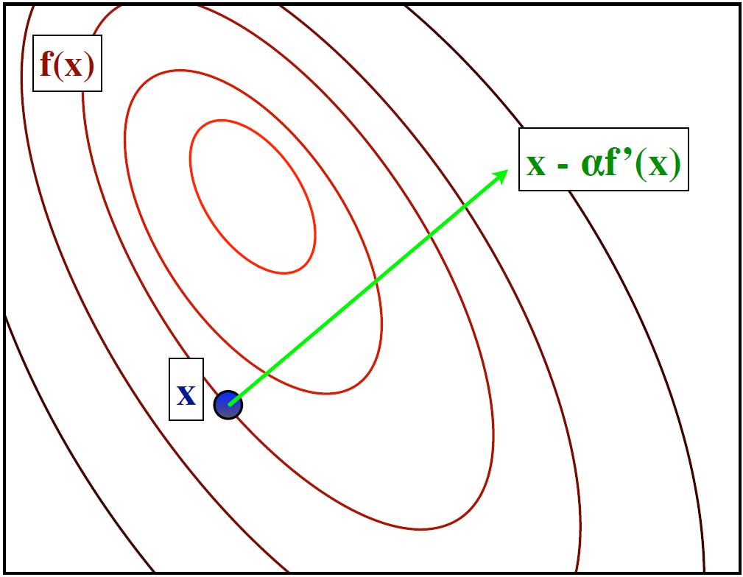
Example: Newton’s Method

Slide 28
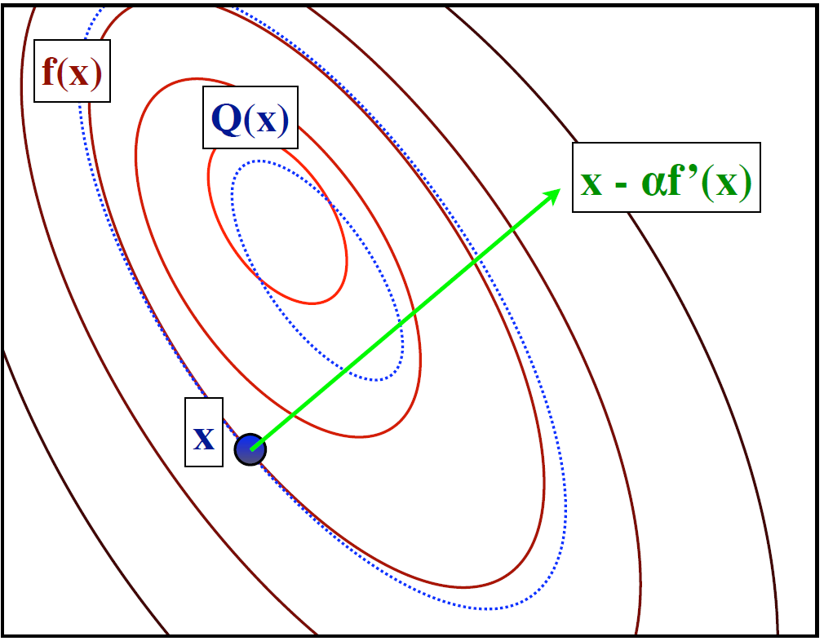
Example: Newton’s Method
Use a quadratic function to approximate the original loss at point x

Slide 29
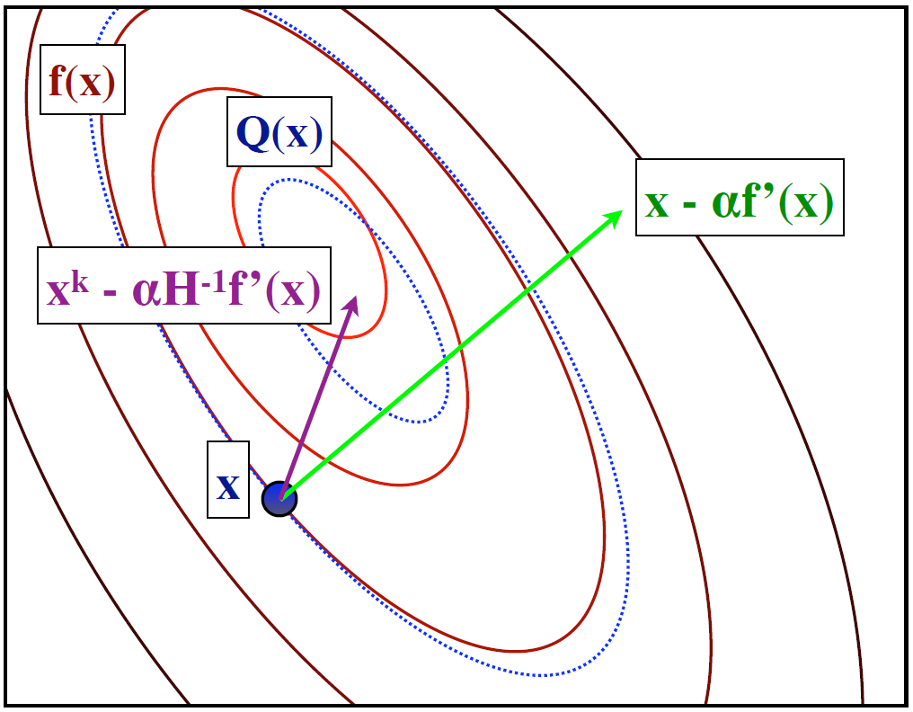
Example: Newton’s Method
Then go to the optimal of the quadratic function as the start for the next step

Slide 30
Challenges for Newton’s Method
The quadratic approximation is normally computed on the entire dataset. This means many passes over the data to complete a series of Newton steps.
The Hessian has size O(d²) if there are d features. This is impractical for large feature spaces, e.g. text or event data.
One Solution is L-BFGS, which stands for “Limited Memory Broyden-Fletcher-Goldfarb-Shanno”. It’s a Newton-like algorithm that use an approximation to the Hessian with only a few rows.
L-BFGS still requires full passes over the dataset however.

Slide 31
Incremental Training - SGD
A very efficient way to train logistic models is with Stochastic Gradient Descent (SGD) – we keep updating the model with gradients one example
One challenge with training on power law data (i.e. most data) is that the terms in the gradient can have very different strengths (because of the power law distribution). We’ll discuss this soon…

Slide 32
Deterministic Gradient vs Stochastic Gradient
Deterministic Gradient method
Stochastic Gradient method

Slide 33
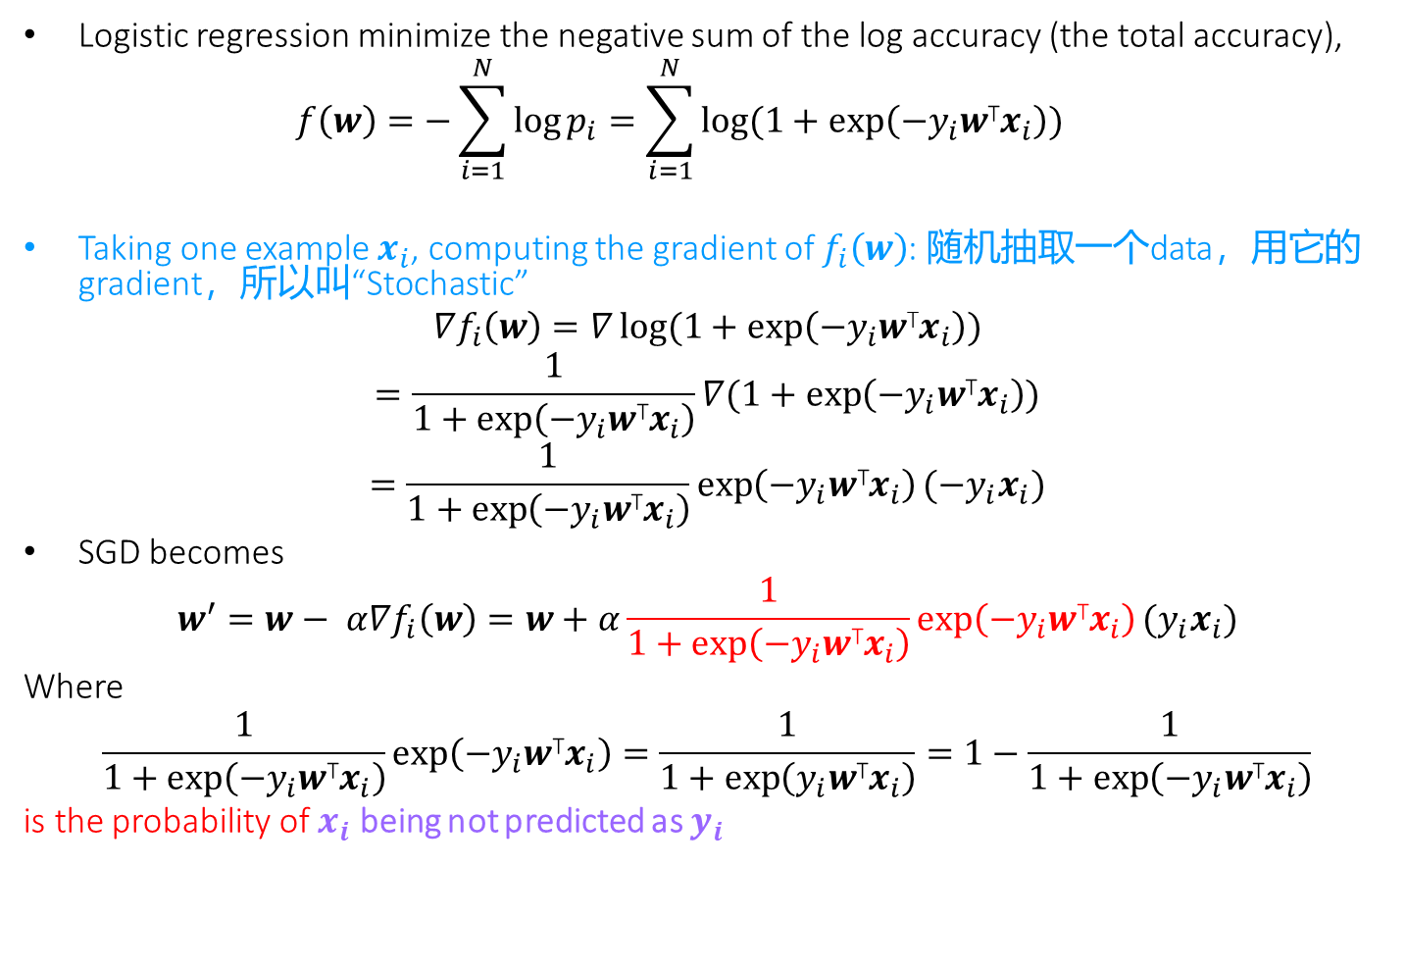
Stochastic Gradient for Logistic Regression
Logistic regression minimize the negative sum of the log accuracy (the total accuracy),
$$f\left(w\right)=−\sum_{i=1}^{N}{\log{p_{i}}}=\sum_{i=1}^{N}{\log{(1+exp⁡\left(−{y_{i}w\text{T}x}_{i}\right))}}$$
Taking one example $x_{i}$, computing the gradient of $f_{i}\left(w\right)$: 随机抽取一个data，用它的gradient，所以叫“Stochastic”
$$∇f_{i}\left(w\right)=∇\log{(1+exp⁡\left(−{y_{i}w\text{T}x}_{i}\right))}$$
$$=\frac{1}{1+\exp\left(−{y_{i}w\text{T}x}_{i}\right)}∇(1+\exp\left(−{y_{i}w\text{T}x}_{i}\right))$$
$$=\frac{1}{1+\exp\left(−{y_{i}w\text{T}x}_{i}\right)}\exp\left(−{y_{i}w\text{T}x}_{i}\right)(−{y_{i}x}_{i})$$
SGD becomes
$$w^{′}=w− α∇f_{i}\left(w\right)=w+α\frac{1}{1+\exp\left(−{y_{i}w\text{T}x}_{i}\right)}\exp\left(−{y_{i}w\text{T}x}_{i}\right)({y_{i}x}_{i})$$
Where
$$\frac{1}{1+\exp\left(−{y_{i}w\text{T}x}_{i}\right)}\exp\left(−{y_{i}w\text{T}x}_{i}\right)=\frac{1}{1+\exp\left({y_{i}w\text{T}x}_{i}\right)}=1−\frac{1}{1+\exp\left(−{y_{i}w\text{T}x}_{i}\right)}$$
is the probability of $x_{i}$ being not predicted as $y_{i}$

Slide 34

Compared to Perceptron
For perceptron:
if y_{i}’!= y_{i}, update the weight vector
w_{k+1} ← w_{k} + a y_{i}x_{i}
For logistic regression:
$$w^{′}=w− α d=w+αP(y_{i}^{′}!=y_{i})({y_{i}x}_{i})$$

Slide 35
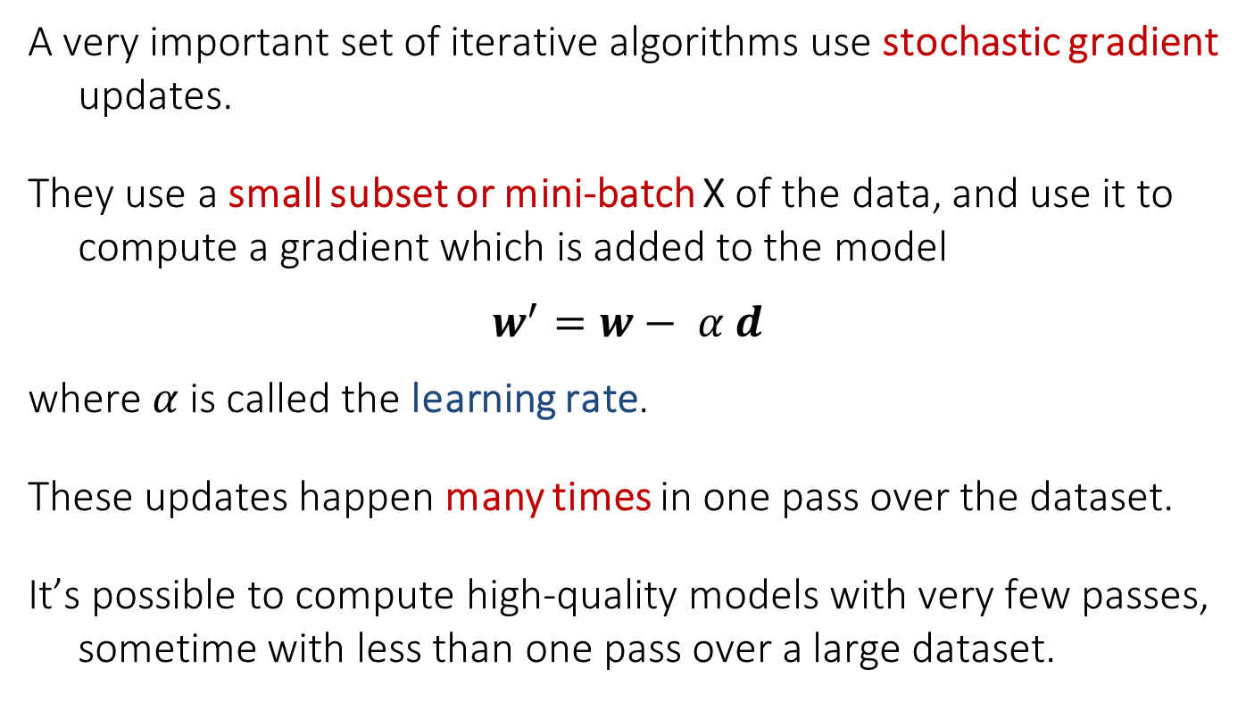
Stochastic Gradient with Mini-Batch
A very important set of iterative algorithms use stochastic gradient updates.
They use a small subset or mini-batch X of the data, and use it to compute a gradient which is added to the model
$$w^{′}=w− α d$$
where $α$is called the learning rate.
These updates happen many times in one pass over the dataset.
It’s possible to compute high-quality models with very few passes, sometime with less than one pass over a large dataset.

Slide 36
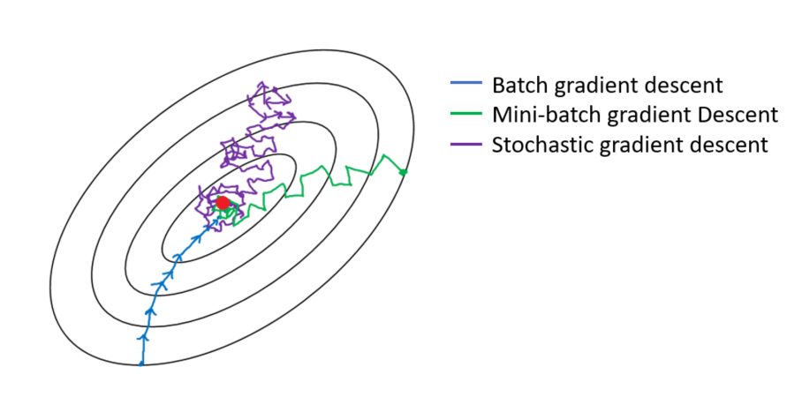
Stochastic Gradient with Mini-Batch

Slide 37
Mini-Batch Methods

Slide 38
Mini-Batch Methods

Slide 39
Challenges for Stochastic Gradient
Stochastic gradient has some serious limitations however, especially if the gradients vary widely in magnitude. Some coefficients change very fast, others very slowly.
This happens for text, user activity and social media data (and other power-law data), because gradient magnitudes scale with feature frequency, i.e. over several orders of magnitude.
It’s not possible to set a single learning rate that trains the frequent and infrequent features at the same time.

Slide 40
ADAGRAD – Adaptive-rate SGD
ADAGRAD is a particularly simple and fast approach to this problem. Let
ADAGRAD updates weights as
Division and square root applied element-wise
This corrects for feature scale factors, and all ADAGRAD-scaled gradient components have similar magnitudes.
ADAGRAD often improves SGD convergence on power-law data by orders of magnitude.

Slide 41
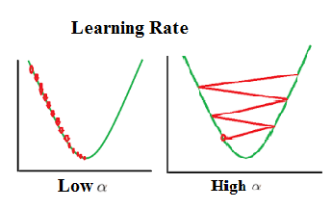
Learning Rate

Slide 42
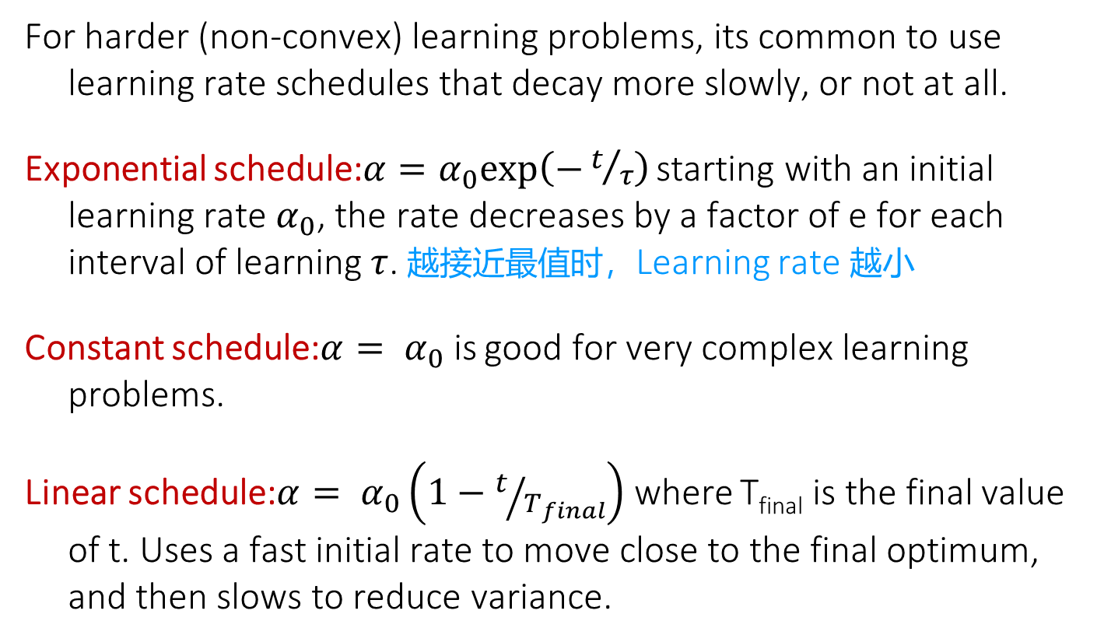
SGD learning rate schedules
For harder (non-convex) learning problems, its common to use learning rate schedules that decay more slowly, or not at all.
Exponential schedule:$α=α_{0}exp\left(−t/τ\right)$ starting with an initial learning rate $α_{0}$, the rate decreases by a factor of e for each interval of learning $τ$. 越接近最值时，Learning rate 越小
Constant schedule:$α= α_{0}$ is good for very complex learning problems.
Linear schedule:$α= α_{0}\left(1−t/{T_{final}}\right)$ where T_{final} is the final value of t. Uses a fast initial rate to move close to the final optimum, and then slows to reduce variance.

Slide 43
More Reading
http://web.stanford.edu/class/cs224n/readings/gradient-notes.pdf

