Slide 1
COMP4901K/Math4824B Machine Learning for Natural Language Processing
Lecture 13: Midterm Review
Instructor: Yangqiu Song

Slide 2
A General Pipeline of Building a Classifier
Pre-processing data
Tokenization
Stemming/
normalization
N-gram
Stopwords filtering
Preparing input data for machine learning
Feature construction (e.g., VSM)
Feature construction (e.g., word embeddings)
Feature selection
(e.g., DF filtering)
Configuration of Data and Metrics for Test
Training/Dev/Testing
K-Fold Cross Validation
Evaluation Metrics
Model Specification and Selection
Specify models based on assumptions
Evaluate model based on C.V. and metrics
Output the model for future use
Notes:
Naïve bayes: features are conditionally independent given the label.
Perceptron: data are linearly separable.

Slide 3
Midterm
We have developed 8 questions
In-class on Oct. 23 (Tuesday)
Haven’t decided whether we will reduce the number of questions in midterm
No cheatsheet is allowed

Slide 4
Question 1
We will ask you about some basic concepts, e.g.,
Overfitting
Smoothing
Feature selection

Slide 5
Overfitting
30
25
20
Degree 15 polynomial
15
10
5
0
-5
-10
-15
0
2
4
6
8
10
12
14
16
18
20

Slide 6


Example: Overfitting
$$\frac{P(w|Not spam) }{P(w|Spam) }$$
$$\frac{P(w|Spam) }{P(w|Not spam) }$$
south-west : inf
nation : inf
morally : inf
nicely : inf
extent : inf
seriously : inf
...
screens : inf
minute : inf
guaranteed : inf
$205.00 : inf
delivery : inf
signature : inf
...
Posteriors determined by relative probabilities (odds ratios):
Overfitting occurs, for example, when you use every word as a feature, including those rare words. Eg: some rare words only show up once in un-spam emails and do not show up in spam emails.

Slide 7
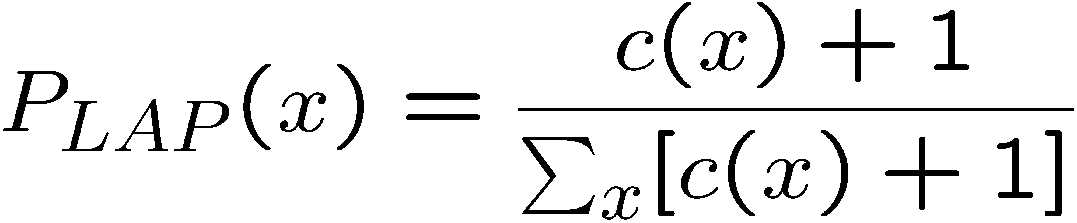
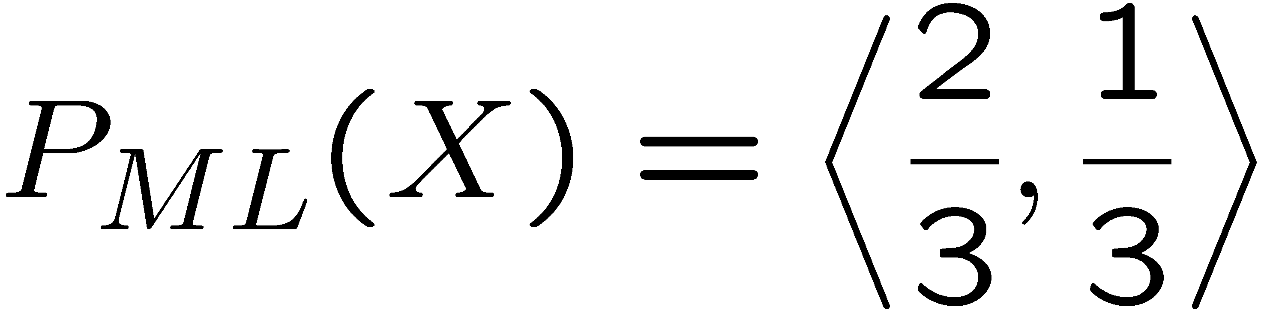
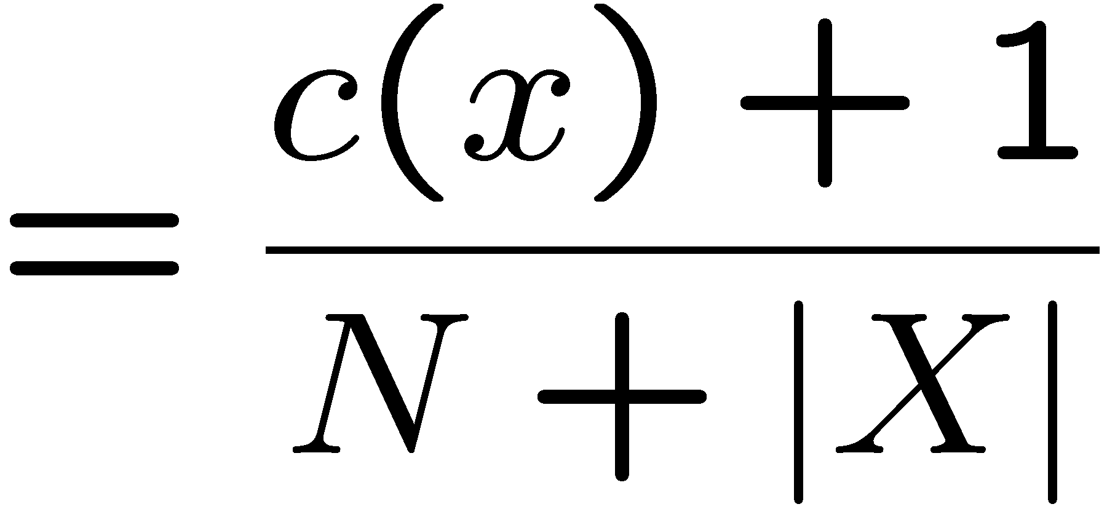
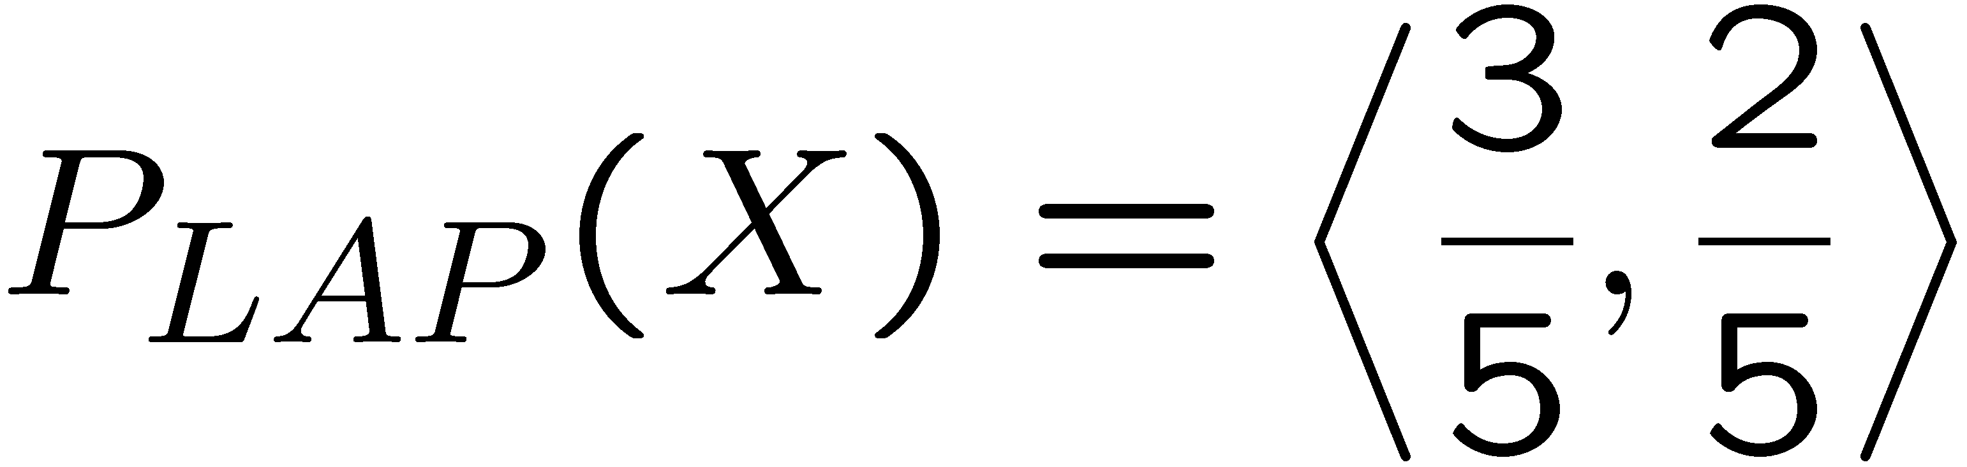
Laplace Smoothing
Laplace’s estimate:
Pretend you saw every outcome once more than you actually did
Can derive this estimate with Dirichlet priors
Very small k: you just want to fit your training data well, and solve the “infinity” problem.
r
r
b

Slide 8
Question 2: Preprocessing
Read some code and provide the results

Slide 9
Summary of Preprocessing
Example: ‘Text mining is to identify useful information.’
Tokenization:
D1: ‘Text’, ‘mining’, ‘is’, ‘to’, ‘identify’, ‘useful’, ‘information’, ‘.’
Stemming/normalization: reduce words in different form to 同一词根
D1: ‘text’, ‘mine’, ‘is’, ‘to’, ‘identify’, ‘use’, ‘inform’, ‘.’
N-gram construction:
D1: ‘text-mine’, ‘mine-is’, ‘is-to’, ‘to-identify’, ‘identify-use’, ‘use-inform’, ‘inform-.’
Stopword/controlled vocabulary filtering:
D1: ‘text-mine’, ‘to-identify’, ‘identify-use’, ‘use-inform’
Optional

Slide 10
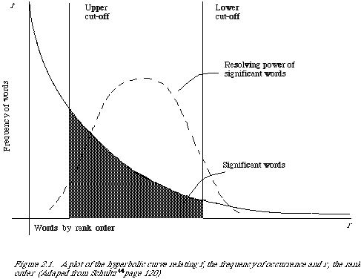
Better Document Representation
Remove non-informative words
Remove rare words

Slide 11
Stopwords
Useless words for document analysis
Not all words are informative
Remove such words to reduce vocabulary size
No universal definition
Risk: break the original meaning and structure of text
E.g., this is not a good option -> option
to be or not to be -> null

Slide 12
Question 3: TFIDF Weighting
Read some code and provide the results

Slide 13
Term Weighting
Term as the basis for vector space
Doc1: Text mining is to identify useful information.
Doc2: Useful information is mined from text.
Doc3: Apple is delicious.
“Repeated occurrences” are less informative than the “first occurrence”
Information about semantic does not increase proportionally with number of term occurrence
 | text | information | identify | mining | mined | is | useful | to | from | apple | delicious
Doc1 | 1 | 1 | 1 | 1 | 0 | 1 | 1 | 1 | 0 | 0 | 0
Doc2 | 1 | 1 | 0 | 0 | 1 | 1 | 1 | 0 | 1 | 0 | 0
Doc3 | 0 | 0 | 0 | 0 | 0 | 1 | 0 | 0 | 0 | 1 | 1

Slide 14
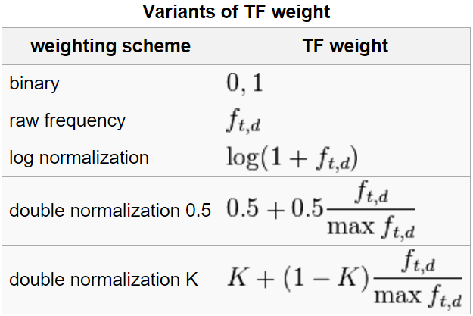
Term Frequency Weights
Examples of weighting terms
Number of times term t appearing in document d

Slide 15
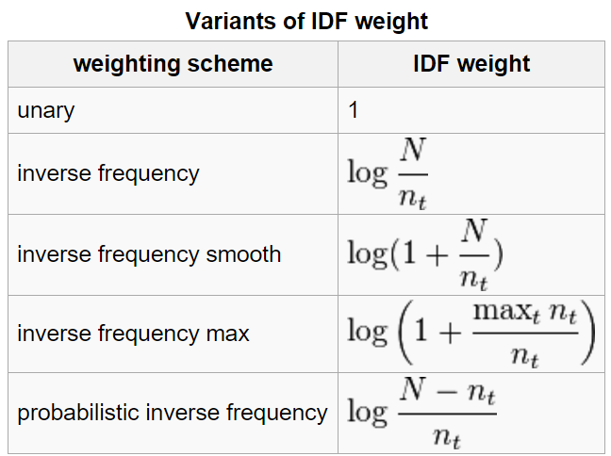
Inverse Document Frequency
Examples of IDF 出现次数特别多 -> inverse frequency 很小
Non-linear scaling
Total number of docs in collection
Number of docs containing term t

Slide 16
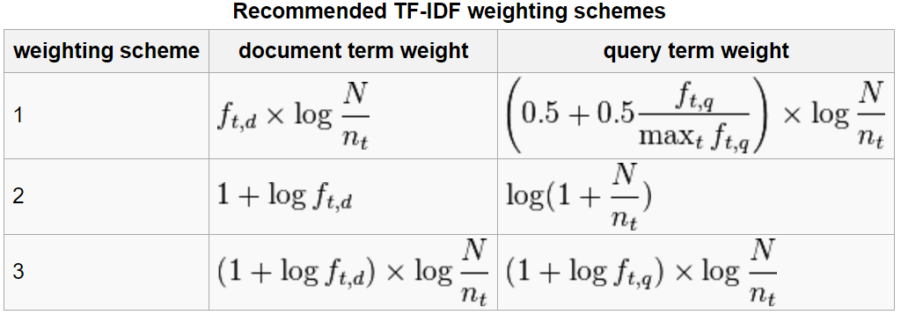
TFIDF
Term frequency–Inverse document frequency
Higher tf: more frequently a word appearing in a document
Higher idf: less frequently a word appearing in a corpus
corpus 包含很多 document

Slide 17
Question 4: WordNet Similarity
Compute the similarity given a WordNet

Slide 18
WordNet Similarity
Path based similarity measure between words
Shortest path between two concepts (Leacock & Chodorow 1998)
sim = 1/|shortest path| path 越短，similarity 越大
Path length to the root node from the least common subsumer (LCS) of the two concepts (Wu & Palmer 1994)
sim = 2*depth(LCS)/(depth(w₁)+depth(w₂))
Others

Slide 19
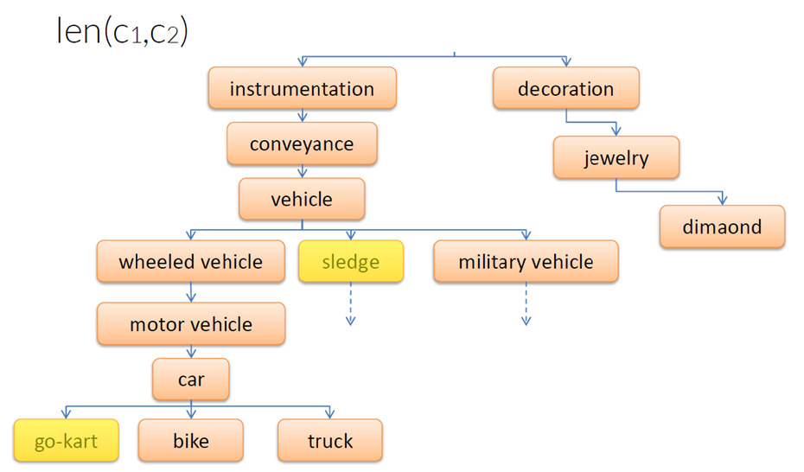
Shortest Path between Two Concepts
sim = 1/len(c1, c2)

Slide 20
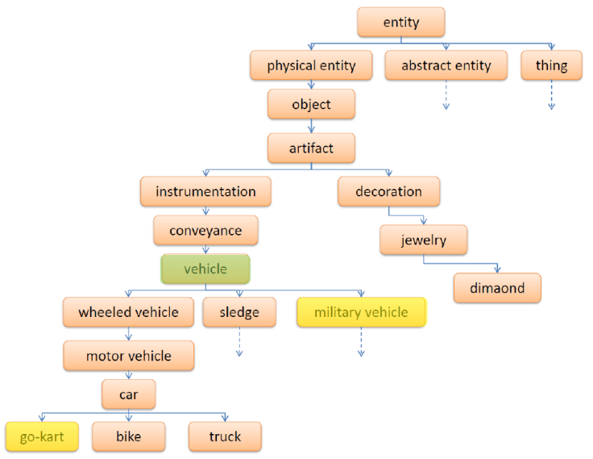
Least Common Subsumer
sim = 2*depth(LCS)/(depth(w₁)+depth(w₂))

Slide 21
Question 5: Vector Space Model
Compute the similarity using VSM

Slide 22
Document Similarity
Finance
TF-IDF space
Euclidean Distance
Cosine Similarity
D₁
The choice of angle
The choice of Euclidean distance
D₂
D₆
Sports
Finance
D₂
TF-IDF space
D₁
D₆
Sports

Slide 23
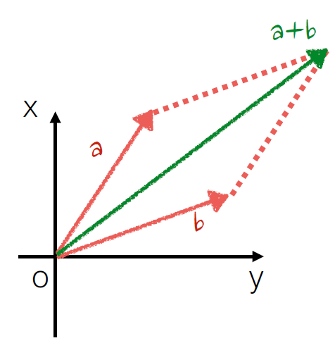
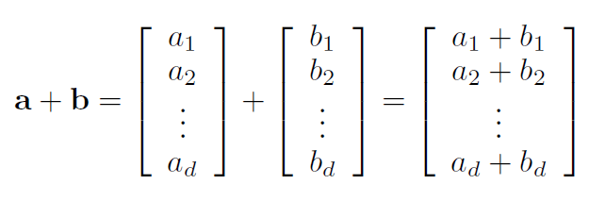
Vector Operations
Addition

Slide 24
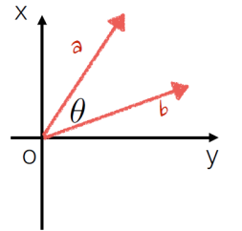
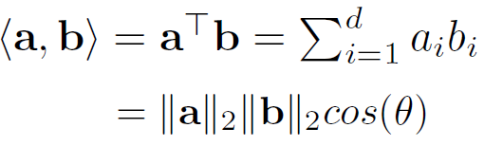

Vector Operations
Inner product
Cosine similarity

Slide 25
Vector Norm
In cosine similarity, we use 2-norm

Slide 26
Question 6: Classification
Concepts about classification and linearly separable data

Slide 27
Classification vs. Clustering
!!! Classification assumes labeled data: we know how many classes there are and we have examples for each class (labeled data).
Classification is supervised
!!! In Clustering we don’t have labeled data; we just assume that there is a natural division in the data and we may not know how many divisions (clusters) there are
Clustering is unsupervised

Slide 28
Classification
Class1
Class2

Slide 29
Classification
Class1
Class2

Slide 30
Classification
Class1
Class2

Slide 31
Classification
Class1
Class2

Slide 32
Clustering

Slide 33
Clustering

Slide 34
Clustering

Slide 35
Clustering
Three-classes clustering

Slide 36
Clustering
Four-classes clustering

Slide 37
Linearly separable data
Class1
Linear Decision boundary
Class2

Slide 38
Non linearly separable data
Class1
Class2

Slide 39
Non linearly separable data
Class1
Non Linear Classifier
Class2

Slide 40
Question 7: Naïve Bayes
Perform parameter estimation and prediction using Naïve Bayes classifier

Slide 41
Parameter Estimation for Naïve Bayes
Maximum likelihood estimation: Simply use the frequencies in the data
For each label
For each word
Create mega-document for label $y_{i}$ by concatenating all docs in this topic
Use frequency of w in mega-document
$$P\left(Y=y_{i}\right)=\frac{\#document(y_{d}=y_{i})}{\#document}$$
$$P\left(W=w_{j}|y_{i}\right)=\frac{\sum_{d}{\#count(y_{d}=y_{i},w_{j})}}{\sum_{w}{\sum_{d}{count(y_{d}=y_{i},w_{j})}}}$$
fraction of times word $w_{j}$ appears among all words in documents of label $y_{i}$

Slide 42
Example: Spam Filtering
$$P\left(Y=y_{i},w_{1},…,w_{M}\right)=P\left(Y=y_{i}\right)\prod_{j}^{M}{P\left(w_{j}|Y=y_{i}\right)}$$
Model:
What are the parameters?
$$P(Y)$$
$$P(w|Y=Spam)$$
$$P(w|Y=Not spam)$$
Not spam : 0.66
Spam: 0.33
the : 0.0156
to : 0.0153
and : 0.0115
of : 0.0095
you : 0.0093
a : 0.0086
with: 0.0080
from: 0.0075
...
the : 0.0210
to : 0.0133
of : 0.0119
2002: 0.0110
with: 0.0108
from: 0.0107
and : 0.0105
a : 0.0100
...

Slide 43
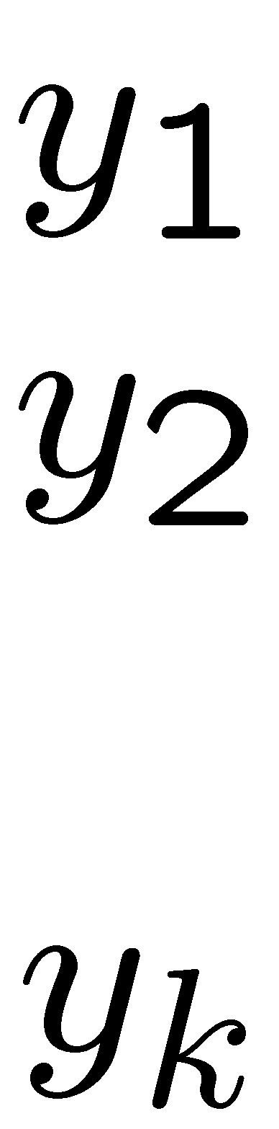
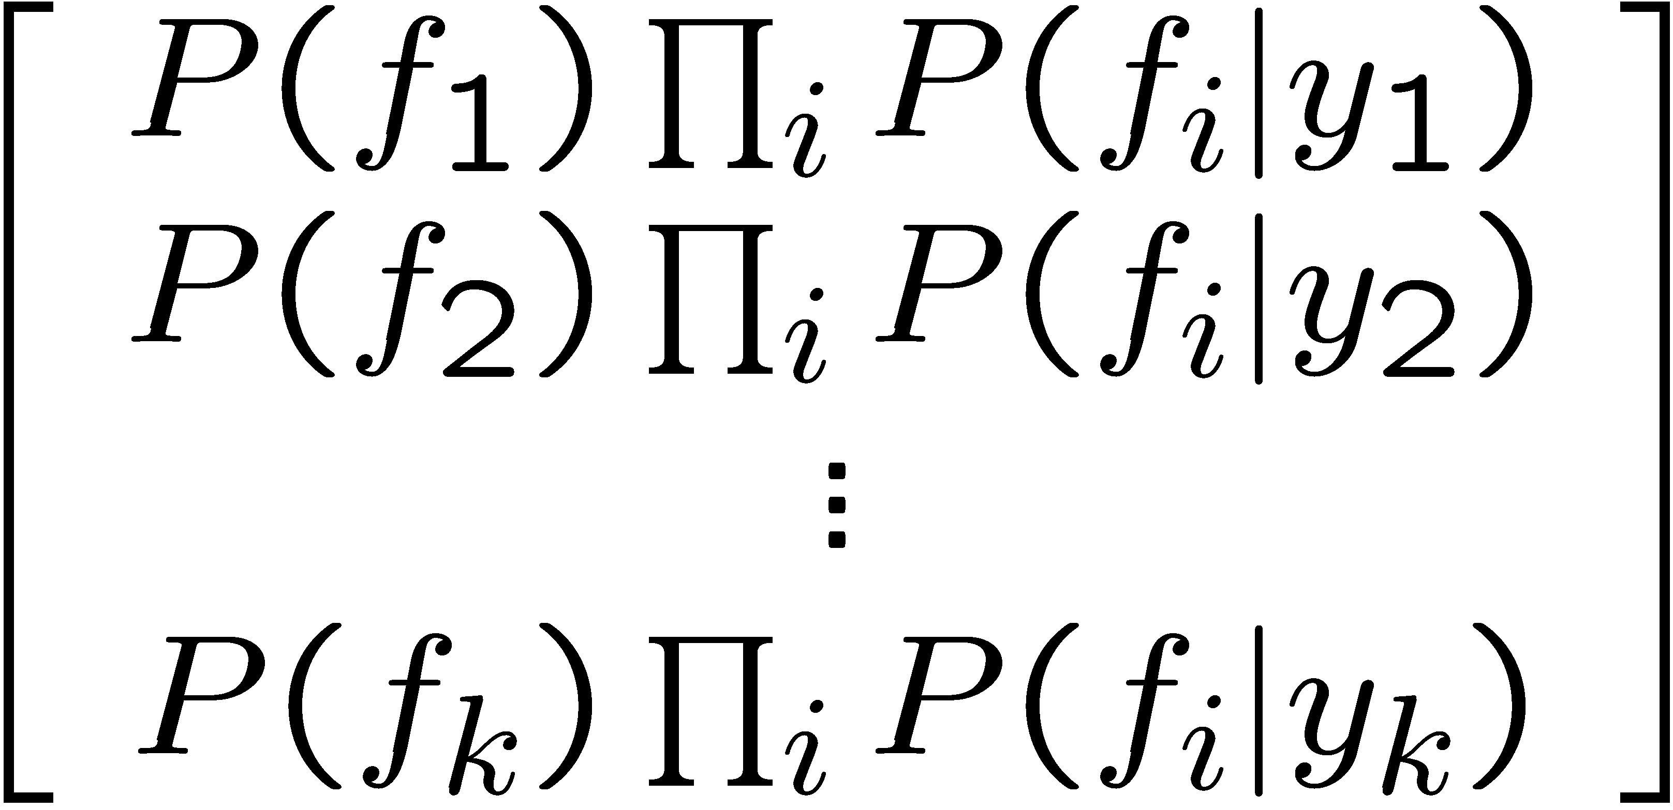



Spam Example
+
Word | P(w|spam) | P(w|not) | Total Spam | Total Not
(prior) | 0.33333 | 0.66666 | -1.1 | -0.4
Gary | 0.00002 | 0.00021 | -11.8 | -8.9
would | 0.00069 | 0.00084 | -19.1 | -16.0
you | 0.00881 | 0.00304 | -23.8 | -21.8
like | 0.00086 | 0.00083 | -30.9 | -28.9
to | 0.01517 | 0.01339 | -35.1 | -33.2
lose | 0.00008 | 0.00002 | -44.5 | -44.0
weight | 0.00016 | 0.00002 | -53.3 | -55.0
while | 0.00027 | 0.00027 | -61.5 | -63.2
you | 0.00881 | 0.00304 | -66.2 | -69.0
sleep | 0.00006 | 0.00001 | -76.0 | -80.5
P(spam | W) = 98.9

Slide 44
Question 8: Evaluation of Classification Results
Compute precision, recall, and F1 for a classifier

Slide 45





Tuning on Held-Out Data
In Naïve Bayes
Parameters: the probabilities P(X|Y), P(Y)
Hyperparameters: e.g. the amount / type of smoothing to do, k, α
What should we learn where?
Learn parameters from training data
Tune hyperparameters on different data
Why?
For each value of the hyperparameters, train and test on the held-out data
Choose the best value and do a final test on the test data

Slide 46
Evaluating classifiers
Contingency table for the evaluation of a binary classifier
 | GREEN is correct | RED is correct
GREEN was assigned | a | b
RED was assigned | c | d
Accuracy = (a+d)/(a+b+c+d) This evaluation method is NOT effective for biased data.
Precision: P_GREEN = a/(a+b), P_ RED = d/(c+d)
Recall: R_GREEN = a/(a+c), R_ RED = d/(b+d)

Slide 47
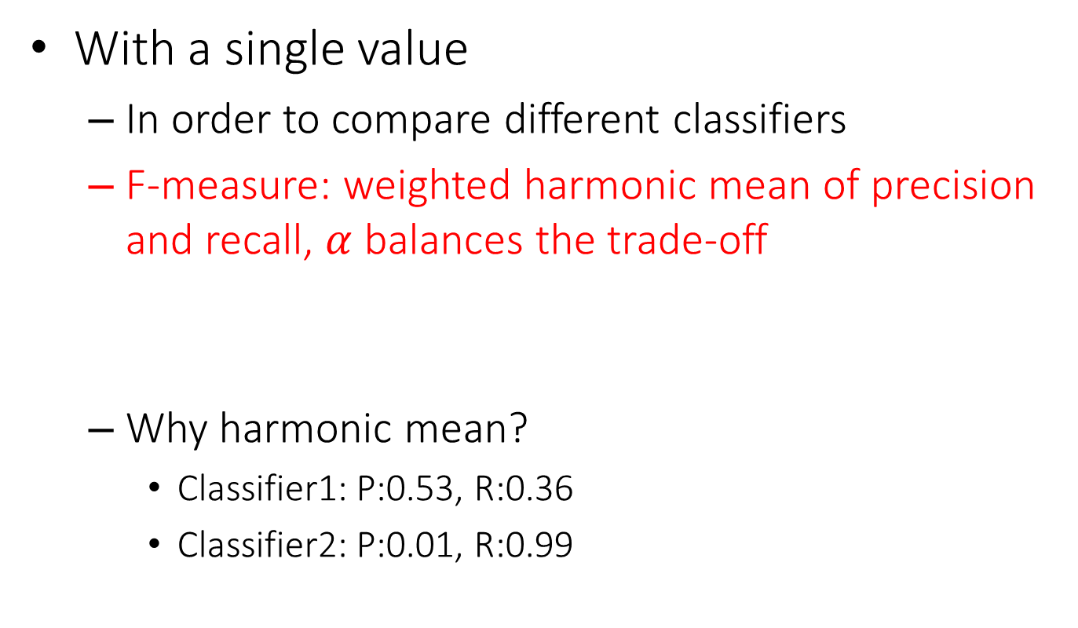
Summarizing precision and recall
With a single value
In order to compare different classifiers
F-measure: weighted harmonic mean of precision and recall, $α$ balances the trade-off
Why harmonic mean?
Classifier1: P:0.53, R:0.36
Classifier2: P:0.01, R:0.99
$$F=\frac{1}{α\frac{1}{P}+\left(1−α\right)\frac{1}{R}}$$
$$\left(F_{1}=\frac{2}{\frac{1}{P}+\frac{1}{R}} \right)$$
Equal weight between precision and recall
Harmonic | Average
0.429 | 0.445
0.019 | 0.500

Slide 48
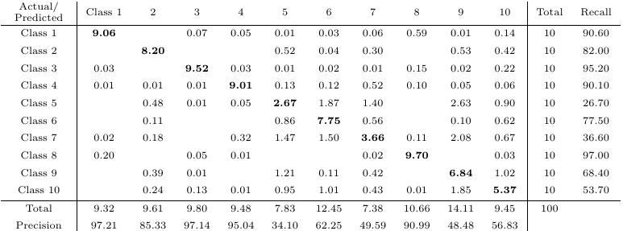
Multi-class Categorization
Confusion matrix
A generalized contingency table for precision and recall

Slide 49

Good Luck! ☺

