Slide 1
COMP4901K/Math4824B Machine Learning for Natural Language Processing
Lecture 14: Logistic Regression and Neural Networks
Instructor: Yangqiu Song
Slides credits: John Canny, Dan Roth

Slide 2
Logistic Regression

Slide 3
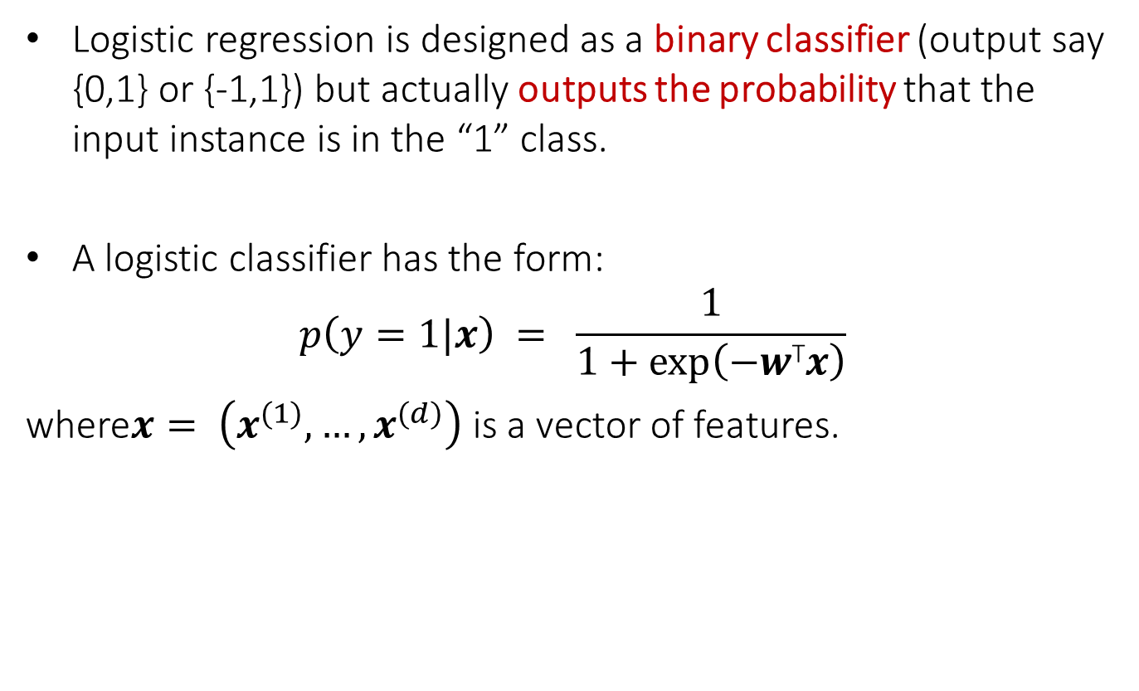
Logistic Regression
Logistic regression is designed as a binary classifier (output say {0,1} or {-1,1}) but actually outputs the probability that the input instance is in the “1” class.
A logistic classifier has the form:
$$p\left(y=1|x\right) = \frac{1}{1+exp⁡\left(−w\text{T}x\right)}$$
where$x= \left(x^{(1)},…,x^{(d)}\right)$ is a vector of features.

Slide 4
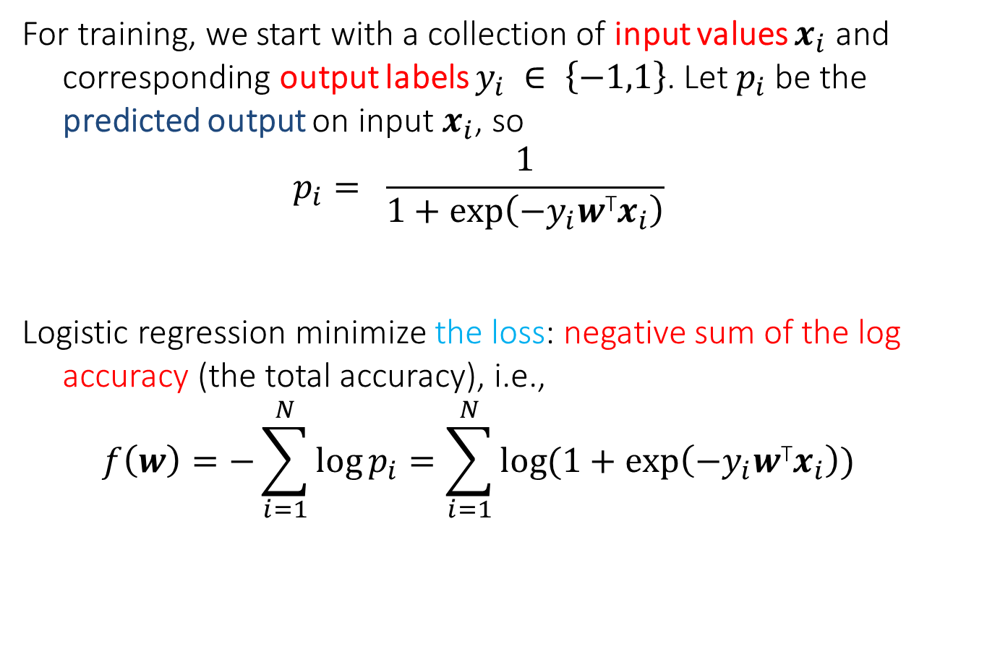
Training
For training, we start with a collection of input values $x_{i}$ and corresponding output labels $y_{i} ∈ \left\{−1,1\right\}$. Let $p_{i}$ be the predicted output on input $x_{i}$, so
$$p_{i}= \frac{1}{1+exp⁡\left(−{y_{i}w\text{T}x}_{i}\right)}$$
Logistic regression minimize the loss: negative sum of the log accuracy (the total accuracy), i.e.,
$$f\left(w\right)=−\sum_{i=1}^{N}{\log{p_{i}}}=\sum_{i=1}^{N}{\log{(1+exp⁡\left(−{y_{i}w\text{T}x}_{i}\right))}}$$

Slide 5
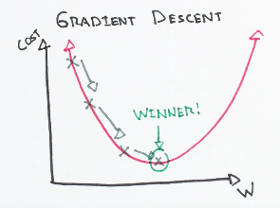
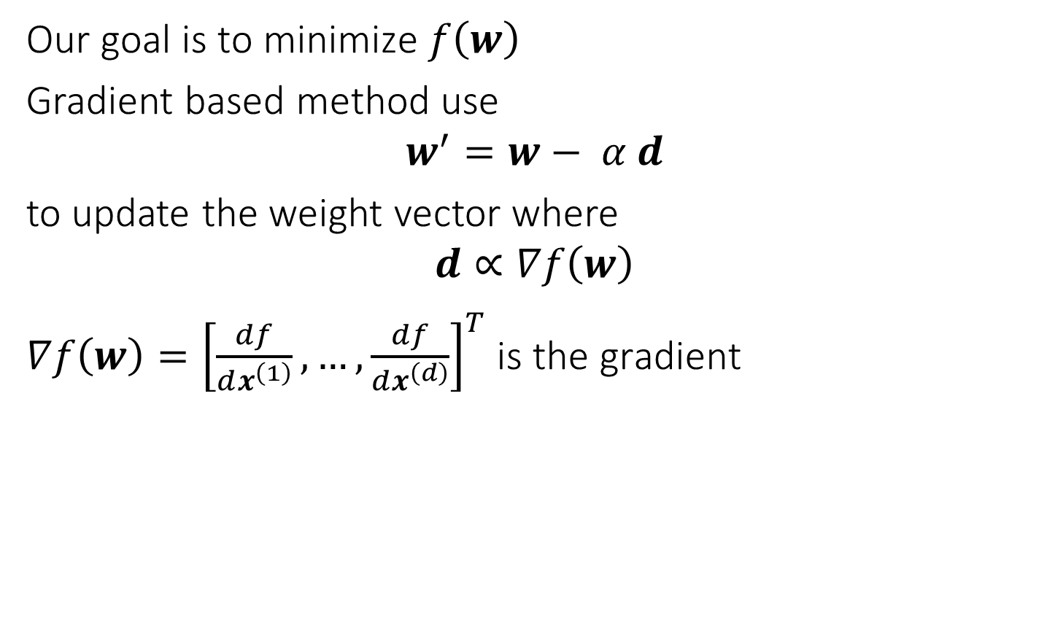
Gradient based methods
Our goal is to minimize $f\left(w\right)$
Gradient based method use
$$w^{′}=w− α d$$
to update the weight vector where
$$d∝∇f\left(w\right)$$
$∇f\left(w\right)={\left[\frac{df}{dx^{\left(1\right)}},…,\frac{df}{dx^{\left(d\right)}}\right]}^{T}$ is the gradient

Slide 6

Deterministic Gradient vs Stochastic Gradient
Deterministic Gradient method: $d∝∇f\left(w\right)$
Stochastic Gradient method:$d∝∇f_{i}\left(w\right)=∇\log{(1+exp⁡\left(−{y_{i}w\text{T}x}_{i}\right))}$

Slide 7
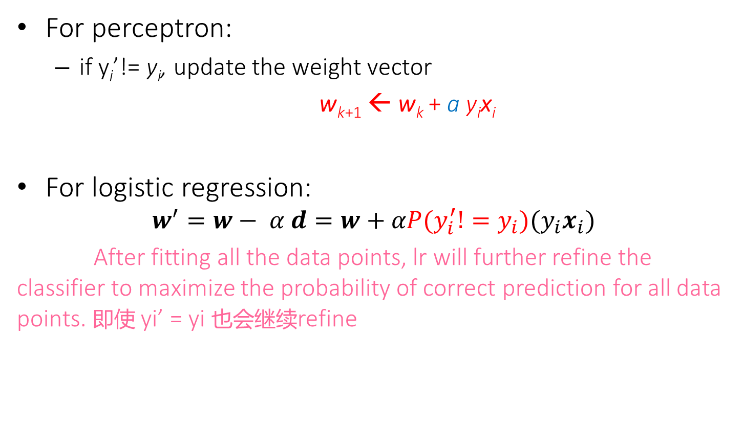
Compared to Perceptron
For perceptron:
if y_{i}’!= y_{i}, update the weight vector
w_{k+1} ← w_{k} + a y_{i}x_{i}
For logistic regression:
$$w^{′}=w− α d=w+αP(y_{i}^{′}!=y_{i})({y_{i}x}_{i})$$
After fitting all the data points, lr will further refine the classifier to maximize the probability of correct prediction for all data points. 即使 yi’ = yi 也会继续refine

Slide 8
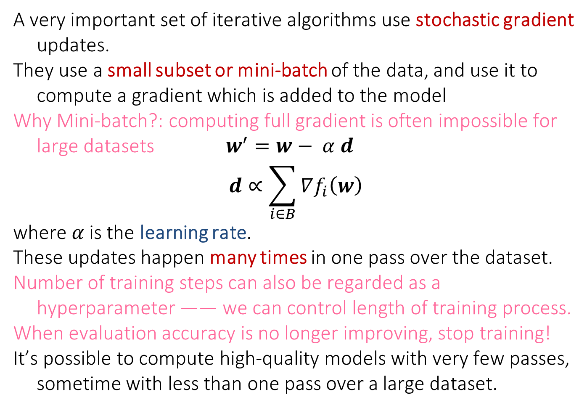
Stochastic Gradient with Mini-Batch
A very important set of iterative algorithms use stochastic gradient updates.
They use a small subset or mini-batch of the data, and use it to compute a gradient which is added to the model
Why Mini-batch?: computing full gradient is often impossible for large datasets $w^{′}=w− α d$
$$d∝\sum_{i∈B}{∇f_{i}\left(w\right)}$$
where $α$is the learning rate.
These updates happen many times in one pass over the dataset.
Number of training steps can also be regarded as a hyperparameter —— we can control length of training process.
When evaluation accuracy is no longer improving, stop training!
It’s possible to compute high-quality models with very few passes, sometime with less than one pass over a large dataset.

Slide 9
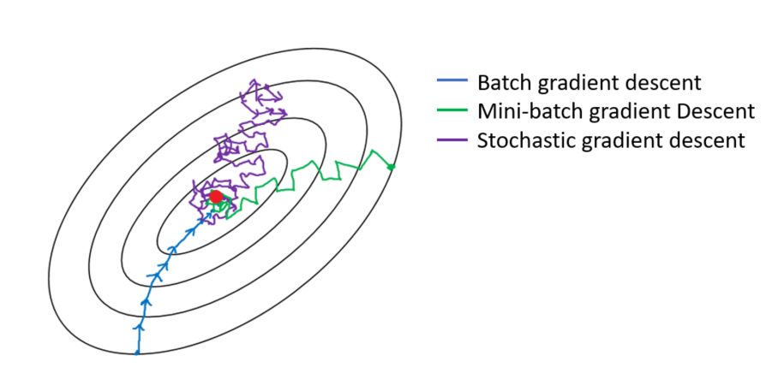
Stochastic Gradient with Mini-Batch

Slide 10
Mini-Batch Methods

Slide 11
Mini-Batch Methods

Slide 12
Challenges for Stochastic Gradient
Stochastic gradient has some serious limitations however, especially if the gradients vary widely in magnitude. Some coefficients change very fast, others very slowly.
This happens for text, user activity and social media data (and other power-law data), because gradient magnitudes scale with feature frequency, i.e. over several orders of magnitude.
It’s not possible to set a single learning rate that trains the frequent and infrequent features at the same time.
The weights of some words may accumulate a lot more than others even if we are using tfidf, but we want to increase the gradient of rare but more informative words. (constructing tfidf is feature engineering part, but here, we just assume the phenomenon that the weights of some features can accumulate).

Slide 13
ADAGRAD – Adaptive-rate SGD
ADAGRAD is a particularly simple and fast approach to this problem. Let
ADAGRAD updates weights as 小圆圈：element-wise operation
Division and square root applied element-wise
g: adaptive gradient
This corrects for feature scale factors, and all ADAGRAD-scaled gradient components have similar magnitudes.
ADAGRAD often improves SGD convergence on power-law data by orders of magnitude.

Slide 14
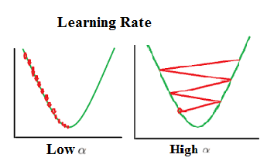
Learning Rate

Slide 15
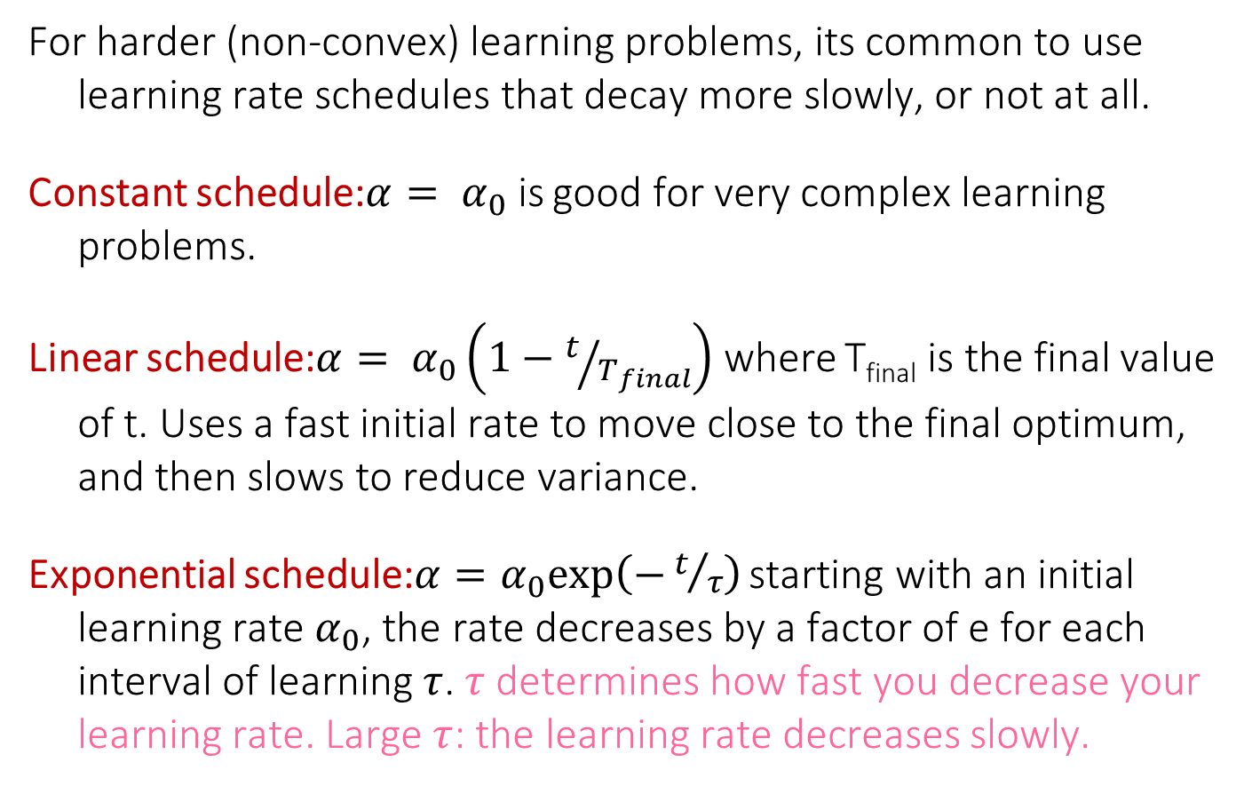
SGD learning rate schedules
For harder (non-convex) learning problems, its common to use learning rate schedules that decay more slowly, or not at all.
Constant schedule:$α= α_{0}$ is good for very complex learning problems.
Linear schedule:$α= α_{0}\left(1−t/{T_{final}}\right)$ where T_{final} is the final value of t. Uses a fast initial rate to move close to the final optimum, and then slows to reduce variance.
Exponential schedule:$α=α_{0}exp\left(−t/τ\right)$ starting with an initial learning rate $α_{0}$, the rate decreases by a factor of e for each interval of learning $τ$. $τ$ determines how fast you decrease your learning rate. Large $τ$: the learning rate decreases slowly.

Slide 16
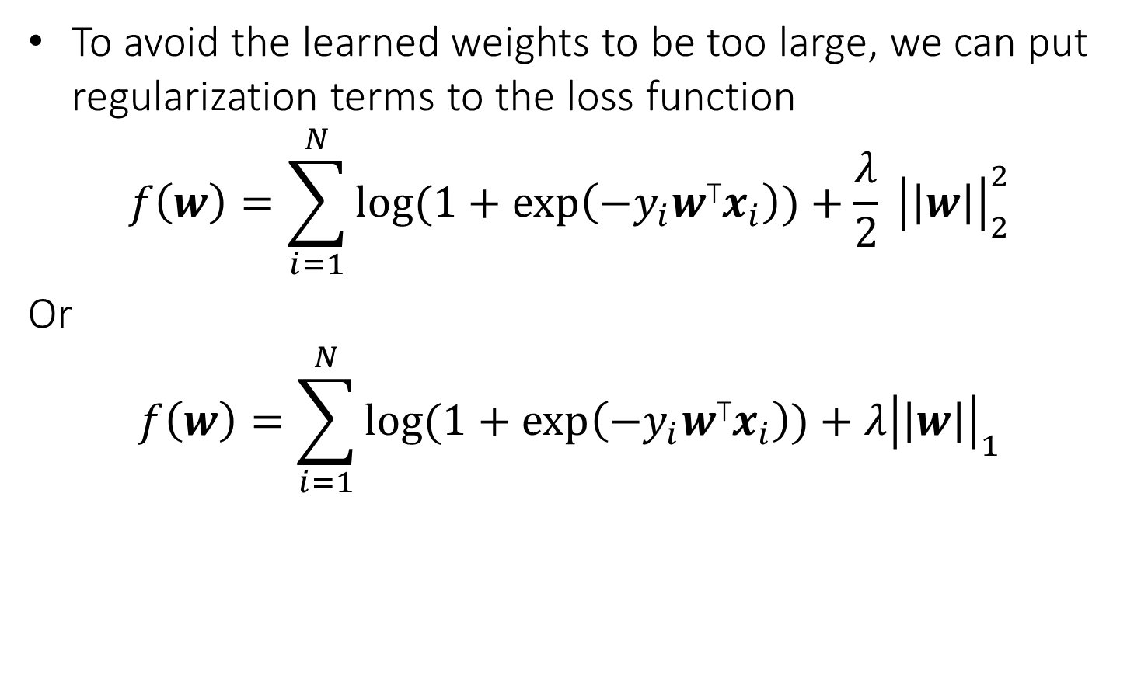
Regularization
To avoid the learned weights to be too large, we can put regularization terms to the loss function
$$f\left(w\right)=\sum_{i=1}^{N}{\log{(1+exp⁡\left(−{y_{i}w\text{T}x}_{i}\right))}+\frac{λ}{2} {\left|\left|w\right|\right|}_{2}^{2}}$$
Or
$$f\left(w\right)=\sum_{i=1}^{N}{\log{(1+exp⁡\left(−{y_{i}w\text{T}x}_{i}\right))}+{λ\left|\left|w\right|\right|}_{1}}$$

Slide 17
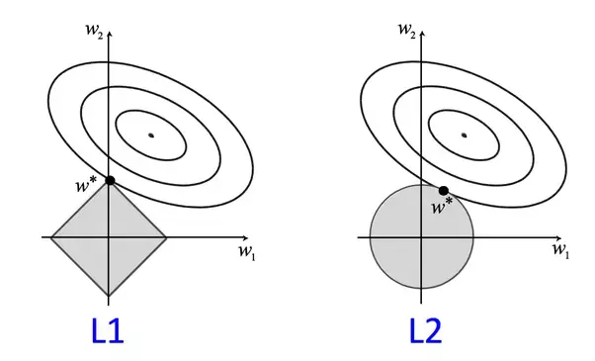
Regularization: Geometric Interpretation
图的意思：在菱形或圆的边界上的点具有相等的norm
L1 can lead to sparse model, very hot in ML!

Slide 18
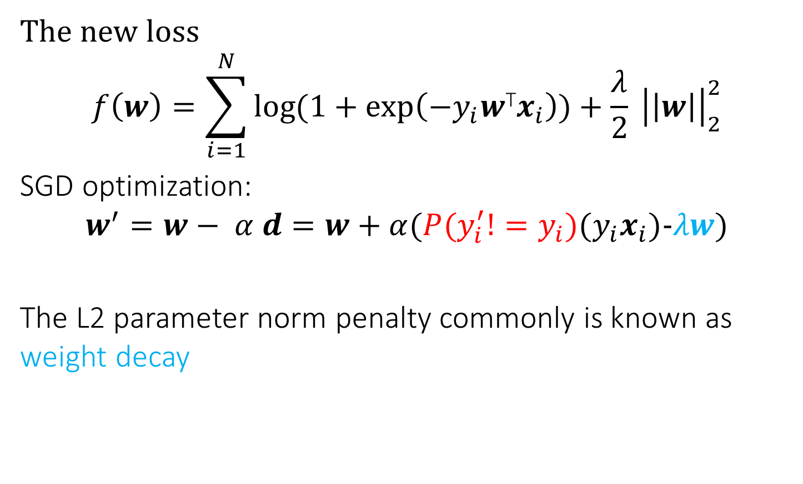
Regularization
The new loss
$$f\left(w\right)=\sum_{i=1}^{N}{\log{(1+exp⁡\left(−{y_{i}w\text{T}x}_{i}\right))}+\frac{λ}{2} {\left|\left|w\right|\right|}_{2}^{2}}$$
SGD optimization:
$$w^{′}=w− α d=w+α(P(y_{i}^{′}!=y_{i})({y_{i}x}_{i})−λw)$$
The L2 parameter norm penalty commonly is known as weight decay

Slide 19
More Reading
Kevin Clark. Computing Neural Network Gradients
http://web.stanford.edu/class/cs224n/readings/gradient-notes.pdf
Daniel Jurafsky and James H. Martin. Logistic regression (Jurafsky and Martin (2017))
https://web.stanford.edu/~jurafsky/slp3/5.pdf
We may come back to related concepts when introducing NN and deep learning algorithms

Slide 20
Neural Networks
Robust approach to approximating real-valued, discrete-valued and vector valued target functions.
Among the most effective general purpose supervised learning method currently known.
Effective especially for complex and hard to interpret input data such as real-world sensory data, where a lot of supervision is available.
The Backpropagation algorithm for neural networks has been shown successful in many practical problems
handwritten character recognition, speech recognition, object recognition, and NLP problems

Slide 21
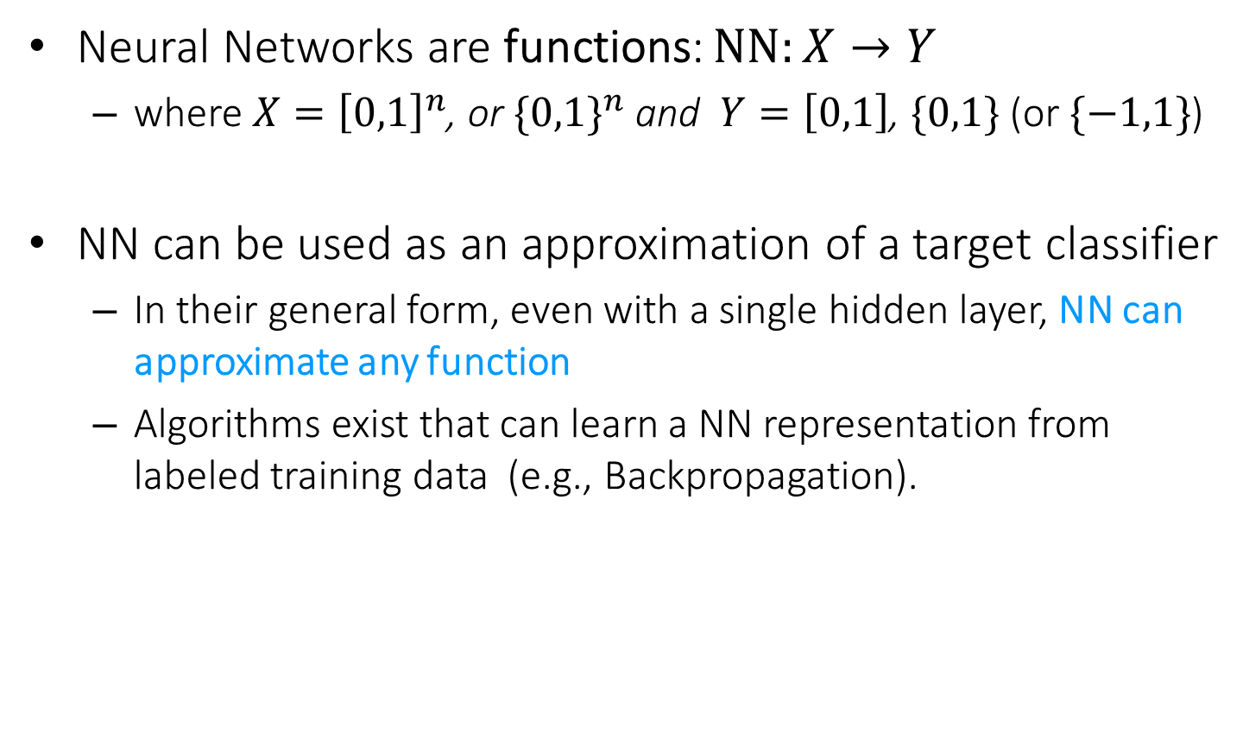
Neural Networks
Neural Networks are functions: $NN:X→Y$
where $X={\left[0,1\right]}^{n}$, or ${\{0,1\}}^{n}$ and $Y=\left[0,1\right]$, $\{0,1\}$ (or $\{−1,1\}$)
NN can be used as an approximation of a target classifier
In their general form, even with a single hidden layer, NN can approximate any function
Algorithms exist that can learn a NN representation from labeled training data (e.g., Backpropagation).

Slide 22
Multi-Layer Neural Networks
Multi-layer network were designed to overcome the computational (expressivity) limitation of a single threshold element.
The idea is to stack several
layers of threshold elements,
each layer using the output of
the previous layer as input.
activation
Output
Hidden
Input

Slide 23
Motivation for Neural Networks
Inspired by biological systems
But don’t take this (as well as any other words in the new on “emergence” of intelligent behavior) seriously;
We are currently on rising part of a wave of interest in NN architectures, after a long downtime from the mid-90-ies.
Better computer architecture (GPUs, parallelism)
A lot more data than before; in many domains, supervision is available.

Slide 24
Motivation for Neural Networks
Little algorithmic changes
Many algorithms/principles have been developed long time ago
One potentially interesting perspective:
Before we looked at NN only as function approximators.
Now, we look at the intermediate representations generated while learning as meaningful, rather than considering it as black-box approach to generate prediction from inputs
Ideas are being developed on the value of these intermediate representations for transfer learning etc. Transfer knowledge from one domain to another, because representation of real-world objects can be shared across multiple domains.
We will present a few of the basic architectures and learning algorithms, and provide some examples for applications

Slide 25
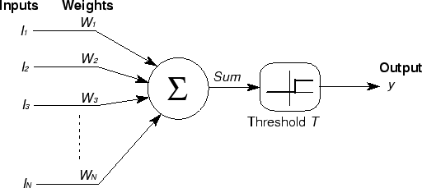






Basic Unit in Multi-Layer Neural Network
Linear Unit: $o_{j}=\vec{w}.\vec{x}$ multiple layers of linear functions produce linear functions. We want to represent nonlinear functions.
Note: Here we use a slightly different notation for dot product $\vec{w}.\vec{x}$
Threshold units: $o_{j}=sgn(\vec{w}.\vec{x}−b)$ are not differentiable, hence unsuitable for gradient descent
$$o_{k}$$
activation
Output
$$w_{jk}$$
$$h_{j}$$
Hidden
$$w_{ij}$$
Input
$$x_{i}$$

Slide 26
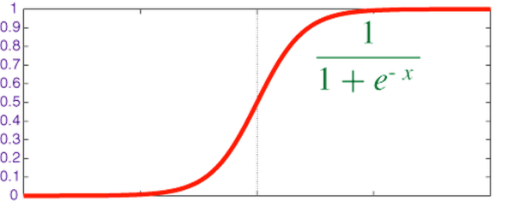

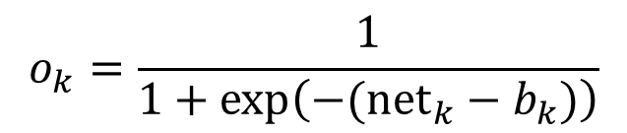

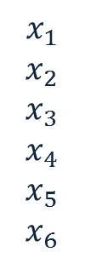



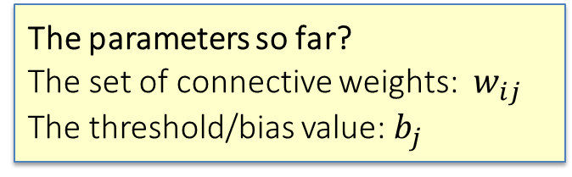

Model Neuron (Logistic, slightly different notations)
Neuron is modeled by a unit $j$ connected by weighted links $w_{ij}$ to other units $i$.
Note: we use a different kind of index of $w$ to indicate different neurons
Use a non-linear, differentiable output function such as the sigmoid or logistic function
Net input to a unit is defined as:
Output of a unit is defined as:
$$x_{1}$$
$$x_{2}$$
$$x_{3}$$
$$x_{4}$$
$$x_{5}$$
$$x_{6}$$
$$w_{17}$$
$${net}_{7}$$
$$o_{7}$$
$$w_{67}$$
The parameters so far?
The set of connective weights: $w_{ij}$ The threshold/bias value: $b_{j}$
$${net}_{k}=∑w_{ik}.x_{i}$$
$$o_{k}=\frac{1}{1+exp\left(−({net}_{k}−b_{k})\right)}$$

Slide 27
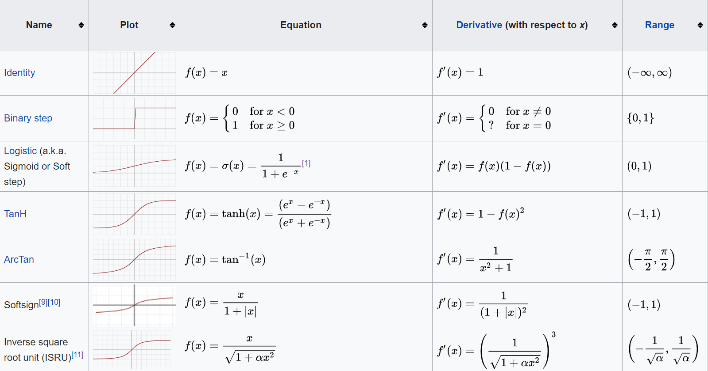
Activation function
https://en.wikipedia.org/wiki/Activation_function

Slide 28



History: Neural Computation
McCollough and Pitts (1943) showed how linear threshold units can be used to compute logical functions
Can build basic logic gates
AND:
OR:
NOT: use negative weight
Can build arbitrary logic circuits, finite-state machines and computers given these basis gates.
Can specify any Boolean function using two layer network (w/ negation)
$${net}_{j}=∑w_{ij}.x_{i}$$
$$o_{j}=\frac{1}{1+exp\left(−({net}_{j}−b_{j})\right)}$$
$$w_{ij}=b_{j}/n$$
$$w_{ij}=b_{j}$$

Slide 29
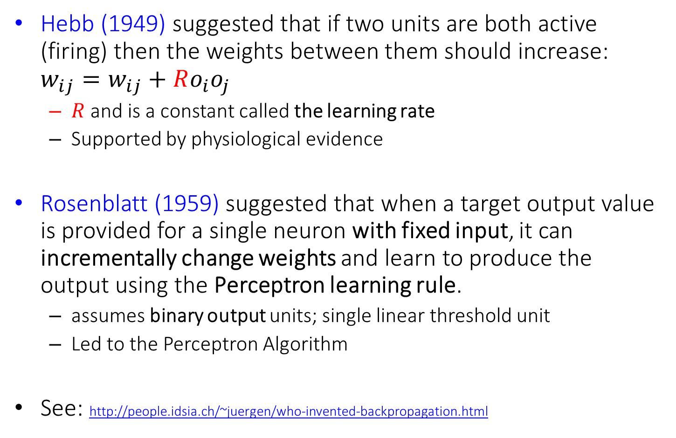
History: Learning Rules
Hebb (1949) suggested that if two units are both active (firing) then the weights between them should increase: $w_{ij}=w_{ij}+Ro_{i}o_{j}$
$R$ and is a constant called the learning rate
Supported by physiological evidence
Rosenblatt (1959) suggested that when a target output value is provided for a single neuron with fixed input, it can incrementally change weights and learn to produce the output using the Perceptron learning rule.
assumes binary output units; single linear threshold unit
Led to the Perceptron Algorithm
See: http://people.idsia.ch/~juergen/who-invented-backpropagation.html

Slide 30


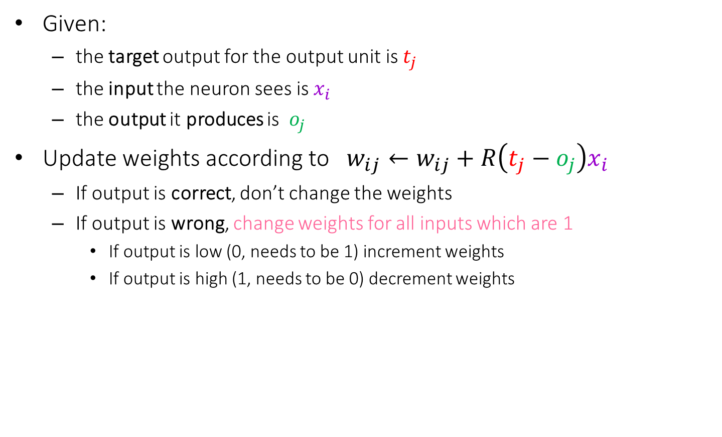




Perceptron Learning Rule: Revisit
Given:
the target output for the output unit is $t_{j}$
the input the neuron sees is $x_{i}$
the output it produces is $o_{j}$
Update weights according to $w_{ij}←w_{ij}+R\left(t_{j}−o_{j}\right)x_{i}$
If output is correct, don’t change the weights
If output is wrong, change weights for all inputs which are 1
If output is low (0, needs to be 1) increment weights
If output is high (1, needs to be 0) decrement weights
$$x_{1}$$
$$x_{2}$$
$$x_{3}$$
$$x_{4}$$
$$x_{5}$$
$$x_{6}$$
$$w_{17}$$
$$x_{7}$$
$$o_{j}$$
$$T_{j}$$
$$w_{67}$$

Slide 31
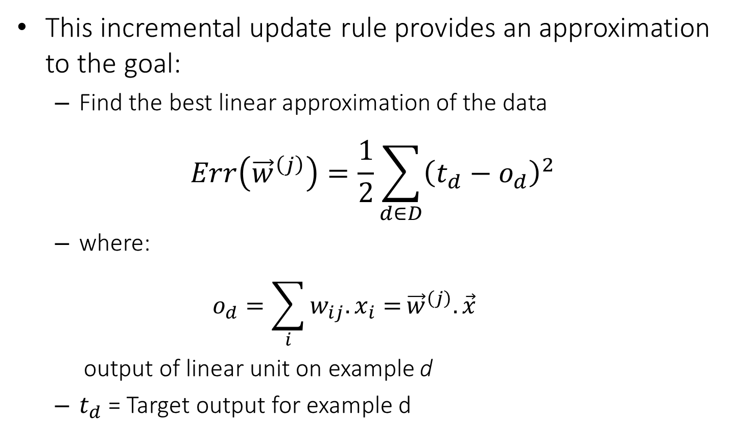
Widrow-Hoff Rule
This incremental update rule provides an approximation to the goal:
Find the best linear approximation of the data
$$Err\left({\vec{w}}^{\left(j\right)}\right)=\frac{1}{2}\sum_{d∈D}{{\left(t_{d}−o_{d}\right)}^{2}}$$
where:
$$o_{d}=\sum_{i}{w_{ij}.x_{i}=}{\vec{w}}^{\left(j\right)}.{\vec{x}}^{}$$
output of linear unit on example d
$t_{d}$ = Target output for example d

Slide 32




Gradient Descent
We use gradient descent determine the weight vector that minimizes $Err\left({\vec{w}}^{\left(j\right)}\right)$;
Fixing the set $D$ of examples, $E$ is a function of ${\vec{w}}^{\left(j\right)}$
At each step, the weight vector is modified in the direction that produces the steepest descent along the error surface.
$Err(w)$
$$w$$
$w_{3}$ $w_{2}$ $w_{1}$ $w_{0}$

Slide 33
Summary: Single Layer Network
Variety of update rules
Multiplicative
Additive
Batch and incremental algorithms
Various convergence and efficiency conditions
There are other ways to learn linear functions
Linear Programming (general purpose)
Probabilistic Classifiers ( some assumption)
Key algorithms are driven by gradient descent
However, the representational restriction is limiting in many applications

Slide 34
Learning with a Multi-Layer Perceptron
It’s easy to learn the top layer – it’s just a linear unit.
Given feedback (truth) at the top layer, and the activation at the layer below it, you can use the Perceptron update rule (more generally, gradient descent) to updated these weights.
The problem is what to do with
the other set of weights – we do
not get feedback in the
intermediate layer(s).
activation
Output
Hidden
Input

Slide 35
Learning with a Multi-Layer Perceptron
activation
Output
The problem is what to do with
the other set of weights – we do
not get feedback in the
intermediate layer(s).
Solution: If all the activation
functions are differentiable, then
the output of the network is also
a differentiable function of the input and weights in the network.
Define an error function (e.g., sum of squares) that is a differentiable function of the output, i.e. this error function is also a differentiable function of the weights.
We can then evaluate the derivatives of the error with respect to the weights, and use these derivatives to find weight values that minimize this error function, using gradient descent (or other optimization methods).
This results in an algorithm called back-propagation.
Hidden
Input

Slide 36
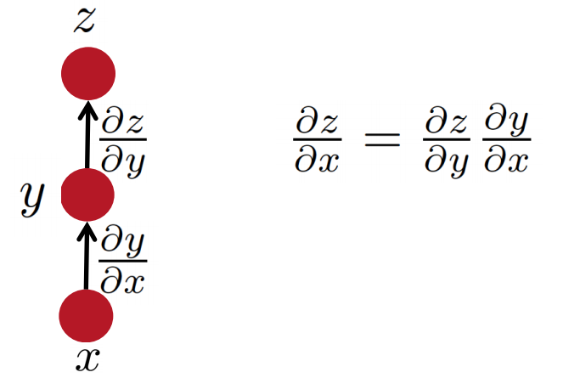

Some facts from real analysis
Simple chain rule
If $z$ is a function of $y$, and $y$ is a function of $x$
Then $z$ is a function of $x$, as well.
Question: how to find $\frac{∂z}{∂x}$
We will use these facts to derive the details of the Backpropagation algorithm.
z will be the error (loss) function.
- We need to know how to differentiate z
Intermediate nodes use a logistics function (or another differentiable step function).
- We need to know how to differentiate it.
Slide Credit: Richard Socher

Slide 37
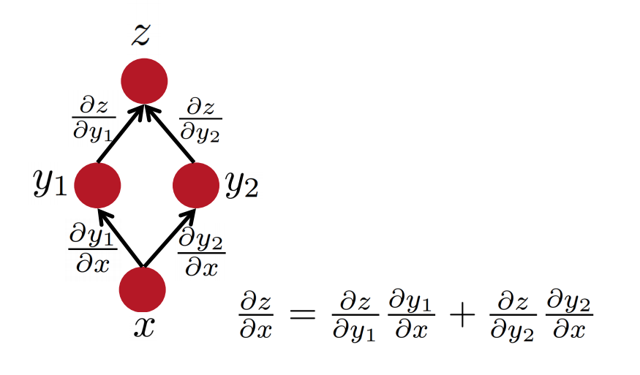
Some facts from real analysis
Multiple path chain rule
Slide Credit: Richard Socher

Slide 38
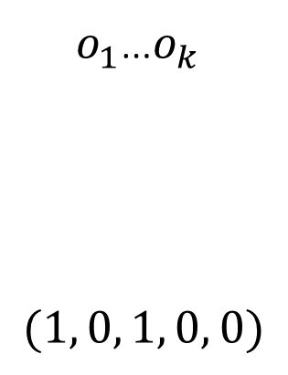
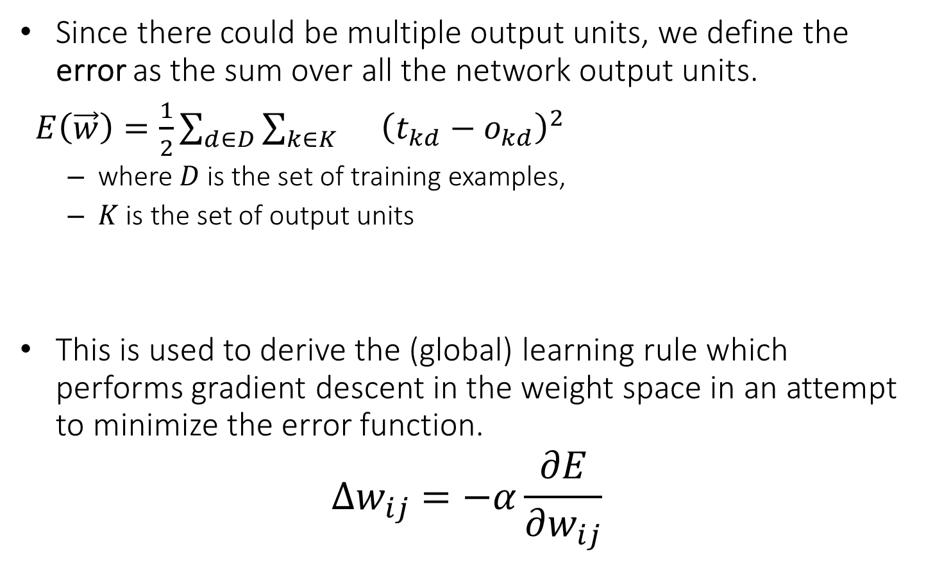
Backpropagation Learning Rule
Since there could be multiple output units, we define the error as the sum over all the network output units.
$E\left(\vec{w}\right)=\frac{1}{2}\sum_{d∈D}{\sum_{k∈K}{}{\left(t_{kd}−o_{kd}\right)}^{2}}$
where $D$ is the set of training examples,
$K$ is the set of output units
This is used to derive the (global) learning rule which performs gradient descent in the weight space in an attempt to minimize the error function.
$$Δw_{ij}=−α\frac{∂E}{∂w_{ij}}$$
$o_{1}$…$o_{k}$
$$(1, 0, 1, 0, 0)$$
Function 1

Slide 39

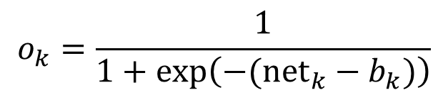
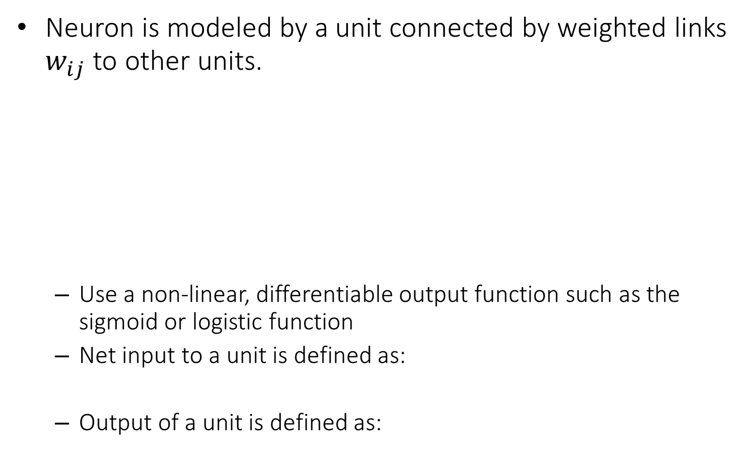
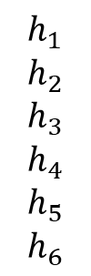


Reminder: Model Neuron (Logistic)
Neuron is modeled by a unit connected by weighted links $w_{ij}$ to other units.
Use a non-linear, differentiable output function such as the sigmoid or logistic function
Net input to a unit is defined as:
Output of a unit is defined as:
$$h_{1}$$
$$h_{2}$$
$$h_{3}$$
$$h_{4}$$
$$h_{5}$$
$$h_{6}$$
$$w_{17}$$
$$x_{7}$$
$$o_{7}$$
$$w_{67}$$
$${net}_{k}=∑w_{jk}.h_{j}$$
Function 3
$$o_{k}=\frac{1}{1+exp\left(−({net}_{k}−b_{k})\right)}$$
Function 2

Slide 40

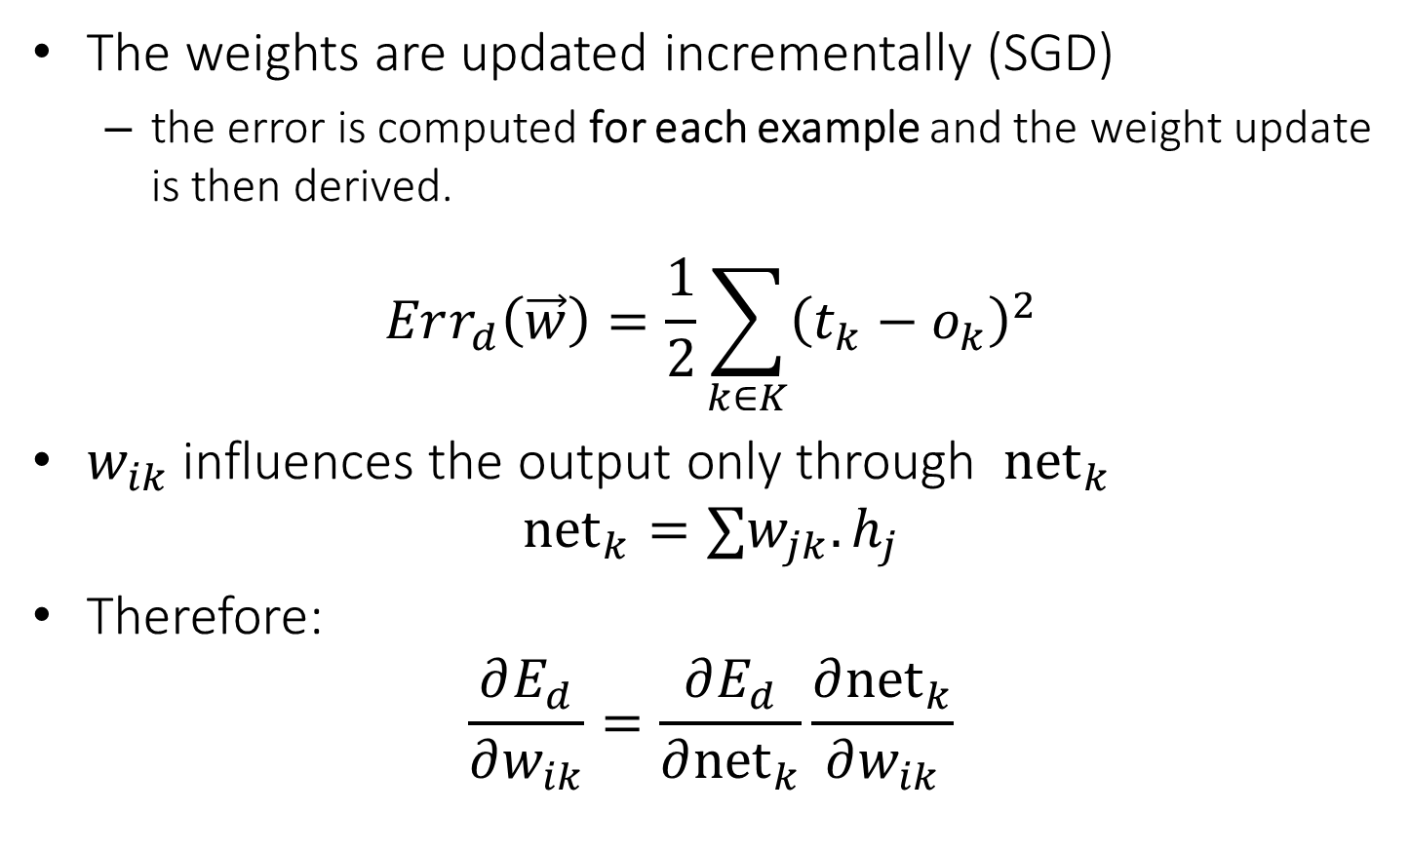


Derivation of Learning Rule
The weights are updated incrementally (SGD)
the error is computed for each example and the weight update is then derived.
$$Err_{d}\left(\vec{w}\right)=\frac{1}{2}\sum_{k∈K}{{\left(t_{k}−o_{k}\right)}^{2}}$$
$w_{ik}$ influences the output only through ${net}_{k}$
$${net}_{k}=∑w_{jk}.h_{j}$$
Therefore:
$$\frac{∂E_{d}}{∂w_{ik}}=\frac{∂E_{d}}{∂{net}_{k}}\frac{∂{net}_{k}}{∂w_{ik}}$$
$o_{k}$
$$w_{jk}$$
$$h_{j}$$

Slide 41
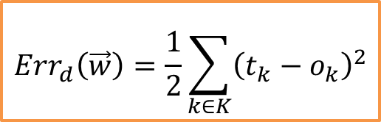





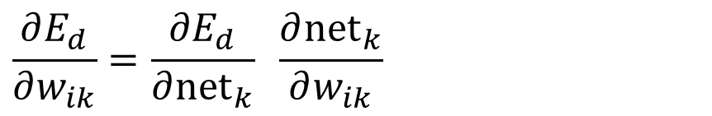

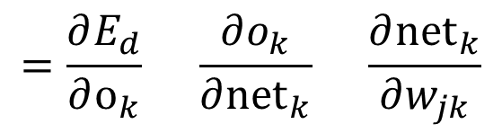

Derivation of Learning Rule (2)
Weight updates of output units:
$w_{ij}$ influences the output only through ${net}_{k}$
Therefore:
$$o_{k}$$
$$w_{jk}$$
$$\frac{∂E_{d}}{∂w_{ik}}=\frac{∂E_{d}}{∂{net}_{k}} \frac{∂{net}_{k}}{∂w_{ik}}$$
$$h_{j}$$
$$=\frac{∂E_{d}}{∂o_{k}} \frac{∂o_{k}}{∂{net}_{k}} \frac{∂{net}_{k}}{∂w_{jk}}$$
$$=−\left(t_{j}−o_{k}\right) o_{k}\left(1−o_{k}\right) h_{j}$$
$$Err_{d}\left(\vec{w}\right)=\frac{1}{2}\sum_{k∈K}{{\left(t_{k}−o_{k}\right)}^{2}}$$
$$\frac{∂o_{k}}{∂{net}_{k}}=o_{k}(1−o_{k})$$
$$o_{k}=\frac{1}{1+\exp{\{−({net}_{k}−b_{k})\}}}$$
$${net}_{k}=∑w_{jk}.h_{j}$$

Slide 42
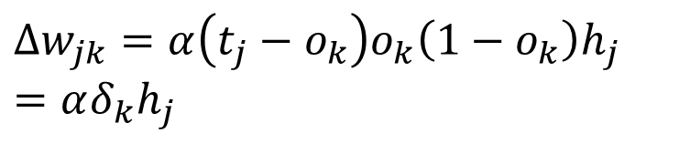




Derivation of Learning Rule (3)
$$o_{k}$$
Weights of output units:
$w_{ik}$ is changed by:
where we set
$δ_{k}=−\frac{∂E_{d}}{∂{net}_{k}}=−\frac{∂E_{d}}{∂o_{k}}\frac{∂o_{k}}{∂{net}_{k}}=\left(t_{k}−o_{k}\right)o_{k}\left(1−o_{k}\right)$
$α$ is the learning rate
$$w_{jk}$$
$$Δw_{jk}=α\left(t_{j}−o_{k}\right)o_{k}\left(1−o_{k}\right)h_{j}=αδ_{k}h_{j}$$
$$h_{j}$$

Slide 43
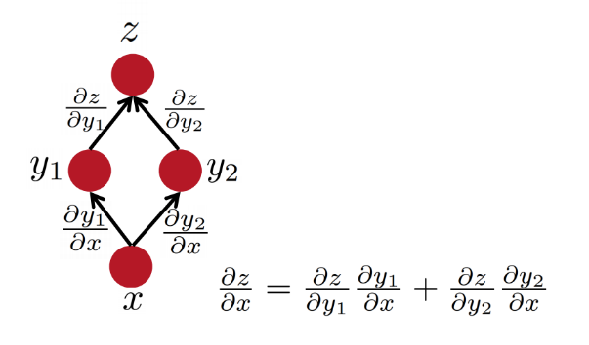

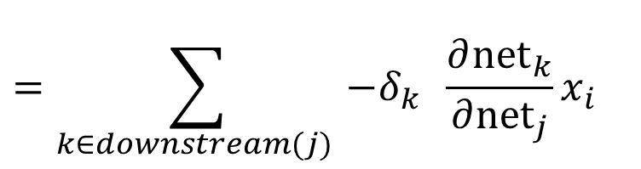



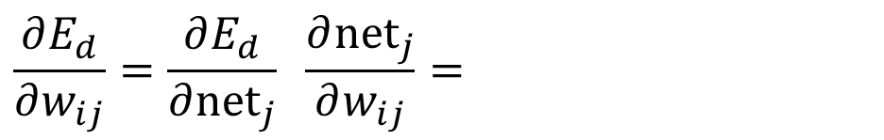

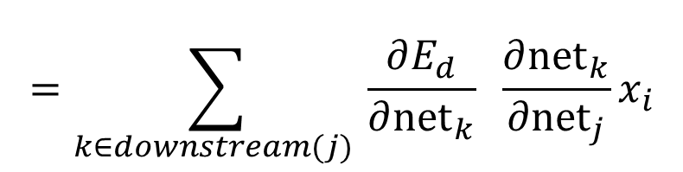

Derivation of Learning Rule (4)
Weights of hidden units:
$w_{ij}$ Influences the output only through all the units whose direct input include $j$
$$E_{d}$$
$$o_{k}$$
$${net}_{j}=∑w_{ij}.x_{i}$$
$h_{j}$
$x_{i}$
$$\frac{∂E_{d}}{∂w_{ij}}=\frac{∂E_{d}}{∂{net}_{j}} \frac{∂{net}_{j}}{∂w_{ij}}=$$
$$w_{ij}$$
$$=\sum_{k∈downstream(j) }{\frac{∂E_{d}}{∂{net}_{k}} \frac{∂{net}_{k}}{∂{net}_{j}}x_{i}}$$
$$=\sum_{k∈downstream(j) }{−δ_{k} \frac{∂{net}_{k}}{∂{net}_{j}}x_{i}}$$

Slide 44
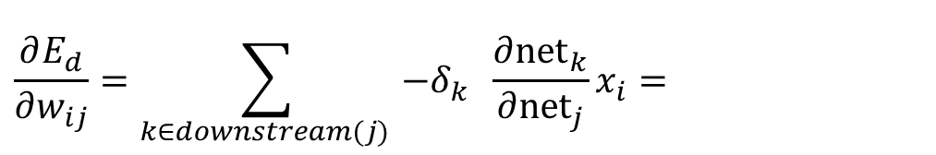








Derivation of Learning Rule (5)
Weights of hidden units:
$w_{ij}$influences the output only through all the units whose direct input include $j$
$$o_{k}$$
$$\frac{∂E_{d}}{∂w_{ij}}=\sum_{k∈downstream(j) }{−δ_{k} \frac{∂{net}_{k}}{∂{net}_{j}}x_{i}}=$$
$h_{j}$
$$x_{i}$$
$$w_{ij}$$
$$=\sum_{k∈downstream(j) }{−δ_{k} \frac{∂{net}_{k}}{∂h_{j}}\frac{∂h_{j}}{∂{net}_{j}}x_{i}}$$
$$=\sum_{k∈downstream(j) }{−δ_{k} w_{jk}{ h}_{j}(1−h_{j}) x_{i}}$$
$${net}_{j}=∑w_{ij}.x_{i}$$
$$\frac{∂h_{j}}{∂{net}_{j}}=h_{j}(1−h_{j})$$
$$h_{j}=\frac{1}{1+\exp{\{−({net}_{j}−b_{j})\}}}$$

Slide 45



Derivation of Learning Rule (6)
Weights of hidden units:
$w_{ij}$ is changed by:
Where
$$δ_{j}=h_{j}\left(1−h_{j}\right).\left(\sum_{k∈downstream\left(j\right)}{−δ_{k} w_{jk} }\right)$$
First determine the error for the output units.
Then, backpropagate this error layer by layer through the network, changing weights appropriately in each layer.
$${Δw_{ij}=α h}_{j}\left(1−h_{j}\right).\left(\sum_{k∈downstream\left(j\right)}{−δ_{k} w_{jk} }\right)x_{ij}=αδ_{j}x_{ij}$$
$$o_{k}$$
$h_{j}$
$$x_{i}$$
$$w_{ij}$$

Slide 46

The Backpropagation Algorithm
Create a fully connected three layer network. Initialize weights.
Until all examples produce the correct output within $ε$ (or other criteria)
For each example in the training set do:
Compute the network output for this example
Compute the error between the output and target value
$$δ_{k}=\left(t_{k}−o_{k}\right)o_{k}\left(1−o_{k}\right)$$
For each output unit k, compute error term
$${δ_{j}=h}_{j}\left(1−h_{j}\right).\sum_{k∈downstream\left(j\right)}{−δ_{k} w_{jk} }$$
For each hidden unit, compute error term:
$$Δw_{ij}=αδ_{j}x_{i}$$
Update network weights
End epoch

Slide 47
More Hidden Layers
The same algorithm holds for more hidden layers.
input $h_{}^{1}$ $h_{}^{2}$ $h_{}^{3}$ output

Slide 48
Comments on Training
No guarantee of convergence; may reach a local minima.
In practice, many large networks can be trained on large amounts of data for realistic problems.
Many epochs (tens of thousands) may be needed for adequate training.
Large data sets may require many hours of CPU
Termination criteria:
Number of epochs;
Threshold on training set error;
No decrease in error;
Increased error on a validation set.
To avoid local minima: several trials with different random initial weights with majority or voting techniques

Slide 49
Over-training Prevention
Running too many epochs may over-train the network and result in over-fitting. (improved result on training, decrease in performance on test set)
Keep an hold-out validation set and test accuracy after every epoch
Maintain weights for best performing network on the validation set and return it when performance decreases significantly beyond that.
To avoid losing training data to validation:
Use 10-fold cross-validation to determine the average number of epochs that optimizes validation performance
Train on the full data set using this many epochs to produce the final results

Slide 50
Over-fitting prevention
Too few hidden units prevent the system from adequately fitting the data and learning the concept.
Using too many hidden units leads to over-fitting.
Similar cross-validation method can be used to determine an appropriate number of hidden units. (general)
Another approach to prevent over-fitting is weight-decay: all weights are multiplied by some fraction in (0,1) after every epoch.
Encourages smaller weights and less complex hypothesis
Equivalently: change Error function to include a term for the sum of the squares of the weights in the network. (L2 norm regularization)

Slide 51

Dropout training
Proposed by (Hinton et al, 2012)
Each time decide whether to delete one hidden unit with some probability p

Slide 52

Dropout training
Dropout of 50% of the hidden units and 20% of the input units (Hinton et al, 2012)

Slide 53

Dropout training
Model averaging effect
Among models, with shared parameters
H: number of units in the network
Only a few get trained
Much stronger than the known regularizer
What about the input space?
Do the same thing!

Slide 54
Input-Output Coding
One way to do it, if you start with a collection of sparsely representation examples, is to use dimensionality reduction methods:
Your m examples are represented as a m x 10⁶ matrix
Multiple it by a random matrix of size 10⁶ x 300, say.
Random matrix: Normal(0,1)
New representation: m x 300 dense rows
Appropriate coding of inputs and outputs can make learning problem easier and improve generalization.
Encode each binary feature as a separate input unit;
For multi-valued features include one binary unit per value rather than trying to encode input information in fewer units.
Very common today to use distributed representation of the input – real valued, dense representation.
For disjoint categorization problem, best to have one output unit for each category rather than encoding N categories into log N bits.

Slide 55
Some Notes: Representational Power
The Backpropagation version presented is for networks with a single hidden layer,
But:
Any Boolean function can be represented by a two layer network (simulate a two layer AND-OR network)
Any bounded continuous function can be approximated with arbitrary small error by a two layer network.
Sigmoid functions provide a set of basis function from which arbitrary function can be composed.
Any function can be approximated to arbitrary accuracy by a three layer network.

Slide 56
Hidden Layer Representation
Weight tuning procedure sets weights that define whatever hidden units representation is most effective at minimizing the error.
Sometimes Backpropagation will define new hidden layer features that are not explicit in the input representation, but which capture properties of the input instances that are most relevant to learning the target function.
Trained hidden units can be seen as newly constructed features that re-represent the examples so that they are linearly separable.

Slide 57

Gradient Checks are useful!
Allow you to know that there are no bugs in your neural network implementation!
Implement your gradient
Implement a finite difference computation by looping through the parameters of your network, adding and subtracting a small epsilon (∼10^-4) and estimate derivatives
$f^{′}\left(θ\right)≈\frac{f\left(θ^{+}\right)−f(θ^{−})}{2ε}$ $θ^{±}=θ^{}±ε$
Compare the two and make sure they are almost the same
保证这个函数连续

