Slide 1
COMP4901K/Math4824B Machine Learning for Natural Language Processing
Lecture 14: Logistic Regression and Neural Networks
Instructor: Yangqiu Song
Slides credits: John Canny, Dan Roth

Slide 2
Multi-Layer Neural Networks
Multi-layer network were designed to overcome the computational (expressivity) limitation of a single threshold element.
The idea is to stack several
layers of threshold elements,
each layer using the output of
the previous layer as input.
activation
Output
Hidden
Input

Slide 3
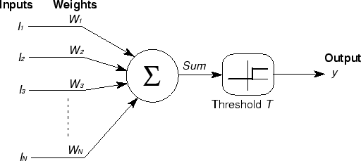






Basic Unit in Multi-Layer Neural Network
Linear Unit: $o_{j}=\vec{w}.\vec{x}$ multiple layers of linear functions produce linear functions. We want to represent nonlinear functions.
Note: Here we use a slightly different notation for dot product $\vec{w}.\vec{x}$
Threshold units: $o_{j}=sgn(\vec{w}.\vec{x}−b)$ are not differentiable, hence unsuitable for gradient descent
$$o_{k}$$
activation
Output
$$w_{jk}$$
$$h_{j}$$
Hidden
$$w_{ij}$$
Input
$$x_{i}$$

Slide 4
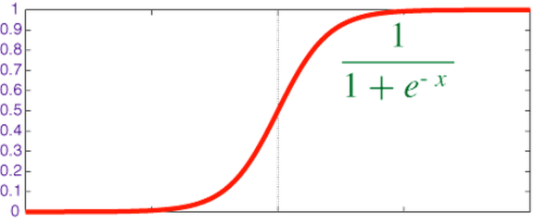

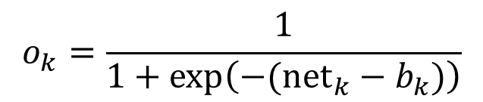

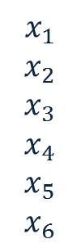



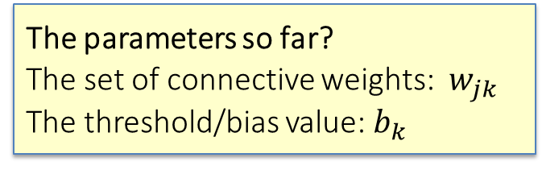

Model Neuron (Logistic, slightly different notations)
Neuron is modeled by a unit $j$ connected by weighted links $w_{ij}$ to other units $i$.
Note: we use a different kind of index of $w$ to indicate different neurons
Use a non-linear, differentiable output function such as the sigmoid or logistic function
Net input to a unit is defined as:
Output of a unit is defined as:
$$x_{1}$$
$$x_{2}$$
$$x_{3}$$
$$x_{4}$$
$$x_{5}$$
$$x_{6}$$
$$w_{17}$$
$${net}_{7}$$
$$o_{7}$$
The parameters so far?
The set of connective weights: $w_{jk}$ The threshold/bias value: $b_{k}$
$$w_{67}$$
$${net}_{k}=∑w_{jk}.x_{j}$$
$$o_{k}=\frac{1}{1+exp\left(−({net}_{k}−b_{k})\right)}$$

Slide 5
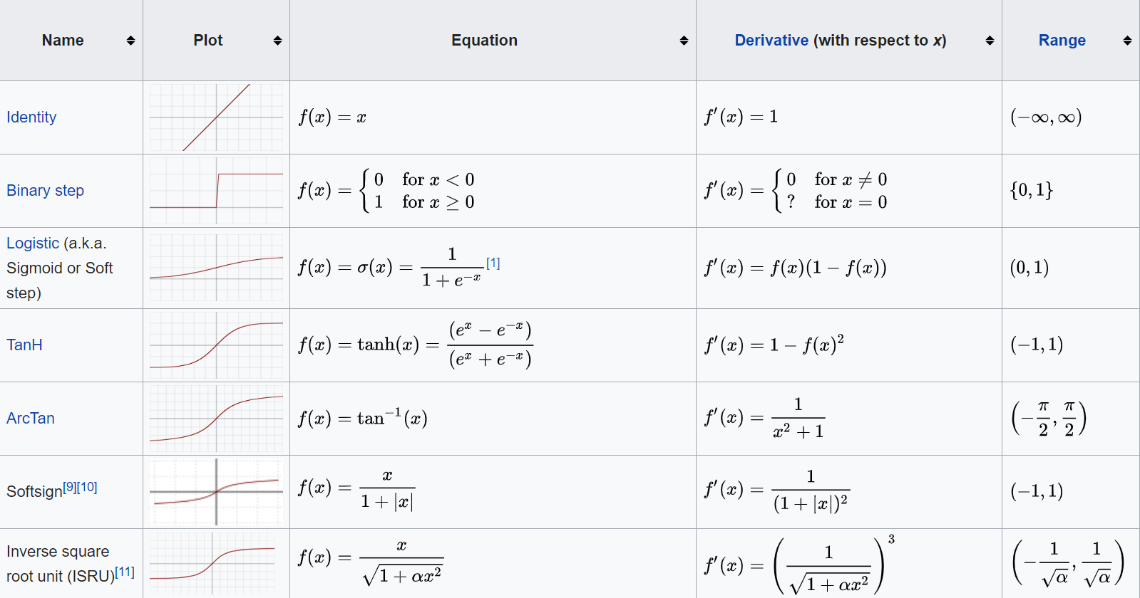
Activation function
https://en.wikipedia.org/wiki/Activation_function

Slide 6
Learning with a Multi-Layer Perceptron
It’s easy to learn the top layer – it’s just a linear unit.
Given feedback (truth) at the top layer, and the activation at the layer below it, you can use the Perceptron update rule (more generally, gradient descent) to updated these weights.
The problem is what to do with
the other set of weights – we do
not get feedback in the
intermediate layer(s).
activation
Output
Hidden
Input

Slide 7
Learning with a Multi-Layer Perceptron
activation
Output
The problem is what to do with
the other set of weights – we do
not get feedback in the
intermediate layer(s).
Solution: If all the activation
functions are differentiable, then
the output of the network is also
a differentiable function of the input and weights in the network.
Define an error function (e.g., sum of squares) that is a differentiable function of the output, i.e. this error function is also a differentiable function of the weights.
We can then evaluate the derivatives of the error with respect to the weights, and use these derivatives to find weight values that minimize this error function, using gradient descent (or other optimization methods).
This results in an algorithm called back-propagation.
Hidden
Input

Slide 8
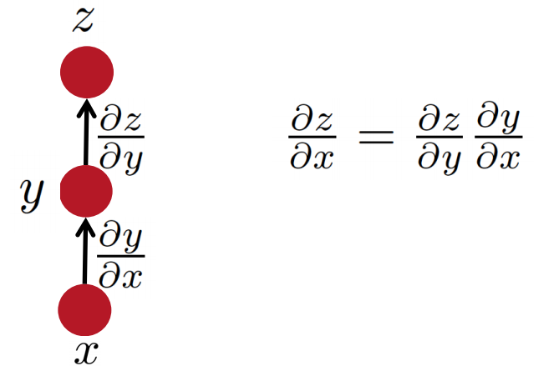

Some facts from real analysis
Simple chain rule
If $z$ is a function of $y$, and $y$ is a function of $x$
Then $z$ is a function of $x$, as well.
Question: how to find $\frac{∂z}{∂x}$
Output is a function of inputs and weight, and also a function of the hidden output.
We will use these facts to derive the details of the Backpropagation algorithm.
z will be the error (loss) function.
- We need to know how to differentiate z
Intermediate nodes use a logistics function (or another differentiable step function).
- We need to know how to differentiate it.
Slide Credit: Richard Socher

Slide 9
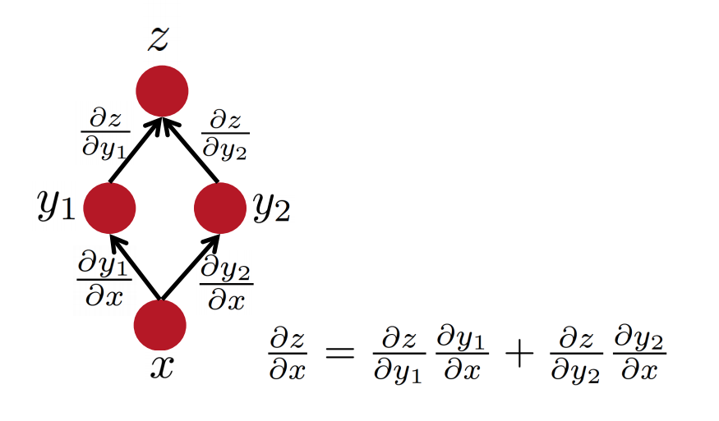
Some facts from real analysis
Multiple path chain rule
Slide Credit: Richard Socher

Slide 10
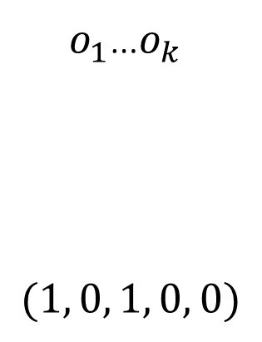
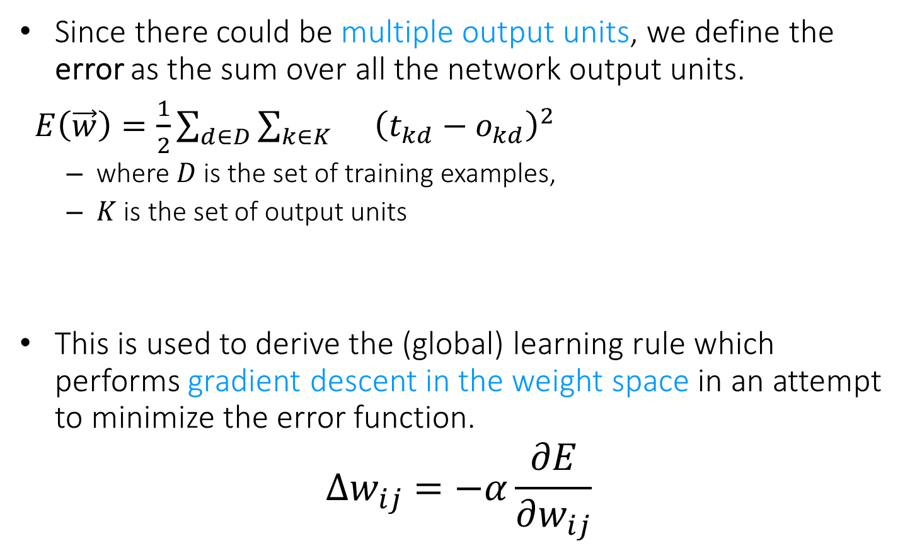
Backpropagation Learning Rule
Since there could be multiple output units, we define the error as the sum over all the network output units.
$E\left(\vec{w}\right)=\frac{1}{2}\sum_{d∈D}{\sum_{k∈K}{}{\left(t_{kd}−o_{kd}\right)}^{2}}$
where $D$ is the set of training examples,
$K$ is the set of output units
This is used to derive the (global) learning rule which performs gradient descent in the weight space in an attempt to minimize the error function.
$$Δw_{ij}=−α\frac{∂E}{∂w_{ij}}$$
$o_{1}$…$o_{k}$
$$(1, 0, 1, 0, 0)$$
Function 1

Slide 11

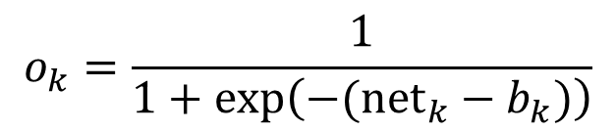
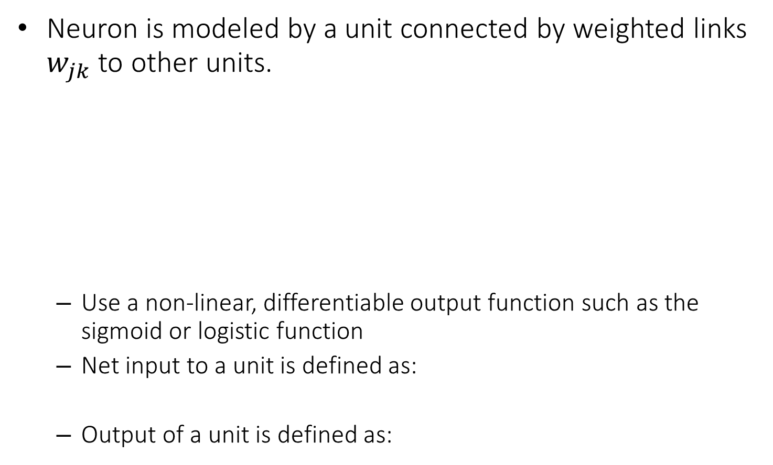
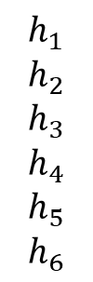


Reminder: Model Neuron (Logistic)
Neuron is modeled by a unit connected by weighted links $w_{jk}$ to other units.
Use a non-linear, differentiable output function such as the sigmoid or logistic function
Net input to a unit is defined as:
Output of a unit is defined as:
$$h_{1}$$
$$h_{2}$$
$$h_{3}$$
$$h_{4}$$
$$h_{5}$$
$$h_{6}$$
$$w_{17}$$
$$x_{7}$$
$$o_{7}$$
$$w_{67}$$
$${net}_{k}=∑w_{jk}.h_{j}$$
Function 3
$$o_{k}=\frac{1}{1+exp\left(−({net}_{k}−b_{k})\right)}$$
Function 2

Slide 12

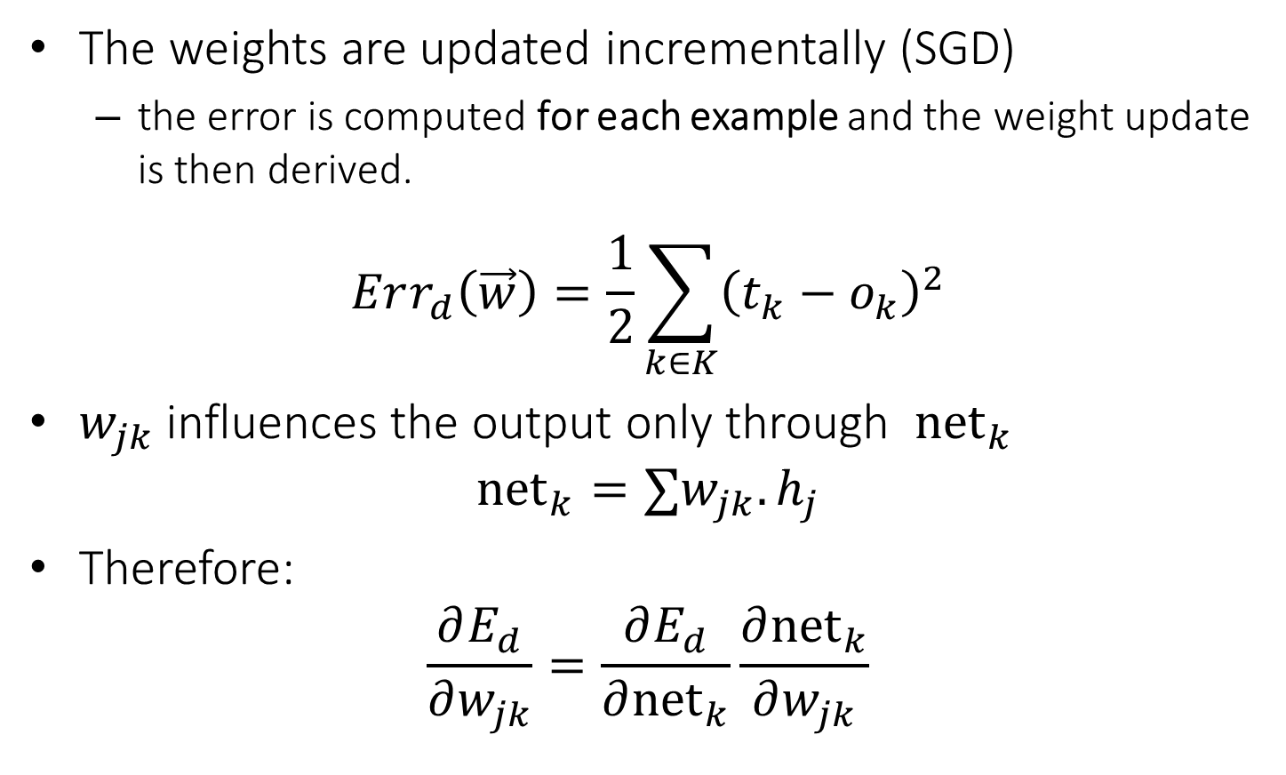


Derivation of Learning Rule
The weights are updated incrementally (SGD)
the error is computed for each example and the weight update is then derived.
$$Err_{d}\left(\vec{w}\right)=\frac{1}{2}\sum_{k∈K}{{\left(t_{k}−o_{k}\right)}^{2}}$$
$w_{jk}$ influences the output only through ${net}_{k}$
$${net}_{k}=∑w_{jk}.h_{j}$$
Therefore:
$$\frac{∂E_{d}}{∂w_{jk}}=\frac{∂E_{d}}{∂{net}_{k}}\frac{∂{net}_{k}}{∂w_{jk}}$$
$o_{k}$
$$w_{jk}$$
$$h_{j}$$

Slide 13
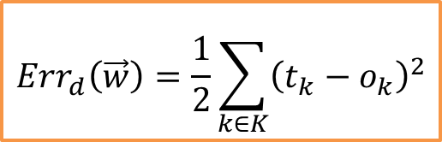





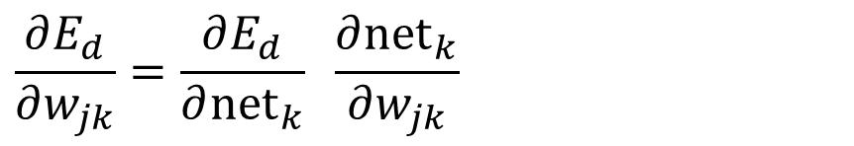

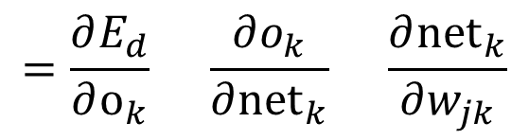

Derivation of Learning Rule (2)
Weight updates of output units:
$w_{jk}$ influences the output only through ${net}_{k}$
Therefore:
$$o_{k}$$
$$w_{jk}$$
$$\frac{∂E_{d}}{∂w_{jk}}=\frac{∂E_{d}}{∂{net}_{k}} \frac{∂{net}_{k}}{∂w_{jk}}$$
$$h_{j}$$
$$=\frac{∂E_{d}}{∂o_{k}} \frac{∂o_{k}}{∂{net}_{k}} \frac{∂{net}_{k}}{∂w_{jk}}$$
$$=−\left(t_{j}−o_{k}\right) o_{k}\left(1−o_{k}\right) h_{j}$$
$$Err_{d}\left(\vec{w}\right)=\frac{1}{2}\sum_{k∈K}{{\left(t_{k}−o_{k}\right)}^{2}}$$
$$\frac{∂o_{k}}{∂{net}_{k}}=o_{k}(1−o_{k})$$
$$o_{k}=\frac{1}{1+\exp{\{−({net}_{k}−b_{k})\}}}$$
$${net}_{k}=∑w_{jk}.h_{j}$$

Slide 14
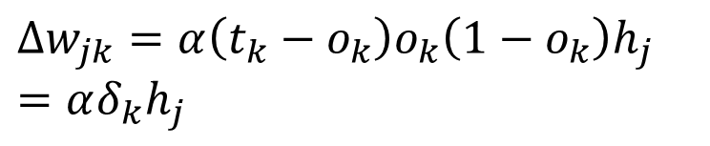




Derivation of Learning Rule (3)
$$o_{k}$$
Weights of output units:
$w_{jk}$ is changed by:
where we set
$δ_{k}=\frac{∂E_{d}}{∂{net}_{k}}=\frac{∂E_{d}}{∂o_{k}}\frac{∂o_{k}}{∂{net}_{k}}=\left(t_{k}−o_{k}\right)o_{k}\left(1−o_{k}\right)$
$α$ is the learning rate
$$w_{jk}$$
$$Δw_{jk}=α\left(t_{k}−o_{k}\right)o_{k}\left(1−o_{k}\right)h_{j}=αδ_{k}h_{j}$$
$$h_{j}$$

Slide 15
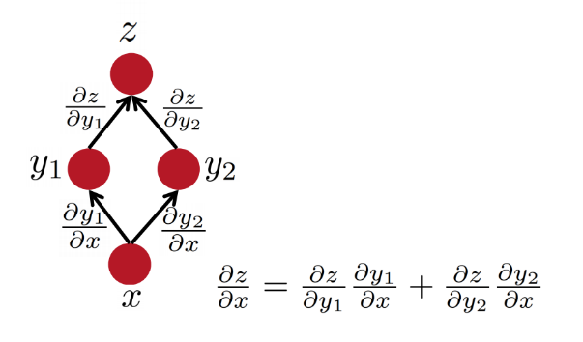

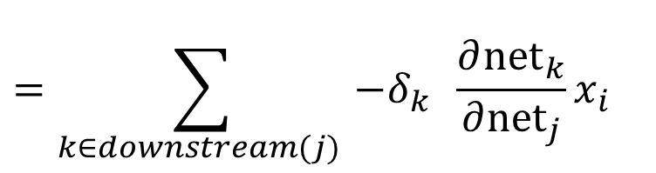



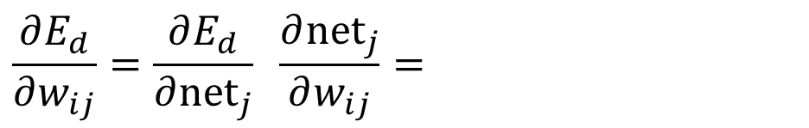

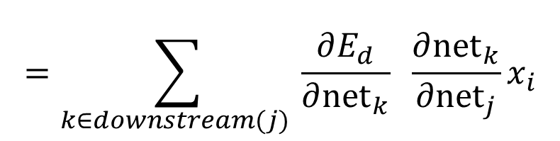

Derivation of Learning Rule (4)
Weights of hidden units:
$w_{ij}$ Influences the output only through all the units whose direct input include $j$
$$E_{d}$$
$$o_{k}$$
$${net}_{j}=∑w_{ij}.x_{i}$$
$h_{j}$
$x_{i}$
$$\frac{∂E_{d}}{∂w_{ij}}=\frac{∂E_{d}}{∂{net}_{j}} \frac{∂{net}_{j}}{∂w_{ij}}=$$
$$w_{ij}$$
$$=\sum_{k∈downstream(j) }{\frac{∂E_{d}}{∂{net}_{k}} \frac{∂{net}_{k}}{∂{net}_{j}}x_{i}}$$
$$=\sum_{k∈downstream(j) }{−δ_{k} \frac{∂{net}_{k}}{∂{net}_{j}}x_{i}}$$

Slide 16
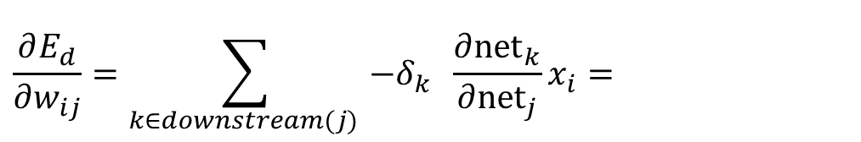
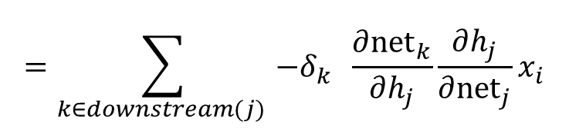





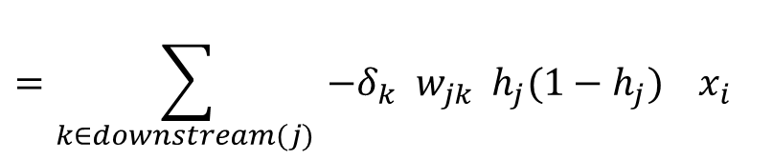

Derivation of Learning Rule (5)
Weights of hidden units:
$w_{ij}$influences the output only through all the units whose direct input include $j$
$$o_{k}$$
$$\frac{∂E_{d}}{∂w_{ij}}=\sum_{k∈downstream(j) }{−δ_{k} \frac{∂{net}_{k}}{∂{net}_{j}}x_{i}}=$$
$h_{j}$
$$x_{i}$$
$$w_{ij}$$
$$=\sum_{k∈downstream(j) }{−δ_{k} \frac{∂{net}_{k}}{∂h_{j}}\frac{∂h_{j}}{∂{net}_{j}}x_{i}}$$
$$=\sum_{k∈downstream(j) }{−δ_{k} w_{jk}{ h}_{j}(1−h_{j}) x_{i}}$$
$$\frac{∂h_{j}}{∂{net}_{j}}=h_{j}(1−h_{j})$$
$$h_{j}=\frac{1}{1+\exp{\{−({net}_{j}−b_{j})\}}}$$
$${net}_{j}=∑w_{ij}.x_{i}$$

Slide 17
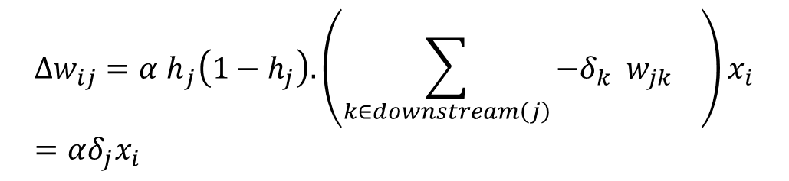


Derivation of Learning Rule (6)
Weights of hidden units:
$w_{ij}$ is changed by:
Where
$$δ_{j}=h_{j}\left(1−h_{j}\right).\left(\sum_{k∈downstream\left(j\right)}{−δ_{k} w_{jk} }\right)$$
First determine the error for the output units.
Then, backpropagate this error layer by layer through the network, changing weights appropriately in each layer.
$${Δw_{ij}=α h}_{j}\left(1−h_{j}\right).\left(\sum_{k∈downstream\left(j\right)}{−δ_{k} w_{jk} }\right)x_{i}=αδ_{j}x_{i}$$
$$o_{k}$$
$h_{j}$
$$x_{i}$$
$$w_{ij}$$

Slide 18

The Backpropagation Algorithm
Create a fully connected three layer network. Initialize weights.
Until all examples produce the correct output within $ε$ (or other criteria)
For each example in the training set do:
Compute the network output for this example
Compute the error between the output and target value
$$δ_{k}=\left(t_{k}−o_{k}\right)o_{k}\left(1−o_{k}\right)$$
For each output unit k, compute error term
$${δ_{j}=h}_{j}\left(1−h_{j}\right).\sum_{k∈downstream\left(j\right)}{−δ_{k} w_{jk} }$$
For each hidden unit, compute error term:
$$Δw_{ij}=αδ_{j}x_{i}$$
Update network weights
End epoch

Slide 19
More Hidden Layers
The same algorithm holds for more hidden layers.
input $h_{}^{1}$ $h_{}^{2}$ $h_{}^{3}$ output

Slide 20
Input-Output Coding
One way to do it, if you start with a collection of sparsely representation examples, is to use dimensionality reduction methods:
Your m examples are represented as a m x 10⁶ matrix
Multiple it by a random matrix of size 10⁶ x 300, say.
Random matrix: Normal(0,1)
New representation: m x 300 dense rows
Appropriate coding of inputs and outputs can make learning problem easier and improve generalization.
Encode each binary feature as a separate input unit;
For multi-valued features include one binary unit per value rather than trying to encode input information in fewer units.
Random Projection: generate dense features. Very common today to use distributed representation of the input – real valued, dense representation.
For disjoint categorization problem, best to have one output unit for each category rather than encoding N categories into log N bits.

Slide 21
Comments on Training
No guarantee of convergence; may reach a local minima.
In practice, many large networks can be trained on large amounts of data for realistic problems.
Many epochs (tens of thousands) may be needed for adequate training.
Large data sets may require many hours of CPU
Termination criteria:
Number of epochs;
Threshold on training set error;
No decrease in error;
Increased error on a validation set.
To avoid local minima: several trials with different random initial weights with majority or voting techniques

Slide 22
Over-training Prevention
Running too many epochs may over-train the network and result in over-fitting. (improved result on training, decrease in performance on test set)
Keep an hold-out validation set and test accuracy after every epoch
Maintain weights for best performing network on the validation set and return it when performance decreases significantly beyond that.
To avoid losing training data to validation:
Use 10-fold cross-validation to determine the average number of epochs that optimizes validation performance
Train on the full data set using this many epochs to produce the final results

Slide 23
Over-fitting prevention
Too few hidden units prevent the system from adequately fitting the data and learning the concept.
Using too many hidden units leads to over-fitting.
Similar cross-validation method can be used to determine an appropriate number of hidden units. (general)
Another approach to prevent over-fitting is weight-decay: all weights are multiplied by some fraction in (0,1) after every epoch.
Encourages smaller weights and less complex hypothesis
Equivalently: change Error function to include a term for the sum of the squares of the weights in the network. (L2 norm regularization)

Slide 24
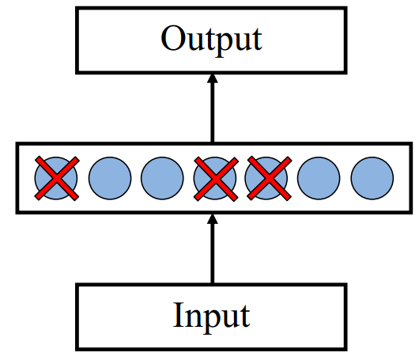
Dropout training
Proposed by (Hinton et al, 2012)
Each time decide whether to delete one hidden unit with some probability p

Slide 25
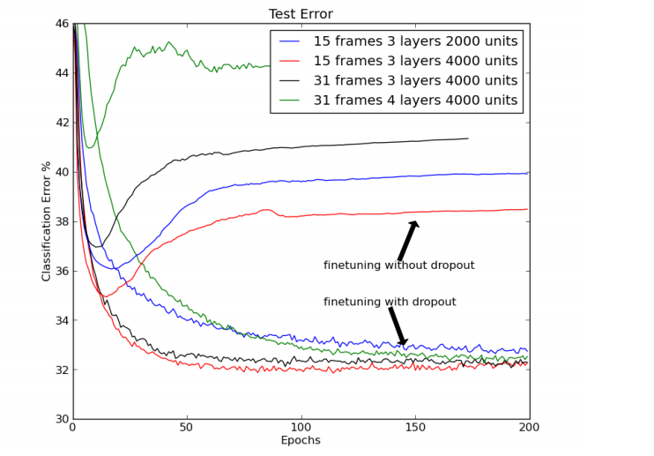
Dropout training
Dropout of 50% of the hidden units and 20% of the input units (Hinton et al, 2012)

Slide 26
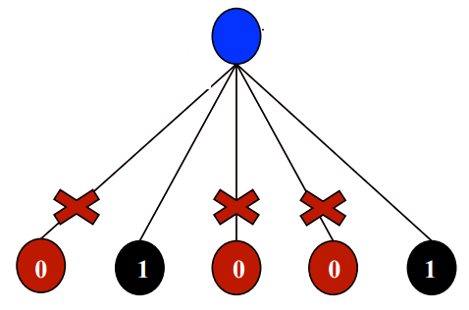
Dropout training
Model averaging effect
Among models, with shared parameters
H: number of units in the network
Only a few get trained
Much stronger than the known regularizer
What about the input space?
Do the same thing!

Slide 27
Some Notes: Representational Power
The Backpropagation version presented is for networks with a single hidden layer,
But:
Any Boolean function can be represented by a two layer network (simulate a two layer AND-OR network)
Any bounded continuous function can be approximated with arbitrary small error by a two layer network.
Sigmoid functions provide a set of basis function from which arbitrary function can be composed.
Any function can be approximated to arbitrary accuracy by a three layer network.

Slide 28
Hidden Layer Representation
Weight tuning procedure sets weights that define whatever hidden units representation is most effective at minimizing the error.
Sometimes Backpropagation will define new hidden layer features that are not explicit in the input representation, but which capture properties of the input instances that are most relevant to learning the target function.
Trained hidden units can be seen as newly constructed features that re-represent the examples so that they are linearly separable

Slide 29

Gradient Checks are useful!
Allow you to know that there are no bugs in your neural network implementation!
Implement your gradient
Implement a finite difference computation by looping through the parameters of your network, adding and subtracting a small epsilon (∼10^-4) and estimate derivatives
$f^{′}\left(θ\right)≈\frac{f\left(θ^{+}\right)−f(θ^{−})}{2ε}$ $θ^{±}=θ^{}±ε$
Compare the two and make sure they are almost the same

