Slide 1
COMP4901K/Math4824B Machine Learning for Natural Language Processing
Lecture 16: Neural Networks
Instructor: Yangqiu Song
Slides credits: Dan Roth

Slide 2



The Backpropagation Algorithm
Create a fully connected three layer network. Initialize weights.
Until all examples produce the correct output within $ε$ (or other stopping criteria)
For each example in the training set do:
Compute the network output for this example
Compute the error between the output and target value
$$δ_{k}=\left(t_{k}−o_{k}\right)o_{k}\left(1−o_{k}\right)$$
For each output unit k, compute error term
$${δ_{j}=h}_{j}\left(1−h_{j}\right).\sum_{k∈downstream\left(j\right)}{−δ_{k} w_{jk} }$$
For each hidden unit, compute error term:
$$Δw_{ij}=αδ_{j}x_{i}$$
Update network weights
End epoch
$$o_{k}$$
$h_{j}$
$$x_{i}$$
$$w_{jk}$$
$$w_{ij}$$

Slide 3

Comments on Training
No guarantee of convergence; may reach a local minima.
In practice, many large networks can be trained on large amounts of data for realistic problems.
Many epochs (tens of thousands) may be needed for adequate training.
Large data sets may require many hours of CPU
Termination criteria:
Number of epochs;
Threshold on training set error;
No decrease in error;
Increased error on a validation set.
To avoid local minima: several trials with different random initial weights with majority or voting techniques
$$o_{k}$$
$h_{j}$
$$x_{i}$$
$$w_{ij}$$

Slide 4
Over-training Prevention
Running too many epochs may over-train the network and result in over-fitting. (improved result on training, decrease in performance on test set)
Keep an hold-out validation set and test accuracy after every epoch
Maintain weights for best performing network on the validation set and return it when performance decreases significantly beyond that.
To avoid losing training data to validation:
Use 10-fold cross-validation to determine the average number of epochs that optimizes validation performance
Train on the full data set using this many epochs to produce the final results

Slide 5
Over-fitting prevention
Too few hidden units prevent the system from adequately fitting the data and learning the concept.
Using too many hidden units leads to over-fitting.
Similar cross-validation method can be used to determine an appropriate number of hidden units. (general)
Another approach to prevent over-fitting is weight-decay: all weights are multiplied by some fraction in (0,1) after every epoch.
Encourages smaller weights and less complex hypothesis
Equivalently: change Error function to include a term for the sum of the squares of the weights in the network. (L2 norm regularization)

Slide 6
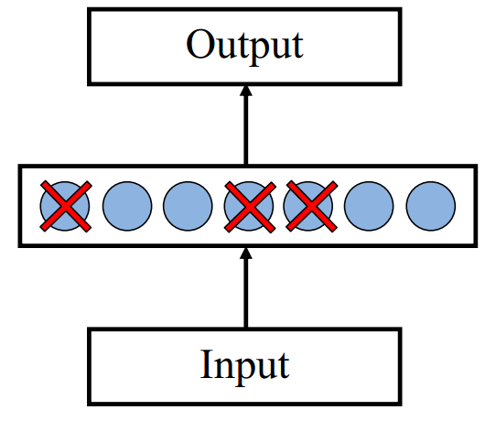
Dropout training
Proposed by (Hinton et al, 2012)
Each time decide whether to delete one hidden unit with some probability p

Slide 7
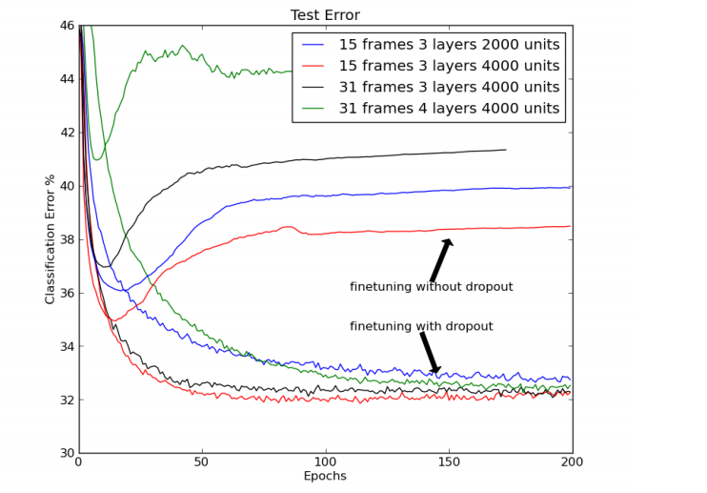
Dropout training
Dropout of 50% of the hidden units and 20% of the input units (Hinton et al, 2012)

Slide 8
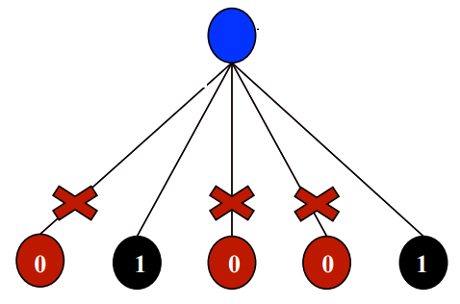
Dropout training
Model averaging effect
Among models, with shared parameters
H: number of units in the network
Only a few get trained
Much stronger than the known regularizer
What about the input space?
Do the same thing!

Slide 9
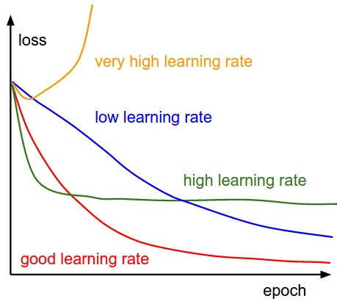
Learning Rates
Higher learning rates will decay the loss faster, but they get stuck at worse values of loss (green line). This is because there is too much “energy” in the optimization and the parameters are bouncing around chaotically, unable to settle in a nice spot in the optimization landscape.

Slide 10
Some Notes: Representational Power
The Backpropagation version presented is for networks with a single hidden layer,
But:
Any Boolean function can be represented by a two layer network (simulate a two layer AND-OR network)
Any bounded continuous function can be approximated with arbitrary small error by a two layer network.
Sigmoid functions provide a set of basis function from which arbitrary function can be composed.
Any function can be approximated to arbitrary accuracy by a three layer network.

Slide 11
Hidden Layer Representation
Weight tuning procedure sets weights that define whatever hidden units representation is most effective at minimizing the error.
Sometimes Backpropagation will define new hidden layer features that are not explicit in the input representation, but which capture properties of the input instances that are most relevant to learning the target function.
Trained hidden units can be seen as newly constructed features that re-represent the examples so that they are linearly separable

Slide 12
Gradient Checks are useful!
Allow you to know that there are no bugs in your neural network implementation!
Implement your gradient
Implement a finite difference computation by looping through the parameters of your network, adding and subtracting a small epsilon (∼10^-4) and estimate derivatives
$f^{′}\left(θ\right)≈\frac{f\left(θ^{+}\right)−f(θ^{−})}{2ε}$ $θ^{±}=θ^{}±ε$
Compare the two and make sure they are almost the same

Slide 13
Recap: Multi-Layer Perceptrons
activation
Output
Multi-layer network
A global approximator
Different rules for training it
The Back-propagation
Forward step
Back propagation of errors
Congrats! Now you know the hardest concept about neural networks!
Today:
Convolutional Neural Networks
Hidden
Input

Slide 14
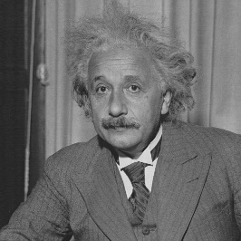
Receptive Fields
The receptive field of an individual sensory neuron is the particular region of the sensory space (e.g., the body surface, or the retina) in which a stimulus will trigger the firing of that neuron.
Designing “proper” receptive fields for the input Neurons is a significant challenge.
Consider a task with image inputs
Receptive fields should give expressive features from the raw input to the system
How would you design the receptive fields for this problem?

Slide 15
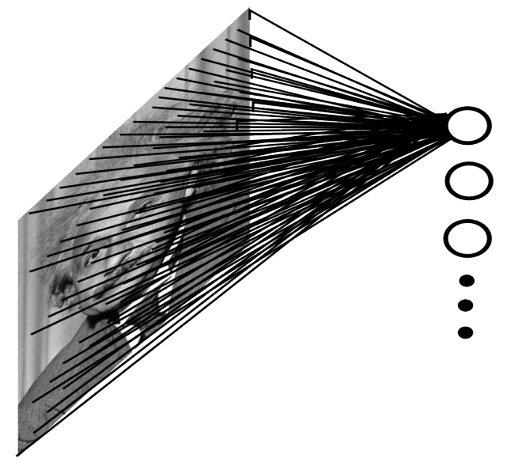
A fully connected layer:
Example:
100x100 images
1000 units in the input
Problems:
10^7 edges!
Spatial correlations lost!
Variables sized inputs.
Slide Credit: Marc'Aurelio Ranzato

Slide 16
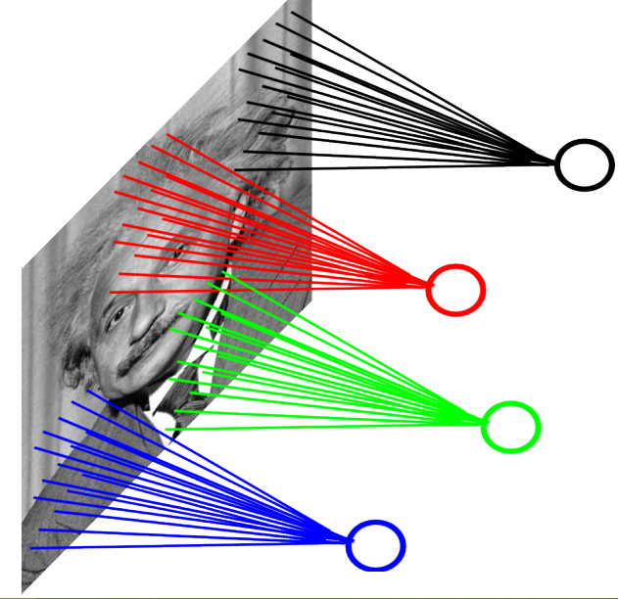
Consider a task with image inputs:
A locally connected layer:
Example:
100x100 images
1000 units in the input
Filter size: 10x10
Local correlations preserved!
Problems:
10^5 edges
This parameterization is good
when input image is registered
(e.g., face recognition).
Variable sized inputs, again.
Slide Credit: Marc'Aurelio Ranzato

Slide 17
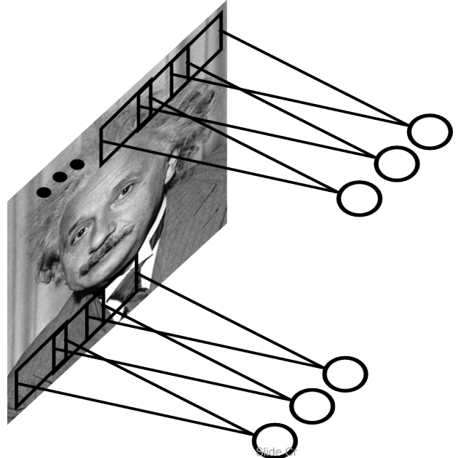
Convolutional Layer
A solution:
Filters to capture different patterns in the input space.
Share parameters across different locations (assuming input is stationary)
Convolutions with learned filters
Filters will be learned during training.
The issue of variable-sized inputs will be
resolved with a pooling layer.
So what is a convolution?

Slide 18
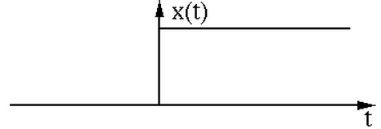
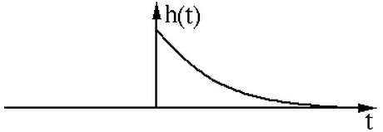
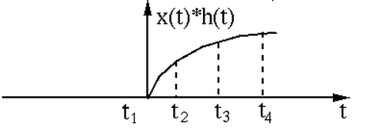
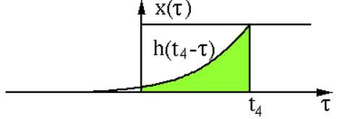
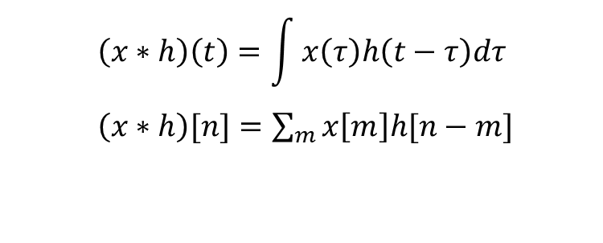

Convolution Operator
Convolution operator: $∗$
takes two functions and gives another function
One dimension:
$$\left(x∗h\right)\left(t\right)=\int{x\left(τ\right)h\left(t−τ\right)dτ}$$
$\left(x∗h\right)[n]=\sum_{m}{x\left[m\right]h[n−m]}$
“Convolution” is very similar to “cross-correlation”, except that in convolution one of the functions is flipped.

Slide 19
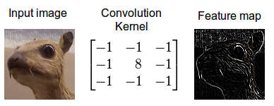
Convolution Operator (2)
Convolution in two dimension:
The same idea: flip one matrix and slide it on the other matrix
Example: edge detection kernel:
Try other kernels: http://setosa.io/ev/image-kernels/

Slide 20
Convolutional Layer
The convolution of the input (vector/matrix) with weights (vector/matrix) results in a response vector/matrix.
We can have multiple filters in each convolutional layer, each producing an output.
If it is an intermediate layer, it can have multiple inputs!
Convolutional Layer
Filter
Filter
Filter
One can add nonlinearity at the output of convolutional layer
Filter

Slide 21
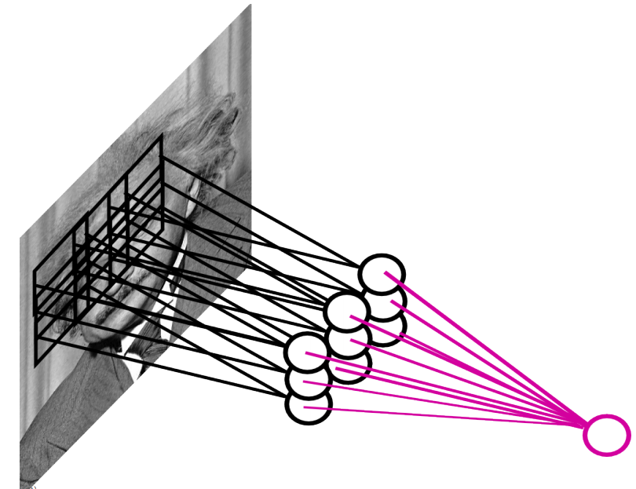
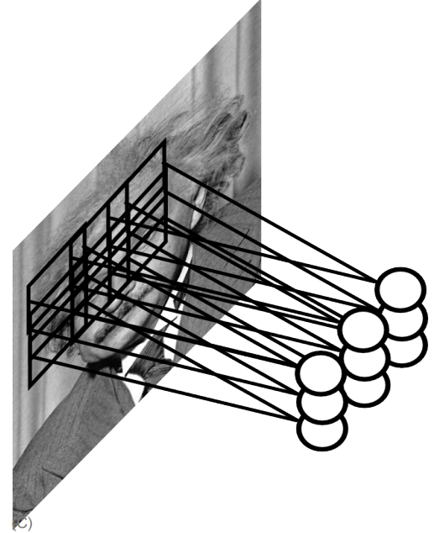
Pooling Layer
How to handle variable sized inputs?
A layer which reduces inputs of different size, to a fixed size.
Pooling
Slide Credit: Marc'Aurelio Ranzato

Slide 22

Pooling Layer
How to handle variable sized inputs?
A layer which reduces inputs of different size, to a fixed size.
Pooling
Different variations
Max pooling
$h_{i}\left[n\right]=\max_{i∈N(n)} \tilde{h} [i]$
Average pooling
$h_{i}\left[n\right]=\frac{1}{n}\underset{i∈N(n)}{∑} \tilde{h} [i]$
L2-pooling
$h_{i}\left[n\right]=\frac{1}{n}\sqrt{\underset{i∈N(n)}{∑} {\tilde{h}}^{2} [i]}$
etc

Slide 23
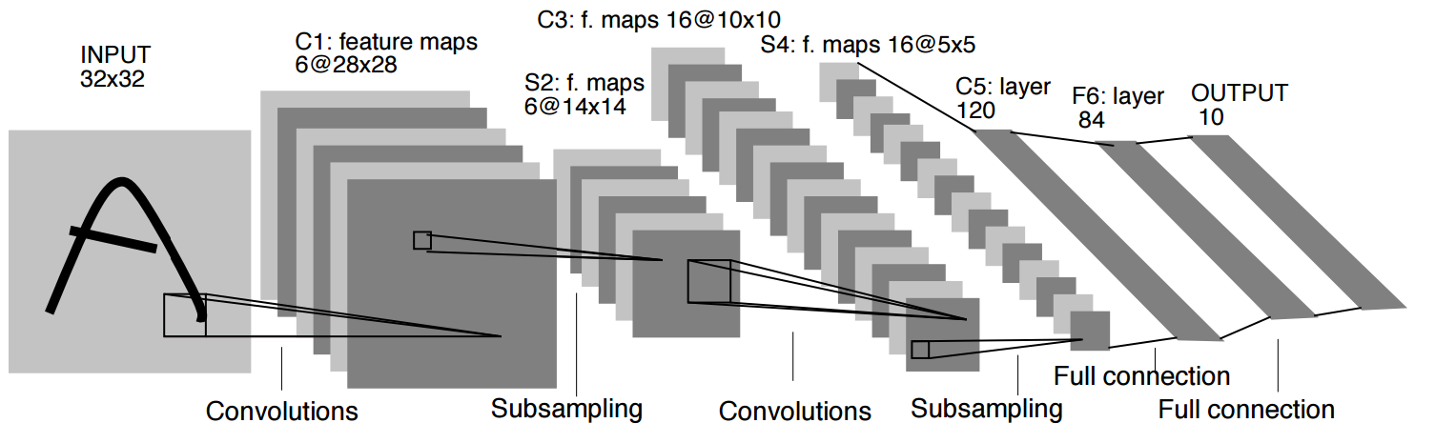
Convolutional Nets
One stage structure:
Whole system:
Convol.
Pooling
Stage 1
Stage 2
Stage 3
Fully Connected Layer
Input Image
Class Label
An example system (LeNet):

Slide 24


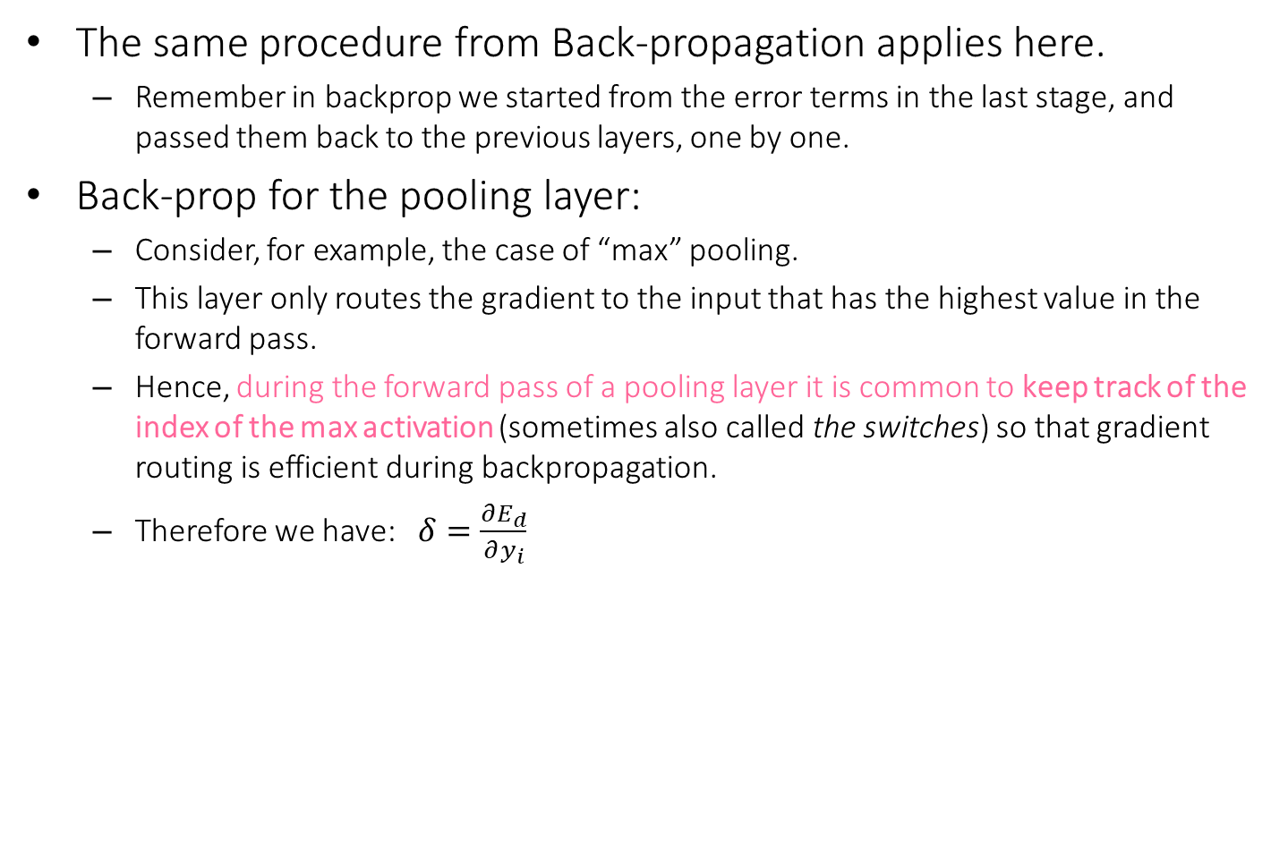



Training a ConvNet
The same procedure from Back-propagation applies here.
Remember in backprop we started from the error terms in the last stage, and passed them back to the previous layers, one by one.
Back-prop for the pooling layer:
Consider, for example, the case of “max” pooling.
This layer only routes the gradient to the input that has the highest value in the forward pass.
Hence, during the forward pass of a pooling layer it is common to keep track of the index of the max activation (sometimes also called the switches) so that gradient routing is efficient during backpropagation.
Therefore we have: $δ=\frac{∂E_{d}}{∂y_{i}}$
$$x_{i}$$
$$y_{i}$$
$$δ_{last−layer}=\frac{∂E_{d}}{∂y_{last−layer}}$$
Convol.
Pooling
$$δ_{first−layer}=\frac{∂E_{d}}{∂y_{first−layer}}$$
$$E_{d}$$
Input Image
Stage 1
Stage 2
Stage 3
Fully Connected Layer
Class Label

Slide 25

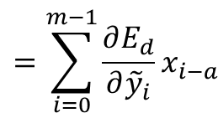

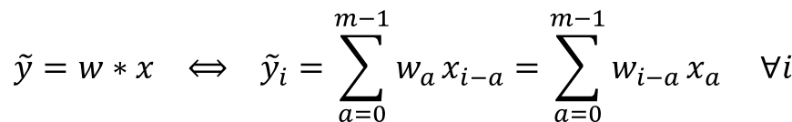
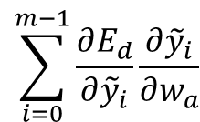


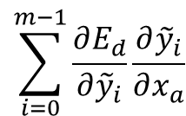








Training a ConvNet
Back-prop for the convolutional layer:
$$\tilde{y}=w∗x ⟺ {\tilde{y}}_{i}=\sum_{a=0}^{m−1}{w_{a}}x_{i−a}=\sum_{a=0}^{m−1}{w_{i−a}}x_{a} ∀i$$
We derive the update rules for a 1D convolution, but the idea is the same for bigger dimensions.
The convolution
$$y=f\left(\tilde{y}\right) ⟺ {y_{i}=f(\tilde{y}}_{i}) ∀i$$
A differentiable nonlinearity
$$\frac{∂E_{d}}{∂w_{a}}=$$
$$\sum_{i=0}^{m−1}{\frac{∂E_{d}}{∂{\tilde{y}}_{i}}\frac{∂{\tilde{y}}_{i}}{∂w_{a}}}$$
$$=\sum_{i=0}^{m−1}{\frac{∂E_{d}}{∂{\tilde{y}}_{i}}x_{i−a}}$$
Now we have everything in this layer to update the filter
Now we can repeat this for each stage of ConvNet.
$$\frac{∂E_{d}}{∂{\tilde{y}}_{i}}=$$
$$\frac{∂E_{d}}{∂y_{i}}\frac{∂y_{i}}{∂{\tilde{y}}_{i}}$$
$$=\frac{∂E_{d}}{∂y_{i}}f′(\tilde{y})$$
$$\sum_{i=0}^{m−1}{\frac{∂E_{d}}{∂{\tilde{y}}_{i}}\frac{∂{\tilde{y}}_{i}}{∂x_{a}}}$$
$$=\sum_{i=0}^{m−1}{\frac{∂E_{d}}{∂{\tilde{y}}_{i}}w_{i−a}}$$
We need to pass the gradient to the previous layer
$$δ= \frac{∂E_{d}}{∂x_{a}}=$$
$$x_{i}$$
$$y_{i}$$
$$δ_{last−layer}=\frac{∂E_{d}}{∂y_{last−layer}}$$
Convol.
Pooling
$$δ_{first−layer}=\frac{∂E_{d}}{∂y_{first−layer}}$$
$$E_{d}$$
Input Image
Stage 1
Stage 2
Stage 3
Fully Connected Layer
Class Label

Slide 26
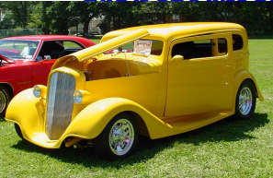
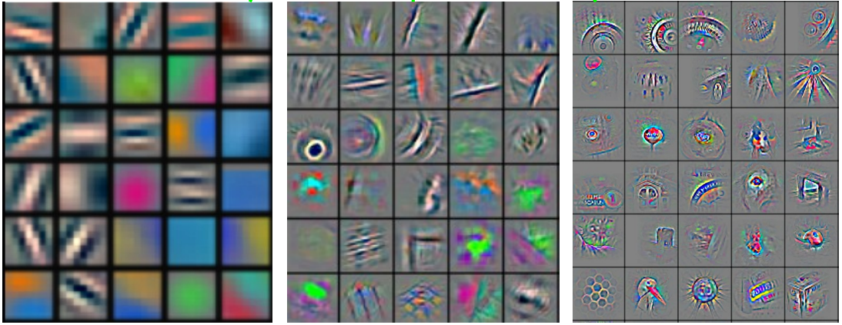
Convolutional Nets
Stage 1
Stage 2
Stage 3
Fully Connected Layer
Input Image
Class Label
Feature visualization of convolutional net trained on ImageNet from [Zeiler & Fergus 2013]

Slide 27
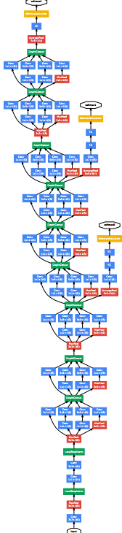
ConvNet roots
Fukushima, 1980s designed network with same basic structure but did not train by backpropagation.
The first successful applications of Convolutional Networks by Yann LeCun in 1990's (LeNet)
Was used to read zip codes, digits, etc.
Many variants nowadays, but the core idea is the same
Example: a system developed in Google (GoogLeNet)
Compute different filters
Compose one big vector from all of them
Layer this iteratively
See more: http://arxiv.org/pdf/1409.4842v1.pdf

Slide 28
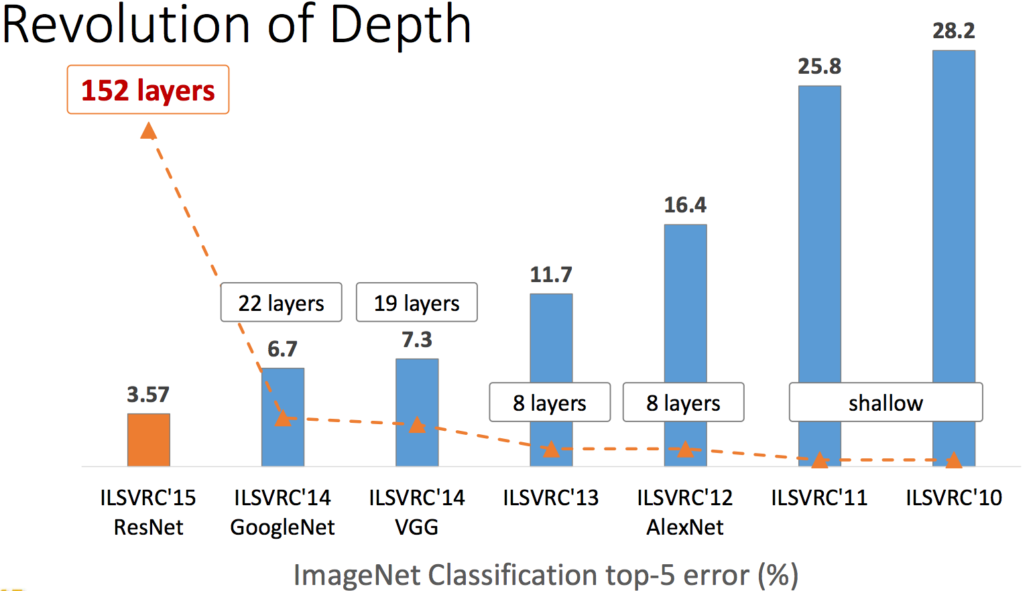
Depth matters
Slide from [Kaiming He 2015]

Slide 29
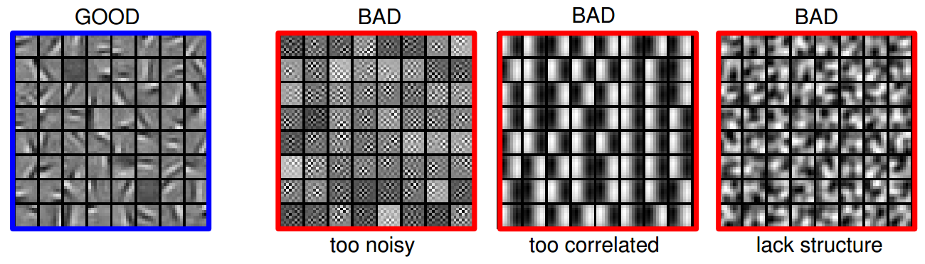
Practical Tips
Before large scale experiments, test on a small subset of the data and check the error should go to zero.
Overfitting on small training
Visualize features (feature maps need to be uncorrelated) and have high variance
Bad training: many hidden units ignore the input and/or exhibit strong correlations.
Figure Credit: Marc'Aurelio Ranzato

Slide 30
Debugging
Training diverges:
Learning rate may be too large → decrease learning rate
BackProp is buggy → numerical gradient checking
Loss is minimized but accuracy is low
Check loss function: Is it appropriate for the task you want to solve? Does it have degenerate solutions?
NN is underperforming / under-fitting
Compute number of parameters → if too small, make network larger
NN is too slow
Compute number of parameters → Use distributed framework, use GPU, make network smaller
Many of these points apply to many machine learning models, no just neural networks.

Slide 31
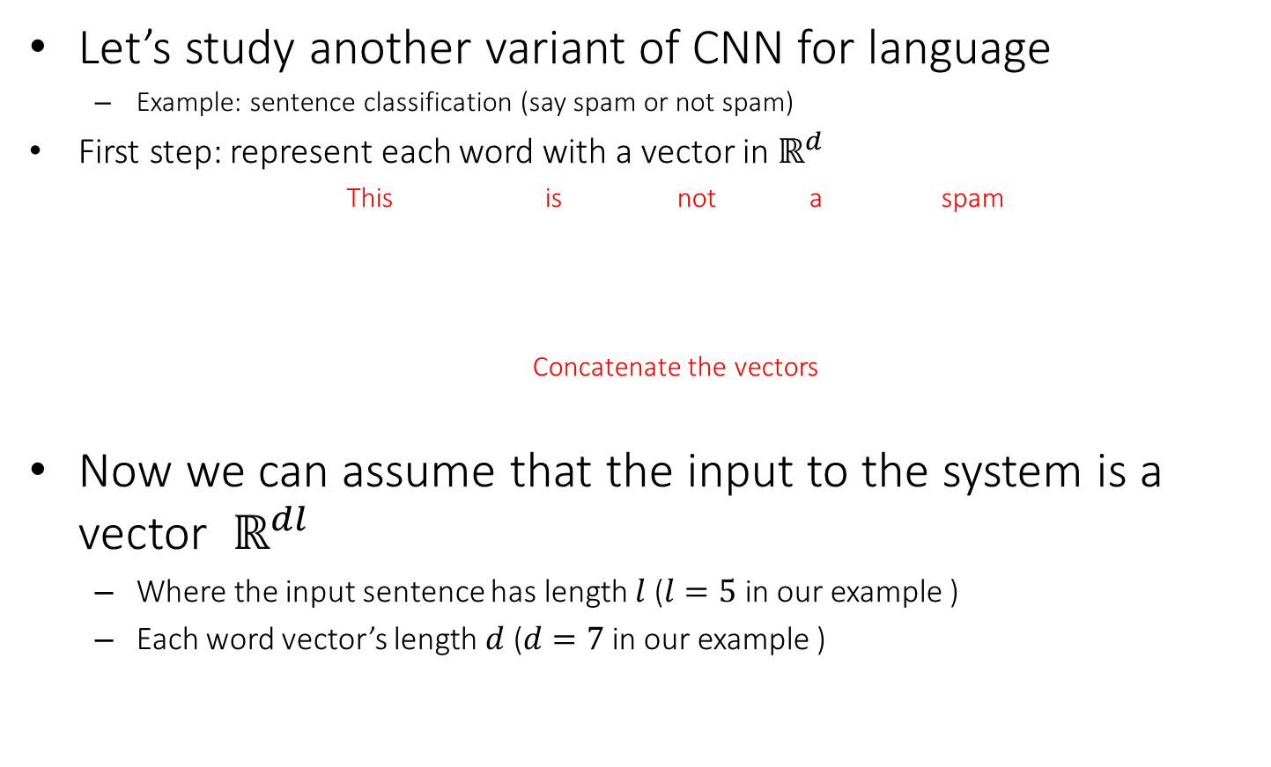
CNN for vector inputs
Let’s study another variant of CNN for language
Example: sentence classification (say spam or not spam)
First step: represent each word with a vector in $ℝ^{d}$
This is not a spam
Concatenate the vectors
Now we can assume that the input to the system is a vector $ℝ^{dl}$
Where the input sentence has length $l$ ($l=5$ in our example )
Each word vector’s length $d$ ($d=7$ in our example )
O O O O O O O
O O O O O O O
O O O O O O O
O O O O O O O
O O O O O O O
O O O O O O O O O O O O O O O O O O O O O O O O O O O O O O O O O O O

Slide 32






Convolutional Layer on vectors
Think about a single convolutional layer
A bunch of vector filters
Each defined in $ℝ^{dh}$
Where $h$ is the number of the words the filter covers
Size of the word vector $d$
Find its (modified) convolution with the input vector
Result of the convolution with the filter
Convolution with a filter that spans 2 words, is operating on all of the bi-grams (vectors of two consecutive word, concatenated): “this is”, “is not”, “not a”, “a spam”.
Regardless of whether it is grammatical (not appealing linguistically)
O O O O O O O O O O O O O O
O O O O O O O O O O O O O O
O O O O O O O O O O O O O O
O O O O O O O O O O O O O O
O O O O O O O O O O O O O O
O O O O O O O O O O O O O O O O O O O O O O O O O O O O O O O O O O O
O O O O O O O O O O O O O O O O O O O O O O O O O O O O O O O O O O O
O O O O O O O O O O O O O O O O O O O O O O O O O O O O O O O O O O O
O O O O O O O O O O O O O O O O O O O O O O O O O O O O O O O O O O O
O O O O O O O O O O O O O O O O O O O O O O O O O O O O O O O O O O O
$$c_{1}=f(w.x_{1:h})$$
$$c_{2}=f(w.x_{h+1:2h})$$
$$c_{3}=f(w.x_{2h+1:3h})$$
$$c_{4}=f(w.x_{3h+1:4h})$$
$$c=[c_{1}, …., c_{n−h+1}]$$
O O O O

Slide 33
Convolutional Layer on vectors
This is not a spam
Get word vectors for each words
O O O O O O O
O O O O O O O
O O O O O O O
O O O O O O O
O O O O O O O
Concatenate vectors
O O O O O O O O O O O O O O O O O O O O O O O O O O O O O O O O O O O
*
Perform convolution with each filter
O O O O O O O
O O O O O O O O O O O O O O
Filter bank
O O O O O O O O O O O O O O
O O O O O O O O O O O O O O O O O O O O O
O O O O O O O O O O O O O O O O O O O O O
How are we going to handle the variable sized response vectors?
Pooling!
O O O O O
O O O O
Set of response vectors
#of filters
O O O O
O O O
O O O
#words - #length of filter + 1

Slide 34
Convolutional Layer on vectors
This is not a spam
Get word vectors for each words
Now we can pass the fixed-sized vector to a logistic unit (softmax), or give it to multi-layer network (last session)
O O O O O O O
O O O O O O O
O O O O O O O
O O O O O O O
O O O O O O O
Concatenate vectors
O O O O O O O O O O O O O O O O O O O O O O O O O O O O O O O O O O O
*
Perform convolution with each filter
O O O O O O O
O O O O O O O O O O O O O O
Filter bank
O O O O O O O O O O O O O O
O O O O O O O O O O O O O O O O O O O O O
O O O O O O O O O O O O O O O O O O O O O
Some choices for pooling:
k-max, mean, etc
Pooling on filter responses
O O O O O
O O O
O O O O
O O O
#of filters
O O O O
O O O
O O O
O O O
O O O
O O O
#words - #length of filter + 1

