Slide 1
COMP4901K/Math4824B Machine Learning for Natural Language Processing
Lecture 21: Sequence to Sequence Learning
Instructor: Yangqiu Song
Slides credits: Richard Socher, Vagelis Hristidis

Slide 2
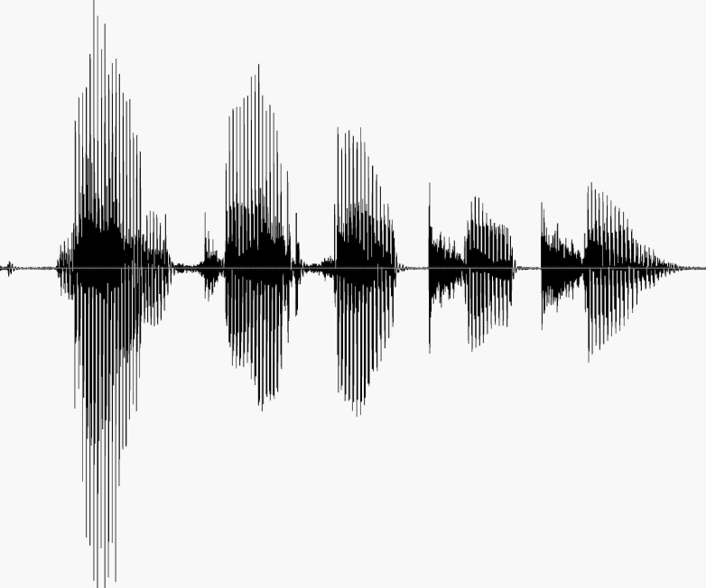
Sequence to Sequence
Speech recognition
http://nlp.stanford.edu/courses/lsa352/

Slide 3

Sequence to Sequence
Question answering

Slide 4

Sequence to Sequence
Machine translation
مرحبا بكم في درس التعلم العميق
Welcome to the deep learning class

Slide 5
Machine Translation
Machine Translation (MT) is the task of translating a sentence x from one language (the source language) to a sentence y in another language (the target language).
1950s: Early Machine Translation
Mostly Russian → English (motivated by the Cold War!)
Systems were mostly rule-based, using a bilingual dictionary to map Russian words to their English counterparts
Source: https://youtu.be/K-HfpsHPmvw

Slide 6
1990s-2010s: Statistical Machine Translation
Core idea: Learn a probabilistic model from data
Suppose we’re translating Language X → English.
We want to find best English sentence y, given Language X sentence x
Use Bayes Rule to break this down into two components to be learnt separately:
Translation Model
Models how words and phrases should be translated.
Learnt from parallel data.
Language Model
Models how to write good English.
Learnt from monolingual data.

Slide 7
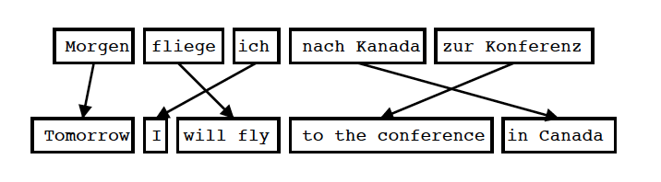
Statistical Machine Translation
Translation model
Input is Segmented in Phrases
Each Phrase is Translated into English
Phrases are Reordered
Koehn 2004

Slide 8
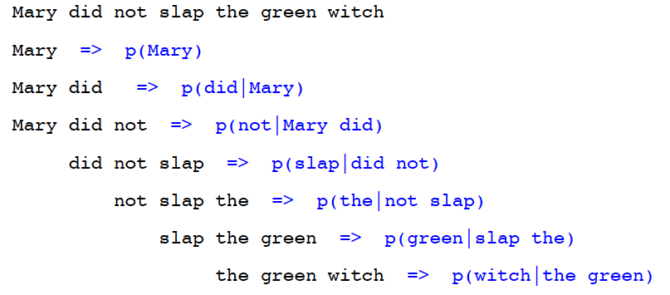
Statistical Machine Translation
Language Model
Goal of the Language Model: Detect good English
For Example: Trigram Model
Knight and Koehn 2003

Slide 9
1990s-2010s: Statistical Machine Translation
We could enumerate every possible y and calculate the probability? → Too expensive!
Answer: Use a heuristic search algorithm to gradually build up the translation, discarding hypotheses that are too low probability
Question:
How to compute
this argmax?
Translation Model
Language Model

Slide 10
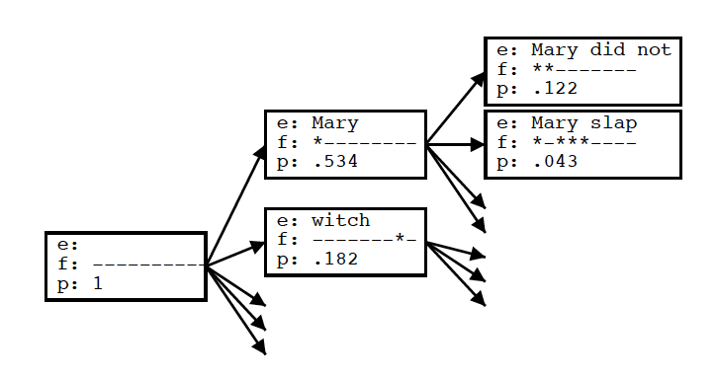
Statistical Machine Translation
Decoding
Goal of the decoding algorithm: Put models to work, perform the actual translation
Koehn 2004

Slide 11
Decoding
Global solution: Dynamic programming
Approximate solutions: Beam inference
At each position keep the top k complete sequences
Extend each sequence in each local way
The extensions compete for the k slots at the next position
Advantages
Fast; beam sizes of 3-5 are almost as good as exact inference in many cases
Easy to implement (no dynamic programming required)
Disadvantage
Inexact: the globally best sequence can fall off the beam

Slide 12
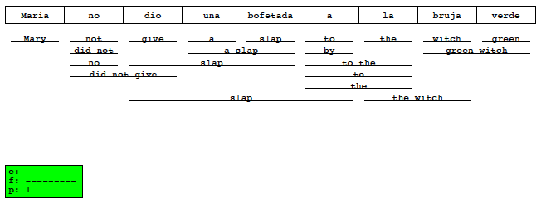
Statistical Machine Translation
Decoding
Goal of the decoding algorithm: Put models to work, perform the actual translation
Koehn 2004

Slide 13
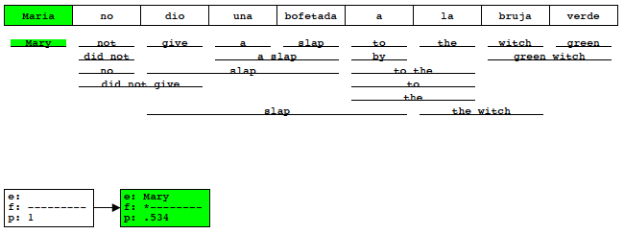
Statistical Machine Translation
Decoding
Goal of the decoding algorithm: Put models to work, perform the actual translation
Koehn 2004

Slide 14
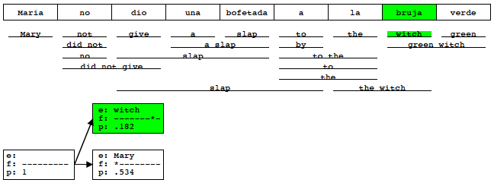
Statistical Machine Translation
Decoding
Goal of the decoding algorithm: Put models to work, perform the actual translation
Koehn 2004

Slide 15
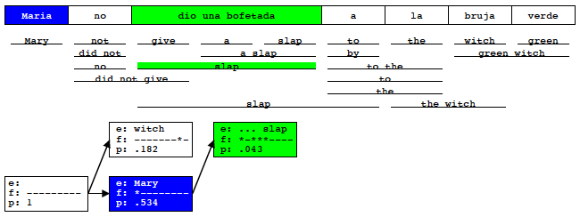
Statistical Machine Translation
Decoding
Goal of the decoding algorithm: Put models to work, perform the actual translation
Koehn 2004

Slide 16
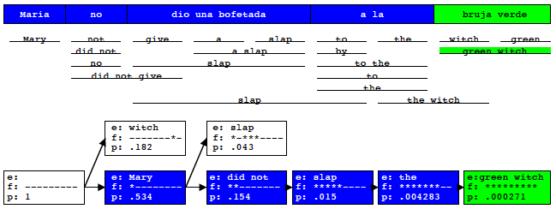
Statistical Machine Translation
Decoding
Goal of the decoding algorithm: Put models to work, perform the actual translation
Koehn 2004

Slide 17
1990s-2010s: Statistical Machine Translation
SMT is a huge research field
The best systems are extremely complex
Hundreds of important details we haven’t mentioned here
Systems have many separately-designed subcomponents
Lots of feature engineering
Need to design features to capture particular language phenomena
Require compiling and maintaining extra resources
Like tables of equivalent phrases
Lots of human effort to maintain
Repeated effort for each language pair!

Slide 18
Neural Machine Translation
Neural Machine Translation (NMT) is a way to do Machine Translation with a single neural network
The neural network architecture is called sequence-to-sequence (aka seq2seq) and it involves two RNNs.
Sutskever et al.,2014
Sequence to Sequence Learning with Neural Networks

Slide 19
Neural Machine Translation
Model
W X Y Z
A B C

Slide 20
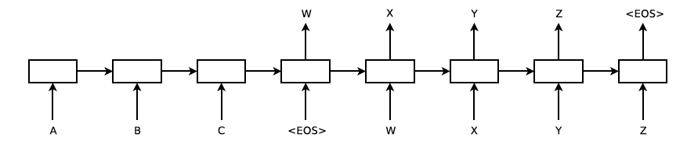
Neural Machine Translation
Model
Sutskever et al. 2014

Slide 21
Neural Machine Translation (NMT)
The sequence-to-sequence model is an example of a Conditional Language Model.
Language Model because the decoder is predicting the next word of the target sentence y
Conditional because its predictions are also conditioned on the source sentence x
NMT directly calculates
Question: How to train a NMT system?
Answer: Get a big parallel corpus…
Probability of next target word, given
target words so far and source sentence x

Slide 22
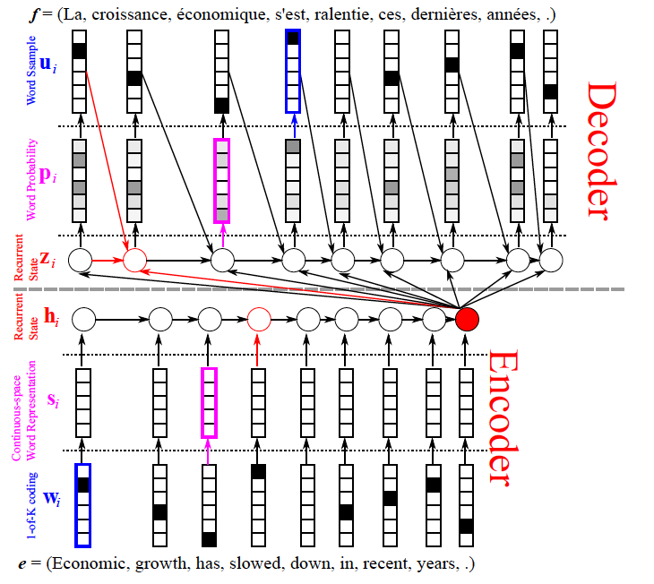
Neural Machine Translation
Model
Output based on the encoded input vector and the previous sequence that has been decoded.
Encode all inputs into a single vector.
Cho: From Sequence Modeling to Translation

Slide 23
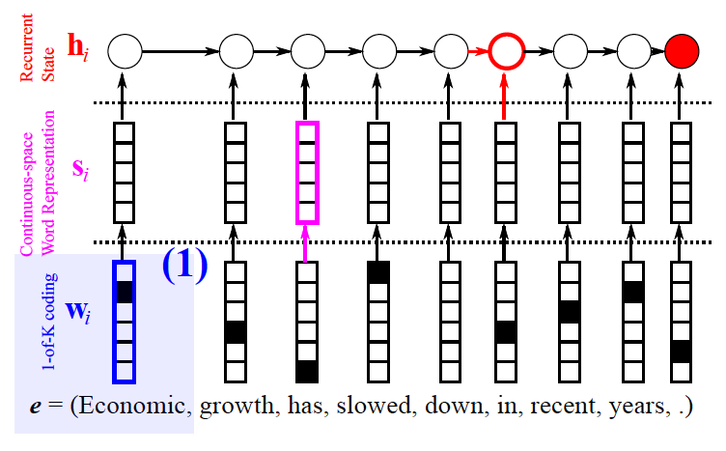
Neural Machine Translation
Model- encoder
Cho: From Sequence Modeling to Translation

Slide 24
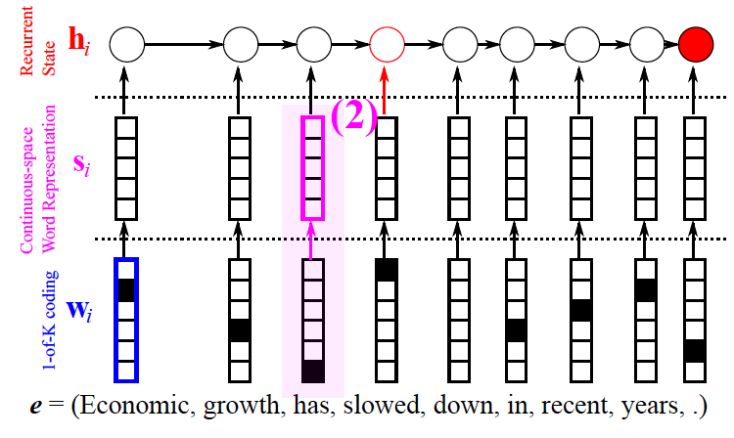
Neural Machine Translation
Model- encoder
Cho: From Sequence Modeling to Translation

Slide 25
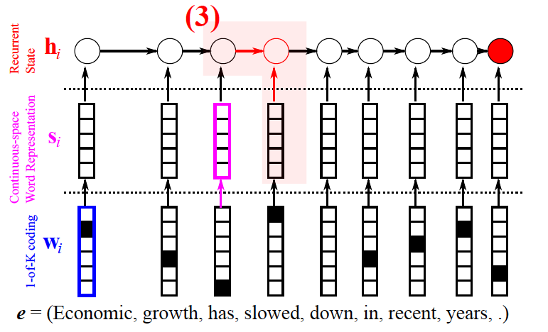
Neural Machine Translation
Model- encoder
Cho: From Sequence Modeling to Translation

Slide 26
Neural Machine Translation
Model- encoder
Cho: From Sequence Modeling to Translation

Slide 27
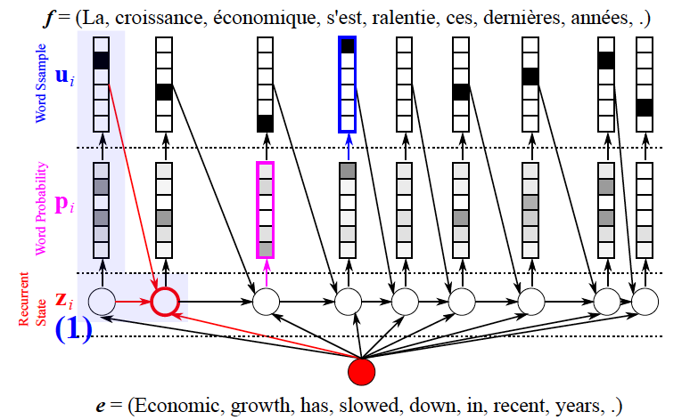
Neural Machine Translation
Model- decoder
Cho: From Sequence Modeling to Translation

Slide 28
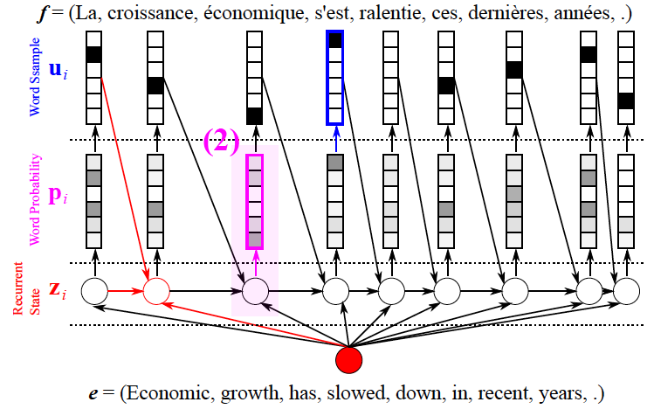
Neural Machine Translation
Model- decoder
Cho: From Sequence Modeling to Translation

Slide 29
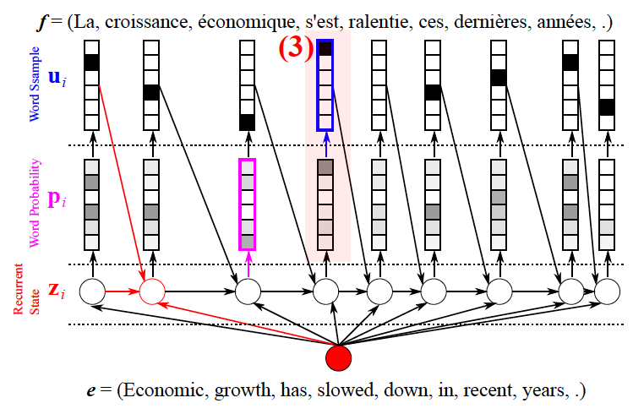
Neural Machine Translation
Model- decoder
Cho: From Sequence Modeling to Translation

Slide 30
Training a Neural Machine Translation system
Cross-entropy Loss function: Negative log prob of “have”
Seq2seq is optimized as a single system.
Backpropagation operates “end to end”.

Slide 31
Advantages of NMT
Compared to SMT, NMT has many advantages:
Better performance
More fluent
Better use of context
Better use of phrase similarities
A single neural network to be optimized end-to-end
No subcomponents to be individually optimized
Requires much less human engineering effort
No feature engineering
Same method for all language pairs

Slide 32
Disadvantages of NMT?
Compared to SMT:
NMT is less interpretable
Hard to debug
NMT is difficult to control
For example, can’t easily specify rules or guidelines for translation
Safety concerns!

Slide 33
Evaluation (Machine Translation)
BLEU (bilingual evaluation understudy) (Papineni et al. (2002))
BLEU compares the machine-written translation to one or several human-written translation(s), and computes a similarity score based on:
n-gram precision (usually up to 3 or 4-grams)
Penalty for too-short system translations
BLEUs output is always a number between 0 and 1(normalized)
1 means identical to the reference translations

Slide 34
BLEU is useful but imperfect
BLEU was one of the first metrics to claim a high correlation with human judgements of quality, and remains one of the most popular automated and inexpensive metrics
There are many valid ways to translate a sentence
So a good translation can get a poor BLEU score because it has low n-gram overlap with the human translation L

Slide 35
MT progress over time [Edinburgh En-De WMT newstest2013 Cased BLEU; NMT 2015 from U. Montréal]
Source: http://www.meta-net.eu/events/meta-forum-2016/slides/09_sennrich.pdf

Slide 36
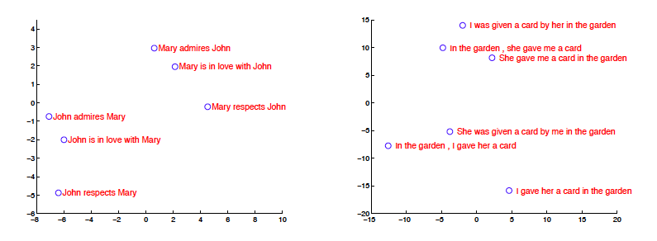
NMT Analysis
Model Analysis
Sutskever et al. 2014

Slide 37
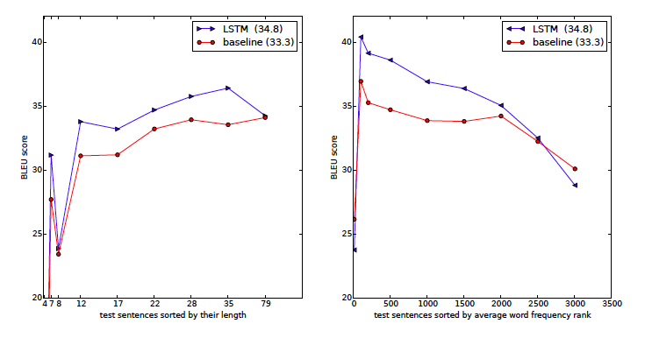
NMT Analysis
Long sentences
Sutskever et al. 2014

Slide 38
NMT: the biggest success story of NLP Deep Learning
Neural Machine Translation went from a fringe research activity in 2014 to the leading standard method in 2016
2014: First seq2seq paper published
2016: Google Translate switches from SMT to NMT
This is amazing!
SMT systems, built by hundreds of engineers over many years, outperformed by NMT systems trained by a handful of engineers in a few months

Slide 39
So is Machine Translation solved?
Nope!
Many difficulties remain:
Out-of-vocabulary words
Domain mismatch between train and test data
Maintaining context over longer text
Low-resource language pairs
(Old) Bad Examples
http://languagelog.ldc.upenn.edu/nll/?p=35120#more-35120
https://hackernoon.com/bias-sexist-or-this-is-the-way-it-should-be-ce1f7c8c683c

Slide 40
NMT research continues
NMT is the flagship (旗舰) task for NLP Deep Learning
NMT research has pioneered many of the recent innovations of NLP Deep Learning
In 2018: NMT research continues to thrive
Researchers have found many, many improvements to the “vanilla” seq2seq NMT system we’ve presented today

