Slide 1
COMP4901K/Math4824B Machine Learning for Natural Language Processing
Lecture 3: Getting started with Python
Instructor: Yangqiu Song

Slide 2
Today
Introduction to Programming with Python
The following slides from Marty Stepp, Diane Litman, and Matt Huenerfauth’s lecture
Notes:
http://songcpu1.cse.ust.hk/sean/notebook

Slide 3
Python and Natural Language Processing
Python is a great language for NLP:
Simple
Easy to debug:
Exceptions
Interpreted language
Easy to structure
Modules
Object oriented programming
Powerful string manipulation

Slide 4
What is Python?
A programming language with strong similarities to PERL, but with powerful typing and object oriented features.
Commonly used for producing HTML content on websites. Great for text files.
Useful built-in types (lists, dictionaries).
Clean syntax, powerful extensions.

Slide 5
Why Python?
Natural Language ToolKit
A lot of deep learning packages
Ease of use; interpreter
AI Processing: Symbolic
Python’s built-in datatypes for strings, lists, and more.
Java or C++ require the use of special classes for this.
AI Processing: Statistical
Python has strong numeric processing capabilities: matrix operations, etc.
Suitable for probability and machine learning code.

Slide 6
Learning Python
Unfortunately, we won’t have time to cover all of Python in class; so, we’re just going to go over some highlights.
You’ll need to learn more on your own.
Our lab tutorials will help you get familiar with it. It also asks you to read some online Python tutorials.
We will fairly rapidly move to using the Natural Language ToolKit.

Slide 7
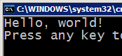



Compiling and interpreting
Many languages require you to compile (translate) your program into a form that the machine understands.
Python is instead directly interpreted into machine instructions.
compile
execute
source code
Hello.java
byte code
Hello.class
output
interpret
source code
Hello.py
output

Slide 8
Basic Concepts

Slide 9
Expressions
expression: A data value or set of operations to compute a value.
Examples: 1 + 4 * 3
42
Arithmetic operators we will use:
+ - * / addition, subtraction/negation, multiplication, division
% modulus, a.k.a. remainder
** exponentiation
precedence: Order in which operations are computed.
* / % ** have a higher precedence than + - 1 + 3 * 4 is 13
Parentheses can be used to force a certain order of evaluation. (1 + 3) * 4 is 16

Slide 10
Math commands
Python has useful commands for performing calculations.
To use many of these commands, you must write the following at the top of your Python program:
from math import *
Command name | Description
abs(value) | absolute value
ceil(value) | rounds up
cos(value) | cosine, in radians
floor(value) | rounds down
log(value) | logarithm, base e
log10(value) | logarithm, base 10
max(value1, value2) | larger of two values
min(value1, value2) | smaller of two values
round(value) | nearest whole number
sin(value) | sine, in radians
sqrt(value) | square root
Constant | Description
e | 2.7182818...
pi | 3.1415926...

Slide 11
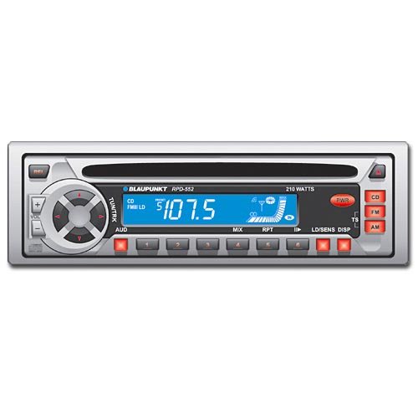
Variables
variable: A named piece of memory that can store a value.
Usage:
Compute an expression's result,
store that result into a variable,
and use that variable later in the program.
assignment statement: Stores a value into a variable.
Syntax:
name = value
Examples: x = 5
gpa = 3.14
x 5 gpa 3.14
A variable that has been given a value can be used in expressions.
x + 4 is 9

Slide 12
Repetition (loops) and Selection (if/else)

Slide 13
The for loop
for loop: Repeats a set of statements over a group of values.
Syntax:
for variableName in groupOfValues:
statements
We indent the statements to be repeated with tabs or spaces.
variableName gives a name to each value, so you can refer to it in the statements.
groupOfValues can be a range of integers, specified with the range function.
Example:
for x in range(1, 6): % 6 will not be included
print (x, "squared is", x * x)
Output:
1 squared is 1
2 squared is 4
3 squared is 9
4 squared is 16
5 squared is 25

Slide 14
range
The range function specifies a range of integers:
range(start, stop) - the integers between start (inclusive)
and stop (exclusive)
It can also accept a third value specifying the change between values.
range(start, stop, step) - the integers between start (inclusive)
and stop (exclusive) by step
Example:
for x in range(5, 0, -1):
print (x)
print ("Blastoff!")
Output:
5
4
3
2
1
Blastoff!

Slide 15
Cumulative loops
Some loops incrementally compute a value that is initialized outside the loop. This is sometimes called a cumulative sum.
sum = 0
for i in range(1, 11):
sum = sum + (i * i)
print ("sum of first 10 squares is", sum)
Output:
sum of first 10 squares is 385

Slide 16
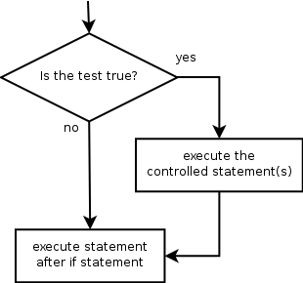
if
if statement: Executes a group of statements only if a certain condition is true. Otherwise, the statements are skipped.
Syntax:
if condition:
statements
Example:
gpa = 3.4
if gpa > 2.0:
print ("Your application is accepted.")

Slide 17
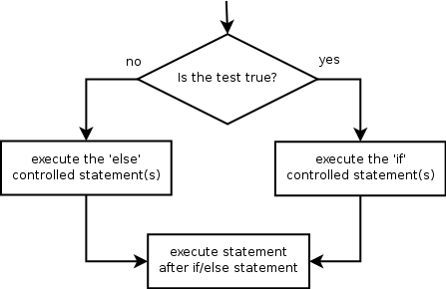
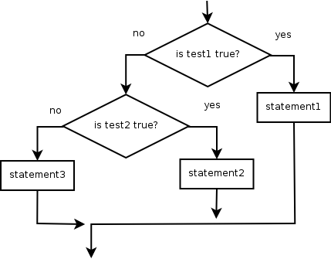
if/else
if/else statement: Executes one block of statements if a certain condition is True, and a second block of statements if it is False.
Syntax:
if condition:
statements
else:
statements
Example:
gpa = 1.4
if gpa > 2.0:
print ("Welcome to Mars University! ")
else:
print ("Your application is denied.")
Multiple conditions can be chained with elif ("else if"):
if condition:
statements
elif condition:
statements
else:
statements

Slide 18
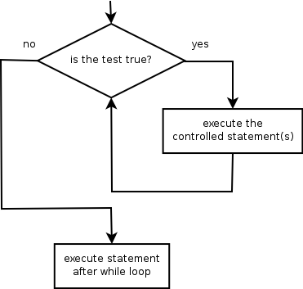
while
while loop: Executes a group of statements as long as a condition is True.
good for indefinite loops (repeat an unknown number of times)
Syntax:
while condition:
statements
Example:
number = 1
while number < 200:
print (number)
number = number * 2
Output:
1
2
4
8
16
32
64
128

Slide 19
Logic
Many logical expressions use relational operators:
Logical expressions can be combined with logical operators:
Operator | Meaning | Example | Result
== | equals | 1 + 1 == 2 | True
!= | does not equal | 3.2 != 2.5 | True
< | less than | 10 < 5 | False
> | greater than | 10 > 5 | True
<= | less than or equal to | 126 <= 100 | False
>= | greater than or equal to | 5.0 >= 5.0 | True
Operator | Example | Result
and | 9 != 6 and 2 < 3 | True
or | 2 == 3 or -1 < 5 | True
not | not 7 > 0 | False

Slide 20
Text and File Processing

Slide 21
Strings
string: A sequence of text characters in a program.
Strings start and end with quotation mark " or prime ' characters.
Examples: "hello" "This is a string" "This, too, is a string. It can be very long!"
A string may not span across multiple lines or contain a " character. "This is not a legal String."
"This is not a "legal" String either."
A string can represent characters by preceding them with a backslash.
\t tab character
\n new line character
\" quotation mark character
\\ backslash character
Example: "Hello\tthere\nHow are you?"

Slide 22
Indexes
Characters in a string are numbered with indexes starting at 0:
Example:
name = "P. Diddy"
Accessing an individual character of a string:
variableName [ index ]
Example:
print (name, "starts with", name[0])
Output:
P. Diddy starts with P
index | 0 | 1 | 2 | 3 | 4 | 5 | 6 | 7
character | P | . |  | D | i | d | d | y

Slide 23
String properties
len(string) - number of characters in a string
(including spaces)
str.lower(string) - lowercase version of a string
str.upper(string) - uppercase version of a string
Example:
name = "Martin Douglas Stepp"
length = len(name)
big_name = str.upper(name)
print (big_name, "has", length, "characters")
Output:
MARTIN DOUGLAS STEPP has 20 characters

Slide 24
input
input : Reads a string of text from user input.
Example:
name = input("Howdy, pardner. What's yer name? ")
print (name, "... what a silly name! ")
Output:
Howdy, pardner. What's yer name? Paris Hilton
Paris Hilton ... what a silly name!

Slide 25
Text processing
text processing: Examining, editing, formatting text.
often uses loops that examine the characters of a string one by one
A for loop can examine each character in a string in sequence.
Example:
for c in "booyah":
print (c)
Output:
b
o
o
y
a
h

Slide 26
Strings and numbers
ord(text) - converts a string into a number.
Example: ord("a") is 97, ord("b") is 98, ...
Characters map to numbers using standardized mappings such as ASCII and Unicode.
chr(number) - converts a number into a string.
Example: chr(99) is "c"

Slide 27
File processing
Many programs handle data, which often comes from files.
Reading the entire contents of a file:
variableName = open("filename").read()
Example:
file_text = open("bankaccount.txt").read()

Slide 28
Line-by-line processing
Reading a file line-by-line:
for line in open("filename").readlines():
statements
Example:
count = 0
for line in open("ins/a0p1/cluster_labels_1.txt").readlines():
count = count + 1
print ("The file contains", count, "lines.")

Slide 29
Other Issues

Slide 30
Whitespace
Whitespace is meaningful in Python: especially indentation and placement of newlines.
Use a newline to end a line of code. (Not a semicolon like in C++ or Java.) (Use \ when must go to next line prematurely.)
No braces { } to mark blocks of code in Python… Use consistent indentation instead. The first line with a new indentation is considered outside of the block.
Often a colon appears at the start of a new block. (We’ll see this later for function and class definitions.)

Slide 31
Comments
Start comments with # – the rest of line is ignored.
Can include a “documentation string” as the first line of any new function or class that you define.
The development environment, debugger, and other tools use it: it’s good style to include one.
def my_function(x, y):
"""This is the docstring. This function does blah blah blah. """ # The code would go here...

Slide 32
Look at a sample of code…
x = 34 - 23 # A comment.
y = "Hello" # Another one.
z = 3.45
if z == 3.45 or y == "Hello":
x = x + 1
y = y + " World" # String concat.
print x
print y

Slide 33
Python and Types
Python determines the data types in a program automatically. “Dynamic Typing”
But Python’s not casual about types, it enforces them after it figures them out. “Strong Typing”
So, for example, you can’t just append an integer to a string. You must first convert the integer to a string itself.
x = "the answer is " # Decides x is string.
y = 23 # Decides y is integer.
print (x + y) # Python will complain about this.

Slide 34
Naming Rules
Names are case sensitive and cannot start with a number. They can contain letters, numbers, and underscores.
bob Bob _bob _2_bob_ bob_2 BoB
There are some reserved words:
and, assert, break, class, continue, def, del, elif, else, except, exec, finally, for, from, global, if, import, in, is, lambda, not, or, pass, print, raise, return, try, while

Slide 35
Accessing Non-existent Name
If you try to access a name before it’s been properly created (by placing it on the left side of an assignment), you’ll get an error.
>>> y
Traceback (most recent call last):
File "<pyshell#16>", line 1, in -toplevel-
y
NameError: name ‘y' is not defined
>>> y = 3
>>> y
3

Slide 36
Multiple Assignment
You can also assign to multiple names at the same time.
>>> x, y = 2, 3 # 同时给x,y赋值
>>> x
2
>>> y
3

Slide 37
Printing with Python
You can print a string to the screen using “print.”
Using the % string operator in combination with the print command, we can format our output text.
>>> print ("%s xyz %d" % ("abc", 34))
abc xyz 34
“Print” automatically adds a newline to the end of the string. If you include a list of strings, it will concatenate them with a space between them.
>>> print （"abc"） >>> print （"abc", "def"）
abc abc def

Slide 38
Modules and Packages
Python modules “package program code and data for reuse.” (Lutz)
Similar to library in C, package in Java.
Python packages are hierarchical modules (i.e., modules that contain other modules).
Three commands for accessing modules:
import
from…import
reload

Slide 39
Modules and Packages: import
The import command loads a module:
# Load the regular expression module
>>> import re
To access the contents of a module, use dotted names:
>>> re.split(r'\W+', 'Words, words, words.')
['Words', 'words', 'words', '']
>>> re.split(r'(\W+)', 'Words, words, words.')
['Words', ', ', 'words', ', ', 'words', '.', '']
>>> re.split(r'\W+', 'Words, words, words.', 1)
['Words', 'words, words.']

Slide 40
Modules and Packages from…import
The from…import command loads individual functions and objects from a module:
# Load the split function from the re module
>>> from re import split
Once an individual function or object is loaded with from…import, it can be used directly:
>>> split(r'\W+', 'Words, words, words.')
['Words', 'words', 'words', '']
>>> split(r'(\W+)', 'Words, words, words.')
['Words', ', ', 'words', ', ', 'words', '.', '']
>>> split(r'\W+', 'Words, words, words.', 1)
['Words', 'words, words.']

Slide 41
Import vs. from…import
Import
Keeps module functions separate from user functions.
Requires the use of dotted names.
from…import
Puts module functions and user functions together.
More convenient names.

