Slide 1
COMP4901K/Math4824B Machine Learning for Natural Language Processing
Lecture 4: Introduction to NLTK
Natural Language Toolkit
Instructor: Yangqiu Song

Slide 2
Today
How shall we transform a huge text collection?
Intro to NLTK
(modified from Edward Loper’s notes)

Slide 3
Corpus文集-based statistical approaches to tackle NLP problem
How can a machine understand these differences?
Decorate the cake with the frosting
Decorate the cake with the kids
Rules based approaches, i.e. hand coded syntactic constraints and preference rules:
The verb decorate require an animate being as agent
The object cake is formed by any of the following, inanimate entities (cream, dough, frosting…..)
Such approaches have been showed to be time consuming to build, do not scale up well and are very brittle to new, unusual, metaphorical use of language
To swallow requires an animate being as agent/subject and a physical object as object
I swallowed his story
The supernova swallowed the planet
Slides Credit: Barbara Rosario

Slide 4
Corpus-based statistical approaches to tackle NLP problem
A Statistical NLP approach seeks to solve these problems by automatically learning lexical and structural preferences from text collections (corpora)
Statistical models are robust, generalize well and behave gracefully in the presence of errors and new data.
So:
Get large text collections
Compute statistics over those collections
(The bigger the collections, the better the statistics)
Slides Credit: Barbara Rosario

Slide 5
Corpus-based statistical approaches to tackle NLP problem
Decorate the cake with the frosting
Decorate the cake with the kids
From (labeled) corpora we can learn that:
#(kids are subject/agent of decorate) > #(frosting is subject/agent of decorate)
From (UN-labeled) corpora we can learn that:
#(“the kids decorate the cake”) >> #(“the frosting decorates the cake”)
#(“cake with frosting”) >> #(“cake with kids”)
etc..
Given these “facts” we then need a statistical model for the attachment decision
Slides Credit: Barbara Rosario

Slide 6
Corpus-based statistical approaches to tackle NLP problem
Topic categorization: classify the document into semantics topics
Document 1 The U.S. swept into the Davis Cup final on Saturday when twins Bob and Mike Bryan defeated Belarus's Max Mirnyi and Vladimir Voltchkov to give the Americans an unsurmountable 3-0 lead in the best-of-five semi-final tie. Topic = sport | Document 2 One of the strangest, most relentless hurricane seasons on record reached new bizarre heights yesterday as the plodding approach of Hurricane Jeanne prompted evacuation orders for hundreds of thousands of Floridians and high wind warnings that stretched 350 miles from the swamp towns south of Miami to the historic city of St. Augustine. Topic = disaster
Slides Credit: Barbara Rosario

Slide 7
Corpus-based statistical approaches to tackle NLP problem
Topic categorization: classify the document into semantics topics
Document 1 (sport) The U.S. swept into the Davis Cup final on Saturday when twins Bob and Mike Bryan … | Document 2 (disasters) One of the strangest, most relentless hurricane seasons on record reached new bizarre heights yesterday as….
From (labeled) corpora we can learn that:
#(sport documents containing word Cup) > #(disaster documents containing word Cup) -- feature
We then need a statistical model for the topic assignment
Slides Credit: Barbara Rosario

Slide 8
Corpus-based statistical approaches to tackle NLP problem
Feature extractions (linguistics motivated, deep learning)
Statistical models
Data (corpora, labels, linguistic resources)
Slides Credit: Barbara Rosario

Slide 9
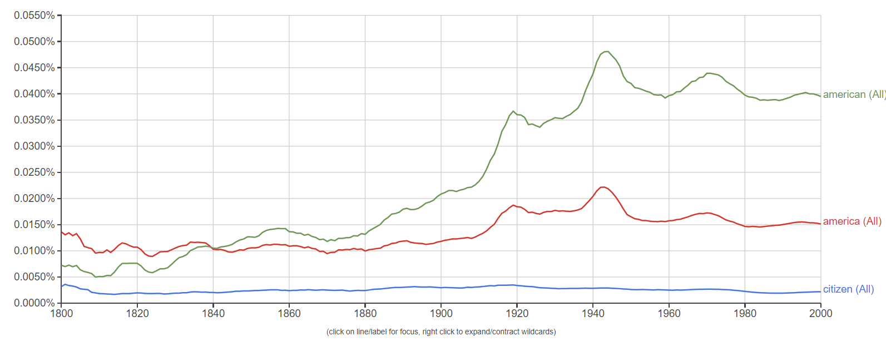
Google N-gram Dataset
https://books.google.com/ngrams
All counts in Google Books (a large collection of electronic books). And do optical character recognition.
Uni-gram: consider word one by one. Bi-gram/Tri-gram
Google actually uses Quin-gram

Slide 10
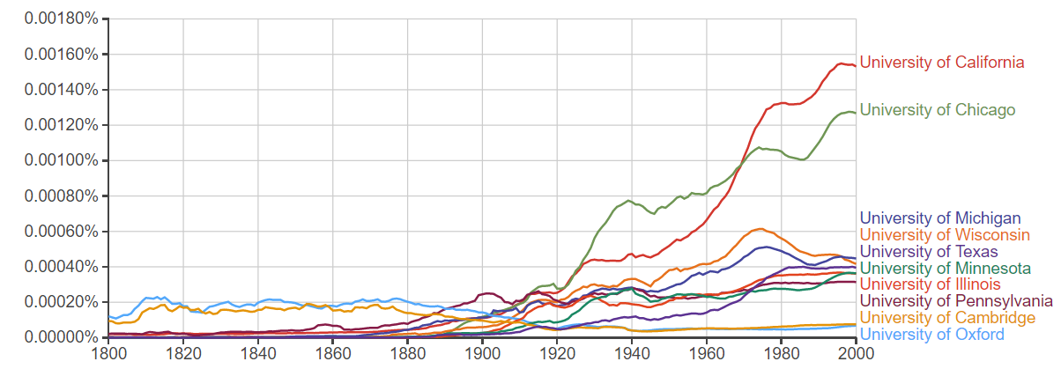
Interesting Search from Google Books
Wildcard search
to find the most popular words following "University of", search for "University of *". (accordance with migration pattern of the USA —— people are moving from east to west coast)

Slide 11
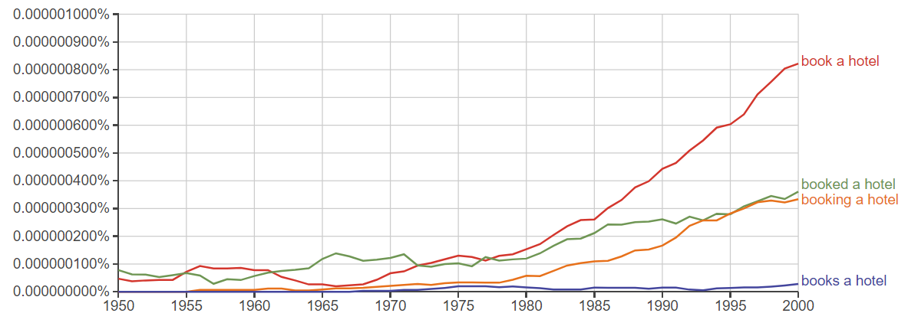
Interesting Search from Google Books
Inflection search
Indicate: people are spending more time on travelling

Slide 12
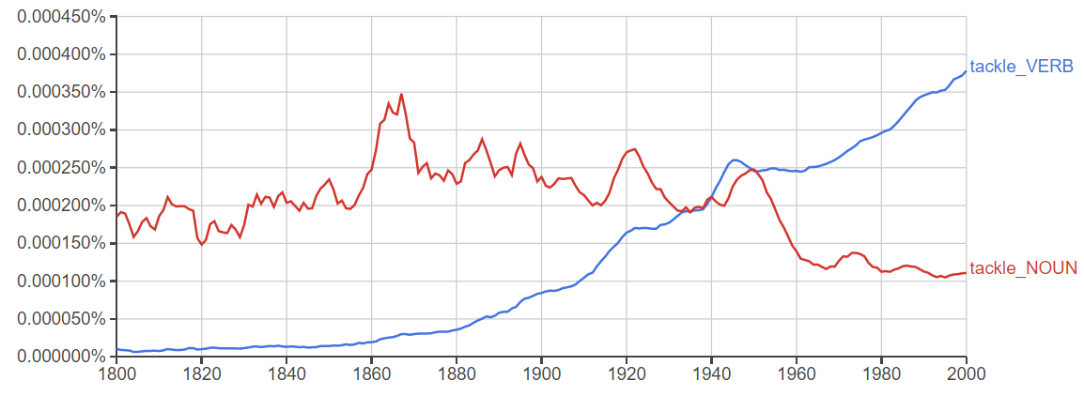
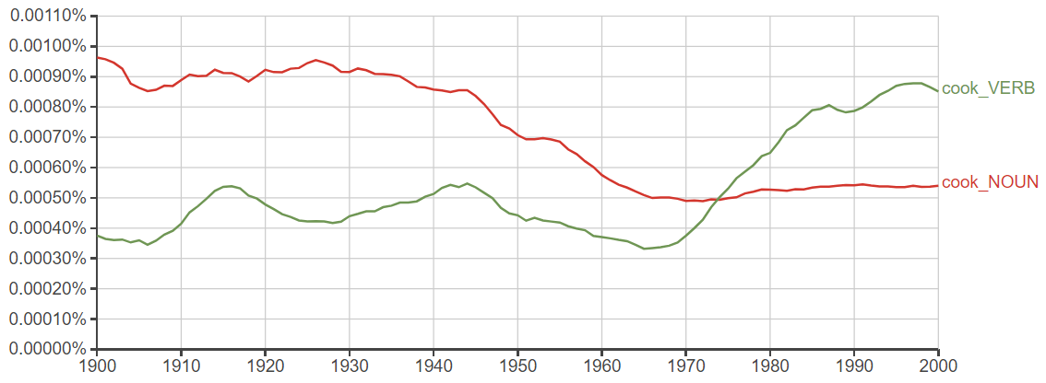
Interesting Search from Google Books
Part-of-speech Tags

Slide 13
Introduction to NLTK
The Natural Language Toolkit (NLTK) provides:
Basic classes for representing data relevant to natural language processing.
Standard interfaces for performing tasks, such as tokenization, tagging, and parsing.
Standard implementations of each task, which can be combined to solve complex problems.

Slide 14
NLTK: Example Modules
nltk.tokenize: processing individual elements of text, such as words or sentences.
nltk.probability: modeling frequency distributions and probabilistic systems.
nltk.tag: tagging tokens with supplemental information, such as parts of speech or wordnet sense tags.
nltk.parse: high-level interface for parsing texts.
nltk.app.chartparser: a chart-based implementation of the parser interface.
nltk.chunk: a regular-expression based surface parser.
http://text-processing.com/demo/

Slide 15
NLTK: Top-Level Organization
NLTK is organized as a flat hierarchy of packages and modules.
Each module provides the tools necessary to address a specific task
Modules contain two types of classes:
Data-oriented classes are used to represent information relevant to natural language processing.
Task-oriented classes encapsulate the resources and methods needed to perform a specific task.

Slide 16
The First Trial
Tokens and Tokenization
Frequency Distributions

Slide 17
The Tokenize Module
It is often useful to think of a text in terms of smaller elements, such as words or sentences.
The nltk.tokenize module defines classes for representing and processing these smaller elements.
What might be other useful smaller elements?

Slide 18
Tokens and Types
The term word can be used in two different ways:
To refer to an individual occurrence of a word
To refer to an abstract vocabulary item
For example, the sentence “my dog likes his dog” contains five occurrences of words, but four vocabulary items.
To avoid confusion use more precise terminology:
Word token: an occurrence of a word
Word Type: a vocabulary item (a lexical word in vocabulary)

Slide 19
Text Locations
A text location @ [s:e] specifies a region of a text:
s is the start index
e is the end index
The text location @ [s:e]specifies the text beginning at s, and including everything up to (but not including) the text at e.
This definition is consistent with Python slice.
Think of indices as appearing between elements: I saw a man
0 1 2 3 4
Shorthand notation when location width = 1.

Slide 20
Text Locations (continued)
Indices can be based on different units:
character
word
sentence
Locations can be tagged with sources (files, other text locations – e.g., the first word of the first sentence in the file)
Location member functions:
start
end
unit
source

Slide 21
Tokenization
The simplest way to represent a text is with a single string.
Difficult to process text in this format.
Often, it is more convenient to work with a list of tokens.
The task of converting a text from a single string to a list of tokens is known as tokenization.

Slide 22
Tokenization (continued)
Tokenization is harder that it seems
I’ll see you in New York.
The aluminum-export ban.
The simplest approach is to use “graphic words” (i.e., separate words using whitespace)
Another approach is to use regular expressions to specify which substrings are valid words.
NLTK provides a generic tokenization interface: TokenizerI

Slide 23
Tokenizer I
Defines a single method, tokenize, which takes a string and returns a list of tokens
Tokenize is independent of the level of tokenization and the implementation algorithm

Slide 24
Example
>>> import nltk, re, pprint
>>> from nltk import word_tokenize
>>> raw = """DENNIS: Listen, strange women lying in ponds distributing swords ... is no basis for a system of government. Supreme executive power derives from ... a mandate from the masses, not from some farcical aquatic ceremony."""
>>> tokens = word_tokenize(raw)
>>> tokens # array of words
>>> ['DENNIS', ':', 'Listen', ',', 'strange', 'women', 'lying', 'in', 'ponds', 'distributing', 'swords', '...', 'is', 'no', 'basis', 'for', 'a', 'system', 'of', 'government', '.', 'Supreme', 'executive', 'power', 'derives', 'from', '...', 'a', 'mandate', 'from', 'the', 'masses', ',', 'not', 'from', 'some', 'farcical', 'aquatic', 'ceremony', '.']

Slide 25
Next: Corpus Statistics
Corpus-based statistical approaches to tackle NLP problem
Feature extractions (linguistics motivated, deep learning)
Statistical models
Data (corpora, labels, linguistic resources)
NLTK provides several corpora which are easy to access and use

Slide 26
Gutenberg Corpus
NLTK includes a small selection of texts from the Project Gutenberg electronic text archive
25,000 free electronic books
hosted at http://www.gutenberg.org/
>>> from nltk.corpus import gutenberg
>>> gutenberg.fileids() ['austen-emma.txt', 'austen-persuasion.txt', 'austen-sense.txt', ...]
>>> emma = gutenberg.words('austen-emma.txt')

Slide 27
More detailed look
>>> macbeth_sentences = gutenberg.sents('shakespeare-macbeth.txt')
>>> macbeth_sentences
[['[', 'The', 'Tragedie', 'of', 'Macbeth', 'by', 'William', 'Shakespeare', '1603', ']'], ['Actus', 'Primus', '.'], ...]
>>> macbeth_sentences[1116] ['Double', ',', 'double', ',', 'toile', 'and', 'trouble', ';', 'Fire', 'burne', ',', 'and', 'Cauldron', 'bubble']
>>> longest_len = max(len(s) for s in macbeth_sentences)
>>> [s for s in macbeth_sentences if len(s) == longest_len]
[['Doubtfull', 'it', 'stood', ',', 'As', 'two', 'spent', 'Swimmers', ',', 'that', 'doe', 'cling', 'together', ',', 'And', 'choake', 'their', 'Art', ':', 'The', 'mercilesse', 'Macdonwald', ...]]

Slide 28
Other Typical Corpora
Web and Chat Text
less formal language
content from a Firefox discussion forum
conversations overheard in New York
the movie script of Pirates of the Carribean
personal advertisements
and wine reviews

Slide 29
Other Typical Corpora
Brown Corpus
the first million-word electronic corpus of English
created in 1961 at Brown University
contains text from 500 sources,
and the sources have been categorized by genre, such as news, editorial, and so on
ID | File | Genre | Description
A16 | ca16 | news | Chicago Tribune: Society Reportage
B02 | cb02 | editorial | Christian Science Monitor: Editorials
C17 | cc17 | reviews | Time Magazine: Reviews
D12 | cd12 | religion | Underwood: Probing the Ethics of Realtors
E36 | ce36 | hobbies | Norling: Renting a Car in Europe
K04 | ck04 | fiction | W.E.B. Du Bois: Worlds of Color
L13 | cl13 | mystery | Hitchens: Footsteps in the Night
M01 | cm01 | science_fiction | Heinlein: Stranger in a Strange Land
N14 | cn15 | adventure | Field: Rattlesnake Ridge
P12 | cp12 | romance | Callaghan: A Passion in Rome
R06 | cr06 | humor | Thurber: The Future, If Any, of Comedy

Slide 30
Other Typical Corpora
Reuters Corpus (used for topic classification)
contains 10,788 news documents totaling 1.3 million words.
The documents have been classified into 90 topics,
and grouped into two sets, called "training" and "test";
Train with training set, report accuracy using testing set.
thus, the text with fileid 'test/14826' is a document drawn from the test set.
A widely used text classification benchmark dataset

Slide 31
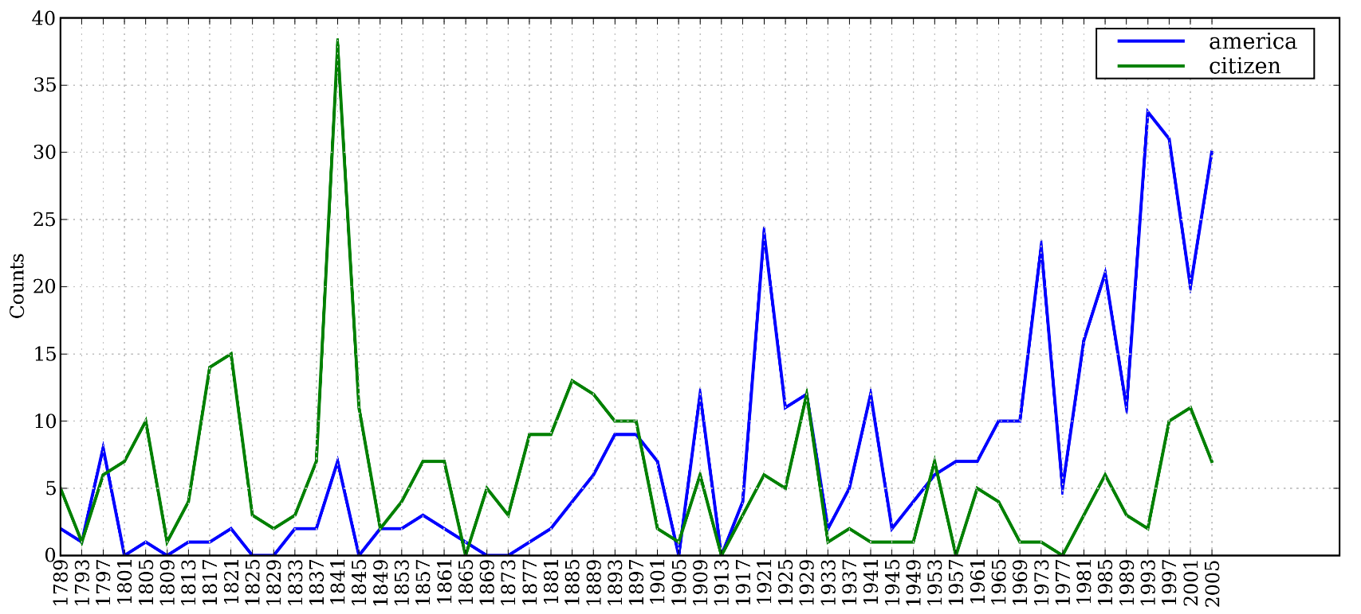
Other Typical Corpora
Inaugural Address Corpus
U.S. Presidential Inaugural Addresses
https://www.nltk.org/book/ch02.html
Plot of a Conditional Frequency Distribution: all words in the Inaugural Address Corpus that begin with america or citizen are counted; separate counts are kept for each address; these are plotted so that trends in usage over time can be observed; counts are not normalized for document length.

Slide 32
Other Typical Corpora
Annotated Text Corpora
Many text corpora contain linguistic annotations,
POS tags,
named entities,
syntactic structures,
semantic roles,
and so forth.
convenient to access several of these corpora,
has data packages containing corpora and corpus samples,
freely downloadable for use in teaching and research.
http://www.nltk.org/nltk_data/

Slide 33


Frequency Distributions
How can we identify the words of a text that are most informative about the topic and genre of the text?
You might go about finding the 50 most frequent words of a book
On Feb. 8, Dong Nguyen announced that he would be removing his hit game Flappy Bird from both the iOS and Android app stores, saying that the success of the game is something he never wanted. Some fans of the game took it personally, replying that they would either kill Nguyen or kill themselves if he followed through with his decision.
Frank Lantz, the director of the New York University Game Center, said that Nguyen's meltdown resembles how some actors or musicians behave. "People like that can go a little bonkers after being exposed to this kind of interest and attention," he told ABC News. "Especially when there's a healthy dose of Internet trolls."
7 February 2014 is going to be a great day in the history of Russia with the upcoming XXII Winter Olympics 2014 in Sochi. As the climate in Russia is subtropical, hence you would love to watch ice capped mountains from the beautiful beaches of Sochi. 2014 Winter Olympics would be an ultimate event for you to share your joys, emotions and the winning moments of your favourite sports champions. If you are really an obsessive fan of Winter Olympics games then you should definitely book your ticket to confirm your presence in winter Olympics 2014 which are going to be held in the provincial town, Sochi. Sochi Organizing committee (SOOC) would be responsible for the organization of this great international multi sport event from 7 to 23 February 2014.
Mobile Games
Sports
Flappy Bird
Russia
iOS
Olympics
Winter
Android
apps
champions
Sochi
stores
game
mountains
beaches
musicians
sports

Slide 34
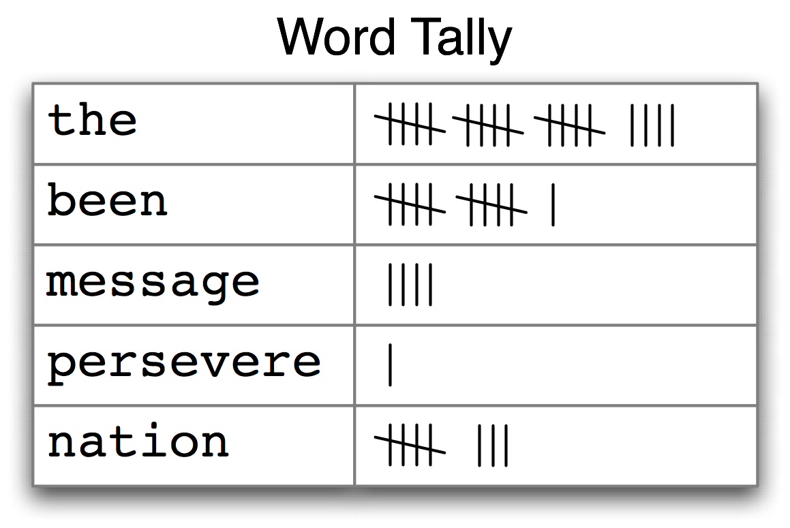
Counting Words Appearing in a Text
A frequency distribution

Slide 35
NLTK provides built-in support
>>> fdist1 = FreqDist(text1) # return 一个 dictionary, (fdist)
>>> print(fdist1)
<FreqDist with 19317 samples and 260819 outcomes>
>>> fdist1.most_common(50)
[(',', 18713), ('the', 13721), ('.', 6862), ('of', 6536), ('and', 6024), ('a', 4569), ('to', 4542), (';', 4072), ('in', 3916), ('that', 2982), ("'", 2684), ('-', 2552), ('his', 2459), ('it', 2209), ('I', 2124), ('s', 1739), ('is', 1695), ('he', 1661), ('with', 1659), ('was', 1632), ('as', 1620), ('"', 1478), ('all', 1462), ('for', 1414), ('this', 1280), ('!', 1269), ('at', 1231), ('by', 1137), ('but', 1113), ('not', 1103), ('--', 1070), ('him', 1058), ('from', 1052), ('be', 1030), ('on', 1005), ('so', 918), ('whale', 906), ('one', 889), ('you', 841), ('had', 767), ('have', 760), ('there', 715), ('But', 705), ('or', 697), ('were', 680), ('now', 646), ('which', 640), ('?', 637), ('me', 627), ('like', 624)]
>>> fdist1['whale']
906
>>>

Slide 36
Count word length distribution
>>> [len(w) for w in text1]
[1, 4, 4, 2, 6, 8, 4, 1, 9, 1, 1, 8, 2, 1, 4, 11, 5, 2, 1, 7, 6, 1, 3, 4, 5, 2, ...]
>>> fdist = FreqDist(len(w) for w in text1)
# 不同长度的Word出现了几次
>>> print(fdist)
<FreqDist with 19 samples and 260819 outcomes>
>>> fdist
FreqDist({3: 50223, 1: 47933, 4: 42345, 2: 38513, 5: 26597, 6: 17111, 7: 14399, 8: 9966, 9: 6428, 10: 3528, ...})
Note that len(w) is applied for every word in text1

Slide 37
External Lexical/Knowledge Sources
NLTK also provide several useful lexical/knowledge sources.
Wordlist Corpora: list of words such as stop words (we will introduce later)
A Pronouncing Dictionary: for speech generation
Comparative Wordlists: words in different languages
WordNet
a semantically-oriented dictionary of English,
similar to a traditional thesaurus (词库) but with a richer structure

Slide 38
Meaning of Words
Polysemy and Synonym
The same word can be shown in different “synset”.
cat
company
fruit
tree
Meaning
Variability
Synonymy
Ambiguity
Polysemy
Language
cat
feline
kitty
moggy
apple

Slide 39
Word Senses
What does ‘bank’ mean?
A financial institution
E.g., “US bank has raised interest rates.”
A particular branch of a financial institution
E.g., “The bank on Main Street closes at 5pm.”
The sloping side of any hollow in the ground, especially when bordering a river
E.g., “In 1927, the bank of the Mississippi flooded.”
A ‘repository’
E.g., “I donate blood to a blood bank.”

Slide 40
WordNet (Starting from 1985)
A machine readable lexical database of English:
117K nouns, 11K verbs, 22K adjectives, 4.5K adverbs
Word senses grouped into synonym sets (“synsets”) linked into a conceptual-semantic hierarchy
82K noun synsets,
13K verb synsets,
18K adjectives synsets,
3.6K adverb synsets
Avg. # of senses:
1.23/noun, 2.16/verb, 1.41/adj, 1.24/adverb
Conceptual-semantic relations
hypernym/hyponym

Slide 41
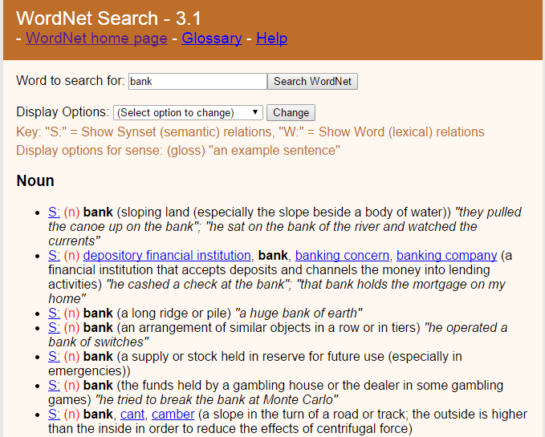
“bank”
http://wordnet.princeton.edu/
Click a synset —— return you different word with the same meaning.

Slide 42
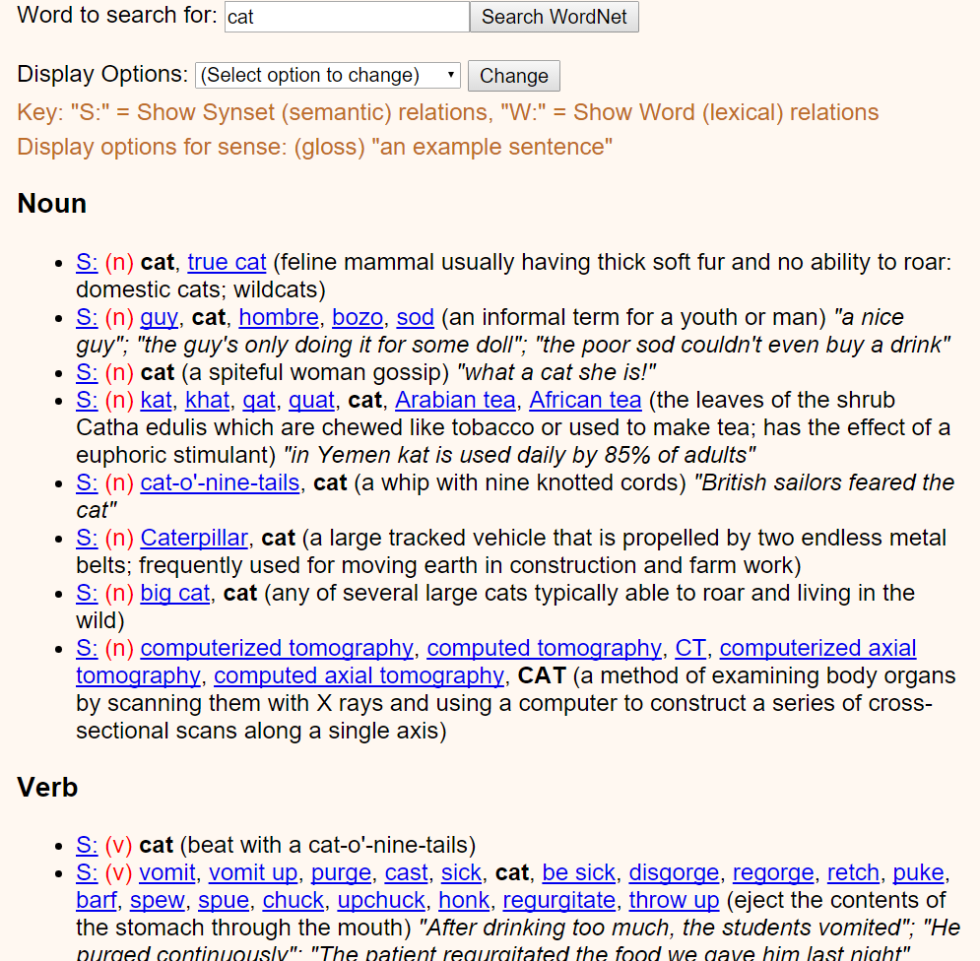

Slide 43
Lexical Relations between Nouns
Hypernym/hyponym (between concepts)
The more general ‘meal’ is a hypernym of the more specific ‘breakfast’
Instance hypernym/hyponym (between concepts and instances)
Austen is an instance hyponym of author
Member holonym/meronym (groups and members)
professor is a member meronym of (a university’s) faculty
Part holonym/meronym (wholes and parts)
wheel is a part meronym of (is a part of) car.
Substance meronym/holonym (substances and components)
flour is a substance meronym of (is made of) bread
Jane Austen, 1775–1817, English novelist

Slide 44
Lexical Relations between Verbs
Hypernym/troponym (between events)
travel/fly, walk/stroll
Flying is a troponym of traveling: it denotes a specific manner of traveling
Entailment (between events):
snore/sleep
Snoring entails (presupposes) sleeping

Slide 45
Example of Sub-graph
Hyponymy
Dwelling,abode
Hypernymy
Meronymy
kitchen
Hyponymy
bckyard
bedroom
M
e
r
o
n
y
m
y
house,home
veranda
Hyponymy
A place that serves as the living quarters of one or mor efamilies
study
guestroom
hermitage
cottage

Slide 46
Semantic Similarity/Relatedness
Similarity is a specific type of relatedness: graded
car vs. automobile -> 1.0
car vs. vehicle -> 0.6
car vs. tire -> 0.2
car vs. street -> 0.1
Similarity: synonyms, hyponyms/hyperonyms, and siblings are highly similar
doctor vs. surgeon, bike vs. bicycle
Relatedness: topically related or based on any other semantic relation
heart vs. surgeon, tire vs. car

Slide 47
WordNet Similarity
Path based similarity measure between words
Shortest path between two concepts (Leacock & Chodorow 1998)
sim = 1/|shortest path|
Path length to the root node from the least common subsumer (LCS) of the two concepts (Wu & Palmer 1994)
sim = 2*depth(LCS)/(depth(w₁)+depth(w₂))
Others

Slide 48
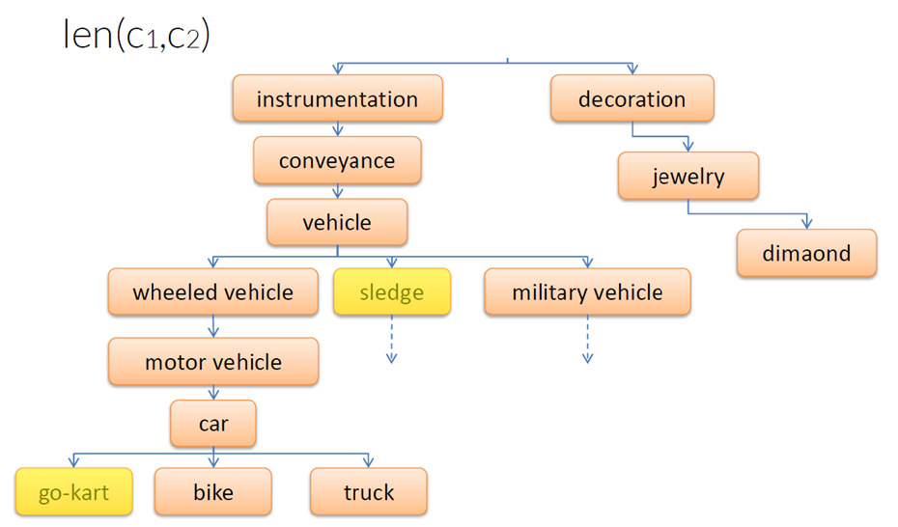
Shortest Path between Two Concepts
sim = 1/len(c1, c2)

Slide 49
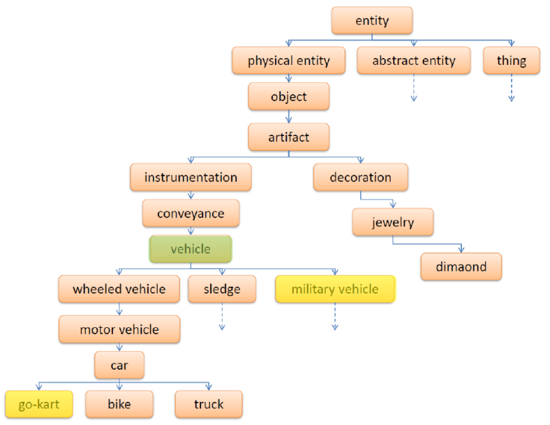
Least Common Subsumer
sim = 2*depth(LCS)/(depth(w₁)+depth(w₂))

Slide 50
Access WordNet with NLTK
Suppose we replace motorcar with automobile
a. Benz is credited with the invention of the motorcar.
b. Benz is credited with the invention of the automobile.
motorcar and automobile have the same meaning, i.e. they are synonyms
We can explore these words with the help of WordNet:
The entity car.n.01 is called a synset
>>> from nltk.corpus import wordnet as wn
>>> wn.synsets(‘motorcar’) # return motorcar 所属的那个 synset
[Synset('car.n.01')]
>>> wn.synset(‘car.n.01’).lemma_names() # print这个synset当中所有词汇：['car', 'auto', 'automobile', 'machine', 'motorcar']
>>> wn.synset('car.n.01').definition()
'a motor vehicle with four wheels; usually propelled by an internal combustion engine'
>>> wn.synset('car.n.01').examples()
['he needs a car to get to work']

Slide 51
Next
Vector Space Model

