Slide 1
COMP4901K/Math4824B Machine Learning for Natural Language Processing
Lecture 5: Vector Space Model
Instructor: Yangqiu Song

Slide 2
External Lexical/Knowledge Sources
NLTK also provide several useful lexical/knowledge sources.
Wordlist Corpora (语料库): list of words such as stop words (we will introduce later)
A Pronouncing Dictionary: for speech generation
Comparative Wordlists: words in different languages
WordNet
a semantically-oriented dictionary of English,
similar to a traditional thesaurus (词库) but with a richer structure

Slide 3
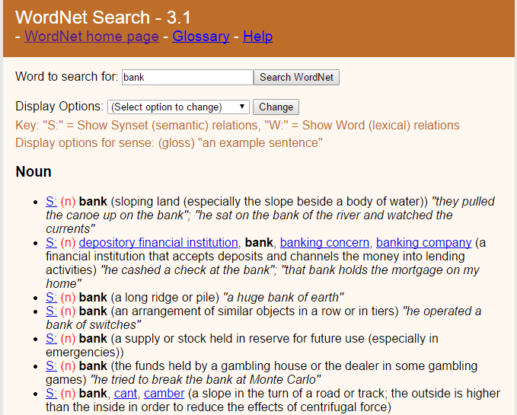
“bank”
http://wordnet.princeton.edu/

Slide 4
WordNet (Starting from 1985)
A machine readable lexical database of English:
117K nouns, 11K verbs, 22K adjectives, 4.5K adverbs
Word senses grouped into synonym sets (“synsets”) linked into a conceptual-semantic hierarchy
82K noun synsets,
13K verb synsets,
18K adjectives synsets,
3.6K adverb synsets
Avg. # of senses:
1.23/noun, 2.16/verb, 1.41/adj, 1.24/adverb
Conceptual-semantic relations
hypernym/hyponym

Slide 5
Lexical Relations between Nouns
Hypernym (上义词) /hyponym (下义词) (between concepts)
The more general ‘meal’ is a hypernym of the more specific ‘breakfast’
Instance hypernym/hyponym (between concepts and instances)
Austen is an instance hyponym of author
Member holonym (全名) /meronym (分体) (groups and members)
professor is a member meronym of (a university’s) faculty
Part holonym/meronym (wholes and parts)
wheel is a part meronym of (is a part of) car.
Substance meronym/holonym (substances and components)
flour is a substance meronym of (is made of) bread
Jane Austen, 1775–1817, English novelist

Slide 6
Lexical Relations between Verbs
Hypernym (上位词) /troponym (方式词) (between events)
travel/fly, walk/stroll
Flying is a troponym of traveling: it denotes a specific manner of traveling
Entailment (between events):
snore/sleep
Snoring entails (presupposes) sleeping

Slide 7
Example of Sub-graph
Hyponymy
Dwelling,abode
Hypernymy
Meronymy
kitchen
Hyponymy
bckyard
bedroom
M
e
r
o
n
y
m
y
house,home
veranda
Hyponymy
A place that serves as the living quarters of one or mor efamilies
study
guestroom
hermitage
cottage

Slide 8
Semantic Similarity/Relatedness
Similarity is a specific type of relatedness: graded
car vs. automobile -> 1.0
car vs. vehicle -> 0.6
car vs. tire -> 0.2
car vs. street -> 0.1
Similarity: synonyms, hyponyms/hyperonyms, and siblings are highly similar
doctor vs. surgeon, bike vs. bicycle
Relatedness: topically related or based on any other semantic relation
heart vs. surgeon, tire vs. car

Slide 9
WordNet Similarity
Path based similarity measure between words
Shortest path between two concepts (Leacock & Chodorow 1998)
sim = 1/|shortest path|
Path length to the root node from the least common subsumer (LCS) of the two concepts (Wu & Palmer 1994)
sim = 2*depth(LCS)/(depth(w₁)+depth(w₂))
Others

Slide 10
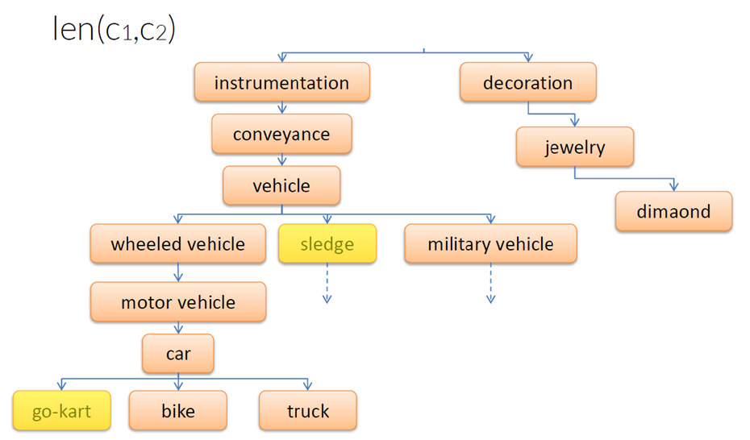
Shortest Path between Two Concepts
sim = 1/len(c1, c2)

Slide 11
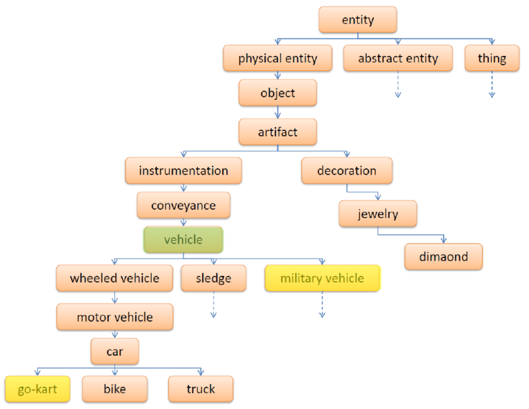
Least Common Subsumer
sim = 2*depth(LCS)/(depth(w₁)+depth(w₂))

Slide 12
Similarities: Computational Approaches
Knowledge base based
WordNet Similarity
…
Corpus based
Distributional similarity
Deep learning

Slide 13
Vector Space Model (VSM)

Slide 14


Frequency Distributions
How can we identify the words of a text that are most informative about the topic and genre of the text?
You might go about finding the 50 most frequent words of a book
On Feb. 8, Dong Nguyen announced that he would be removing his hit game Flappy Bird from both the iOS and Android app stores, saying that the success of the game is something he never wanted. Some fans of the game took it personally, replying that they would either kill Nguyen or kill themselves if he followed through with his decision.
Frank Lantz, the director of the New York University Game Center, said that Nguyen's meltdown resembles how some actors or musicians behave. "People like that can go a little bonkers after being exposed to this kind of interest and attention," he told ABC News. "Especially when there's a healthy dose of Internet trolls."
7 February 2014 is going to be a great day in the history of Russia with the upcoming XXII Winter Olympics 2014 in Sochi. As the climate in Russia is subtropical, hence you would love to watch ice capped mountains from the beautiful beaches of Sochi. 2014 Winter Olympics would be an ultimate event for you to share your joys, emotions and the winning moments of your favourite sports champions. If you are really an obsessive fan of Winter Olympics games then you should definitely book your ticket to confirm your presence in winter Olympics 2014 which are going to be held in the provincial town, Sochi. Sochi Organizing committee (SOOC) would be responsible for the organization of this great international multi sport event from 7 to 23 February 2014.
Mobile Games
Sports
Flappy Bird
Russia
iOS
Olympics
Winter
Android
apps
champions
Sochi
stores
game
mountains
beaches
musicians
sports

Slide 15
Corpus based Approach
Distributional semantics
The distributional hypothesis in linguistics is derived from the semantic theory of language usage, i.e. words that are used and occur in the same contexts tend to purport similar meanings.
The basic idea of distributional semantics can be summed up in the so-called Distributional hypothesis: linguistic items with similar distributions have similar meanings.
We will mention distributed representation based neural language models in later classes

Slide 16
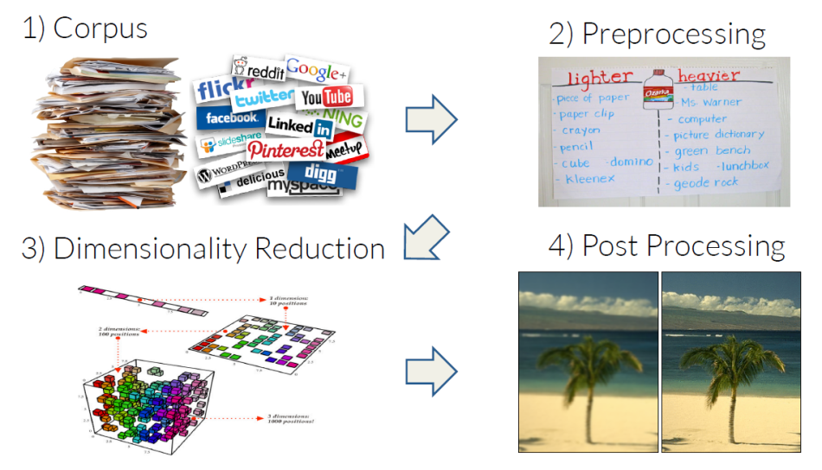
Corpus based Approach

Slide 17
Context of Words —— The words surround it
Let's try to keep the kitchen clean .
We used WordNet to the synset of cat.
What does mean?

Slide 18
Let's try to keep the kitchen .
Observation: context can tell us a lot about word meaning
Context: local window around a word occurrence (for now)
Roots in linguistics:
Distributional hypothesis [Harris, 1954]:
Semantically similar words occur in similar contexts
“If A and B have almost identical environments we say that they are synonyms.”
"You shall know a word by the company it keeps." [Firth, 1957]
Pros: data-driven, easy to implement
Cons: ambiguity

Slide 19
Intuition of distributional word similarity
Nida example:
From context words humans can guess tesgüino means
an alcoholic beverage like beer
Intuition for algorithm:
Two words are similar if they have similar word contexts.
A bottle of tesgüino is on the table
Everybody likes tesgüino
Tesgüino makes you drunk
We make tesgüino out of corn.
Dan Jurafsky

Slide 20
Different Kinds of Vector Models
Sparse vector representations
Weighted word co-occurrence matrices
Dense vector representations:
Singular value decomposition (and Latent Semantic Analysis)
Neural-network-inspired models (word embeddings)

Slide 21
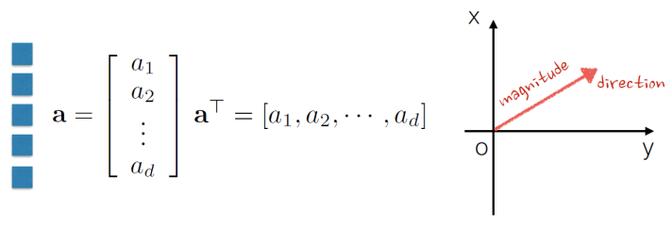
A Little Linear Algebra
Scalar: A number: length, area, density, pressure, temperature
Magnitude only! a, b, c
Vector: A collection of scalars
d is called dimensionality of vector a
Scalar is one-dimensional vector

Slide 22
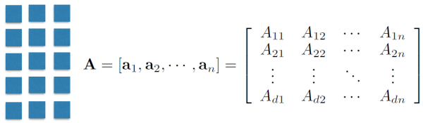
A Little Linear Algebra
Matrix: A collection of vectors

Slide 23
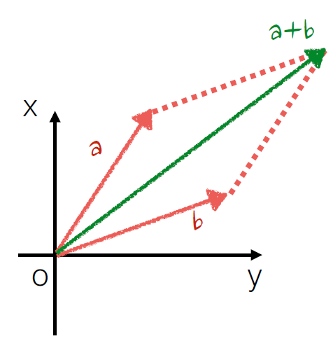
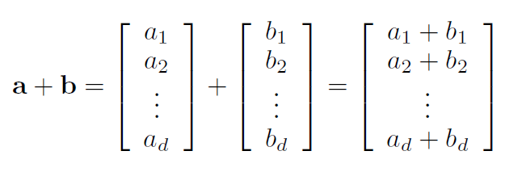
Vector Operations
Addition
Can vectors with different dimensionalities be added together?
The resultant thing is a vector or a scalar?

Slide 24
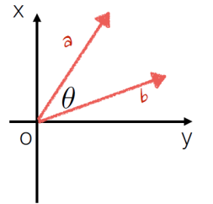
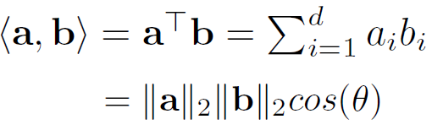

Vector Operations
Inner product
Can inner product be operated on vectors with different dimensionalities?
The resultant thing is a vector or a scalar?

Slide 25
Vector Norm
The resultant thing is a vector or a scalar?
Can vector norms be negative?

Slide 26
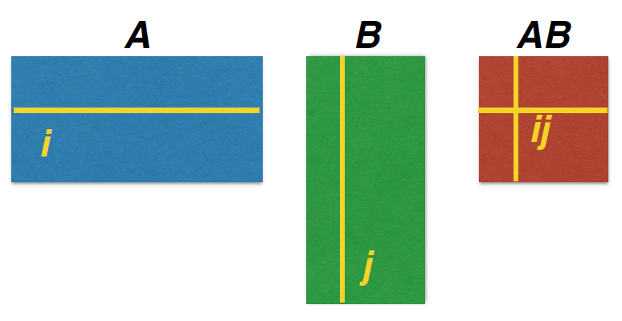
Matrix Multiplication
What is the dimensionality requirement for matrix multiplication?
What is the dimensionality of the resultant matrix?

Slide 27
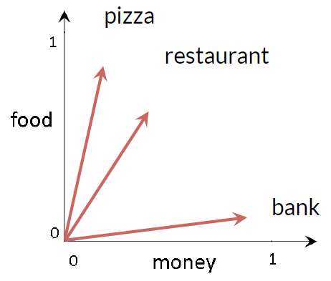
Back to Distributional Representation
Vector Space Model (VSM)
Represent each word with its context words

Slide 28
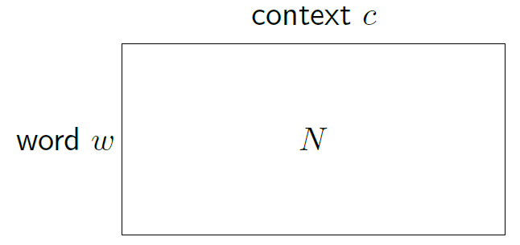
Context Vector Construction
Form a word-context matrix of counts (data)
clean
1
1
1
1
kitchen
try
Let's
keep
Let's try to keep the kitchen clean.

Slide 29
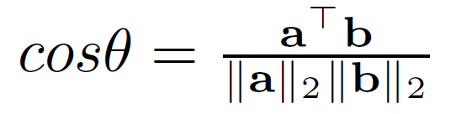
Similarity between Words

Slide 30
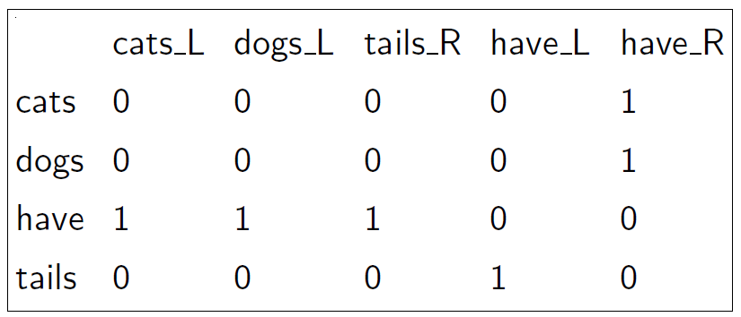
Features for Part-of-speech Induction
Matrix: contexts (2) = words on left, words on right
Doc1: Cats have tails.
Doc2: Dogs have tails.

Slide 31
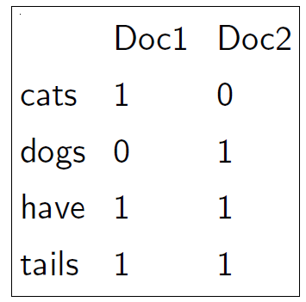
Document Representation
Matrix: contexts = documents that word appear in
Doc1: Cats have tails.
Doc2: Dogs have tails.

Slide 32
Document Vector Space Model
All documents are projected into this concept space
Finance
|D₂-D₄|
D₂
D₄
D₃
Sports
D₅
D₁
Education

Slide 33
Is This Just as Simple as Counting?
What if I give you a raw document?

Slide 34
Let’s take a look at a document
On Feb. 8, Dong Nguyen announced that he would be removing his hit game Flappy Bird from both the iOS and Android app stores, saying that the success of the game is something he never wanted. Some fans of the game took it personally, replying that they would either kill Nguyen or kill themselves if he followed through with his decision.
Frank Lantz, the director of the New York University Game Center, said that Nguyen's meltdown resembles how some actors or musicians behave. "People like that can go a little bonkers after being exposed to this kind of interest and attention," he told ABC News. "Especially when there's a healthy dose of Internet trolls."

Slide 35
Document Tokenization
Regular expressions
\\w+: so-called -> ‘so’, ‘called’
\\s+: It’s -> ‘It’s’ instead of ‘It’, ‘’s’
Statistical methods
Explore rich features to decide where the boundary of a word is
Apache OpenNLP (http://opennlp.apache.org/)
Stanford NLP Parser (http://nlp.stanford.edu/software/lex-parser.shtml)
Online Demo
Stanford (http://corenlp.run/)
UIUC/UPenn (http://cogcomp.org/curator/demo/index.html)

Slide 36
Bag-of-words Representation
Term as the basis for vector space
Doc1: Text mining is to identify useful information.
Doc2: Useful information is mined from text.
Doc3: Apple is delicious.
 | text | information | identify | mining | mined | is | useful | to | from | apple | delicious
Doc1 | 1 | 1 | 1 | 1 | 0 | 1 | 1 | 1 | 0 | 0 | 0
Doc2 | 1 | 1 | 0 | 0 | 1 | 1 | 1 | 0 | 1 | 0 | 0
Doc3 | 0 | 0 | 0 | 0 | 0 | 1 | 0 | 0 | 0 | 1 | 1
BoW representation: {text:2, information:2, ... , delicious:1}
可将这个 document 表示为一个11维向量: [2,2, ... ,1]
Assumption-Words are independent from each other
Pros-Simple
Cons
Basis vectors are clearly not linearly independent!
Grammar and order are missing 单词在文本中的顺序没关系，只考虑出现的频率.

Slide 37
Bag-of-Words with N-grams
N-grams: a contiguous sequence of n tokens from a given text
“Text mining is to identify useful information.”
Bi-grams: “text_mining”, “mining_is”, “is_to”, “to_identify” , “identify_useful”, “useful_information”, “information_.”
Pros: capture local dependency and order
Cons: increase the vocabulary size

Slide 38
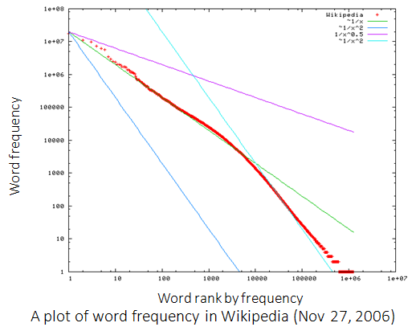
Statistics of Words in Corpus
Zipf’s law
Frequency of a word is inversely proportional to its rank in the frequency table

Slide 39
Zipf’s Law Tells Us
Head words take large portion of occurrences, but they are semantically meaningless
E.g., the, a, an, we, do, to
Tail words take major portion of vocabulary, but they rarely occur in documents
E.g., dextrosinistral
The rest is most representative
To be included in the controlled vocabulary
In the Brown Corpus of American English text, the word "the" is the most frequently occurring word, and by itself accounts for nearly 7% of all word occurrences; the second-place word "of" accounts for slightly over 3.5% of words.

Slide 40
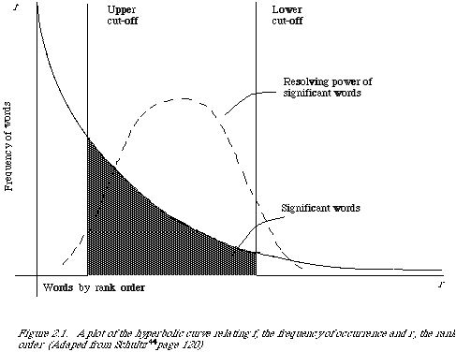
Better Document Representation
Remove non-informative words
Remove rare words

Slide 41
Stopwords
Useless words for document analysis
Not all words are informative
Remove such words to reduce vocabulary size
No universal definition
Risk: break the original meaning and structure of text
E.g., this is not a good option -> option
to be or not to be -> null

Slide 42
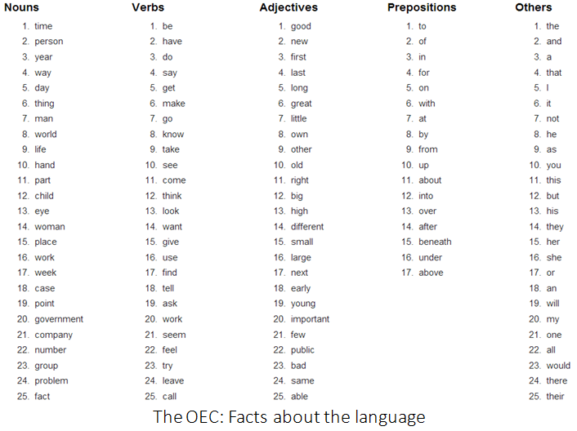

Slide 43
Stemming
Reduce inflected (有字尾变化的) or derived words to their root form
Plurals, adverbs, inflected word forms
E.g., ladies -> lady, referring -> refer, forgotten -> forget
Solutions (for English)
Porter stemmer: patterns of vowel-consonant sequence
Krovetz stemmer: morphological rules
Risk: lose precise meaning of the word
E.g., lay -> lie (a false statement? or be in a horizontal position?)

Slide 44
Summary of Preprocessing
Example: ‘Text mining is to identify useful information.’
Tokenization:
D1: ‘Text’, ‘mining’, ‘is’, ‘to’, ‘identify’, ‘useful’, ‘information’, ‘.’
Stemming/normalization:
D1: ‘text’, ‘mine’, ‘is’, ‘to’, ‘identify’, ‘use’, ‘inform’, ‘.’
N-gram construction:
D1: ‘text-mine’, ‘mine-is’, ‘is-to’, ‘to-identify’, ‘identify-use’, ‘use-inform’, ‘inform-.’
Stopword/controlled vocabulary filtering:
D1: ‘text-mine’, ‘to-identify’, ‘identify-use’, ‘use-inform’
Optional

Slide 45
Term Weighting
TFIDF 算“重要性权重”——哪些词更好的代表一类文件（找关键词）
Term as the basis for vector space
Doc1: Text mining is to identify useful information.
Doc2: Useful information is mined from text.
Doc3: Apple is delicious.
“Repeated occurrences” are less informative than the “first occurrence”
Information about semantic does not increase proportionally with number of term occurrence
 | text | information | identify | mining | mined | is | useful | to | from | apple | delicious
Doc1 | 1 | 1 | 1 | 1 | 0 | 1 | 1 | 1 | 0 | 0 | 0
Doc2 | 1 | 1 | 0 | 0 | 1 | 1 | 1 | 0 | 1 | 0 | 0
Doc3 | 0 | 0 | 0 | 0 | 0 | 1 | 0 | 0 | 0 | 1 | 1

Slide 46
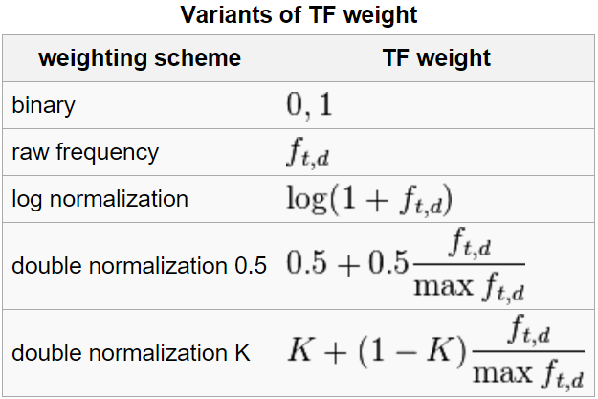
Term Frequency Weights
Examples of weighting terms
Number of times term t appearing in document d

Slide 47


Norm. TF
1
Raw TF
Norm. TF
Raw TF

Slide 48
Document Frequency Weighting
Idea: a term is more discriminative if it occurs only in fewer documents

Slide 49
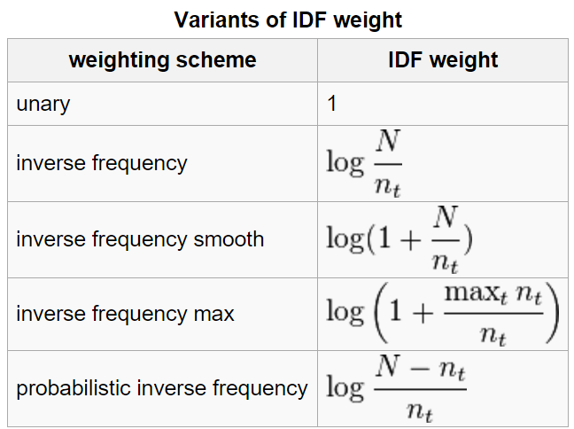
Inverse Document Frequency
Examples of IDF
Non-linear scaling
Total number of docs in collection
Number of docs containing term t

Slide 50
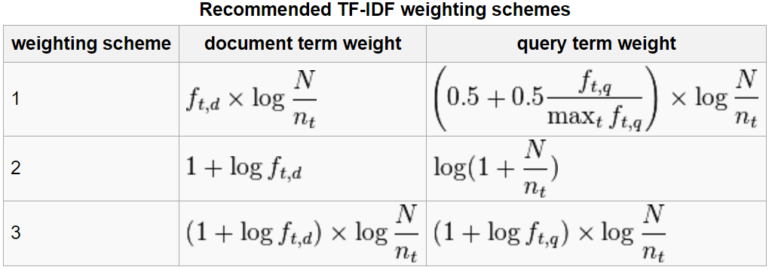
TFIDF
Term frequency–Inverse document frequency
Higher tf: more frequently a word appearing in a document
Higher idf: less frequently a word appearing in a corpus

Slide 51
Document Similarity
（1）使用TF-IDF算法，找出两篇文章的关键词；
（2）每篇文章各取出若干个关键词（比如20个），合并成一个集合，计算每篇文章对于这个集合中的词的词频（为了避免文章长度的差异，可以使用相对词频）；
（3）生成两篇文章各自的词频向量；BoW representation
（4）计算两个向量的余弦相似度，值越大就表示越相似。

Slide 52
Document Similarity
Finance
TF-IDF space
Euclidean Distance
Cosine Similarity
D₁
The choice of angle
The choice of Euclidean distance
D₂
D₆
Sports
Finance
D₂
TF-IDF space
D₁
D₆
Sports

Slide 53
Cosine as a Similarity Metric
-1: vectors point in opposite directions
+1: vectors point in same directions
0: vectors are orthogonal

Slide 54
Summary of Vector Space Model
Pros:
Empirically effective!
Intuitive
Easy to implement
Well-studied/mostly evaluated
Warning: many variants of TF-IDF!
Cons
Assume term independence
Lack of “predictive adequacy”
Arbitrary term weighting
Arbitrary similarity measure
Lots of parameter tuning!
Any improvements?

