Slide 1
COMP4901K/Math4824B Machine Learning for Natural Language Processing
Lecture 6: Introduction to Classification
Instructor: Yangqiu Song

Slide 2
Vector Space Model (VSM)

Slide 3
Let’s take a look at a document
On Feb. 8, Dong Nguyen announced that he would be removing his hit game Flappy Bird from both the iOS and Android app stores, saying that the success of the game is something he never wanted. Some fans of the game took it personally, replying that they would either kill Nguyen or kill themselves if he followed through with his decision.
Frank Lantz, the director of the New York University Game Center, said that Nguyen's meltdown resembles how some actors or musicians behave. "People like that can go a little bonkers after being exposed to this kind of interest and attention," he told ABC News. "Especially when there's a healthy dose of Internet trolls."

Slide 4
Document Tokenization
Regular expressions
\\w+: so-called -> ‘so’, ‘called’
\\s+: It’s -> ‘It’s’ instead of ‘It’, ‘’s’
Statistical methods
Explore rich features to decide where the boundary of a word is
Apache OpenNLP (http://opennlp.apache.org/)
Stanford NLP Parser (http://nlp.stanford.edu/software/lex-parser.shtml)
Online Demo
Stanford (http://corenlp.run/)
UIUC/UPenn (http://cogcomp.org/curator/demo/index.html)

Slide 5
Bag-of-words Representation
Term as the basis for vector space
Doc1: Text mining is to identify useful information.
Doc2: Useful information is mined from text.
Doc3: Apple is delicious.
 | text | information | identify | mining | mined | is | useful | to | from | apple | delicious
Doc1 | 1 | 1 | 1 | 1 | 0 | 1 | 1 | 1 | 0 | 0 | 0
Doc2 | 1 | 1 | 0 | 0 | 1 | 1 | 1 | 0 | 1 | 0 | 0
Doc3 | 0 | 0 | 0 | 0 | 0 | 1 | 0 | 0 | 0 | 1 | 1
Assumption
Words are independent from each other
Pros
Simple
Cons
Basis vectors are clearly not linearly independent!
Grammar and order are missing

Slide 6
Bag-of-Words with N-grams
N-grams: a contiguous sequence of n tokens from a given text
“Text mining is to identify useful information.”
Bi-grams: “text_mining”, “mining_is”, “is_to”, “to_identify” , “identify_useful”, “useful_information”, “information_.”
Pros: capture local dependency and order
Cons: increase the vocabulary size

Slide 7
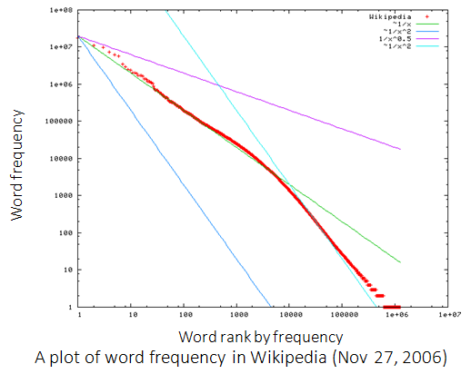
Statistics of Words in Corpus
Zipf’s law
Frequency of a word is inversely proportional to its rank in the frequency table

Slide 8
Zipf’s Law Tells Us
Head words take large portion of occurrences, but they are semantically meaningless
E.g., the, a, an, we, do, to
Tail words take major portion of vocabulary, but they rarely occur in documents
E.g., dextrosinistral
The rest is most representative
To be included in the controlled vocabulary
In the Brown Corpus of American English text, the word "the" is the most frequently occurring word, and by itself accounts for nearly 7% of all word occurrences; the second-place word "of" accounts for slightly over 3.5% of words.

Slide 9
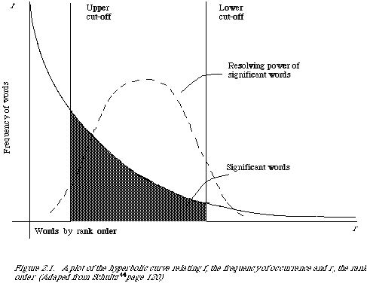
Better Document Representation
Remove non-informative words
Remove rare words

Slide 10
Stopwords
Useless words for document analysis
Not all words are informative
Remove such words to reduce vocabulary size
No universal definition
Risk: break the original meaning and structure of text
E.g., this is not a good option -> option
to be or not to be -> null

Slide 11
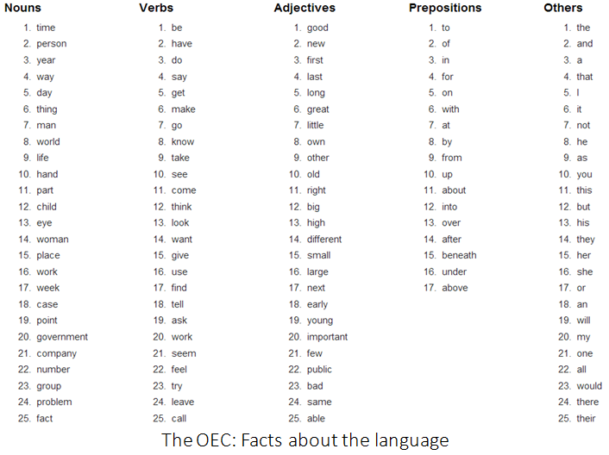

Slide 12
Stemming
Reduce inflected or derived words to their root form
Plurals, adverbs, inflected word forms
E.g., ladies -> lady, referring -> refer, forgotten -> forget
Solutions (for English)
Porter stemmer: patterns of vowel (元音)-consonant sequence
Krovetz stemmer: morphological (形态) rules
Risk: lose precise meaning of the word
E.g., lay -> lie (a false statement? or be in a horizontal position?)

Slide 13
Summary of Preprocessing
Example: ‘Text mining is to identify useful information.’
Tokenization:
D1: ‘Text’, ‘mining’, ‘is’, ‘to’, ‘identify’, ‘useful’, ‘information’, ‘.’
Stemming/normalization:
D1: ‘text’, ‘mine’, ‘is’, ‘to’, ‘identify’, ‘use’, ‘inform’, ‘.’
N-gram construction:
D1: ‘text-mine’, ‘mine-is’, ‘is-to’, ‘to-identify’, ‘identify-use’, ‘use-inform’, ‘inform-.’
Stopword/controlled vocabulary filtering:
D1: ‘text-mine’, ‘to-identify’, ‘identify-use’, ‘use-inform’
Optional

Slide 14
Term Weighting
Term as the basis for vector space
Doc1: Text mining is to identify useful information.
Doc2: Useful information is mined from text.
Doc3: Apple is delicious.
“Repeated occurrences” are less informative than the “first occurrence”
Information about semantic does not increase proportionally with number of term occurrence
 | text | information | identify | mining | mined | is | useful | to | from | apple | delicious
Doc1 | 1 | 1 | 1 | 1 | 0 | 1 | 1 | 1 | 0 | 0 | 0
Doc2 | 1 | 1 | 0 | 0 | 1 | 1 | 1 | 0 | 1 | 0 | 0
Doc3 | 0 | 0 | 0 | 0 | 0 | 1 | 0 | 0 | 0 | 1 | 1

Slide 15
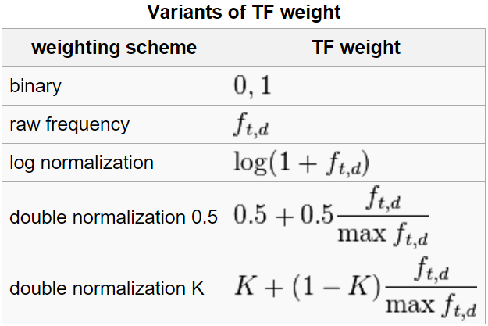
Term Frequency Weights
Examples of weighting terms
Number of times term t appearing in document d

Slide 16


Norm. TF
1
Raw TF
Norm. TF
Raw TF

Slide 17
Document Frequency Weighting
Idea: a term is more discriminative if it occurs only in fewer documents

Slide 18
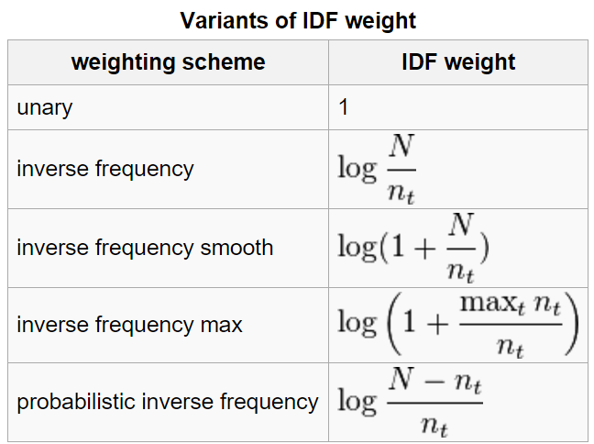
Inverse Document Frequency
Examples of IDF
Non-linear scaling
Total number of docs in collection
Number of docs containing term t

Slide 19
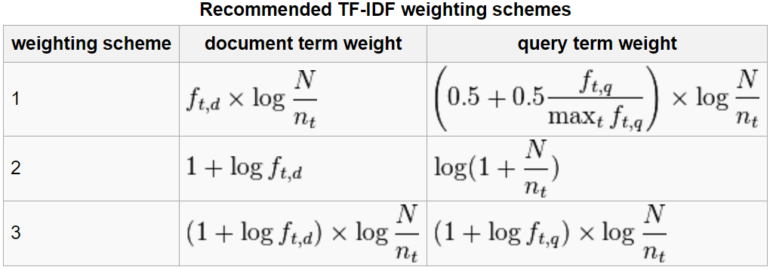
TFIDF
Term frequency–Inverse document frequency
Higher tf: more frequently a word appearing in a document
Higher idf: less frequently a word appearing in a corpus

Slide 20
Document Similarity
Finance
TF-IDF space
D₁
Euclidean Distance
TF-IDF space: 用TFIDF 算法找出两个document 的关键词，对两个 document 生成这些关键词的词频向量。
Cosine Similarity
The choice of angle
The choice of Euclidean distance
D₂
D₆
Sports
Finance
D₂
TF-IDF space
D₁
D₆
Sports

Slide 21
Cosine as a Similarity Metric
-1: vectors point in opposite directions
+1: vectors point in same directions
0: vectors are orthogonal

Slide 22
Summary of Vector Space Model
Pros:
Empirically effective!
Intuitive
Easy to implement
Well-studied/mostly evaluated
Warning: many variants of TF-IDF!
Cons
Assume term independence
Lack of “predictive adequacy”
Arbitrary term weighting
Arbitrary similarity measure
Lots of parameter tuning!
Any improvements?

Slide 23
Today
Classification
Text categorization (and other applications)
Various issues regarding classification
Clustering vs. classification, binary vs. multi-way, flat vs. hierarchical classification…
Feature Selection

Slide 24
Classification
Goal: Assign ‘objects’ from a universe to two or more classes or categories
Examples:
Problem Object Categories
Tagging Word POS
Sense Disambiguation Word The word’s senses
Information retrieval Document Relevant/not relevant
Sentiment classification Document Positive/negative
Author identification Document Authors

Slide 25
Author identification
They agreed that Mrs. X should only hear of the departure of the family, without being alarmed on the score of the gentleman's conduct; but even this partial communication gave her a great deal of concern, and she bewailed it as exceedingly unlucky that the ladies should happen to go away, just as they were all getting so intimate together.
Gas looming through the fog in divers places in the streets, much as the sun may, from the spongey fields, be seen to loom by husbandman and ploughboy. Most of the shops lighted two hours before their time--as the gas seems to know, for it has a haggard and unwilling look. The raw afternoon is rawest, and the dense fog is densest, and the muddy streets are muddiest near that leaden-headed old obstruction, appropriate ornament for the threshold of a leaden-headed old corporation, Temple Bar.
Jane Austen (1775-1817), Pride and Prejudice
or
Charles Dickens (1812-70), Bleak House ?
Notes:
Mrs. Bennet

Slide 26
Language identification
Tutti gli esseri umani nascono liberi ed eguali in dignità e diritti. Essi sono dotati di ragione e di coscienza e devono agire gli uni verso gli altri in spirito di fratellanza.
Alle Menschen sind frei und gleich an Würde und Rechten geboren. Sie sind mit Vernunft und Gewissen begabt und sollen einander im Geist der Brüderlichkeit begegnen.
Universal Declaration of Human Rights, UN, in 363 languages

Slide 27
Language identification
égaux
eguali
iguales
edistämään
Ü
¿

Slide 28
Classification
Goal: Assign ‘objects’ from a universe to two or more classes or categories
Examples:
Problem Object Categories
Author identification Document Authors
Language identification Document Language
Text categorization Document Topics

Slide 29
Text categorization
Topic categorization: classify the document into semantics topics
The U.S. swept into the Davis Cup final on Saturday when twins Bob and Mike Bryan defeated Belarus's Max Mirnyi and Vladimir Voltchkov to give the Americans an unsurmountable 3-0 lead in the best-of-five semi-final tie. | One of the strangest, most relentless hurricane seasons on record reached new bizarre heights yesterday as the plodding approach of Hurricane Jeanne prompted evacuation orders for hundreds of thousands of Floridians and high wind warnings that stretched 350 miles from the swamp towns south of Miami to the historic city of St. Augustine.

Slide 30
Text categorization
http://news.google.com/
Reuters
Collection of (21,578) newswire documents.
For research purposes: a standard text collection to compare systems and algorithms
135 valid topics categories

Slide 31
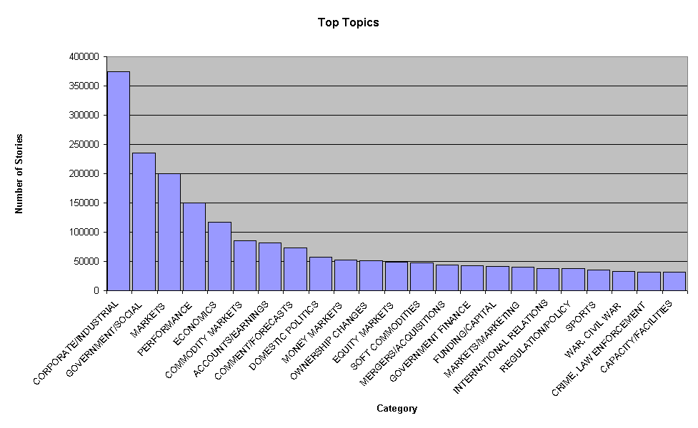
Reuters
Top topics in Reuters

Slide 32
Reuters
<REUTERS TOPICS="YES" LEWISSPLIT="TRAIN" CGISPLIT="TRAINING-SET" OLDID="12981" NEWID="798">
<DATE> 2-MAR-1987 16:51:43.42</DATE>
<TOPICS><D>livestock</D><D>hog</D></TOPICS>
<TITLE>AMERICAN PORK CONGRESS KICKS OFF TOMORROW</TITLE>
<DATELINE> CHICAGO, March 2 - </DATELINE><BODY>The American Pork Congress kicks off
tomorrow, March 3, in Indianapolis with 160 of the nations pork producers from 44 member states determining industry positions on a number of issues, according to the National Pork Producers Council, NPPC.
Delegates to the three day Congress will be considering 26 resolutions concerning various issues, including the future direction of farm policy and the tax law as it applies to the agriculture sector. The delegates will also debate whether to endorse concepts of a national PRV (pseudorabies virus) control and eradication program, the NPPC said.
A large trade show, in conjunction with the congress, will feature the latest in technology in all areas of the industry, the NPPC added. Reuter
&#3;</BODY></TEXT></REUTERS>

Slide 33
Text categorization: examples
Topic categorization
http://news.google.com/
Reuters.
Spam filtering
Determine if a mail message is spam (or not)
Customer service message classification

Slide 34
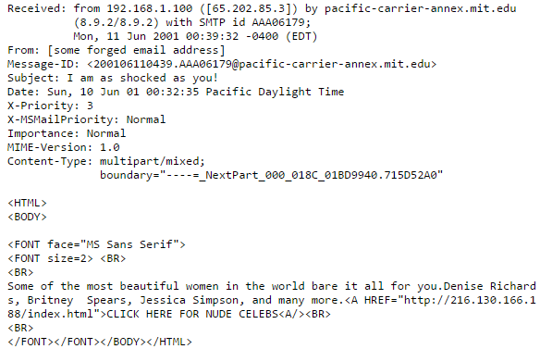
Text Categorization
Recognizing spam emails
Spam=True/False

Slide 35
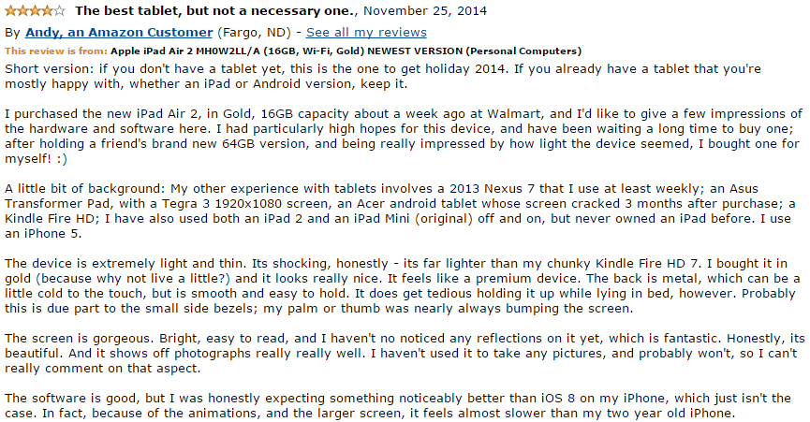
Applications of Text Categorization
Sentiment analysis

Slide 36
Classification vs. Clustering
Classification assumes labeled data: we know how many classes there are and we have examples for each class (labeled data).
Classification is supervised
In Clustering we don’t have labeled data; we just assume that there is a natural division in the data and we may not know how many divisions (clusters) there are
Clustering is unsupervised

Slide 37
Classification
Class1
Class2

Slide 38
Classification
Class1
Class2

Slide 39
Classification
Class1
Class2

Slide 40
Classification
Class1
Class2

Slide 41
Clustering

Slide 42
Clustering

Slide 43
Clustering

Slide 44
Clustering

Slide 45
Clustering

Slide 46
Categories (Labels, Classes)
Labeling data
2 problems:
Decide the possible classes (which ones, how many)
Domain and application dependent
http://news.google.com
Label text
Difficult, time consuming, inconsistency between annotators

Slide 47
Binary vs. multi-way classification
两个 label（是与不是）还是多个label
Binary classification: two classes
Multi-way classification: more than two classes
Sometime it can be convenient to treat a multi-way problem like a binary one: one class versus all the others, for all classes （label 1 V.S. not label 1）

Slide 48
Flat vs. Hierarchical classification
Flat classification: relations between the classes undetermined
Hierarchical classification: hierarchy where each node is the sub-class of its parent’s node

Slide 49
Single- vs. multi-category classification
一个 document 只能属于一个 label 还是多个label
In single-category text classification each text belongs to exactly one category
In multi-category text classification, each text can have zero or more categories

Slide 50
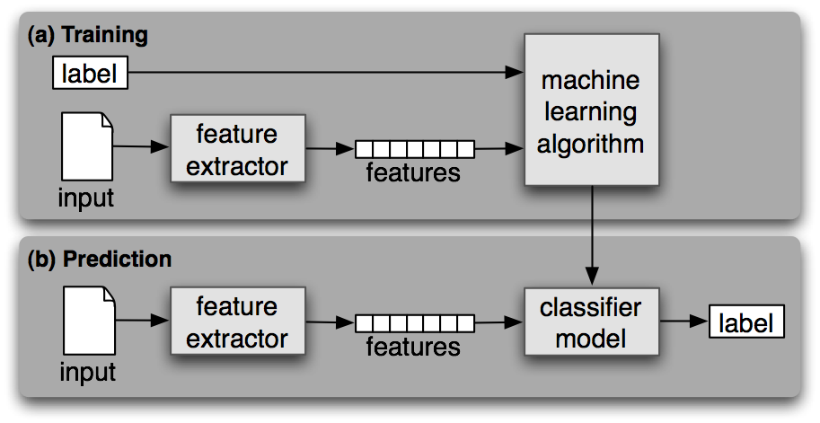
General Pipeline of Classification

Slide 51
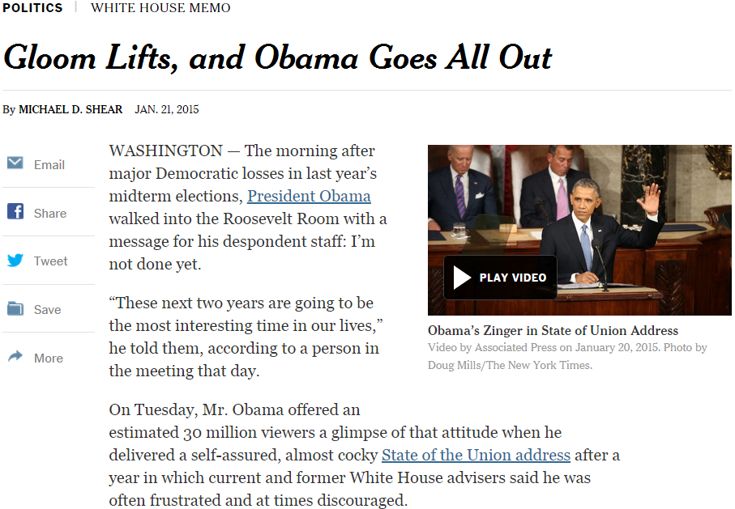

General steps for text categorization
Feature construction and selection
Model specification
Model estimation and selection
Evaluation
Political News
Sports News
Entertainment News
Consider:
1.1 How to represent the text documents?
1.2 Do we need all those features?

Slide 52
Feature construction for text categorization
Vector space representation
Standard procedure in document representation
Features
N-gram, POS tags, named entities, topics
Feature value
Binary (presence/absence)
TF-IDF (many variants)

Slide 53
A Typical Corpus
How many unigram+bigram are there in our controlled vocabulary?
130K on Yelp_small
How many review documents do we have there for training?
629K Yelp_small
Sparse feature:
More likely to make the
data linearly separable.
Deal with only the most
informative features.
Very sparse feature representation!

Slide 54
Feature Selection
A small corpus can have millions of unigram+bigram features
Select the most informative features for model training
Reduce the feature space
Improve the final classification performance
Improve training/testing efficiency
Less tuning time
Fewer training data

Slide 55

Feature selection methods
Filter method
Evaluate the features independently from the classifier and other features
No indication of a classifier’s performance on the selected features
No dependency among the features
Feasible for very large feature set
Usually used as a preprocessing step
R. Kohavi, G.H. John/Artijicial Intelligence 97 (1997) 273-324

Slide 56
Feature scoring metrics
Document frequency
Rare words: non-influential for global prediction, reduce vocabulary size
riskier to remove head words
safer to remove rare words

Slide 57
General steps for text categorization
Feature construction and selection
Model specification
Model estimation and selection
Evaluation
Political News
Sports News
Entertainment News
Consider:
1.1 How to represent the text documents?
1.2 Do we need all those features?

