Slide 1
COMP4901K/Math4824B Machine Learning for Natural Language Processing
Lecture 7: Introduction to Classification
Instructor: Yangqiu Song
Slides credits: Hongning Wang, Marti Hearst, Barbara Rosario

Slide 2
Today
Classification
Text categorization (and other applications)
Various issues regarding classification
Clustering vs. classification, binary vs. multi-way, flat vs. hierarchical classification…
Feature Selection

Slide 3
Classification vs. Clustering
Classification assumes labeled data: we know how many classes there are and we have examples for each class (labeled data).
Classification is supervised
In Clustering we don’t have labeled data; we just assume that there is a natural division in the data and we may not know how many divisions (clusters) there are
Clustering is unsupervised

Slide 4
Classification
Class1
Class2

Slide 5
Classification
Class1
Class2

Slide 6
Classification
Class1
Class2

Slide 7
Classification
Class1
Class2

Slide 8
Clustering

Slide 9
Clustering

Slide 10
Clustering

Slide 11
Clustering

Slide 12
Clustering

Slide 13
Categories (Labels, Classes)
Labeling data
2 problems:
Decide the possible classes (which ones, how many)
Domain and application dependent
http://news.google.com
Label text
Difficult, time consuming, inconsistency between annotators

Slide 14
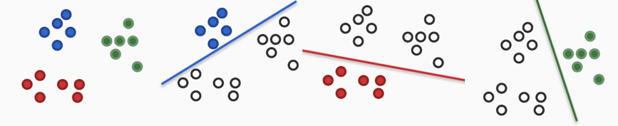
Binary vs. multi-way classification
Binary classification: two classes
Multi-way classification: more than two classes
Sometime it can be convenient to treat a multi-way problem like a binary one: one class versus all the others, for all classes

Slide 15
Flat vs. Hierarchical classification
Flat classification: relations between the classes undetermined
Hierarchical classification: hierarchy where each node is the sub-class of its parent’s node
c₁
c₂
c₃
c₄
c₅
c₆
c₇

Slide 16
Single- vs. multi-category classification
In single-category text classification each text belongs to exactly one category
In multi-category text classification, each text can have zero or more categories
Also called multi-label classification

Slide 17
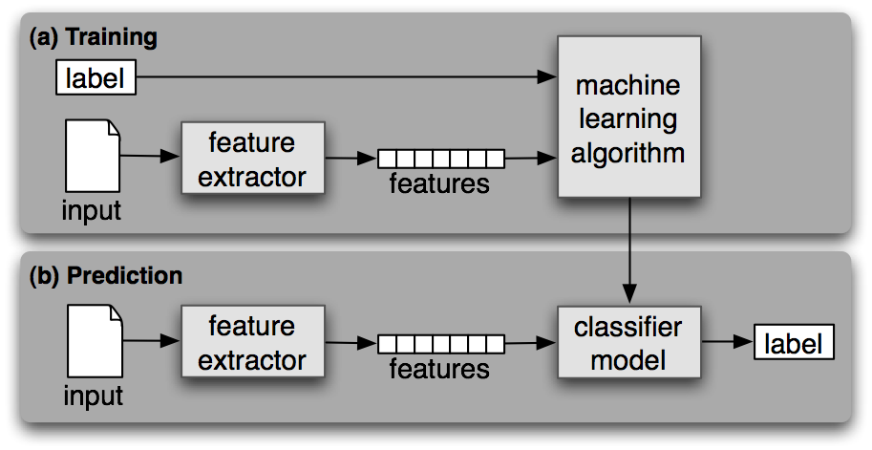
General Pipeline of Classification

Slide 18
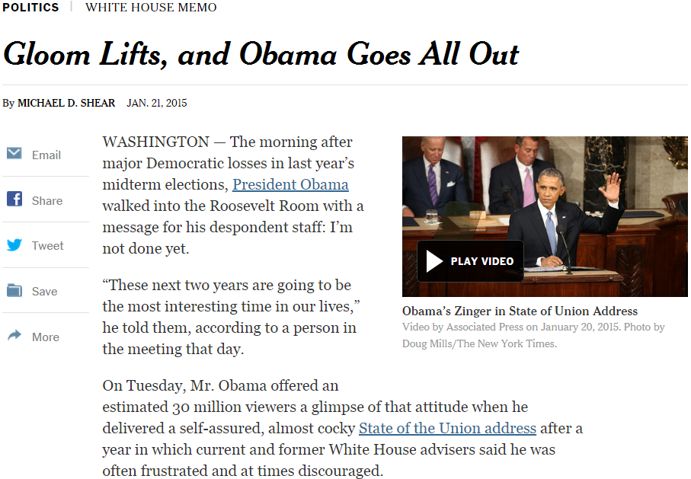

General steps for text categorization
Feature construction and selection
Model specification
Model estimation and selection
Evaluation
Political News
Sports News
Entertainment News
Consider:
1.1 How to represent the text documents?
1.2 Do we need all those features?

Slide 19
Feature construction for text categorization
Vector space representation
Standard procedure in document representation
Features
N-gram, POS tags, named entities, topics
Feature value
Binary (presence/absence)
TF-IDF (many variants)

Slide 20
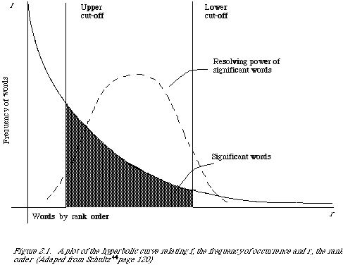
A Typical Corpus
How many unigram+bigram are there in our controlled vocabulary?
130K on Yelp_small
How many review documents do we have there for training?
629K Yelp_small
Very sparse feature representation!

Slide 21
Feature Selection
A small corpus can have millions of unigram+bigram features
Select the most informative features for model training
Reduce the feature space
Improve the final classification performance
Improve training/testing efficiency
Less tuning time
Fewer training data

Slide 22

Feature selection methods
Filter method
Evaluate the features independently from the classifier and other features
No indication of a classifier’s performance on the selected features
No dependency among the features
Feasible for very large feature set
Usually used as a preprocessing step
R. Kohavi, G.H. John/Artijicial Intelligence 97 (1997) 273-324

Slide 23
Feature scoring metrics
Document frequency
Rare words: non-influential for global prediction, reduce vocabulary size
riskier to remove head words
safer to remove rare words

Slide 24
General steps for text categorization
Feature construction and selection
Model specification
Model estimation and selection
Evaluation
Political News
Sports News
Entertainment News
Consider:
2.1 What is the unique property of this problem?
2.2 What type of classifier we should use?

Slide 25
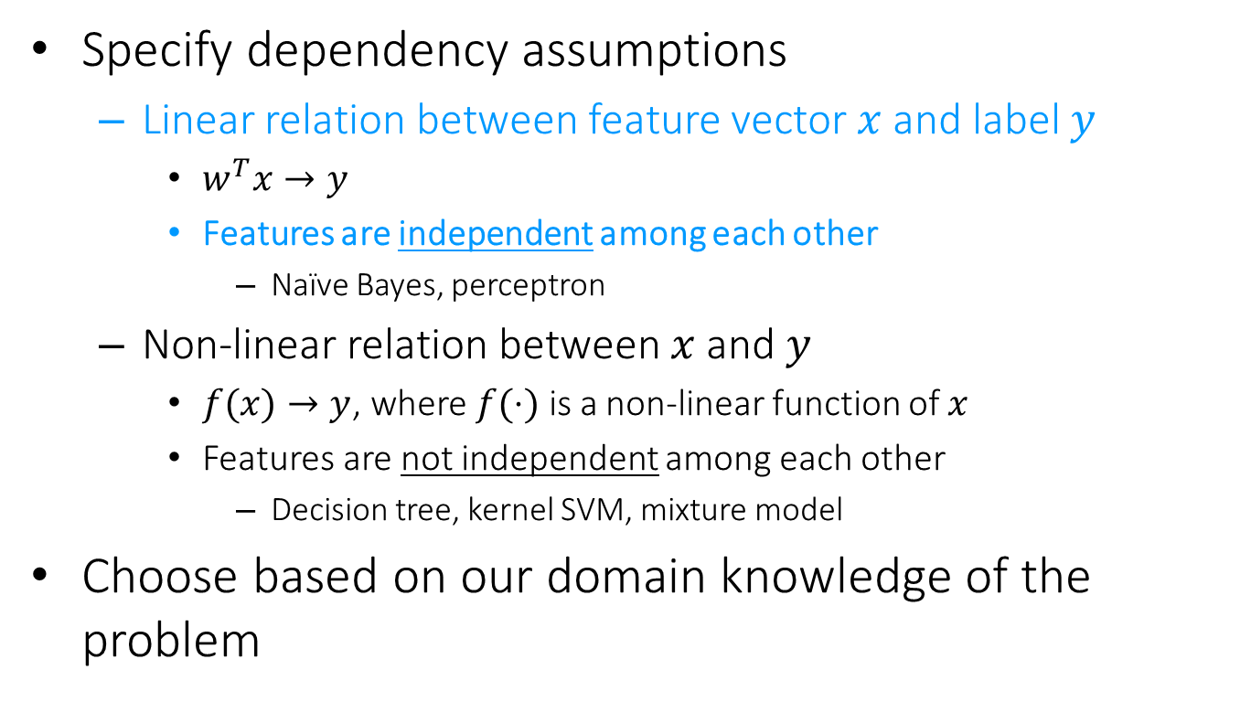
Model specification
Specify dependency assumptions
Linear relation between feature vector $x$ and label $y$
$w^{T}x→y$
Features are independent among each other
Naïve Bayes, perceptron
Non-linear relation between $x$ and $y$
$f(x)→y$, where $f(⋅)$ is a non-linear function of $x$
Features are not independent among each other
Decision tree, kernel SVM, mixture model
Choose based on our domain knowledge of the problem
We will discuss these choices later

Slide 26
General steps for text categorization
Feature construction and selection
Model specification
Model estimation and selection
Evaluation
Political News
Sports News
Entertainment News
Consider:
3.1 How to estimate the parameters in the selected model?
3.2 How to control the complexity of the estimated model?

Slide 27
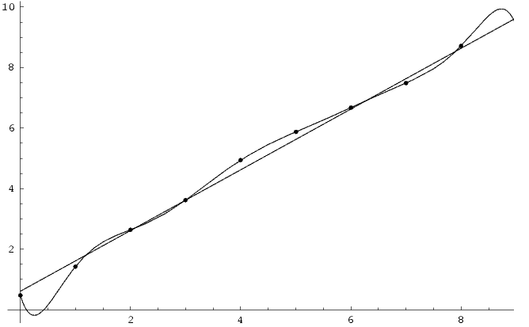
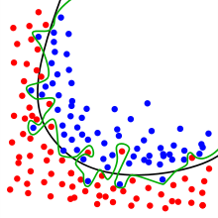
Empirical loss minimization
Overfitting
Good empirical loss, terrible generalization loss
High model complexity -> prone to overfit noise
Over-complicated dependency assumption: polynomial
Underlying dependency: linear relation

Slide 28
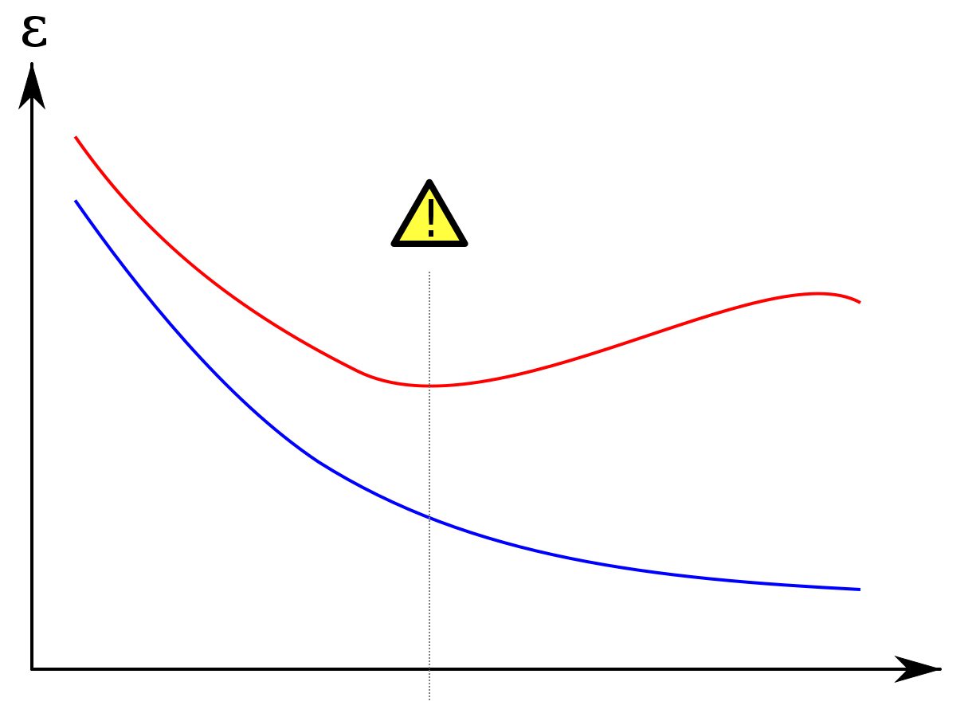
Generalization loss minimization
Avoid overfitting
Measure model complexity as well
Model selection and regularization
Error
Error on testing set
Error on training set
Model complexity

Slide 29
Generalization loss minimization
Cross validation
Avoid noise in train/test separation
k-fold cross-validation
Partition all training data into k equal size disjoint subsets;
Leave one subset for validation and the other k-1 for training;
Repeat step (2) k times with each of the k subsets used exactly once as the validation data.

Slide 30
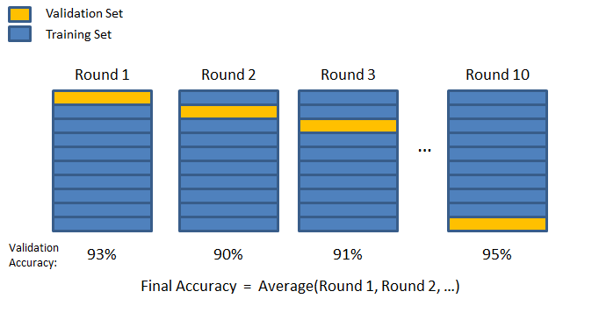
Generalization loss minimization
Cross validation
Avoid noise in train/test separation
k-fold cross-validation

Slide 31
Generalization loss minimization
Cross validation
Avoid noise in train/test separation
k-fold cross-validation
validation set 用来调整model，以及model的hyperpatameter
Choose the model (among different models or same model with different settings) that has the best average performance on the validation sets
Some statistical test is needed to decide if one model is significantly better than another
—— 即说明 prediction correctness 不仅仅是因为test data的差异，而是因为classifier的不同。
Will cover it shortly

Slide 32
General steps for text categorization
Feature construction and selection
Model specification
Model estimation and selection
Evaluation
Political News
Sports News
Entertainment News
Consider:
4.1 How to judge the quality of learned model?
4.2 How can you further improve the performance?

Slide 33
Testing, evaluation of the classifier
After choosing the parameters of the classifiers (i.e. after training it) we need to test how well it’s doing on a test set (not included in the training set)
Calculate misclassification on the test set

Slide 34
Baselines
First step: get a baseline (the probability or correct by random guess provides a baseline about the problem’s complexity)
Help determine how hard the task is
Help know what a “good” accuracy is
Weak baseline: most frequent label classifier
Gives all test instances whatever label was most common in the training set
E.g. for spam filtering, might label everything as “not spam”
Accuracy might be very high if the problem is skewed
E.g. calling everything “not spam” gets 66%, so a classifier that gets 70% isn’t very good…
For real research, usually use previous work as a (strong) baseline

Slide 35
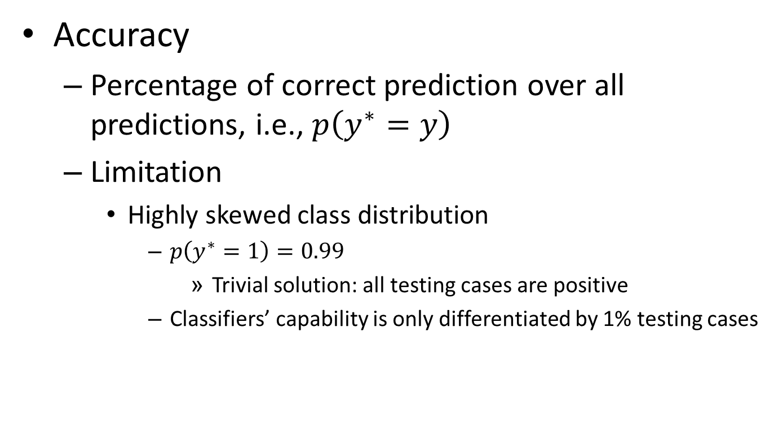
Classification evaluation
Accuracy
Percentage of correct prediction over all predictions, i.e., $p\left(y^{∗}=y\right)$
Limitation
Highly skewed class distribution
$p\left(y^{∗}=1\right)=0.99$
Trivial solution: all testing cases are positive
Classifiers’ capability is only differentiated by 1% testing cases

Slide 36
Evaluating classifiers
Contingency table for the evaluation of a binary classifier
 | GREEN is correct | RED is correct
GREEN was assigned | a | b
RED was assigned | c | d
Accuracy = (a+d)/(a+b+c+d)
Precision: P_GREEN = a/(a+b), P_ RED = d/(c+d)
Recall: R_GREEN = a/(a+c), R_ RED = d/(b+d)

Slide 37
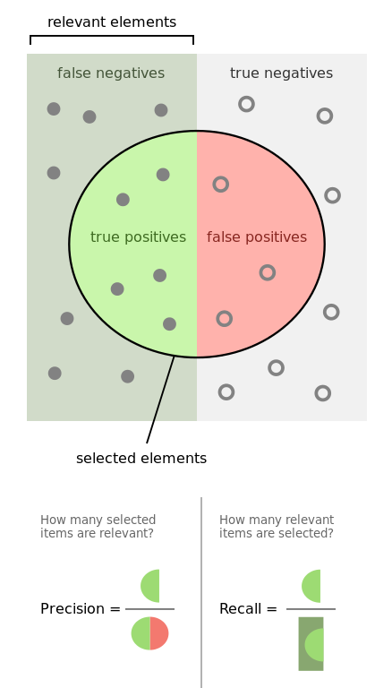
Evaluation of Binary Classification
Precision
Fraction of predicted positive documents that are indeed positive, i.e., P(gold = 1 | prediction = 1)
Recall
Fraction of positive documents that are predicted to be positive, i.e., P(prediction = 1 | gold = 1)
https://en.wikipedia.org/wiki/Precision_and_recall
https://en.wikipedia.org/wiki/F1_score

Slide 38
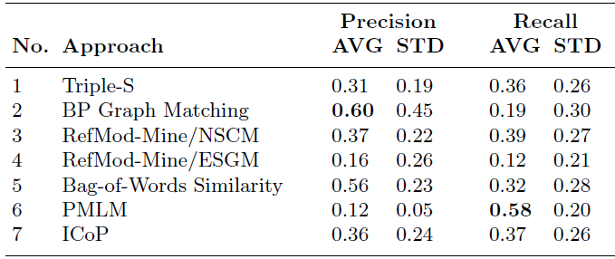
Precision and recall trade off
Precision decreases as the number of documents predicted to be positive increases (unless in perfect classification), while recall keeps increasing
Emphasize on different perspectives of a classifier
Precision: prefers a classifier to recognize fewer documents, but highly accurate
Recall: prefers a classifier to recognize more documents

Slide 39

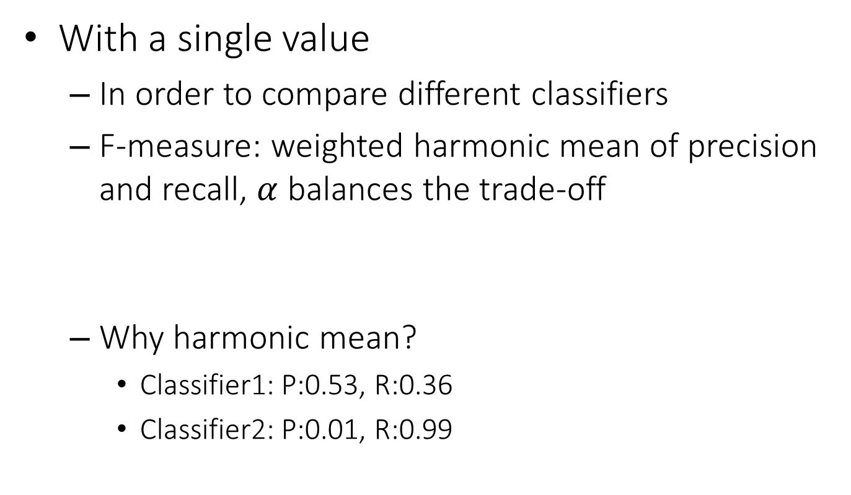

Summarizing precision and recall
With a single value
In order to compare different classifiers
F-measure: weighted harmonic mean of precision and recall, $α$ balances the trade-off
Why harmonic mean?
Classifier1: P:0.53, R:0.36
Classifier2: P:0.01, R:0.99
$$F=\frac{1}{α\frac{1}{P}+\left(1−α\right)\frac{1}{R}}$$
$$\left(F_{1}=\frac{2}{\frac{1}{P}+\frac{1}{R}} \right)$$
Equal weight between precision and recall
Harmonic | Average
0.429 | 0.445
0.019 | 0.500

Slide 40
Summarizing precision and recall
With a curve
Order all the testing cases by the classifier’s prediction score (assuming the higher the score is, the more likely it is positive);
Scan through each testing case: treat all cases above it as positive (including itself), below it as negative; compute precision and recall;
Plot precision and recall computed for each testing case in step (2).

Slide 41



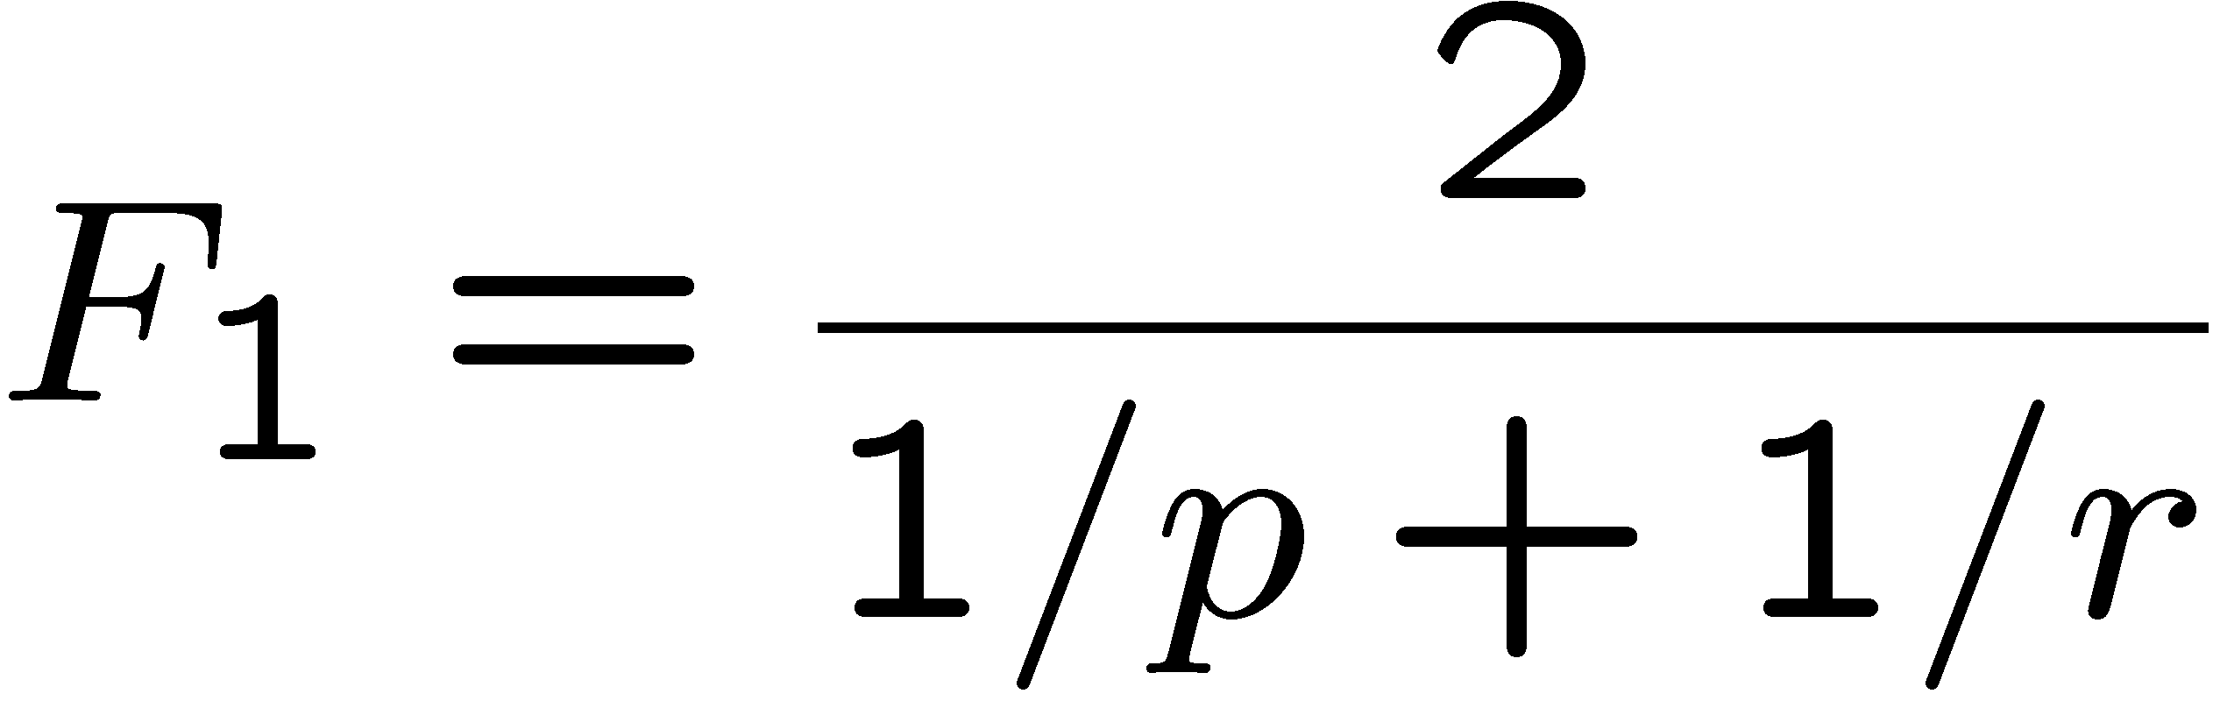
Summarizing precision and recall
With a curve
A.k.a., precision-recall curve
F-measure: harmonic mean of p and r:
Break-even point: precision value when p = r

Slide 42
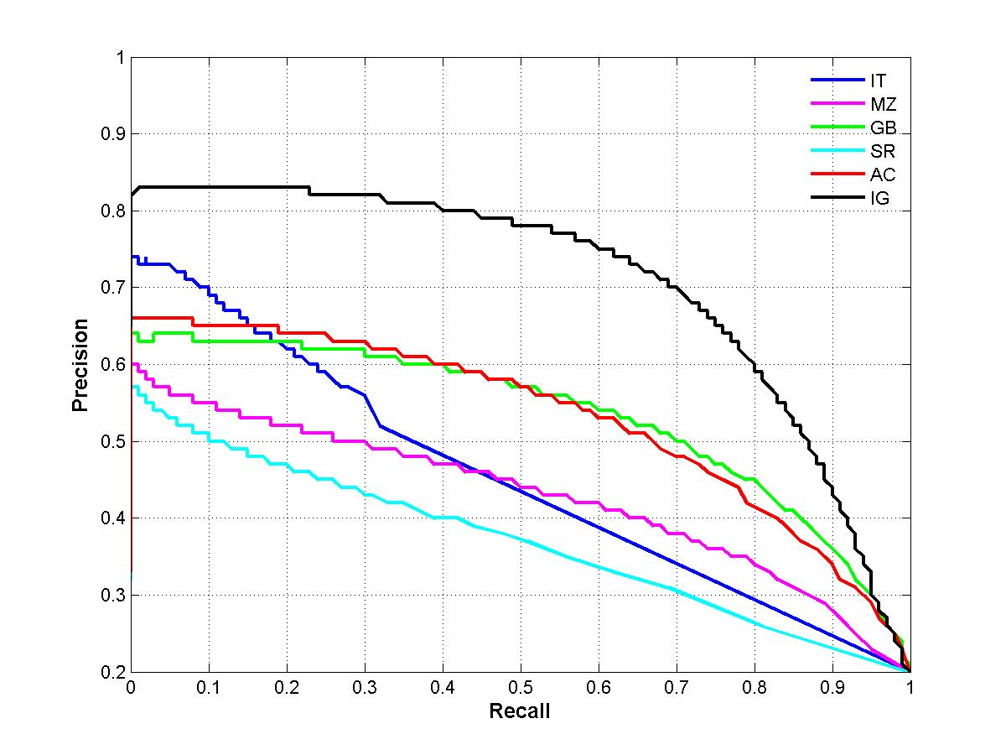
Summarizing precision and recall
With a curve
A.k.a., precision-recall curve
Area Under Curve (AUC)
Under each recall level, we prefer a higher precision

Slide 43
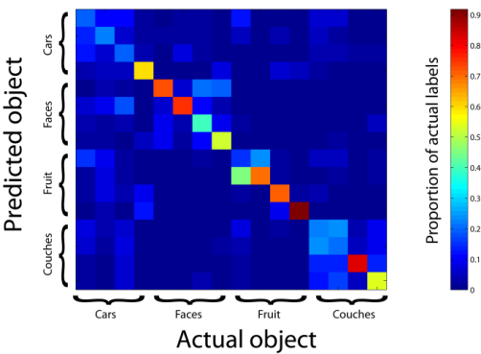
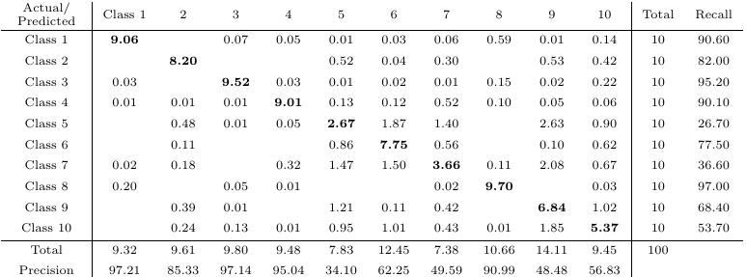
Multi-class Categorization
Confusion matrix
A generalized contingency table for precision and recall

Slide 44
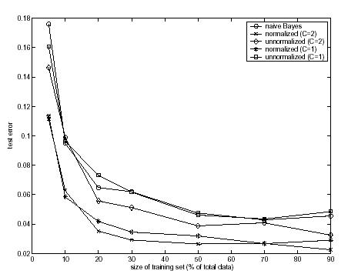
Training size
The more the better! (usually)
Results for text classification*

Slide 45
Statistical significance tests
How confident you are that an observed difference doesn’t simply result from the train/test separation you chose?
Fold
Classifier 1
Classifier 2
1
2
3
4
5
0.20
0.21
0.22
0.19
0.18
0.18
0.19
0.21
0.20
0.37
Average
0.20
0.23

Slide 46
Background knowledge
p-value in statistic test is the probability of obtaining data as totally randomly, if the null hypothesis were true
If p-value is smaller than the chosen significance level (α), we reject the null hypothesis (e.g., observation is not random)
We seek to reject the null hypothesis (we seek to show that the observation is not a random result), and so small p-values are good
46

Slide 47
Paired t-test
Paired t-test
Test if two sets of observations are significantly different from each other
On k-fold cross validation, different classifiers are applied onto the same train/test separation
Hypothesis: difference between two responses measured on the same statistical unit has a zero mean value
One-tail v.s. two-tail?
If you aren’t sure, use two-tail
Algorithm 1
Algorithm 2

Slide 48
Statistical significance test
Fold
Classifier A
Classifier B
paired t-test
1
2
3
4
5
0.20
0.21
0.22
0.19
0.18
0.18
0.19
0.21
0.20
0.37
+0.02
+0.02
+0.01
-0.01
-0.19
Average
0.20
0.23
p=0.4987
95% of outcomes
0

Slide 49
What you should know
General steps for text categorization
Text feature construction
Feature selection methods
Model specification and estimation
Evaluation metrics

Slide 50
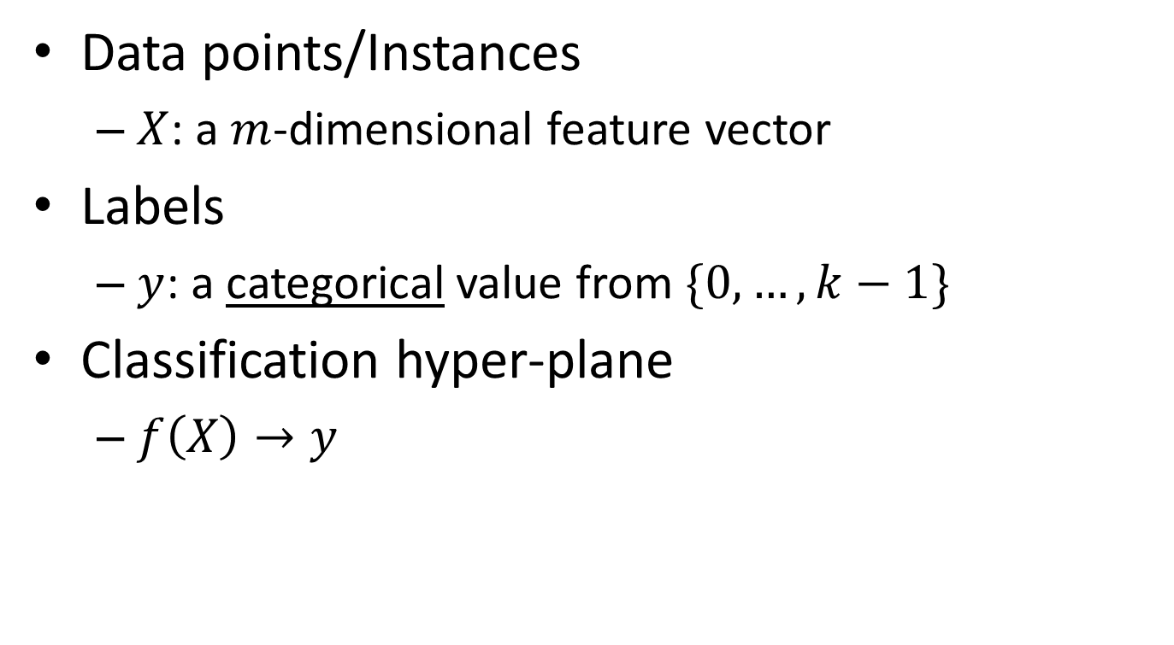
Basic notions about categorization
vector space representation
Data points/Instances
$X$: a $m$-dimensional feature vector
Labels
$y$: a categorical value from $\{0,…,k−1\}$
Classification hyper-plane
$f\left(X\right)→y$
Key question: how to find such a mapping?

Slide 51


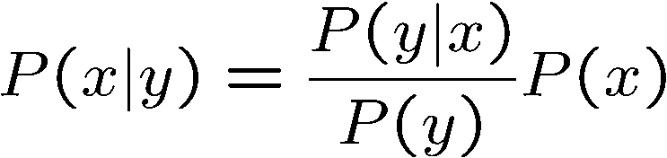
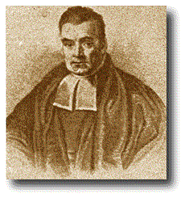
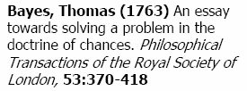
Bayes’ Rule
Two ways to factor a joint distribution over two variables:
Dividing, we get:
Why is this at all helpful?
Lets us build one conditional from its reverse
Often one conditional is tricky but the other one is simple
Foundation of many systems we’ll see later (e.g. ASR, MT)
In the running for most important AI equation!
That’s my rule!

Slide 52

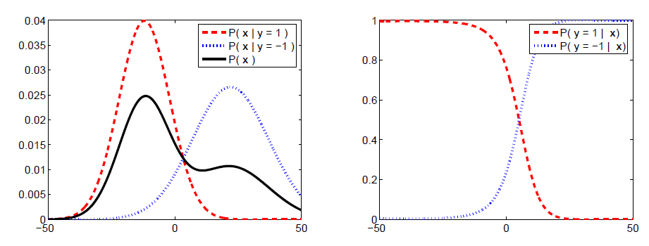

Slide 53
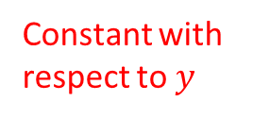
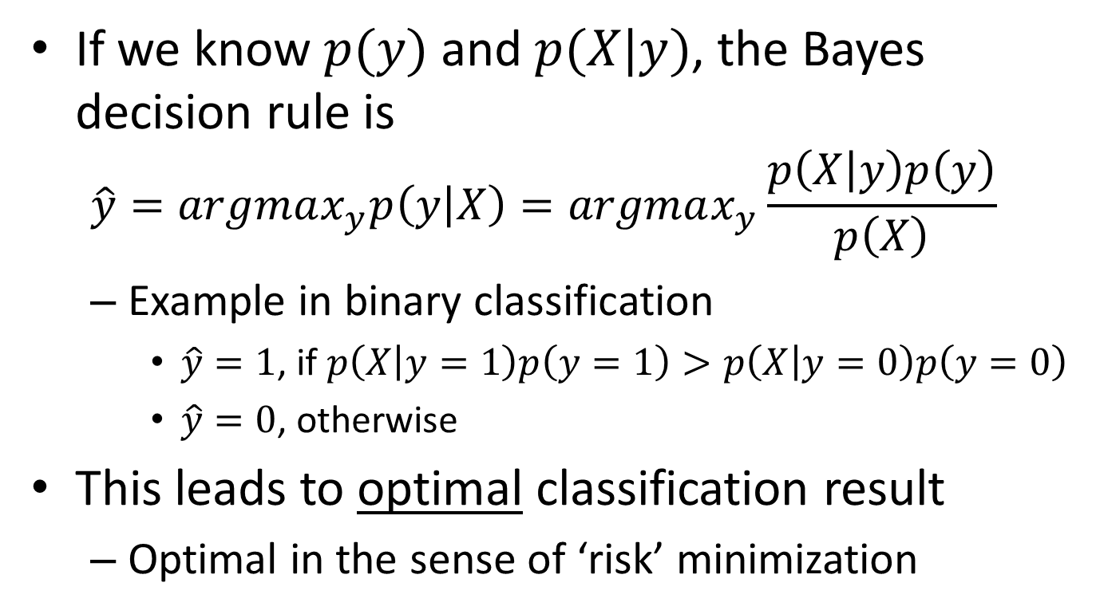
Bayes decision theory
If we know $p(y)$ and $p(X|y)$, the Bayes decision rule is
$$\hat{y}=argmax_{y}p\left(y | X\right)=argmax_{y}\frac{p\left(X | y\right)p\left(y\right)}{p\left(X\right)}$$
Example in binary classification
$\hat{y}=1$, if $p\left(X | y=1\right)p\left(y=1\right)>p\left(X | y=0\right)p\left(y=0\right)$
$\hat{y}=0$, otherwise
This leads to optimal classification result
Optimal in the sense of ‘risk’ minimization
Constant with respect to $y$

Slide 54
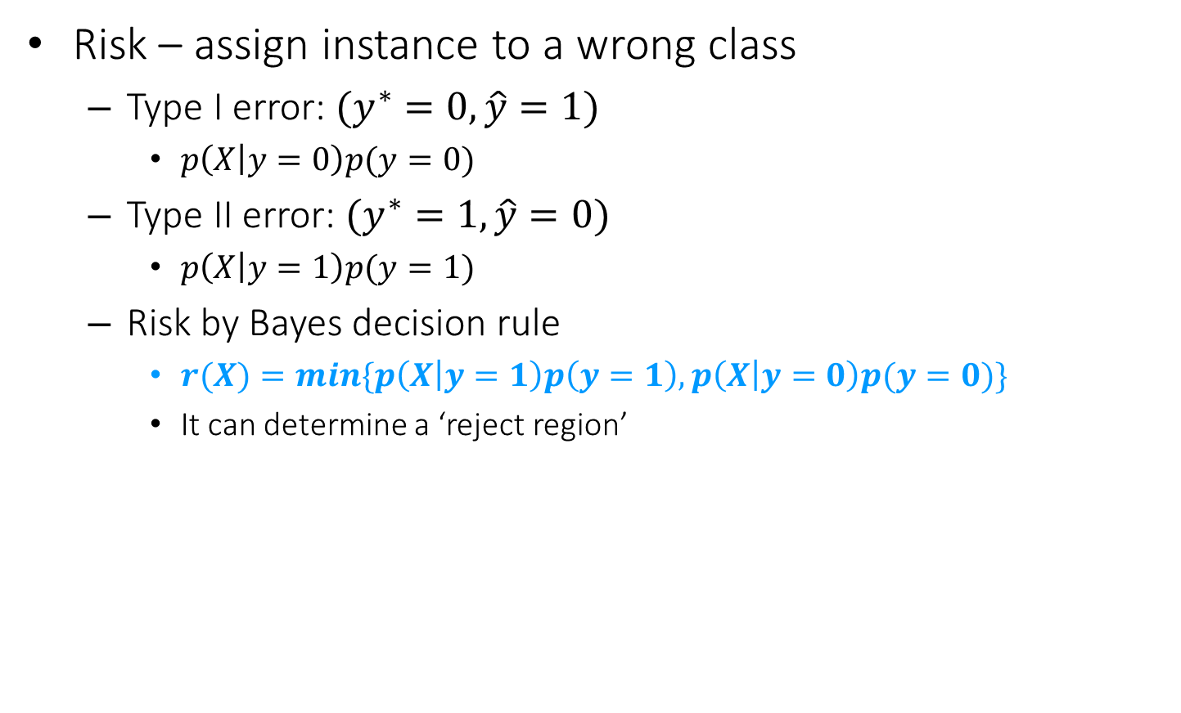
Bayes risk
Risk – assign instance to a wrong class
Type I error: $(y^{∗}=0, \hat{y}=1)$
$p\left(X | y=0\right)p(y=0)$
Type II error: $(y^{∗}=1, \hat{y}=0)$
$p\left(X | y=1\right)p(y=1)$
Risk by Bayes decision rule
$r(X)=min⁡\{p\left(X | y=1\right)p\left(y=1\right), p\left(X | y=0\right)p(y=0)\}$
It can determine a ‘reject region’
False positive
False negative

Slide 55






Bayes risk
Risk – assign instance to a wrong class
Bayes decision boundary
$$p(X,y)$$
$$\hat{y}=0$$
$$\hat{y}=1$$
$$p\left(X | y=0\right)p(y=0)$$
$$p\left(X | y=1\right)p(y=1)$$
$$X$$
False negative
False positive

Slide 56
Bayes risk
Risk – assign instance to a wrong class
$$p(X,y)$$
$$\hat{y}=0$$
$$\hat{y}=1$$
$$p\left(X | y=0\right)p(y=0)$$
$$p\left(X | y=1\right)p(y=1)$$
Increased error
$$X$$
False negative
False positive

Slide 57
Bayes risk
Risk – assign instance to a wrong class
*Optimal Bayes decision boundary
$$p(X,y)$$
$$\hat{y}=0$$
$$\hat{y}=1$$
$$p\left(X | y=0\right)p(y=0)$$
$$p\left(X | y=1\right)p(y=1)$$
$$X$$
False negative
False positive

Slide 58
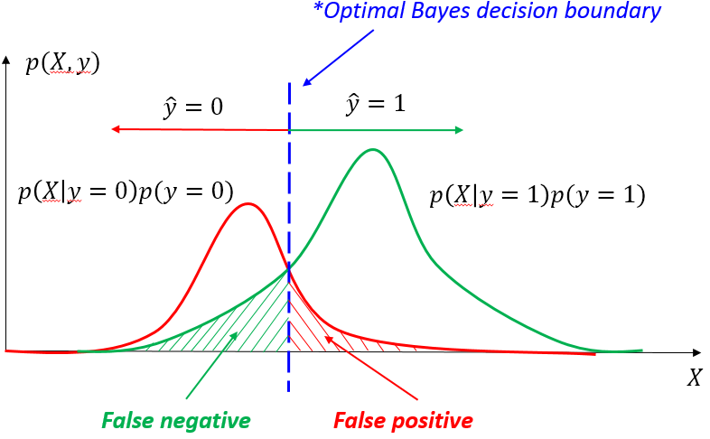
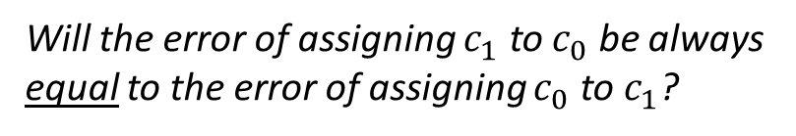
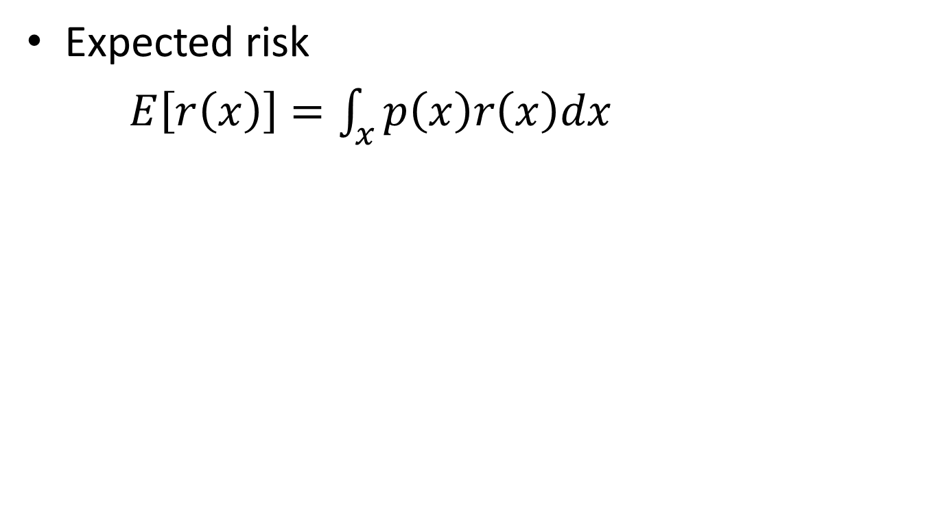



Bayes risk
Expected risk
$E\left[r\left(x\right)\right]=\int_{x}{p\left(x\right)r\left(x\right)dx}$
$$=\int_{x}{p\left(x\right)min⁡\{p\left(x | y=1\right)p\left(y=1\right), p\left(x | y=0\right)p(y=0)\}\text{dx} }$$
$$=p\left(y=1\right)\int_{R_{0}}{p(x)p\left(x|y=1\right)dx}+p\left(y=0\right)\int_{R_{1}}{p(x)p\left(x|y=0\right)dx}$$
Region where we assign $x$ to class 0
Region where we assign $x$ to class 1
Will the error of assigning $c_{1}$ to $c_{0}$ be always equal to the error of assigning $c_{0}$ to $c_{1}$?

Slide 59




Supervised text categorization
Supervised learning
Estimate a model/method from labeled data
It can then be used to determine the labels of the unobserved samples
Training
Testing
Sports
Business
Education
Science
Sports
Business
Education
Classifier
$f\left(x,θ\right)→y$
…
…
$${\left\{\left(x_{i},y_{i}\right)\right\}}_{i=1}^{n}$$
$${\left\{\left(x_{i}, ?\right)\right\}}_{i=1}^{m}$$
$${\left\{\left(x_{i},\hat{y_{i}}\right)\right\}}_{i=1}^{m}$$

Slide 60
Type of classification methods
Model-less
Instance based classifiers
Use observation directly
E.g., kNN
Key: assuming similar items have similar class labels!
Training
Testing
Sports
Business
Education
Science
Sports
Business
Education
Instance lookup
Classifier
$f\left(x,θ\right)→y$
…
…
$${\left\{\left(x_{i},y_{i}\right)\right\}}_{i=1}^{n}$$
$${\left\{\left(x_{i}, ?\right)\right\}}_{i=1}^{m}$$
$${\left\{\left(x_{i},\hat{y_{i}}\right)\right\}}_{i=1}^{m}$$

Slide 61




Type of classification methods
Model-based
Generative models
Modeling joint probability of $p(x,y)$
E.g., Naïve Bayes
Discriminative models
Directly estimate a decision rule/boundary
E.g., SVM
Key: i.i.d. assumption!
Training
Testing
Sports
Business
Education
Science
Sports
Business
Education
Classifier
$f\left(x,θ\right)→y$
…
…
$${\left\{\left(x_{i},y_{i}\right)\right\}}_{i=1}^{n}$$
$${\left\{\left(x_{i}, ?\right)\right\}}_{i=1}^{m}$$
$${\left\{\left(x_{i},\hat{y_{i}}\right)\right\}}_{i=1}^{m}$$

Slide 62
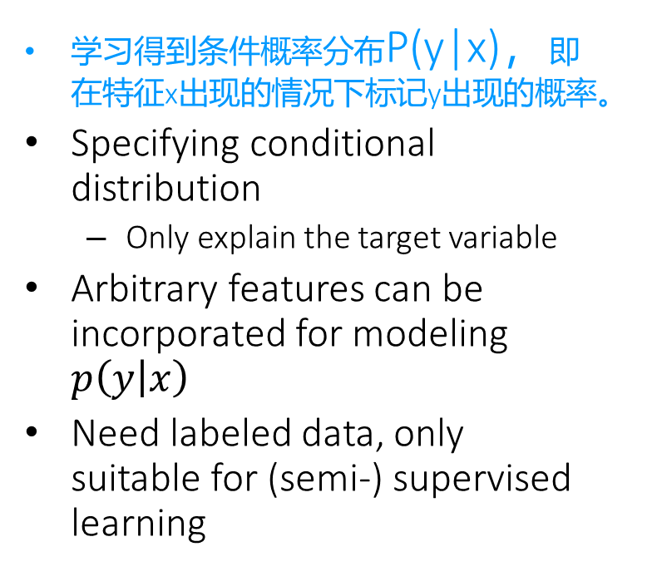
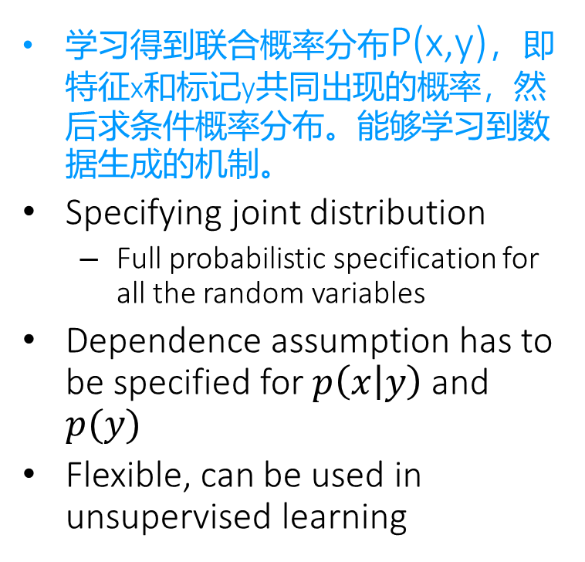
Generative V.S. discriminative models
Generative
Discriminative
学习得到联合概率分布P(x,y)，即特征x和标记y共同出现的概率，然后求条件概率分布。能够学习到数据生成的机制。
Specifying joint distribution
Full probabilistic specification for all the random variables
Dependence assumption has to be specified for $p\left(x | y\right)$ and $p(y)$
Flexible, can be used in unsupervised learning
学习得到条件概率分布P(y|x)，即在特征x出现的情况下标记y出现的概率。
Specifying conditional distribution
Only explain the target variable
Arbitrary features can be incorporated for modeling $p\left(y | x\right)$
Need labeled data, only suitable for (semi-) supervised learning

Slide 63
General steps for text categorization
Feature construction and selection
Model specification
Model estimation and selection
Evaluation
Political News
Sports News
Entertainment News

Slide 64
Recap: Bayes risk
Risk – assign instance to a wrong class
*Optimal Bayes decision boundary
$$p(X,y)$$
$$\hat{y}=0$$
$$\hat{y}=1$$
$$p\left(X | y=0\right)p(y=0)$$
$$p\left(X | y=1\right)p(y=1)$$
$$X$$
False negative
False positive

Slide 65
Recap: Bayes risk
Risk – assign instance to a wrong class
$$p(X,y)$$
$$\hat{y}=0$$
$$\hat{y}=1$$
$$p\left(X | y=0\right)p(y=0)$$
$$p\left(X | y=1\right)p(y=1)$$
Increased error
$$X$$
False negative
False positive

