Slide 1
COMP4901K/Math4824B Machine Learning for Natural Language Processing
Lecture 8: Naïve Bayes
Instructor: Yangqiu Song
Slides credits: Hongning Wang, Dan Klein, Chris Callison-Burch

Slide 2
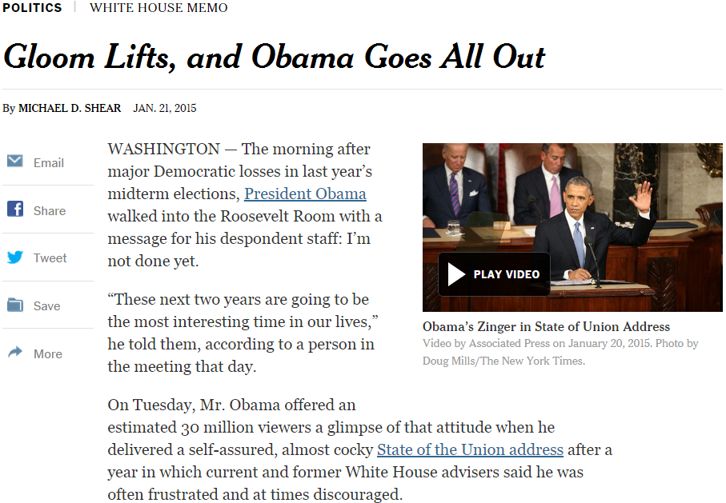

General steps for text categorization
Feature construction and selection
Model specification
Model estimation and selection
Evaluation
Political News
Sports News
Entertainment News
Consider:
4.1 How to judge the quality of learned model?
4.2 How can you further improve the performance?

Slide 3
Testing, evaluation of the classifier
After choosing the parameters of the classifiers (i.e. after training it) we need to test how well it’s doing on a test set (not included in the training set)
Calculate misclassification on the test set

Slide 4
Baselines
First step: get a baseline
Help determine how hard the task is
Help know what a “good” accuracy is
Weak baseline: most frequent label classifier
E.g. calling everything “not spam” gets 66%, so a classifier that gets 70% isn’t very good…

Slide 5
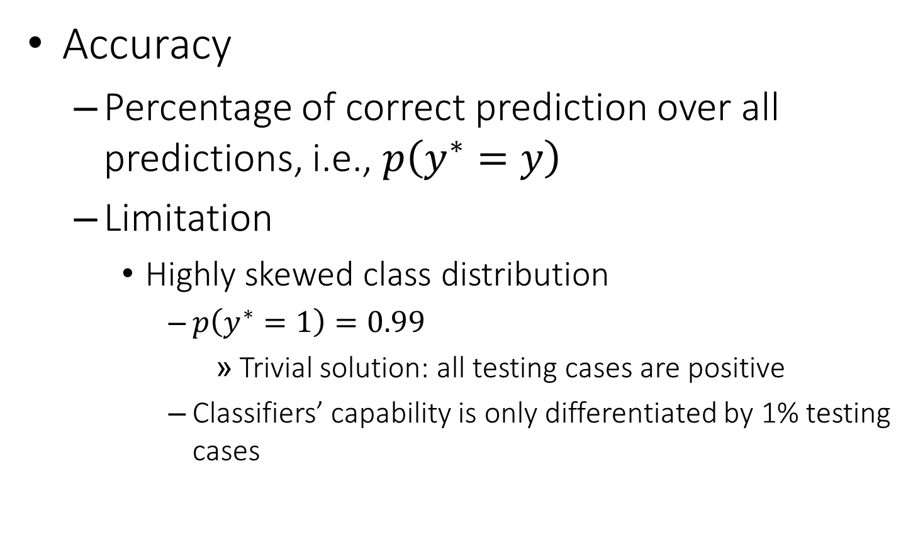
Classification evaluation
Accuracy
Percentage of correct prediction over all predictions, i.e., $p\left(y^{∗}=y\right)$
Limitation
Highly skewed class distribution
$p\left(y^{∗}=1\right)=0.99$
Trivial solution: all testing cases are positive
Classifiers’ capability is only differentiated by 1% testing cases

Slide 6
Evaluating classifiers
Contingency table for the evaluation of a binary classifier
 | GREEN is correct | RED is correct
GREEN was assigned | a | b
RED was assigned | c | d
Accuracy = (a+d)/(a+b+c+d)
Precision: P_GREEN = a/(a+b), P_ RED = d/(c+d)
Recall: R_GREEN = a/(a+c), R_ RED = d/(b+d)

Slide 7
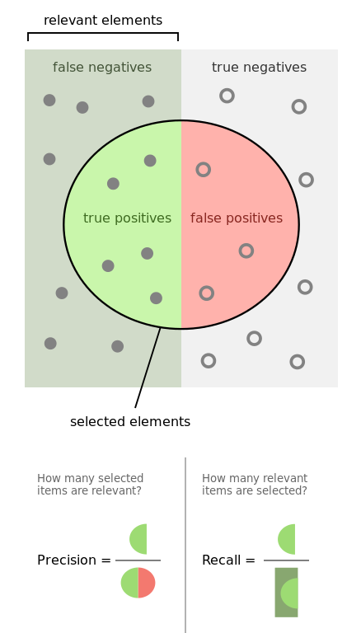
Evaluation of Binary Classification
Precision
Fraction of predicted positive documents that are indeed positive, i.e., P(gold = 1 | prediction = 1)
Recall
Fraction of positive documents that are predicted to be positive, i.e., P(prediction = 1 | gold = 1)
https://en.wikipedia.org/wiki/Precision_and_recall
https://en.wikipedia.org/wiki/F1_score

Slide 8
Precision and recall trade off
Precision decreases as the number of documents predicted to be positive increases (unless in perfect classification), while recall keeps increasing
These two metrics emphasize different perspectives of a classifier
Precision: prefers a classifier to recognize fewer documents, but highly accurate
Recall: prefers a classifier to recognize more documents

Slide 9

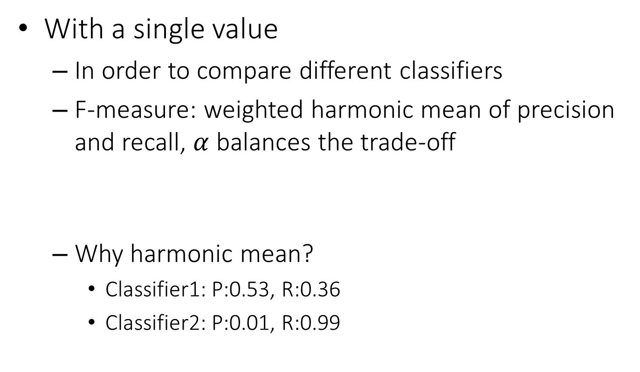
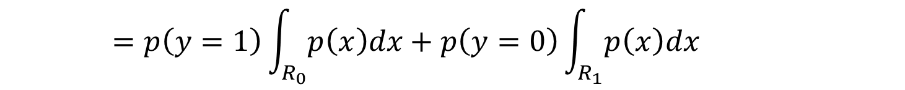
Summarizing precision and recall
With a single value
In order to compare different classifiers
F-measure: weighted harmonic mean of precision and recall, $α$ balances the trade-off
Why harmonic mean?
Classifier1: P:0.53, R:0.36
Classifier2: P:0.01, R:0.99
$$F=\frac{1}{α\frac{1}{P}+\left(1−α\right)\frac{1}{R}}$$
$$\left(F_{1}=\frac{2}{\frac{1}{P}+\frac{1}{R}} \right)$$
Equal weight between precision and recall
Harmonic | Average
0.429 | 0.445
0.019 | 0.500

Slide 10
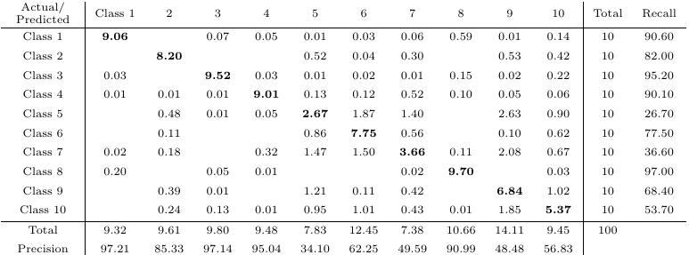
Multi-class Categorization
Confusion matrix
A generalized contingency table for precision and recall

Slide 11
What you should know
General steps for text categorization
Text feature construction
Feature selection methods
Model specification and estimation
Avoid overfitting: control model complexity & cross-validation
Evaluation metrics

Slide 12
A General Pipeline of Building a Classifier
Pre-processing data
Tokenization
Stemming/
normalization
N-gram
Stopwords filtering
Preparing input data for machine learning
Feature construction (e.g., VSM)
Feature construction (e.g., word embeddings)
Feature selection
(e.g., DF filtering)
Configuration of Data and Metrics for Test
Training/Dev/Testing
K-Fold Cross Validation
Evaluation Metrics
Model Specification and Selection
Specify models based on assumptions
Evaluate model based on C.V. and metrics
Output the model for future use

Slide 13
Today’s lecture
k nearest neighbors
Naïve Bayes classifier

Slide 14
Example: Spam Filter
Input: an email
Output: spam/not spam
Setup:
Get a large collection of example emails, each labeled “spam” or “not spam”
Note: someone has to hand label all this data!
Want to learn to predict labels of new, future emails
Features: The attributes used to make the spam/not spam decision
Words: FREE!
Text Patterns: $dd, CAPS
Non-text: SenderInContacts
…
Dear Sir.
First, I must solicit your confidence in this transaction, this is by virture of its nature as being utterly confidencial and top secret. …
TO BE REMOVED FROM FUTURE MAILINGS, SIMPLY REPLY TO THIS MESSAGE AND PUT "REMOVE" IN THE SUBJECT.
99 MILLION EMAIL ADDRESSES
FOR ONLY $99
Ok, Iknow this is blatantly OT but I'm beginning to go insane. Had an old Dell Dimension XPS sitting in the corner and decided to put it to use, I know it was working pre being stuck in the corner, but when I plugged it in, hit the power nothing happened.

Slide 15
How to classify this document?
Documents by vector space representation
?
Sports
Politics
Finance

Slide 16
Let’s check the nearest neighbor
Are you confident about this?
?
Sports
Politics
Finance

Slide 17
Let’s check more nearest neighbors
Ask k nearest neighbors
Let them vote
?
Sports
Politics
Finance

Slide 18
Problems with k nearest neighbors
Memorize all instances (documents here)
Perform search over large database
High-dimensional data
Can we do it in a simpler way?
Summarizing the classification using a simpler function

Slide 19
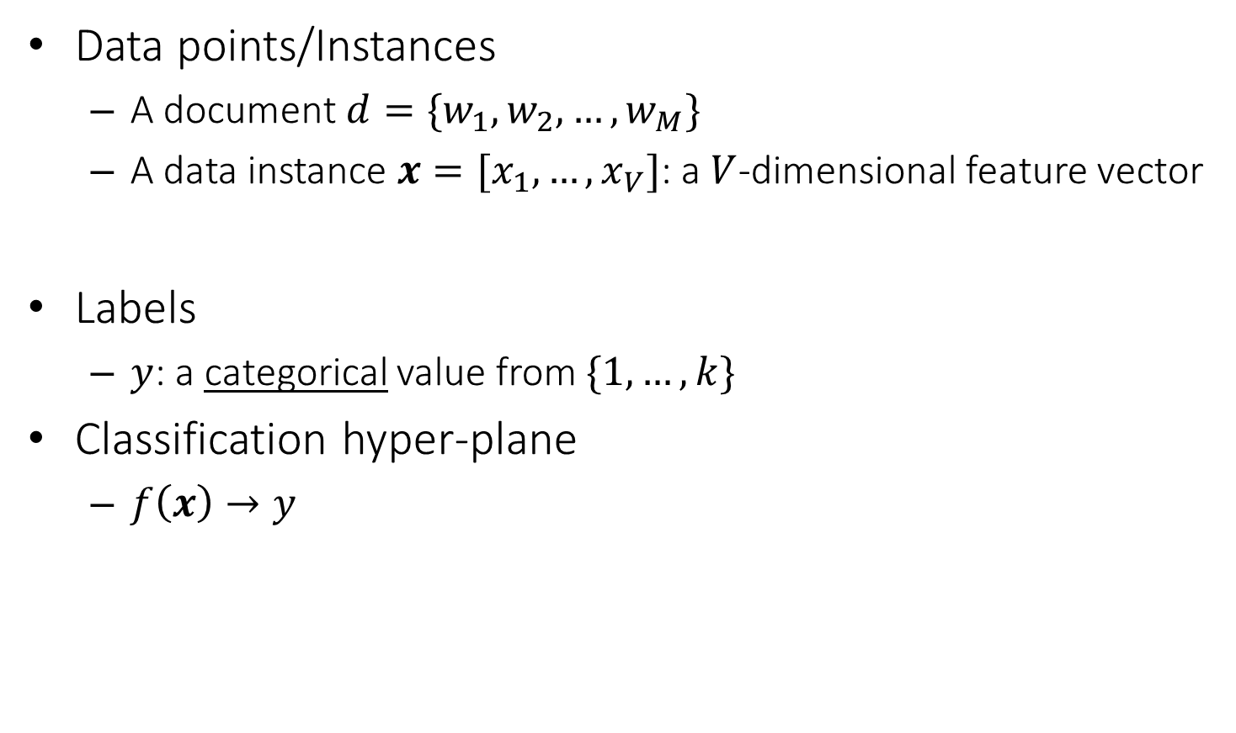
Basic notions about a classifier
Data points/Instances
A document $d=\{w_{1},w_{2},…,w_{M}\}$
A data instance $x=[x_{1},…,x_{V}]$: a $V$-dimensional feature vector
Labels
$y$: a categorical value from $\{1,…,k\}$
Classification hyper-plane
$f\left(x\right)→y$
Sequence of tokens
vector space representation
Key question: how to find such a mapping?

Slide 20


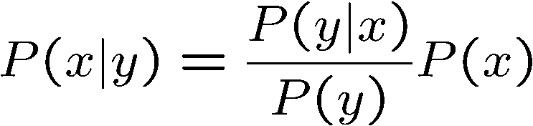
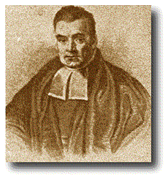
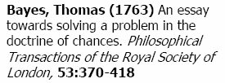
Bayes’ Rule
Two ways to factor a joint distribution over two variables:
Dividing, we get:
Why is this at all helpful?
Lets us build one conditional from its reverse
Often one conditional is tricky but the other one is simple
In the running for most important AI equation!
That’s my rule!

Slide 21
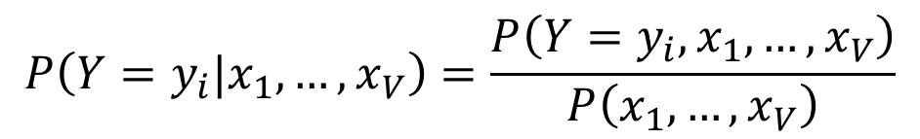
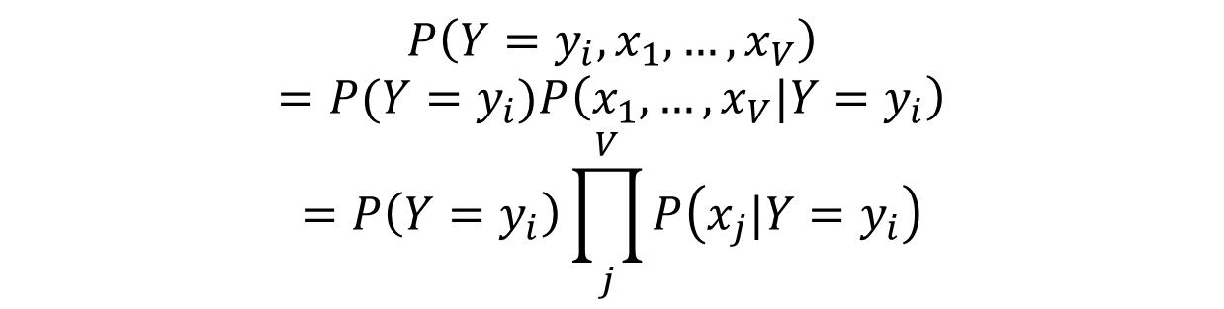
Naïve Bayes Assumption and Classifier
Naïve Bayes: Assume all features are independent effects of the label
For prediction, we use
$$P\left(Y=y_{i},x_{1},…,x_{V}\right)$$
$$=P(Y=y_{i})P\left(x_{1},…,x_{V}|Y=y_{i}\right)$$
$$=P\left(Y=y_{i}\right)\prod_{j}^{V}{P\left(x_{j}|Y=y_{i}\right)}$$
$$P\left(Y=y_{i}|x_{1},…,x_{V}\right)=\frac{P\left(Y=y_{i},x_{1},…,x_{V}\right)}{P\left(x_{1},…,x_{V}\right)}$$

Slide 22
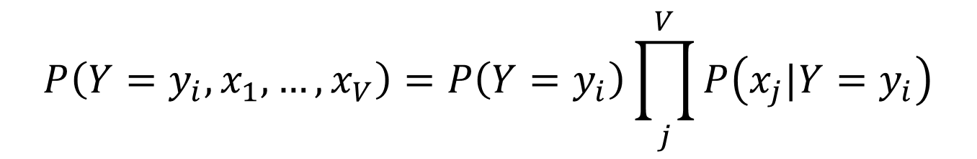
Number of Parameters
A general Naive Bayes model:
We only have to specify how each feature depends on the class
Total number of parameters is linear in V
Model is very simplistic, but often works anyway
|Y| parameters
$$P\left(Y=y_{i},x_{1},…,x_{V}\right)=P\left(Y=y_{i}\right)\prod_{j}^{V}{P\left(x_{j}|Y=y_{i}\right)}$$
|Y| * |X|^{V} values
V * |X| * |Y| parameters

Slide 23
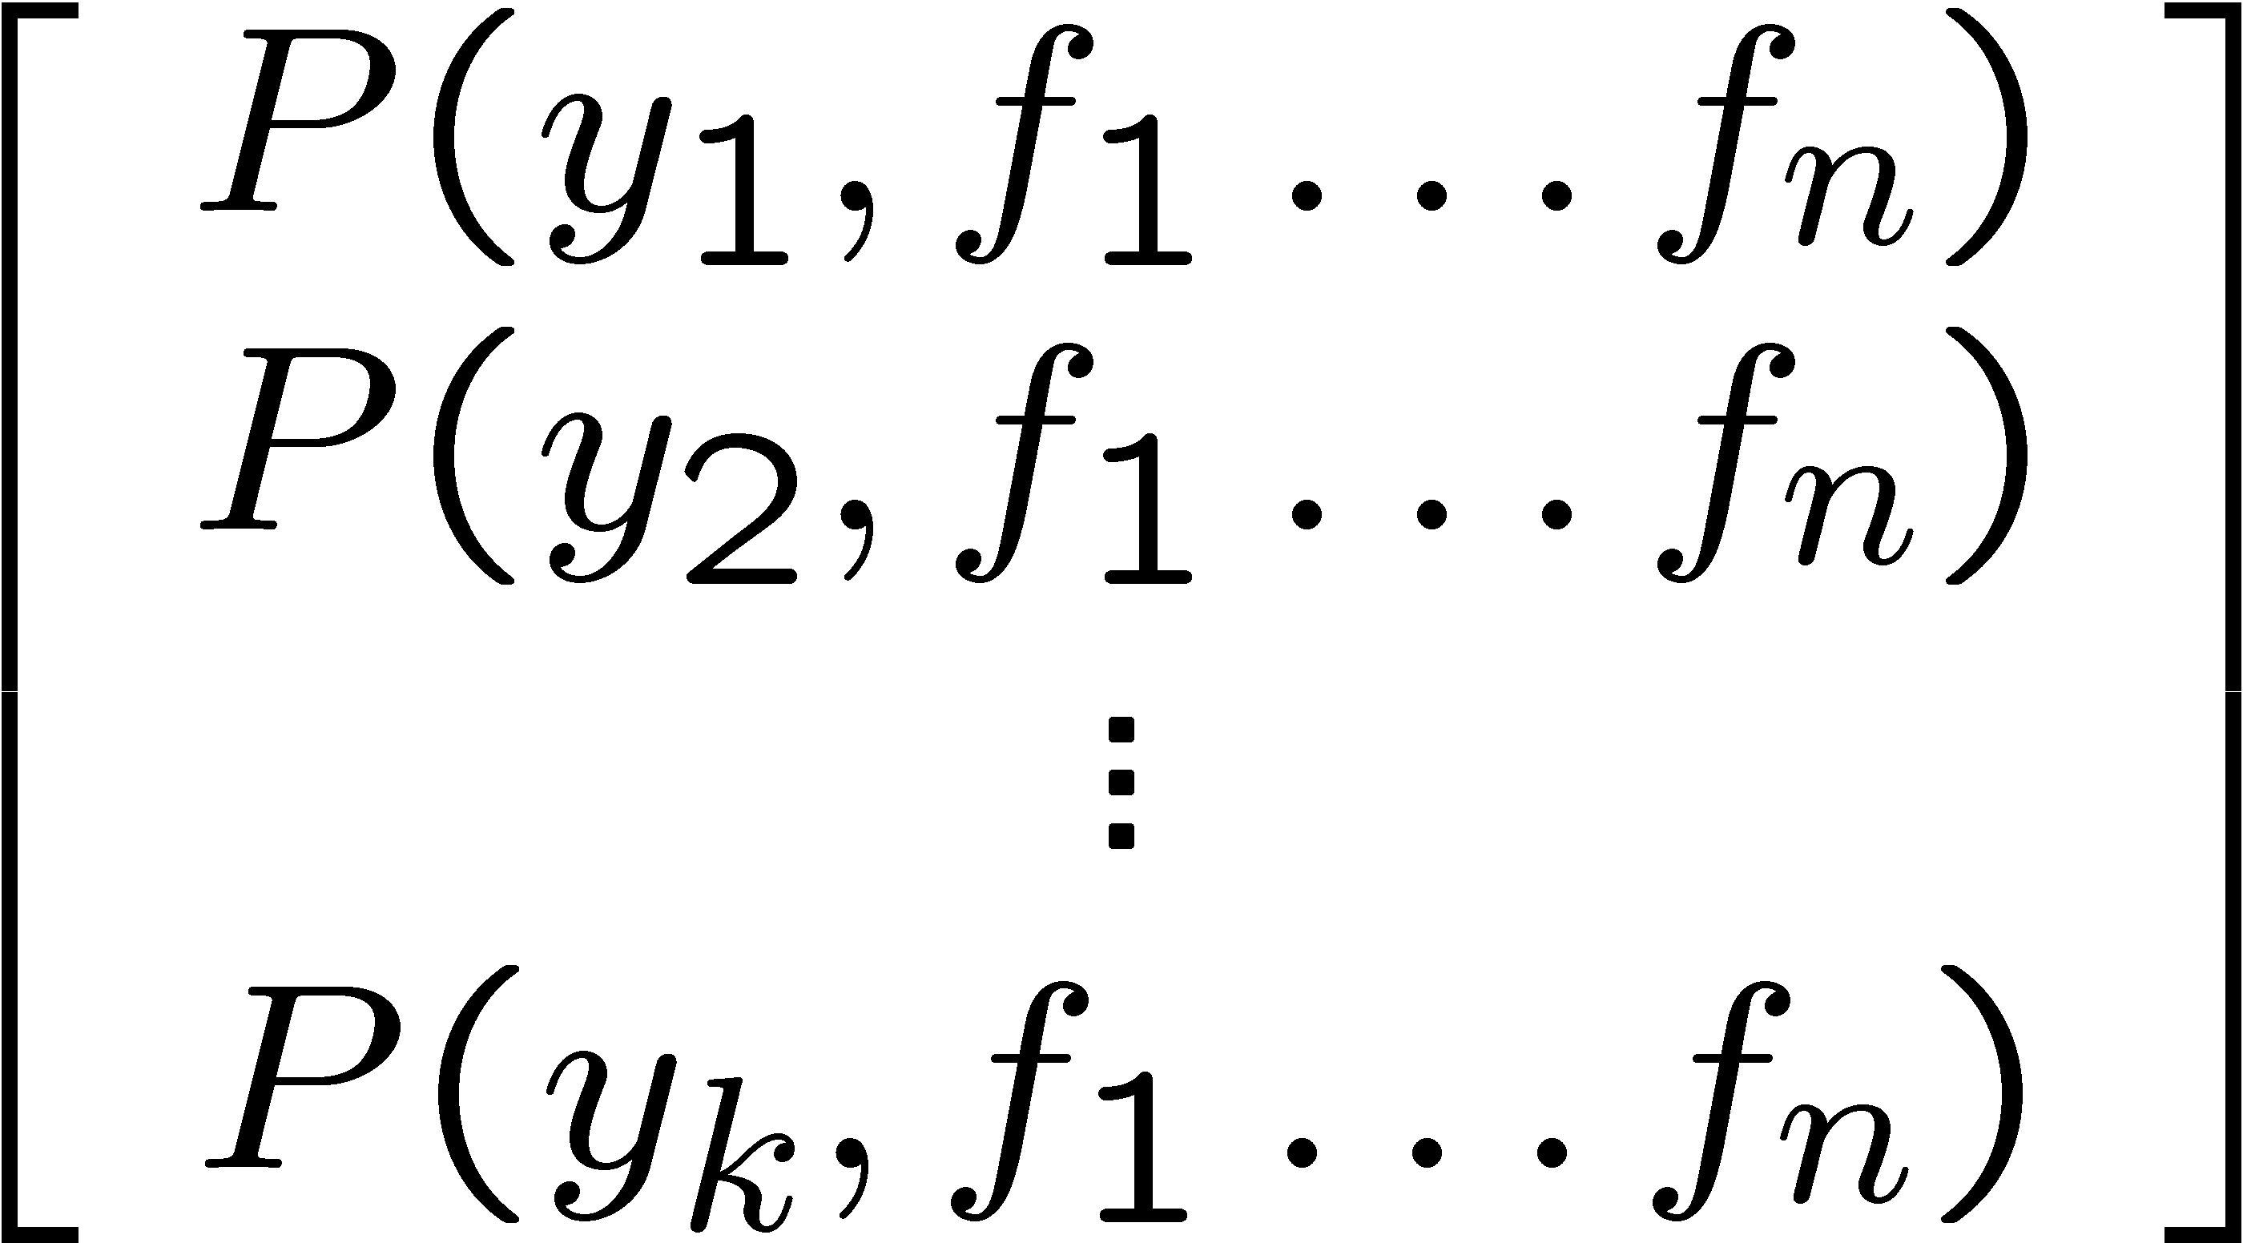
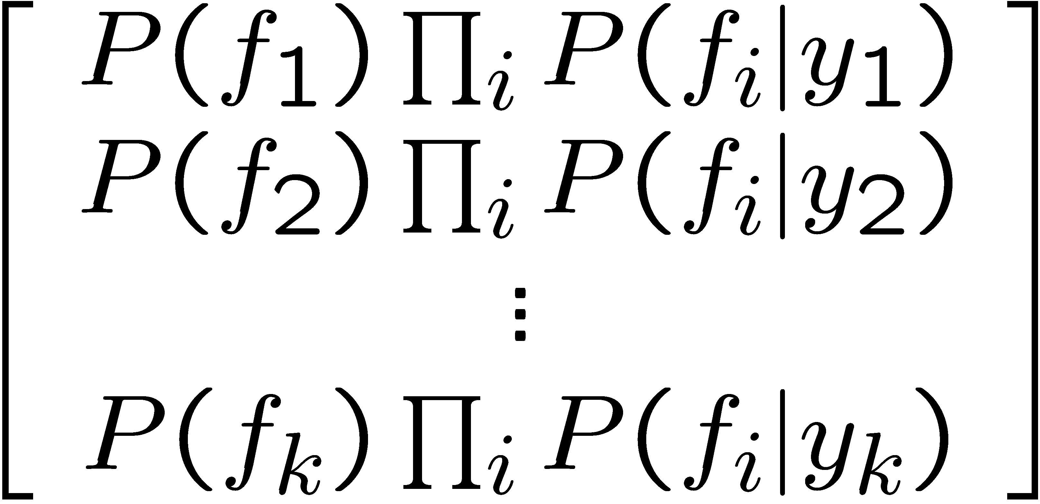

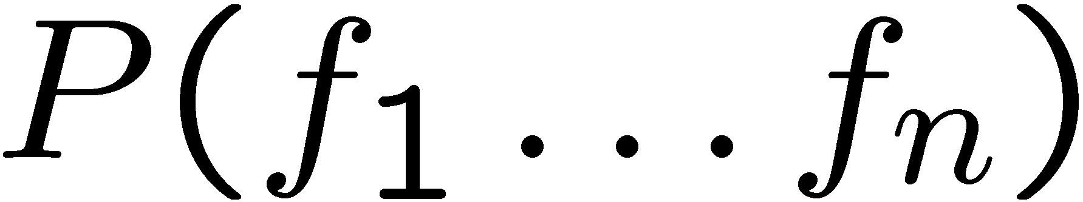
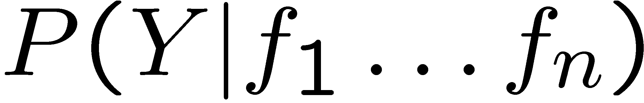
Inference for Naïve Bayes
Goal: compute posterior distribution over label variable Y
Step 1: get joint probability of label and evidence for each label
其实我们算的仅仅是第一个matrix，
若想得到第二个，就把第一个normalize，
让他们的和=1
Step 2: sum to get probability of evidence
Step 3: normalize by dividing Step 1 by Step 2
+

Slide 24
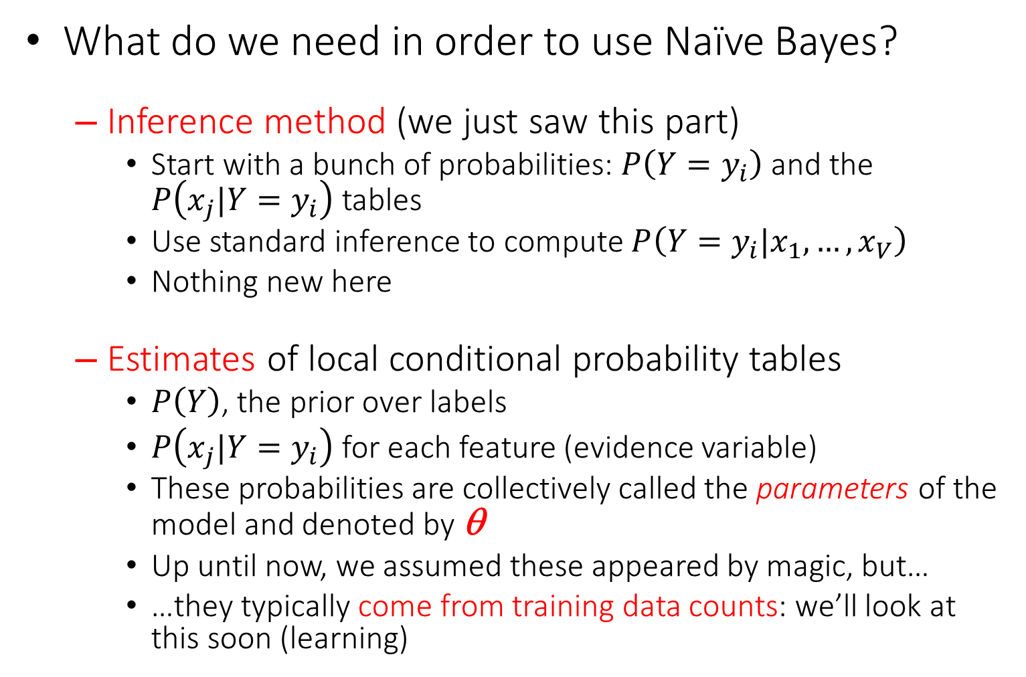
General Naïve Bayes
What do we need in order to use Naïve Bayes?
Inference method (we just saw this part)
Start with a bunch of probabilities: $P\left(Y=y_{i}\right)$ and the $P\left(x_{j}|Y=y_{i}\right)$ tables
Use standard inference to compute $P\left(Y=y_{i}|x_{1},…,x_{V}\right)$
Nothing new here
Estimates of local conditional probability tables
$P\left(Y\right)$, the prior over labels
$P\left(x_{j}|Y=y_{i}\right)$ for each feature (evidence variable)
These probabilities are collectively called the parameters of the model and denoted by θ
Up until now, we assumed these appeared by magic, but…
…they typically come from training data counts: we’ll look at this soon (learning)

Slide 25

Naïve Bayes for Text
Bag-of-words Naïve Bayes:
Features: w_{i} is the word at position i
As before: predict label conditioned on feature variables (spam vs. not spam)
As before: assume features are conditionally independent given label
New: each w_{i} is identically distributed
$$P\left(Y=y_{i},w_{1},…,w_{M}\right)$$
$$=P(Y=y_{i})P\left(w_{1},…,w_{M}|Y=y_{i}\right)$$
$$=P\left(Y=y_{i}\right)\prod_{j}^{M}{P\left(w_{j}|Y=y_{i}\right)}$$
$$=P\left(Y=y_{i}\right)\prod_{j}^{V}{P{\left(x_{j}|Y=y_{i}\right)}^{c(x_{j})}}$$

Slide 26
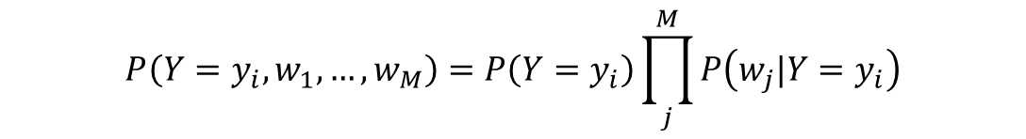


Example: Spam Filtering
$$P\left(Y=y_{i},w_{1},…,w_{M}\right)=P\left(Y=y_{i}\right)\prod_{j}^{M}{P\left(w_{j}|Y=y_{i}\right)}$$
Model:
What are the parameters?
Where do these tables come from?
$$P(Y)$$
$$P(w|Y=Spam)$$
$$P(w|Y=Not spam)$$
Not spam : 0.66
Spam: 0.33
the : 0.0156
to : 0.0153
and : 0.0115
of : 0.0095
you : 0.0093
a : 0.0086
with: 0.0080
from: 0.0075
...
the : 0.0210
to : 0.0133
of : 0.0119
2002: 0.0110
with: 0.0108
from: 0.0107
and : 0.0105
a : 0.0100
...

Slide 27
Spam Example
+
Word | P(w|spam) | P(w|not) | Total Spam | Total Not
(prior) | 0.33333 | 0.66666 | -1.1 | -0.4
Gary | 0.00002 | 0.00021 | -11.8 | -8.9
would | 0.00069 | 0.00084 | -19.1 | -16.0
you | 0.00881 | 0.00304 | -23.8 | -21.8
like | 0.00086 | 0.00083 | -30.9 | -28.9
to | 0.01517 | 0.01339 | -35.1 | -33.2
lose | 0.00008 | 0.00002 | -44.5 | -44.0
weight | 0.00016 | 0.00002 | -53.3 | -55.0
while | 0.00027 | 0.00027 | -61.5 | -63.2
you | 0.00881 | 0.00304 | -66.2 | -69.0
sleep | 0.00006 | 0.00001 | -76.0 | -80.5
P(spam | W) = 98.9

Slide 28
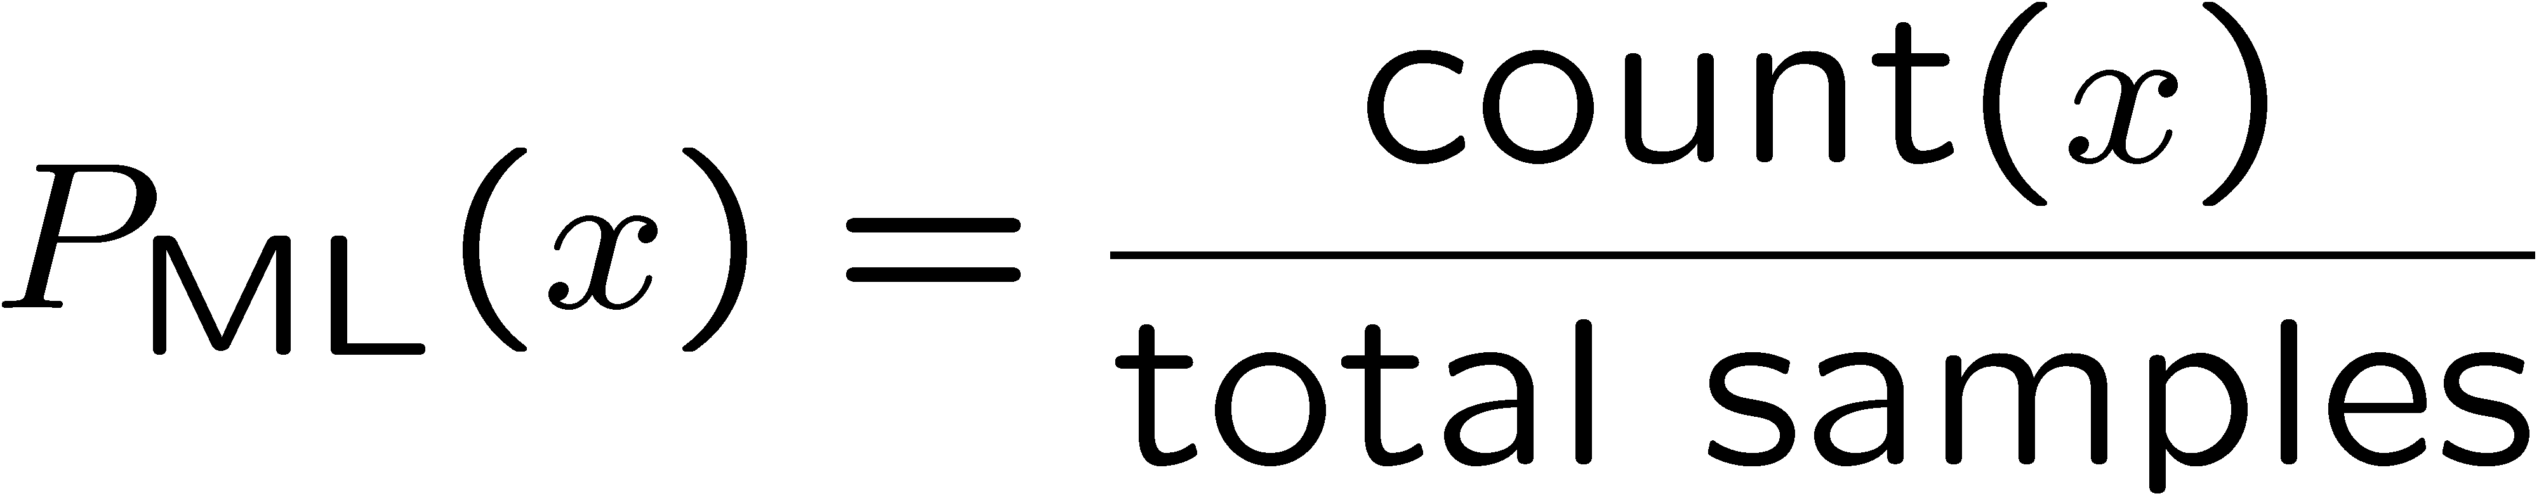

Parameter Estimation
Estimating the distribution of a random variable
Empirically: use training data (learning!)
E.g.: for each outcome x, look at the empirical rate of that value:
This is the estimate that maximizes the likelihood of the data
r
r
b
r
b
b
r
b
b
r
b
b
r
r
b
b
b
b

Slide 29
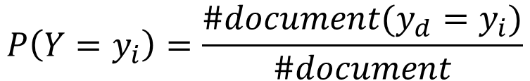

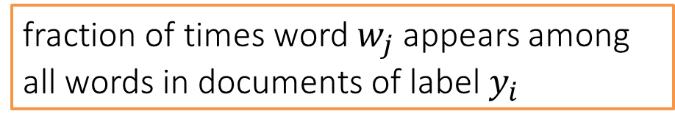
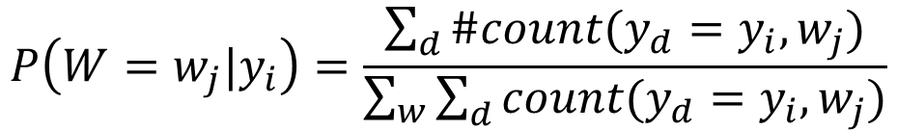
Parameter Estimation for Naïve Bayes
Maximum likelihood estimation: Simply use the frequencies in the data
For each label
For each word
Create mega-document for label $y_{i}$ by concatenating all docs in this topic (label)
Use frequency of w in mega-document
$$P\left(Y=y_{i}\right)=\frac{\#document(y_{d}=y_{i})}{\#document}$$
$$P\left(W=w_{j}|y_{i}\right)=\frac{\sum_{d}{\#count(y_{d}=y_{i},w_{j})}}{\sum_{w}{\sum_{d}{count(y_{d}=y_{i},w_{j})}}}$$
fraction of times word $w_{j}$ appears among all words in documents of label $y_{i}$

Slide 30
Overfitting
30
25
20
Degree 15 polynomial
15
10
5
0
-5
-10
-15
0
2
4
6
8
10
12
14
16
18
20

Slide 31


Example: Overfitting
Posteriors determined by relative probabilities (odds ratios):
$$\frac{P(w|Not spam) }{P(w|Spam) }$$
$$\frac{P(w|Spam) }{P(w|Not spam) }$$
south-west : inf
nation : inf
morally : inf
nicely : inf
extent : inf
seriously : inf
...
screens : inf
minute : inf
guaranteed : inf
$205.00 : inf
delivery : inf
signature : inf
...
What went wrong here?
Unlikely that every occurrence of “minute” is 100% spam
Unlikely that every occurrence of “seriously” is 100% not spam
What about all the words that don’t occur in the training set at all?

Slide 32
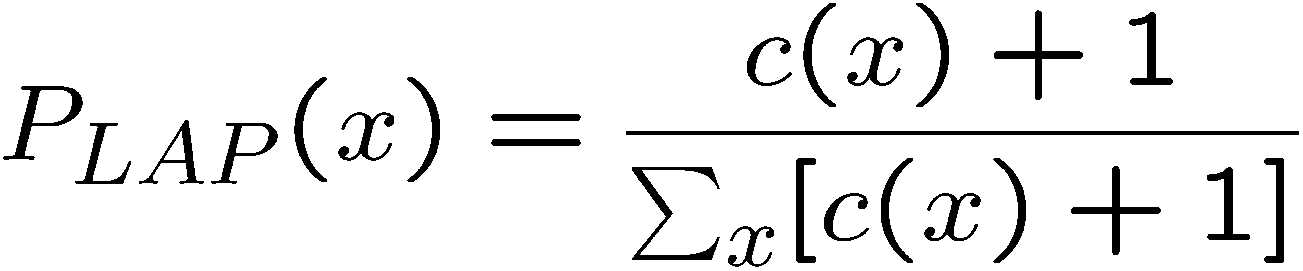
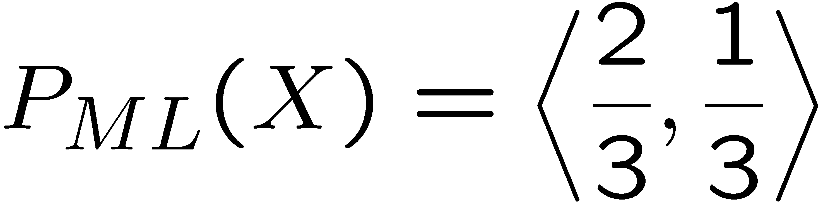
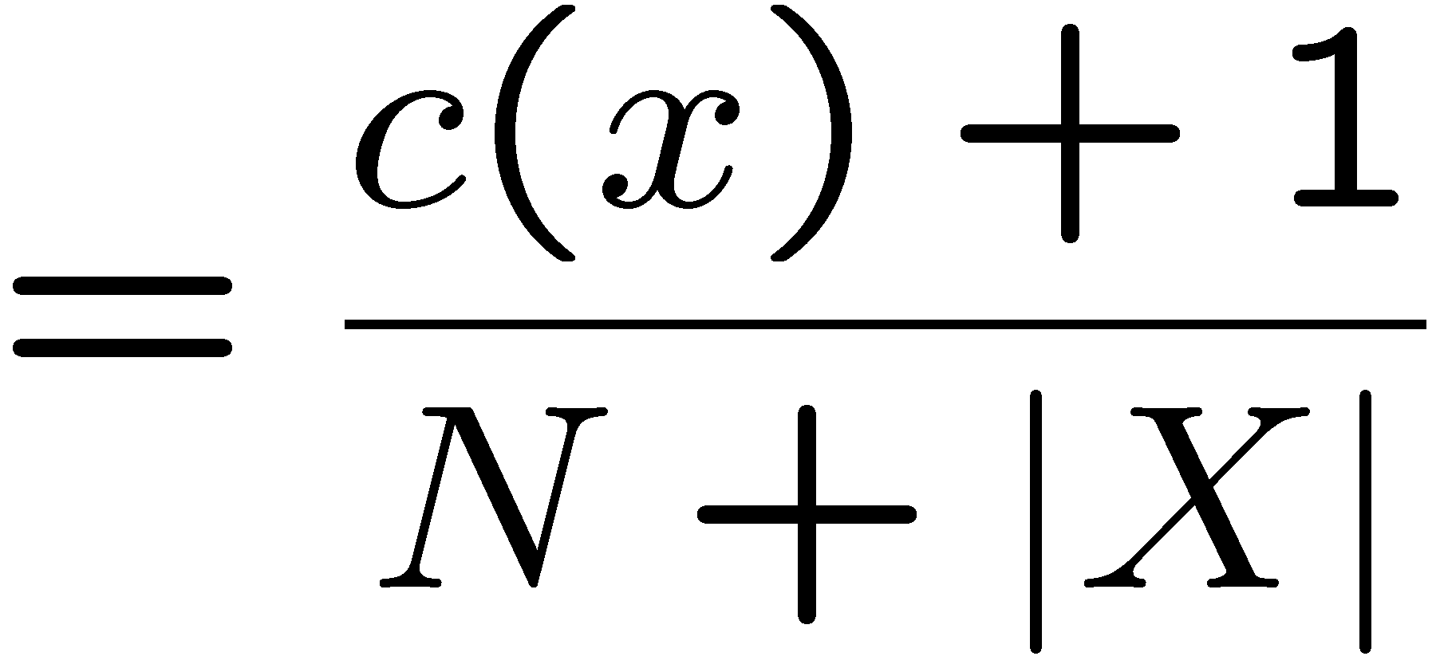
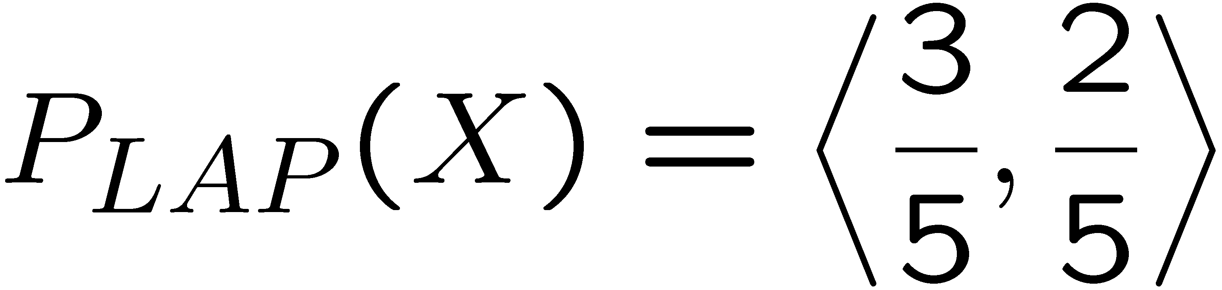
Laplace Smoothing
Laplace’s estimate:
Pretend you saw every outcome once more than you actually did
Can derive this estimate with Dirichlet priors
r
r
b

Slide 33
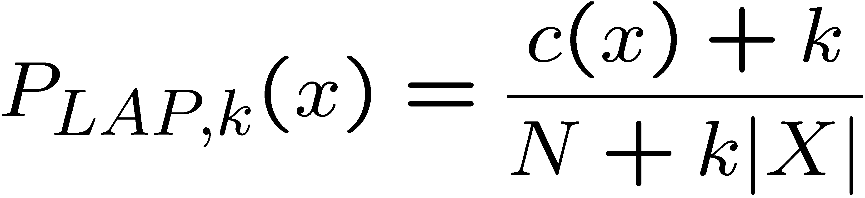
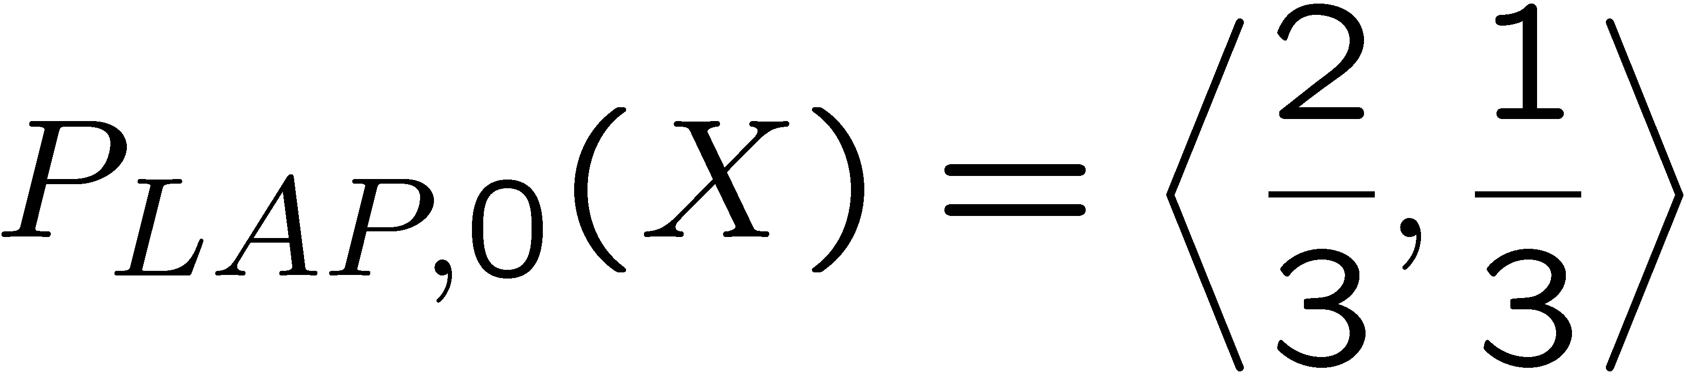
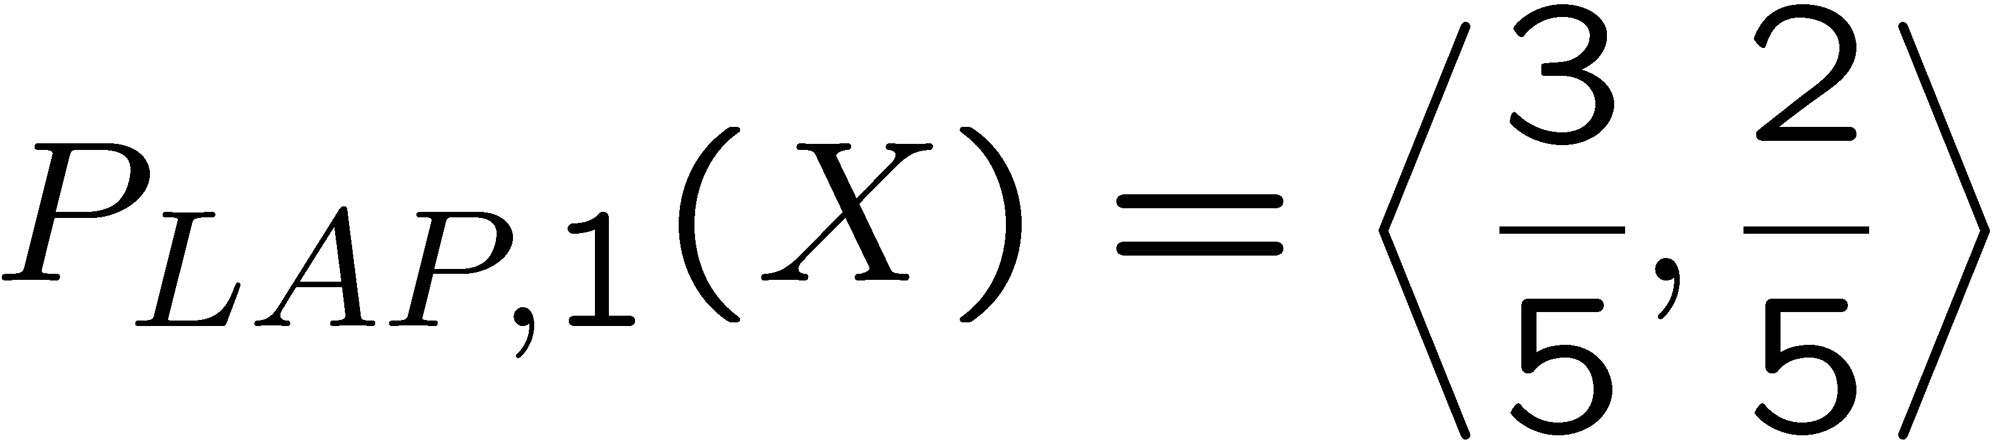
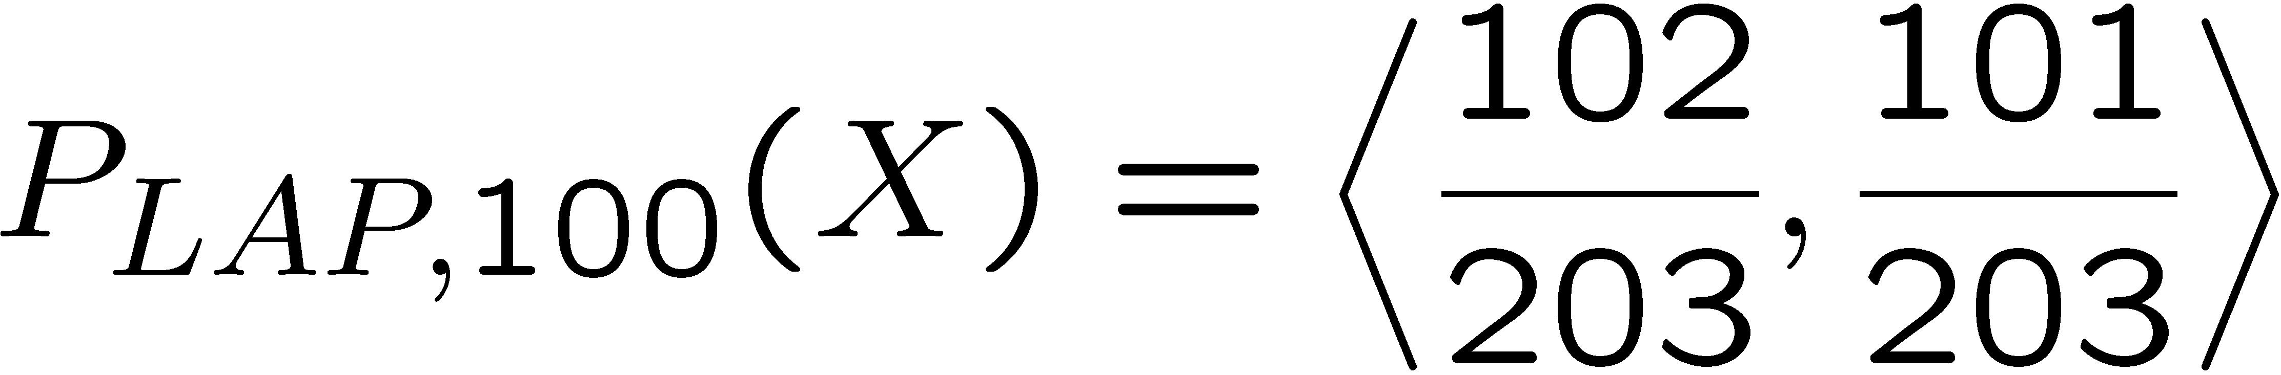
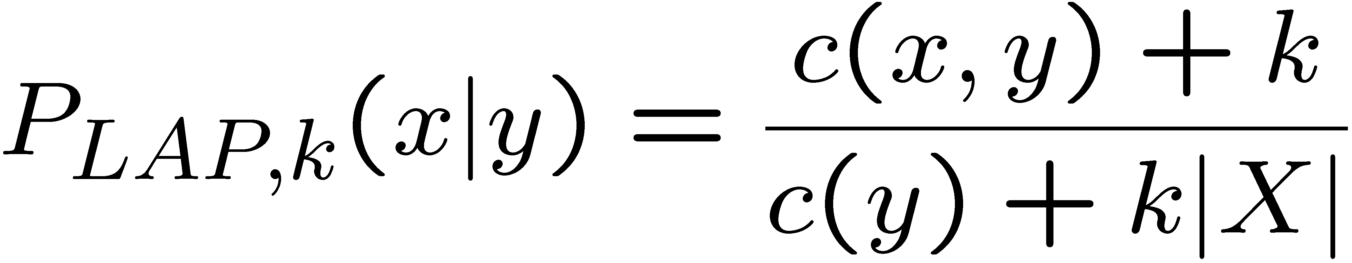
Laplace Smoothing
Laplace’s estimate (extended):
Pretend you saw every outcome k extra times
What’s Laplace with k = 0?
k is the strength of the prior
Laplace for conditionals:
Smooth each condition independently:
r
r
b

Slide 34


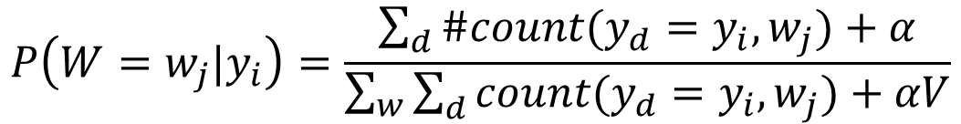
Real NB: Smoothing
For real classification problems, smoothing is critical
New odds ratios:
$$P\left(W=w_{j}|y_{i}\right)=\frac{\sum_{d}{\#count(y_{d}=y_{i},w_{j})}+α}{\sum_{w}{\sum_{d}{count(y_{d}=y_{i},w_{j})+αV}}}$$
$$\frac{P(w|Not spam) }{P(w|Spam) }$$
$$\frac{P(w|Spam) }{P(w|Not spam) }$$
helvetica : 11.4
seems : 10.8
group : 10.2
ago : 8.4
areas : 8.3
...
verdana : 28.8
Credit : 28.4
ORDER : 27.2
<FONT> : 26.9
money : 26.5
...
Do these make more sense?

Slide 35
A General Pipeline of Building a Classifier
Pre-processing data
Tokenization
Stemming/
normalization
N-gram
Stopwords filtering
Preparing input data for machine learning
Feature construction (e.g., VSM)
Feature construction (e.g., word embeddings)
Feature selection
(e.g., DF filtering)
Configuration of Data and Metrics for Test
Training/Dev/Testing
K-Fold Cross Validation
Evaluation Metrics
Model Specification and Selection
Specify models based on assumptions
Evaluate model based on C.V. and metrics
Output the model for future use

Slide 36





Tuning on Held-Out Data
Now we’ve got two kinds of unknowns
Parameters: the probabilities P(X|Y), P(Y)
Hyperparameters: e.g. the amount / type of smoothing to do, k, α
What should we learn where?
Learn parameters from training data
Tune hyperparameters on different data
Why?
For each value of the hyperparameters, train and test on the held-out data
Choose the best value and do a final test on the test data

Slide 37
Important Concepts
Data: labeled instances, e.g. emails marked spam/not spam
Training set
Held out set (development set/validation set)
Test set
Features: attribute-value pairs which characterize each x
Experimentation cycle
Learn parameters (e.g. model probabilities) on training set
(Tune hyperparameters on held-out set)
Compute accuracy of test set
Very important: never “peek” at the test set!
Training
Data
Held-Out
Data
Test
Data

Slide 38
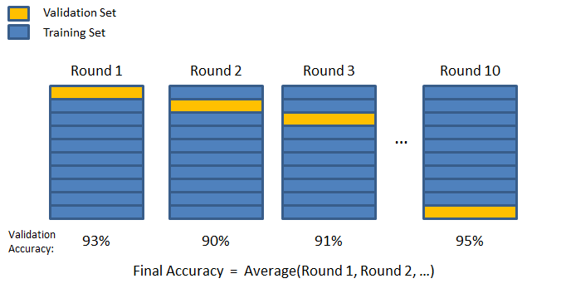
Cross validation
Cross validation
Avoid noise in train/test separation
k-fold cross-validation

Slide 39
Errors, and What to Do
Examples of errors
Dear GlobalSCAPE Customer,
GlobalSCAPE has partnered with ScanSoft to offer you the latest version of OmniPage Pro, for just $99.99* - the regular list price is $499! The most common question we've received about this offer is - Is this genuine? We would like to assure you that this offer is authorized by ScanSoft, is genuine and valid. You can get the . . .
. . . To receive your $30 Amazon.com promotional certificate, click through to
http://www.amazon.com/apparel
and see the prominent link for the $30 offer. All details are there. We hope you enjoyed receiving this message. However, if you'd rather not receive future e-mails announcing new store launches, please click . . .

Slide 40
What to Do About Errors?
Need more features other than words!
Have you emailed the sender before?
Have 1K other people just gotten the same email?
Is the sending information consistent?
Is the email in ALL CAPS?
Do inline URLs point where they say they point?
Does the email address you by (your) name?
Can add these information sources as new variables in the NB model

Slide 41
Summary
Bayes rule lets us do diagnostic queries with causal probabilities
The naïve Bayes assumption takes all features to be independent given the class label
We can build classifiers out of a naïve Bayes model using training data
Smoothing estimates is important in real systems

