Slide 1
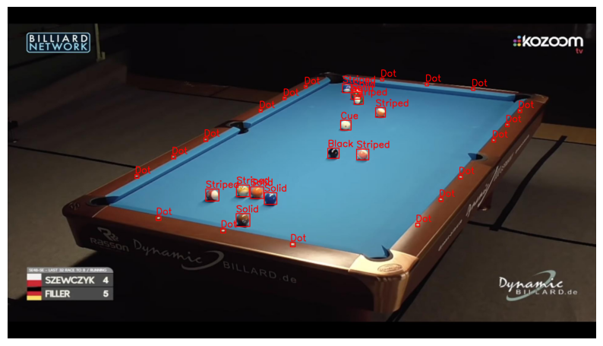
Task 3: Ball Detection and Pool-Table Retrieval
Notebook goal: detect the physical pool balls and retrieve the most similar table state from the training set.
Dataset and evaluation setup
• Source: Roboflow Universe 8-Ball Pool dataset, published by BachelorThesis.
• 247 annotated images in YOLO format, under a CC BY 4.0 license.
• Split: 197 training, 24 validation, 26 test images.
• Physical classes: Black, Cue, Solid, Striped; Dot is ignored because it is not an independent ball.
Notebook pipeline
Core idea
1. Train YOLOv8n
2. Compare YOLOv8n with DETR-ResNet50
3. Evaluate detection and count-level errors
4. Retrieve tables using top-view + CLIP
5. Use a ball-layout fallback when top-view fails
Separate the task into robust ball detection and table-state comparison.
YOLOv8n is the main detector because it is lightweight and works well with a small dataset and small objects. Retrieval is improved by comparing normalized table views instead of full camera images.
Detection
Counting
Retrieval
Fallback
Computer Vision project - Task 3

Slide 2
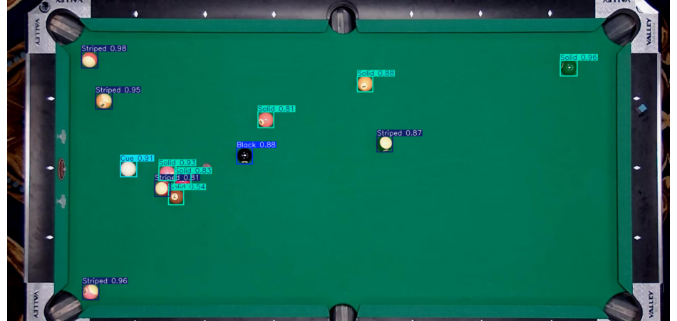
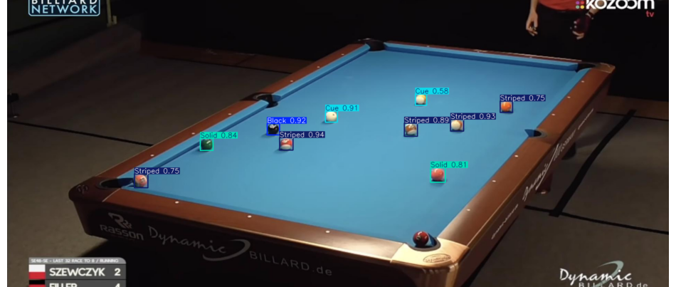
Detection Results: YOLOv8n Is the Clear Choice
Report-aligned test results after removing the Dot class from evaluation.
Localization metrics
Count-level metrics
0.920
0.765
0.539
69.2%
mAP@0.5
mAP@0.5:0.95
Count MAE
Exact count
Recall: 0.795
Within ±1: 88.5%
YOLOv8n vs DETR-ResNet50
Low count-error example
Why DETR underperformed
DETR-ResNet50 struggled with calibration on this small dataset: at lower thresholds it over-predicted, and at higher thresholds it missed most detections. The report concludes that YOLOv8n is better adapted to small, clustered pool balls.
Higher error example
Main result: YOLOv8n outperforms DETR-ResNet50 in localization and count-level metrics

Slide 3
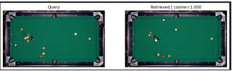
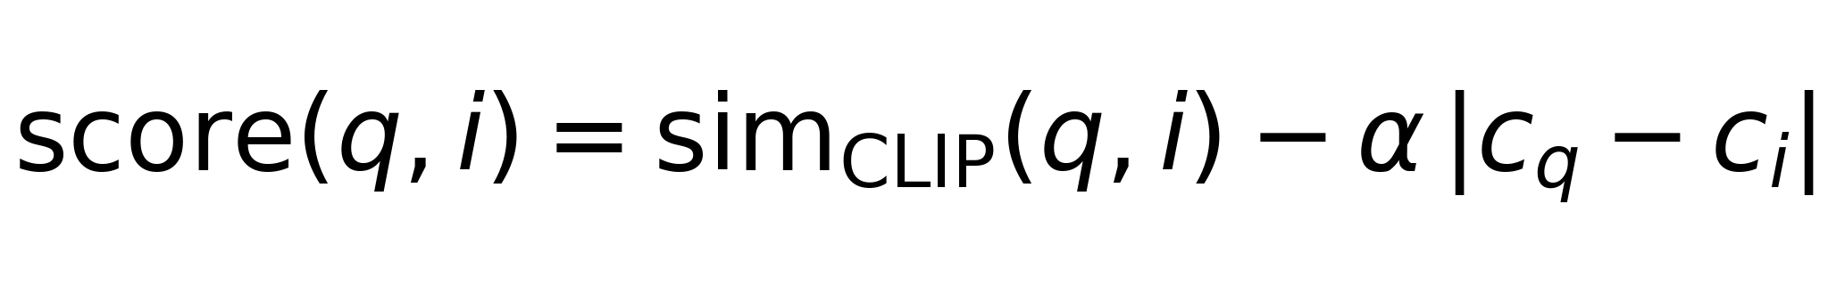
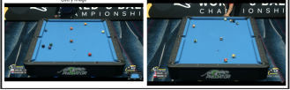
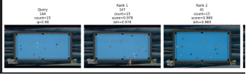
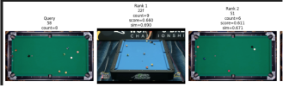
Retrieval: Comparing Table States
HSV and CNN embeddings are useful baselines; the strongest method uses top-view CLIP with a count penalty.
Baselines
Score formula
HSV histogram compares global color distributions. It is simple and explainable, but sensitive to lighting, background and overlays.
ResNet18/CNN embedding captures more scene structure, but still compares the full camera view rather than only the ball arrangement.
HSV histogram baseline
• q: query image.
• i: candidate image in the retrieval database.
ResNet18 / CNN embedding
Main method
• sim_CLIP(q, i): CLIP cosine similarity; higher means more visually similar table states.
Top-view normalization reduces viewpoint and background variation. CLIP retrieves visually similar normalized table states, while the count penalty discourages matches with different numbers of balls.
• c_q, c_i: estimated ball counts for query and candidate.
• |c_q − c_i|: absolute count difference; penalizes mismatched game states.
Top-view CLIP
Fallback
• α: penalty strength; larger α gives more weight to matching counts.
If top-view quality is rejected, YOLOv8n detects ball centers in the original image and converts them into table-relative positions for retrieval.
Ball-layout fallback
Final ranking = visual similarity − count mismatch.
Final message: detector + normalized retrieval + robust fallback

