Slide 1


Capstone – II WORDNXT

Slide 2
Business Problem
The average person types 38 to 40 words per minute and now with our whole life being online, all are conversations are text messages.
We need an application that would make conversations effortless and fast not only for professional writers but for everyday typing users.
We propose an application that would complete the sentences for the user with suitable word predictions.

Slide 3

Scope
THE USER WILL GET MULTIPLE SUGGESTIONS BASED ON WHAT HE/SHE TYPES. (FOCUS WILL BE ON PHRASES, CONTEXT, GENERAL LINES ETC)
OPTION FOR SAVING USED SUGGESTION WILL BE ENABLED USER WISE BOTH USER INITIATED AND OPTING FROM PREDICTOR SYSTEM.
EASE OF USE WILL BE DEFINED.
FEEDBACK SYSTEM TO IMPROVE THE SYSTEM WILL BE INSTATED.

Slide 4
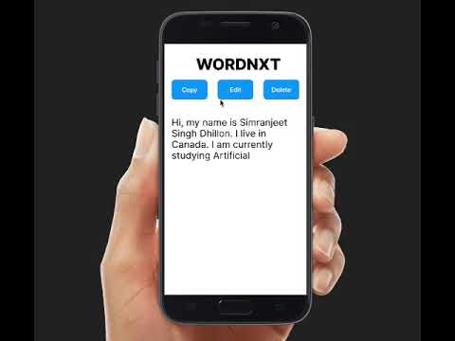
Prototype

Slide 5
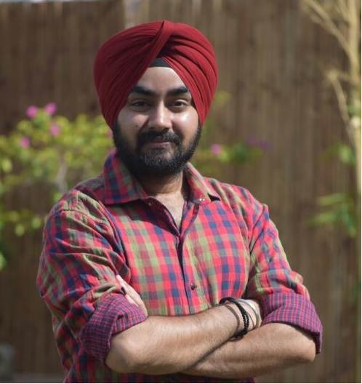



Team WordNXT
Inderjit Singh
Sahiba Sachdeva
Yoginder Kumar
Simranjeet Singh Dhillon

Slide 6
Links
Github
https://github.com/ze-row/CAPSTONE-II-WordNXT

