Slide 1
The Cerebellum

Slide 2
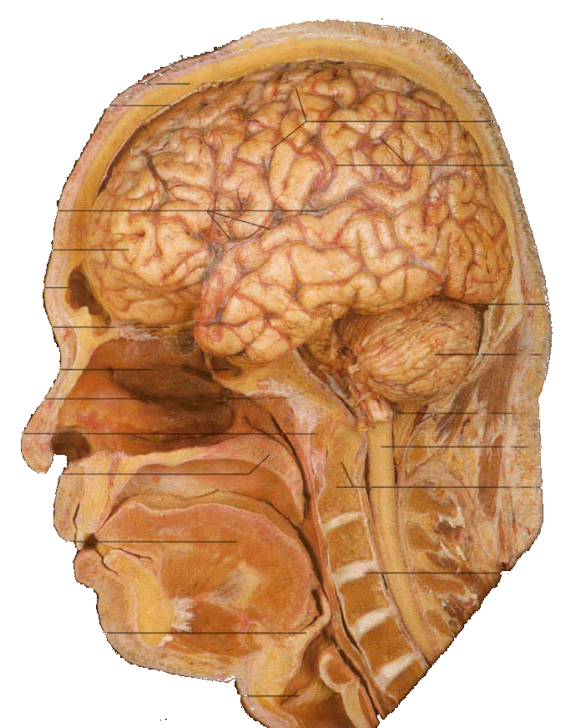
Position
Lies above and behind the medullar and pons and occupies posterior cranial fossa
Cerebellum

Slide 3
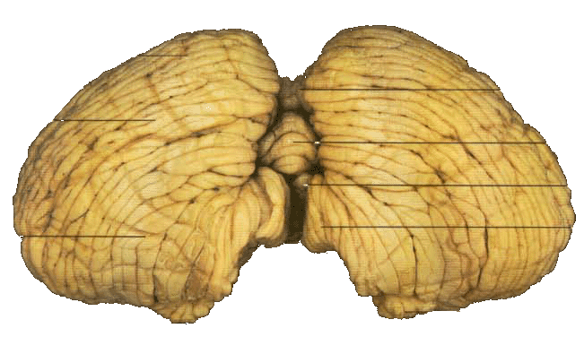
External features
Consists of two cerebellar hemisphere united in the midline by the vermis

Slide 4
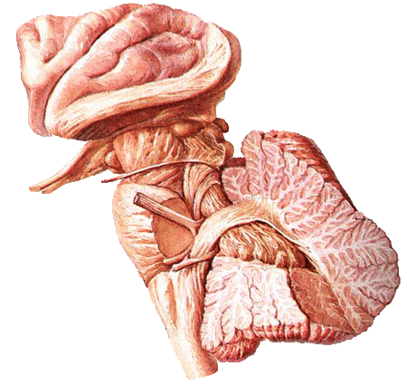
External features
Three peduncles
Inferior cerebellar peduncle 小脑下脚 －connect with medulla and with spinal cord, contain both afferent and efferent fibers
Middle cerebellar peduncle 小脑中脚－connect with pons, contain afferent fibers
Superior cerebellar peduncle 小脑上脚－connect with midbrain, contain mostly efferent fibers

Slide 5
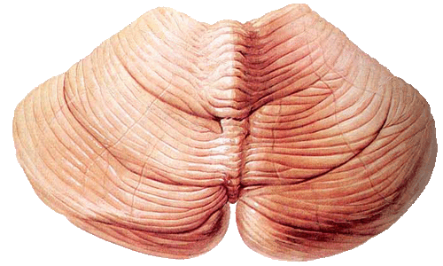
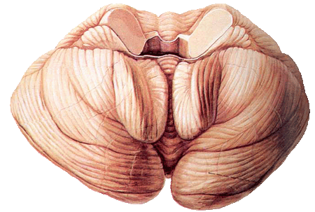
External features
Tonsil of cerebellum two elevated masses on inferior surface of hemispheral portion just nearby foramen magnum

Slide 6
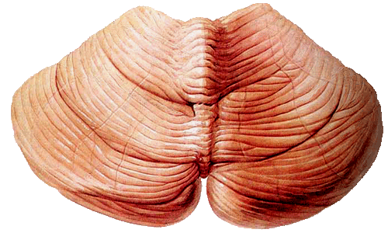
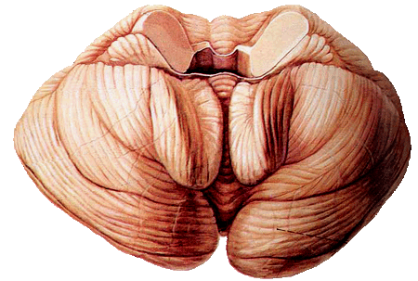
Lobs
Two deep fissures
  Primary fissure 原裂
  Posterolateral fissure 后外侧裂
Three lobs
  Flocculonodular lobe 绒球小结叶 flocculus and nodule
  Anterior lobe
  Posterior lobe
Corpus of
cerebellar 小脑体

Slide 7
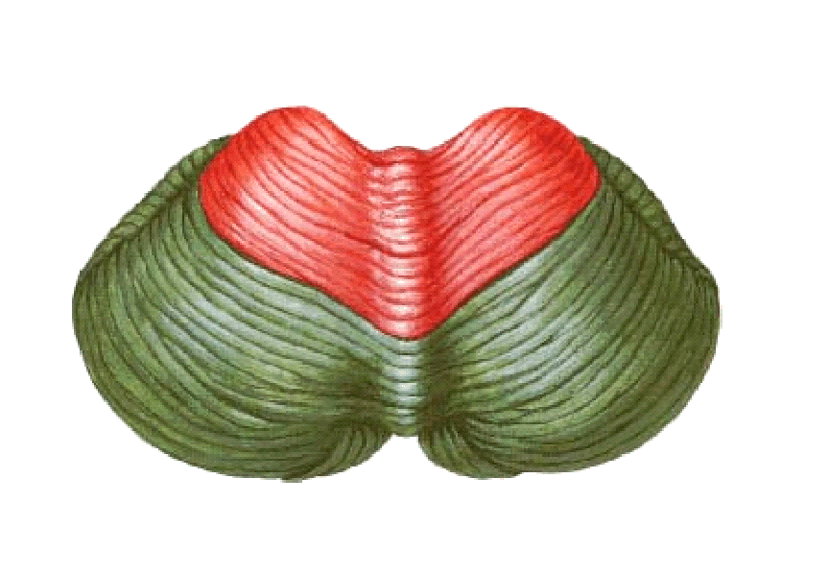
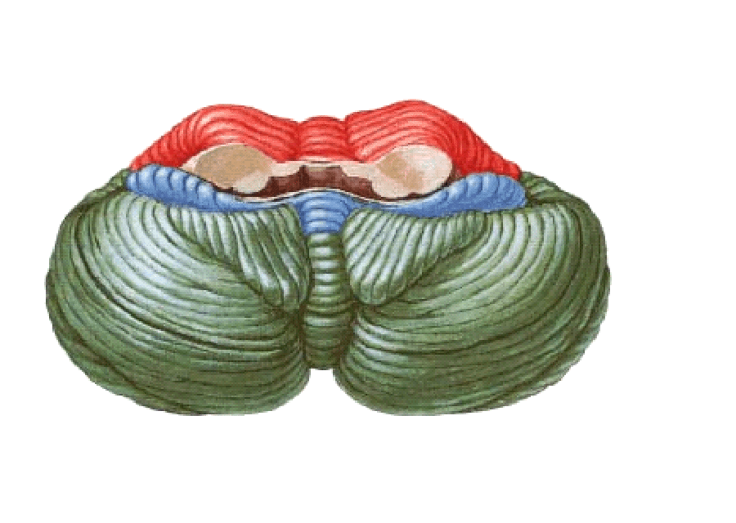
Lobs
Anterior lobe
corpus of
cerebellar
Primary fissure
Posterior lobe
Flocculonodular lobe
Posterolateral fissure

Slide 8
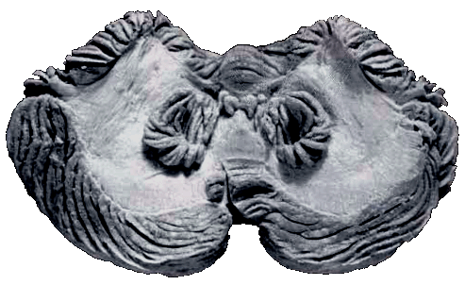
Internal structures
Gray matter
Cerebellar cortex
Cerebellar nuclei
  Dentate nucleus 齿状核
  Fastigial nucleus 顶核
  Interposed nucleus 中间核
    Emboliform nucleus 栓状核
    Globose nucleus球状核
White matter－medullary center 髓体

Slide 9
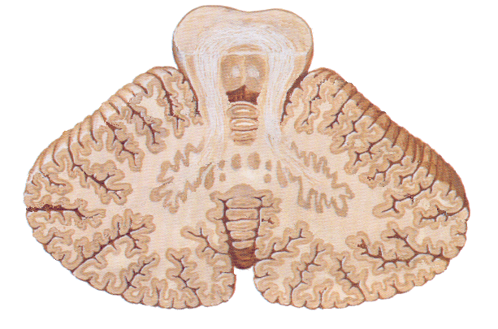
Internal structures
Cerebellar cortex
Fastigial nucleus
Globose nucleus
Dentate nucleus
Emboliform nucleus
medullary center

Slide 10
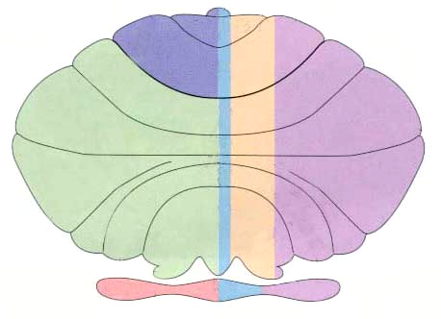
Three functional divisions
Vestibulocerebellum 前庭小脑
  Archicerebellum 原小脑
  Flocculonodular lobe
Spinocerebellum 脊髓小脑
  Paleocerebellum旧小脑
  Vermis and intermediate zone
Cerebrocerebellum 大脑小脑
  Neocerebellum 新小脑
  Lateral zone
Vermis
Intermediate zone
Lateral zone
Flocculonodular lobe

Slide 11
Connections and function of cerebellum
Vestibulocerebellum
Connections
  Afferents: receive input from vestibular nuclei and primary vestibular
  Efferents: projects to the vestibular nucleus → vestibulospinal tract and medial longitudinal fasciculus → motor neurons of anterior horn
Function: involved in eye movements and maintain balance

Slide 12
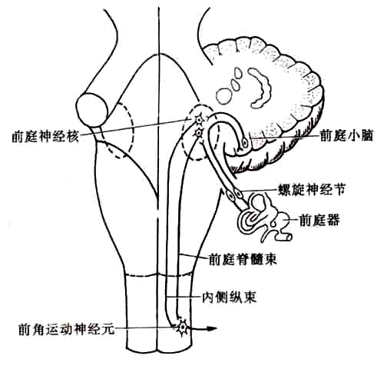

Slide 13
Connections and function of cerebellum
Spinocerebellum
Connnection
  Afferents: receive somatic sensory information via spinocerebellar tracts

Slide 14
  Efferents:
    Vermis projects to the fastigial nucleus → vestibular nuclei and reticular formation → vestibulospinal tract and reticulospinal tract → motor neurons of anterior horn
    Intermediate zone projects to the interposed nuclei
      Contralateral red nucleus → rubrospinal tract →motor neurons of anterior horn
      Contralateral VI →cerebral cortex→ coticospinal tract→motor neurons of anterior horn
Function: play an important role in control of muscle tone and coordination of muscle movement on the same side of the body

Slide 15
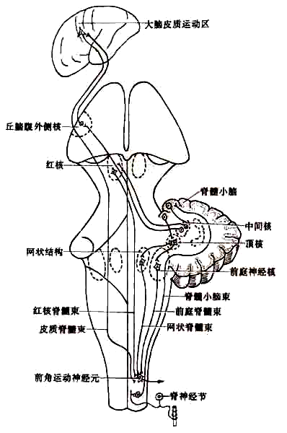

Slide 16
Connections and function of cerebellum
Cerebrocerebellum
Connection
  Afferents: receives input from the cerebral cortex via a relay in pontine nuclei
  Efferents: projects to dentate nucleus → VI → primary motor cortex → corticospinal tract → motor neurons of anterior horn
Function: participates in planning movements

Slide 17
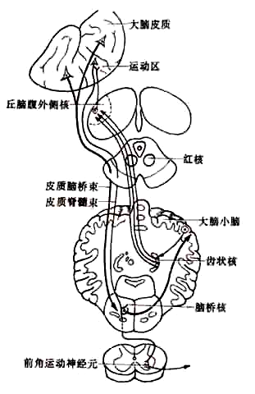

Slide 18
The Diencephalon

Slide 19
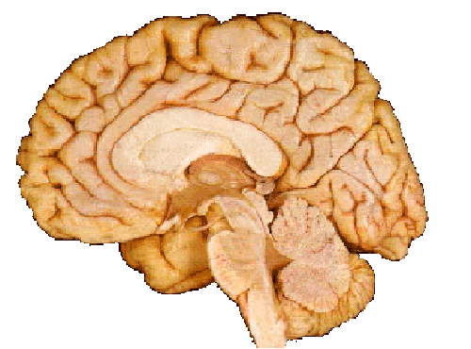
Position
Position: Lies between midbrian and cerebrum, almost entirely surrounded by cerebral hemisphere

Slide 20
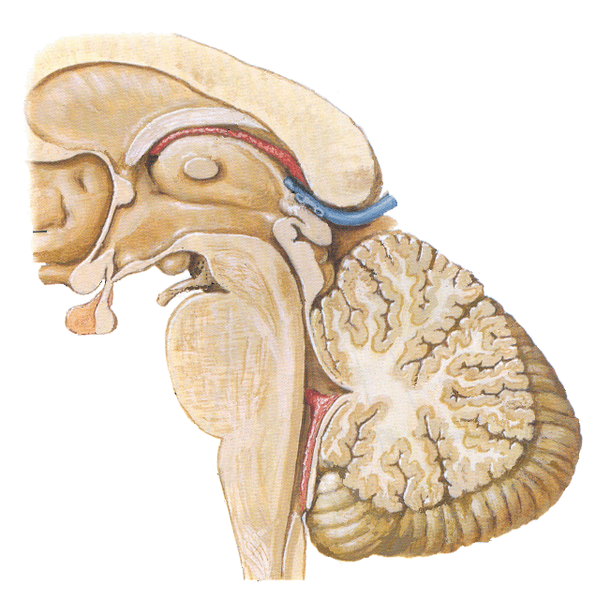
Subdivision
Doral thalamus
Metathalamus
Epithalamus
Subthalamus
Hypothalamus

Slide 21

Dorsal thalamus
External features
A large egg-shaped nucleus mass,
Anterior end called anterior thalamic tubercle,
Posterior end called pulvinar
Right and left portion of thalamus are joined by interthalamic adhesion
Floor－hypothalamic sulcus

Slide 22
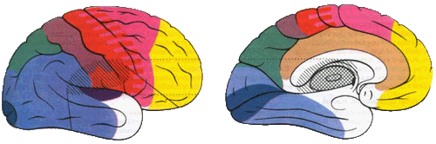
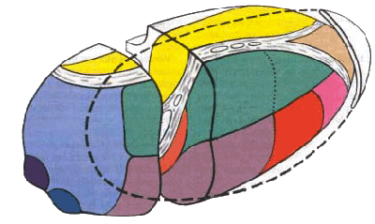

Slide 23
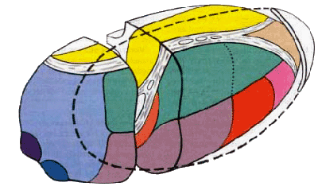
Classification of nuclei of dorsal thalamus
Three nuclear group－divided by internal medullary lamina
Anterior nuclear group
Medial nuclear group
Lateral nuclear group

Slide 24
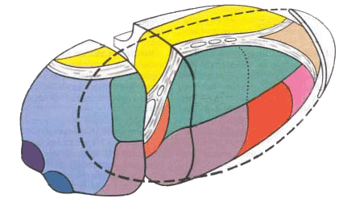
internal medullary lamina
Med. nuclear group
Dorsal tier
Ant. nuclear group
Pulvinar
Medial geniculate body (MGN)
Ventral anterior
Ventral intermediate
Ventral posterior nucleus (VP)
Lateral geniculate body (LGN)
Ventral posterolateral (VPL)
Ventral posteromedial (VPM )

Slide 25
Subdivision | Principal Nuclei | Common abbreviation
Ant. nuclear group
Med. nuclear group
Lat. nuclear group
Dorsal tier | Lateral dorsal | LD
 | Lateral posterior | LP
 | Pulvinar
Ventral tier | Ventral anterior | VA
 | Ventral intermediate | VI
 | Ventral posterior | VP
 | Ventral posterolateral | VPL
 | Ventral posteromedial | VPM

Slide 26
Functional subdivision
Nonspecific relay nuclei－receive afferents from rhinencephalon and reticular formation of brain stem, project mainly to hypothalamus and corpus striatum
Midline nucleus group
Intralaminar nuclear group
Thalamic reticular nucleus
Association nuclei －receive input from many converging sours and in turn project widely to the association areas of cerebral cortex
Anterior nuclear group
Medial nuclear group
Dorsal tier of lateral nuclear group

Slide 27
Special relay nuclei
Vent. anterior nucleus (VA)
Vent. intermediate nucleus (VI)
Receiving dentate nucleus, globus pallidus and substantia nigra to motor cortex
Vent. posteromedial nucleus (VPM) －receives trigeminal lemniscus and teste fibers
Vent. posterolateral nucleus (VPL) －receives medial lemniscus and spinal lemniscus
Projects to first somatic sensory area via central thalamic radiation

Slide 28
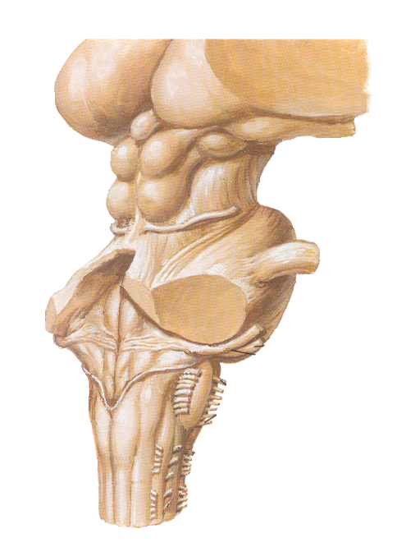
Metathalamus
Lateral geniculate body (LGN)
Medial geniculate body (MGN)
Metathalamus

Slide 29

Metathalamus
Medial geniculate body (MGN)
  Relay station of audition
  Receive fibers from inferior colliculus
  Projects to auditory area via acoustic radiation
Lateral geniculate body (LGN)
  Relay station of vision
  Receive fibers from optic tract
  Projects to visual area via optic radiation

Slide 30

Epithalamus
Includes
Thalamic medullary stria
Habenular trigone
Habenular commissure
Pineal body
posterior commissure

Slide 31
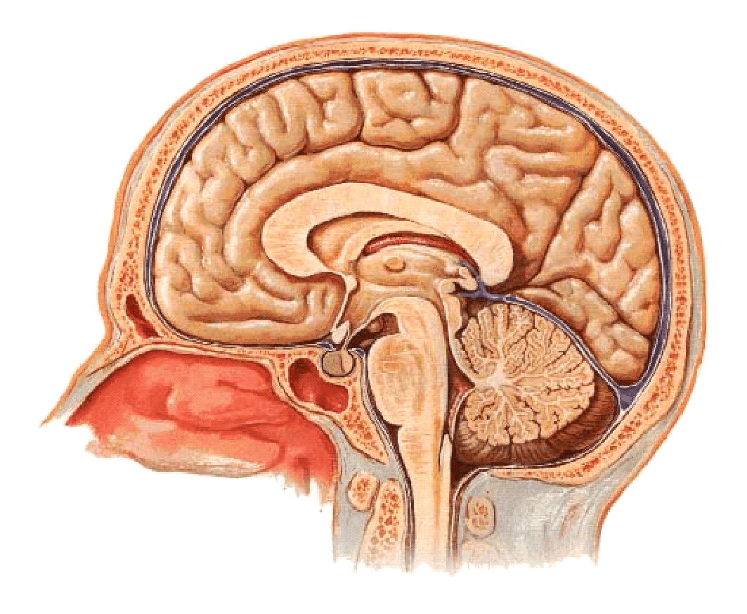
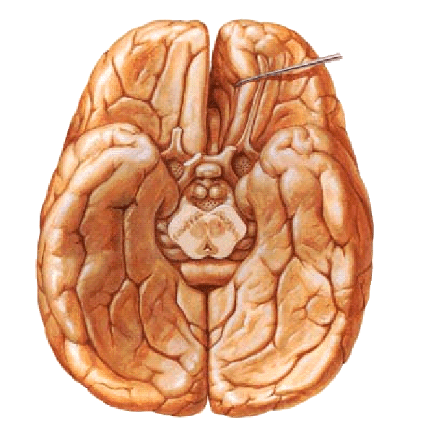

Hypothalamus
Position－lies ventral to thalamus
Boundaries
Superiorly: hypothalamic sulcus
Inferiorly:
  optic chiasma
  tuber cinereum
  Infundibulum
  mamillary body
Anterior: lamina terminalis
Posterior: continues with midbrain tegmentum

Slide 32
Subthalamus
Transition zone between diencephalons and tegmentum of midbrain
Contain subthalamic nucleus, parts of red nucleus and substantia nigra

Slide 33
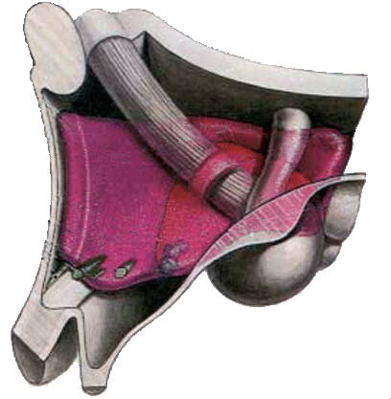
Subdivisions
Preoptic region
Supraoptic region
Tuberal region
Mamillary region

Slide 34
Important nuclei
Supraoptic region
  Supraoptic nucleus －produce antidiuretic hormone (ADH， vasopressin )
  Paraventricular nucleus －produce oxytocin
Tuberal region
  Infundibular nucleus
  Ventromedial nucleus
  Dorsomedial nucleus
Mamillary region
  Mamillary nucleus
  Posterior hypothalamic nucleus

Slide 35
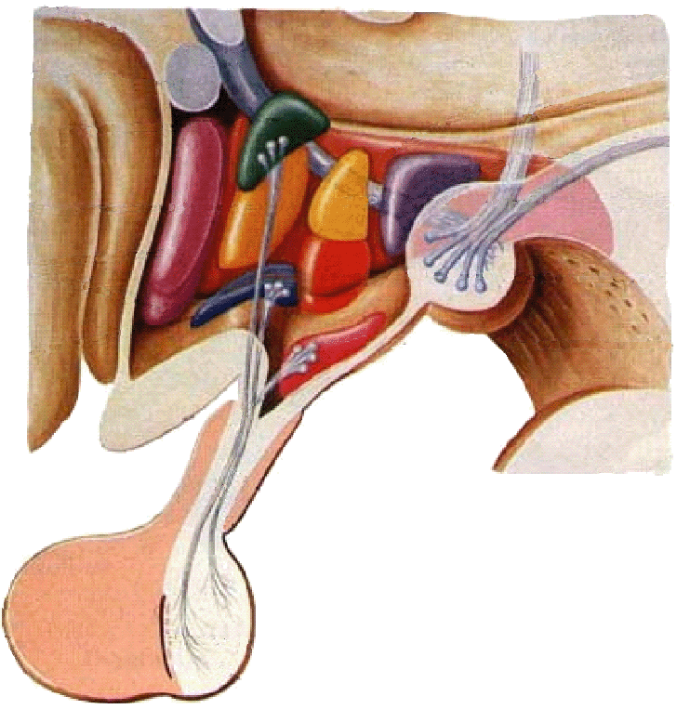
Paraventricular nucleus
Paraventriculohypophyeal
tract
Supraoptic nucleus
Supraopticohypophyseal
tract
Mamillary nucleus
arcuate nucleus
tuberoinfundibular tract
infundibulum
anterior lobe of hypophsis
posterior lobe of hypophysis

Slide 36
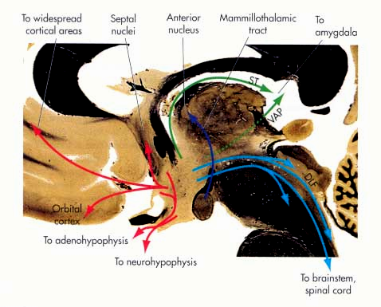
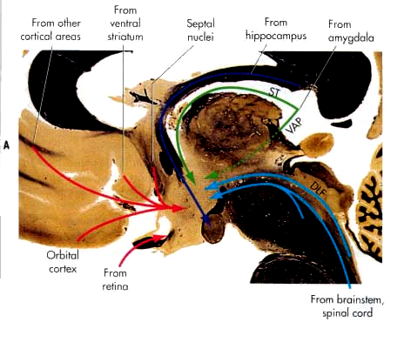
Hypothalamus --connection
Connects with limbic system
Connects with brainstem and spinal cord
Connects with dorsal thalamus
Connects with hypophysis

Slide 37
Hypothalamus --connection
Supraoptic nucleus →supraoptic nucleus (ADH) →supraopticohypophyseal tract →posterior lobe of hypophysis
Paraventricular nucleus → paraventicular nucleus (oxytocin) →paraventriculohypophyseal tract→posterior lobe of hypophysis

Slide 38
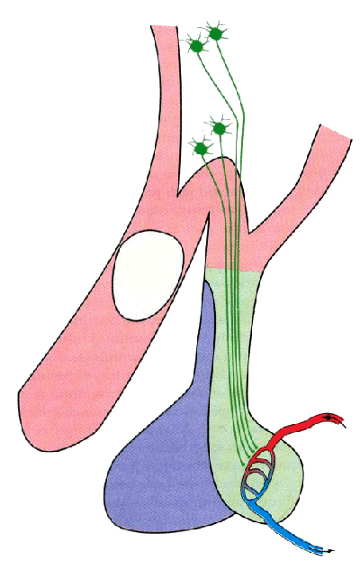
Paraventricular nucleus
Paraventriculohypophyseal tract
Supraoptic nucleus
Supraopticohypophyseal trac
Inferior hypophyseal a.
posterior lobe of hypophysis
Hypophyseal v.

Slide 39
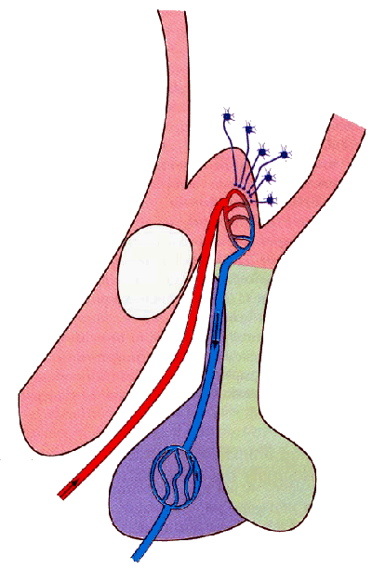
Parvicellular neurons in the arcuate nucleus and nearby region of the walls of the third ventricle secrete releasing and inhibiting hormones → tuberoinfundibular tract →portal vein of hypophsis → anterior lobe of hypophsis
Tuberoinfundibular tract
Median eminence
Portal v.
Superior hypophyseal a.
anterior lobe
Hypophyseal v.

Slide 40
Hypothalamus
Function
Regulates functions of neuroendocrine system
Autonomic nervous system

Slide 41
Third ventricle
Position: a narrow ventricle cleft lies within diencephalons
Boundaries
  Roof: choroids plexus
  Floor: optic chiasma, tuber cinereum, infundibulum and mamillary body
  Anterior: lamina terminalis
  Posterior: continuous with mesencephalic aqueduct
  Lateral wall: dorsal thalamus and hypothalamus
Communication
Third ventricle →mesencephalic aqueduct → fourth ventricle

