Slide 1
HUMAN INFORMATION
PROCESSING SYSTEM
OR
BIOLOGICAL INFORMATION
PROCESSING

Slide 2
Human Perception
Human or biological information processing
uses senses – which include sensors for receiving (but also for producing) signals
which encode information
Perception is a process of understanding sensory information

Slide 3
WHAT ARE THE HUMAN PERCEPTUAL SENSES? - THAT SHOULD BE EASY:
SENSE: INPUT OUTPUT
VISUAL EYES -
ACOUSTICAL EARS VOCAL TRACT
HAPTIC TOUCH/WARM MOTORIC
SMELL NOSE SKIN/BODY???
TASTE TONGUE -
NOTICE THAT: USUALLY MULTIPLE
SENSES OPERATE AT THE SAME TIME. THERE IS
OPERATION ACROSS DIFFERENT SENSES, FOR
EXAMPLE MOTORIC OUTPUT CAN BE A VISUAL
SIGNAL, LIKE HAND WAVING.

Slide 4
BUT SENSES MEAN LITTLE WITHOUT
PROCESSING AND COMMAND CENTER WHICH IS BRAIN
BRAIN+SENSES=PERCEPTUAL SYSTEM
HUMAN SENSES OPERATE IN PERFECTLY COORDINATED WAY, THEY FORM COMPLETELY INTEGRATED SYSTEM
THIS SYSTEM CAN RECEIVE AND PROCESSES MULTIMODAL SIGNALS FROM EXTERNAL WORLD AND PRODUCE MULTIMEDIA OUTPUT SEEMINGLY WITH NO EFFORT

Slide 5
HOW THIS IS DONE IN THE BRAIN WE DON’T KNOW EXACTLY AND IT WOULD BE GOOD TO KNOW THIS:
THE MORE WE THINK ABOUT IT THE MORE WE CONCLUDE THAT HUMANS ARE FANTASTIC MULTIMEDIA ”SYSTEMS”:
WE USE MANY ENCODING LEVELS OF
INFORMATION FROM BASIC TO VERY
ABSTRACT FOR EXAMPLE: SOUNDS,
SPEECH-LANGUAGE, MUSIC
GESTURES, READING, WRITING

Slide 6
THERE ARE GOOD REASONS TO THINK THAT HUMAN SENSORY SYSTEM IS
OPTIMIZED TO PRODUCE AND RECEIVE MULTIMODAL INFORMATION –
BUT OPTIMALITY IS DONE ON MANY
LEVELS :
WE CAN EASILY PRODUCE AND RECEIVE SINGLE MEDIA INFORMATION E.G. WHEN TALKING ON THE PHONE
BUT WE CAN ALSO EASILY DEAL WITH MULTIPLE MEDIA INFORMATION E.G. HAVING DIRECT CONVERSATION AND LOOKING TO FACE EXPRESSION

Slide 7
WHAT IS MULTIMEDIA FROM THE
POINT OF HUMAN PERCEPTION?
REMEMBER THAT WE HAVE MULTIPLE MEDIA INPUTS AND OUTPUTS
MULTIMEDIA MEANS USING MULTIMODAL INFORMATION TO ACHIEVE OPTIMAL STIMULATION
OF PERCEPTUAL SYSTEM
- OFTEN STIMULATION ALSO DEPENDS ON EXTERNAL CONDITIONS

Slide 8
EXAMPLE OF CINEMA: CONDITIONS ARE CREATED FOR OPTIMAL STIMULATION:
THEATER, DARKNESS, SCREEN AND PLAY ACTION +MUSIC
WHAT MEANS OPTIMAL STIMULATION?
IT IS DESCRIBED AS ’CONCENTRATION’,
’FULL INVOLVEMENT’, ’LIVING
EXPERIENCE’ AND CINEMA ILLUSTRATES
THIS. BUT ALSO PLAYING COMPUTER GAMES INDUCES VERY HIGH STIMULATION

Slide 9

MULTIMEDIA TECHNOLOGY AIMS
TO PROVIDE (SOME) MATCHING OF
INFORMATION DEVICES TO HUMAN
PERCEPTION SYSTEM
MULTIMEDIA
SYSTEM:
INTERFACE,
PROCESSING,
DELIVERY OF
INFORMATION
NETWORK

Slide 10
MULTIMEDIA TECHNOLOGY
COVERS:
- INTERFACES
- PROCESSING OF MEDIA
- DELIVERY OF MEDIA
(SYSTEMS AND NETWORKING)
MULTIMEDIA SIGNAL PROCESSING
DEALS WITH ALGORITHMS NEEDED FOR THESE TASKS

Slide 11
FOR EXAMPLE: WE WOULD LIKE TO HAVE COMPUTERS WITH CAMERAS AND
MICROPHONES, SHOWING FACES
ON SCREENS AND WE WOULD
COMMUNICATE WITH THEM LIKE
WITH PEOPLE
THIS IS NOT IMPOSSIBLE, IT IS BECOMING POSSIBLE BECAUSE THE PROCESSING POWER AND COMPUTER INTERFACES ARE GETTING VERY, VERY FAST

Slide 12
SO IMAGINE THAT NOW WITH THE CAMERA AND MICROPHONE ATTACHED AND PERSON ON THE SCREEN WE CAN
IMAGINE WE COULD TALK TO THE PERSON ON SCREEN, THIS PERSON COULD SEE US AND COULD REPLY
IT WOULD BE LIKE TALKING TO
A PERSON ON TV....

Slide 13
... BUT THE PERSON WOULD EXIST
IN THE MACHINE ONLY
THE QUESTION IS:
IS THIS POSSIBLE? HOW?
IS THIS IMPOSSIBLE? WHY?

Slide 14
IF SUCH THING IS DONE IT WOULD BE HUMAN-LIKE MACHINE INTERFACE, IT WOULD NOT BE DIFFERENT FROM
HUMAN-HUMAN COMMUNICATION
TO REALIZE IT WE WOULD NEED
MACHINES WITH CAPABILITIES
OF PROCESSING INFORMATION
SIMILAR TO HUMAN SENSES:

Slide 15
ASSUME THAT WE HAVE A MACHINE
WHICH HAS
CAMERA – ’EYE’
MICRPOHONE – ’EAR’
HOW WE COULD MAKE THAT THIS
EYE AND EAR WOULD FUNCTION
IN A SIMILAR WAY AS HUMAN
EAR AND EYE FUNCTION?

Slide 16
SUCH MACHINES WOULD BE ABLE
TO
- HEAR, SEE, SPEAK
- CONTROL THEIR FACE (OR BODY)
ON SCREEN
BUT, FURTHERMORE, THEY SHOULD BE ABLE TO:
UNDERSTAND EVERYTHING...
MAYBE THINK???

Slide 17
OTHERWISE HUMAN-LIKE DIALOGUE IS NOT POSSIBLE
HOW TO MAKE THIS?
HOW TO MAKE MACHINES TO RECEIVE, UNDERSTAND, PROCESS INFORMATION LIKE HUMAN SENSES DO?
THIS IS HUGE TASK AND WE DO NOT REALLY KNOW HOW TO DO THIS

Slide 18
ASSUME STILL THAT OUR MACHINE HAS A SCREEN AND
THIS SCREEN WE CAN SEE
A PERSON SPEAKING.
THIS PERSON WOULD BE GENERATED BY THE MACHINE,
IT WOULD NOT EXIST IN REALITY
BUT IT WOULD LOOK SO REAL
THAT WE WOULD NOT BE ABLE TO
TELL IT IS NOT REAL

Slide 19
WE TRY TO MAKE SOME STUDY OF THESE PROBLEMS BY REFERRING TO
THE SYSTEMS WHICH ARE DOING THIS –
BIOLOGICAL NERVOUS SYSTEMS
AND ESPECIALLY THE MOST
DEVELOPED ONE – THE HUMAN BRAIN

Slide 20
THERE ARE SOME REASONS WHY
SOME STUDY OF THE (HUMAN) BRAIN CAN BE USEFUL FOR MMSP
- BRAIN IS WORKING SO IT MAY BE
A WORKING MODEL
TO UNDERSTAND BRAIN MAY HELP
BUILD INTERFACE TO IT

Slide 21
SO TALKING ABOUT BRAIN AS AN INFORMATION PROCESSING DEVICE CAN BE PERHAPS USEFUL IN SOME WAYS: INFORMATION IS ACQUIRED BY THE BRAIN,
PROCESSED BY SOME KIND OF ALGORITHMS
AND RESULTS PRODUCED
HOW THIS IS DONE, WHAT KIND OF ALGORITHMS ARE USED? THAT WE DO NOT KNOW, WE ARE TALKING HERE ABOUT UNSOLVED PROBLEMS

Slide 22
WE DO NOT KNOW HOW TO DO THIS ALL PROCESSING
WE EVEN HAVE PROBLEMS WITH
FORMULATING THE PROBLEM WE TRY
TO UNDERSTAND: WHAT KIND OF
PROBLEMS ARE INVOLVED IN THIS.
WE WILL WANT ESPECIALLY TO POINT OUT CERTAIN PUZZLING AND UNSOLVED ISSUES IN HUMAN INFORMATION PROCESSING SINCE THIS MAY HELP IN
THINKING ABOUT ALGORITHMS

Slide 23
SO OUR FIRST QUESTION IS: HOW THE BIOLOGICAL INFORMATION PROCESSING WORKS?
THIS WE KNOW:
IT IS IMPLEMENTED BY THE
NERVOUS SYSTEM.
WHAT IS THE NERVOUS SYSTEM?
IT IS A COLLECTION OF SPECIAL
SENSORS, CELLS AND LINKS

Slide 24
THE SYSTEM HAS ONE CENTER:
IT IS THE BRAIN
THE BRAIN PERFORMS
MOST INFORMATION PROCESSING
FUNCTIONS
HOW THE NERVOUS SYSTEM IS BUILT?

Slide 25
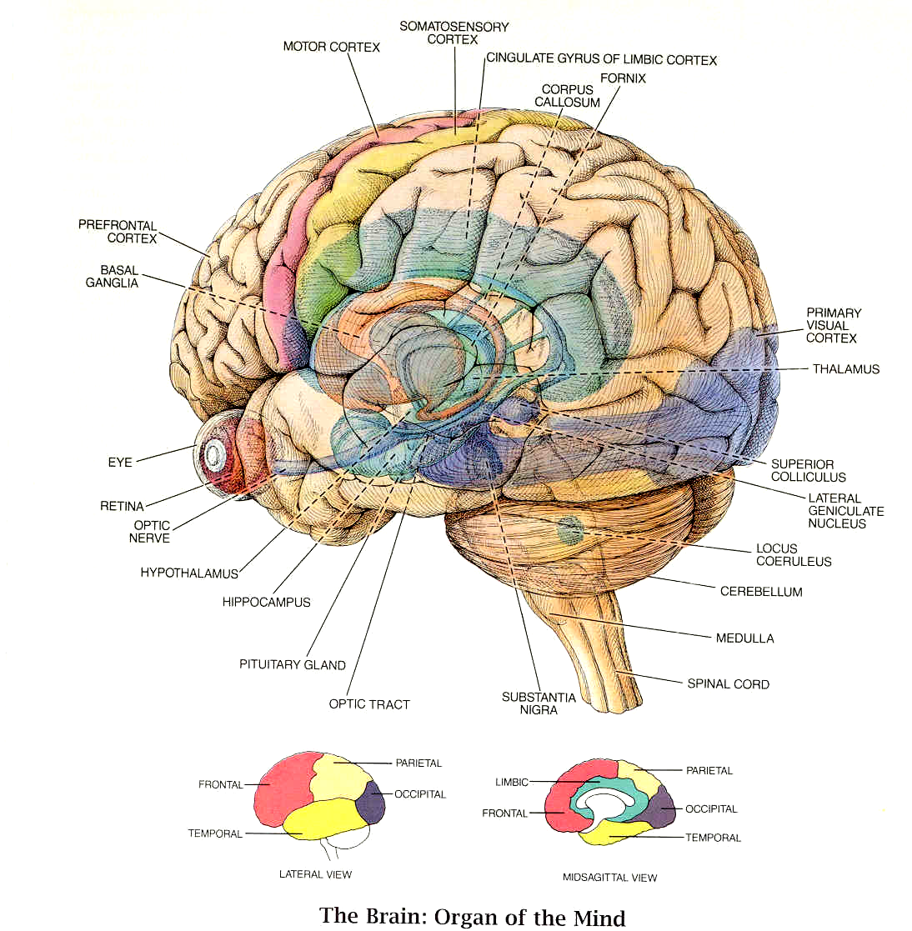

Slide 26
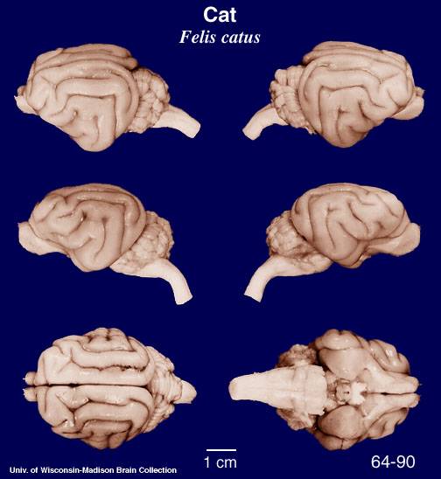
OUR BRAIN IS NOT UNIQUE....

Slide 27

... BUT BIGGER AND....

Slide 28
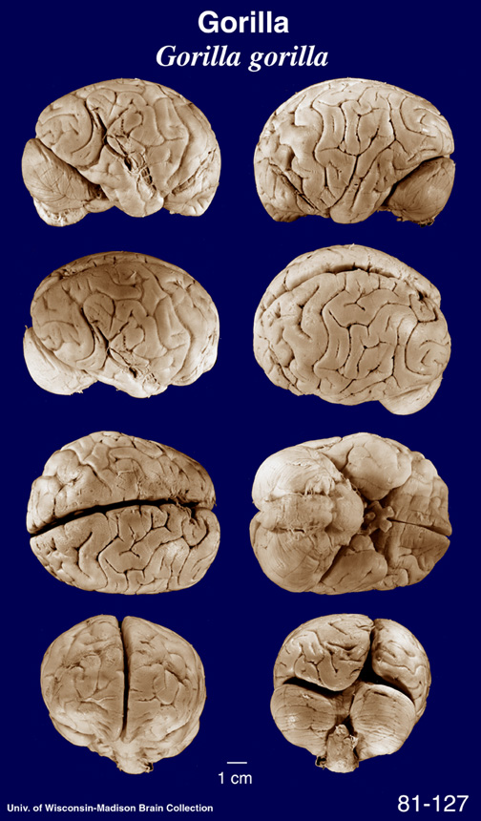
....AND MUCH
MORE COMPLEX
THAN SOME OF
OUR....

Slide 29
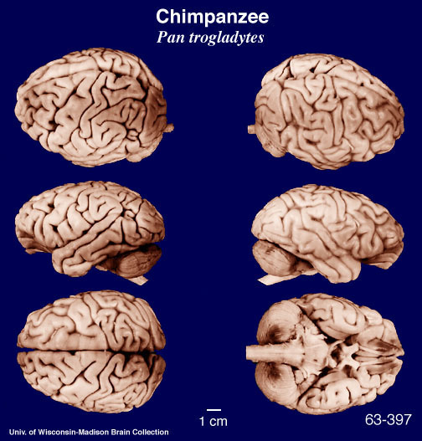
...RELATIVES. AND WE CAN SEE
SOME SIMILARITIES...

Slide 30
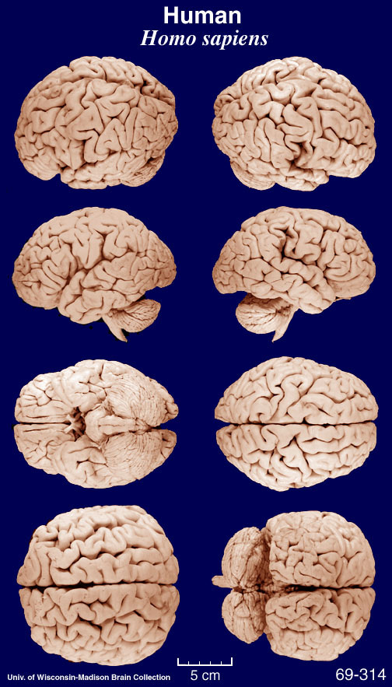
... TO OUR BRAINS....

Slide 31
WHAT IS BRAIN?
COLLECTION OF INFORMATION
PROCESSING & CONTROL SYSTEMS
IT WORKS BY ELECTRICAL AND
CHEMICAL SIGNALLING
IT HAS AMAZING CAPABILITIES
EXTREMELY ADVANCED
PROCESSING (E.G. THINKING...)

Slide 32
THINKING ABOUT THE BRAIN
(THINK ABOUT IT: THE BRAIN THINKS ABOUT ITSELF)
- CAN IT FUNCTIONS BE MODELED
BY MACHINES??? (COMPUTERS?)
IS THERE MAGIC IN ITS FUNCTION
OR IT IS JUST EXTREMELY POWERFUL MACHINE?
- FOR EXAMPLE: CAN MACHINES THINK???

Slide 33
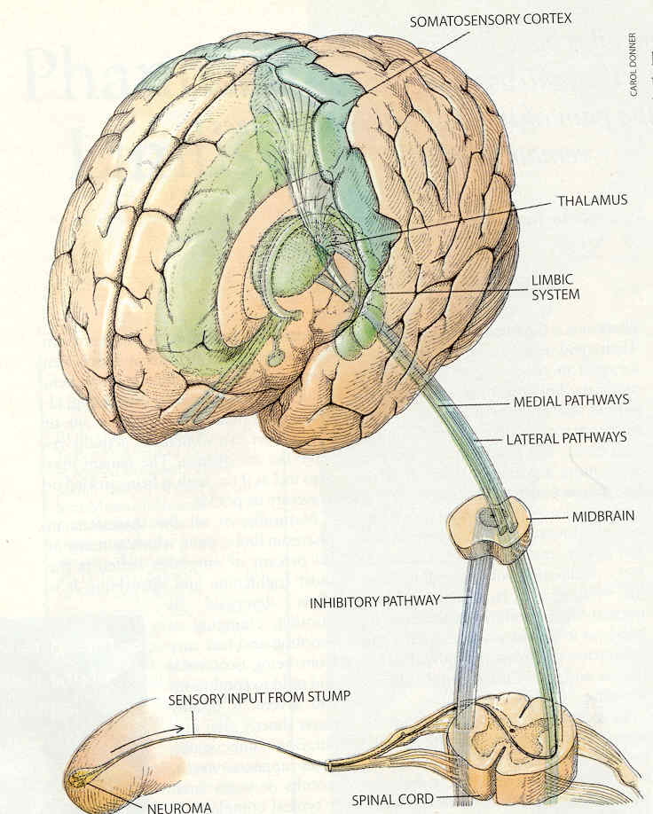
NEURAL PATHWAYS

Slide 34
WE WOULD LIKE TO KNOW HOW
BRAIN DOES ITS PROCESSING
THIS IS VERY DIFFICULT PROBLEM
BUT THERE IS CERTAIN ORGANIZATION
IN ITS WORK
SPECIAL STRUCTURES INVOLVED IN
SPECIALIZED PROCESSING
GENERAL SCHEMATIC OF PATHWAYS
E.G. EXCITATORY INHIBITORY BUNDLES CONNECTING BRAIN WITH
ORGANS (PREVIOUS SLIDE)

Slide 35
WHAT WE KNOW FOR CERTAIN:
THERE IS A LOT OF ELECTRICAL
AND CHEMICAL ACTIVITY IN THE
BRAIN
SUBSEQUENT SLIDES ILLUSTRATE
SOME PATHWAYS FROM THE BRAIN
TO GLANDS AND IMMUNE SYSTEM

Slide 36
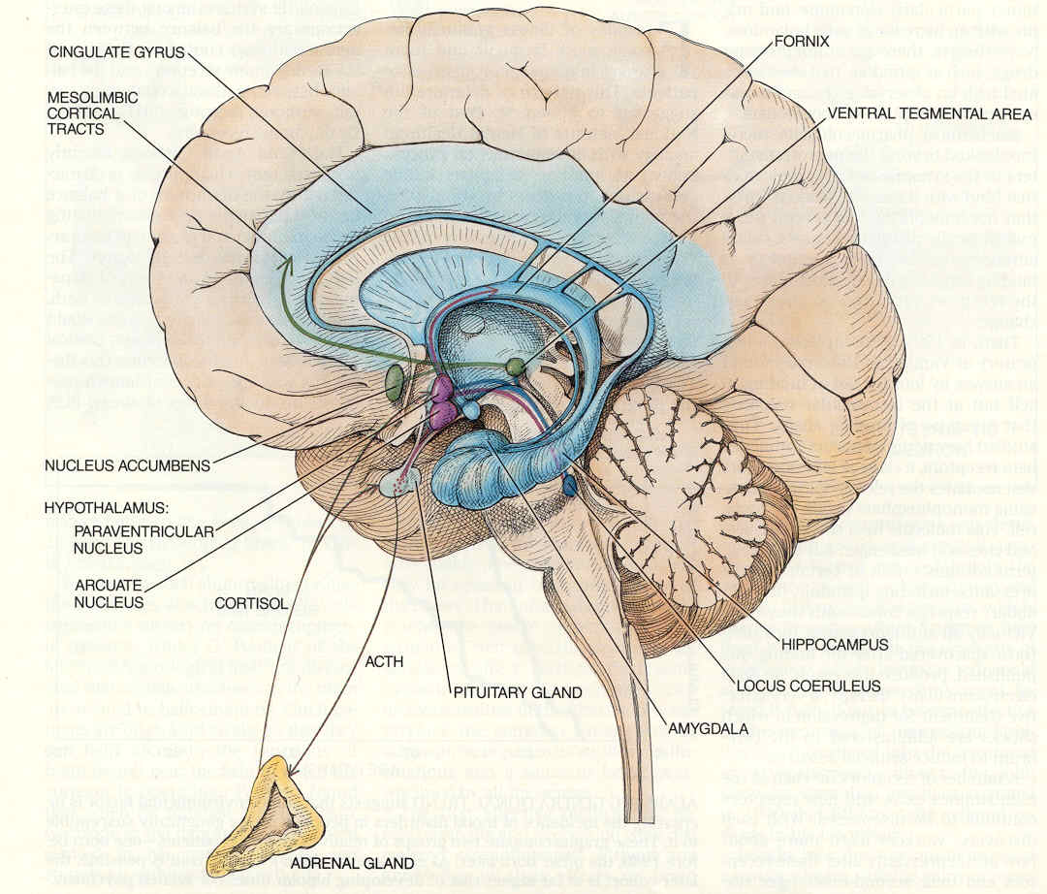
AROUSAL SYSTEM (ADRENALINE)

Slide 37
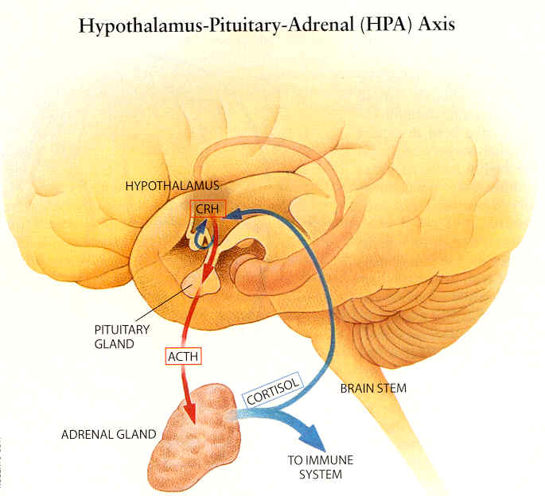
IMMUNE SYSTEM SIGNALLING

Slide 38
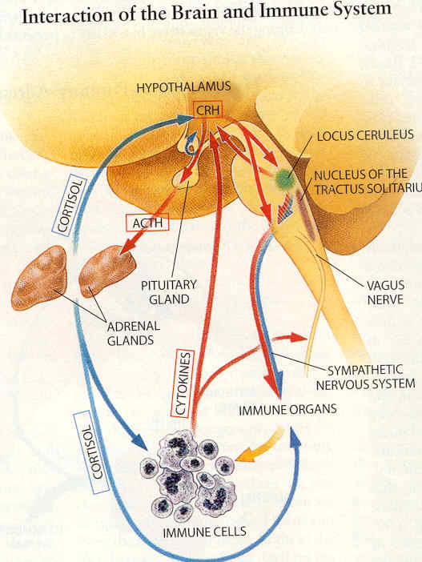
SIGNALLING TO IMMUNE CELL
PRODUCTION
THIS IS MOSTLY
CHEMICAL ACTIVITY

Slide 39
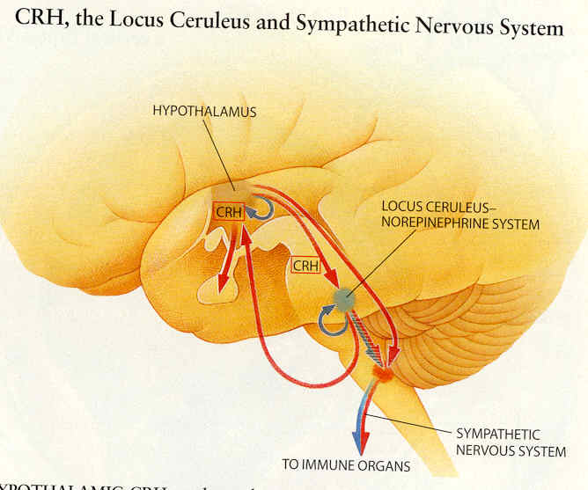
SINGALLING TO IMMUNE SYSTEM

Slide 40
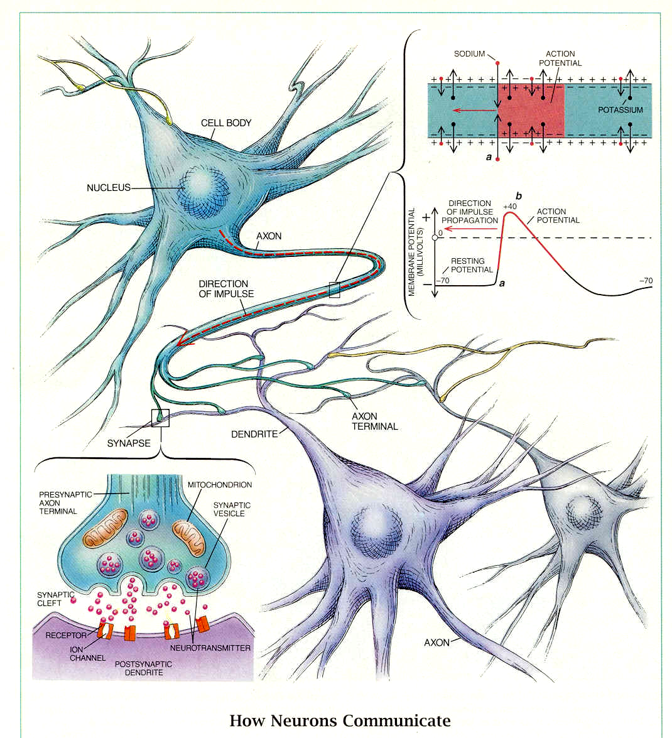
NEURAL CELLS - NEURONS

Slide 41
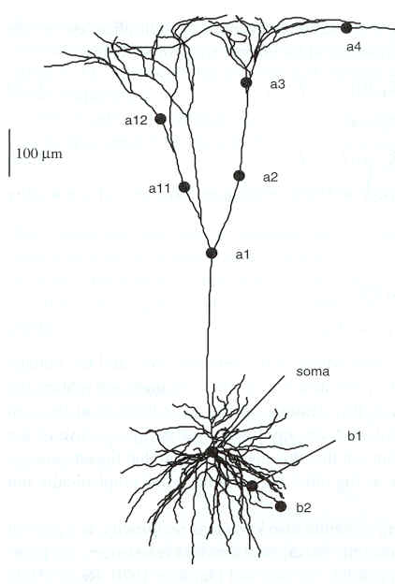
NEURON MAY LOOK LIKE THIS
SPINES
AXON
SOMA
DENDRITES

Slide 42
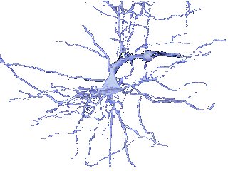
THREE DIMENSIONAL RECONSTRUCTION OF NEURON:
THE SHAPE INDEED LOOKS VERY COMPLEX

Slide 43
THE NERVOUS SYSTEM IS BUILT MAINLY FROM NEURONS. THESE ARE
PROCESSING CELLS, THEY HAVE
FANTASTICALLY COMPLEX SHAPES.
TO THE BODY (SOMA) OF EACH CELLS
ARE COMING INPUTS (DENDRITES)
THERE IS AN OUTPUT (AXON)
THE CELL OPERATES STOCHASTICALLY
REACTING TO INPUTS.
CONNECTIONS BETWEE CELLS (SYNAPSES) ARE CHEMICAL

Slide 44
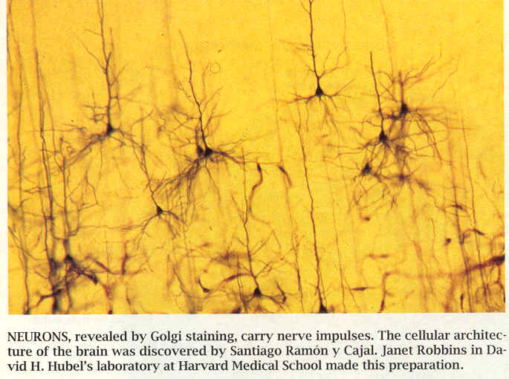
THERE ARE BILIONS & BILIONS
OF NEURONS...

Slide 45
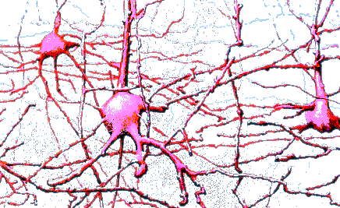
NEURONS FORM INCREDBLE MAZE
A ”FOREST ” OF FANTASTIC FORMS
FOREST MIGHT BE ACTUALLY A GOOD METAPHORE: EACH
TREE IN A FOREST IS DIFFERENT, HAS COMPLEX SHAPE, YET
TREES BELONGING TO SAME SPECIES HAVE VERY DISTINCTIVE
FEATURES AND ARE EASY TO RECOGNIZE

Slide 46
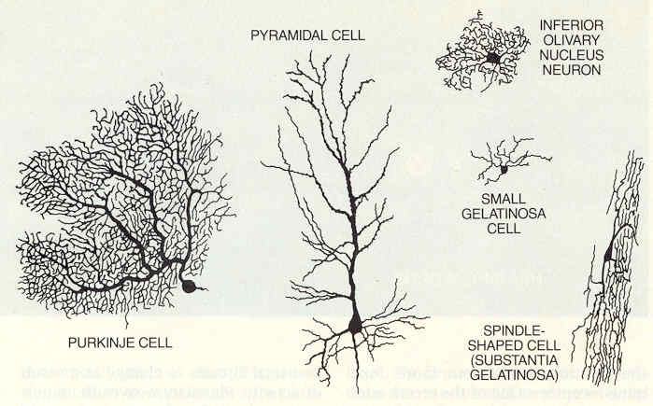
HOW THEY LOOK?
THEY ARE VERY COMPLEX...

Slide 47
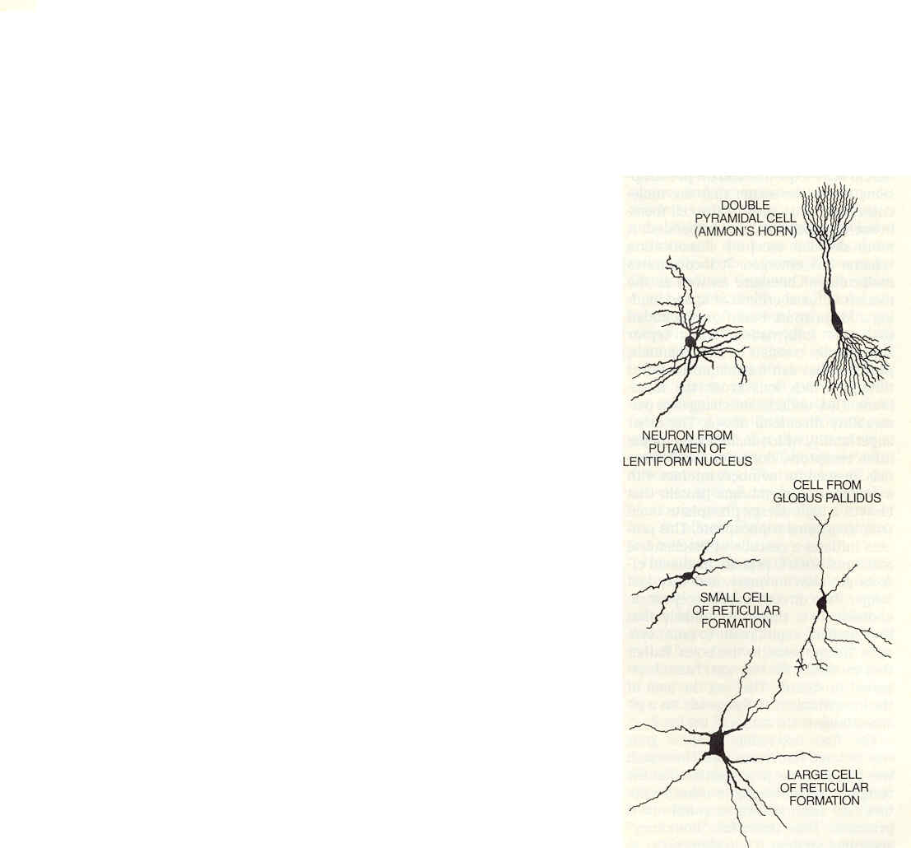

THEY ARE IMMENSLY COMPLEX....
THE NUMBER OF NEURONS IS ESTIMATED AT 10¹¹
THE NUMBER OF
CONNECTIONS
BETWEEN NEURONS
MIGHT BE
10¹⁵ to 10¹⁷

Slide 48
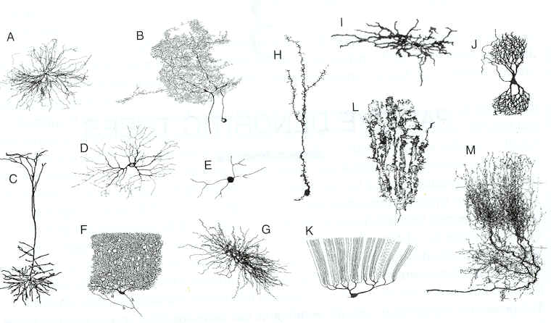
EACH NEURON IS DIFFERENT
BUT THEY BELONG TO CERTAIN
CLASSES – SHAPES ARE SIMILAR

Slide 49
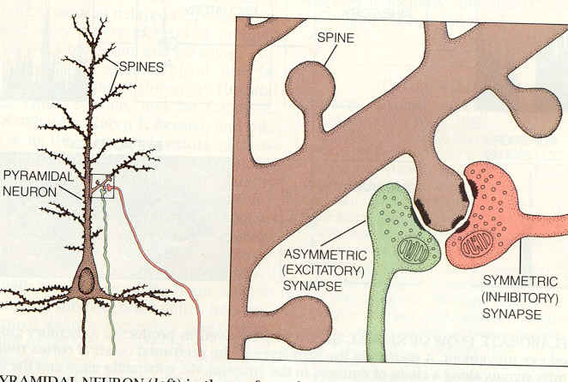
SPINES ARE KIND OF BUMPS ON
DENDRITES/AXONS FOR TRANSMITTING INFORMATION

Slide 50
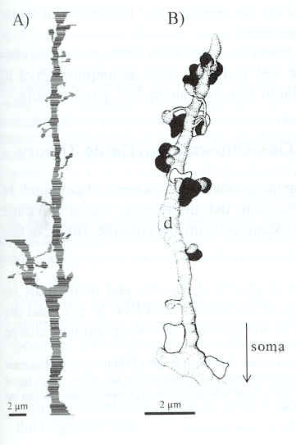
DENDRITES WITH SPINES:
ALL LOOKS VERY IRREGULAR...

Slide 51
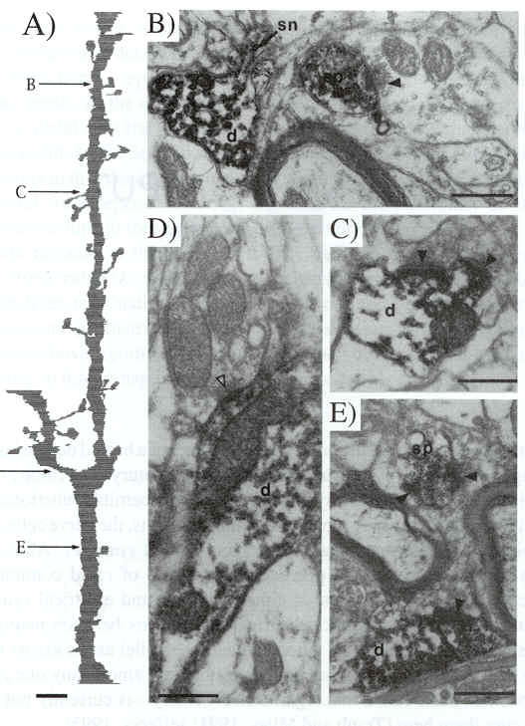
DENDRITES AND SPINES UNDER
MICROSCOPE

Slide 52
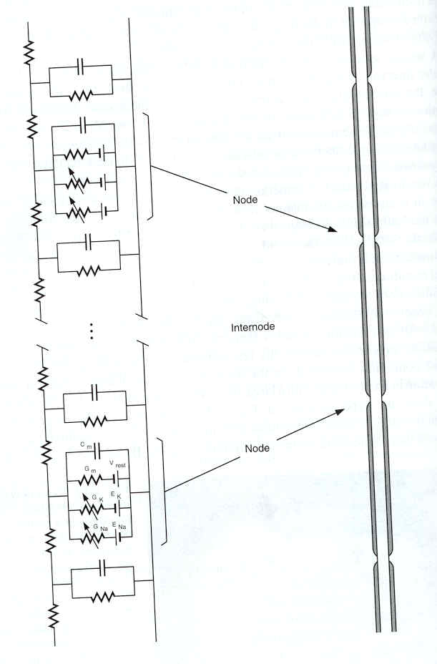
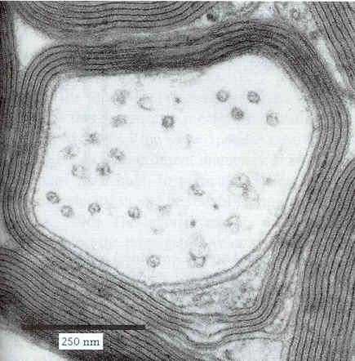
AXON – IT IS
LIKE CABLE
ISOLATING
SHEATH
(MYELIN)
AXON CONDUCTS
ELECTRICAL
PULSES BY COMPLEX
ELECTORCHEMICAL PROCESS
ELECTRICAL
MODEL OF AXON

Slide 53
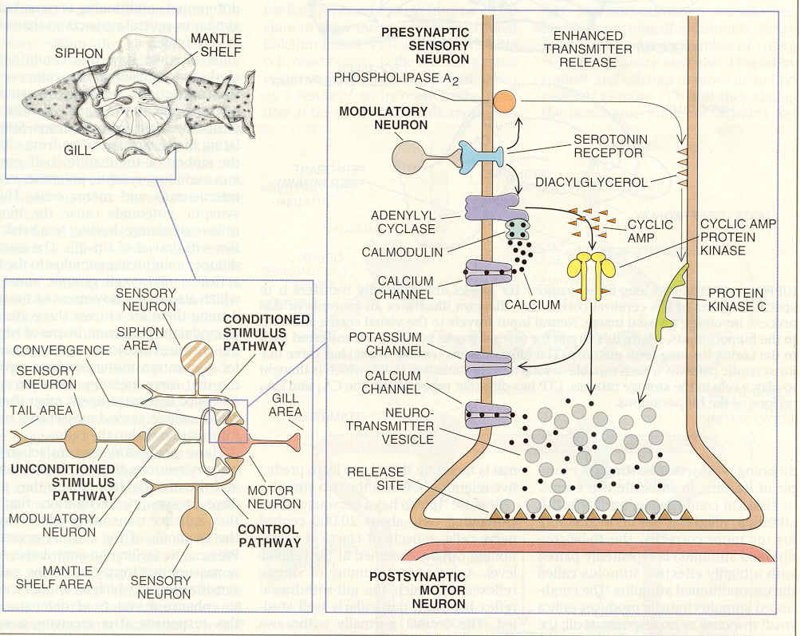
COMMUNICATION BETWEEN NEURONS
SYNAPSE
IT IS A COMPLEX CHEMICAL PROCESS

Slide 54
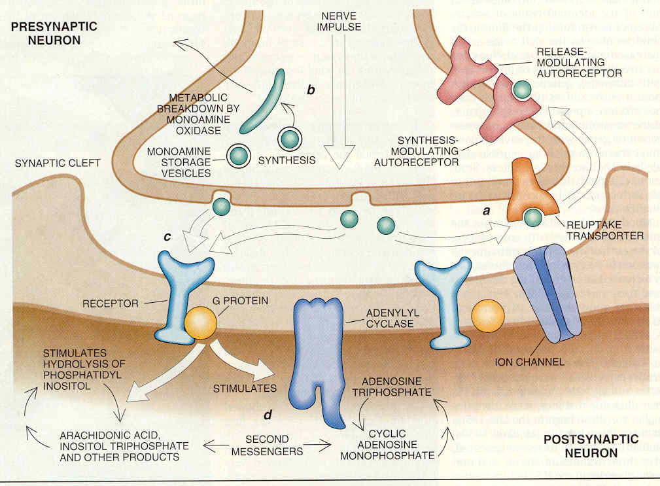
SIGNAL TRANSFER CAN BE MODULATED BY CHEMICALS
(E.G. DRUGS, ALCOHOL)

Slide 55
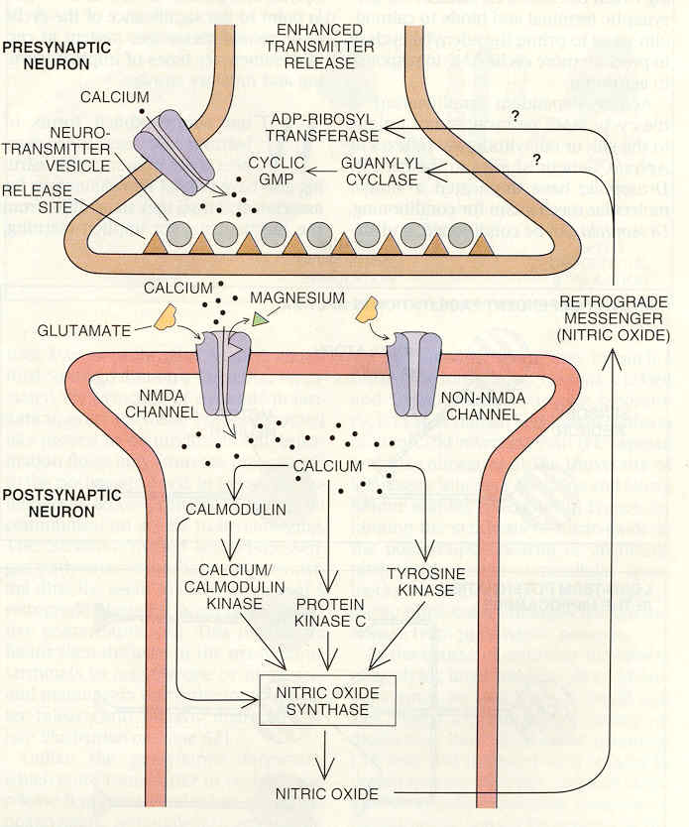
DIFFERENT CHEMICALS
ARE USED
IN DIFFERENT
NEURONS
NEURONS ARE
LIKE SMALL
CHEMICAL
FACTORIES

Slide 56
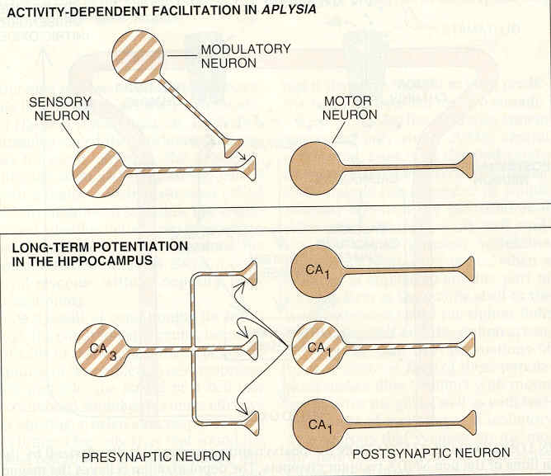
HOW SYNAPSES OPERATE?
THEY ARE EXCITATORY OR
INHIBITORY FOR SIGNALS

Slide 57
SOME NUMBERS:
THE DEPTH OF CORTEX IS 2 MM (HUMANS)
THE AREA IS ABOUT 200 000 MM²
IN ONE CUBIC MILIMETER OF CORTEX
THERE ARE 100 000 NEURAL CELLS AND
70 000 000 SYNAPSES!
AXONS HAVE DIAMETER OF 0.3 μm
THE LENGTH OF AXONS IN 1 MM³ CORTEX IS ABOUT 4100 M AND THE LENGTH OF
DENDRITES IS ABOUT 456 M !!!

Slide 58
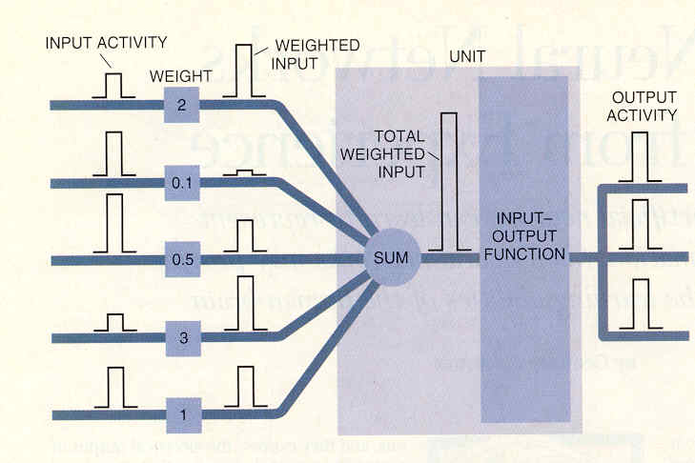
HOW NEURONS OPERATE?
THIS IS VERY COMPLEX QUESTION.
OUTPUT IS TRIGGERRED IF INPUT
IS SUFFICIENTLY HIGH
INPUT IMPULSES
MAY TRIGGER
OUTPUT IF THEIR
SUM IS SUFFICIENTLY
HIGH.
THERE IS ALWAYS
STOCHASTIC ELEMENT
IN OPERATION AND
GREAT VARIABILITY

Slide 59
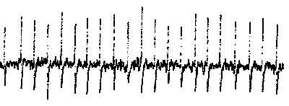
NEURONS EMIT BURTS OF IMPULSES
THEY ALSO HAVE SOME ACTIVITY
WITHOUT EXTERNAL INPUT
sound
THERE ARE GREAT VARIATIONS IN SIGNALLING BETWEEN NEURONS
Please copy soundair.wav file to listen

Slide 60
STRUCTURES IN THE BRAIN
THEY ARE RESPONSIBLE FOR
SPECIFIC FUNCTIONS
WE KNOW THAT GLOBALLY THE
BRAIN IS ORGANIZED INTO MAPS
THAT IS SPECIFIC FUNCTIONS ARE
MAPPED ONTO ITS STRUCTURE

Slide 61
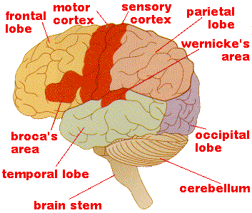
PLEASE NOTE STRUCTURES HERE
MOVEMENTS OF BODY PARTS
TOUCHING BODY PARTS
SPEECH, LANGUAGE
SPEECH, LANGUAGE
BASIC LIFE FUNCTIONS

Slide 62
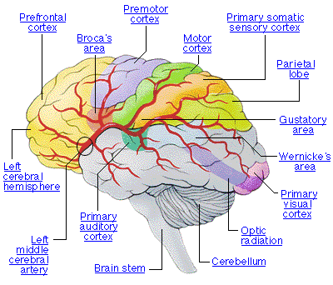
ANOTHER PICTURE OD MAPS

Slide 63
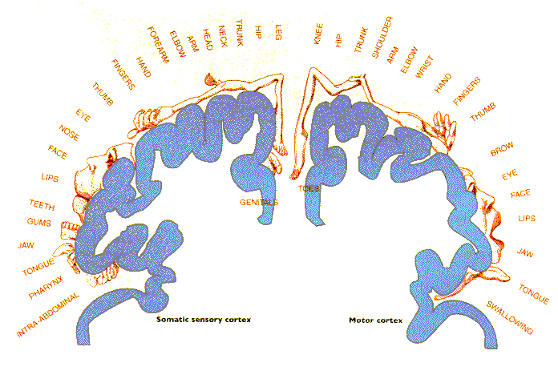
MAPPING OF BODY PARTS

Slide 64
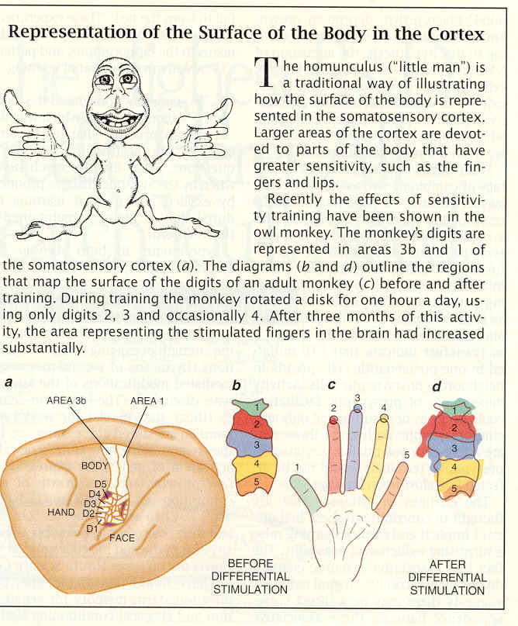

Slide 65
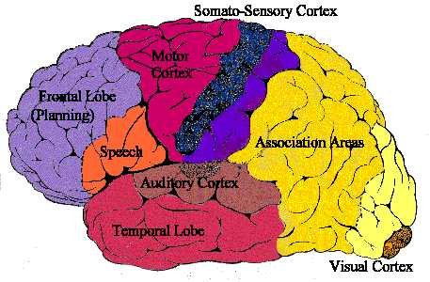
VIEW OF BASIC BRAIN STRUCTURES

Slide 66
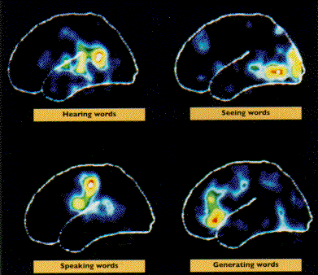
OPERATION OF DIFFERENT MAPS
ACTIVATION PATTERNS WHEN
DEALING WITH WORDS

Slide 67
STRUCTURES IN THE BRAIN
WE ARE VERY INTERESTED ABOUT
THE INFORMATION PROCESSING
FUNCTIONS:
AS A FIRST EXAMPLE TAKE
VISUAL SYSTEM
WHAT IT DOES? ... IT IMPLEMENTS VISION, VISUAL SENSE
HOW DOES IT?... WE KNOW
SOMETHING BUT STILL MISSING
A LOT, FIRST LOOK INTO IT:

Slide 68
FIRST BIG PROBLEM IS WHAT IS VISION?
WE SEE LIKE LIVE CINEMA AROUND
US
BUT WE DO NOT HAVE CINEMA SCREEN
IN OUR HEADS!!! (WHO WOULD WATCH IT?)
WHAT WE HAVE IS A KIND OF PROCESS
WHICH MAPS EXTERNAL WORLD INTO
ITS REPRESENTATION
HOW THIS IS EXACTLY DONE WE DO NOT
KNOW

Slide 69
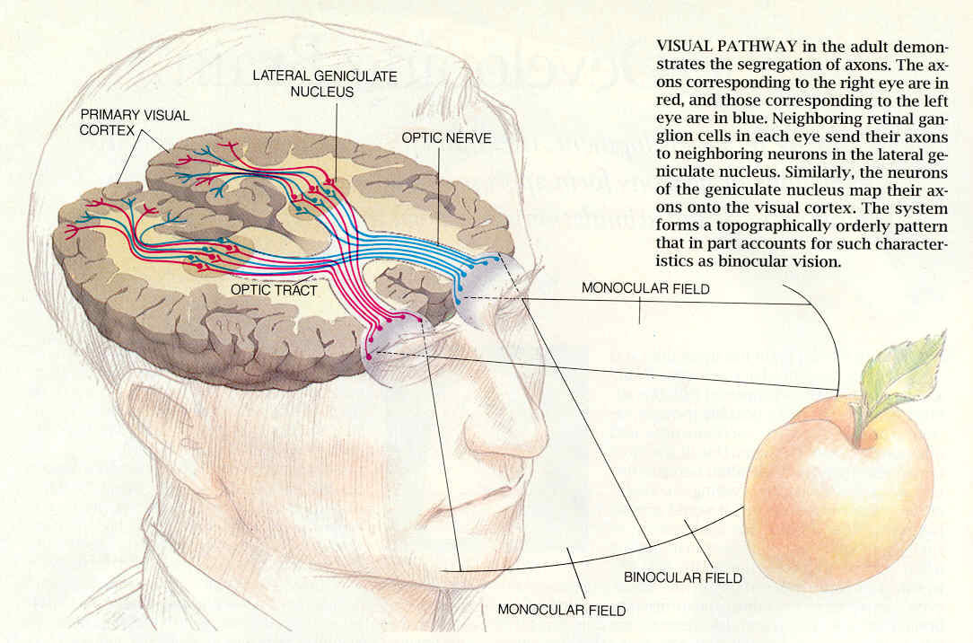
VISUAL PATHWAYS
A WELL ORGANIZED STRUCTURE CAN BE SEEN!
REMEMBER: THE PICTURE PROJECTED BY EYES IS TURNED
UPSIDE DOWN! (BASIC OPTICS)

Slide 70
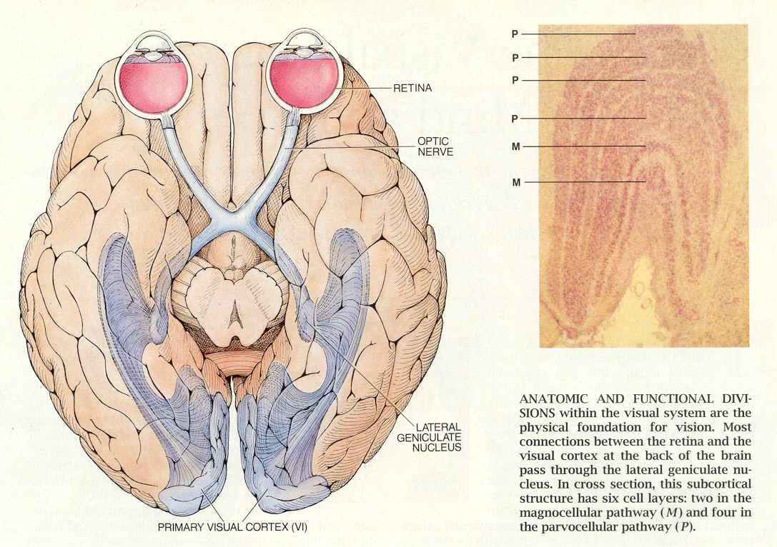
VISUAL SYSTEM
CORTEX
IS LAYERED
STRUCTURE
NEURONS OF
DIFFERENT
TYPES
ARE IN
EACH LAYER

Slide 71
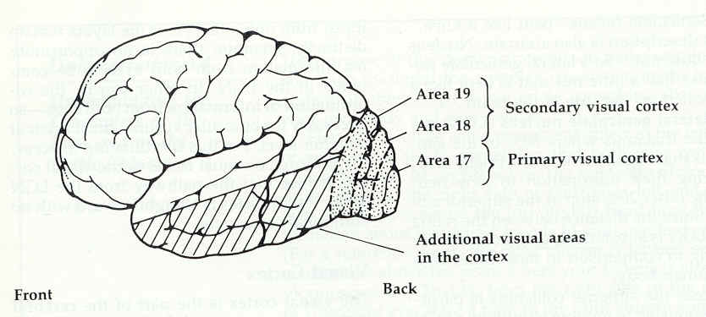
SIDE VIEW, THERE IS A LOT OF PROCESSING IN THOSE AREAS

Slide 72
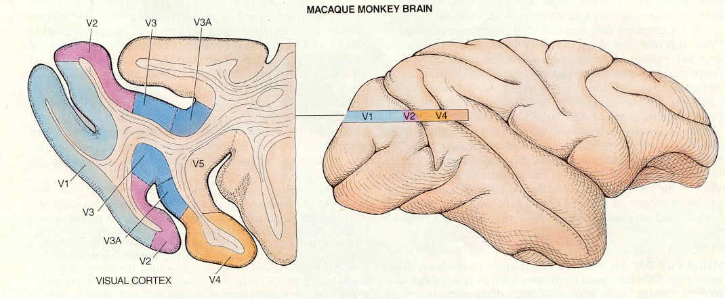
VISUAL CORTEX IS COMPOSED OF
MANY REGIONS
VISUAL CORTEX IS THE MAIN INITIAL PROCESSING STATION FOR VISUAL
SIGNAL. (IN FACT PROCESSING ALREADY TAKES PLACE IN THE RETINA
AND LGN (LATERAL GENICULATE NUCLEUS)

Slide 73
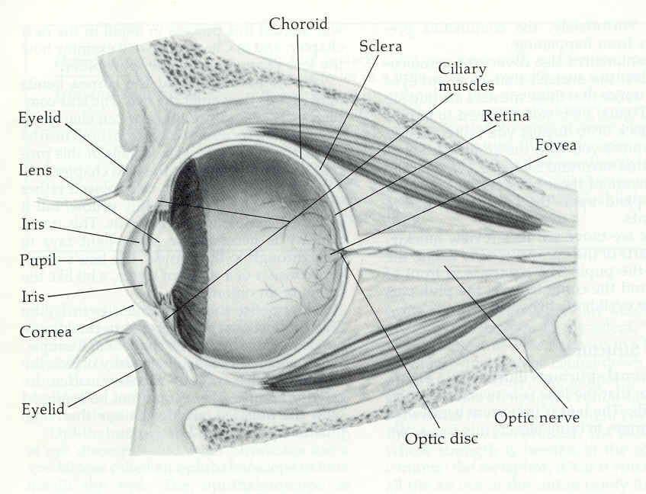
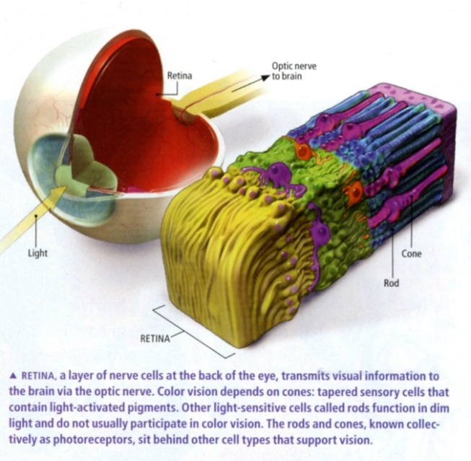
EYE ANATOMY: PICTURE IS PROJECTED ON THE BACK OF THE EYE CALLED RETINA, CONVERTED TO ELECTRICAL
SIGNAL AND SEND VIA OPTIC NERVE

Slide 74
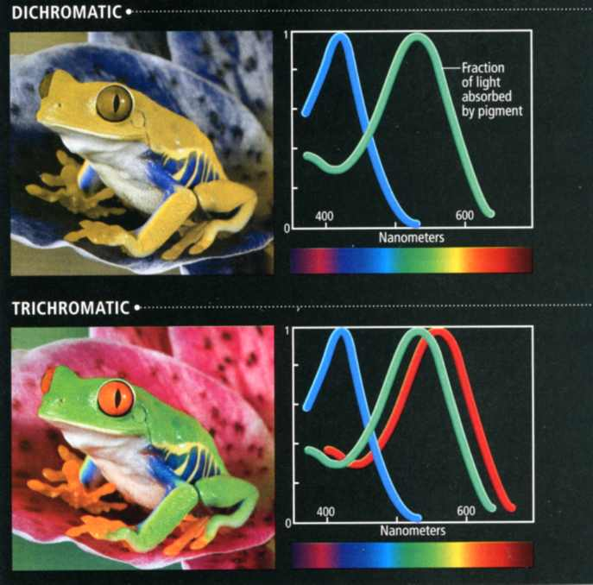
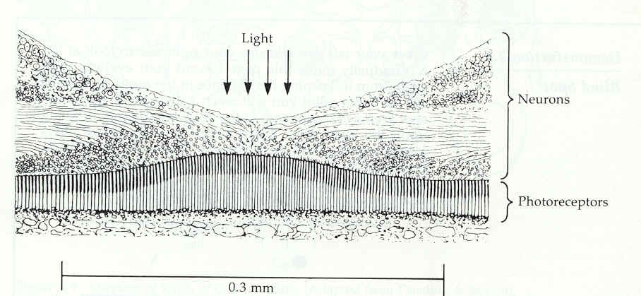
LIGHT SENSITIVE LAYER OF THE EYE IS CALLED RETINA, IN HUMANS IT HAS THREE TYPES OF COLOR RECEPTORS AND BLACK AND WHITE RECEPTORS
MOST VERTEBRATES HAVE ONLY TWO
COLOR RECEPTORS, APES AND PEOPLE
HAVE THREE
NOTICE THAT COLOR SENSITIVITY
CURVES OVERLAP MUCH FOR RED AND
GREEN RECEPTORS

Slide 75
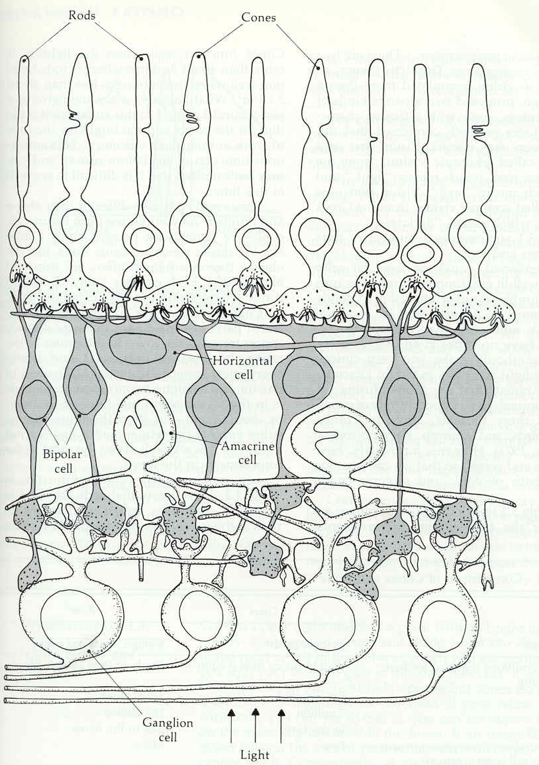
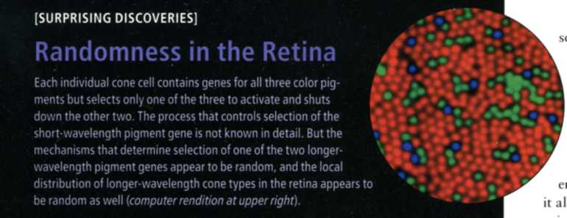
COLOR RECEPTORS ARE
CALLED CONES
BLACK AND WHITE
RECEPTORS ARE CALLED
RODS
THERE IS ALSO PROCESSING
STRUCTURE COMPOSED OF
NEURONS
LIGHT ENTERS RETINA
THROUGH NEURONS!
RECEPTORS ARE AT THE
BOTTOM!
BUT IT IS SURPRISING THAT COLOR
RECEPTORS ARE DISTIRBUTED OVER
RETINA NOT REGULARILY BUT QUITE
RANDOMLY

Slide 76
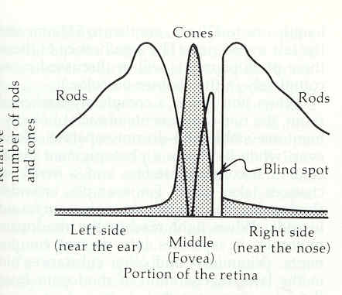
DENSITY OF RODS AND
CONES
RECEPTORS HAVE SOME SURPRISES:
THERE ARE 130 MLN RODS
THERE ARE ABOUT 6.5 MLN CONES
DENSITY OF DISTRIBUTION IS
CHANGING VERY MUCH SEE FIGURE
CONES ARE LOCATED IN THE CENTER
ANOTHER SURPRISE: THERE IS BLIND
SPOT IN THE CENTER THROUGH
WHICH THE OPTIC NERVES BUNDLE
ARE COMING OUT.
THUS WE HAVE A HOLE IN VISUAL
PICTURE BUT WE DO NOT SEE IT !!!
EYES HAVE EXTREMELY WIDE RANGE
OF SENSITIVITY, VERY HIGH LEVEL
ADAPTATION TO LIGHT INTENSITY
CONES OPERATE AT GOD LIGHT
LEVEL, RODS AT LOW LEVEL

Slide 77
WHAT ALL THESE STRUCTURES ARE
DOING?
RETINA:
RODS AND CONES CONVERT LIGHT TO
ELECTRICAL STIMULUS
RETINAL CELLS (GANGLIONS) PROCESS
INFORMATION: HOW?
WE CAN SEE IT:
THEY EXTRACT LOCAL DIFFERENCES
IN LIGHT LEVEL

Slide 78
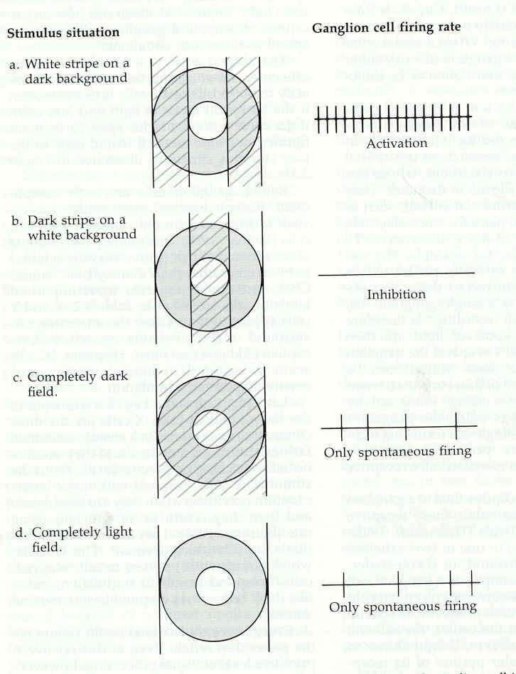
HERE WE CAN SEE GANGLION
CELL WHICH FIRES WHEN WHITE
STRIP ON DARK BACKGROUND
IS OVER ITS RECEPTIVE FIELD
FOR THIS CELL DARK STRIP ON
WHITE BACKGROUND INTRODUCES
STRONG INHIBITION
COMPLETELY DARK OR WHITE
FIELD MAKES SOME
SPONTANTANEOUS FIRING

Slide 79
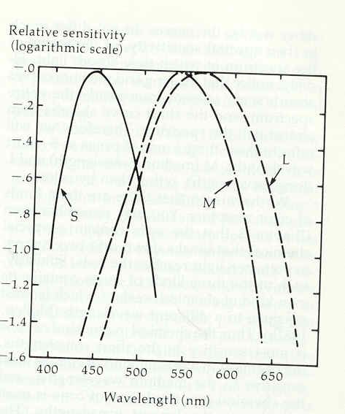
COLOR INFORMATION PROCESSING
RECEPTOR SENSITIVITY TO DIFFERENT
WAVELENGTHS OF LIGHT, THERE ARE
THREE TYPE OF RECEPTORS

Slide 80
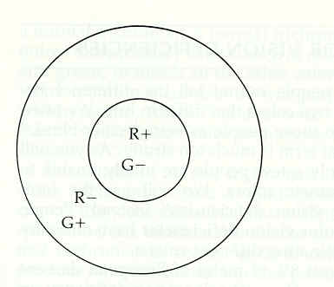
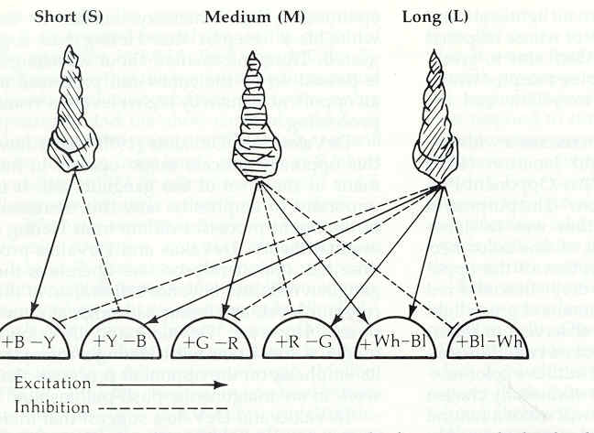
HOW THE COLOR
INFORMATION
IS PROCESSED;
SIGNALS
FROM COLOR
RECEPTORS
ARE PROCESSED
IN DIFFERENTIAL
WAY, COLOR
DIFFERENCES
ARE FORMED

Slide 81



HERE WE HAVE INTERESTING SIGNAL PROCESSING QUESTION: WHY COLOR INFORMATION IS PROCESSED IN THIS WAY?
REMEMBER THE PLOT OF LIGHT SENSITIVITY OF RECEPTORS?
THE CURVES OVERLAP, IT WOULD BE DIFFICULT TO JUDGE
ABOUT COLOR FROM SINGLE RECEPTOR.
IF ALL THE DIFFERENCES ARE TAKEN THEN THIS CAN BE DONE
ANOTHER PROBLEM: WE CAN GENERATE ANY COLOR FROM A MIXTURE OF BLUE,
GREEN AND RED – BECAUSE WE HAVE RECEPTORS ONLY FOR THEM. BUT WHICH
COLOR WILL BE RELATIVELY MOST DIFFICULT TO GENERATE? YELLOW, BECAUSE
IT IS A MIXTURE OS SIGNALS FROM TWO RECEPTORS LYING BETWEEN THEM. ALSO
ORANGE COLOR MAY BE DIFFICULT.
SOLUTION TO THIS PROBLEM? USE YELLOW SUBPIXEL TO GENERATE YELLOW COLOR
IN 2010 SHARP COMPANY DEMONSTRATED TV PANELS WITH
YELLOW SUBPIXEL. IT IS NOT KNOWN YET HOW VISIBLE IS
IMPROVEMENT IS COLOR REPRODUCTION

Slide 82
FROM OUR EYES THERE ARE NOT
TRANSMITTED SIGNALS ABOUT LIGHT
LEVEL – ONLY ABOUT LIGHT DIFFERENCE LEVELS
OUR EYES CONSTANTLY MOVE, THIS IS SO CALLED SACCADIC MOVEMENT, SLIGHT TREMOR + JUMPS OVER VISUAL FIELD. THIS
PRODUCES CONSTANT CHANGES IN LIGHT LEVEL OVER RETINA
WHEN EYE IS STABILIZED, E.G. BY PARALYZING EYE MUSCLES AND STABILIZING
HEAD, PICTURE DISAPPEARS !!! THEN, MOVING
OBJECTS CAN BE SEEN, THEY POP OUT SUDDENLY

Slide 83

WHAT ARE THE CORTICAL CELLS
DOING? THERE ARE SEVERAL LAYERS
OF THEM. THEY SIGNAL ABOUT FEATURES IN SMALL LOCAL AREAS
OF PICTURES

Slide 84

HERE IS AN EXAMPLE OF A CELL
SIGNALLING FOR VERTICAL LINE
SIGNAL STRENGTH DEPENDS ON THE
ORIENTATION OF THE BAR:

Slide 85

THE STRUCTURE OF THE VISUAL CORTEX HAS BEEN MAPPED
WE CAN SEE THAT FOR EACH SMALL AREA OF VISUAL FIELD THERE IS A STRCUTURE WHICH
RESPONDS FOR ORIENTATION OF LINES AND SMALL FEATURES THIS STRUCTURE IS
REPEATING ALL OVER THE VISUAL FIELD. THE STRUCTURE IS INTERLEAVED FOR LEFT AND RIGHT EYE

Slide 86
SIMILAR STRUCTURE EXISTS IN
THE LGN BUT NOT FOR ORIENTED FEATURES, ONLY FOR CHANGES IN LOCAL LIGHT INTENSITIES
THUS,
RETINA DETECT AND CONSTRUCT
LGN FROM LOCAL LIGHT
CORTEX INTENSITIES SMALL
FEATURES OF THE WORLD
BUT WE SHOULD ALWAYS REMEMBER
THAT THIS IS SIMPLIFIED PICTURE

Slide 87
THERE ARE VERY MANY AREAS IN THE
CORTEX PROCESSING DIFFERENT ASPECTS OF VISUAL INFORMATION
THE PRINCIPLE SEEMS TO BE
SEGREGATION: DIFFERENT FEATURES
ARE DEALT WITH IN DIFFERENT AREAS:
LINES THE STRUCTURES WHICH
BLOBS DEAL WITH THESE FEATURES
COLOR ARE INTERCONNECTED AS
MOTION SEEN ON NEXT PAGE

