Slide 1
Learning for Control from
Multiple Demonstrations
Adam Coates, Pieter Abbeel, and Andrew Y. Ng
Stanford University
ICML 2008
TexPoint fonts used in EMF.
Read the TexPoint manual before you delete this box.: AAAAA

Slide 2
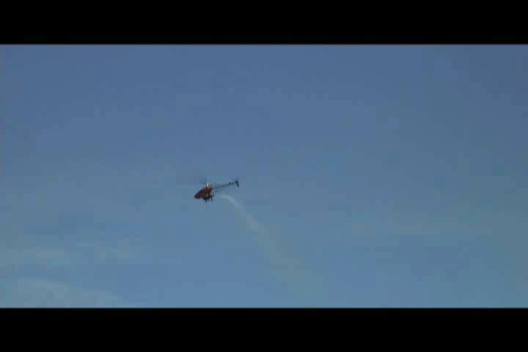
Motivating example
How do we specify a task like this???
Notes:
I want to start off with a motivating example.
About a year and a half ago, we were working on getting our autonomous helicopter to perform expert-level aerobatics.
In our previous work we managed to perform some challenging aerobatic maneuvers, like flipping the helicopter over in place, and flying at high speeds.
It took some time to get things right, but we could achieve pretty reasonable performance on these tasks.
{play video}
Then we wanted to do a new maneuver---and this maneuver is called tic-toc.
So we spent several weeks working on this maneuver, trying to specify this trajectory by hand and fly it using our existing approach.
But we kept running into the same problem. It’s actually very hard to articulate just how the helicopter should behave during this maneuver.
Now, maybe, if we spent enough time, we could have come up with a trajectory that worked---but if we expect to solve autonomous aerobatics soon,
It seemed like we needed a much more automated procedure.

Slide 3
Introduction
Data
Dynamics
Model
Trajectory +
Penalty Function
Reward
Function
Reinforcement
Learning
Policy
We want a robot to follow a desired trajectory.
Notes:
Trajectory following is really a common task in robotics---not just with helicopters.
A standard way to approach this problem is to use model-based reinforcement learning.
(1) Here, we first, use data collected from our robot to build a dynamics model.
(2) And then we specify a reward function that encodes the task to be performed.
In our case, the task is specified by a trajectory, and some penalty function that penalizes deviations from the trajectory.
(3)(4) These we use a reinforcement learning algorithm to compute a policy for accomplishing the task.
(5) In this talk, we will focus primarily on how to obtain a good trajectory for the reward function, which turns out to be as important, and often more important than the particular choice of penalty.
(6) But if we expect to actually fly these trajectories we’ll need a good dynamics model. We’ll see later, though, how working with trajectories can help us solve this problem.

Slide 4
Key difficulties
Often very difficult to specify trajectory by hand.
  Difficult to articulate exactly how a task is performed.
  The trajectory should obey the system dynamics.
Use an expert demonstration as trajectory.
  But, getting perfect demonstrations is hard.
Use multiple suboptimal demonstrations.
Notes:
Unfortunately, it can be very difficult to specify the trajectory by hand.
(1) We may not be able to really explain how task is performed.
(2) Trajectory should obey the true system dynamics. Not strictly necessary, but it makes control more difficult otherwise.
(3) We had this idea: one way to satisfy these requirements is to use an expert demonstration.
(4) but, getting a perfect demonstration is far from easy.
After watching several suboptimal demonstrations though, it becomes very clear to a human spectator---even a spectator with no knowledge of helicopters---what the expert intended to do.
(5) So, maybe, if we use multiple demonstrations, even suboptimal ones, we can create an algorithm that extracts the trajectory that the expert was trying to demonstrate.

Slide 5
Outline
Generative model for multiple suboptimal demonstrations.
Learning algorithm that extracts:
  Intended trajectory
  High-accuracy dynamics model
Experimental results:
  Enabled us to fly autonomous helicopter aerobatics well beyond the capabilities of any other autonomous helicopter.
Notes:
So, how do we do this…?
(1) First, we’re going to propose a generative model for the suboptimal demonstrations provided by our expert.
(2) We will give a learning algorithm that not only extracts the underlying intended trajectory, but also allows us to build an accurate dynamics model for control.
(3) We have applied this algorithm to our autonomous helicopter, and it has allowed us to fly aerobatic maneuvers well beyond the previous state-of-the-art.
Although we’ll be using the helicopter as our running example throughout the talk, I want to emphasize that this algorithm is just as applicable to other robots.

Slide 6
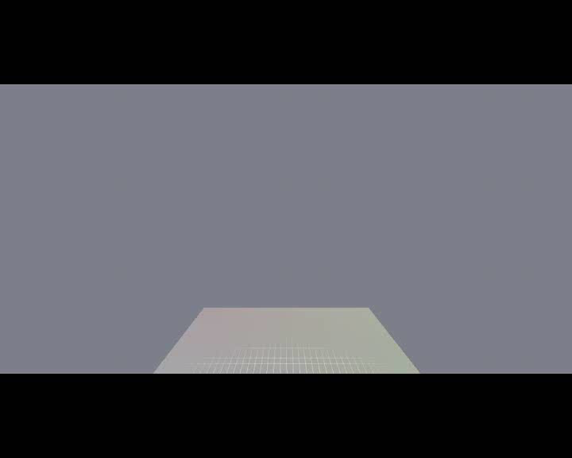
Expert demonstrations: Airshow
Notes:
So, here is what our demonstration data looks like.
We asked our human pilot to fly our helicopter through the same aerobatic sequence several times.
And you’ll notice some clear suboptimalities; they’re all flying different paths, and at different speeds.
But even though they’re all different, you can clearly see that there is some intended trajectory that the pilot is trying to follow.

Slide 7
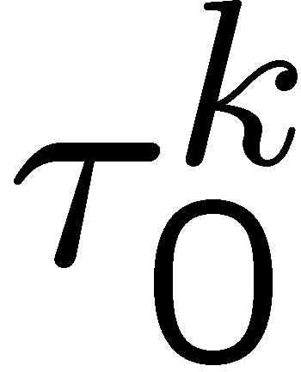

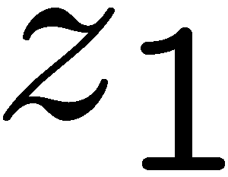
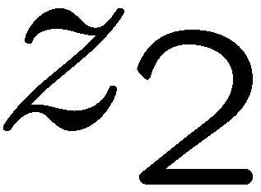
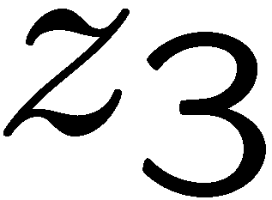
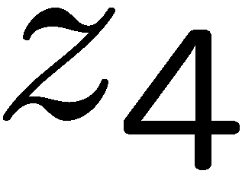
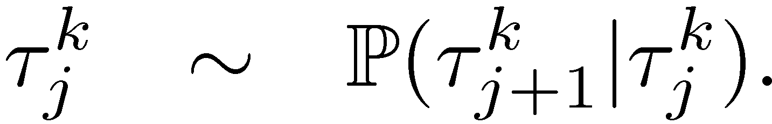
Graphical model
Intended trajectory
Expert demonstrations
Time indices
Intended trajectory satisfies dynamics.
Expert trajectory is a noisy observation of one of the hidden states.
  But we don’t know exactly which one.
Notes:
To address these problems, we’re first going to propose a generative model for the expert’s suboptimal demonstrations.
We assume that that is some “hidden” intended trajectory, represented here by the variables ‘z’
(1) and that this trajectory follows a nonlinear dynamical system with gaussian noise.
(2) We also have a sequence of states from each expert demonstration, which we model as independent observations of one of the hidden trajectory states.
(3) Unfortunately, we don’t know _which_ hidden state corresponds to each of the demonstration states because the demonstrations occur at different rates.
So, we assume that there is some unknown set of time indices, the taus, that match these observations to the hidden states.
For instance, y1 could be an observation of z1, z2, or z3. And the variable tau1 tells us which of these is the case.

Slide 8
Learning algorithm
Similar models appear in speech processing, genetic sequence alignment.
  See, e.g., Listgarten et. al., 2005
Maximize likelihood of the demonstration data over:
  Intended trajectory states
  Time index values
  Variance parameters for noise terms
  Time index distribution parameters
Notes:
(1) We note that this type of model appears in other fields. For instance, speech recognition, and genetic sequence alignment. And while the details of our inference algorithm differ slightly, there are some existing inference methods for models of this kind.
One example is the work of Listgarten, et. al., though the particulars there are somewhat different because they are working in a different setting.
As is common, we use a maximum likelihood approach where
we maximize the likelihood of all the demonstration data over
the intended trajectory states
the time index values
the variance parameters for the gaussian noise terms,
and the distribution parameters for the time indices

Slide 9
Learning algorithm
If ¿ is unknown, inference is hard.
If ¿ is known, we have a standard HMM.
Make an initial guess for ¿.
Alternate between:
  Fix ¿. Run EM on resulting HMM.
  Choose new ¿ using dynamic programming.
Notes:
How do we do this?
First, looking back at our model, we can see that inference when the time indices, \tau, are unknown inference is difficult because there are a large number of dependencies.
On the other hand, if we know the time indices then the model is simpler.
For instance, if we know that y1 corresponds to the intended state z2, then we don’t have to consider the direct dependence between z1 and y1, or z3 and y1.
In this case we just have a standard hidden markov model for a nonlinear-gaussian system.
So we use an alternating procedure.
We start out with a guess for tau.
Then we run EM on the resulting HMM to find the intended trajectory and distribution parameters.
And then we choose a new value for tau using a dynamic programming algorithm.
We give details for both of these steps in the full version of the paper on our website.

Slide 10
Details: Incorporating prior knowledge
Might have some limited knowledge about how the trajectory should look.
  Flips and rolls should stay in place.
  Vertical loops should lie in a vertical plane.
  Pilot tends to “drift” away from intended trajectory.
Notes:
It would be nice if we could incorporate the expert’s advice into our trajectory learning.
Some of this knowledge is very specific in nature:
We know that loops should look flat when you view them from the edge,
And we know that flips and rolls should stay roughly in place.
But some of it is more dynamic. For instance, we know that the pilot tends to “drift”
away from the intended trajectory slowly over time.
Because we have a very rich model representation we can actually incorporate this knowledge to improve the trajectories,
And we give examples of how to do that in the paper.

Slide 11
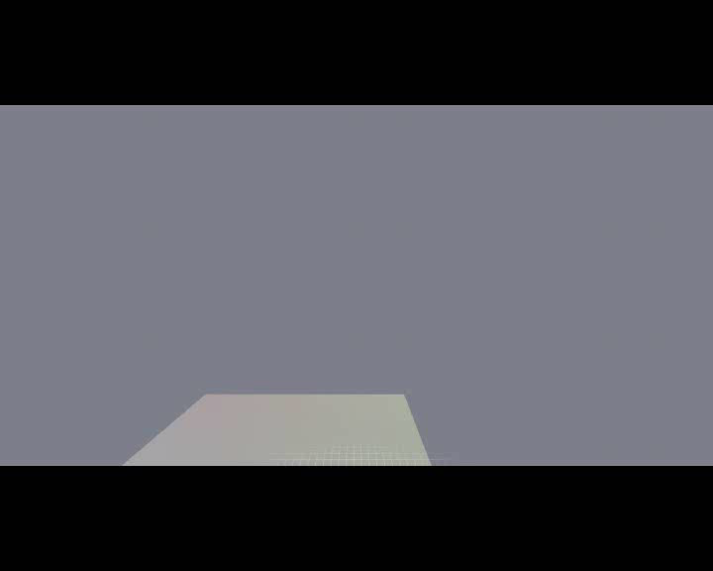
Results: Time-aligned demonstrations
White helicopter is inferred “intended” trajectory.
Notes:
(start video)
So, what does the result look like?
The white helicopter is the resulting inferred trajectory that we think is the expert’s intended trajectory.
The demonstrations here are the same as before, but now they’re being shown after time-warping them to match up with the intended trajectory, which is shown in white. You can do this using the time indices computed by the algorithm.
You can see that the white trajectory really does capture what we might intuitively describe as the “typical” or “intended” behavior of these trajectories.

Slide 12
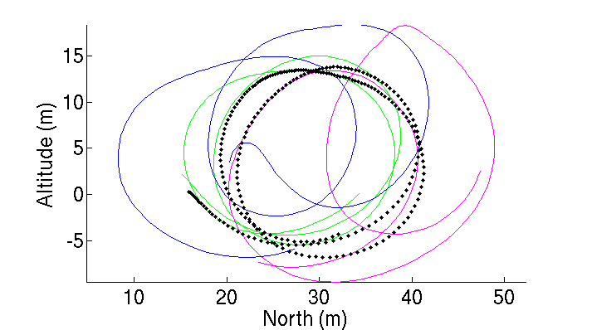
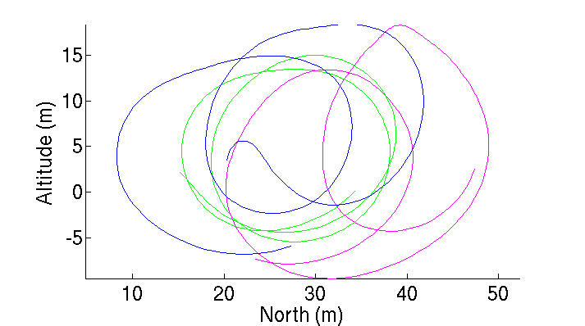
Results: Loops
Even without prior knowledge, the inferred trajectory is much closer to an ideal loop.
Notes:
Here’s a plot of the loops that were flown by our pilot (only 3 are shown).
(1) And here’s what the algorithm gives as the most likely intended path.
No prior knowledge of the loop’s structure was used, but you can see that the inferred trajectory is much closer to an ideal loop.

Slide 13
Recap
Data
Dynamics
Model
Trajectory +
Penalty Function
Reward
Function
Reinforcement
Learning
Policy
Notes:
So, let’s go back now.
We’ve just presented an algorithm for extracting a good trajectory that we can use for our reward function.
But if we actually want to fly this trajectory, we need to have a good dynamics model.

Slide 14
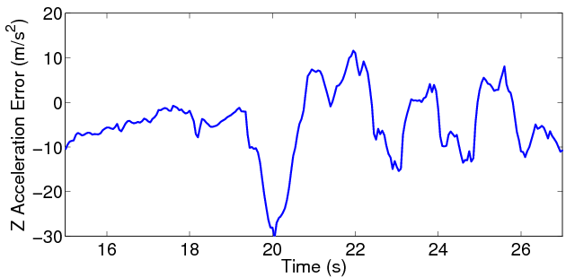
Standard modeling approach
Collect data
  Pilot attempts to cover all flight regimes.
Build global model of dynamics
3G error!
Notes:
So, what’s the standard approach to getting a model.
First, we typically have our pilot fly the helicopter and perform frequency sweeps.
This is a maneuver where the pilot sweeps the controls back and forth to gather data from different parts of the flight regime.
Then we use off-the-shelf machine learning algorithms to build a global model of the helicopter dynamics.
(1) The question is: how good is this model for the maneuvers that we’re trying to fly.
Here’s a plot that explains.
Each of these lines corresponds to one of the airshow demonstrations that you saw earlier.
On the horizontal axis is time.
And the vertical axis is the amount of error that our model makes in predicting the vertical acceleration of the helicopter.
Unfortunately, you can see that it doesn’t do very well. In fact, you can see that we often make prediction errors in excess of 2Gs.
We might be able to tolerate such errors for a short time, but certainly not throughout the trajectory.

Slide 15
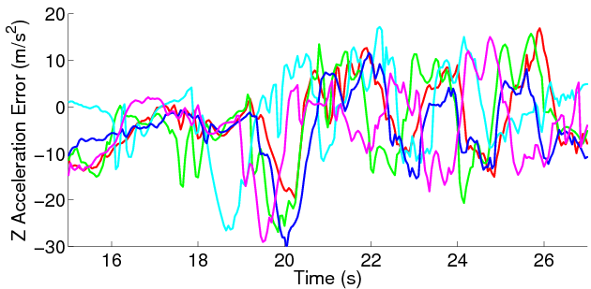
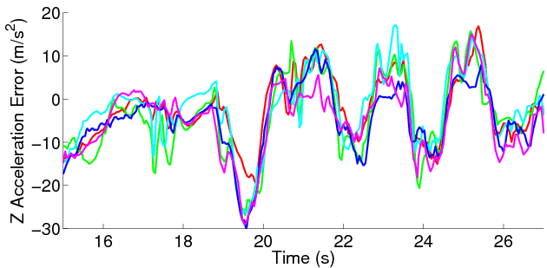
Errors aligned over time
Errors observed in the “crude” model are clearly consistent after aligning demonstrations.
Notes:
But if we look back at these model errors after running our learning algorithm, we can see something interesting.
Once we’ve aligned the demonstration data we can see that the errors are actually very consistent over time.

Slide 16
Model improvement
Key observation:
  If we fly the same trajectory repeatedly, errors are consistent over time once we align the data.
  There are many hidden variables that we can’t expect to model accurately.
    Air (!), rotor speed, actuator delays, etc.
  If we fly the same trajectory repeatedly, the hidden variables tend to be the same each time.
Notes:
This is a key observation:
If we fly the same trajectory repeatedly, errors are consistent over time once we align the data.
You might ask why is this true?
The reason is that the true dynamics are extremely complex.
There are many hidden variables that we can’t hope to model accurately
For instance, on a helicopter, the state of the air around the , the rotor speed and actuator delays all have a big influence on how our helicopter behaves. Even the behavior of the helicopter’s onboard avionics start to play a role when you’re trying to fly very aggressively.
If we fly the same trajectory each time, then the hidden variables tend to take on the same values each time.
So the errors that are caused by these variables will tend to be the same, and hence we can predict them more accurately.

Slide 17
Trajectory-specific local models
Learn locally-weighted model from aligned demonstration data.
  Since data is aligned in time, we can weight by time to exploit repeatability of hidden variables.
  For model at time t: W(t’) = exp(- (t – t’)² /σ² )
Suggests an algorithm alternating between:
  Learn trajectory from demonstration.
  Build new models from aligned data.
Can actually infer an improved model jointly during trajectory learning.
Notes:
To exploit this, once we’ve aligned all of our demonstration data, and extracted the intended trajectory, we learn a set of locally weighted models.
Note: Andrew says “locally-weighted” model may be unclear. Make analogy with taking a window of data around corresponding states in intended/demonstrated trajectories.
(1) Only now we weight the data points by their proximity in time along the intended trajectory rather than in space, because the “time” of the data point implicitly captures the state of these hidden variables in the dynamics.
You might ask if we can now go back and re-learn the trajectory using our improved dynamics model.
In fact, in the paper we explain how to simultaneously optimize over both the trajectory and the dynamics model.

Slide 18
Experiment setup
Expert demonstrates an aerobatic sequence several times.
  Inference algorithm extracts the intended trajectory, and local models used for control.
We use a receding-horizon DDP controller.
  Generates a sequence of closed-loop feedback controllers given a trajectory + quadratic penalty.
Notes:
In our experiments, we had our expert pilot fly an aerobatic routine several times.
We then:
Run our inference algorithm to extract the intended trajectory and to learn a set of local models using the method I just described.
We use a receding-horizon Differential Dynamic Programming controller; this is an instance of model predictive control.
This system generates a sequence of feedback controllers that attempt to follow our trajectory, minimize a quadratic penalty.

Slide 19
Related work
Bagnell & Schneider, 2001; LaCivita, Papageorgiou, Messner & Kanade, 2002; Ng, Kim, Jordan & Sastry 2004a (2001);
Roberts, Corke & Buskey, 2003; Saripalli, Montgomery & Sukhatme, 2003; Shim, Chung, Kim & Sastry, 2003; Doherty et al., 2004.
Gavrilets, Martinos, Mettler and Feron, 2002; Ng et al., 2004b.
Abbeel, Coates, Quigley and Ng, 2007.
Maneuvers presented here are significantly more challenging and more diverse than those performed by any other autonomous helicopter.
Notes:
Before we show our final results, we note that there has been quite a lot of excellent work on autonomous helicopter flight.
Bagnell & Schneider, etc. all developed helicopters that performed well during hover and low-speed flight. And these results were certainly ground-breaking.
Since then there have been a number of other impressive applications; but we note that most of them are restricted still to low speed, non-aerobatic flight.
In contrast, the work of Gavrilets et. al. in 2002, as well as Andrew Ng’s group at Stanford really pushed the envelope of helicopter control---
demonstrating that with some work, we could get autonomous helicopters to fly a limited range of very impressive aerobatic maneuvers.
But we want to point out that the maneuvers we’re now able to perform are significantly more challenging than those flown by any other autonomous helicopter, and not only that, but we can fly maneuvers in a truly vast variety.

Slide 20

Results: Autonomous airshow
Notes:
Let’s see the result.
So, while you’re watching this, feel free to think about how long it would take you to code the entire trajectory by hand.
{pause}
We’ve shown this video to a lot of people, and a common question is,
How long did this take you? How long would it take to put together a new airshow?
On typical day, we spend about 30 minutes collecting demonstrations from our pilot,
We spend another 30 minutes or so running our learning algorithm.
Then, it only takes about a minute to generate our diff. dyn. Prog. Controllers,
And shortly thereafter we’re flying the new airshow as well as you see here.
It’s a very routine procedure now; and you can come to the poster to see some of the other shows and maneuvers that we’ve done.

Slide 21
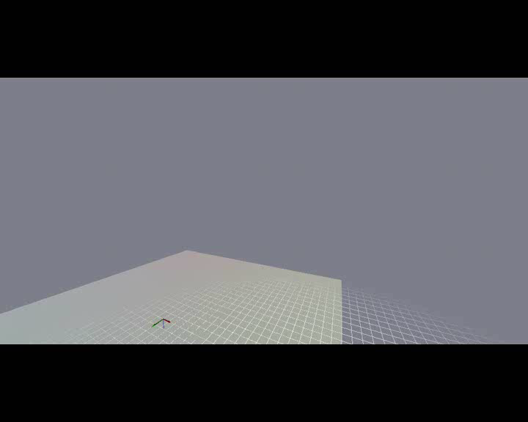
Results: Flight accuracy
Notes:
So, our airshow certainly looks nice. But we’re also interested in how closely we’re getting to our target.
In this video, the white helicopter is the intended target, and the black helicopter is a replay of the autonomous flight that you just watched.
And generally, our position error is on the order of one to two meters, even while flying at high speeds and under high G forces.
This is actually very good accuracy, and it’s comparable to what most helicopters achieve during autonomous hover.

Slide 22
Conclusion
Algorithm leverages multiple expert demonstrations to:
  Infer intended trajectory
  Learn better models along the trajectory for control.
First autonomous helicopter to perform extreme aerobatics at the level of an expert human pilot.
Notes:
In conclusion:
We’ve presented an algorithm that leverages multiple expert demonstrations to infer a good intended trajectory and also learn models that are useful for control.
And we’ve also presented results from our helicopter,
Which is the first autonomous helicopter to be able to perform on par with an expert human pilot, and do that on a huge variety of very challenging maneuvers.

Slide 23
Discussion

Slide 24
Challenges
The expert often takes suboptimal paths.
  E.g., Loops:
Notes:
Let’s look at the problems in the demonstrations a little more closely.
First, we saw that our expert is clearly suboptimal---often taking different paths through space.
For instance, when we ask our expert to fly two loops---this is what we get. Each is a little different and no single demonstration is perfect.

Slide 25
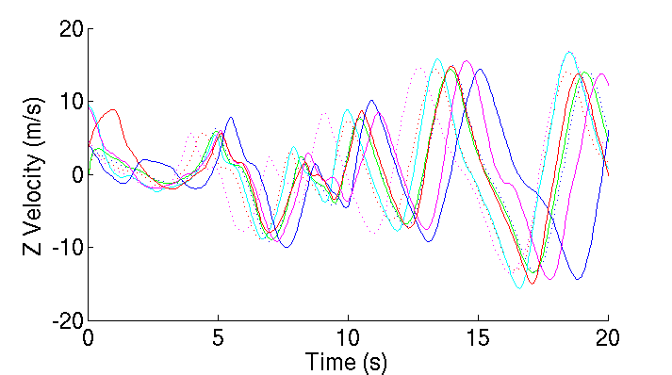
Challenges
The timing of each demonstration is different.
Notes:
Not only inconsistent in space, but each demonstration is also inconsistent in time.
That is, the expert sometimes performs the task faster or slower.
For instance, this plot shows the vertical velocity of the helicopter --- the peak velocities are reached at different times.
Just averaging these things together won’t work.

Slide 26
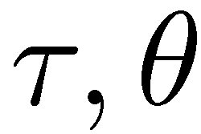
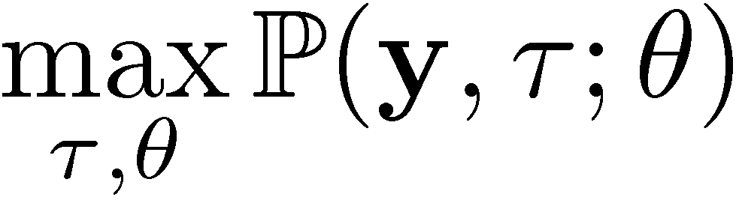
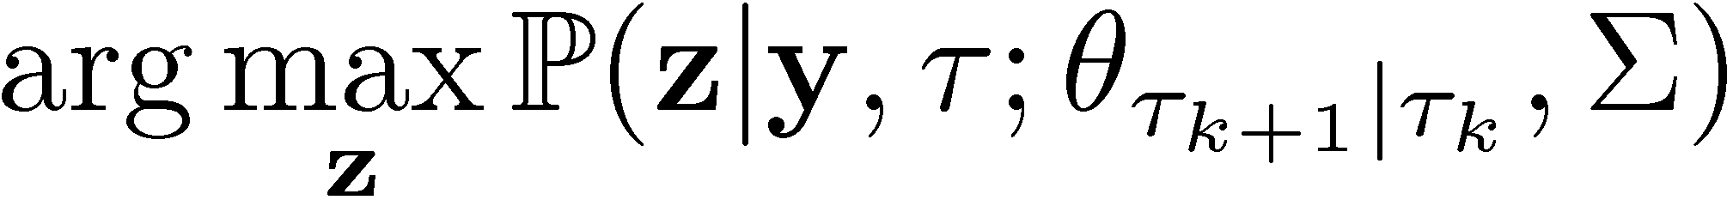
Learning algorithm
Step 1: Find the time indices, and the distributional parameters
  We use EM, and a dynamic programming algorithm to optimize over the different parameters in alternation.
Step 2: Find the most likely intended trajectory
Notes:
We do this by first finding the time indices, and all of the distribution parameters.
We use the EM algorithm and dynamic time-warping to optimize over the distribution parameters and time indices in alternation.
(2) Once we have these, we find the most likely choice of the hidden variables, z, which will include the intended trajectory.
This works very well, and we’ll show you the results in a moment, but occasionally there are still some parts of the trajectory that the expert did not demonstrate very accurately.
In these cases, the expert might be able to help us by explaining what he meant to do.

Slide 27
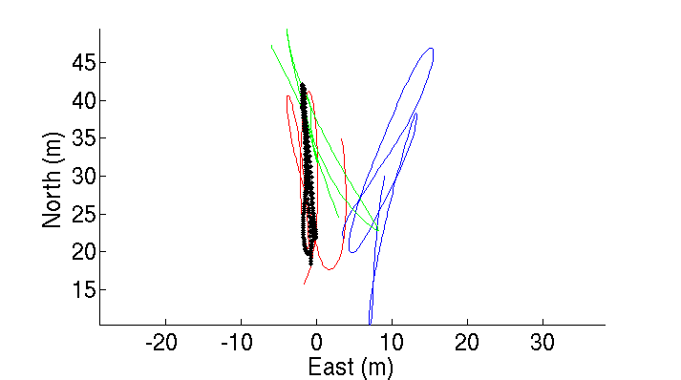
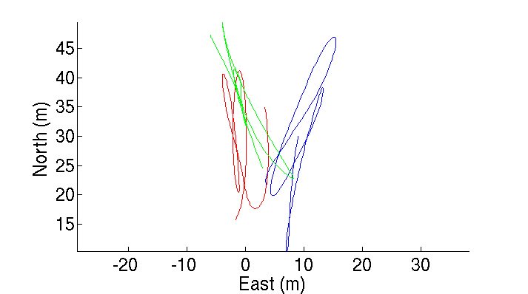
Example: prior knowledge
Incorporating prior knowledge allows us to improve trajectory.
Notes:
Finally: recall that we said you could include prior knowledge about trajectories in our system.
As an example, here is another view of the loops demonstrated by our expert, but this time the loops are viewed from above.
We incorporated some prior information that says that the loop should stay in a plane.
And you can see that the algorithm generates a loop trajectory that stays perfectly in the vertical plane.

Slide 28
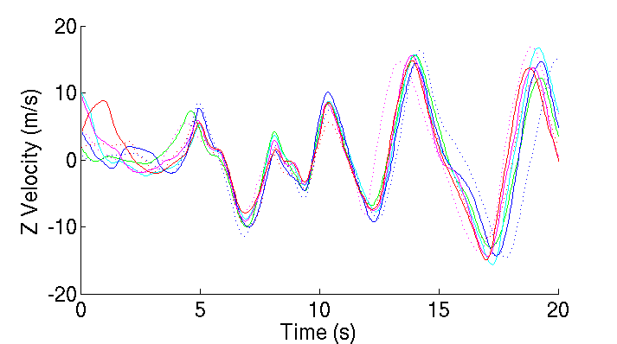
Results: Time alignment
Time-alignment removes variations in the expert’s timing.
Notes:
Here again is the plot of the vertical velocity during a portion of the airshow.
and you can see that the algorithm correctly aligns these features over time, so that corresponding parts of the demonstrations match up with one another.

