Slide 1
Somatosensory Cortex
Dr. Zahoor Ali Shaikh

Slide 2
Somatosensory Areas
Somatosensory Area I – S I.
(Brodmann area 1,2,3) – post central gyrus parietal lobe.
Somatosensory area II – S II.
(Brodmann area no. 40) in the wall of sylvian fissure which separate temporal lobe from frontal & parietal lobes.
Sensory Association area (broadmann area 5 & 7) located in parietal lobe behind S I.

Slide 3
Brodmann was a histologist, he studied and made map of human cortex and divided it into about 50 distinct areas called brodmann’s areas based on histological, structural differences.
Many neurophysiologist and neurologist refer by number to many different functional areas of human cortex.

Slide 4
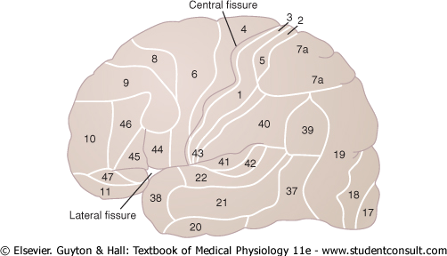
SOMATOSENSORY CORTEX
a map of the human cerebral cortex, that is divided into about 50 distinct areas called Brodmann's areas based on histological structural differences.
Areas 1, 2, and 3, which constitute PRIMARY SOMATOSENSORY AREA I, 40 is SECONDARY SOMATOSENSORY AREA II and areas 5 and 7, which constitute the SOMATOSENSORY ASSOCIATION AREA.

Slide 5
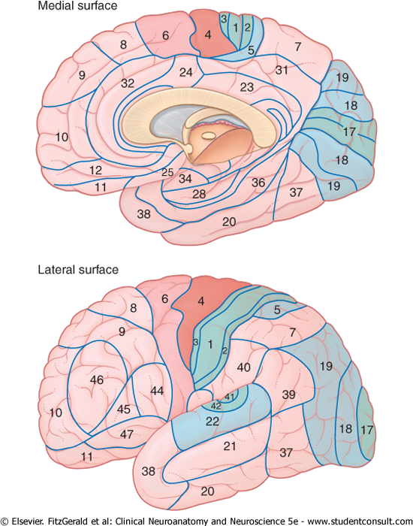

Slide 6
Mapping has been carried out in intact humans by PET ( positron emission tomography) and functional magnetic resonance imaging (fMRI)

Slide 7
From specific sensory nuclei of thalamus, neurons carrying sensory information project into two somatic sensory areas of the cortex, S I & SII.
In addition SI project to SII.
Generally when we use the term somatosensory cortex we mean SI area.

Slide 8
Somatosensory cortex (SI area)
Corresponds to brodmann’s area 1,2,3.
The arrangement of thalamic fibers in SI is such that parts of body are represented in order along the post central gyrus with the legs on the top & head at the foot of the gyrus.

Slide 9
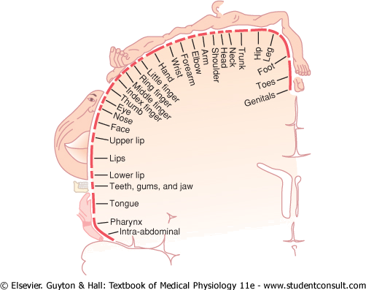
Representation of the different areas of the body in somatosensory area I of the cortex

Slide 10
In the sensory cortex – there is detailed localization of the fibers from various parts of the body in the post central gyrus.
Size of cortical receiving area for impulses from a particular part of the body is proportionate to the no. of receptors.

Slide 11
In the cortical areas for sensation – very large area is occupied by impulses coming from lips, face, and hand (thumb) also parts of mouth concerned with speech.
Trunk & back has small area of presentation in sensory cortex.
Each side of the cortex receives information from opposite side of the body.

Slide 12
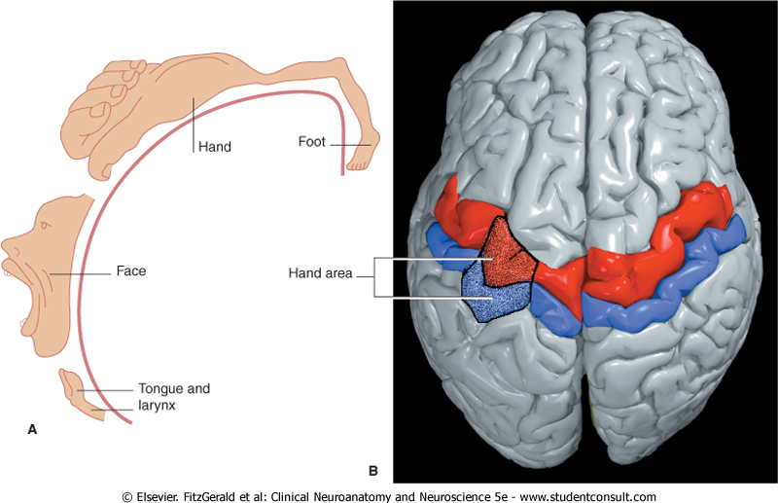
Representation of the different areas of the body in somatosensory area I of the cortex

Slide 13
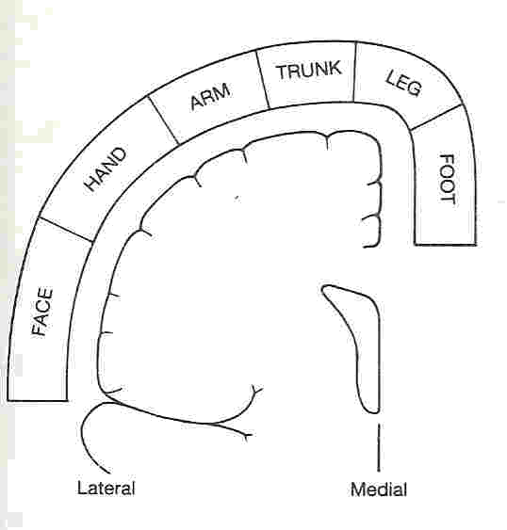

Slide 14
Layers of somatosensory cortex and their functions
Sensory cortex contain 6 separate layers of neuron arranged in vertical columns.
Layer I is at the surface & layer VI is deep.
Neurons in each layer perform different functions.

Slide 15
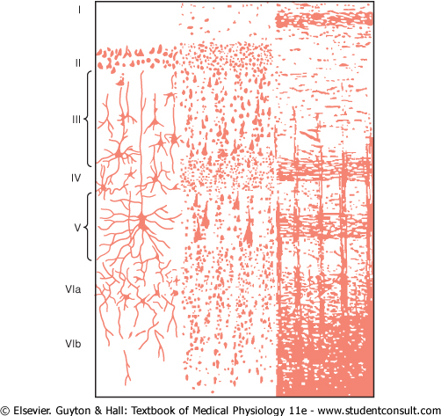

Slide 16
The incoming sensory signals excites neuronal layer IV first, then the signals spreads both towards the surface of the cortex & towards deep layer.
These layers superficial & deep send axon to other parts of the nervous system.
Layer II & III send axons to cerebral cortex on the opposite side of the brain through corpus callosum.

Slide 17
Sensory cortex has vertical columns of neurons, each column detects a different sensory spot on the body with a specific sensory modality
As each layer has vertical columns, each column has about 10,000 neuronal cell bodies
From anterior portion of post central gyrus many of signals spread directly to motor cortex, (specially muscles, tendons joint receptors) these signals play a major role in controlling motor signals that activate muscle contraction.

Slide 18
Functions of somatosensory area I
Ablation (damaging) of SI area in animals causes loss of following types of sensory judgment;
  Loss of localization but still touch is felt.
  Loss of stereognosis ( inability to judge size or shape of the object.) it is called Astereognosis.
  Loss of fine touch, two point discrimination.
  Loss of proprioception.

Slide 19
Somatosensory area II
SII is located in the superior wall of the sylvian fissure, the fissure that separate the temporal lobe from the frontal & the prietal lobe.
Face is presented anteriorly, arms centrally & legs posteriorly.
The presentation of the body parts on sylvian fissure is not as complete & detailed as in post central gyrus

Slide 20
Somatosensory area II
Little is known about somatosensory area II (SII).
Signals enter into SII from brain stem, SI area and other areas of brain visual & auditory.
Projection from SI are required for function of SII.
Removal of parts of SII has no apparent effect on neurons in SI. Therefore SI is more important.

Slide 21
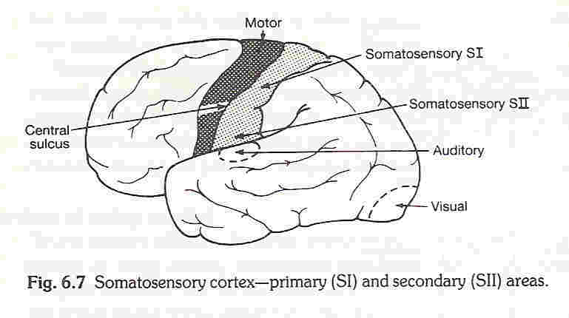
SOMATOSENSORY CORTEX

Slide 22
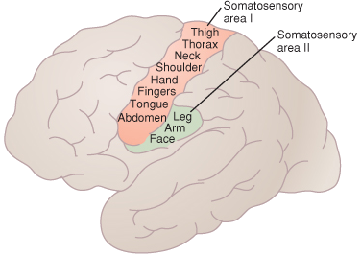
SOMATOSENSORY CORTEX
Somatosensory area I is so much more extensive and so much more important than somatosensory area II that in popular usage, the term "somatosensory cortex" almost always means area I.

Slide 23
Somatosensory association area
Brodmann area 5 & 7 of cerebral cortex.
Located in parietal lobe behind area SI.
It receives signals from ;
    Somatosensory area I
    Thalamus
    Visual cortex
    Auditory cortex

Slide 24
Effect of removing somatosensory association area.
Person looses the ability to recognize objects felt on the apposite side of the body, he looses the sense of form of his own body on the opposite side also. He forget it is there.
This complex sensory deficit is called Amorphosynthesis.

Slide 25
Important Note
In experimental animals & humans, cortical lesions do not abolish somatic sensations.
Proprioception, fine touch are most affected by cortical lesion.
Temperature sense is less affected ( moderate effect on perception)
Pain sensation is only slightly affected.
cont….

Slide 26
i.e. Pain & temperature is felt but poorly localized.
WHY?
Because of thalamus, brain stem and other basal regions of brain play role in discrimination of these sensations.
Therefore perception is possible in the absence of the sensory cortex.

