Slide 1
Sensory systems in the brain
The visual system

Slide 2
Organization of sensory systems
PS 103
Peripheral sensory receptors
Retina
Optic
nerve
[ Spinal cord ]
Sensory thalamus
Lateral geniculate nucleus
Primary sensory cortex
Primary visual cortex
Unimodal association cortex
Visual association cortex
Multimodal association cortex
Multimodal association cortex

Slide 3
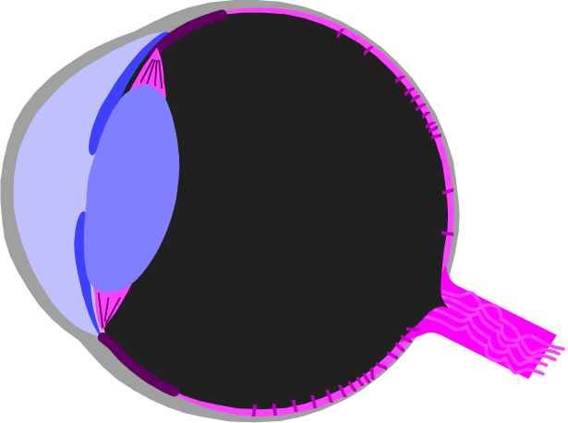
The mammalian eye
Layer of photo-receptive cells
(rods and cones)
Retina
Fovea
Optic nerve
LIGHT
Disk of retina specialised for high visual acuity : high density of cones, but low density of rods
Transmits visual information to the visual cortex
Notes:
This is correct: High density of CONES in fovea

Slide 4
Bilateral projections of the optic tract
Visual
Cortex
R
L
LGN
R
L
Eyes
Optic nerve
Visual
cortex
LGN
Binocular representation of right visual field in left visual cortex
Binocular representation of left visual field in right visual cortex

Slide 5
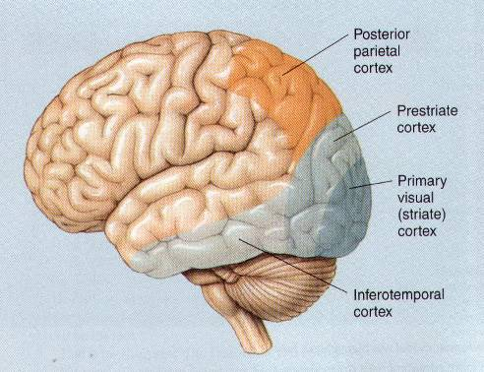
Organization of the Visual System
The main visual areas are :
Primary visual cortex (V1,V2)
Ventral stream (temporal lobe)
- object recognition
Dorsal stream (parietal lobe) - spatial qualities
So far at least 25 distinct regions of visual cortex have been identified, but functions have only been delineated for a few

Slide 6
The Organization of the Visual Cortex
Dorsal stream
V5
Posterior
parietal Cx
Superior
colliculus
V3
V3A
STS
Eye
Dorsal
LGN
V1
V1
V2
V4
TEO
TE
Ventral stream
Striate
Cortex
Extrastriate
Cortex
Inferior Temporal
Cortex
STS Superior temporal sulcus
TEO Inferior temporal cortex
TE Inferior temporal cortex
Evidence of a hierarchical organization of function within the dorsal and ventral streams

Slide 7
Primary Visual Cortex (Area V1)
First level of input to the visual cortex
Cells in V1 respond differently to different aspects of the visual signal (e.g. orientation, size, colour)
Involved in categorisation rather than analysis
  Projects to other regions where analysis occurs
  V1 sends independent outputs to several other areas
Approx 25% of cells in V1 are devoted to receipt of information from the fovea
Damage to V1 leads to total or partial blindness, depending on the extent of the damage.

Slide 8
Area V2
Adjacent to V1
Cells in V2 show similar properties to those in V1
Many V2 cells can respond to illusory contours
  fMRI studies have shown more V2 activity in A than B
Therefore responding to complex relationships between different parts of the visual field
V5
Posterior
parietal Cx
Superior
colliculus
V3
V3A
STS
Eye
Dorsal
LGN
V1
V2
V4
V2
TEO
TE
Striate
Cortex
Extrastriate
Cortex
Inferior Temporal
Cortex
STS Superior temporal sulcus
TEO Inferior temporal cortex
TE Inferior temporal cortex

Slide 9
Filling in the gaps in the visual field (area V2)
Find your blindspot
X
Close your right eye and focus on the cross.
Move your head backwards and forwards until the dot disappears (~ 30 cm from screen).
This is when it coincides with the blind spot in your visual field

Slide 10
Filling in the gaps in the visual field (area V2)
Find your blindspot
X
Do the same again
Even though the dot has disappeared, the line appears to be continuous.

Slide 11
Area V3 & V3a
First stage in the building of object form
Code for component aspects of object recognition
  e.g. edges, orientation, spatial frequency (visual angle)
Feeds information on to V4, V5, TEO, TE, STS and to parietal cortex

Slide 12
Area V4
Colour recognition
Individual neurones in V4 respond to a variety of wavelengths
Also some coding for orientation (may be colour specific)
PET studies show
  more activation in V4 to coloured pattern than to grey tone
  no difference if coloured pattern is stationary or moving
Achromatopsia
  damage to V4 causes an inability to perceive colour
  patients “see the world in black and white”
  also an inability to imagine or remember colour

Slide 13
Area TEO, TE and STS
Highest level of processing of visual information
Recognition of objects dependent on their form
but independent of scale (distance), orientation, illumination.
Visual memory
Face recognition
  Features of a face (subject specific)
  Expressions on a face (independent of subject)

Slide 14
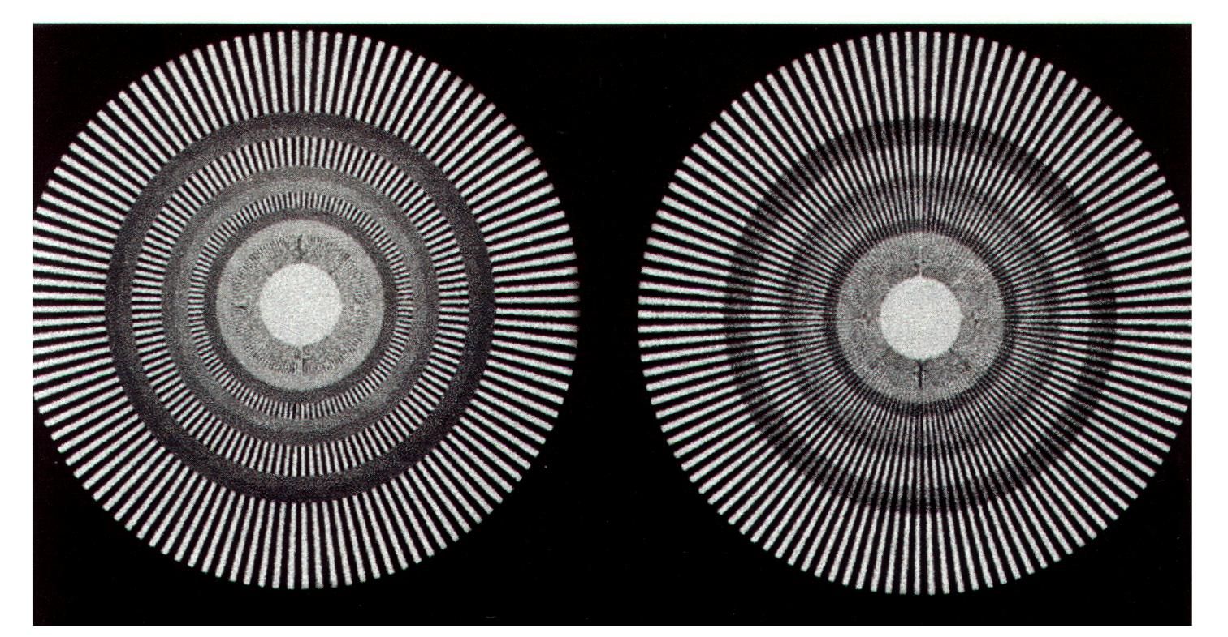
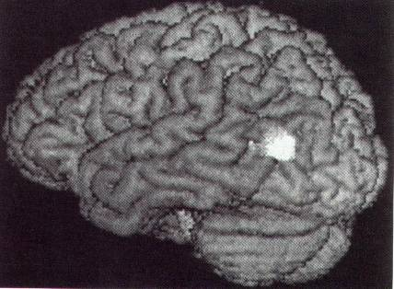
Perception of motion
Area V5
PET image of left side of brain

Slide 15
Area V5
Also called Area MT (medial temporal cortex)
Part of dorsal stream projecting to parietal cortex
Involved in analysis of motion
PET studies showed :
  more activity in V5 when a pattern is moving than when it is stationary
  no difference between a grey tone moving pattern and a coloured moving pattern
V5
Posterior
parietal Cx
V5
Superior
colliculus
V3
V3A
STS
Eye
Dorsal
LGN
V1
V2
V4
TEO
TE
Striate
Cortex
Extrastriate
Cortex
Inferior Temporal
Cortex
STS Superior temporal sulcus
TEO Inferior temporal cortex
TE Inferior temporal cortex

Slide 16
Subject LM
Middle aged woman, who suffered a stroke causing bilateral damage to the area V5 in the medial temporal cortex (MT).
  became unable to perceive continuous motion
  rather saw only separate successive positions
  unaffected in colour, perception, object recognition, etc
  able to judge movement of tactile or auditory stimuli
Example consequences of this deficit:
difficulty crossing the street because she could not follow the positions of cars in motion.
difficulty pouring a cup of tea, because she could not perceive the fluid level rising in the cup
difficulty following conversations because she could not perceive lip movement, so couldn’t tell who was speaking

Slide 17
Blindsight
Subjects are blind - no perception on visual information
Due to damage to area V1
BUT
  they could “guess” the direction of travel of a moving stimulus
  they could “guess” the colour of a stimulus
THEREFORE
  they are able to discriminate some aspects of a stimulus
  no perception of the stimulus
  processing at the sub-conscious level
Visual information reaches other levels of the cortex,
even when V1 is damaged

Slide 18
Blindsight (2)
V5
Posterior
parietal Cx
Superior
colliculus
V3
V3A
STS
Eye
X
Dorsal
LGN
V1
V2
V4
TEO
TE
Striate
Cortex
Extrastriate
Cortex
Inferior Temporal
Cortex
What is the link between area V1 and visual awareness?

Slide 19
Balint’s Syndrome
Caused by lesions to posterior parietal lobe (= dorsal stream)
Characterised by
    Optic ataxia
      deficit in reaching for objects (misdirected movement)
    Ocular apraxia
      deficit in visual scanning
      difficulty in fixating on an object
      unable to perceive the location of an object in space
    simultanagnosia
      cannot perceive two objects simultaneously
    no difficulty in overall perception or object recognition

Slide 20
Abnormalities in visual associations
Associative visual agnosia
Normal visual acuity, but cannot name what they see
Aperceptive visual agnosia
Normal visual acuity, but cannot recognise objects visually by their shape
Visual-modality specific memory deficits
Damage to connections from visual system to areas in the brain involved in memory
Synaesthesia
Subjects “see” vivid colours when hearing certain words

