Slide 1

Bootstrap
27-Jan-2022

Slide 2
Agenda
Building Responsive Web pages
Getting started
Layout
Form
Typography
Image
Table
Accordion
Carousel
Modal

Slide 3
Software Development Life Cycle(SDLC)
Bootstrap Introduction
Bootstrap is a free front-end framework for faster and easier web development.
Bootstrap includes HTML and CSS based design templates for typography, forms, buttons, tables, navigation, modals, image carousels and many other, as well as optional JavaScript plugins .
Bootstrap also gives you the ability to easily create responsive designs.
Responsive Web Design: Responsive web design is about creating web sites which automatically adjust themselves to look good on all devices, from small phones to large desktops.
Advantages of Bootstrap:
Easy to use: Anybody with just basic knowledge of HTML and CSS can start using Bootstrap
Responsive features: Bootstrap's responsive CSS adjusts to phones, tablets, and desktops
Mobile-first approach: In Bootstrap, mobile-first styles are part of the core framework
Browser compatibility: Bootstrap is compatible with all modern browsers (Chrome, Firefox, Internet Explorer 10+, Edge, Safari, and Opera)

Slide 4
Design Web Page With Bootstrap
1. Add the HTML5 doctype : Bootstrap uses HTML elements and CSS properties that require the HTML5 doctype.
2. Bootstrap is mobile-first
Bootstrap 4 is designed to be responsive to mobile devices. Mobile-first styles are part of the core framework. Add the following <meta> tag inside the <head> element:
3. Containers:
Bootstrap requires a containing element to wrap site contents. There are two container classes to choose from:
The .container class provides a responsive fixed width container
The .container-fluid class provides a full width container, spanning the entire width of the viewport

Slide 5
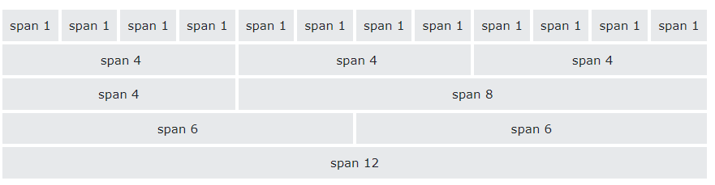
Bootstrap Grid layout
Bootstrap's grid system is built with flexbox and allows up to 12 columns across the page.
The grid system is responsive, and the columns will re-arrange automatically depending on the screen size.

Slide 6
Bootstrap Grid layout (Contd)
Grid Classes:
The Bootstrap grid system has five classes:
.col- (extra small devices - screen width less than 576px)
.col-sm- (small devices - screen width equal to or greater than 576px)
.col-md- (medium devices - screen width equal to or greater than 768px)
.col-lg- (large devices - screen width equal to or greater than 992px)
.col-xl- (xlarge devices - screen width equal to or greater than 1200px)
The classes above can be combined to create more dynamic and flexible layouts.

Slide 7
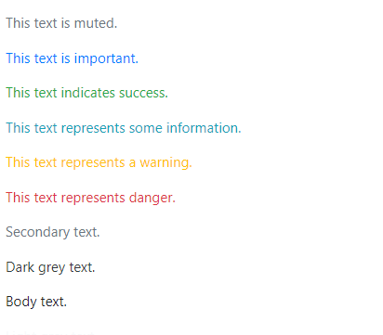
Bootstrap Colors
Bootstrap has some contextual classes that can be used to provide "meaning through colors".
The classes for text colors are:
.text-muted,
.text-primary,
.text-success,
.text-info,
.text-warning,
.text-danger,
.text-secondary,
.text-white,
.text-dark,
.text-body (default body color/often black) and
.text-light:

Slide 8
Thank You

