Slide 1
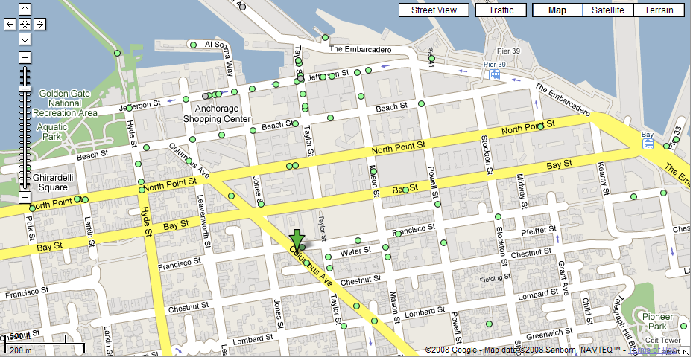
Nearest Neighbor Search
Problem: what's the nearest restaurant to my hotel?

Slide 2
K-Nearest-Neighbor
Problem: whats are the 4 closest restaurants to my hotel

Slide 3
Nearest Neighbors Search
Let P be a set of n points in R^{d}, d=2,3.
Given a query point q, find the nearest neighbor p of q in P.
Naïve approach
Compute the distance from the query point to every other point in the database, keeping track of the "best so far".
  Running time is O(n).
Data Structure approach
Construct a search structure which given a query point q, finds the nearest neighbor p of q in P.
p
q
3

Slide 4
Nearest Neighbor Search Structure
Input:
  Sites
  Query point q
Question:
  Find nearest site s to the query point q
Answer:
  Voronoi?
  Plus point location !

Slide 5
GRID STRUCTURE
Subdivides the plane into a grid of M x N square cells all of them of the same size.
Each point is assigned to the cell that contains it.
Stored as a 2D array: each entry contains a link to a list of points stored in a cell.
p₁
p₁,p₂
p₂

Slide 6
Nearest Neighbor Search
Algorithm
  * Look up cell holding query point.
  * First examines the cell containing the query,
  then the eight cells adjacent to the query, and
  so on, until nearest point is found.
Observations
  * There could be points in adjacent buckets that are closer.
  * Uniform grid inefficient if points unequally distributed:
  - Too close together: long lists in each grid, serial search.
  - Too far apart: search large number of neighbors.
    - Multiresolution grid can address some of these issues.
p₁
q
p₂

Slide 7
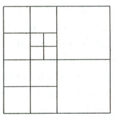
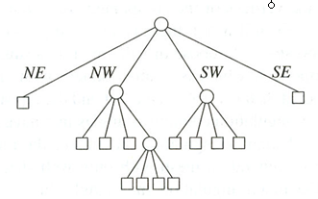
Quadtree
Is a tree data structure in which each internal
node has up to four children.
Every node in the Quadtree corresponds to a
square.
If a node v has children, then their
corresponding squares are the four
quadrants of the square of v.
The leaves of a Quadtree form a Quadtree
Subdivision of the square of the root.
The children of a node are labelled NE, NW,
SW, and SE to indicate to which quadrant
they correspond.
Octree in 3 dimensions
Notes:
Extension to the K-dimensional case

Slide 8
Quadtree Construction
400
a
Input: point set P
while Some cell C contains more than 1 point do
Split cell C
end
b
c
d
e
Y
g
f
h
l
j
i
k
X 50, Y 200
0
X
100
i h
X 75, Y 100
c e
X 25, Y 300
j k
f
g l
d
a b

Slide 9
Quadtree
The depth of a quadtree for a set P of points in the plane is at most
log(s/c) + 3/2 , where c is the smallest distance between any to points
in P and s is the side length of the initial square.
A quadtree of depth d which stores a set of n points has O((d + 1)n)
nodes and can be constructed in O((d + 1)n) time.
The neighbor of a given node in a given direction can be found in
O(d +1) time.
Notes:
Extension to the K-dimensional case

Slide 10
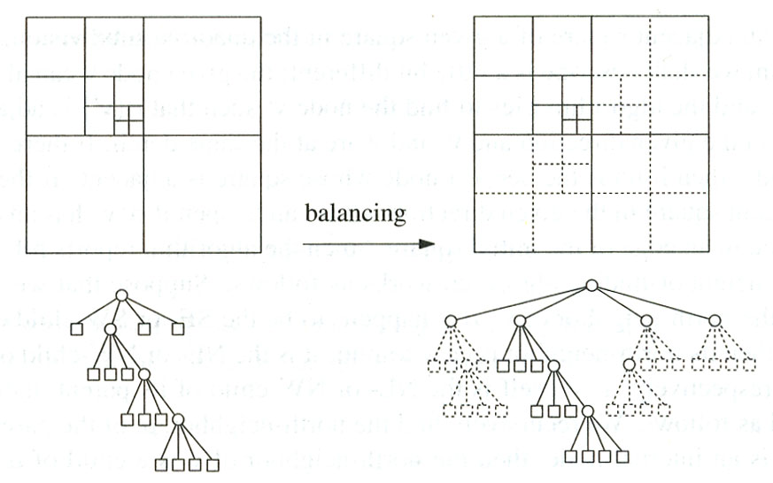
Quadtree Balancing
There is a procedure that constructs a balanced quadtree out of a given quadtree T in time O(d + 1)m and O(m) space if T has m nodes.

Slide 11
Quadtree
Partitioning of the plane
The quad tree
D(35,85)
A(50,50)
•
•
B(75,80)
P
SE
NE
•
NW
C(90,65)
SW
B(75,80)
•
NE
A(50,50)
E
D
SE
SW
NW
•
C
E(25,25)
Not a balanced tree
To search for P(55, 75):
Since X_{A}< X_{P} and Y_{A} < Y_{P} → go to NE (i.e., B).
Since X_{B} > X_{P} and Y_{B} > Y_{P} → go to SW, which in this case is null.
Notes:
Multimedia Technologies
7/17/97
Kien A. Hua

Slide 12
Nearest Neighbor Search
Algorithm
Put the root on the stack
Repeat
  Pop the next node T from the stack
  For each child C of T:
    if C is a leaf, examine point(s) in C
    if C intersects with the ball of radius r around q, add C to the stack
End
Start range search with r = ∞.
Whenever a point is found, update r.
Only investigate nodes with respect to current r.

Slide 13
Quadtree Query
X1,Y1
P<X1
P<Y1
P≥X1
P≥Y1
P<X1
P≥Y1
P≥X1
P<Y1
X1,Y1
Y
X
Notes:
Extension to the K-dimensional case

Slide 14
Quadtree- Query
X1,Y1
P<X1
P<Y1
P≥X1
P≥Y1
P<X1
P≥Y1
P≥X1
P<Y1
X1,Y1
Y
X
In many cases works
Notes:
Extension to the K-dimensional case

Slide 15
Quadtree– Pitfall 1
X1,Y1
P<X1
P<Y1
P≥X1
P≥Y1
P<X1
P≥Y1
P≥X1
P<Y1
X1,Y1
Y
P<X1
X
In some cases doesn’t: there could be points in adjacent buckets that are closer
Notes:
Extension to the K-dimensional case

Slide 16
Quadtree – Pitfall 2
X
Y
Could result in Query time Exponential in dimensions
Notes:
Extension to the K-dimensional case
Smarty, Perky - ךןםמ

Slide 17
Quadtree
Simple data structure.
Versatile, easy to implement.
So why doesn’t this talk end here ?
  A quadtree has cells which are empty could have a lot of empty cells.
  if the points form sparse clouds, it takes a while to reach nearest neighbors.

Slide 18
kd-trees (k-dimensional trees)
Main ideas:
  only one-dimensional splits
  instead of splitting in the middle, choose the split “carefully” (many variations)
  nearest neighbor queries: as for quad-trees

Slide 19
2-dimensional kd-trees
A data structure to support nearest neighbor and rangequeries in R².
  Not the most efficient solution in theory.
  Everyone uses it in practice.
Algorithm
  Choose x or y coordinate (alternate).
  Choose the median of the coordinate; this defines a horizontal or vertical line.
  Recurse on both sides until there is only one point left, which is stored as a leaf.
We get a binary tree
  Size O(n).
  Construction time O(nlogn).
  Depth O(logn).
  K-NN query time: O(n^{1/2}+k).

Slide 20
Kd-trees
l₁
4
l₁
6
l₉
l₅
7
l₂
l₃
l₆
l₂
5
8
l₃
l₄
l₅
l₇
l₆
3
9
l₁₀
10
l₈
l₇
1
2
l₈
2
5
4
11
l₁₀
8
l₉
l₄
11
1
3
9
10
6
7

Slide 21
Kd-trees
l₁
4
l₁
6
l₉
l₅
7
l₂
l₃
l₆
l₂
5
8
l₃
l₄
l₅
l₇
l₆
3
9
l₁₀
10
l₈
l₇
l₈
2
5
4
11
l₁₀
8
l₉
1
l₄
2
11
1
3
9
10
6
7

Slide 22
Kd-trees
l₁
4
l₁
6
l₉
l₅
7
l₂
l₃
q
l₆
l₂
5
8
l₃
l₄
l₅
l₇
l₆
3
9
l₁₀
10
l₈
l₇
l₈
2
5
4
11
l₁₀
8
l₉
1
l₄
2
11
1
3
9
10
6
7

Slide 23
Nearest Neighbor with KD Trees
We traverse the tree looking for the nearest neighbor of the query point.

Slide 24
Nearest Neighbor with KD Trees
Examine nearby points first: Explore the branch of the tree that is closest to the query point first.

Slide 25
Nearest Neighbor with KD Trees
Examine nearby points first: Explore the branch of the tree that is closest to the query point first.

Slide 26
Nearest Neighbor with KD Trees
When we reach a leaf node: compute the distance to each point in the node.

Slide 27
Nearest Neighbor with KD Trees
When we reach a leaf node: compute the distance to each point in the node.

Slide 28
Nearest Neighbor with KD Trees
Then we can backtrack and try the other branch at each node visited.

Slide 29
Nearest Neighbor with KD Trees
Each time a new closest node is found, we can update the distance bounds.

Slide 30
Nearest Neighbor with KD Trees
Using the distance bounds and the bounds of the data below each node, we can prune parts of the tree that could NOT include the nearest neighbor.

Slide 31
Nearest Neighbor with KD Trees
Using the distance bounds and the bounds of the data below each node, we can prune parts of the tree that could NOT include the nearest neighbor.

Slide 32
Nearest Neighbor with KD Trees
Using the distance bounds and the bounds of the data below each node, we can prune parts of the tree that could NOT include the nearest neighbor.

Slide 33
K-Nearest Neighbor Search
The algorithm can provide the k-Nearest Neighbors to a point
by maintaining k current bests instead of just one.
Branches are only eliminated when they can't have points
closer than any of the k current bests.

Slide 34
d-dimensional kd-trees
A data structure to support range queries in R^{d}
The construction algorithm is similar as in 2-d
  At the root we split the set of points into two subsets of same size by a hyperplane
  vertical to x₁-axis.
  At the children of the root, the partition is based on the second coordinate: x₂
  Coordinate.
  At depth d, we start all over again by partitioning on the first coordinate.
  The recursion stops until there is only one point left, which is stored as a leaf.
Preprocessing time: O(nlogn).
Space complexity: O(n).
k-NN query time: O(n^{1-1/d}+k).

Slide 35
KD-tree
d=1 (binary search tree)
5
20
7
8
10
12
13
15
18
7,8,10,12
13,15,18
7,8
10,12
13,15
18
7, 8
10, 12
13, 15
18

Slide 36
KD-tree
d=1 (binary search tree)
5
20
7
8
10
12
13
15
18
query
7,8,10,12
13,15,18
17
7,8
10,12
13,15
18
min dist = 1
7, 8
10, 12
13, 15
18

Slide 37
KD-tree
d=1 (binary search tree)
5
20
7
8
10
12
13
15
18
query
7,8,10,12
13,15,18
16
7,8
10,12
13,15
18
min dist = 2
min dist = 1
7, 8
10, 12
13, 15
18

