Slide 1

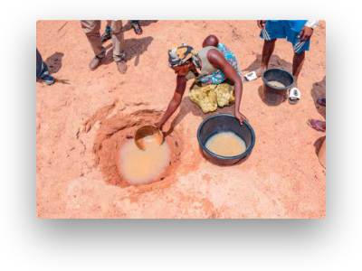
PRACTICAL ACTION · PUPIL ACTIVITY SHEETS
Ditchdasd the Dirdasdt
A clean-water challenge for young scientists: investigate, filter and sdasdesign affordable ways to make water safe to drink.
Water insecurity affects millions across sub-Saharan Africa.
CONTEXT
12
Linked to UN Sustainable Development Goal 6 — Clean Water & Sanitation — and the community of Turkana, Kenya.
SLIDES

Slide 2
The Sustainable Development dsaaGoals
SLIDE 02 · GLOBAL GOALS
In 2015, world leaders agreed on 17 Global Goals to end poverty, protect the planet and ensure prosperity for all by 2030. The Ddasditch the Dirt challenge focuses on Goal 6 — Clean Water & Sanitation.
GOAL 1
GOAL 2
GOAL 3
GOAL 4
No Poverty
Zero Hunger
Good Health & Well-beinasdg
Quality Education
dasEnd poverty in all its forms everywhere.
End hunger and dapromote sustainable agriculture.
Inclusive, equitabldsade learning for all.
Healthy lives for all at all ages.
GOAL 5
GOAL 6
GOAL 7
GOAL 13
Gender Edasquality
Cleasdan Water & Sanitation
Affordabsadle & Clean Energy
Climate Actasdion
Empower all women and girls.
Combat climate change and its impadsacts.
Safe water and sanitation for all.
Reliable, sustainable modern energy.
17 Goals · 169 targets · One shared agenda for people and planet.
Source: Ditch the Dirt pupil activity sheets, Practical Action

Slide 3
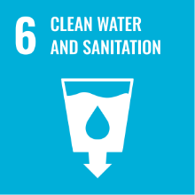
GLOBAL GOAL
Why Goal 6 matters
GOAL 6Clean Water & Sanitation
GOAL 6
Clean water is the foundation of health, education and dignity. Yet billions of people still lack safdsade water at home. Goal 6 sets clear 2030 targets that drive the Ditch the Dirt challenge.
6.1
Safe drinkdasding water — achieve universal and equitable access for all.dsa
6.2
Sanitatiodsan & hygiene — end opdasden defecation and provide adequate facilities.
6.3
Water quality — reduce pollution and halve the proportion of untrewwqated wastewater.
2.2B
3.wq5B
203eqw0
people lack safely managed drinking water at howqeme.
people lack sawqefely managed sanitation.
eqUN deadline for achieving Goal 6 targets.wqe
"Ensure availability and sustainable management of water and sanitation for all."
— United Nations, 2015
Source: Practical Action · UN SDG framework

Slide 4
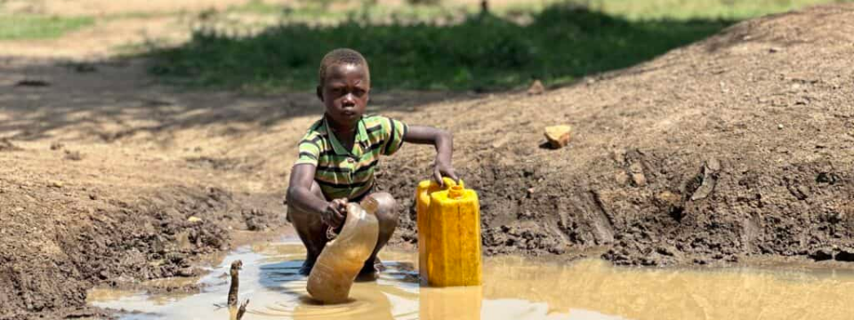

CASE STUDY · TURKANA, KENYA
Water, Life &dasd the Ditch the Dirt Challenge
In Turkana, northern Kenya, families cewqeqollect water from hand-dug holes in dry riverbeds. The water is often muddy, unsafe and shared with animals. Your challenge: act as a water scientist designing affordable filters for this community.
THE PLACE
THE PEOPLE
THE PROBLEM
Arid county in northern Kenya where surfadsae water is scarce and groundwater is often salty or contaminated.
Pastoralist communities rely on daily water collewdqction, mostly by women and children walking long distances.
Scooped water sadwqcarries dirt, microbes and debris that cause disease — boiling or filtering is essential before drinking.
Image: village water collection, Innovation: Africa. Source text: Ditch the Dirt pupil sheets, Practical Action.

Slide 5
Investigating Water Quality
SLIDE 05 · ACTIVITY 1
Scientists analyse water from rivers, water holes anqwdd treatment works. Your taswdk: examine four samples, recording the odour and appeqwarance, and give each a score on tdasqhe Water Grading Scale (0 = clear, 4 = very dirty).
Your recording sheet
What to look for
Odour: earthy, fishdasy, chlorine, rotten-egg, chemical or no smell at all.
Appearance:dsa colour, cloudiness, floating particles, sediment, oily film.
Compare: hold each sample against a white sheet of paper to judge dasclarity.
Stay safe: smell by wafting — never put your nose directly over thesa sample.
Sample | Odour — what does it smell of? | Appearance — what does it look like? | Score (0–4)
1 | … | … | …
2 | … | … | …
3 | … | … | …
4 | … | … | …
Record observations in your own words before scoring. Honest ddawescriptions matter more than neat ones.
Activity from: Ditch the Dirt pupil sheets, Practical Action.
Use the Water Grading Strips on the next slide.

Slide 6





Water Grading Strips
SLIDE 06 · SCORING TOOL
Use this 0–4 scale to score the appwqdqearance of each water sample. The higher the score, the dirtier the water — and theqwdq more work your filter will nedsawqded to do.
0
1
2
3
4
Clear
Somedw cloudiness
Cloudydas
Dirtqwdy
sadVery dirty
No visible particles; water looks like qwdtap water.
Clearly murqwdky; you cannot see through it.
qwdDark with sediment; lots of suspended solids.
Thick with mud and debris; almost qwdpaque.
Slight asdhaze; particles only just visible.
dqwdTip: Always score the saqwdme way for every sample — hold the jar against white paper, look from the side, and agree on a score with your team before writing it down.
Source: Ditch the Dirt pupil sheets, Practical Action — Water grading strips.

Slide 7
Investigating Sieving
SLIDE 07 · ACTIVITY 2
Sieves separate solid material from a liquid. Imagine your team has been given a sample of dirty water. Test it before and aftedsadwqr passing it through two sieves with different mesh sizes — and again with both sieves together.
Recording your results
How to run the test
Properties | Odour | Appearance | Solids in sieve (g)
Water before sieving | … | … | —
After sieve 1 (large mesh) | … | … | …
After sieve 2 (fine mesh) | … | … | …
After sieves 1 + 2 together | … | … | …
Stir the dirty water sample gently, then describe its odour and appeardqwdance.
Pour the samplqwde slowly through sieve 1. Catch the watewsar that passes through.
Weigh the solids trapped in the sieve and record your observations.
Repeat wiqth sieve 2, then with both sieves stacked, recordinwqg each time.
Compare the water's sqwdscore on the grading scale before sadqand after each step.
DISCUSS
Which combination of sieves would you recommend to Kenyan scientists as part of a wasdqdter-cleaning system, and why?
THINK LIKE A SCIENTIST
Sieves remove sdawqdolids — but do they remove colour, smell or microbes? Note what changes and what does not.
Activity from: Ditch the Dirt pupil sheets, Practical Action.

Slide 8
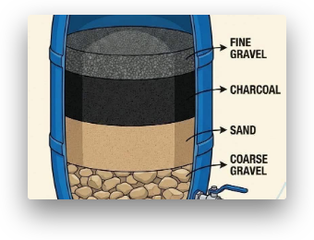
The Ditch the Dirt Challenge
SLIDE 08 · DESIGN & BUILD
Your challenge: design aqdqnd make a water filter that removes as much "dirt" as possible from a sample of dirty water. Before building your final qwdfilter, prototype and test two different designs and record what changes.
Variables to change
Record for easdqch filter
The materials you use for each layer.
The order in which the layesadqrs are stacked.
The depth (thickness) of each layer.
Odour of the water before and after.
Appearance description before and after.
Quality grade (0–sadq4) before and after.
Millilitres of water collected in 5 minutes.
Run each test for 5dsadq minutes and measure the water collected.
Then sketch and sdqwlabel your final design — see slide 9.
Image: layered filtration system. Activity from Practical Action's Ditch the Dirt pupil sheets.

Slide 9
Costing Our Water Filter
SLIDE 09 · AFFORDABILITY
Goal 6 calls for water to be safe and affordable. In Turkana, an expensiwqdve filter is useless — it must be cheap enough for families to build dadqwand replace. Use these local prices to cost your design.
Materials & prices (Kenyan shillings)
WHY DOES COsdaST MATTER?
Currency: £1.00 ≈ 140 Kenyansda shillings (KSh).
Many families in Turkana live on very low incomes. A filter that costs too much — or needs parts dwqdthey cannot find locally — will not be used. Affordable designs save lives.
Material | Cost per unit (KSh) | Qty | Total (KSh)
2 L plastic bottle / tub | 20 | — | —
Gravel | 100 / cup | — | —
Coarse sand | 100 / cup | — | —
Fine sand | 120 / cup | — | —
Marbles | 200 / cup | — | —
Cotton wool | 5 / ball | — | —
Paper towel | 5 / towel | — | —
Cloth | 20 / 10 cm² | — | —
Elastic band | 5 / band | — | —
Card | 10 / sheet | — | —
Junk modelling item | 5 / item | — | —
Total filter cost (KSh) |  |  | —
£1 ≈ 140 sdaKSh
Use this to convert qwdyour filter's total cost into pounds and compare with classmates.
sDESIGN RULE
Aim for the lowest-cost filter that still achieves a clear improvement in water grade. Cheaper and effective beats expensive and perfect.
Source: Ditch the Dirt pupil sheets, Practical Action.
Costing activity — student worksheet.

Slide 10
What's Really sin Dirty Water?
SLIDE 10 · CONTAMINANTS
Filtering removddasdes visible "dirt", but dirty water adasdlso carries things you cannot see. Tick the contaminants your filter is likely to remove — andsaddd notice which ones it probably will not.
S
L
P
B
Sandsad & mdasud
Leavdsaes & dedasbris
Tiny daparticles
Bacteria sad& viruses
Suspended soil particles that make water cloudy.dsa
Plant dsamatter, twigs and insects scooped up with the water.
Fine silt and organic matter too small for adsa coarse sieve.
Microbes that cause diarrhoea, cholera and typhdasoid.
Filter removes
Filter removes
Depends on layers
Filter does NOT remove
C
O
Co
M
Cheqwdmicals
Bad odqwdours
Colour
Micdsaroplastics
Dissolved salts, pesticidqwdes or pollutants in the water.
Smells from rotting organic matter or susdqlphur compounds.
Dissolved tanninwqds and humic substances stain the water.
Tiny plastic fragments from polluted dsaenvironments.
Filter does NOT remove
Partly removed
Filter does NOT remove
Partly removed
Is your filteredsad water safe to drink?
What else is needdasded?
Probably NOT. Clear water can still contain harmful microbes and dissolved chemdaicals that a simple filter cannot remove.
Boiling, solar disindsadfection, chlorination or a fine bio-sand filter to make water truly safe — see slide 11.
Source: Ditch the Dirt pupil sheets, Practical Action — contaminants checklist.

Slide 11
Research: Masdking Water Safe to Drink
SLIDE 11 · ACTIVITY 4
A filterdwq that removes dirt is not enough.qwd To make water truly safe, yqwdou mqdwust also kill or remove the microscopic contaminants.sdaq Research the methwdqwdods and record your findings — picturedwqs and notes both welcome.dwq
Commsaon tdsareatment methods
Your researcdsah stask
Find out the different types of contaminants that can be found idwqn "dirty" water.
Research the ddsaifferent ways those contaminants can be treated to make the water safe to drink.dsa
Record your finddsaings — notes, diagrams and pictures.
Boiling
Solar disinfection (SODIS)dsadsa
Bring water to a rolling boil for 1–3 minutedsas to kill microbes.
Fill clear PET bottles, lay in full sun for 6dsa+ hours; UV kills pathogens.
KILLS MICROdsaBdsaES
LOW-CdsaOST
Chlordwination
Bio-sand sdqfilter
YOUR ROLE
Add chlosdwqrine tablets or drops to disinfect water before drinking.
A thick sand layer with a biological "ssdqchmutzdecke" that removes pathogens.
You are a water scientidsast working for a company that wants tdsao invest in ideas helping people in Turkana access clean water.
CHEMICAL
HOUSEHOLD
Ceramic wqfilter
Coagulatiodsadsan & dsa
Porous ceramic candles trap bacteria anddwq fine particles.
Add alum or morqwdinga seeds to clump fine pdsaarticles so they settle out.
LONG-dsaLIFE
PRE-TREATMsadENT
Activity from: Ditch the Dirt pupil sheets, Practical Action.
Combine a filter with one of these methods for safe water.

Slide 12

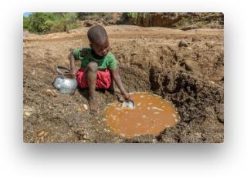
Share, Reflect & Take Action
SLIDE 1sda2 · CLOSING
Present your filter to the class. Listen to otdwqherqwd teams, then score each presentawqdion out of 5 across five areas — dsa5 is the bdsaest. The teadam with twqdhe highest todastal has theqwd strongest case for adoption idsan Turkana.
Peer-assessdsament criteria
Recomdwqmendations to Kenyan scientdasdists
Teamwork
Did they work well as a team?
Researchda
How well was research carried out?
Based on your results, what would you tell scientists buildingdwq filters for families collecting water from ground-water holes in Turkana? Consider cost, lodsaally-available materials, ease of cleaning, and theda extra stedsap needsaqded to make water truly safe to drink.
Developing ideas
Good, innovative and improved ideas?
Final model
How good is the finished filter?
Presentation
How well did they communicate?
BIG dIdsaDEA
Clean watdsaer is not just a sciedsance problem — it is a justice issue. Adasffordable, well-designed fildsaters bring Goal dsa6 closer for codsammunities like Turkana. Every filter built in a classroom is a step toward that gdasoal.dsa
Source: Ditch the Dirt pupil shedsaets, Practical Action.
pradsacticalaction.org

