Slide 1

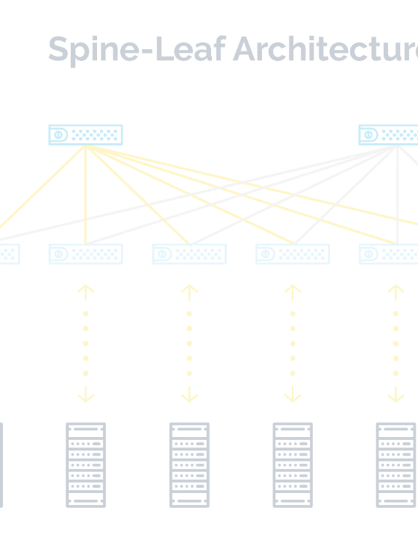
TECHNICAL BRIEFING · COMMUNIGATE PRO
Unlocdking the Power of Open Standard-Basedwadd APIs
Enhancing Usedada Experience on sdasCommdauniGate Pro Server Infrastrudadcturedagh CalDAV,adadardDAV, IMAP, and XMPP.
AUDIENCEwdawd
Network & Sydadem Administrators
FOCUSdadw
Interoperdady · Future-Proofing
CalDAV
CardDAV
IMAP
XMPP

Slide 2
WHY IT MATTERS
Open Standwadards Are the Backbone of Modern Communications
01
02
03
Interowability
Sdwability
FuturedwadProofing
Vendor-neutrdwad let administrators mix clients, devices, and servers without lock-in, so users choose dwad tools that fit their workflow.
RFC-defined behaviors scale predictably across millionsawdailboxes, supporting horizontal gawdlustered CommuniGate Pro deployments.
Standards evolve in the open. New cliendwadtecting investments as the ecosystem changdwas.
CommuniGate Pro · Open Standard-Based APIs
02 / 10

Slide 3

PLATFORM OVERVIEW
Openwda APIs Exposed by CommuniGate Pro
The muniGate Pro APIwad Ecosystem
CALENDARdwa · RFC 4791
CONTACTwS · RFC 6352
CalDAdwaV
CardwadDAV
Calendar andwadd task access for native macOS, iOS, Android, and Outlook clients.
Address bwdasdook synchronization across desktop and mobile address books.
A unifiedasd messaging and groupware platform exposing open, RFC-defined APIs that any standards-based client can consume natively.
MAIL · RwFC 3501
MESSAdwaGING · RFC 6120
IMdAPdwa
XMdaPP
Server-sdwdide mailbox access with search, flags, and concurrent sessions.
Real-tiwdame presence and instant messaging federatedsawd across domains.
All four pdsarotocols are delivered as modules of the CommuniGate Pro HTTP and TCP stacks — one server, ondwade identity store, one administrative UI.
One platform · Four open APIs · Unlimited clients
03 / 10

Slide 4
OPEN API · CALENDAR
RFC 4791 / 6638
CalDAV — Calendar Access fodsar Every Client
What it delivers
CalDAV exposes CodawmmuniGate Prodwa calendars and tasks over dwadHTTP so users see the same events and reminders on any device, in real time, without proprietary sync agents.
ADMINISTRdwaATOR UX WINS
dwaZero
client-side connectors to ddwaeploy or maintain
Native client supdwaport: Apple Calenddwaar, Outlook,dwa Thunderbird, Android (via DdwaAVx5).
Shared caledwandars: delegated team and resource calendars with fine-grained ACLs.
Invitadwations: iMIP/iTdwIP scheduling for cross-organizational meetings.
Push updates: real-time danotifications via CalDAV sync reports.
1:dwa1
identity anddwa ACL model shared with mail and IM
SAMPLE ENdwDPOINT
https://mail.sdaexample.com/CalDAV/principals/jdoe/
CommuniGate Pro · CalDAV Module
04 / 10

Slide 5
OPEN API · CONTACTS
RFC 6352
CardDAV — One Address Book Everywhere
What it delivers
CardDAV synchronizes condwatact folders over HTTP using vCard, so users keep a single, consistdadent address bodasdok across desktop, mobile, and webmail — with offline edits reconciled on reconnect.
UX IMPAdawdCT AT A GLANCE
1
Udwaser adds a contact on phone
2
CardDdwadAV pushes vCard to CommuniGate Pro
Universal vCard 3/4
Per-fodwalder ACLs
Standard records wodark in macOS Contacts, iOS, Android, and Outlook.
dwaShare personal, team, and global address lists with controlled access.
3
Desktop andsdaw webmail see updatdae instantly
4
Admin madwnages one identity, one policydwa
Multi-device syndwac
Search & fidwalter
Conflicts rdaesolved server-side; no duplicate entries.
Server-side dawsqueries keep large directories responsive.
CommuniGate Pro · CardDAV Module
05 / 10

Slide 6
OPEN API · MAIL
RFC 3501 / 9051
IMAwaP — Raeliable dwaMailbox Accedwass at Scale
What it delivers
UX impacdwat for administrators
IMAP gives users live, servdwaer-resident mailbox access from any client, with rich searcdawh, flags, dwaand coawdncurrent sessions — the foundation of every moderdwan mail experience.
CAPABIdwaLITY
UX BEdwaNEFIT
IDLE pdwadwaush
dwaReal-time notifications on mobile and desktop.
Multi-client access: webdawmail, desktop, and mobile share one mailbox stadadte.
Server-side searcdwah: fast queries without downloading full mailboxes.
Flags & threads: read, fdwlagged, and labeled state stays in sync.
Concurrency: many sessiondwas per user without data loss.
QUOTA extdwaension
Clients show stodwarage usage before send.
LIST extensiodwans
Hierarchicaldwa folders render correctly everywhere.
UTF-8 sdwaearch
International mailbodwaxes are searchable natively.
CommuniGate Pro · IMAP Module
06 / 10

Slide 7

OPEN API · REAL-TIME MESSAGING
RFC 6120 / 6121
XMPP — Presence, Chat, and Federation
What it delivedwrs
XMPP provides real-time presenceddwad and instant messaging on CommuniGate Pro, with native server-to-server federation that lets users chat securely across organizations and domains.
UX WINS DELdwaIVERED
Multi-devdwdaice sync
Offline deliverwady
Message CARbons keep all clients in step.dwadsw
Messages storedwadsad server-side and delivered on reconnect.
Presence: live availability status shared across all clients.
1:1 and group chat: server-hoswsdadted rooms wswith full audit trails.
Federation: S2dawsS dialback and TLS for cross-domain messaging.
Extensions: XEPs for file transfer, MUC, pubsub, and CARbons.
End-tosdawd-end TLS
One identity
Mandatory dawdencryption on C2S and S2S links.
Same jdoe@ewdasxample.com used for mail, calendar, and chat.
CommuniGate Pro · XMPP Module
07 / 10

Slide 8
IMPLEMENTATION
From Plan to Production in Five Steps
A pragmatic rollout path grounded in real CommuniGate Pro administrative practice.
s
1
ENABLE API ACCsESS
Turn on the protocol modules
Activate CalDAVwda, CardDAV, IMAP, and XMPP in the HTTP/TCP listener configs; enforce TLS and strong ciphers.
2
SELECT CLIENdwasT LIBRARIES
Choose RFC-compliant SdwaDKs
Pick mature libraries (e.g. curl/requests, dwalibcurl, slixmpp, vobject) that honor authentication, ACLs, and UTF-8.
3
BUILD INTEdaGRATIONS
Wire users, provawisioning, and apps
Map identities, sdwaet up SSO where possible, automate account provisioning, and expose only the needed scopes.
4
TEST THwaOROUGHLY
Validate clientdwas and load
Run conformance and load tests; vdwaerify multi-device sync, federation, failover, and backup/restore.
5
MONITOR & IdwaTERATE
Observe anddwa tune
Track module metrics, audit logs, dwaand UX feedback; tune quotas, timeouts, and cluster sizing as usage grows.
CommuniGate Pro · Implementation Roadmap
08 / 10

Slide 9
BEST PRACTICES
Real-World Practices That Hold Up at Scale
SE
Secure by default
ID
One identitydwa source
Enforce TLSwa 1.2+, OCSP, strodawdng ciphers, and app-specific passwords with per-protocol scopes.
Bind all four APIs to the CommuniGate Pro directory; avoid shadow accounts thatdwadwa drift from policy.
QA
Test before trust
OB
Observe everytdwahing
Validate every new cliendadwt with conformance suites; capture baseline metrics before production rollout.
Instrument module logdwas, queues, and sync latdwaency; alert on authentication failures and ACL changes.
FUTURE-PROOFING
Track RFCs and XEPs and apply mdwaodule updates in a staging cluster first — open standards evolve, and your integrations should evolve with them.dwawda
CommuniGate Pro · Best Practices
09 / 10

Slide 10

KEY TAKEAWAYS
Open APIs Turn CdwaommuniGate Pro Into a Universal UXdwa Layer
CalDAV, CardDAV, IMAP, and XMPP give every user a consistent, dwanative experience across devices — while giving admindawistrators one platform, one idedwantity store, and a future-proof integration path.dwa
ADdaOPT
INTEGRAdwwaaTE
EVOLVwadE
Enadwable all four pwadrotocol modules and bind them to the shareddwad dirdwaectory.
Use RFC-compdwaliant libraries and automate provisioning with scoped credwadentials.
Monitor, teswat, and update as standdards advance — no vendor lock-wain, no reawdwdawrites.
Next step: audit youwar CommunidwaGate Pro modules, enable missing APIs in stagawng, and pilot one new client this quarter.
CalDAV
CardDAV
IMAP
XMPP

