Slide 1

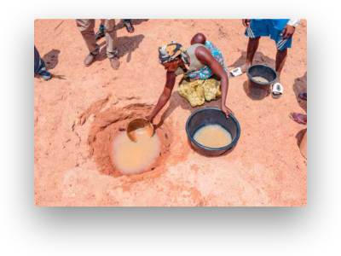
PRACTICAL ACTION · PUPIL ACTIVITY SHEETS
Ditch the Dirt
A clean-water challenge for young scientists: investigate, filter and design affordable ways to make water safe to drink.
Water insecurity affects millions across sub-Saharan Africa.
CONTEXT
12
Linked to UN Sustainable Development Goal 6 — Clean Water & Sanitation — and the community of Turkana, Kenya.
SLIDES

Slide 2
The Sustainable Development Goals
SLIDE 02 · GLOBAL GOALS
In 2015, world leaders agreed on 17 Global Goals to end poverty, protect the planet and ensure prosperity for all by 2030. The Ditch the Dirt challenge focuses on Goal 6 — Clean Water & Sanitation.
GOAL 1
GOAL 2
GOAL 3
GOAL 4
No Poverty
Zero Hunger
Good Health & Well-being
Quality Education
End poverty in all its forms everywhere.
End hunger and promote sustainable agriculture.
Inclusive, equitable learning for all.
Healthy lives for all at all ages.
GOAL 5
GOAL 6
GOAL 7
GOAL 13
Gender Equality
Clean Water & Sanitation
Affordable & Clean Energy
Climate Action
Empower all women and girls.
Combat climate change and its impacts.
Safe water and sanitation for all.
Reliable, sustainable modern energy.
17 Goals · 169 targets · One shared agenda for people and planet.
Source: Ditch the Dirt pupil activity sheets, Practical Action

Slide 3
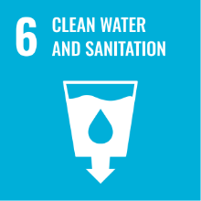
GLOBAL GOAL
Why Goal 6 matters
GOAL 6Clean Water & Sanitation
GOAL 6
Clean water is the foundation of health, education and dignity. Yet billions of people still lack safe water at home. Goal 6 sets clear 2030 targets that drive the Ditch the Dirt challenge.
6.1
Safe drinking water — achieve universal and equitable access for all.
6.2
Sanitation & hygiene — end open defecation and provide adequate facilities.
6.3
Water quality — reduce pollution and halve the proportion of untreated wastewater.
2.2B
3.5B
2030
people lack safely managed drinking water at home.
people lack safely managed sanitation.
UN deadline for achieving Goal 6 targets.
"Ensure availability and sustainable management of water and sanitation for all."
— United Nations, 2015
Source: Practical Action · UN SDG framework

Slide 4
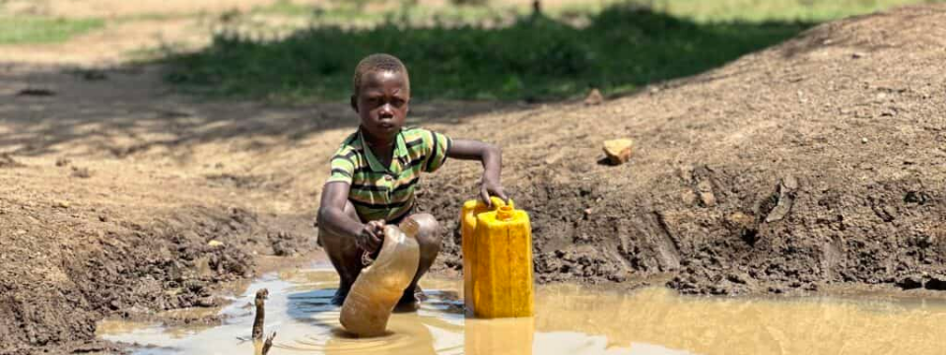

CASE STUDY · TURKANA, KENYA
Water, Life & the Ditch the Dirt Challenge
In Turkana, northern Kenya, families collect water from hand-dug holes in dry riverbeds. The water is often muddy, unsafe and shared with animals. Your challenge: act as a water scientist designing affordable filters for this community.
THE PLACE
THE PEOPLE
THE PROBLEM
Arid county in northern Kenya where surface water is scarce and groundwater is often salty or contaminated.
Pastoralist communities rely on daily water collection, mostly by women and children walking long distances.
Scooped water carries dirt, microbes and debris that cause disease — boiling or filtering is essential before drinking.
Image: village water collection, Innovation: Africa. Source text: Ditch the Dirt pupil sheets, Practical Action.

Slide 5
Investigating Water Quality
SLIDE 05 · ACTIVITY 1
Scientists analyse water from rivers, water holes and treatment works. Your task: examine four samples, recording the odour and appearance, and give each a score on the Water Grading Scale (0 = clear, 4 = very dirty).
Your recording sheet
What to look for
Odour: earthy, fishy, chlorine, rotten-egg, chemical or no smell at all.
Appearance: colour, cloudiness, floating particles, sediment, oily film.
Compare: hold each sample against a white sheet of paper to judge clarity.
Stay safe: smell by wafting — never put your nose directly over the sample.
Sample | Odour — what does it smell of? | Appearance — what does it look like? | Score (0–4)
1 | … | … | …
2 | … | … | …
3 | … | … | …
4 | … | … | …
Record observations in your own words before scoring. Honest descriptions matter more than neat ones.
Activity from: Ditch the Dirt pupil sheets, Practical Action.
Use the Water Grading Strips on the next slide.

Slide 6





Water Grading Strips
SLIDE 06 · SCORING TOOL
Use this 0–4 scale to score the appearance of each water sample. The higher the score, the dirtier the water — and the more work your filter will need to do.
0
1
2
3
4
Clear
Some cloudiness
Cloudy
Dirty
Very dirty
No visible particles; water looks like tap water.
Clearly murky; you cannot see through it.
Dark with sediment; lots of suspended solids.
Thick with mud and debris; almost opaque.
Slight haze; particles only just visible.
Tip: Always score the same way for every sample — hold the jar against white paper, look from the side, and agree on a score with your team before writing it down.
Source: Ditch the Dirt pupil sheets, Practical Action — Water grading strips.

Slide 7
Investigating Sieving
SLIDE 07 · ACTIVITY 2
Sieves separate solid material from a liquid. Imagine your team has been given a sample of dirty water. Test it before and after passing it through two sieves with different mesh sizes — and again with both sieves together.
Recording your results
How to run the test
Properties | Odour | Appearance | Solids in sieve (g)
Water before sieving | … | … | —
After sieve 1 (large mesh) | … | … | …
After sieve 2 (fine mesh) | … | … | …
After sieves 1 + 2 together | … | … | …
Stir the dirty water sample gently, then describe its odour and appearance.
Pour the sample slowly through sieve 1. Catch the water that passes through.
Weigh the solids trapped in the sieve and record your observations.
Repeat with sieve 2, then with both sieves stacked, recording each time.
Compare the water's score on the grading scale before and after each step.
DISCUSS
Which combination of sieves would you recommend to Kenyan scientists as part of a water-cleaning system, and why?
THINK LIKE A SCIENTIST
Sieves remove solids — but do they remove colour, smell or microbes? Note what changes and what does not.
Activity from: Ditch the Dirt pupil sheets, Practical Action.

Slide 8
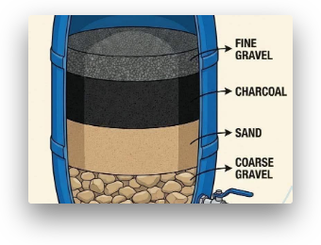
The Ditch the Dirt Challenge
SLIDE 08 · DESIGN & BUILD
Your challenge: design and make a water filter that removes as much "dirt" as possible from a sample of dirty water. Before building your final filter, prototype and test two different designs and record what changes.
Variables to change
Record for each filter
The materials you use for each layer.
The order in which the layers are stacked.
The depth (thickness) of each layer.
Odour of the water before and after.
Appearance description before and after.
Quality grade (0–4) before and after.
Millilitres of water collected in 5 minutes.
Run each test for 5 minutes and measure the water collected.
Then sketch and label your final design — see slide 9.
Image: layered filtration system. Activity from Practical Action's Ditch the Dirt pupil sheets.

Slide 9
Costing Our Water Filter
SLIDE 09 · AFFORDABILITY
Goal 6 calls for water to be safe and affordable. In Turkana, an expensive filter is useless — it must be cheap enough for families to build and replace. Use these local prices to cost your design.
Materials & prices (Kenyan shillings)
WHY DOES COST MATTER?
Currency: £1.00 ≈ 140 Kenyan shillings (KSh).
Many families in Turkana live on very low incomes. A filter that costs too much — or needs parts they cannot find locally — will not be used. Affordable designs save lives.
Material | Cost per unit (KSh) | Qty | Total (KSh)
2 L plastic bottle / tub | 20 | — | —
Gravel | 100 / cup | — | —
Coarse sand | 100 / cup | — | —
Fine sand | 120 / cup | — | —
Marbles | 200 / cup | — | —
Cotton wool | 5 / ball | — | —
Paper towel | 5 / towel | — | —
Cloth | 20 / 10 cm² | — | —
Elastic band | 5 / band | — | —
Card | 10 / sheet | — | —
Junk modelling item | 5 / item | — | —
Total filter cost (KSh) |  |  | —
£1 ≈ 140 KSh
Use this to convert your filter's total cost into pounds and compare with classmates.
DESIGN RULE
Aim for the lowest-cost filter that still achieves a clear improvement in water grade. Cheaper and effective beats expensive and perfect.
Source: Ditch the Dirt pupil sheets, Practical Action.
Costing activity — student worksheet.

Slide 10
What's Really in Dirty Water?
SLIDE 10 · CONTAMINANTS
Filtering removes visible "dirt", but dirty water also carries things you cannot see. Tick the contaminants your filter is likely to remove — and notice which ones it probably will not.
S
L
P
B
Sand & mud
Leaves & debris
Tiny particles
Bacteria & viruses
Suspended soil particles that make water cloudy.
Plant matter, twigs and insects scooped up with the water.
Fine silt and organic matter too small for a coarse sieve.
Microbes that cause diarrhoea, cholera and typhoid.
Filter removes
Filter removes
Depends on layers
Filter does NOT remove
C
O
Co
M
Chemicals
Bad odours
Colour
Microplastics
Dissolved salts, pesticides or pollutants in the water.
Smells from rotting organic matter or sulphur compounds.
Dissolved tannins and humic substances stain the water.
Tiny plastic fragments from polluted environments.
Filter does NOT remove
Partly removed
Filter does NOT remove
Partly removed
Is your filtered water safe to drink?
What else is needed?
Probably NOT. Clear water can still contain harmful microbes and dissolved chemicals that a simple filter cannot remove.
Boiling, solar disinfection, chlorination or a fine bio-sand filter to make water truly safe — see slide 11.
Source: Ditch the Dirt pupil sheets, Practical Action — contaminants checklist.

Slide 11
Research: Making Water Safe to Drink
SLIDE 11 · ACTIVITY 4
A filter that removes dirt is not enough. To make water truly safe, you must also kill or remove the microscopic contaminants. Research the methods and record your findings — pictures and notes both welcome.
Common treatment methods
Your research task
Find out the different types of contaminants that can be found in "dirty" water.
Research the different ways those contaminants can be treated to make the water safe to drink.
Record your findings — notes, diagrams and pictures.
Boiling
Solar disinfection (SODIS)
Bring water to a rolling boil for 1–3 minutes to kill microbes.
Fill clear PET bottles, lay in full sun for 6+ hours; UV kills pathogens.
KILLS MICROBES
LOW-COST
Chlorination
Bio-sand filter
YOUR ROLE
Add chlorine tablets or drops to disinfect water before drinking.
A thick sand layer with a biological "schmutzdecke" that removes pathogens.
You are a water scientist working for a company that wants to invest in ideas helping people in Turkana access clean water.
CHEMICAL
HOUSEHOLD
Ceramic filter
Coagulation & settlement
Porous ceramic candles trap bacteria and fine particles.
Add alum or moringa seeds to clump fine particles so they settle out.
LONG-LIFE
PRE-TREATMENT
Activity from: Ditch the Dirt pupil sheets, Practical Action.
Combine a filter with one of these methods for safe water.

Slide 12

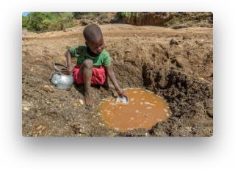
Share, Reflect & Take Action
SLIDE 12 · CLOSING
Present your filter to the class. Listen to other teams, then score each presentation out of 5 across five areas — 5 is the best. The team with the highest total has the strongest case for adoption in Turkana.
Peer-assessment criteria
Recommendations to Kenyan scientists
Teamwork
Did they work well as a team?
Research
How well was research carried out?
Based on your results, what would you tell scientists building filters for families collecting water from ground-water holes in Turkana? Consider cost, locally-available materials, ease of cleaning, and the extra step needed to make water truly safe to drink.
Developing ideas
Good, innovative and improved ideas?
Final model
How good is the finished filter?
Presentation
How well did they communicate?
BIG IDEA
Clean water is not just a science problem — it is a justice issue. Affordable, well-designed filters bring Goal 6 closer for communities like Turkana. Every filter built in a classroom is a step toward that goal.
Source: Ditch the Dirt pupil sheets, Practical Action.
practicalaction.org

