Slide 1

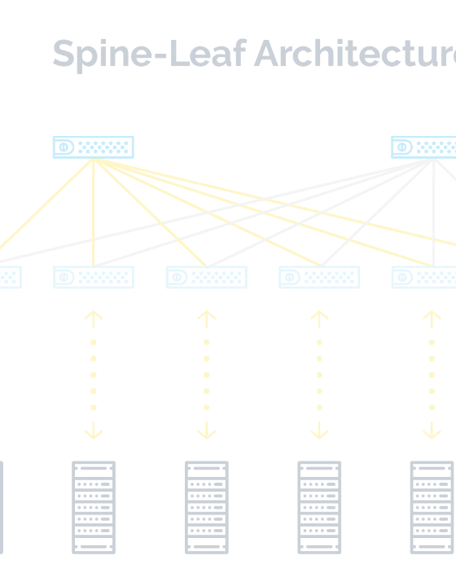
TECHNICAL BRIEFING · COMMUNIGATE PRO
Unlocking the Power of Open Standard-Based APIs
Enhancing User Experience on CommuniGate Pro Server Infrastructure through CalDAV, CardDAV, IMAP, and XMPP.
AUDIENCE
Network & System Administrators
FOCUS
Interoperability · Scalability · Future-Proofing
CalDAV
CardDAV
IMAP
XMPP

Slide 2
WHY IT MATTERS
Open Standards Are the Backbone of Modern Communications
01
02
03
Interoperability
Scalability
Future-Proofing
Vendor-neutral protocols let administrators mix clients, devices, and servers without lock-in, so users choose the tools that fit their workflow.
RFC-defined behaviors scale predictably across millions of mailboxes, supporting horizontal growth and clustered CommuniGate Pro deployments.
Standards evolve in the open. New clients and platforms integrate without rewrites, protecting investments as the ecosystem changes.
CommuniGate Pro · Open Standard-Based APIs
02 / 10

Slide 3

PLATFORM OVERVIEW
Open APIs Exposed by CommuniGate Pro
The CommuniGate Pro API Ecosystem
CALENDAR · RFC 4791
CONTACTS · RFC 6352
CalDAV
CardDAV
Calendar and task access for native macOS, iOS, Android, and Outlook clients.
Address book synchronization across desktop and mobile address books.
A unified messaging and groupware platform exposing open, RFC-defined APIs that any standards-based client can consume natively.
MAIL · RFC 3501
MESSAGING · RFC 6120
IMAP
XMPP
Server-side mailbox access with search, flags, and concurrent sessions.
Real-time presence and instant messaging federated across domains.
All four protocols are delivered as modules of the CommuniGate Pro HTTP and TCP stacks — one server, one identity store, one administrative UI.
One platform · Four open APIs · Unlimited clients
03 / 10

Slide 4
OPEN API · CALENDAR
RFC 4791 / 6638
CalDAV — Calendar Access for Every Client
What it delivers
CalDAV exposes CommuniGate Pro calendars and tasks over HTTP so users see the same events and reminders on any device, in real time, without proprietary sync agents.
ADMINISTRATOR UX WINS
Zero
client-side connectors to deploy or maintain
Native client support: Apple Calendar, Outlook, Thunderbird, Android (via DAVx5).
Shared calendars: delegated team and resource calendars with fine-grained ACLs.
Invitations: iMIP/iTIP scheduling for cross-organizational meetings.
Push updates: real-time notifications via CalDAV sync reports.
1:1
identity and ACL model shared with mail and IM
SAMPLE ENDPOINT
https://mail.example.com/CalDAV/principals/jdoe/
CommuniGate Pro · CalDAV Module
04 / 10

Slide 5
OPEN API · CONTACTS
RFC 6352
CardDAV — One Address Book Everywhere
What it delivers
CardDAV synchronizes contact folders over HTTP using vCard, so users keep a single, consistent address book across desktop, mobile, and webmail — with offline edits reconciled on reconnect.
UX IMPACT AT A GLANCE
1
User adds a contact on phone
2
CardDAV pushes vCard to CommuniGate Pro
Universal vCard 3/4
Per-folder ACLs
Standard records work in macOS Contacts, iOS, Android, and Outlook.
Share personal, team, and global address lists with controlled access.
3
Desktop and webmail see update instantly
4
Admin manages one identity, one policy
Multi-device sync
Search & filter
Conflicts resolved server-side; no duplicate entries.
Server-side queries keep large directories responsive.
CommuniGate Pro · CardDAV Module
05 / 10

Slide 6
OPEN API · MAIL
RFC 3501 / 9051
IMAP — Reliable Mailbox Access at Scale
What it delivers
UX impact for administrators
IMAP gives users live, server-resident mailbox access from any client, with rich search, flags, and concurrent sessions — the foundation of every modern mail experience.
CAPABILITY
UX BENEFIT
IDLE push
Real-time notifications on mobile and desktop.
Multi-client access: webmail, desktop, and mobile share one mailbox state.
Server-side search: fast queries without downloading full mailboxes.
Flags & threads: read, flagged, and labeled state stays in sync.
Concurrency: many sessions per user without data loss.
QUOTA extension
Clients show storage usage before send.
LIST extensions
Hierarchical folders render correctly everywhere.
UTF-8 search
International mailboxes are searchable natively.
CommuniGate Pro · IMAP Module
06 / 10

Slide 7

OPEN API · REAL-TIME MESSAGING
RFC 6120 / 6121
XMPP — Presence, Chat, and Federation
What it delivers
XMPP provides real-time presence and instant messaging on CommuniGate Pro, with native server-to-server federation that lets users chat securely across organizations and domains.
UX WINS DELIVERED
Multi-device sync
Offline delivery
Message CARbons keep all clients in step.
Messages stored server-side and delivered on reconnect.
Presence: live availability status shared across all clients.
1:1 and group chat: server-hosted rooms with full audit trails.
Federation: S2S dialback and TLS for cross-domain messaging.
Extensions: XEPs for file transfer, MUC, pubsub, and CARbons.
End-to-end TLS
One identity
Mandatory encryption on C2S and S2S links.
Same jdoe@example.com used for mail, calendar, and chat.
CommuniGate Pro · XMPP Module
07 / 10

Slide 8
IMPLEMENTATION
From Plan to Production in Five Steps
A pragmatic rollout path grounded in real CommuniGate Pro administrative practice.
1
ENABLE API ACCESS
Turn on the protocol modules
Activate CalDAV, CardDAV, IMAP, and XMPP in the HTTP/TCP listener configs; enforce TLS and strong ciphers.
2
SELECT CLIENT LIBRARIES
Choose RFC-compliant SDKs
Pick mature libraries (e.g. curl/requests, libcurl, slixmpp, vobject) that honor authentication, ACLs, and UTF-8.
3
BUILD INTEGRATIONS
Wire users, provisioning, and apps
Map identities, set up SSO where possible, automate account provisioning, and expose only the needed scopes.
4
TEST THOROUGHLY
Validate clients and load
Run conformance and load tests; verify multi-device sync, federation, failover, and backup/restore.
5
MONITOR & ITERATE
Observe and tune
Track module metrics, audit logs, and UX feedback; tune quotas, timeouts, and cluster sizing as usage grows.
CommuniGate Pro · Implementation Roadmap
08 / 10

Slide 9
BEST PRACTICES
Real-World Practices That Hold Up at Scale
SE
Secure by default
ID
One identity source
Enforce TLS 1.2+, OCSP, strong ciphers, and app-specific passwords with per-protocol scopes.
Bind all four APIs to the CommuniGate Pro directory; avoid shadow accounts that drift from policy.
QA
Test before trust
OB
Observe everything
Validate every new client with conformance suites; capture baseline metrics before production rollout.
Instrument module logs, queues, and sync latency; alert on authentication failures and ACL changes.
FUTURE-PROOFING
Track RFCs and XEPs and apply module updates in a staging cluster first — open standards evolve, and your integrations should evolve with them.
CommuniGate Pro · Best Practices
09 / 10

Slide 10

KEY TAKEAWAYS
Open APIs Turn CommuniGate Pro Into a Universal UX Layer
CalDAV, CardDAV, IMAP, and XMPP give every user a consistent, native experience across devices — while giving administrators one platform, one identity store, and a future-proof integration path.
ADOPT
INTEGRATE
EVOLVE
Enable all four protocol modules and bind them to the shared directory.
Use RFC-compliant libraries and automate provisioning with scoped credentials.
Monitor, test, and update as standards advance — no vendor lock-in, no rewrites.
Next step: audit your CommuniGate Pro modules, enable missing APIs in staging, and pilot one new client this quarter.
CalDAV
CardDAV
IMAP
XMPP

