Slide 1

Hybrid QAOA Portfolio Optimizer
Andry Paez
Womanium & WISER 2025 Quantum Program

Slide 2
Problem statement
Classical tool-chain (GUROBI / CPLEX) struggles
More than 100 constraints, dense quadratic cost
Compute budget; real-time trading loop
Goal: hit near-optimal solutions fast and shallow enough for NISQ hardware
Business impact: cheaper hedging, tighter tracking error, richer scenario sampling

Slide 3
Solution
Replace full-blown MILP with binary QUBO black-box
Demonstrate QAOA (varying p) on 31 qubits
Make use of already implemented bit-flip local search to close residual gap
Compare against pure CPLEX optimum

Slide 4
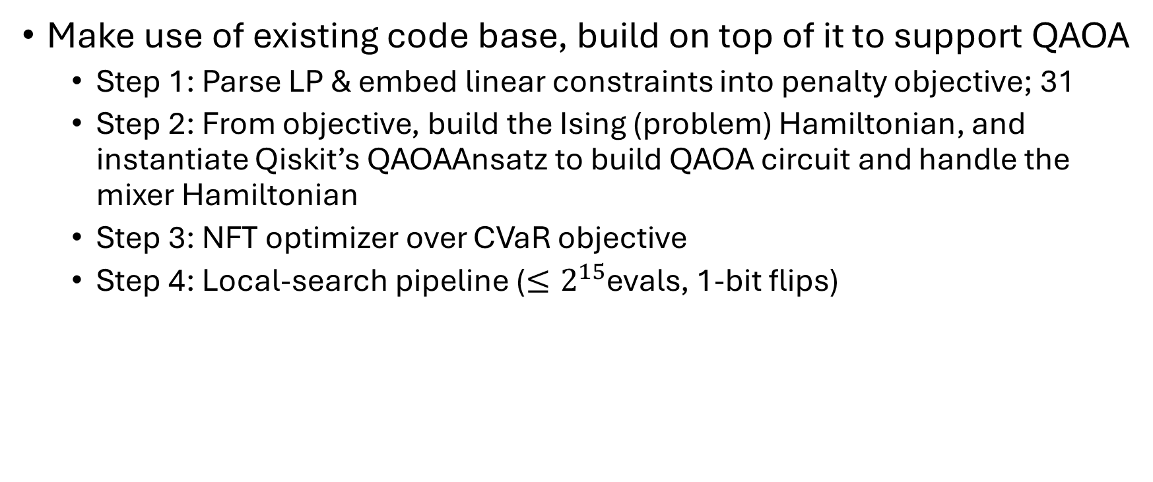
Methods
Make use of existing code base, build on top of it to support QAOA
Step 1: Parse LP & embed linear constraints into penalty objective; 31
Step 2: From objective, build the Ising (problem) Hamiltonian, and instantiate Qiskit’s QAOAAnsatz to build QAOA circuit and handle the mixer Hamiltonian
Step 3: NFT optimizer over CVaR objective
Step 4: Local-search pipeline ($≤2^{15}$evals, 1-bit flips)

Slide 5
Results and Impact
Metric (median of 100 runs) | CPLEX | QAOA (p=3) pre-LS | QAOA (p=3) post-LS
Median Objective Gap | 0 % | 5.6180 % | 0.0186 %
2-Qubit depth |  | 49 | 49
Runs hitting optimum | 0 / 1 | 0 % | 40 %

Slide 6
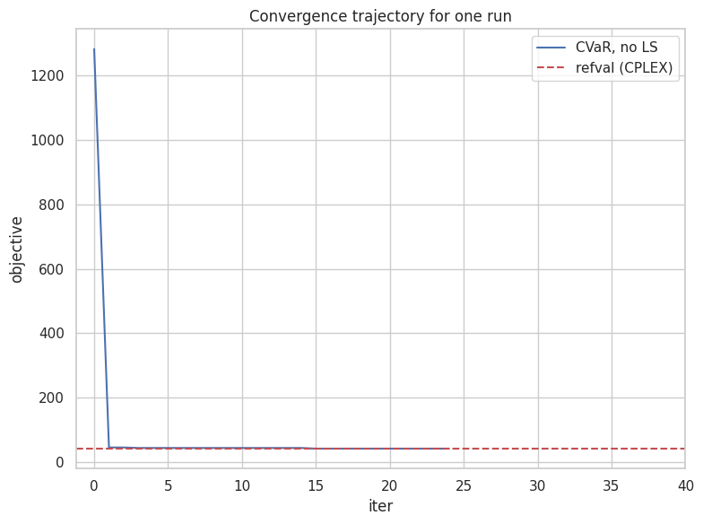
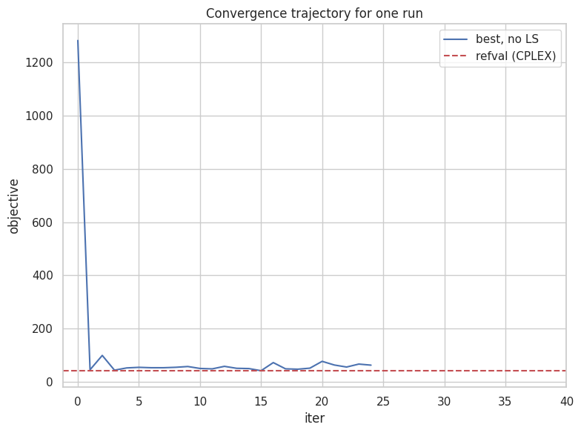
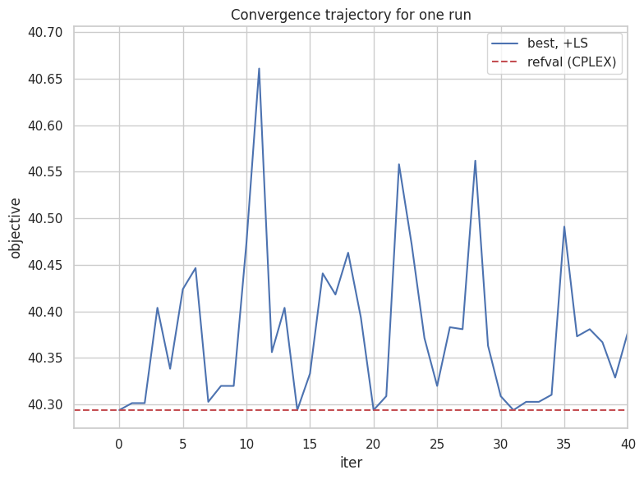
Results and Impact

Slide 7
Results and Impact
Practical: Shows production-sized bond basket can be solve on NISQ depths
Technical: minimal-touch integration of Qiskit patterns into legacy code
Open-source add-ons: Poetry env, CLI wrappers, QAOA handlers

Slide 8
Future Work
Automated depth-vs-gap sweeps (p = 1 … 6) under realistic hardware noise
Swap bit-flip LS for ILP bootstrapped Tabu to speed post-processing
Integrate AI transpiler passes for further depth-cuts
Extend benchmark to multi-period & factor risk constraints

Slide 9
Thank You!

