Slide 1

1M1B INITIATIVE • UN SDG 2: ZERO HUNGER
FoodWatch
Real-Time Surplus Food Redistribution & Policy Intelligence Platform
Connecting restaurants, banquet halls, and commercial donors with local grassroots NGOs, orphanages, and community kitchens in real time before fresh food perishes.
Real-Time Geospatial Coordination
Live interactive Leaflet maps, dynamic shelf-life countdowns, and atomic lock claims to eliminate urban food waste.
🌱 Developed for 1M1B (1 Million for 1 Billion) Foundation
Full-Stack Web Architecture | Policy Portal | AI Assistant | 2026
FoodWatch — SDG 2 Zero Hunger Surplus Food Platform | 1M1B Initiative
Slide 1 of 12

Slide 2
EXECUTIVE SUMMARY
Project Overview & Strategic Vision
A comprehensive ecosystem tackling food waste through technology, policy, and AI.
01
02
03
Hyperlocal Redistribution Platform
Full-stack MERN platform connecting food surplus donors (restaurants, caterers, hotels) with verified NGOs and shelters within a critical 2-hour window before cooked food spoils.
KEY CAPABILITIES:
• Sub-minute donation listings
• Interactive Leaflet geospatial map
• Atomic race-condition safe claiming
• Live impact tracker (meals & CO2)
National Policy & Research Hub
Data-driven portal synthesizing primary-source loss datasets from ICAR, CAG, and NITI Aayog, alongside actionable guidance on key government schemes.
KEY CAPABILITIES:
• ICAR & FAO post-harvest metrics
• PMKSY & RKVY cold-chain analysis
• APMC Mandi price distortion studies
• Citizen & community action frameworks
AI Assistant: 'IBM Bob'
Conversational AI advisor inspired by IBM watsonx, engineered to answer complex questions regarding food preservation, government subsidies, and logistics.
KEY CAPABILITIES:
• Instant scheme eligibility answers
• Storage & hygiene guidelines
• NGO onboarding assistance
• FSSAI compliance recommendations
🎯 Core Mission: Accelerate UN SDG 2 (Zero Hunger) by transforming uncoordinated food waste into dignified community nutrition.
FoodWatch — SDG 2 Zero Hunger Surplus Food Platform | 1M1B Initiative
Slide 2 of 12

Slide 3
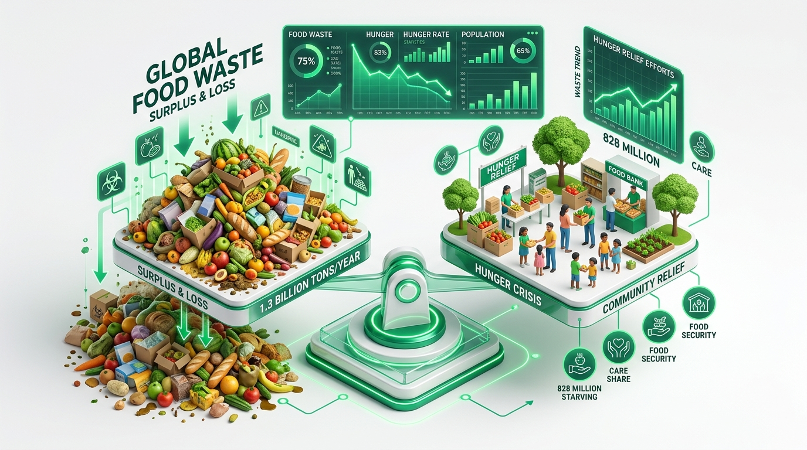
THE CRISIS
The Grand Paradox: Massive Waste Amid Chronic Hunger
India's food distribution crisis stems from broken logistics, missing cold chains, and lack of coordination.
₹1.53 Lakh Crore
Annual Value of Food Lost
According to ICAR (2022) and NITI Aayog, food loss across post-harvest and supply chain amounts to 1.53 Lakh Cr annually.
67 Million MT
Food Wasted Annually
India throws away over 67 million metric tonnes of food each year — equal to the total food consumption of the state of Bihar.
Why Cooked Food Is Discarded Nightly:
• Unpredictable Event Surplus: Banquet halls and caterers over-prepare by 15-25% to avoid shortages.
• Missing Real-Time Channels: No quick directory of nearby shelters with active night-time capacity.
• Liability & Trust Hesitation: Fear of food safety liabilities without verified hygiene declarations.
111th / 125
Global Hunger Index Rank
Despite record agricultural yields, severe child wasting (18.7%) and micronutrient deficiencies afflict vulnerable populations.
FoodWatch — SDG 2 Zero Hunger Surplus Food Platform | 1M1B Initiative
Slide 3 of 12

Slide 4
DATA & RESEARCH
Primary-Source Research & Supply Chain Bottlenecks
Synthesized from national audits (CAG, ICAR, Shanta Kumar Committee, NHB).
COLD CHAIN CONCENTRATION
PERISHABLE COLD CHAIN
75% — Concentrated in 5 States
India has 8,186 cold storage units (37.4M MT capacity), but 75% of capacity is clustered in just UP, WB, Punjab, Gujarat, and MP. Rural India remains almost entirely disconnected.
📄 Source: National Horticulture Board (NHB 2023) / MoFPI
11% — Produce in Integrated Chain
Only 11% of India's perishable fruits and vegetables move through an unbroken temperature-controlled cold chain, causing rapid biological decomposition.
📄 Source: Ministry of Food Processing Industries (MoFPI 2023)
MSP BENEFIT GAP
POST-HARVEST TRANSIT LOSS
6% — Farmers Benefiting from MSP
The Shanta Kumar Committee Report documented that only 6% of Indian farmers receive official MSP rates. The remaining 94% suffer distress sales and lack storage.
📄 Source: High Level Committee on Agri Marketing (2015)
7–15% — Weight Lost in Transport
ICAR studies found 7% to 15% vegetable weight loss during transport due to rough handling, non-ventilated vehicles, and 41% unpaved rural road networks.
📄 Source: ICAR Assessment (2022) / PMGSY Progress Report
FoodWatch — SDG 2 Zero Hunger Surplus Food Platform | 1M1B Initiative
Slide 4 of 12

Slide 5
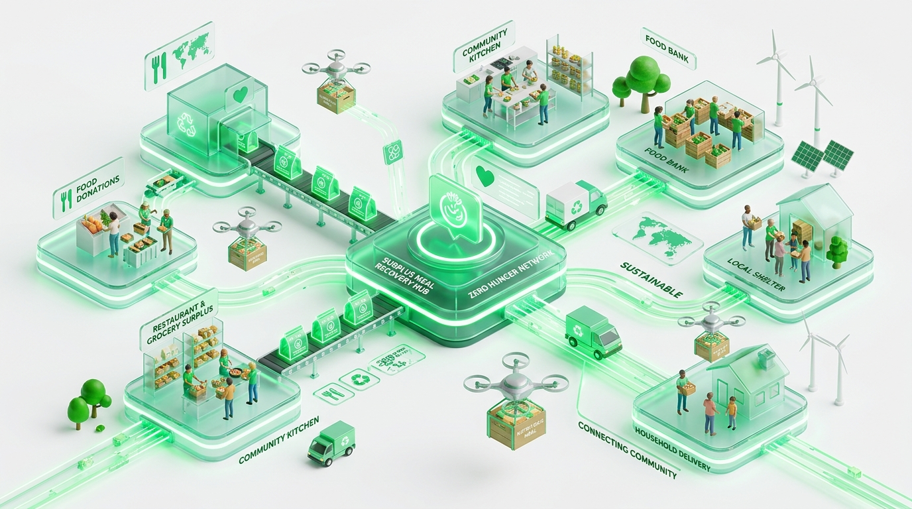
OUR SOLUTION
FoodWatch: Real-Time Geospatial Food Rescue
A technology platform engineered to bridge donors and grassroots relief agencies within minutes.
⚡ 60-Second Surplus Listing
Kitchens and banquet managers can post meals in under a minute with portions, photos, preparation timestamps, and dietary tags (Veg, Non-Veg, Vegan).
🗺️ Interactive Geospatial Map
Built on Leaflet and OpenStreetMap. Verified NGOs visualize listings within 5km/10km/25km radiuses with immediate distance sorting.
⏳ Automated Shelf-Life Engine
Dynamic server-calculated countdown timers. Warning notifications trigger when items approach expiry, preventing spoiled food delivery.
Closing the Urban Surplus Loop
FoodWatch turns an otherwise discarded resource into high-protein, balanced nourishment for underprivileged children, elderly homes, and migrant shelters.
🛡️ Trust & Verification Shield
Mandatory food hygiene declarations, phone OTP verification for accountability, and 1-5 star post-collection donor review system.
FoodWatch — SDG 2 Zero Hunger Surplus Food Platform | 1M1B Initiative
Slide 5 of 12

Slide 6
LIFECYCLE
End-to-End Operational Workflow
From kitchen surplus creation to verified NGO distribution and carbon accounting.
STEP 1
STEP 2
STEP 3
STEP 4
STEP 5
Surplus Listed
Donor uploads meal info, portions, shelf-life, and location. Signs hygiene declaration.
Expiry Calculated
Engine sets expiresAt = preparedAt + shelfLife. Listing appears LIVE on map.
Discovery & Filter
NGOs discover food on Leaflet map, filter by dietary tags (Veg/Vegan) and distance.
Atomic Claim
System uses atomic findOneAndUpdate to lock listing and prevent duplicate claims.
Handover & Review
NGO collects food, marks collected. Donor receives 1-5 star review. Impact calculated.
⚙️ Automated Background Engine (node-cron Active Job Queue)
• Expiry Watchdog: Runs every 5 minutes. Evaluates all active donations against UTC server time.
• Urgent Alerts: Sends SMS and in-app alerts to donor if listing remains unclaimed 30 minutes prior to expiry.
• Auto-Prune: Flips expired items to EXPIRED status, removing them from the public map to guarantee food safety.
FoodWatch — SDG 2 Zero Hunger Surplus Food Platform | 1M1B Initiative
Slide 6 of 12

Slide 7
TECH STACK
Robust Full-Stack Engineering Architecture
Built for high availability, transactional integrity, and responsive user experience.
FRONTEND ECOSYSTEM
BACKEND PLATFORM
DATABASE & PRIVACY
React 18 & React Router v6
Component-driven SPA architecture with client-side routing.
Leaflet & OpenStreetMap
Geospatial mapping without costly proprietary API vendor lock-in.
Recharts Library
Dynamic data visualization for impact metrics and trends.
Vanilla CSS Design Tokens
Modern responsive design with CSS variables, zero framework bloat.
Node.js & Express.js
Asynchronous, event-driven RESTful API endpoints.
node-cron Job Engine
Automated background jobs executing every 5 minutes.
JWT & Bcrypt Security
Stateless authentication with salt-hashed password security.
SMS OTP Gateway Support
MSG91/Twilio integration with local dev console fallback.
MongoDB with Mongoose
Flexible NoSQL schema handling rapid status state transitions.
Atomic findOneAndUpdate
Eliminates race conditions when multiple NGOs claim simultaneously.
DPDP Act Compliance
Zero raw 12-digit Aadhaar storage; uses optional last 4 digits only.
Comprehensive Seeds
Preloaded test scenarios for donors, recipients, and claims.
FoodWatch — SDG 2 Zero Hunger Surplus Food Platform | 1M1B Initiative
Slide 7 of 12

Slide 8
CORE FEATURES
Engineering Highlights & Concurrency Handling
Purpose-built architectural mechanisms solving the real-world operational challenges of food redistribution.
Atomic Claim Locks (Anti-Race Condition)
Challenge: In high-density urban areas, popular surplus listings can be targeted by multiple shelters at once. Standard read-then-write updates cause double-claiming disasters.
Technical Solution: Leverages MongoDB's atomic findOneAndUpdate with status === 'available' filter. The first receiver acquires an exclusive lock; subsequent calls receive HTTP 409 Conflict with friendly UI explanations.
Dynamic Shelf-Life & Expiry Math
Challenge: Food safety is non-negotiable. Static pickup times fail when events conclude earlier or later than planned.
Technical Solution: Computes precise expiresAt from preparation timestamp and certified shelf-life hours. Displays real-time countdown badges on cards and auto-delists items upon expiry.
Phone OTP & DPDP Act Privacy Guard
Challenge: NGOs and donors require mutual trust without violating India's Digital Personal Data Protection (DPDP) Act 2023.
Technical Solution: Verification relies on phone OTP. Strict data minimization ensures no full 12-digit Aadhaar numbers are collected or stored in database records.
Two-Way Feedback & Accountability Loop
Challenge: Eliminating poor-quality donations through social accountability and donor recognition.
Technical Solution: Post-collection review prompt where recipient NGOs rate food freshness, hygiene, and packaging on a 1-to-5 star scale, building an immutable community trust score.
FoodWatch — SDG 2 Zero Hunger Surplus Food Platform | 1M1B Initiative
Slide 8 of 12

Slide 9
IMPACT METRICS
Quantifying Social & Environmental Impact
Automated real-time mathematical calculations converting rescued meals into environmental equivalents.
MEALS RESCUED
CO2e DIVERTED
VIRTUAL WATER
2.5x
Meals per kg Rescued
Every kilogram of surplus cooked food collected provides approximately 2.5 wholesome, calorically sufficient meal portions.
2.5 kg
Emissions Avoided / kg
Prevents organic waste from entering landfills, stopping anaerobic decay and high-potency methane gas release.
1,000 L
Water Saved / kg
Preserves the agricultural irrigation water already invested into cultivating, harvesting, and preparing the food.
Transparent Public Impact Dashboard
FoodWatch features an open, real-time public impact page (/impact) providing full institutional transparency:
• Donor Leaderboards: Recognizing top corporate and hotel donors to encourage CSR competition.
• Category Breakdown: Live analytics tracking Grain, Dairy, Vegetable, and Cooked Meal distributions.
• Live Verification Auditing: Every rescued batch displays verified pickup timestamps and NGO recipient receipts.
FoodWatch — SDG 2 Zero Hunger Surplus Food Platform | 1M1B Initiative
Slide 9 of 12

Slide 10
POLICY & AI
Government Scheme Alignment & AI Advisory
Empowering users with actionable policy insights and conversational guidance.
Key Government Policy Interfaces
• PM Kisan SAMPADA Yojana (PMKSY)
Ministry of Food Processing Industries scheme offering up to 50% capital subsidy for integrated cold chain and post-harvest infrastructure.
• Operation Greens (TOP to TOTAL)
Price stabilization program for Tomatoes, Onions, and Potatoes, funding 50% transport and cold storage subsidies during gluts.
• FSSAI IFSA (Save Food Share Food)
Food Safety & Standards Authority guidelines establishing hygiene regulations and liability shields for surplus food donations.
• RKVY-RAFTAAR Grants
Funds agritech startups and community farmer producer organizations (FPOs) building hyperlocal aggregation centers.
🤖 IBM Bob — AI Food Policy Assistant
Inspired by IBM watsonx, 'Bob' is an embedded conversational assistant helping grassroots NGOs, caterers, and citizens navigate policy and food handling.
Example Queries Handled by Bob:
💬 "How do I apply for the PMKSY cold chain capital subsidy?"
💬 "What are the FSSAI hygiene rules for donating cooked rice?"
💬 "Which states have the highest post-harvest potato wastage?"
💬 "How can our shelter set up an automated pickup route?"
FoodWatch — SDG 2 Zero Hunger Surplus Food Platform | 1M1B Initiative
Slide 10 of 12

Slide 11
FUTURE SCOPE
Scalability Model & Multi-Phase Roadmap
A phased deployment strategy taking FoodWatch from city pilot to national scale.
PHASE 1 (DEPLOYED)
PHASE 2 (NEAR-TERM)
PHASE 3 (MID-TERM)
PHASE 4 (SCALE)
Metro Foundation
• Full-stack web platform active
• Leaflet geospatial discovery
• Atomic claim locking
• Seed data across Delhi, Bengaluru, and Mumbai
Mobile & Logistics
• React Native iOS/Android app
• 'FoodWatch Runners' volunteer delivery network
• Push notifications via Firebase FCM
• Automated route bundling
IoT & Smart Chillers
• Integration with smart BLE temperature sensors
• Real-time cold storage container tracking
• Predictive AI forecasting wedding surplus volume
• Neighborhood food bank micro-hubs
Corporate CSR & 80G
• Automated 80G tax exemption certificates
• Corporate ESG/CSR compliance reporting
• FSSAI national portal integration
• Pan-India scale across Tier 2/3 cities
FoodWatch — SDG 2 Zero Hunger Surplus Food Platform | 1M1B Initiative
Slide 11 of 12

Slide 12
CONCLUSION & SDG 2 ALIGNMENT
Feeding People, Not Landfills
FoodWatch bridges the critical divide between urban abundance and chronic hunger. By uniting geospatial technology, atomic state-locks, and grassroots community mobilization, we make Zero Hunger a tangible reality.
SDG 2.1 Access to Food
Ensuring safe, nutritious food all year round for the poor and vulnerable.
SDG 12.3 Halve Food Waste
Cutting retail and consumer food waste while reducing supply chain losses.
1M1B Youth Leadership
Mobilizing technology to impact 1 million leaders for 1 billion citizens.
🔗 GitHub: github.com/zeaqc/FoodWatch-1m1b • Live Platform: localhost:3000
FoodWatch — SDG 2 Zero Hunger Surplus Food Platform | 1M1B Initiative
Slide 12 of 12

