Slide 1
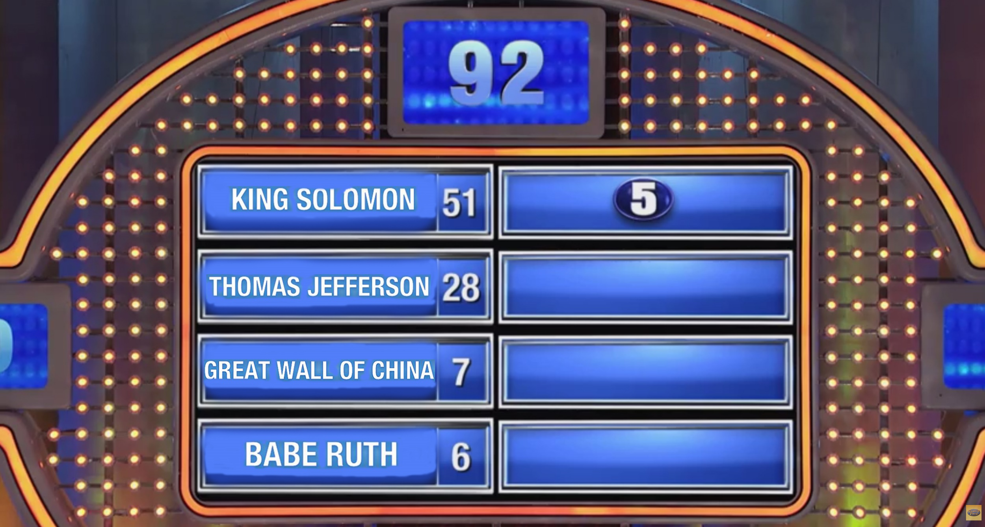

Slide 2
1
31
COFFEE

Slide 3
31
1
31
5
COFFEE
2
3
4

Slide 4
31
1
31
5
COFFEE
2
3
4

Slide 5
31
1
31
5
COFFEE
2
3
4

