Slide 1
Book1
File created on: 3/6/2023 9:42:25 PM

Slide 2
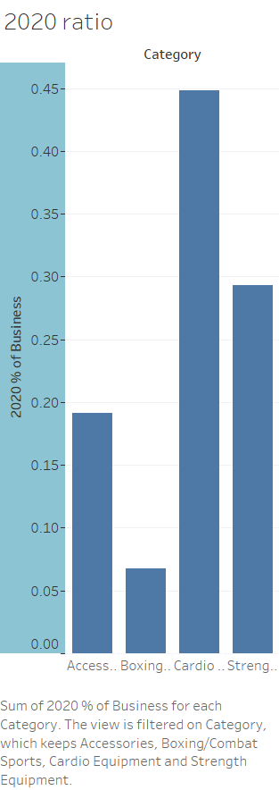

Slide 3
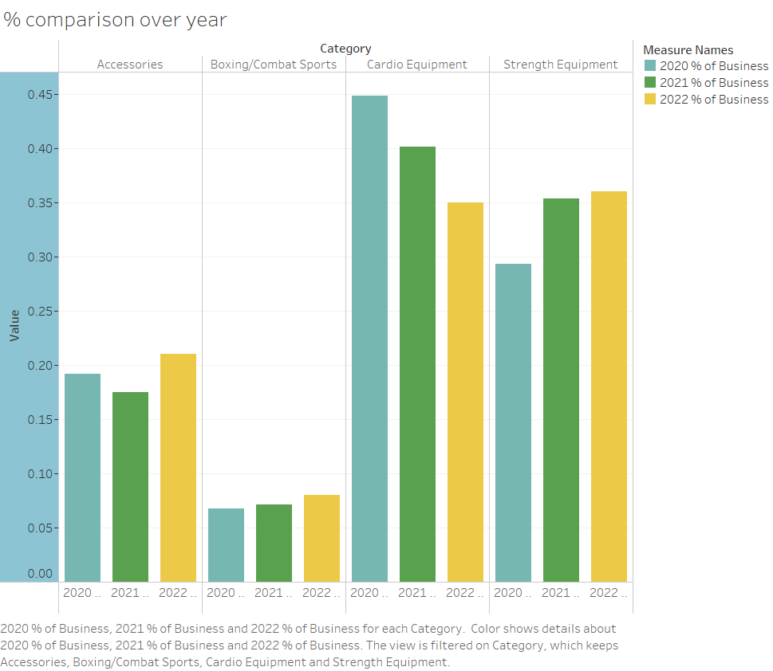

Slide 4
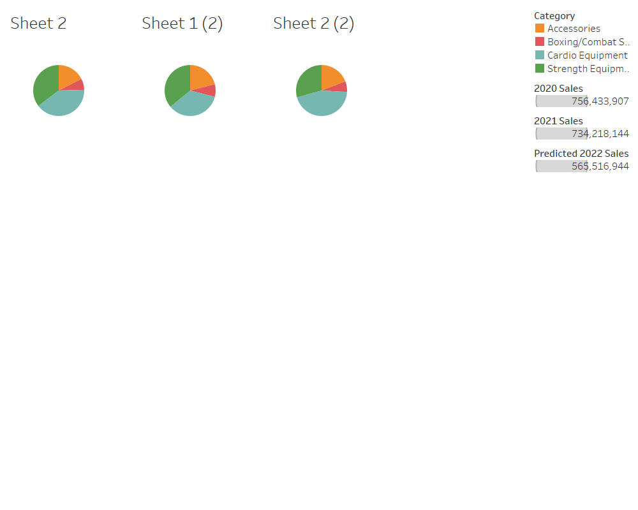

Slide 5
