Slide 1
STZWorkbook
File created on: 3/6/2023 9:37:42 PM

Slide 2
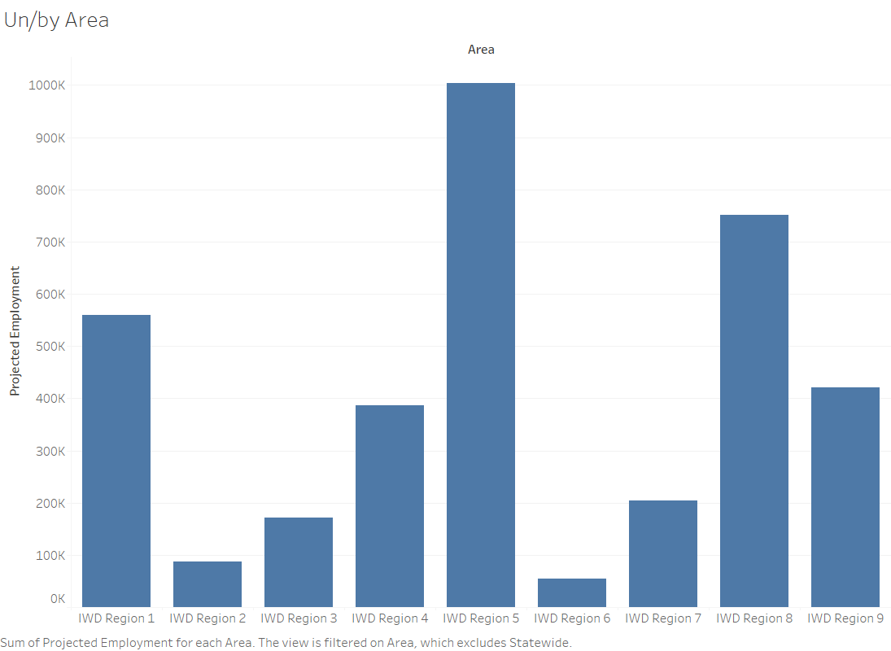

Slide 3
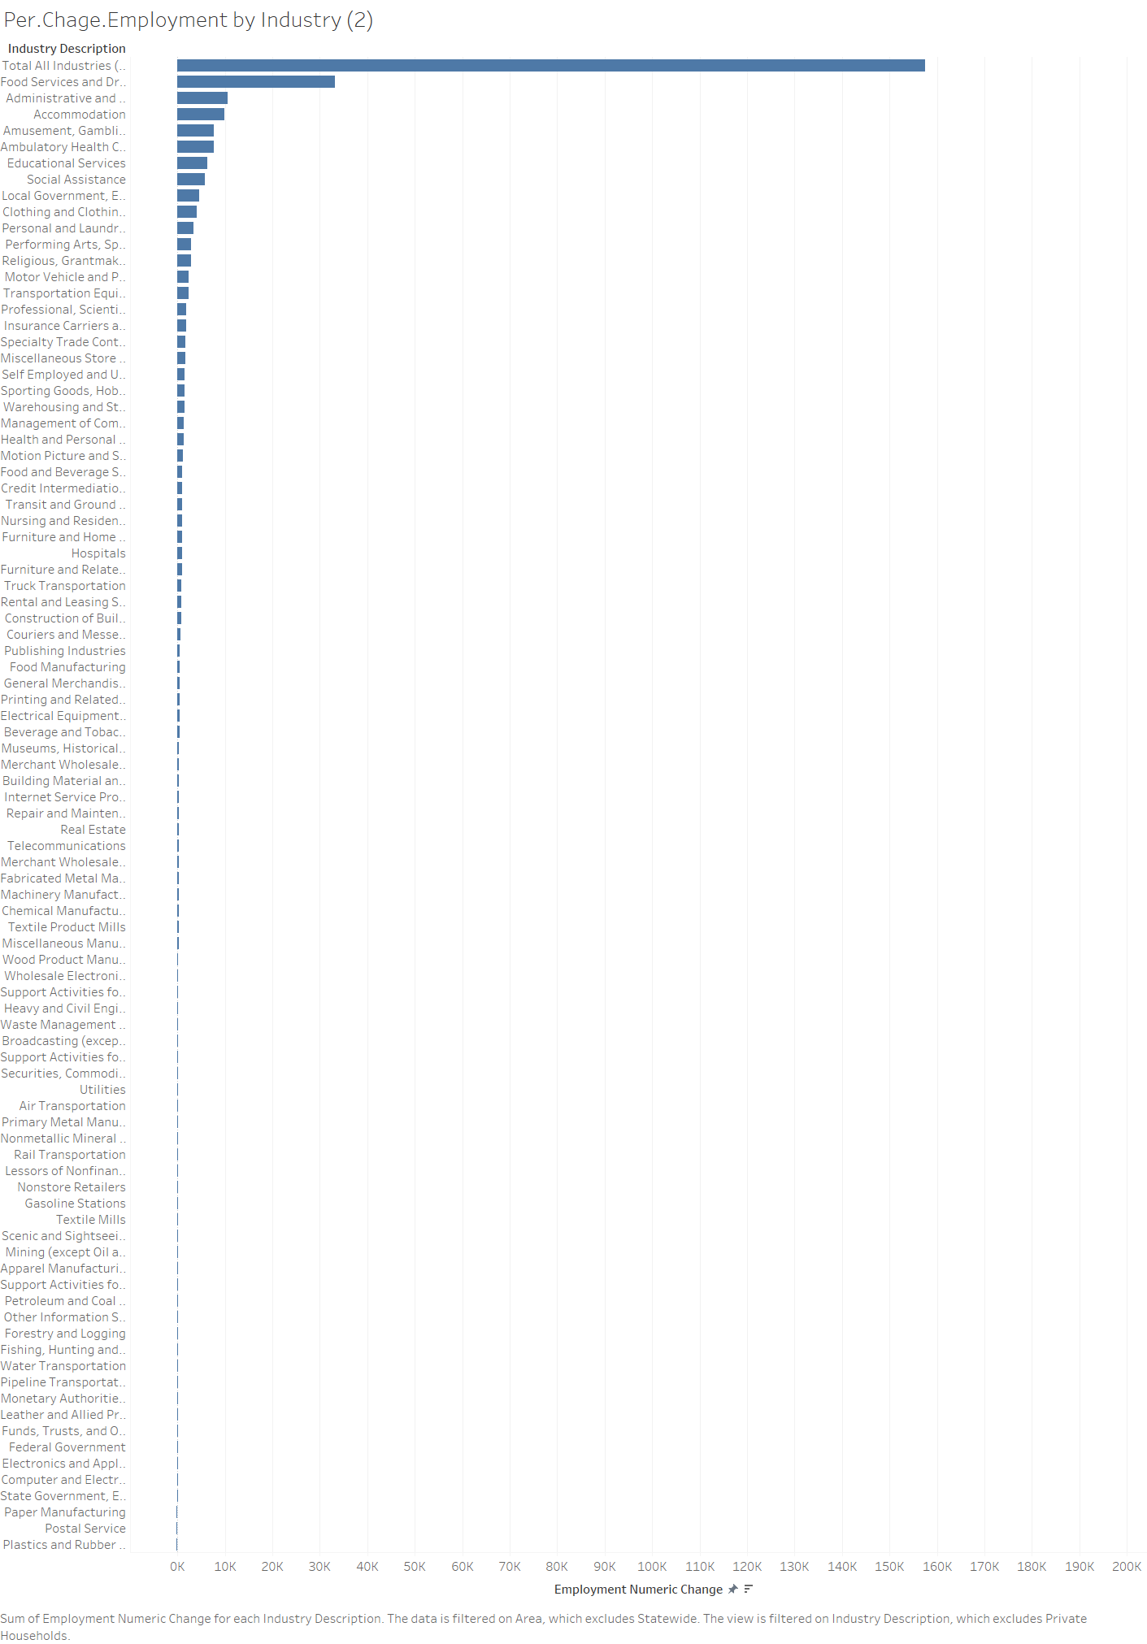

Slide 4
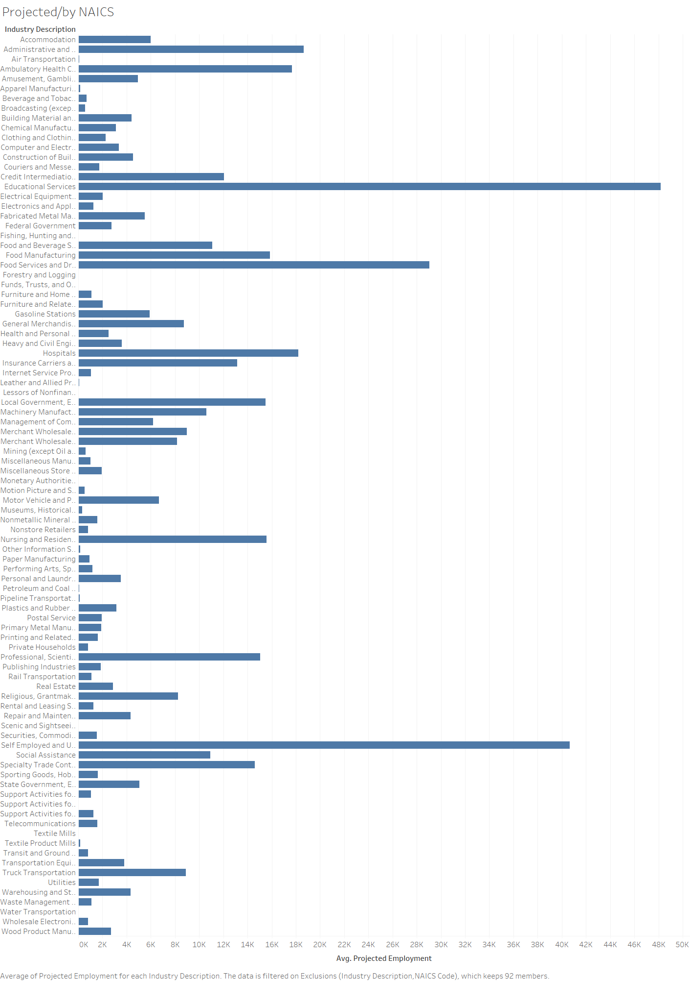

Slide 5
