Slide 2


Subtitle: Streamlining the automation of fundamental data lake components, such as AWS Glue, Amazon SQS, AWS Lambda, and Amazon S3, across multiple AWS accounts.
Title: Serverless Automated Datalake Deployment using AWS services
Presenters: AWS & DevOps POD

Slide 3
Problem
Time Intensive process to setup foundational structure for data lake.
Delay in operationalizing data lake to serve even after development is completed.
Issues while final E2E deployment of data lake.
Developer to spend additional time in setting up CI/CD pipeline.

Slide 4
POC Overview
1.Creating AWS CodePipeline with CloudFormation
2.Deployment of resources across multiple AWS accounts
3.Automating ETL job deployment

Slide 5
Required Components
AWS Accounts
Tools Account
Code Pipeline
CloudFormation
Stacks
Target Account
Source: CodeCommit
Artifacts: CodeArtifacts
Build: CodeBuild
Pipeline: CodePipeline
KMS Key
Customer managed key
Cross-Account Roles
sts: AssumeRole
IAC
AWS Glue ETL
Cross access policy
SQS, Lambda Function, Iceberg database

Slide 6
AWS CodePipeline Overview
Definition and Purpose
A fully managed continuous delivery service.
Automates the build, test, and deployment phases of the release process
CodePipeline:
Source: CodeCommit
Build: CodeBuild
Pipeline: CodePipeline
Artifacts: CodeArtifacts
AWS CodeCommit is a fully-managed source control service
CodeCommit ensures secure and compliant source code management
CodeArtifacts encompass compiled binaries, deployment packages, or any output essential for application deployment
Compiles source code, runs tests, and produces deployable artifacts.
It automates the end-to-end release process for building, testing, and deploying applications.

Slide 7
Key Features of AWS CodePipeline
End-to-End Automation:
Customizable Stages and Actions:
Artifact Storage:
Orchestrate release pipelines from source to production.
Integration with AWS Services
Seamless integration with CodeBuild, CodeDeploy, and CloudFormation.
Define and customize stages, actions, and deployment processes
CodePipeline automatically stores and manages the artifacts produced during the build process, making it easy to trace and deploy specific versions of your application

Slide 8
Introduction to AWS CloudFormation and IAC
Definition: AWS service for provisioning and managing AWS infrastructure through code
Purpose: Automates the deployment of resources, enabling consistent and repeatable infrastructure setups.
AWS CloudFormation:
Automation
Automates resource provisioning, reducing manual effort and errors.
Consistency:
Ensures consistent configurations across environments, minimizing drift.
Version Control:
Manages infrastructure configuration in version-controlled code repositories.
Collaboration:
Manages infrastructure configurations in version-controlled code repositories.
Efficiency:
Streamlines resource deployment and updates, saving time and resources.
Scalability
Easily scales infrastructure up or down based on demand using code.
.
Documentation:
Serves as documentation, detailing infrastructure configurations in code.
Reusability:
Encourages the reuse of code for similar infrastructure

Slide 9
CloudFormation Commands
aws cloudformation create-stack --stack-name DevOpsCodePipelineRepo --template-body file://1_CodeCommit.yaml --parameters file://params/1_CodeCommit-params.json
aws cloudformation create-stack --stack-name S3ArtifactBucket --template-body file://2_S3ArtifactBucket.yaml --parameters file://params/2_S3ArtifactBucket-params.json
aws cloudformation create-stack --stack-name DevOpsCodeBuild --template-body file://3_CodeBuild.yaml --parameters file://params/3_CodeBuild-params.json --capabilities CAPABILITY_IAM --capabilities CAPABILITY_NAMED_IAM
aws cloudformation create-stack --stack-name DevOpsCodeDeploy --template-body file://4_CodeDeploy.yaml --parameters file://params/4_CodeDeploy-params.json --capabilities CAPABILITY_IAM --capabilities CAPABILITY_NAMED_IAM
aws cloudformation create-stack --stack-name DevOpsCodePipeline --template-body file://5_CodePipeline.yaml --parameters file://params/5_CodePipeline-params.json --capabilities CAPABILITY_IAM --capabilities CAPABILITY_NAMED_IAM

Slide 10

Multi-Account Strategy
Benefits of Multi-Account Deployment:
Security
Isolate resources for enhanced
Scalability
Independent scaling of resources
Resource Management
Organize resources effectively

Slide 11
Cross-Account Roles
Importance of cross-account roles
Security Isolation
Enhanced Security: Cross-account roles enable you to define granular permissions, restricting access to only what is necessary.
Resource Sharing
Resource Access:This is crucial for scenarios where services or data need to be shared across different accounts.
Collaboration and Development
Collaborative Projects: Facilitates collaboration on projects that span multiple AWS accounts.

Slide 12
KMS Key
1.AWS Managed Keys
KMS provides a centralized key management system, allowing you to have better control over your encryption keys across your AWS environment.
2.Customer Managed Keys

Slide 13
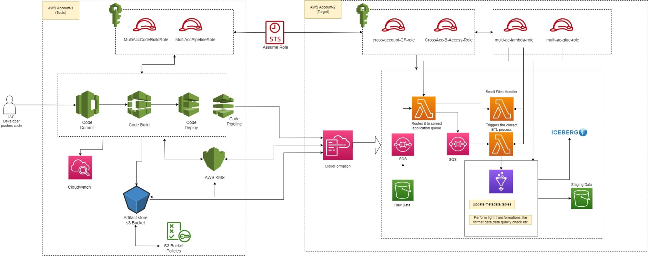
Architectural Flow of the POC

Slide 14
ETL FLOW
Source Bucket: This is where your raw data resides, and it serves as the initial point for your ETL process.
Source Bucket -> Queue1 : Data from the source bucket is sent to queue1
Queue1 - > Lambda 1: Upon receiving a message from queue1, lambda1 is triggered.
Lambda 1 -> Lambda 3: Lambda1 processes the event by checking the file size. If the file size is below a specified threshold, it triggers Lambda3
Lambda1 -> Queue 2: If the file size is not below the specified threshold, it checks if the received files match the expected files. If all expected files are received, Lambda1 sends a message to Queue2
Queue 2 -> Lambda 2: When a message arrives in Queue2, it triggers Lambda2. Lambda2 processes the message and starts a Glue job.
Lambda 2 -> Glue: The Glue Job performs the required transformations and writes the transformed data to an output path in the destination bucket and relevant metadata is written to the Iceberg table.

Slide 15
IAC
Resource Deployment Automation
For our use case, we automate the deployment of various AWS resources using CloudFormation templates.
Resources include S3 buckets, SQS queues, Lambda functions, Glue jobs, Iceberg table, Glue databases, and an Athena workgroup.
We maintain separate CloudFormation templates for each resource type, including additional templates to establish dependencies.
Adding a new resource is simplified: Create a CloudFormation template with the required properties and add a deploy stage in the pipeline for seamless deployment in our target account.

Slide 16
Demo
Demo
Demo
Demo
Demo

Slide 17


